Slide 1


The European and global data landscape in Geochemistry
Marthe Klöcking¹ Kerstin Lehnert², Lesley Wyborn³, Kirsten Elger⁴, Angus Nixon⁵, Marie Traun⁶, Keith Sircombe⁷, Nina Welti⁸
¹U. Münster, DE; ²Columbia U., USA; ³ANU, AU; ⁴GFZ, DE; ⁵U. Adelaide, AU; ⁶U. Göttingen, DE; ⁷Geoscience AU; ⁸CSIRO, AU
mkloecking@uni-muenster.de

Slide 2

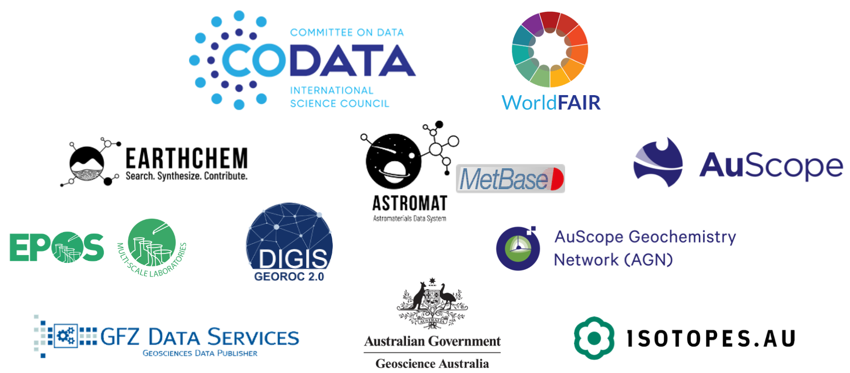

OneGeochemistry
International collaboration to establish global standards for Open and FAIR geochemical laboratory analytical data
Alliance of data systems: Interoperability of global geochemical data services
Promoting discovery & reuse: Compilation of standards & best practices for geochemical data
Community platform: developing digital best practices for specific methods or data types
Endorsed by major scientific societies & unions:
www.onegeochemistry.org
Notes:
EPOS MSL is member
Endorsed by 6 of the 15 societies
academic focus

Slide 3
Geochemical data types
Geochemical data standards
Integration with EPOS

Slide 4
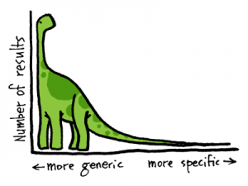
Geochemistry: “Long Tail” research data
“…investigation of the chemical and physical properties of all geological formations and of their age relationships… ”
Organised
big data
Schönbein (1838), Manten (1966)
A ‘Long Tail’ community with many subdisciplines, highly specific and small size datasets
Long-tail data
Heidorn (2008)
Image credit: https://www.webheat.com/blog/implied-usage-odd-keyword-phrases-used/the-long-tail-dinosaur/
Notes:
Geochemistry emerged as a discipline in the mid 19th century
As you can see from this definition, it is a classically long tail community
Long tail: diversity of geochemical data
makes it challenging to develop (informatics) workflows for geochemistry because one-size-fits-all doesn't work

Slide 5
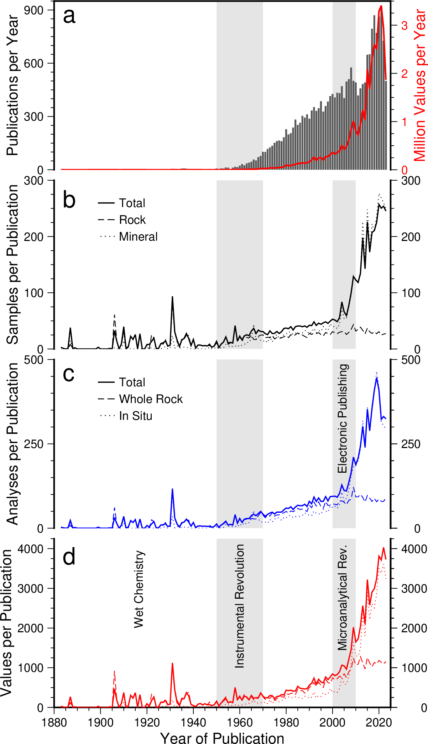
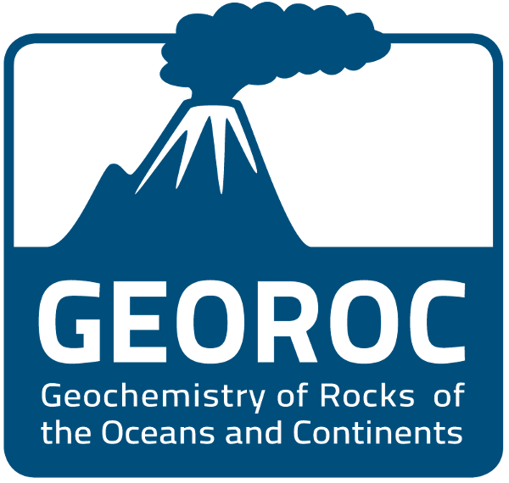
The Rise of Geochemical Data
Electronic publishing &
Publications / data compiled in GEOROC database as proxy for igneous geochemistry
Klöcking, Lehnert & Wyborn (2025)
Notes:
But we need workflows! because... the volume of data has exploded in the last few decades as new data types have emerged
Nr of values compiled in GEOROC by publication year as proxy for igneous geochemistry. Averaged by the number of publications.
Dramatic increase of the number of data values/points published in each paper in recent years, driven by in situ techniques. Instrumentation; microanalytical = in situ analyses (minerals)
these increasing volumes of data are perfect for analysis by computational/statistical tools, such as machine learning
There is a story about how geochemical data were published as well, but I am not going to go into this now.

Slide 6
The geochemical data pipeline
LOCAL
Samples
Labs
Methods
Data + Metadata
Manuscript
GLOBAL
Database
Scientific Insights

Slide 7
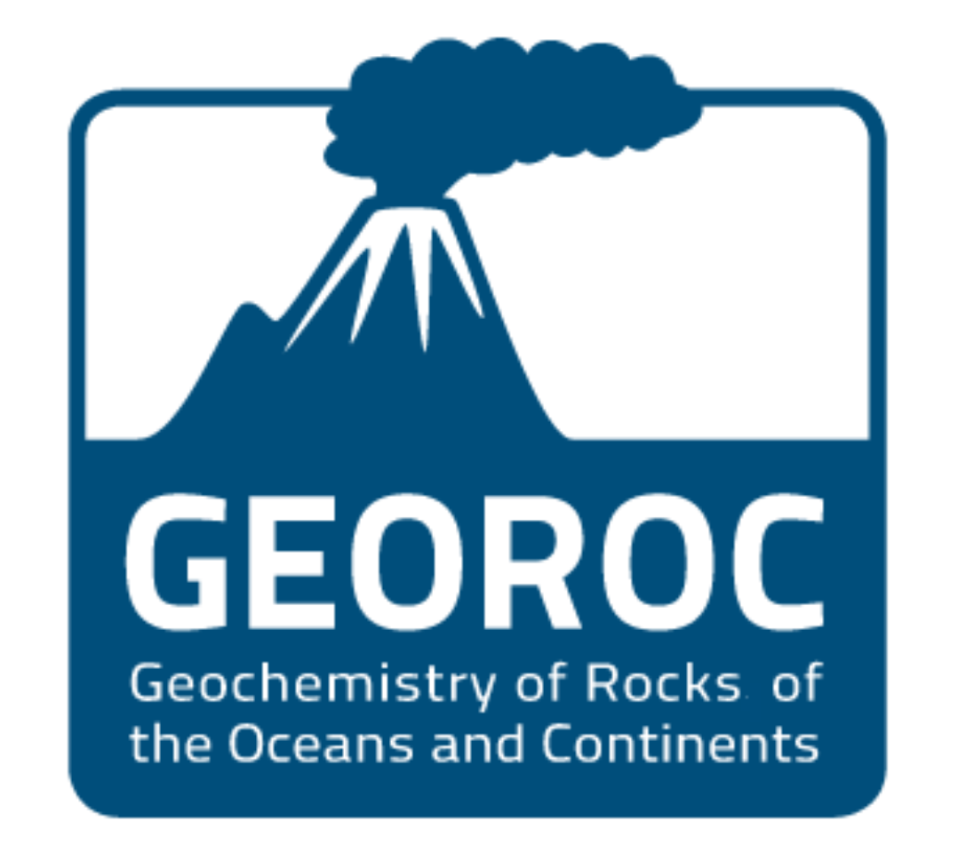
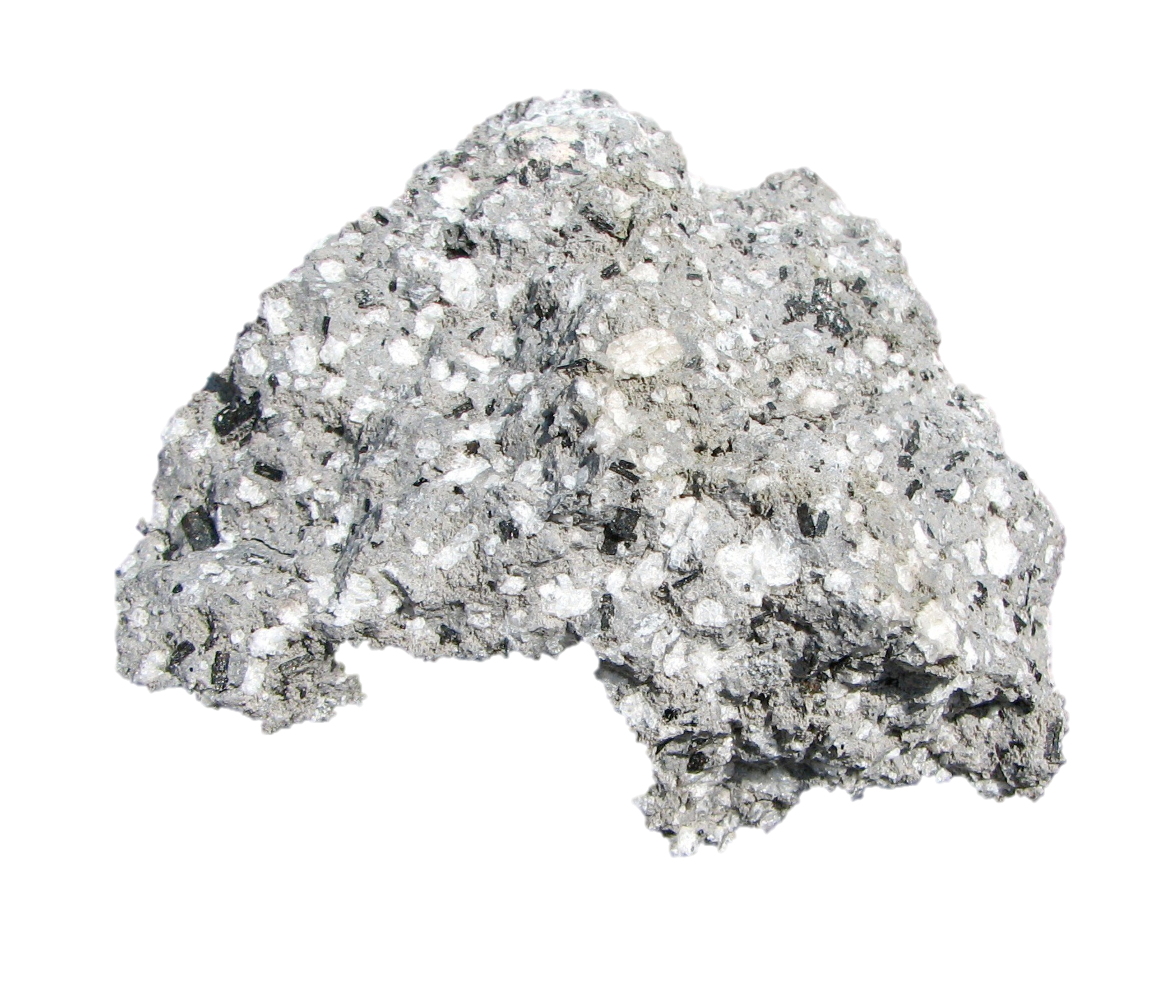
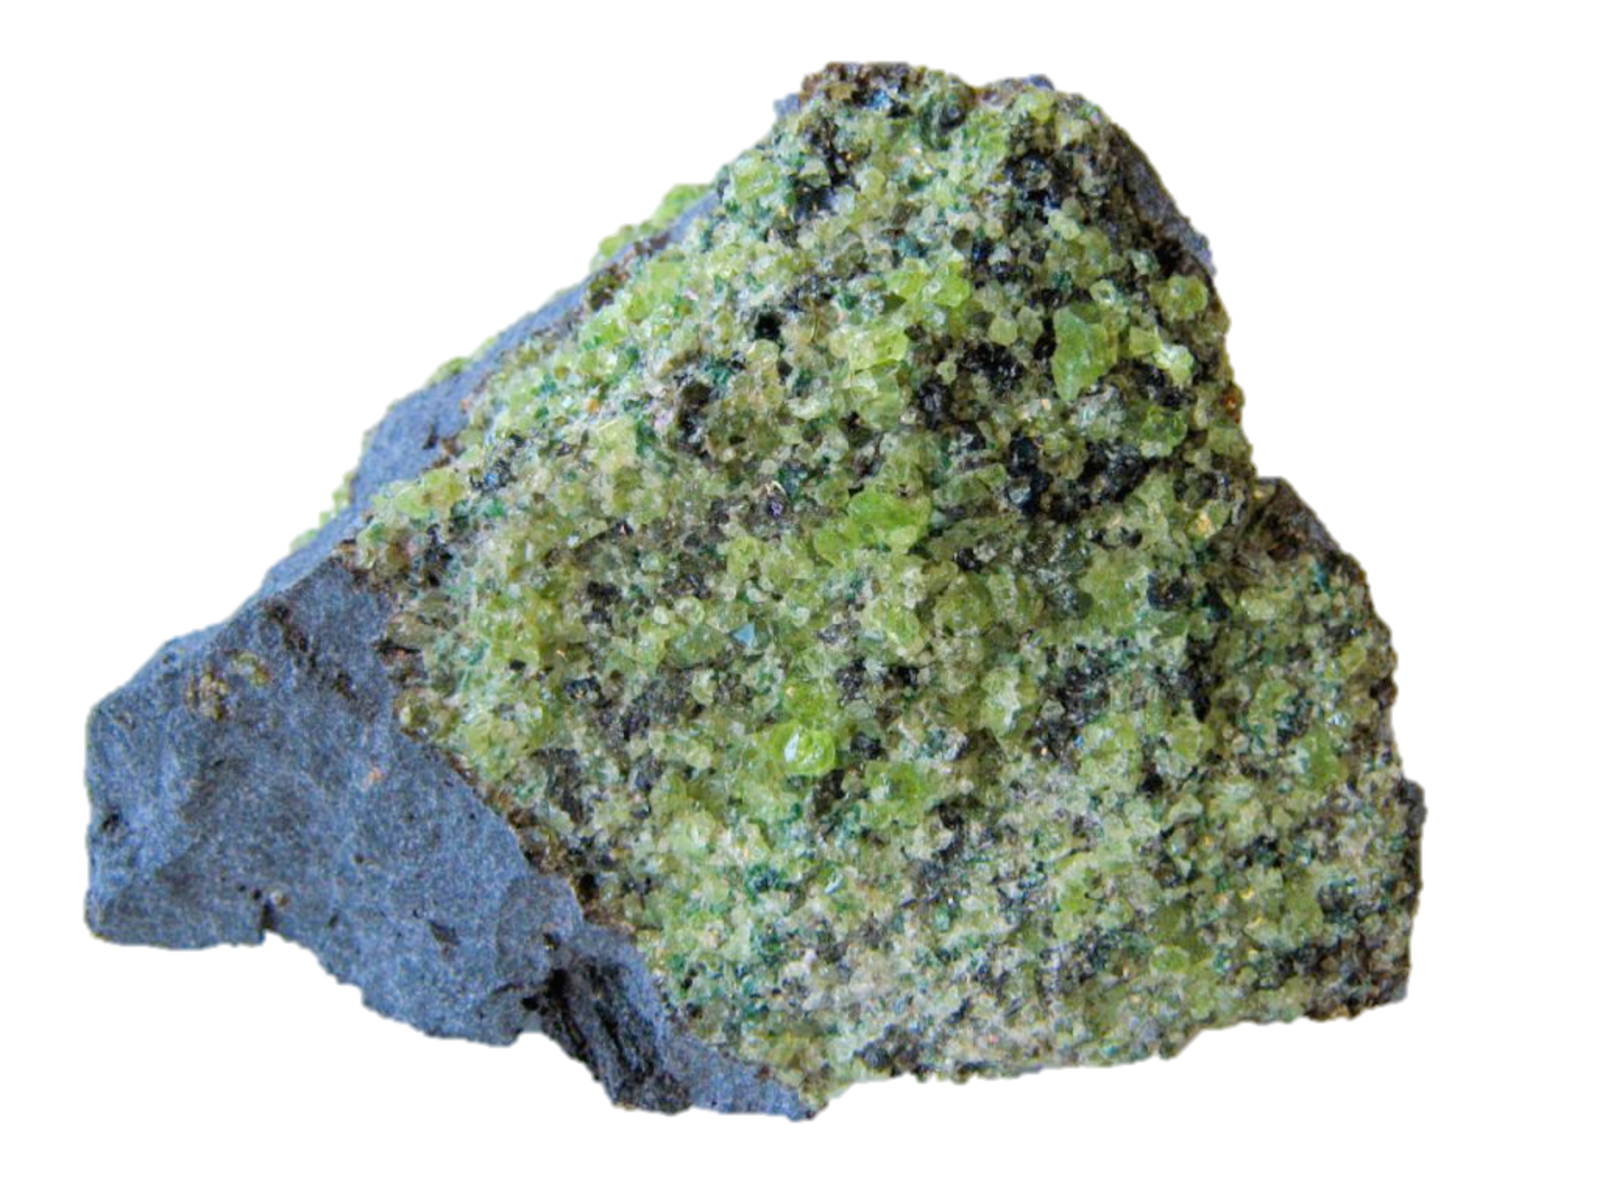
Aggregation in synthesis database
Igneous data compilation
from published literature: 1883-today
major- and minor elements,
trace elements,
stable and radiogenic isotopes,
analytical ages
of rocks, glasses, minerals and inclusions
Rich Sample, Location & Analytical Metadata
Related Publication(s) | Samples | Methods
Authors | Coordinates, elevation | Analytical method
Institutions | Location description | Accuracy & Precision
Citation | Rock/Mineral classification | Units
DOI | Sample description | Standards
 | Age | Normalisation (isotopes)
 |  | Fractionation correction
Recorded exactly as reported in the publication!

Slide 8
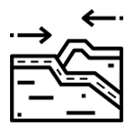



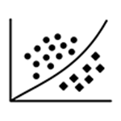
Integrated search/filter options
22
geological settings
306,772
locations
533
mineral species
351
lithologies
10
major elements
158
trace elements
14
rare earth elements
120
end members
85
stable isotopes & ratios
159
radiogenic isotopes & ratios
70
U-series isotopes & ratios
26
rare gases & their isotopes
chemistry
Notes:
Together enables highly customisable search by any number of differnt filter criteria.

Slide 9
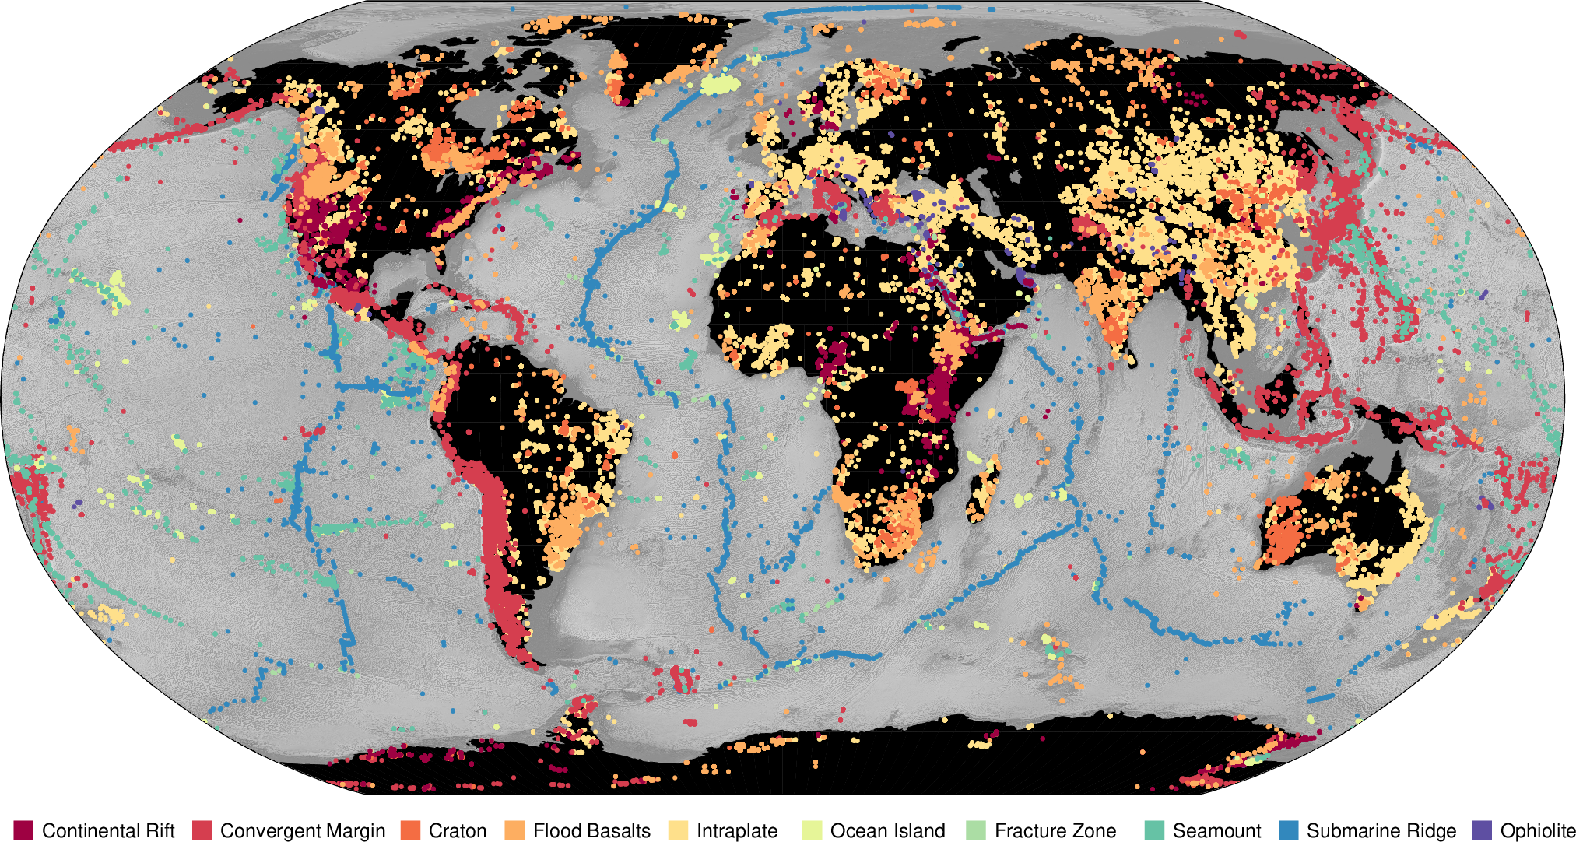

Data discovery via synthesis databases
26.5M minerals
16.3M whole-rocks
1.8M volc. glasses
1.5M inclusions
27,097 papers
846,741 samples
48,158,050 data values

Slide 10
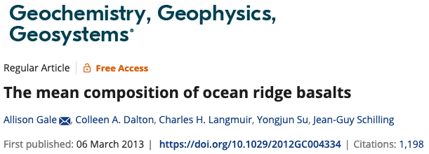
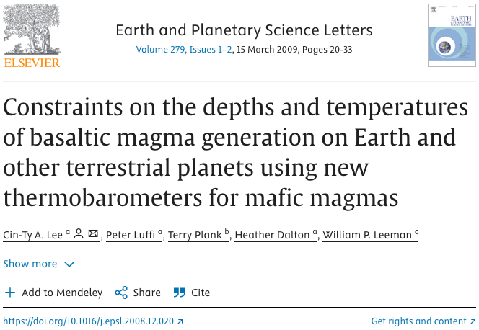
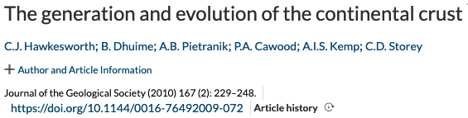
Enabling global, integrative research
Notes:
Increasingly provide data infrastructure for Earth Science research

Slide 11
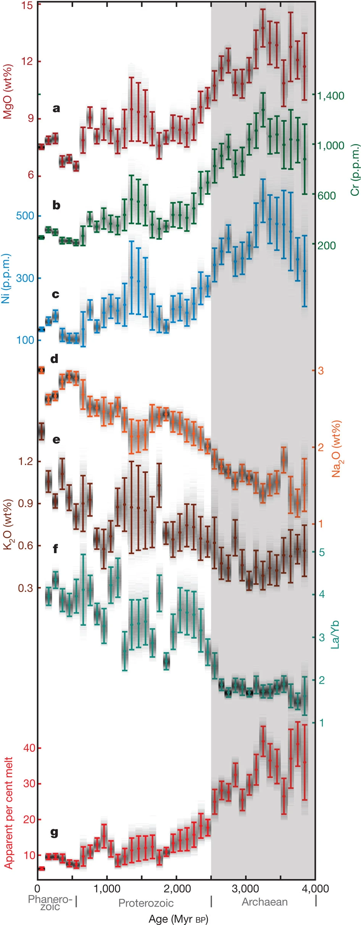
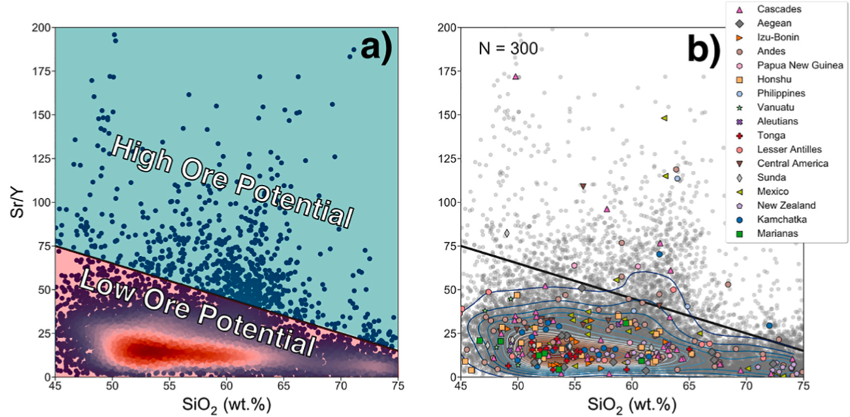
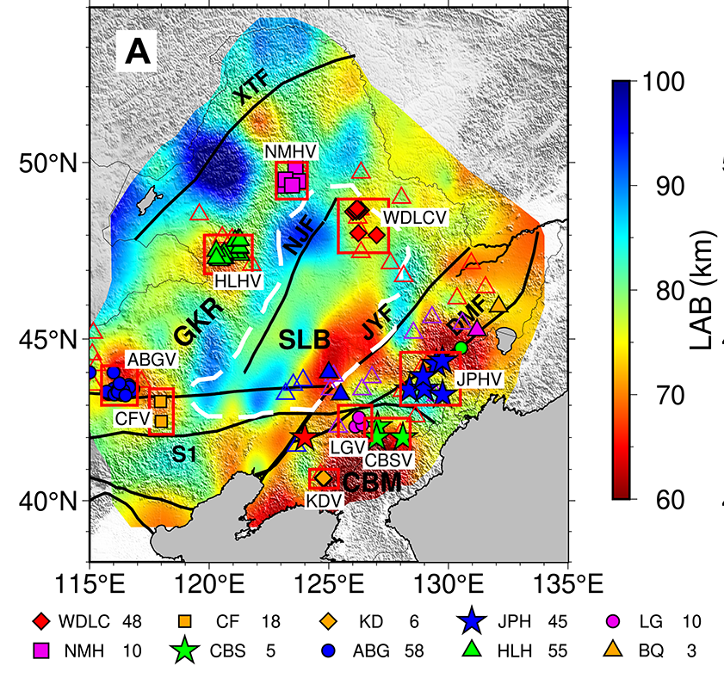
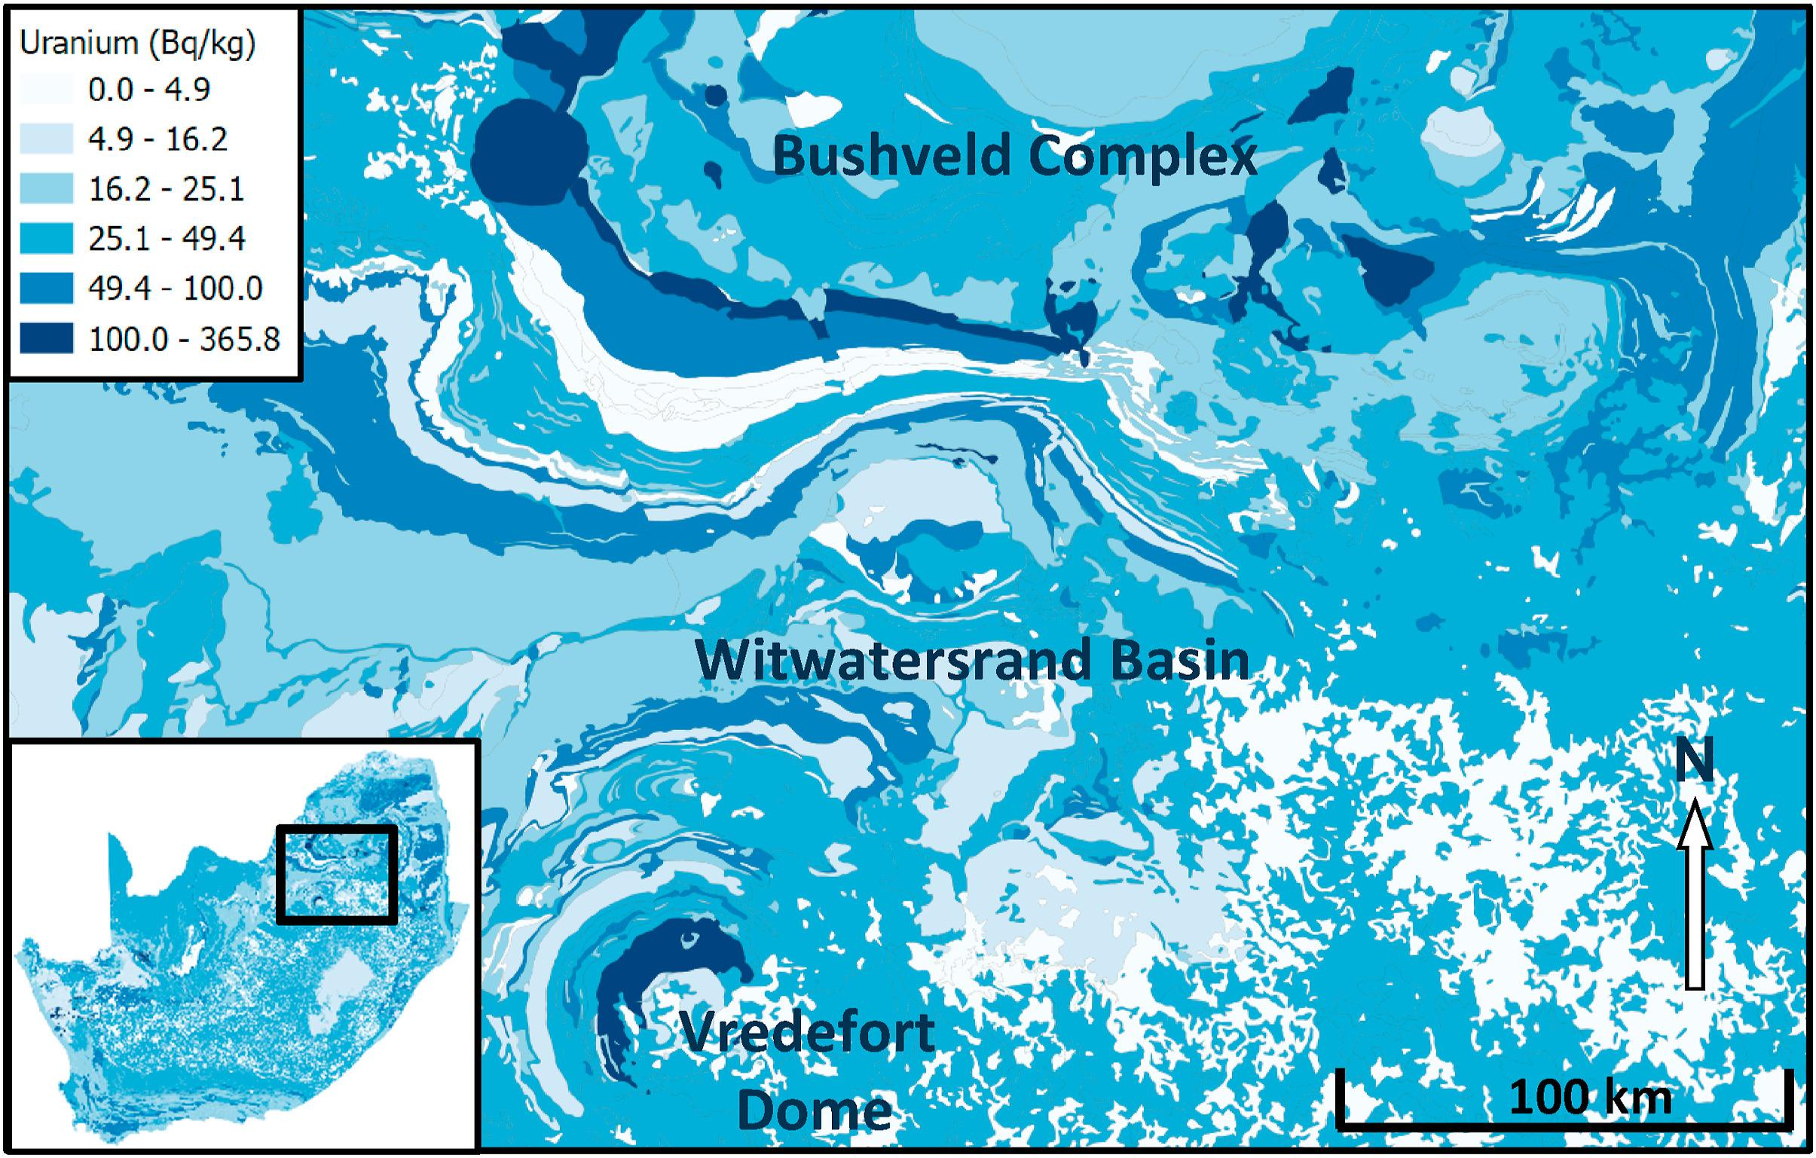
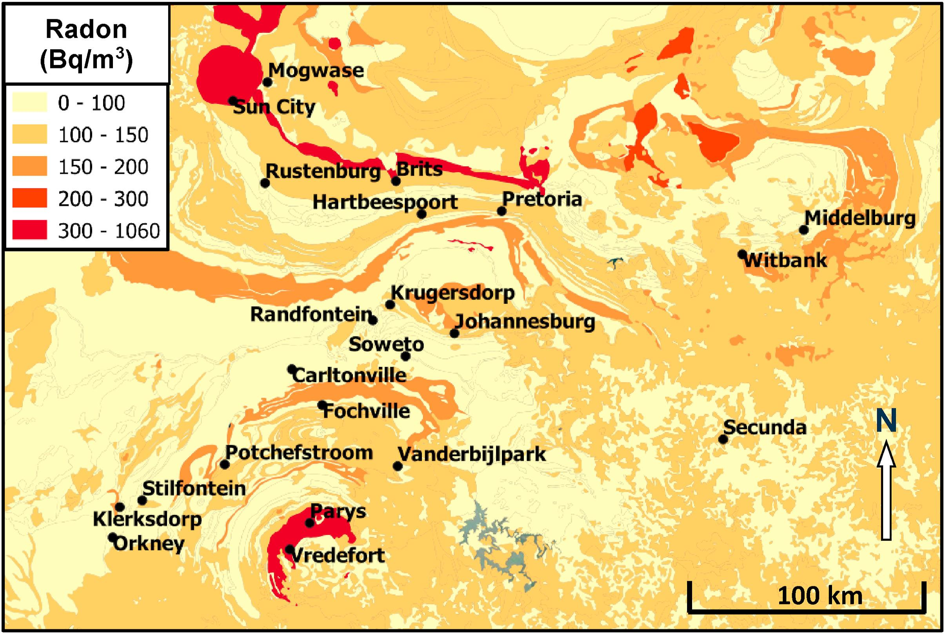
Enabling global, integrative research
Exploration: Barber et al. (2021, GCA)
Geodynamics
Zhang et al. (2022, Geology)
Earth Evolution
Keller & Schoene (2012, Nature)
GeoHealth: Bezuidenhout (2021, J Environ Radioactiv)
Notes:
But maybe even more exciting….

Slide 12
The geochemical data pipeline
Different
protocols
Incomplete
metadata
Samples
Labs
Methods
Data + Metadata
Manuscript
Breaks in chain = Breaks in interoperability
Data publication
Database

Slide 13
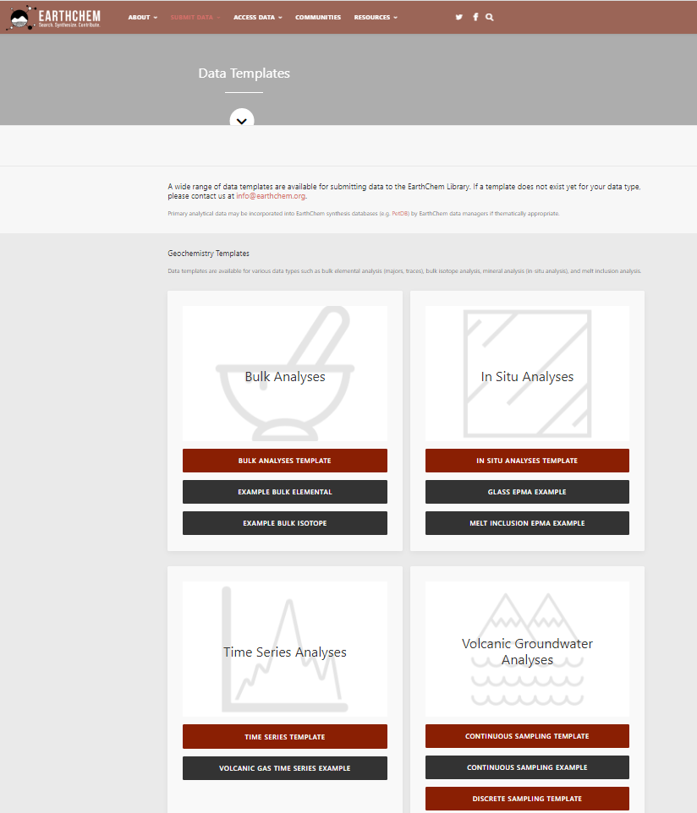
Templates for citeable data publications
earthchem.org/ecl/templates
Standardised format for data publication & archiving
Used by global geochemical domain repositories: EarthChem Library, GFZ Data Services

Slide 14
The geochemical data pipeline
Data Publication & Preservation
Data Mining, Visualisation & Analytics
paper
Synthesis Database
Compilation by Data Curators from Literature
Synthesis Database (Data + Metadata)

Slide 15
The geochemical data pipeline
Data Publication & Preservation
Data Mining, Visualisation & Analytics
paper
Domain Repository
Synthesis Database
Data Portal
User Submission
Compilation by Data Curators from Literature & User Submissions
Data Transfer from Network of Databases
Synthesis Database (Data + Metadata)
Fusion of multiple Databases
(Data + Metadata)
Metadata Catalogue
citeable data
publication
+ File System
other
EarthChem Portal
EarthChem
GEOROC
SedDB
MetPetDB
NAVDAT
USGS
GANSEKI
EarthChem Library
EarthChem Synthesis/PetDB
GFZ Data Services (DIGIS/GEOROC)
GEOROC

Slide 16
Geochemical data types
Geochemical data standards
Integration with EPOS

Slide 17
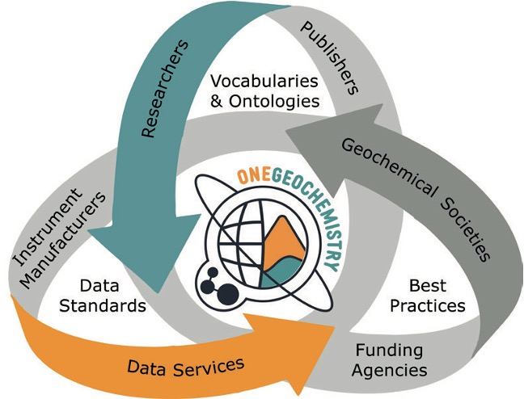
How OneGeochemistry advances standards
Build community
Create awareness
Broaden engagement
Constitute framework
Create communication paths
Inform policy
Advance technical solutions
Facilitate developments
Promote implementation
Notes:
one of the primary goals of 1GC is to advance data standards/best practices
we strongly advocate that whichever community you are in, go find your community resource and join the conversation there. And if you don‘t have one, come talk to us.

Slide 18
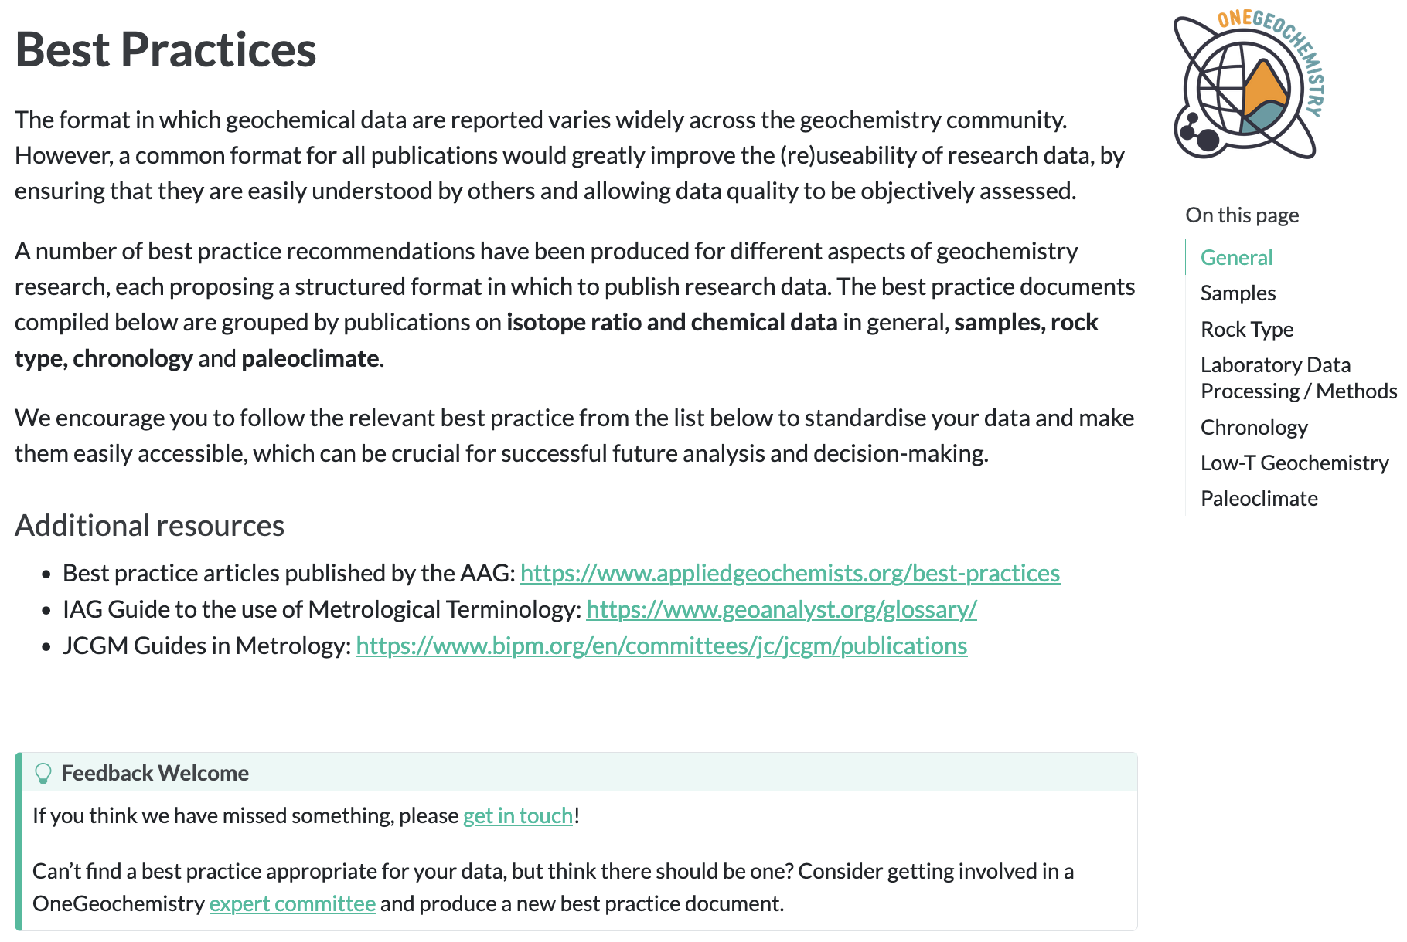
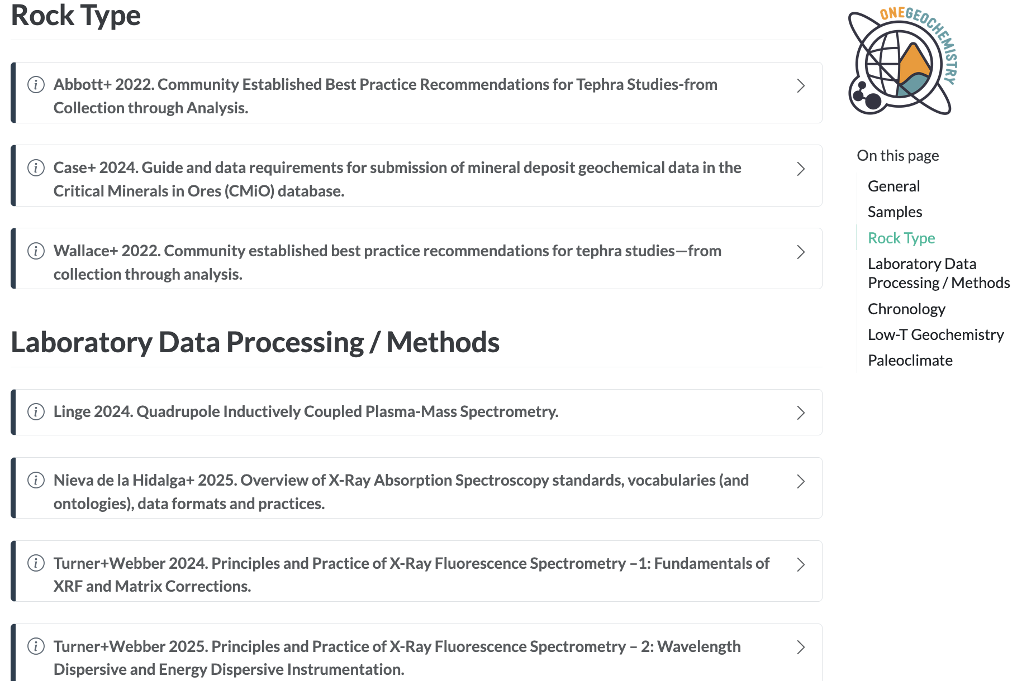
Compilation of best practices
www.onegeochemistry.org

Slide 19
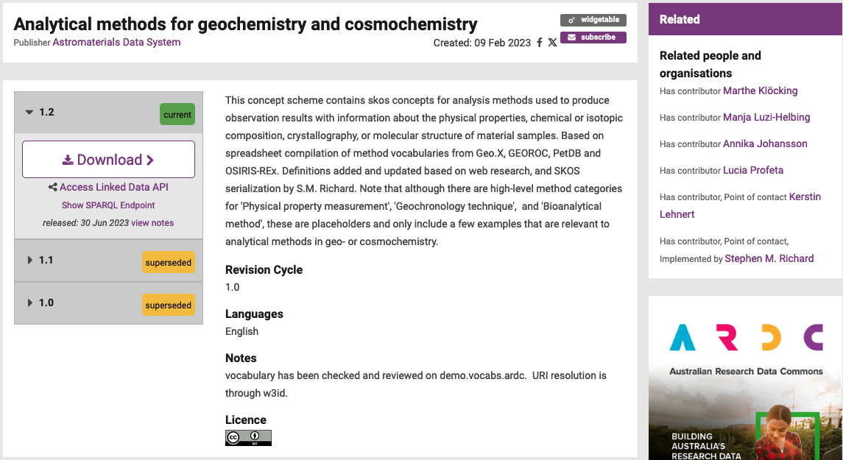
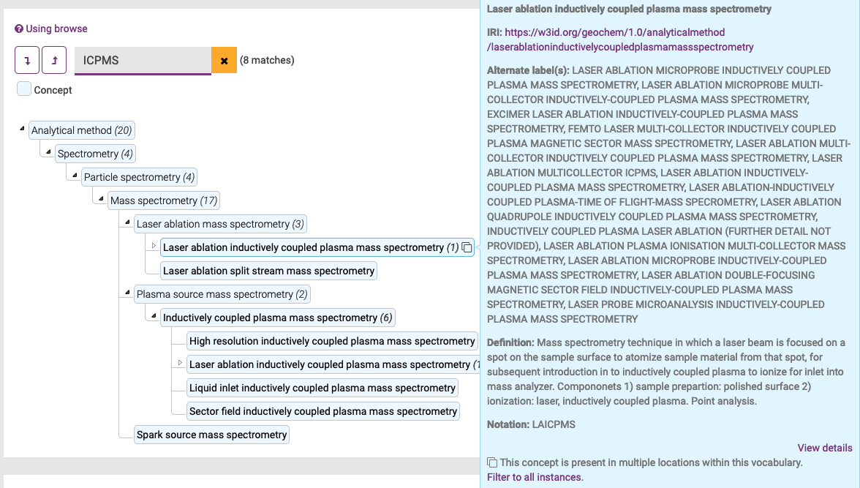
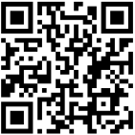
Vocabulary registration (SKOS/RDF)
Research Vocabularies Australia
Hierarchical
Human & machine readable
Linked data
https://vocabs.ardc.edu.au/viewById/650
Notes:
SKOS
RDF

Slide 20
Vocabulary registration (SKOS/RDF)

Slide 21
Data templates: standards for researchers
earthchem.org/ecl/templates
Standardised format for data publication & archiving
Used by all global geochemical domain repositories: EarthChem Library, GFZ Data Services

Slide 22
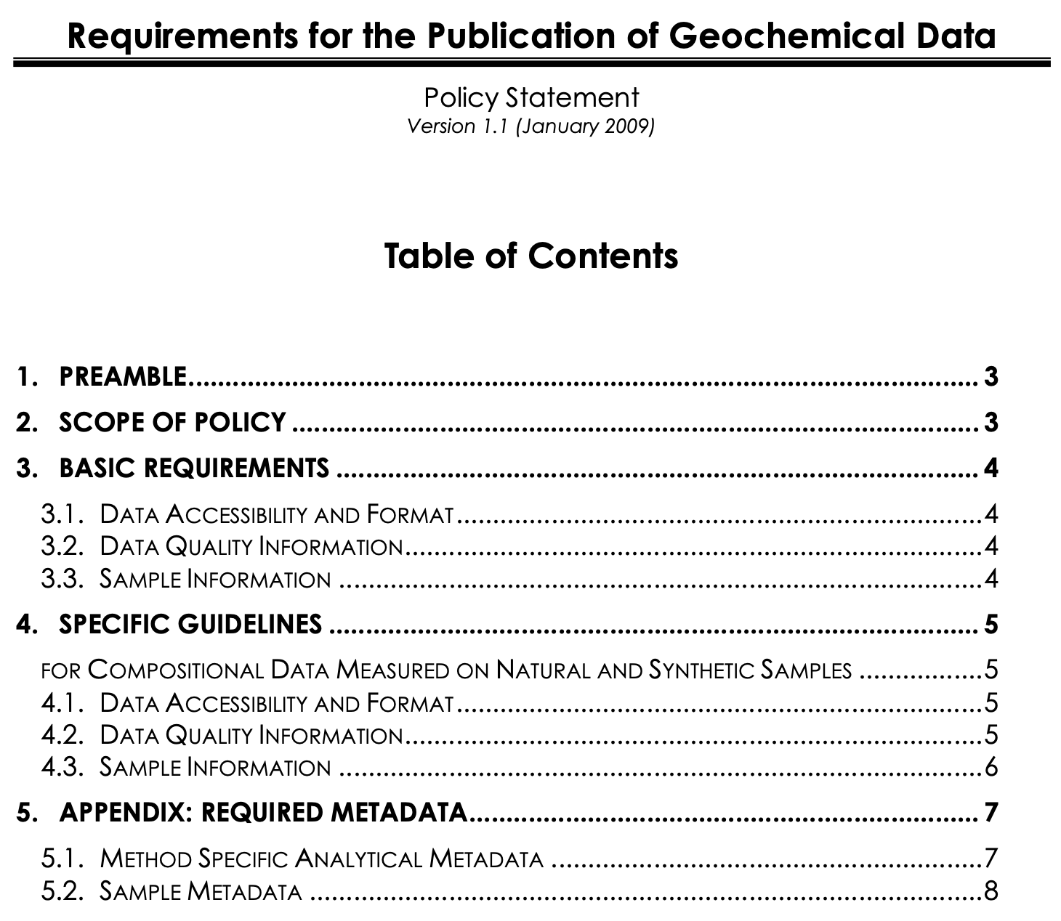
Working with community & journals
Editors’ Roundtable
Foster a dialogue between geochemical journals, publishers, and curated domain repositories
Coordinate policies and procedures pertaining to the reporting of geo/cosmochemical data
First held in 2007/08; policy statement released in 2009
Annual meeting at the Goldschmidt conference
https://doi.org/10.1594/IEDA/100426

Slide 23






Working with community & journals
Long format diamond OA journal in
Geochemistry and Cosmochemistry
Community driven and run
FAIR data, code, Aligned with international standards (COPDESS, OneGeochemistry) and outputs policy All data/software must be archived in (domain) repositories before manuscript submission Multiple stages of data and code review prior to article publication
Editorial Policies, Guide for authors and Submission Templates on
www.agcj.org

Slide 24
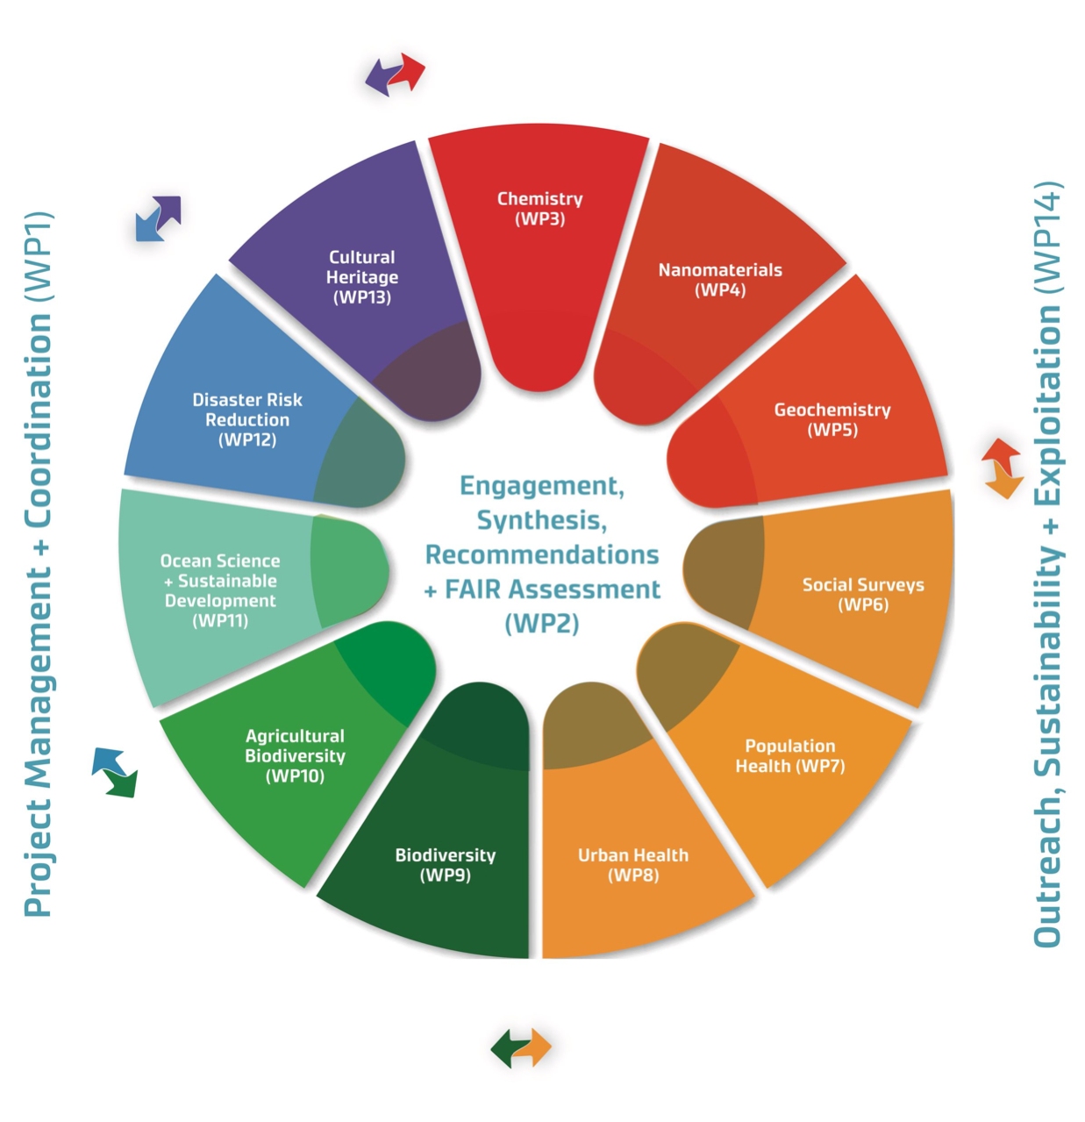
Cross-domain interoperability (WorldFAIR)
WorldFAIR Project on Global Cooperation on FAIR Data Policy and Practice
https://worldfair-project.eu
Led by the Committee On DATA of the International Science Council (CODATA) and the Research Data Alliance (RDA)
funded by the European Commission 2022-2024
11 discipline and cross-discipline case studies
Geochemistry use case to articulate interoperability framework for research domains
collectively sought to advance implementation of the FAIR principles and improve Interoperability and reusability
Enabling FAIR data in Geochemistry through the WorldFAIR Project
https://doi.org/10.5281/zenodo.13932070
Notes:
So relevant that
1GC invited to contribute to cross-domain standard development
Beschreibung der Standards mit FIPs;

Slide 25
Geochemical data types
Geochemical data standards
Integration with EPOS

Slide 26
OneGeochemistry – EPOS integration
Data exposure/discovery:
Repository datasets (e.g. GFZ Data Services → EPOS MSL)

Slide 27
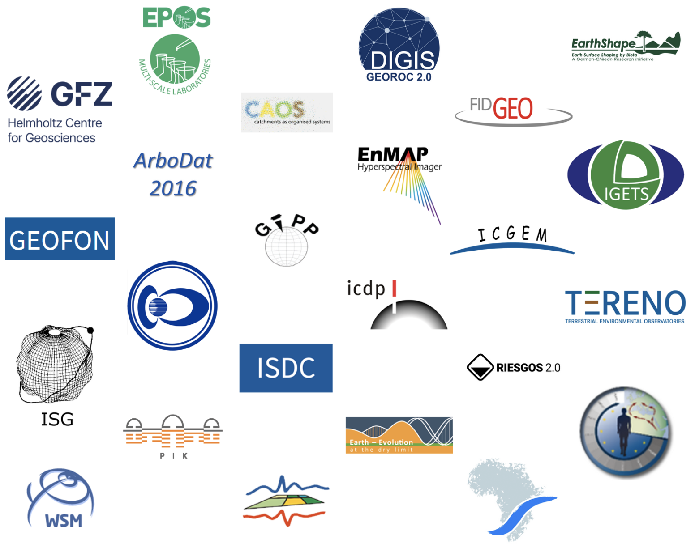

Integration of repository datasets
Data exposure/discovery:
Repository datasets (e.g. GFZ Data Services → EPOS MSL)
Data Centres
Connect additional data centre in GFZ Data Services to EPOS MSL Portal
Harvest metadata from dataset DOI
Extend to other geochemical repositories?

Slide 28
OneGeochemistry – EPOS integration
Data exposure/discovery:
Repository datasets (e.g. GFZ Data Services → EPOS MSL)
Database holdings

Slide 29
Data discovery via synthesis databases
26.5M minerals
16.3M whole-rocks
1. 8M volc. glasses
1.5M inclusions
27, 097 papers
846,741 samples
48,158,050 data values

Slide 30
OneGeochemistry – EPOS integration
Data exposure/discovery:
Repository datasets (e.g. GFZ Data Services → EPOS MSL)
Database holdings
OneGeochemistry → EPOS
EPOS as multiplicator of and contributor to geochemical standards
Tap into EPOS community
Multi-Scale Laboratories
Volcano Observations
Others?
Contribute to further standard development/harmonisation
EPOS → OneGeochemistry

Slide 31
Discussion points
What geochemical data exist in EPOS TCSs?
Do you have standards for these data(sets)?
Data exposure options for OneGeochemistry members
Integrating data from different sectors & domains
Notes:
Are they already included in our synthesis databases?

