Slide 1


VOLC-TCS | EPOS Days 2026
Giuseppe Puglisi
The Consortium Board: Domínguez Cerdeña Itahiza Francisco (2), Adelina Geyer (3), Jean-Christophe Komorowski (4),
Rikey Juliusdottir (5), Philippe Labazuy, (6), Kristín Vogfjörd (5)
The Management Team: Enrico Indovina (1), Rosella Nave (1), Letizia Spampinato (1), and Danilo Reitano (1)
(1) Istituto Nazionale di Geofisica e Vulcanologia, Italy
(2) Istituo Geografico National; Spain
(3) Geosciences Barcelona, CSIC, Lluis Solé Sabaris s/n, 08028 Barcelona, Spain
(4) Université Paris Cité, Institut the Physique du Globe, CNRS, F-75005 Paris, France
(5) Icelandic Meteorological Office, Iceland
(6) Université Clermont Auvergne, CNRS, OPGC, F-63000 Clermont-Ferrand, France,

Slide 2






TCS Volcano in a nutshell
VOLC-TCS Objectives
provides coordination between the European Volcano Observatories (VOs) and Volcano Research Institutions (VRIs) to implements interoperable volcanological services (VA and TNA)
provides long-term and sustainable access to Volcanological DDSSs related to volcanic areas monitored and/or studied by the European VOs and VRIs
promotes good practices through EPOS among the volcanological community
The intrinsic heterogeneity of the VOLC-TCS data required harmonization with
SEIS-TCS
NFO-TCS
GNSS-TCS
SAT-TCS
MSL-TCS
Seismic/Acceleration
Waveforms
Earthquake parameters
Services
Geochemistry
products
Services
GNSS Raw data Services
SAR products Services
TNA activities
Geochemistry products
Services
Notes:
Max.1 slide, minimum font 18
Introduction to the scientific area of the TCS and connection to other TCS (if any)

Slide 3
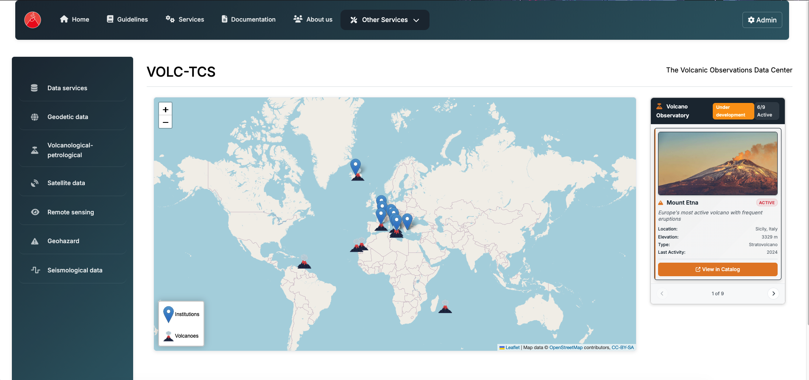
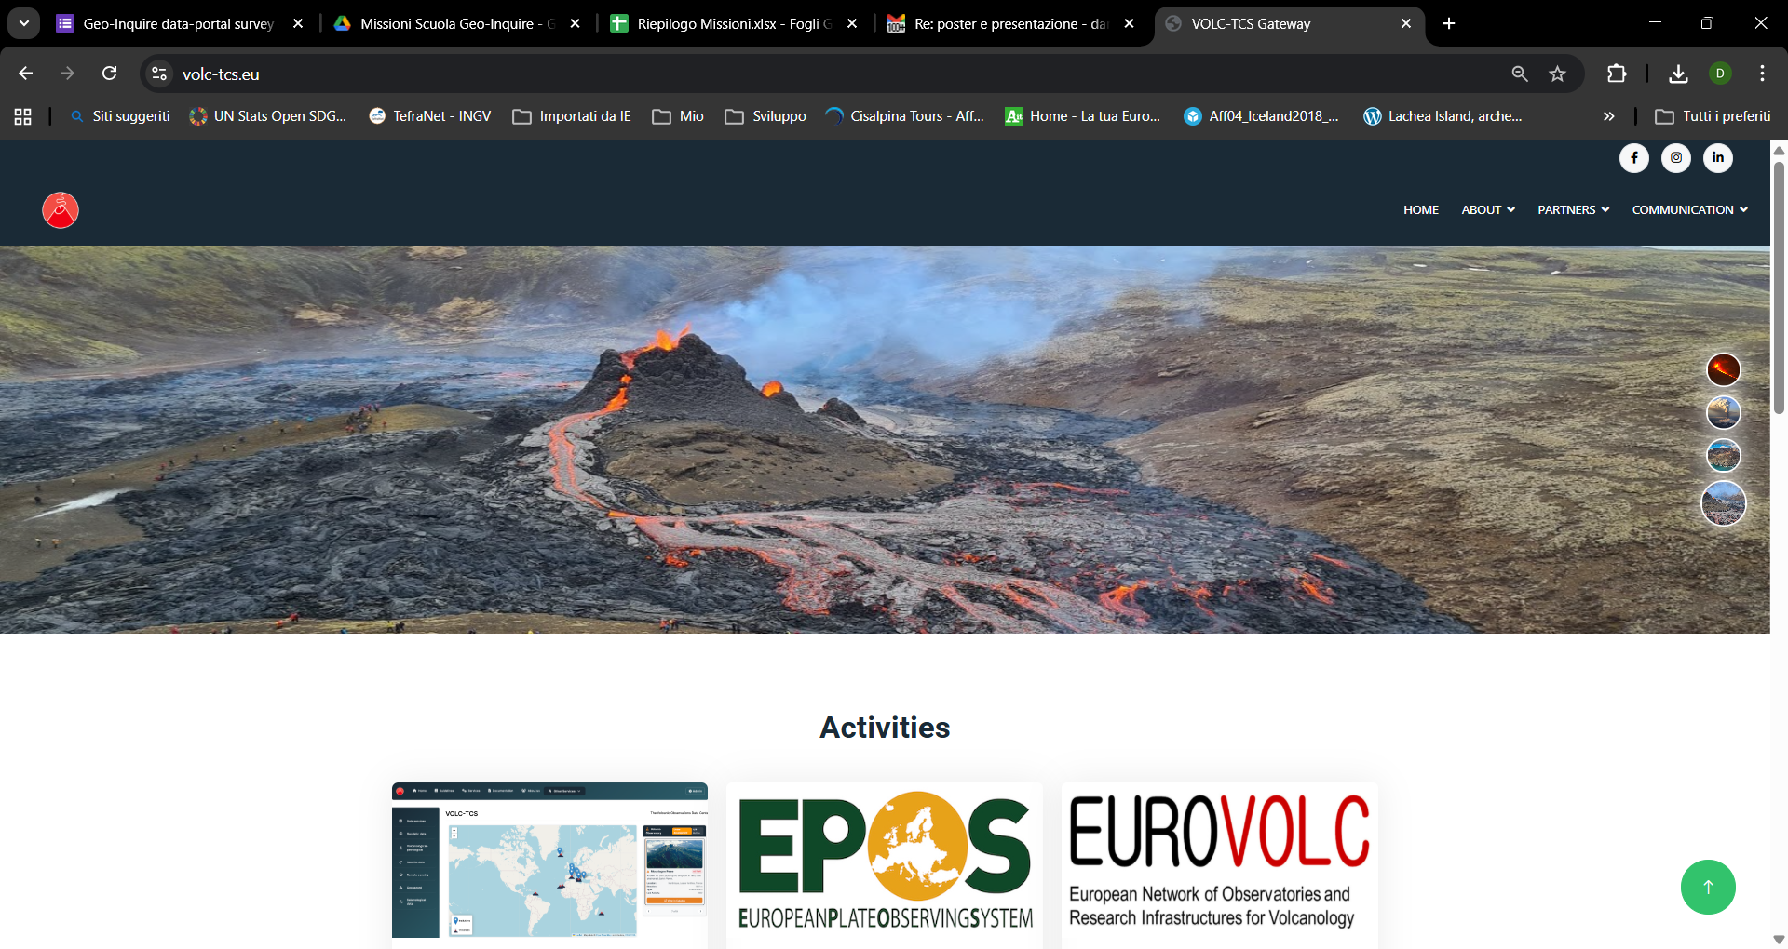
Active Work Plan and new perspectives
Upgrade of the Community Portal (Gateway – https://volc-tcs.eu/). It is the legacy of the EUROVOLC Project. It is an incubator, with the multiple objectives:
    Test of new services
    Management of future TNAs
    Standardization of new metadata structure
    Access to services not fully compliant with EPOS
    Implementation of new services and upgrade of the payload for the existing ones
    New use case definition (see ECR presentations)
Engagement of new partners / countries (Sweden under way; Portugal will come)
Participation to the EC proposals (this will increase the services and improve the way to access)
Participation to the 2026 SRA projects
https://volc-tcs.eu/dataportal)

Slide 4
Implementation of new services / upgrade the existing ones
Notes:
IMO SP; IMO, UI and NSII DP: GNSS station list,raw data, site logs: Adding more stations to service (Updated service) (2026-2027)
IMO: Lava flow simulations at Reykjanes (Under implementation) (2026-2027)
IMO: Radar data from Grímsvötn 2004 eruption (Under implementation) (2026-2027)

Slide 5
SP / DP | Under implementation | New service | Updated service
IMO (SP) | Electrical conductivity in rivers emerging from glacially capped volcanoes in S-Iceland | Tephra isopach lines of explosive eruptions in Iceland. | Adding reports in to both VONA and WVR services
 | Seismic bulletin list for 2016-2019 at selected volcanoes (Vatnajökull region, Katla, Hekla, Eyjafjallajökull, etc.) | Wind roses from volcanic areas in Iceland. | Adding plume height data from radar as CovJson
 | Impact maps: probabilistic hazard maps of tephra fall on infrastructure |  | Aviation colour code as CovJson
IMO (SP) UI, NSII (DP) | GNSS station list, raw data, site logs: Adding more stations to service (2026-2027) Lava flow simulations at Reykjanes (2026-2027) (IMO) Radar data from Grímsvötn 2004 eruption (2026-2027) (IMO) |  | InSAR data Svartsengi and Grindavík 2023-2024
IMO (SP) UI, CSIC (DP) |  |  | Image gallery: El Hierro and La Palma eruptions, Hekla 1991, Krafla 1975-84, Grímsvötn 1983 and more
NSII (SP) | Rock samples from Reykjanes
INGV (SP) | Tiltmeter data Italy Active at the end of this Pitch cycle | Volcano Observations Mobile Equipment and Volcano Observations Laboratories (EPOS Facilities section) | Software catalogue Italy : Revamping of volcanological software catalogue (in cooperation with EU Geo-INQUIRE project)
INGV (SP), CSIC (DP) |  |  | Bulk rock analysis : The bulk rock analysis from El Hierro, provided by CSIC, have already been integrated into INGV database.
OPGC (SP) | Test and debug the service DDSS thermal orthophotos at Soufrière de Guadeloupe |  | Thermal Monitoring of Volcanic Activity from Geostationary Satellite Data on HOTVOLC (15 minutes update)
 | Test and debug the service DDSS ground and UAV magnetic surveys at Piton de la Fournaise
IPGP (SP) |  |  | All services (seismic and GNSS data and metadata, seismic events): daily payload update

Slide 6
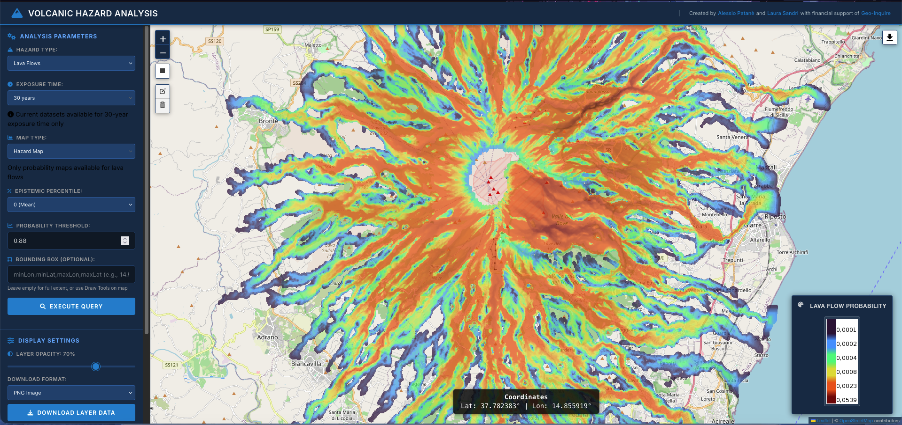
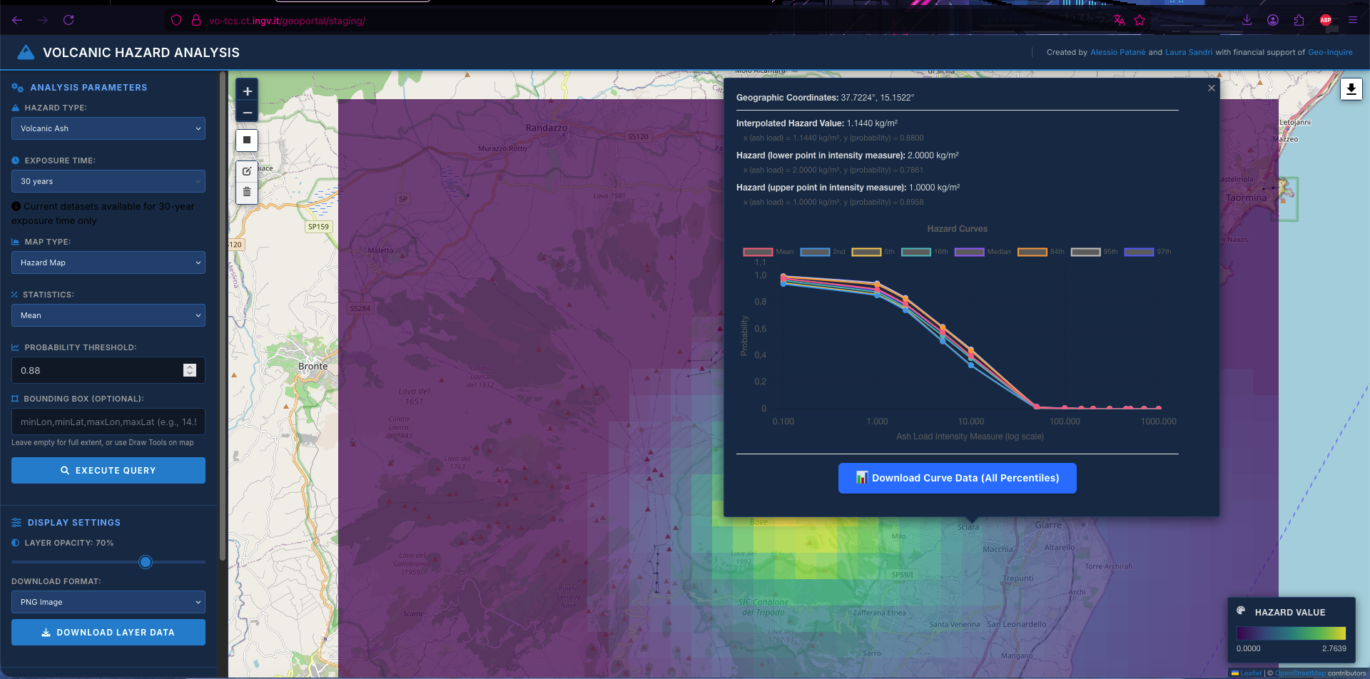
Geoportal for static and dynamic maps (https://vo-tcs.ct.ingv.it/geoportal/staging/)
New use case definition
look for Alessio Patanè at the poster session

Slide 7

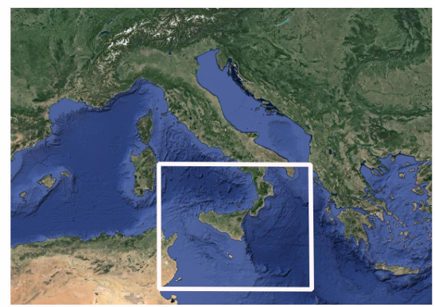

Retrieval of volcanic sulfur dioxide from Sentinel-5P TROPOMI satellite
New use case definition
Sentinel-5 Precursor Satellite
Area under investigation
look for Maddalena Dozzo at the poster session

Slide 8
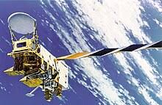
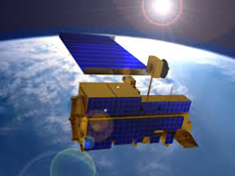
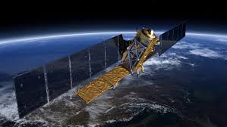
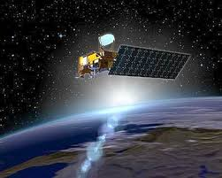

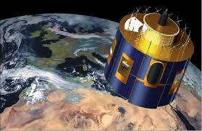
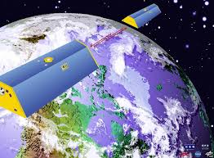
Semi-Supervised Learning applied to Mt Etna
New use case definition
LAND SURFACE TEMPERATURE
MODIS
GROUND
DISPLACEMENT
AQUA
TERRA
SO2 Flux
SAR
OMI
ENVISAT
AURA
SENTINEL 1
RADIANCE
GRAVITATIONAL ANOMALIES
SEVIRI
MSG
GEOSPATIAL DATABASE
GRACE
look for Francesco Spina at the poster session

Slide 9

Please visit the VOLC-TCS poster area
Thank you!

