Slide 1


TCS AH in 2025 dissemination, education and RI development
Ania Lesnodorska

Slide 2
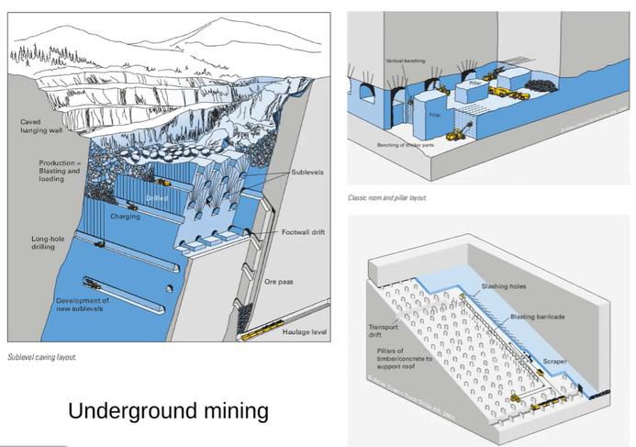
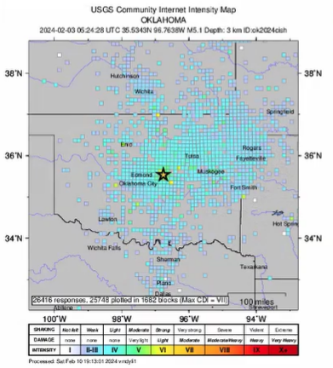
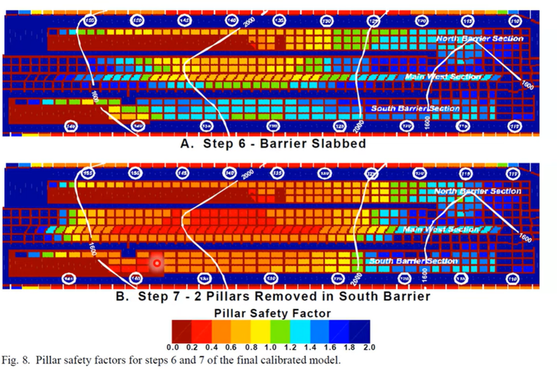
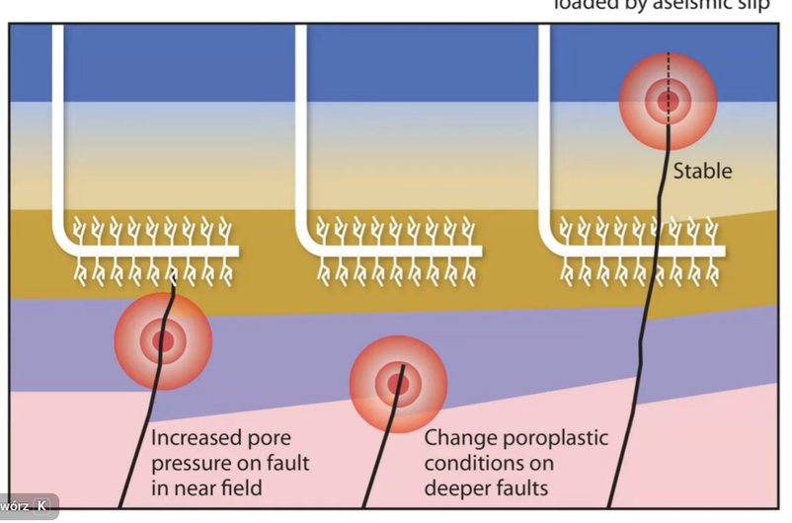
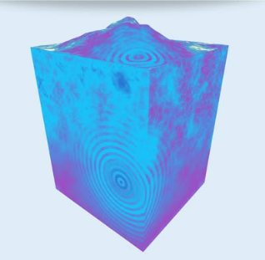
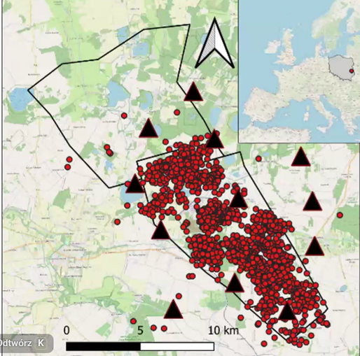
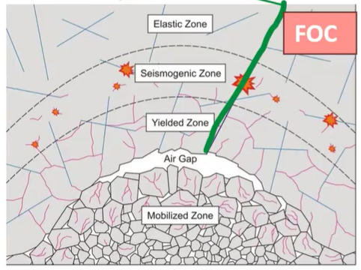
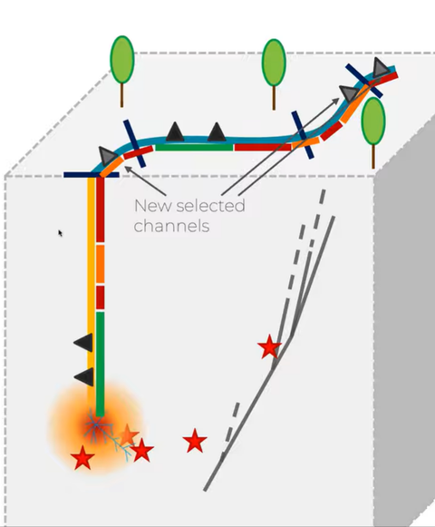
Dmitriy
Malovichko
Thomas H
Goebel
Erik
Westman
Luigi
Passarell
WEBINARS
Massimo
Cocco
Lukasz
Rudzinski
Zara
Anderson
Emanuele
Bozzi

Slide 3

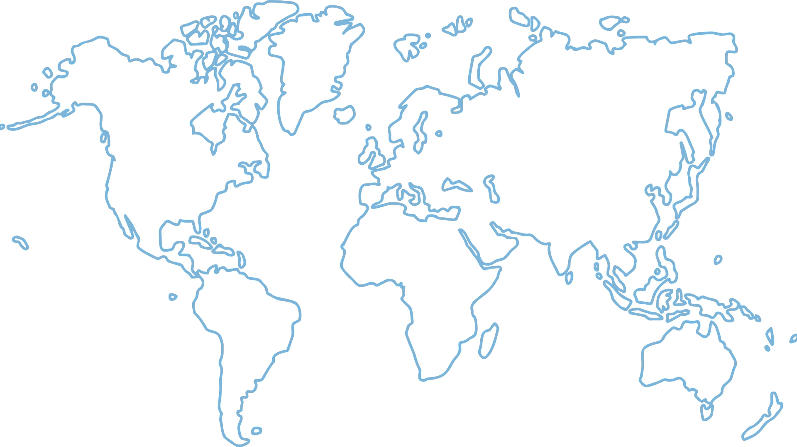
EVENTS
WORKSHOPS

Slide 4


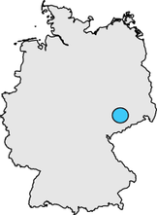
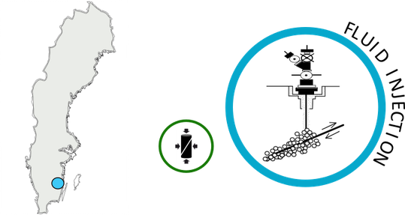
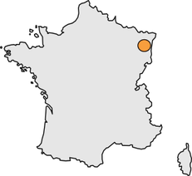
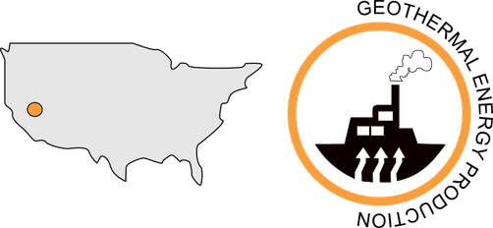
NEW EPISODES
  Integrated 3 new episodes (in the framework of Geo-INQUIRE project):
    STIMTEC: Fluid injection experiment (Germany) - the 4th GFZ episode - complements the family of multi-scale GFZ laboratory experiment episodes
    2 geothermal CNRS episodes: 2019 Vendenheim Stimulation and 2020 Vendenheim Stimulation
STIMTEC
VENDENHEIM 2019 STIMULATION
VENDENHEIM 2020 STIMULATION

Slide 5

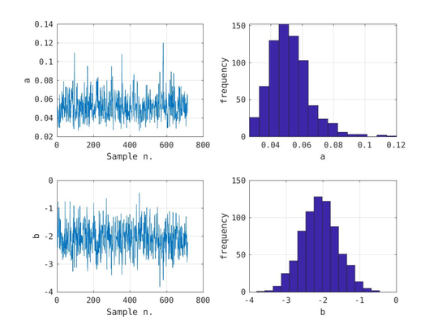
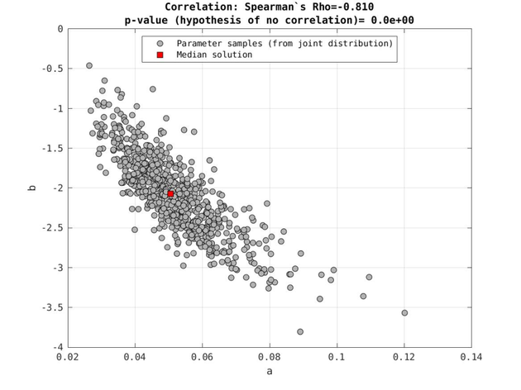
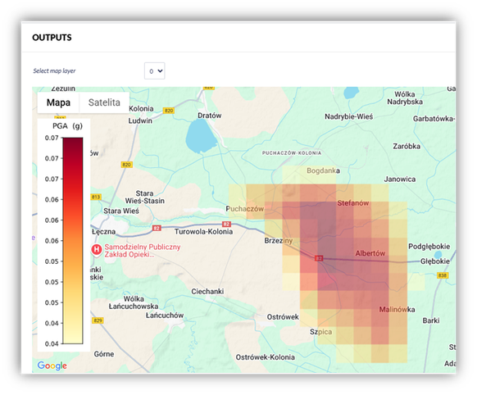
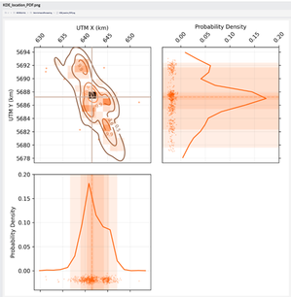
NEW APLICATIONS
  Implemented 2 new applications (in the framework of DT-GEO project):
    Seismic Hazard Forecasting application - computes probabilistic seismic hazard estimates of ground shaking intensity. Different ground motion prediction models (GMPEs) defined.
    MIDSTREAM („Modeling fluid induced Seismicity Rates using a covariate Model”) - Testing and forecasting
MIDSTREAM
Seismic Hazard Forecasting

Slide 6
Thank you!

