Slide 1
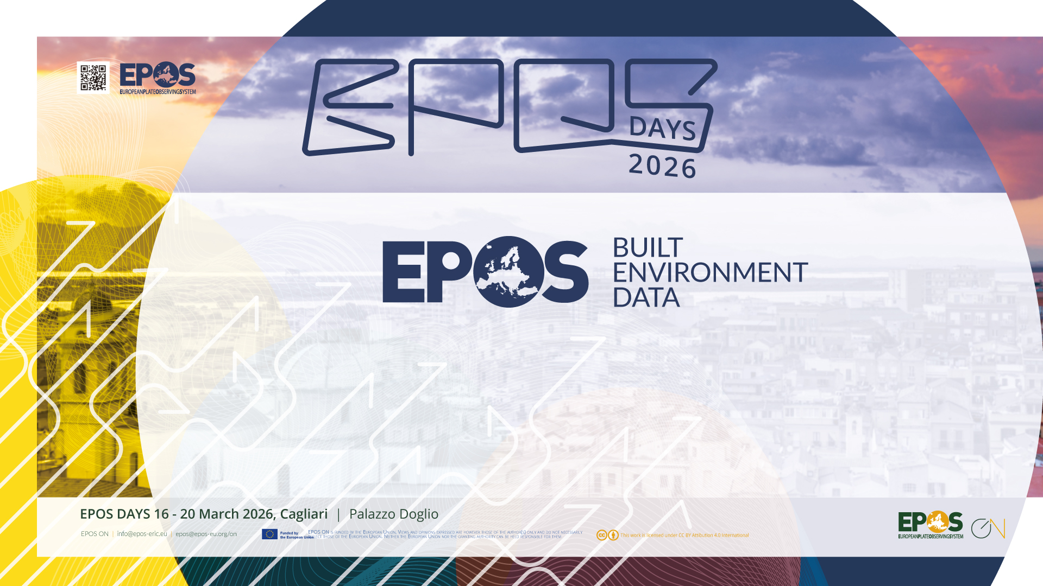
Candidate TCS Applicant
Rui Pinho

Slide 2
What is Built Environment Data (BED)?
A potential Thematic Core Service (TCS) providing FAIR-compliant data, products, services and software (DDSS) related to buildings and urban infrastructure, to support multi-hazard risk assessment and resilience research.
Services cover:
  Hazard-agnostic exposure databases (buildings, infrastructure and population)
  Dynamic models of exposure evolution
  Access to structural testing facilities and experimental data
  Data characterising built environment vulnerability
  Integration of social sciences, urban planning and climate adaptation
Website: www.builtenvdata.eu
6
Active services already running
26
Organisations from 15 countries already committed
100%
FAIR-compliant open data services
EPOS
Transversal TCS in the EPOS ecosystem

Slide 3

BED Community — 26 Supporting Organisations
🇮🇹 Eucentre Foundation (coordinator) | GEM Foundation | Univ. of Trento | Univ. of Genoa
🇨🇭 EPFL (École Polytechnique Fédérale de Lausanne)
🇵🇹 Univ. of Aveiro | LNEC | Univ. of Minho | Univ. of Porto | IST
🇬🇷 Aristotle Univ. of Thessaloniki | Univ. of Patras | NTUA
🇬🇧 University College London | Univ. of Bristol | Imperial College London
🇧🇪 UCLouvain
🇫🇷 CSTB — Centre Scientifique et Technique du Bâtiment
🇳🇱 Eindhoven University of Technology (TU/e)
🇪🇸 Universitat Politècnica de Catalunya | Universidad de Sevilla
🇸🇮 University of Ljubljana
🇭🇷 University of Zagreb
🇷🇸 University of Belgrade
🇲🇰 Univ. Ss. Cyril & Methodius, Skopje
🇨🇦 Western University (Canada)

Slide 4
BED Services Portfolio — 6 Active Services
Experiments [EUCENTRE]
  Open-access experimental test data | 66 datasets | DOI-linked, 100% FAIR compliant
RESSLab-Hub [EPFL]
  Earthquake risk data for steel structures
URM Data [EPFL]
  Shake-table test data on unreinforced masonry buildings
Stone Masonry Data [EPFL]
  Shear-compression test data on stone masonry walls
SimDesign [U. Porto / EUCENTRE]
  Simulated building design (BCIM + BDIM) for seismic vulnerability analysis
Embodied Carbon [GEM Foundation]
  Maps of embodied carbon in residential, commercial & industrial buildings

Slide 5
BED Governance
Governance Structure
  General Assembly (GA) → Executive Committee
  Services & User Board (UFG + VA/TA providers)
  Outreach & Interaction Board
Planned TCS Collaborations
  Seismology | Tsunami | Volcanology | others
Data Policy
  Full compliance with EPOS ERIC Data Policies
  All services: 100% FAIR-compliant

Slide 6
Thank you..
Rui Pinho — Coordinator, Built Environment Data
rui.pinho@eucentre.it | Eucentre Foundation, Pavia (Italy)
www.builtenvdata.eu

