Slide 1


Geomagnetic and geoelectric data
Maxim Smirnov, Juliane Hübert, Aude Chambodut, Oli Chambers, Juan Jose Curto, Santiago Marsalis, Roman Leonhardt, Vincent Lesur, Jürgen Matzka, Anne Neska, Oliver Ritter, Ari Viljanen, Petya Trifonova, Jan Michalek, Patrick Arneitz

Slide 2
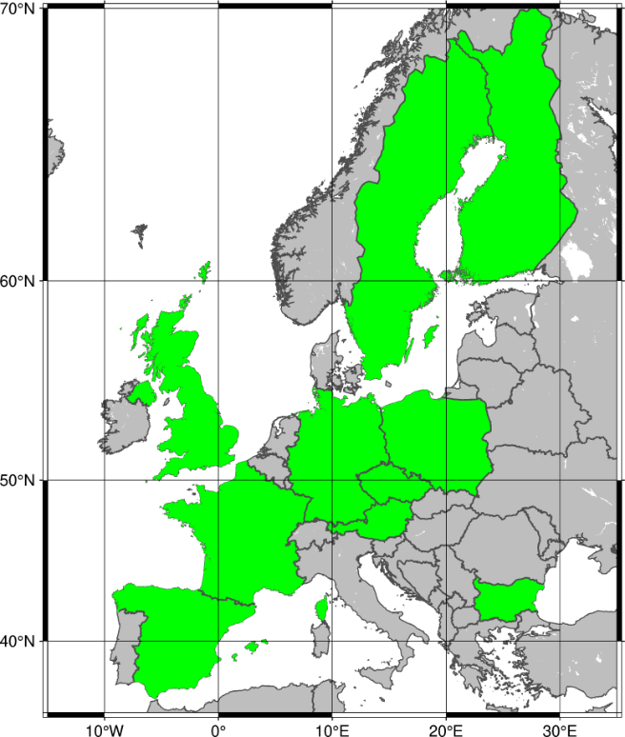
TCS Geomag Consortium
Luleå University of Technology (LTU), Sweden
Centre National de la recherche Scientifique (CNRS ), France
[UK Research and Innovation - British Geological Survey (UKRI – BGS ), United Kingdom]
The GFZ Helmholtz Centre for Geosciences, Germany
Institute of Geophysics of the Czech Academy of Sciences (IG-CAS), Czechia
Observatori de l’Ebre, Spain
Finnish Meteorological Institute (FMI), Finland
Institute of Geophysics Polish Academy of Sciences (IG-PAS), Poland
Geosphere Austria, Austria
National Institute of Geophysics, Geodesy and Geography (NIGGG-BAS), Bulgaria

Slide 3
TCS Geomag existing data products
WP13-DDSS-001 | Geomag. observatory data (WDC & INTERMAGNET) | BGS
WP13-DDSS-002 | Variometer data IMAGE + Baltic extensions | FMI
WP13-DDSS-003 | Magnetic survey data (e.g. WDC) | BGS
WP13-DDSS-004 | Magnetotelluric time-series (TS) | LTU
WP13-DDSS-006 | Geomagnetic indices (ISGI) | CNRS, GFZ
WP13-DDSS-007 | Geomagnetic events (OE, ISGI) | CNRS, EBRO
WP13-DDSS-008 | IMAGE electrojet indices (IE/IL/IU) | FMI
WP13-DDSS-009 | IMAGE Substorm events | FMI
WP13-DDSS-010 | Magnetotelluric transfer functions (TF) | LTU
WP13-DDSS-012 | IGRF and WMM (global magnetic models) | BGS
WP13-DDSS-013 | Lithospheric conductivity models | LTU

Slide 4
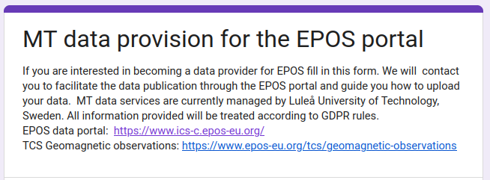
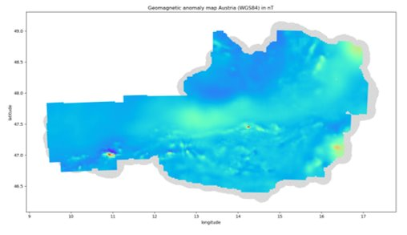
New developments and future data additions
MT data and models
Airborne magnetic survey data
Historical geomagnetic data
Robust web services
Training materials
3D visualisation tool
Application examples (Space Weather, Mineral exploration)

Slide 5
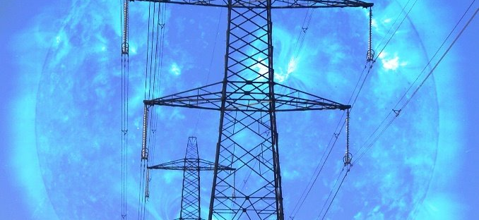
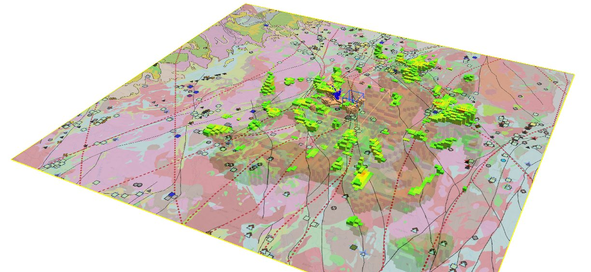
Applications
Data for Space physics
Space weather analysis
Regional 3D conductivity models
Remote References data

Slide 6
Thank you!

