Slide 1












Marc URVOIS
BRGM – French Geological Survey
TCS GIM Coordinator

Slide 2
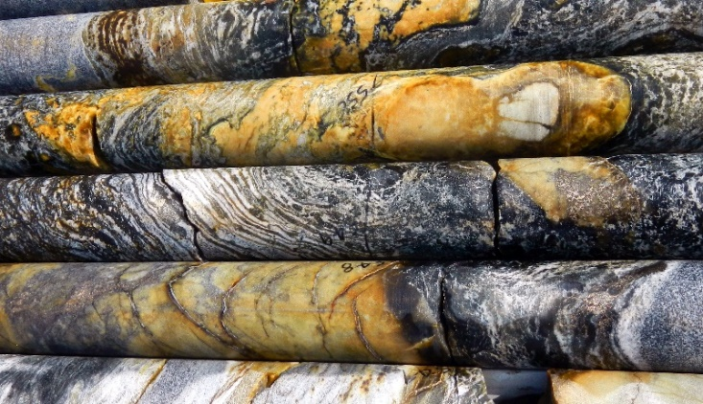
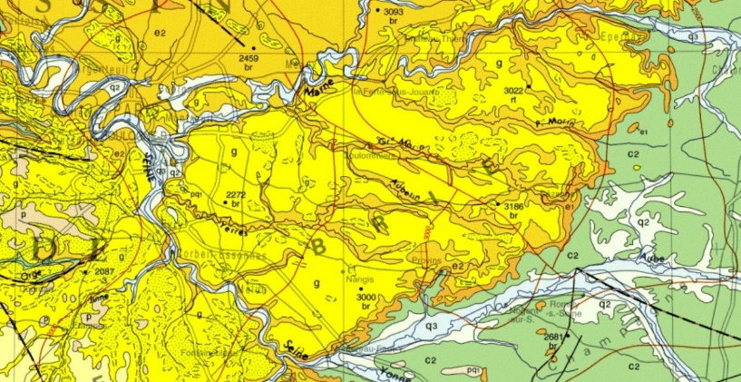
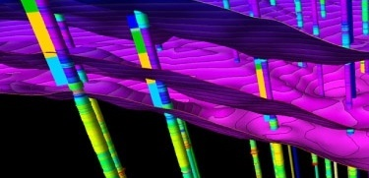
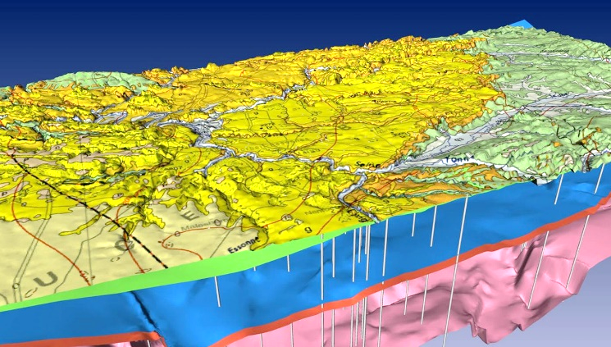
TCS in a nutshell… Scientific Areas of Interest
Mission: Design and implement efficient and sustainable access to geological multi-scale data assets: observations, measurements, maps and models
Complements the data contents made accessible by the other TCS mostly in the field of geophysics
Geological map: interpretation from field and remote sensing observations with the most recent knowledge. Revisable document with new observations and updated geological concepts
In addition to geological outcrops, boreholes are the only subsurface features observable in-situ: (1) sample material (drill cores) supplemented by a geological description, image documentation and geophysical downhole logs; (2) time series data from downhole sensors (e.g., seismometers, piezometers…)
Public Service mission of Geological Surveys: provide data and knowledge to support researchers, education, land planning, sustainable usage of georesources, etc.

Slide 3
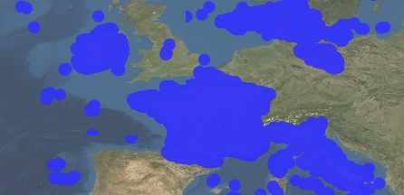
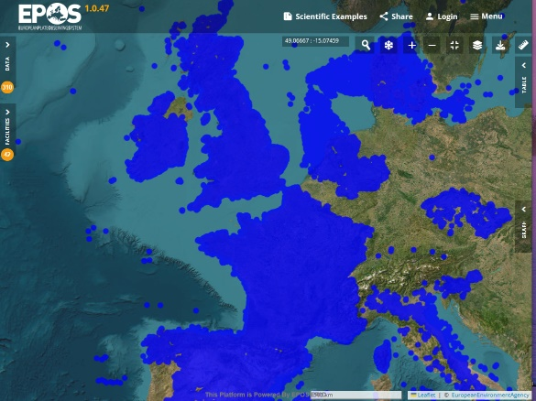
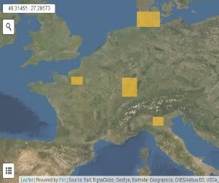
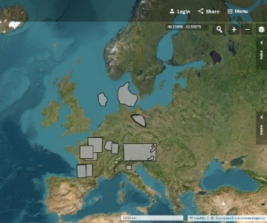
Key activities in 2025
2019
Extend the geographical coverage with new data assets and upgrade current TCS services
Boreholes from new providers: Czech Republic (3,258), the Netherlands (6,666 <-> EPOS eNLarge), Iceland (4,028)
Additional boreholes from current providers (Italy re. shallow drillings for geothermal exploration – France, United Kingdom, Denmark re. daily updates)
Improve the borehole harvesting process -data flow and payload- (e.g. improved compliance with controlled vocabularies, persistent identifiers…) to strengthen live connections with other data sets (e.g. TCS AH episodes, linked analytical data publications of IODP-Intl. Ocean Drilling Program…)
FAIRness: DOIs minted to each TCS GIM data service => first FAIR scores ~76%
ICS-D & Interdisciplinarity
Jupyter Notebook combining TCS GIM, SEIS, GNSS. Used for education at 1st EPOS Summer School
1st Connection of BRGM VRE-Virtual Research Environment to EPOS Platform (GIM, SEIS, TSU)
Communication: EGU25, EPOS Summer School and Intl. Conf. on Arctic Margins (ICAM)
2025
Boreholes
2019
2025
3D geological models

Slide 4
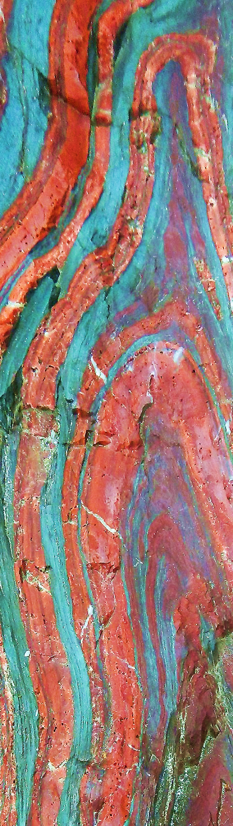
Future Plans
Extend the geographical coverage with new data assets and upgrade the operational TCS services
Stepwise ambition: from 2.3 M boreholes (2025) to 2.5 and 3 M entities
Regular national data declarations (e.g., in France and Denmark) and bulk digitisation of borehole log collections (e.g. Italy and Iceland) – Critical parameter: compliance of data models and vocabularies
Integration of boreholes of Germany through the federation of regional databases by BGR-Federal Geological Survey and German Länder
Boreholes from synergy through EGDI-European Geological Data Infrastructure with EUGM-European Groundwater Monitoring Database (26 countries: 18,935 water level monitoring points with time series; 60,000 chemical monitoring points with 50 M chemical analytic results)
Increase the granularity of data: finalise implementing the access to borehole detailed information (geological and geophysical log, water level…) [EPOS Borehole Linked Services]
Extend the list of data services exposed by EGDI on EPOS Platform: new geological maps (extension, thematic): world and regional geology; marine geology; lava flows… [EGDI Editorial Board]
Improve the IT components at central and federated node levels to ensure reliability, security and sustainability of this distributed implementation

Slide 5

Training session on boreholes
Part of the Geo-INQUIRE Training Program | 20 May 2026 – 10h00-12h00
Scope: Discover the borehole web data services (view and download) in Europe through thematic descriptors on the EPOS platform | Explore the linked data access to induced seismicity events (episodes) | Showcase community web map portals : Geological Survey of Italy portal, EPISODES platform and ECCSEL/PITOP
Target audience: Geoscientist, Geologist, Hydrogeologist conducting applied research and/or public service projects
Research fields: Geology, Hydrogeology, Mineral Resources, Geoenergy, Natural Hazards, Geotechnics, Land Planning, Cross-disciplinary
Prerequisites: None
Save the date & Register here: https://events.hifis.net/event/3715/

Slide 6
Merci!
Thank you!
Grazie!
Morgan Bezard, Franck Chan Thaw, Lucas Valarcher, Jérémie Pragout, Jørgen Tulstrup, Marianne Wiese, Jasna Šinigoj, Matija Krivic, Luca Guerrieri, Paolo Primerano, Dana Čápová, Henning Lorenz, James Trench, Martin Nayembil, Helen Glaves, Julie Hollis, Lucas Ferreiros

