Slide 1


GNSS Data and Products
Paul Crocker

Slide 2
GNSS Data & Products – Scientific Area
Implement the distributed dissemination of:
  Correct and Verified CORS Station Metadata
  File-based GNSS observation Rinex data currently for almost ~2400 (2026) up from ~2000 (EPOSDays 2025)
    Quality Controlled
  Derived Products (currently accessible for ~2500 stations + 1000 stations awaiting metadata)
    Coordinate Time Series, Velocities, Strain Rates, …
    Analysis centers: EPOS (UGA-CNRS FR,INGV IT) EUREF (ROB BE, WUT PL), SGO-EPND (HU), LM SW
Interact with the geodetic community in Europe, at National and Pan-European (EUREF, EUMETNET) levels
Ensure interoperability between EPOS GNSS services and EPOS Integrated Core Service
Promote multidisciplinary interoperability with other disciplines within EPOS, particularly: NFO & Volcanoes
Notes:
Sgo ambrus waiting for metadata

Slide 3
TCS Participants @EPOS Days & role in the TCS
Rui Fernandes (UBI, Portugal), Chair of Governing Board, Products Portal
Holger Steffen (Lantmäteriet, Sweden), Chair of Executive Board, Strain Rates
Luis Carvalho (UBI, Portugal), TCS-ICS Iterations, Software
Paul Crocker (UBI, Portugal), Software
Juliette Legrand (ROB, Belgium), Software, Data quality Monitoring
Jean-Luc Menut (CNRS-OCA, France), Software, Nodes
Michela Ravanelli (CNRS/OCA, France), Nodes
Andras Fabian (ROB, Belgium), Station and data providers metadata
Fikri Bamahry (ROB, Belgium), Early Career Researcher
Ruben Carvalho (UBI, Portugal), Software, Early Career Researcher
Notes:
Michela Ravanelli is the person that will take over the scientific responsibilities related to EPOS-GNSS at OCA at the end of February.
David Mencin EarthScope Consortium/National Geophysical Observatory United
Dina Vales Instittuto Português do Mar e da Atmosfera Portugal
Holger Steffen Lantmäteriet Sweden
Carine Bruyninx (ROB, Belgium), Chair of Executive Board, Harmonization data providers
Anne Socquet (CNRS-UGA, France), Products
Mathilde Vergnolle (CNRS-UGA, France), Data Porta
Michela Ravanelli CNRS/OCA France
David Jessop CNRS Observatoire de Physique du Globe de Clermont-Ferrand France
Philippe Labazuy CNRS / OPGC / UCA France
l

Slide 4
GNSS Station Metadata and Providers
New Stations
  All the stations of the EUREF Permanent Network have joined EPOS and have been populated at the ROB-EUREF data node
New EPOS data suppliers (since March 2025): 30
Number of unique users who accessed the M3G gnss-metadata.eu home page in 2025: 10,773
Notes:
HighLights – Stations @ Iceland and Greenland

Slide 5
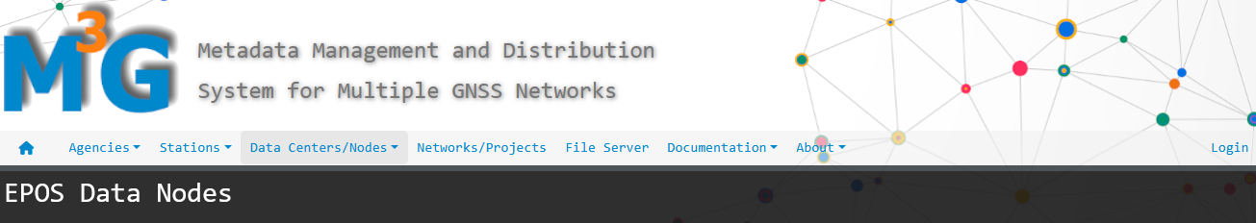
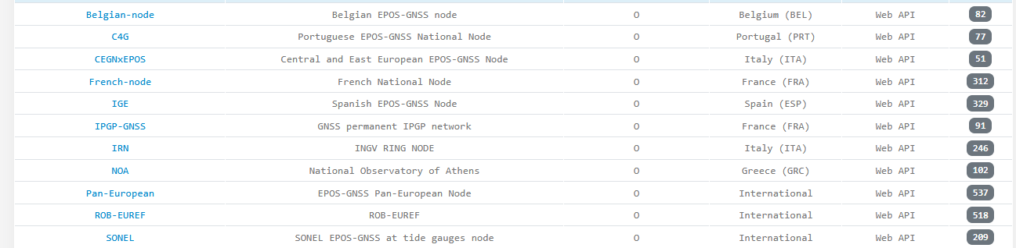
EPOS GNSS Data Nodes
New Nodes : Planned 2026
Icelandic EPOS-GNSS node

Slide 6
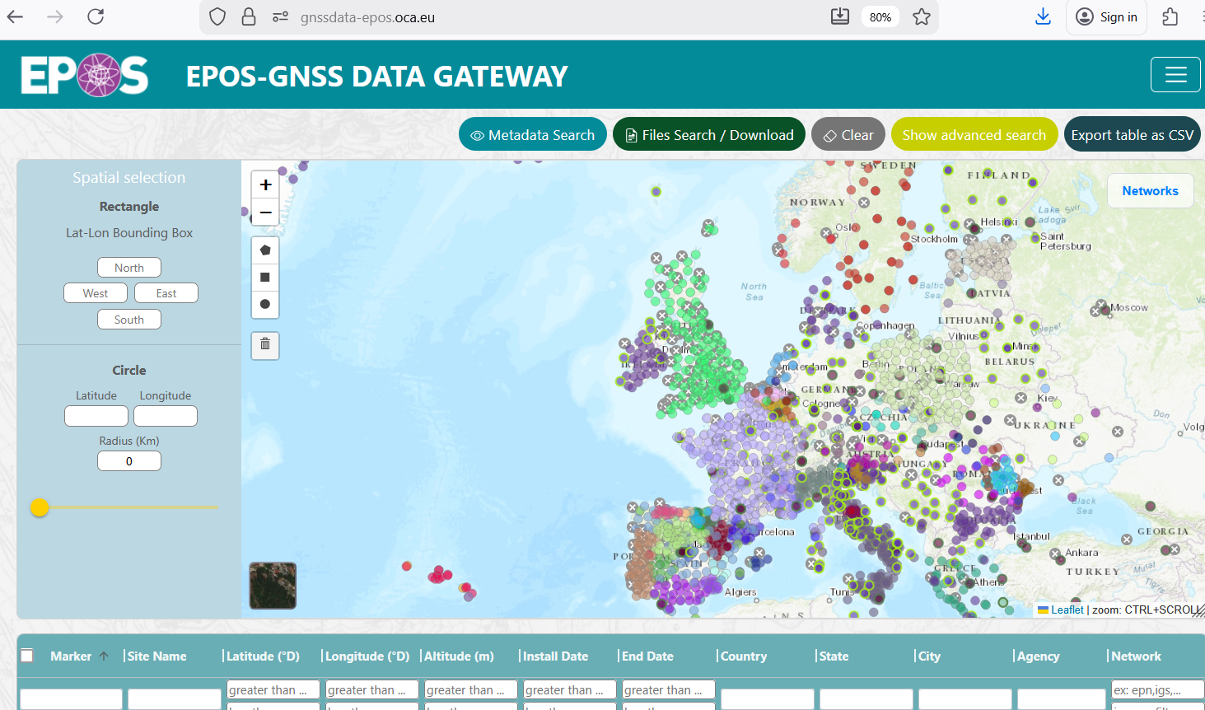
GNSS DATA
ROB-EUREF node
500k+ new files and 71 new stations since last EPOS days populated at the ROB-EUREF node
GNSS Data Gateway DGW
Around 11 million RINEX (9.6M daily RINEX, 0.8M High Rate RINEX)
Available via TCS Portal GUI, API and ICS Portal
New GUI (Nodejs->React) and BackEnd
Notes:
GUI – update tech to react + backend monitoring/stats
34k new files at Belgium node since last EPOS days populated at Belgium node
Nao vale a pena, se não tinha de ter dados de todos os nós

Slide 7
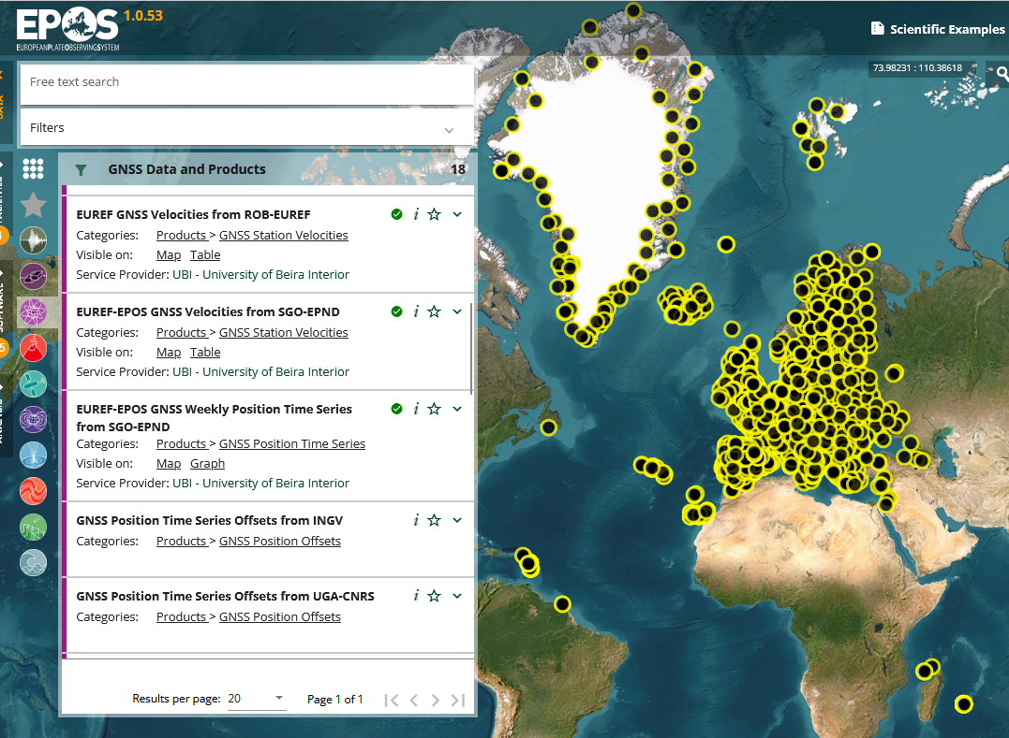
ICS
Number of services 14 (EPOSDays 2025)
Number of services 18 (EPOSDays 2025)
Services:
GNSS Stations Discovery
  with RINEX Data
  with HIGH RATE RINEX Data
  GNSS Stations Metadata
  List of RINEX Files search Parameters
Metadata and urls of RINEX Files
Metadata and urls of HIGH RATE RINEX Files
GNSS Stations with Products
Positions Time-Series (4 providers)
  Time Series Offsets from INGV
  Time Series Offsets from UGA-CNRS
Velocities Solutions (4 providers)
Strain Rates (1 Provider)

Slide 8
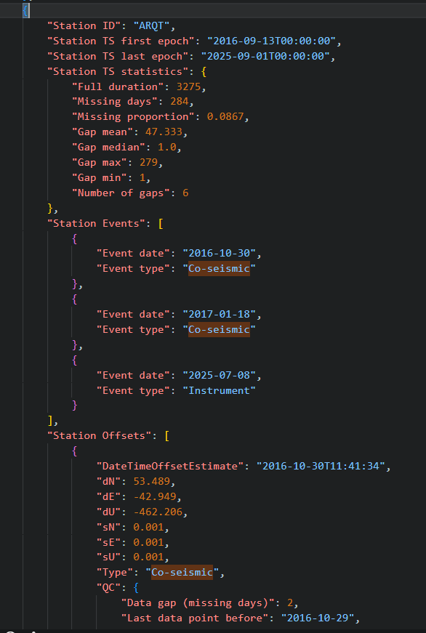
ICS New Services
Time-Series offsets—sudden position changes at permanent stations—are critical as they provide direct, high-precision measurements of how the Earth’s surface moves during events such as earthquakes, volcanic intrusions, landslides.
GNSS TCS provides station offsets labelled as station events as Instrument, Co-Seismic or Other (json format) –
  future will be graphic, geojson, e json.
  More details in ECR talk (Ruben cARVALHO)

Slide 9
GNSS Planned Products Highlights for 2026
A new reprocessed solution based on EPN-repro3 will be online shortly after EPOS days
TimeSeries and Velocity Products: New Solutions from INGV and UGA AC to be published shortly with DOI’s
Portals Offsets :
  GNSS Product Portal : map view for the offsets - allowing a search by time
  EPOS-ICS : search by seismic event

Slide 10
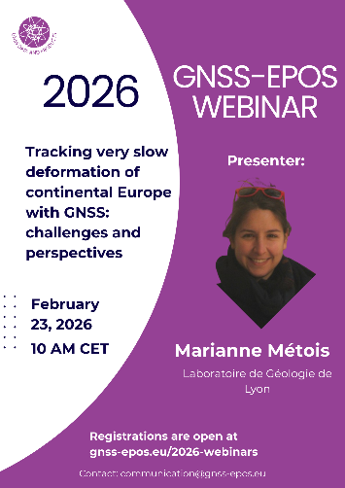
GNSS Community
Webinar
  1st Webinar 23/2/26 was organized with over 140 persons attending the webinar !
  Further events planned.
    Next Event The GNSS Data Quality Management Service (DQM)
    For the whole EPOS community and EUREF station managers
EUREF Symposium 2025 Portugal
Communications and Journal Publications
  https://shorturl.at/7DbYq
Notes:
Dr. Métois is a Lecturer at Université Lyon 1 within the "Surface and Lithosphere" group.
Her research focuses on the short-term deformation of the lithosphere associated with the seismic cycle. She specializes in processing GPS data
using GAMIT/GIPSYX and applying continuous lithosphere formalisms to model deformation patterns, particularly in the Balkans, Europe, and Chile.
The presentation will take place via Microsoft Teams, on Monday, 23rd of February, from 10:00 CET to 11:00 CET.

Slide 11
Software Iniciatives
Internal - GNSS TCS API & database – new updates
Ongoing - FAIRness improvements for the GNSS services
RRINGG (2025)
  An open-source program to correct InSAR velocity fields and reference InSAR time series to a standard global geodetic reference system, e.g. International Terrestrial Reference Frame
  This software relies on data from GNSS stations available through EPOS (European Plate Observing System) and NGL (Nevada Geodetic Laboratory) portals. https://zenodo.org/records/14800884
StrainTool (2024) https://github.com/DSOlab/StrainTool/
Cloud Native GNSS data storage Formats
  Technical Workshop on Storage and Exchange Formats for GNSS Data - Feb 24-26, 2026 – Portugal with EarthScope and GFZ focusing on the standardization of Array Based (TileDB & Apache Parquet) file formats for observation data and its usage.

Slide 12
Thank you!

