Slide 1

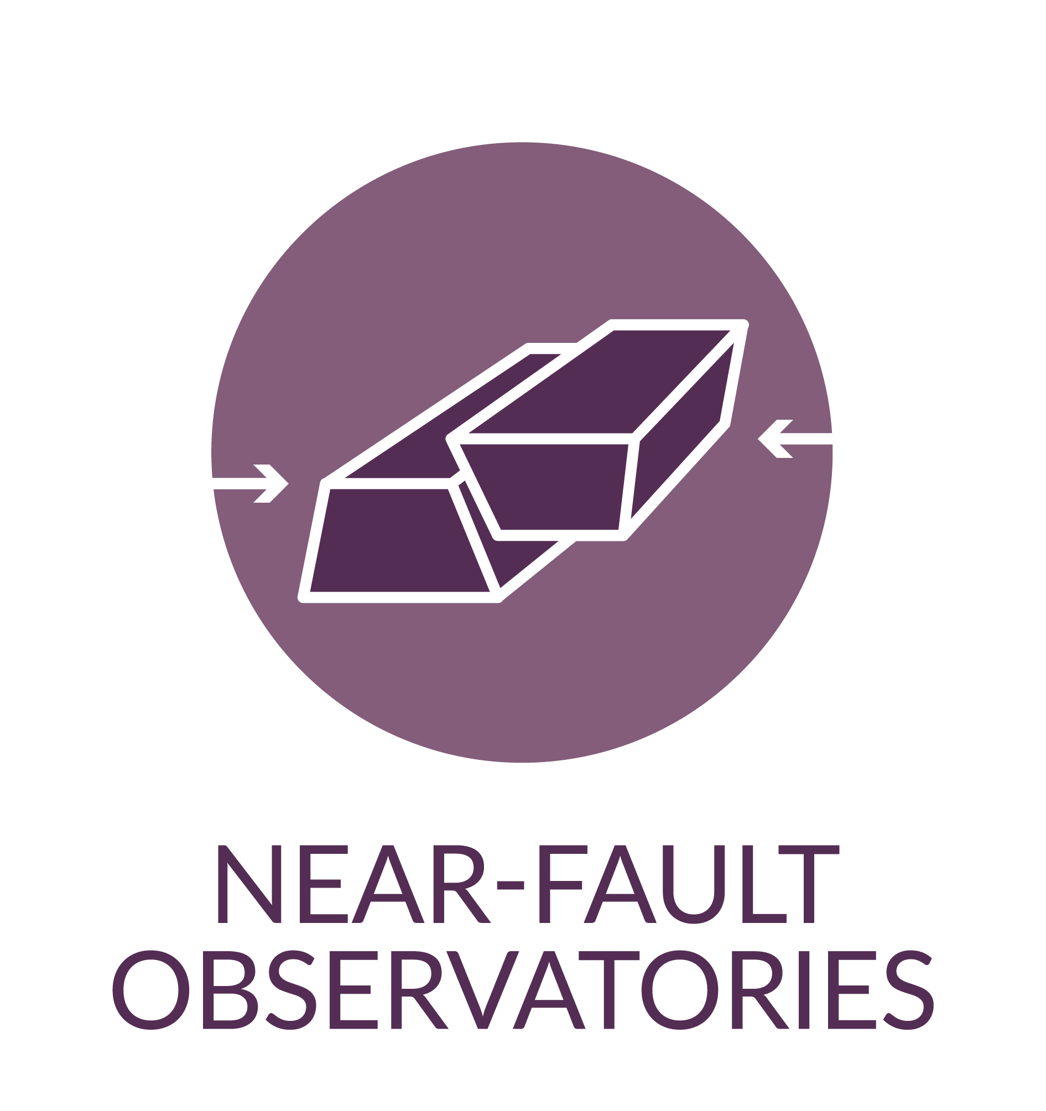
Exploring Active Fault Processes with High-Resolution Observation
Lauro Chiaraluce, Gaetano Festa, Alexandru Marmureanu, Ovidiu Jianu, Luca Elia, Ivano Matiddi, Antonio Scala, Mihaela Dragan, Pascal Bernard, Christos Evanghelidis, Sokos Efthimios, George Kaviris, Semih Ergintav, Stanka Šebela, Meier Men-Andrin, Alessandro Vuan, Giovanni Costa, Panagiotis Elias, El-Madani Aissaoui, Enrico Magrin, Žan Kafol, Ioannis Karamitros, Christos Babekos, Lambotte Sophie

Slide 2
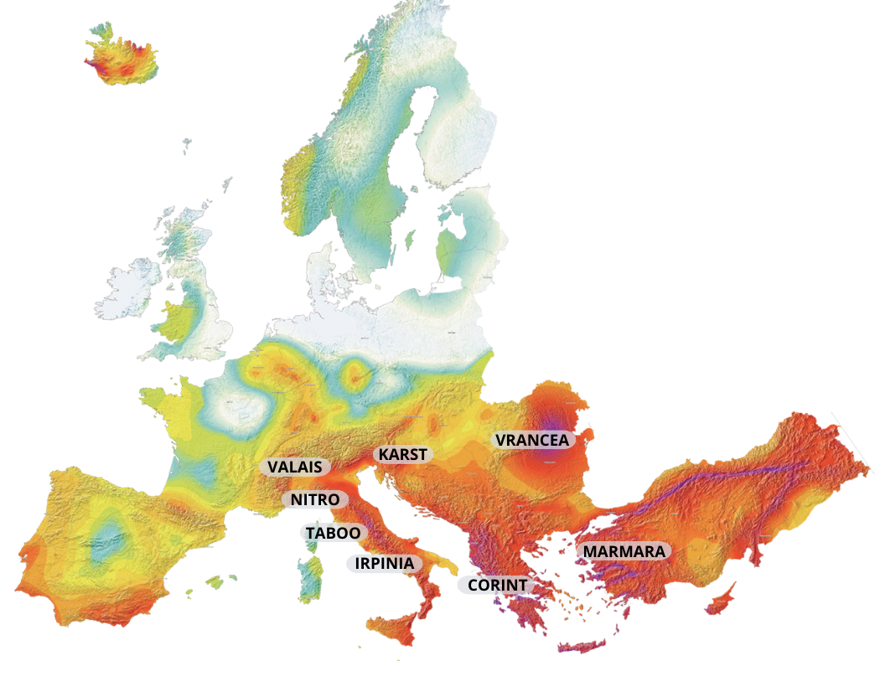
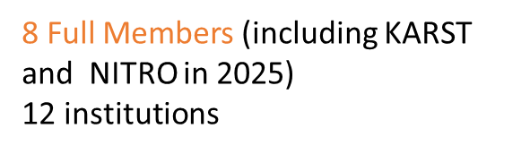





TCS NFO Consortium - Scientific area
Toward a better understanding of the multi-scale, physical/chemical processes responsible for the earthquakes
8 Full Members (new KARST - NITRO)
7 countries/12 institutions
SPAIN and possibly Hungary and Czech Republic too, soon become OBSERVERS
FRIDGE - Federated data gateway for sharing multidisciplinary data and scientific products
We develop tools for scientific analysis, target-oriented alert systems and decision modules for risk mitigation actions
CREW – testing centre for earthquake early warning systems comparison on benchmarked datasets
Earthquake studies involve phenomena from multiple research fields.
We installed modern multidisciplinary infrastructures near active faults in different tectonic settings.
High-resolution data from dense networks enable the development of innovative scientific products
Connections: Seismology – Geodesy – Satellite - Anthropogenic Hazard - Volcanology

Slide 3
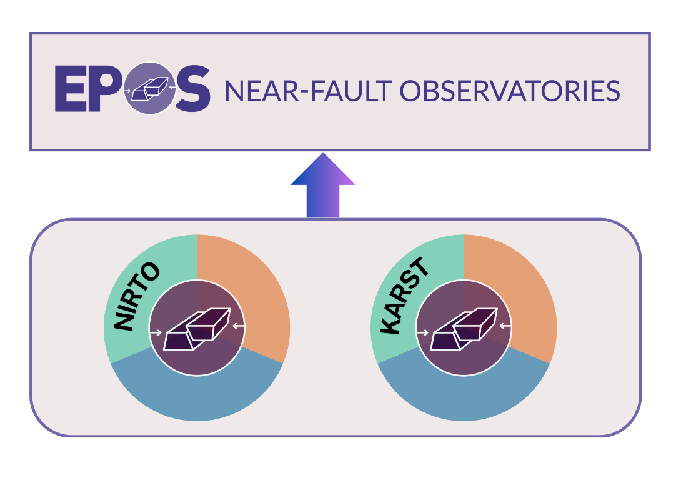
Work Plan 2025-2026
Improvement existing services and interoperability - harmonization of DDSS across the TCSs and ICS, plus increase service robustness through improved interoperability layer (FRIDGE)
Enlarging the DDSS portfolio through new services - services development for new products like: Velocity and attenuation models (1D-2D-3D); Enhanced earthquakes catalogues.
Ongoing integration of DDSS from Observer NFOs (NITRO and KARST).
New tools - Visualization of multidisciplinary time series for comparison and analysis, software for specific data/products quality assurance.
New service for EPOS as innovative geochemical technology and data (EPOS-ON),
Deformation data (TRANSFORM2 and National projects)
Extend the TCS participation to new NFOs across Europe (Spain, Hungary, Czech Republic )
Interaction with international initiatives worldwide
(United States - China - Japan –via EPOS - ON)
Connecting EEW facility CREW with data provision from different NFOs (EPOS- ON)
Notes:
I WOULD MENTION HOW TRASFORM2 IS HELPING THE COMMUNITY…

Slide 4


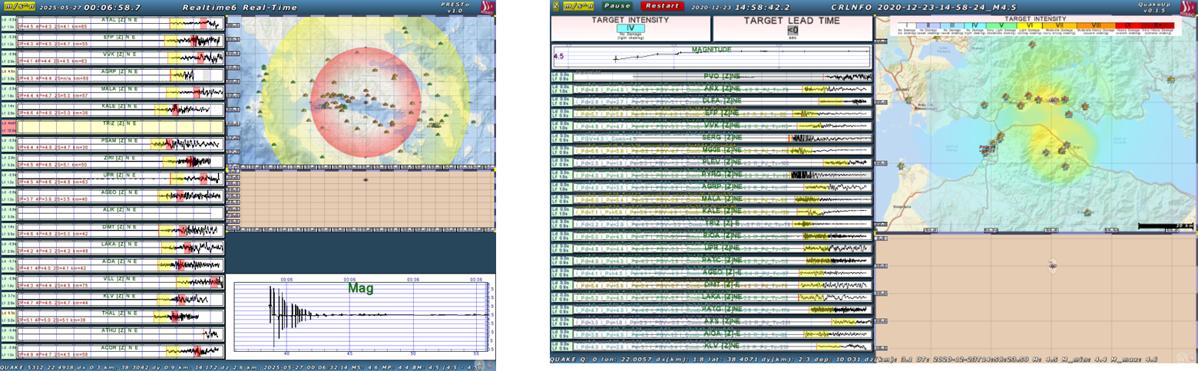
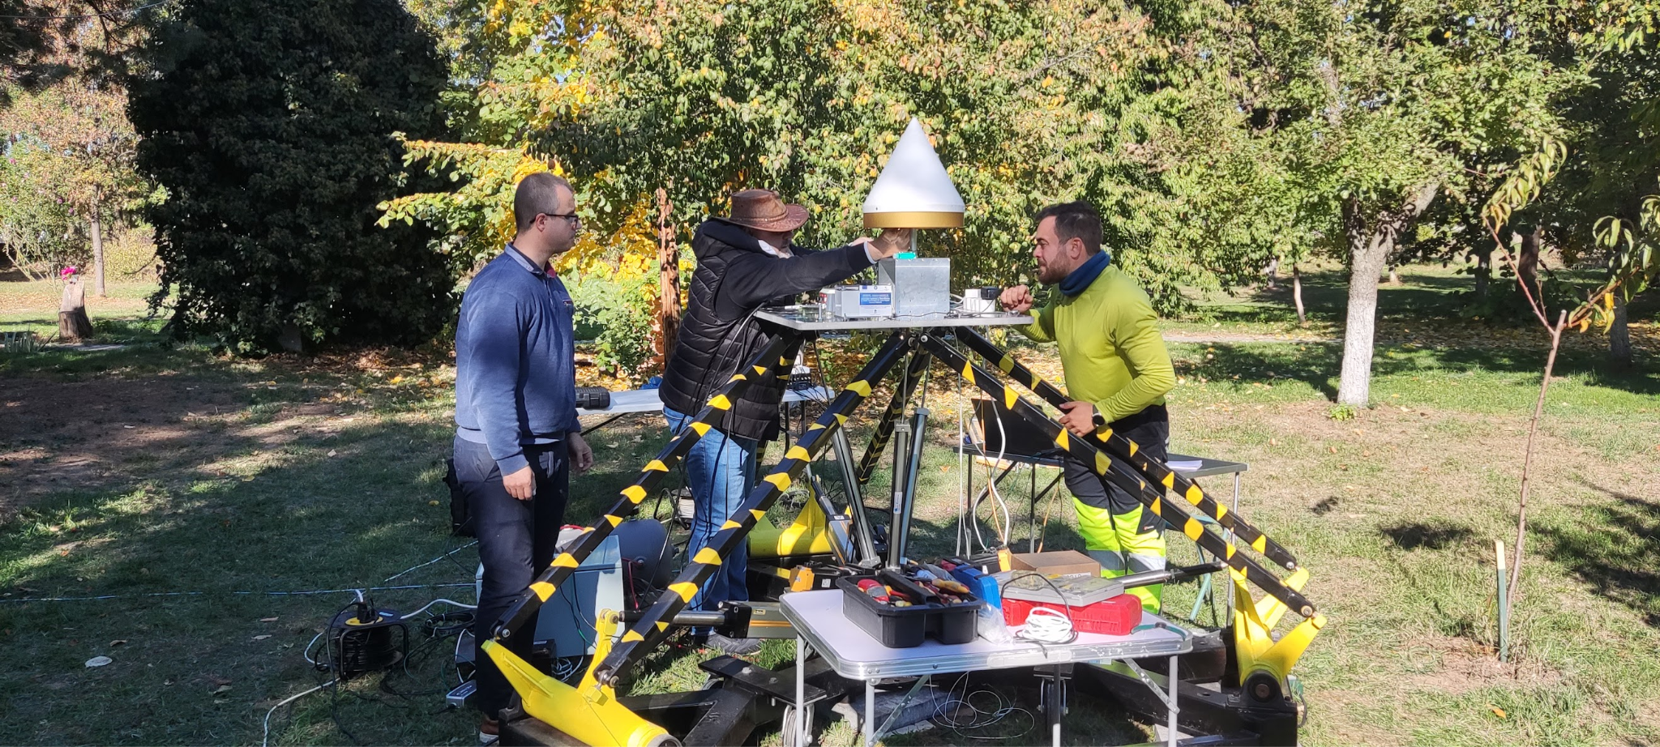
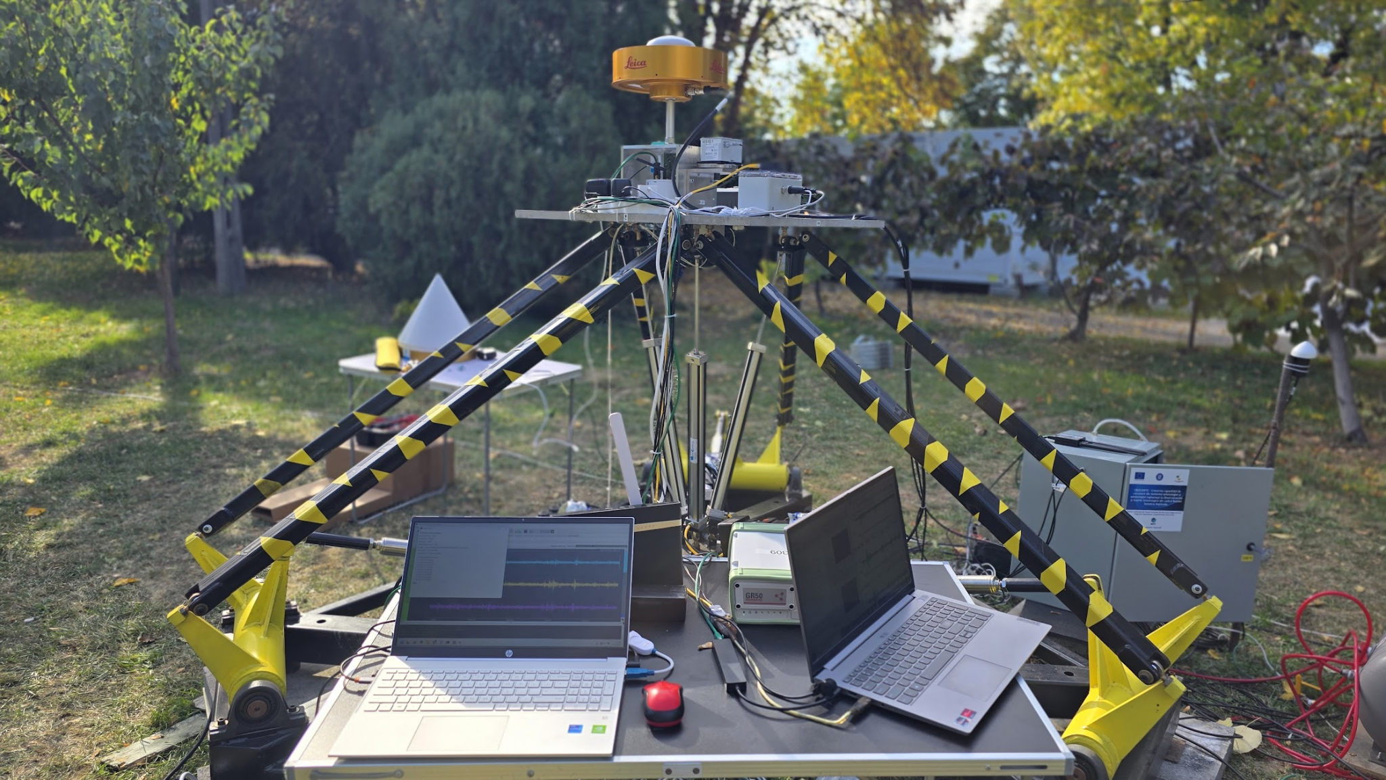
NFO Community projects:
Innovative sensor concept: aim to test and study the feasibility of new sensors (seismic, acoustic, geodetic, and geochemical) that will go beyond the state-of-the-art and will become a strategic asset for the next generation of NFO
Workflows for enhanced detectability and earthquakes catalogues - Machine Learning (ML) algorithms and Digital Acoustic Sensing (DAS) of fiber optic cables
Test Bed concept - use and test new measuring sensors and methodologies for studying natural systems at several sites (test-beds)
Testing and implementation of software platforms for EEWS that combine recent algorithms for real-time, rapid earthquake location, magnitude estimation and damage assessment
Data coming from NFOs monitored by geochemical spectrometer will be made available as a service.

Slide 5
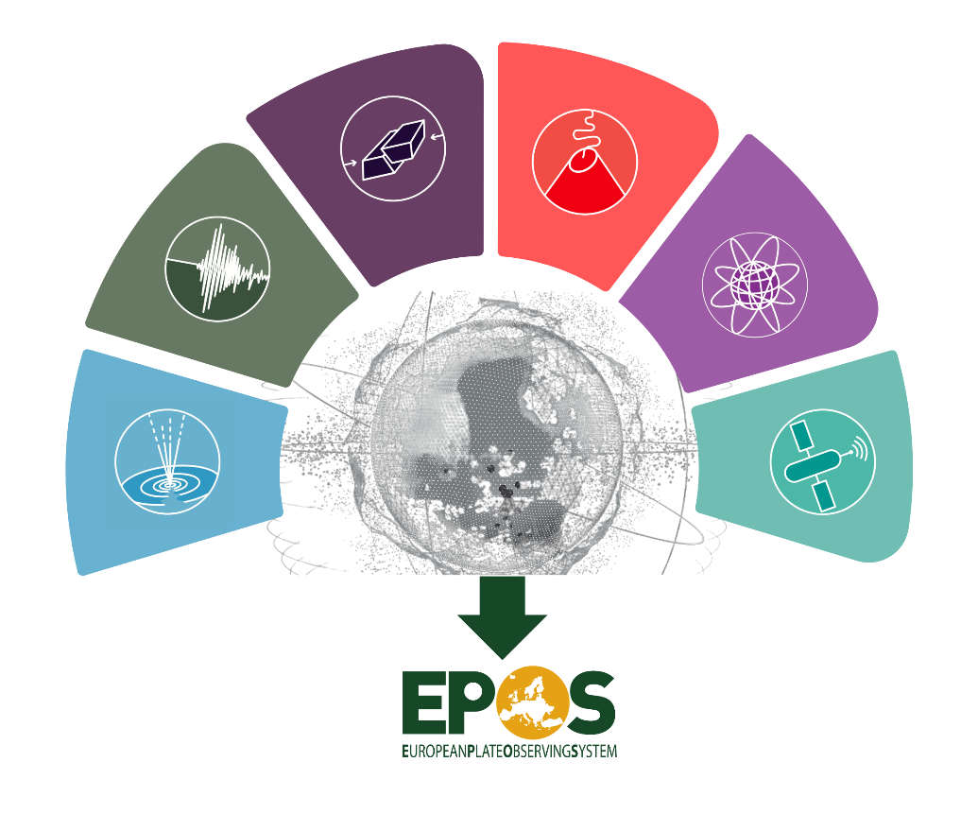
Cross TCS collaboration:
EPOS Sponsored Research Activity (SRA) called:
"Advanced Deformation Service (ADeS)"
The TCS benefitting from this activity: VOLC, GNSS, SAT, AH, NFO, SEIS.

Slide 6
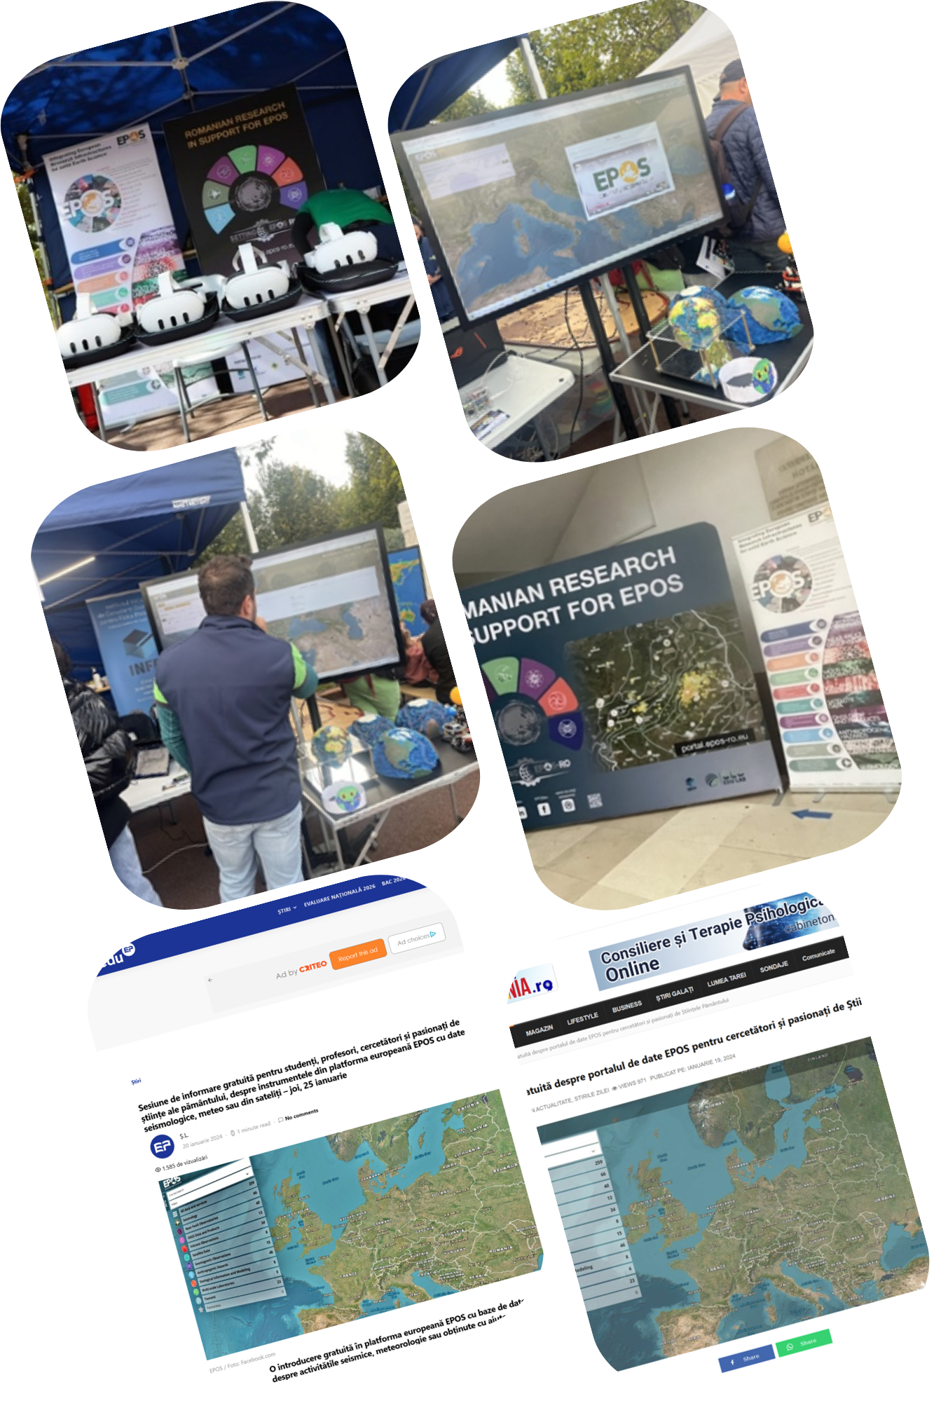
TCS Communication and Dissemination
⮚ Promoted EPOS ERIC infrastructure, and the EPOS Data Portal
⮚ Focus on projects: EPOS-ON and NFO TCS
⮚ Target audiences: scientific community and general public
⮚ Communication through social media channels, press, and event participation
⮚ European Researchers’ Night (Bucharest & Magurele, Romania) as a key outreach event
⮚ Public engagement through roll-ups, printed leaflets, and live demonstrations of the EPOS Data Portal
⮚ Participation EPOS Communication TCS meetings
⮚ Interaction with EPOS communication team about EPOS website
⮚ EPOS Presentation at the ‘Gheorghe Ionescu-Șișești’ Academy of Agricultural and Forestry Sciences (ASAS) on the Occasion of World Earth Day – April 22. Event organized by ASAS in collaboration with INCDFP and the ‘Ecological Initiative and Sustainable Development Group’ Foundation.

Slide 7
Thank you!

