Slide 1
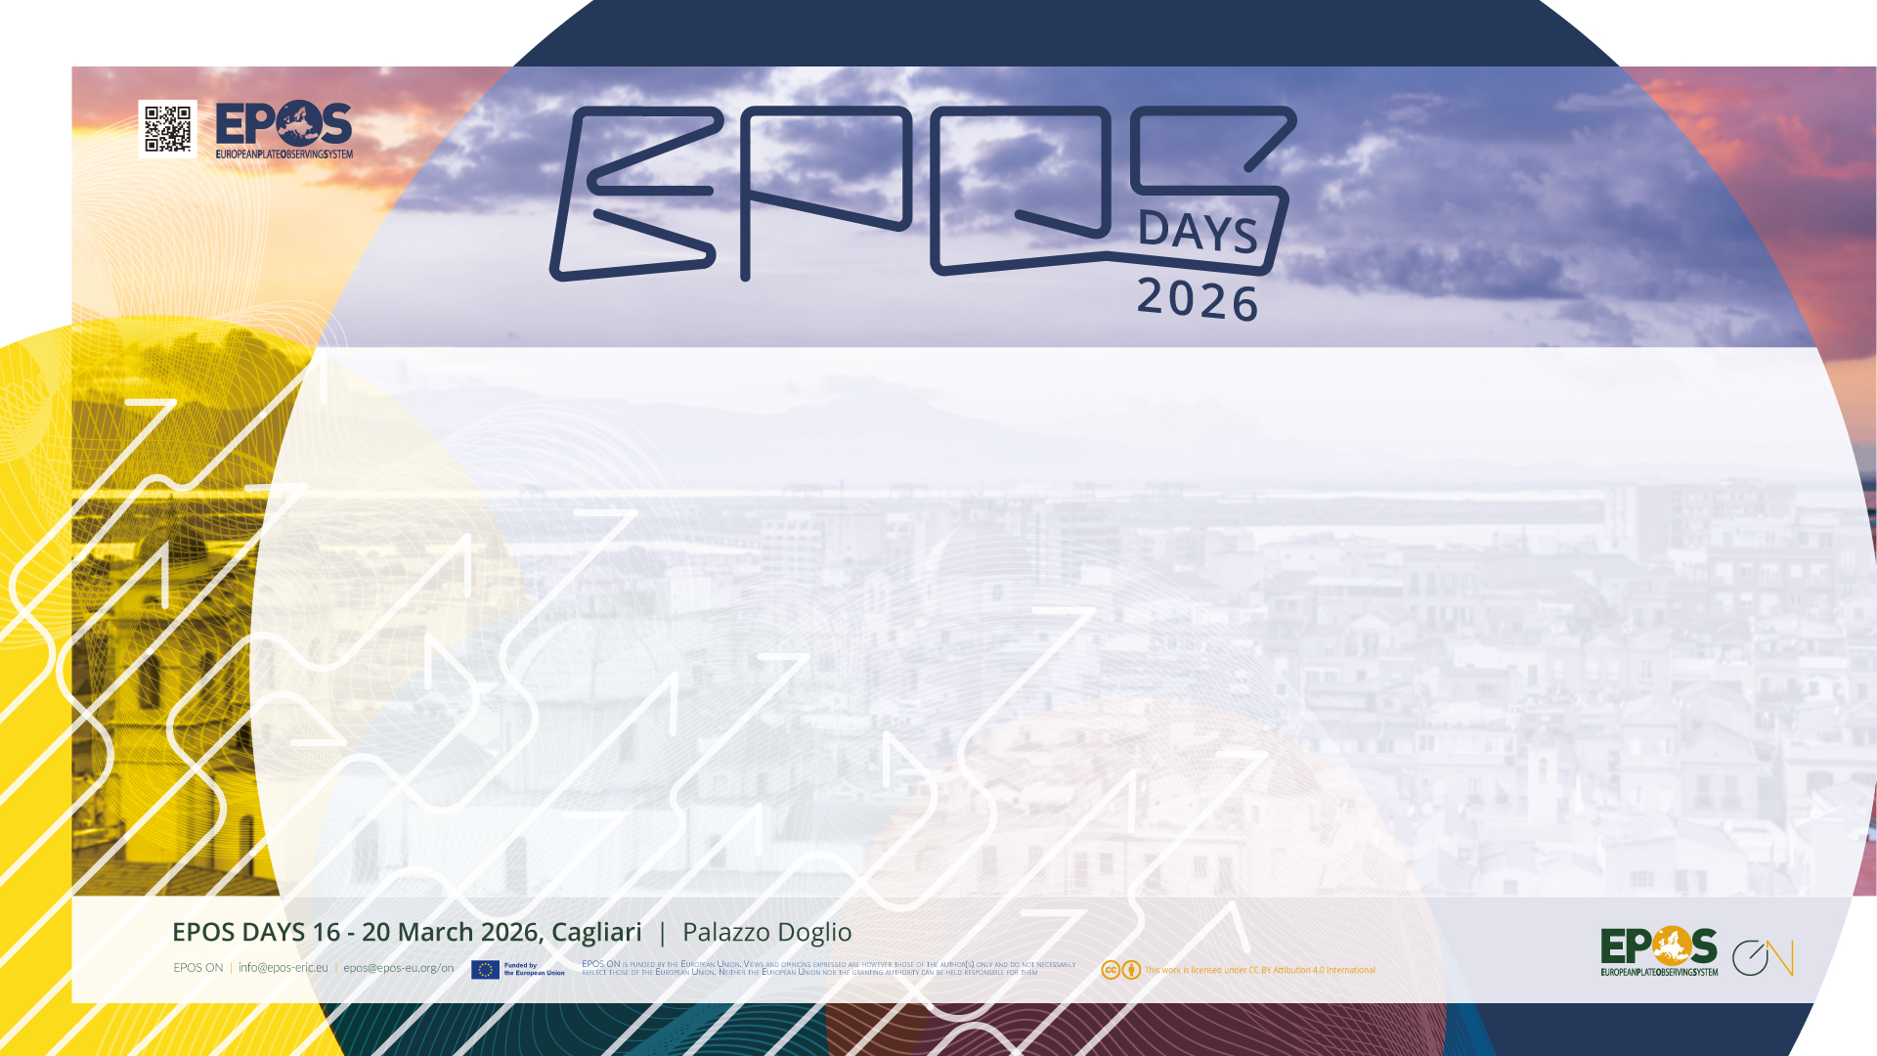
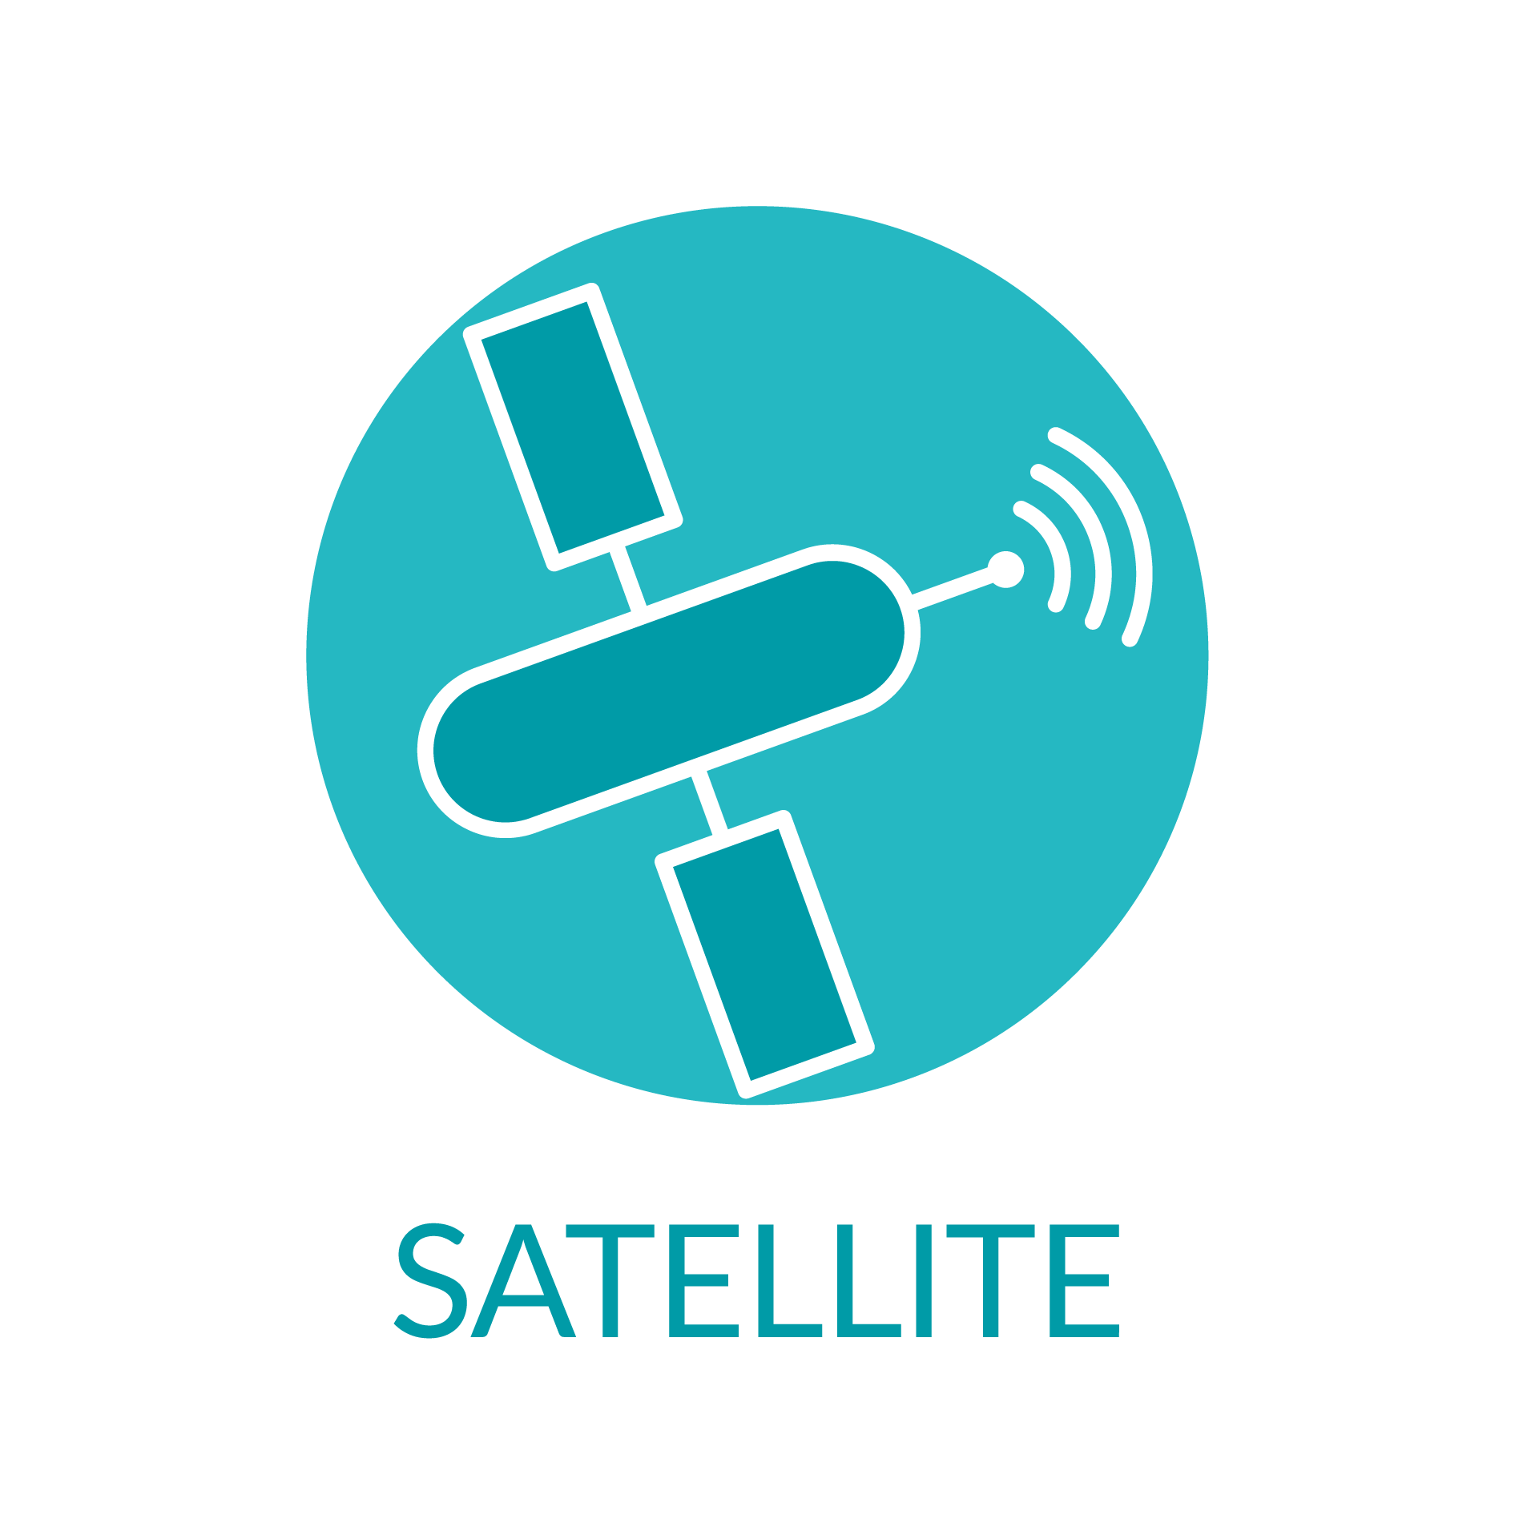
TCS Satellite Data: Mission and Perspectives
Michele Manunta, CNR-IREA
TCS Satellite Data Director

Slide 2
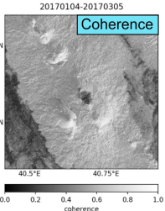
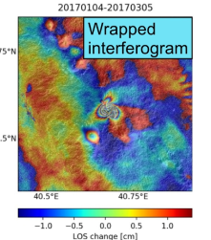
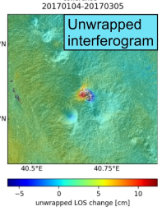
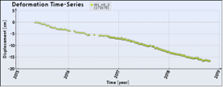
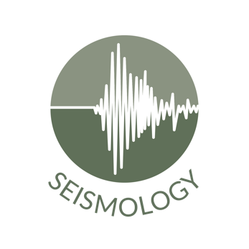


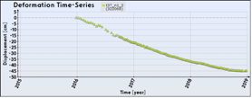
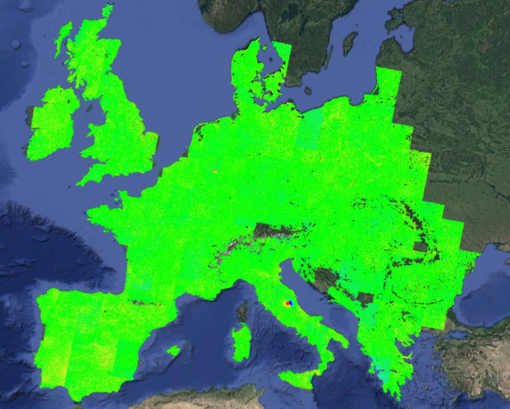

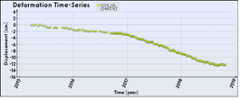


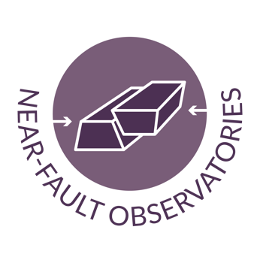
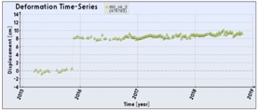
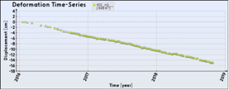
TCS Satellite Data Mission
TCS Satellite Data aims to foster the use and re-use of satellite data and products to establish multidisciplinary research in Earth sciences. TCS SATD widely benefits from the Copernicus Programme, which enables the deployment of advanced satellite services under a free and open data access policy.
Surface deformation maps and time series with cm to mm accuracy to study natural hazards and anthropogenic phenomena
Volcanoes, Earthquakes, Landslides, Man-made activity
>3
Mean deformation velocity [cm/year]
<-3

Slide 3
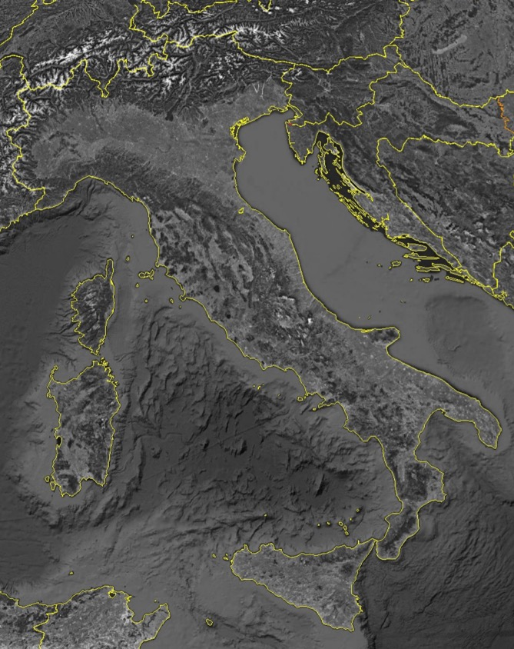
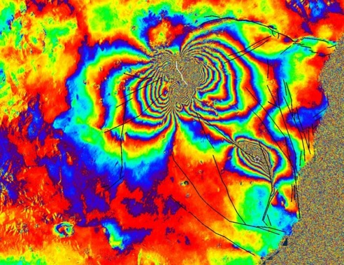
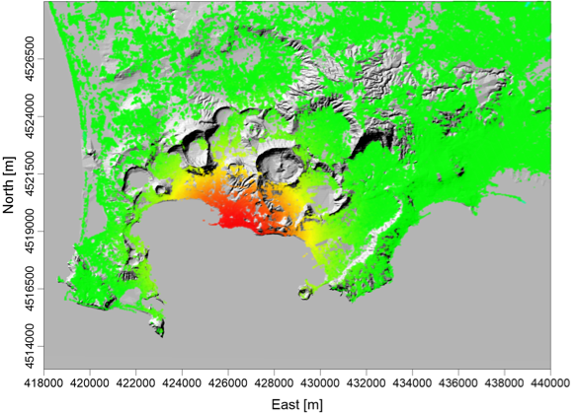
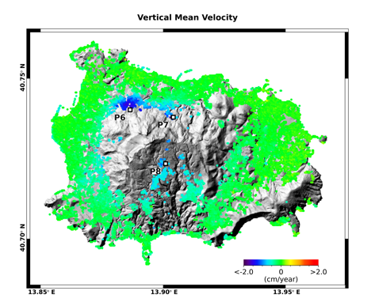
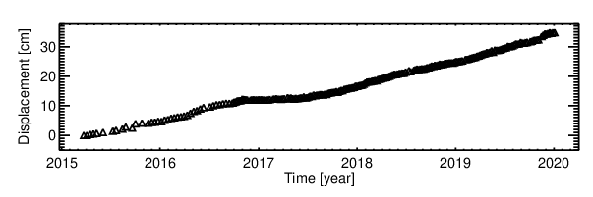
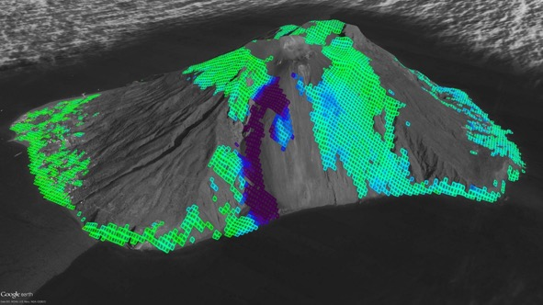

TCS Satellite Data Scientific Context
Campi Flegrei
Ischia
Etna
> 6
Down
Up
Down
Up
[cm/year]
Mw 3.9 21.08.2017
< -6
Napoli area
Stromboli
Eolie
Etna
Down
Up
< -5
[cm/year]
> 5

Slide 4

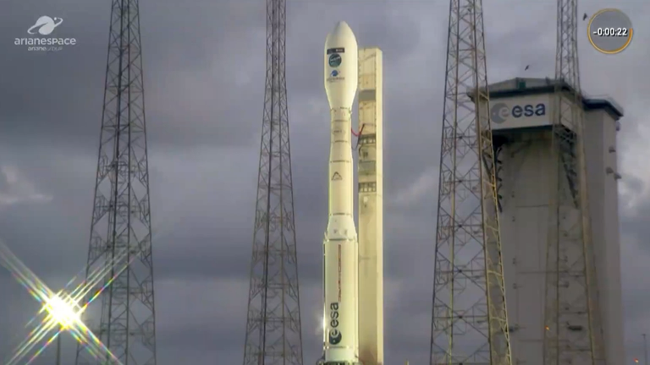

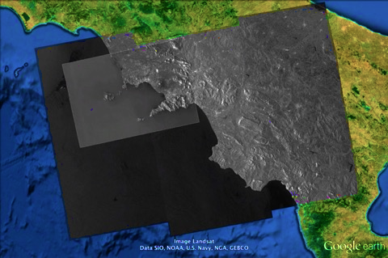
Exploited Copernicus Data
Dec 2021
Dec 2024
Sentinel-1A
Sentinel-1B
Sentinel-1C
Sentinel-1A
5TH December 2024
French Guyana
Time
6 days
12 days
Spatial resolution (TOPS): 15 x 4 m
Ground coverage (TOPS): 250km
C-band
2014 - present
Global coverage
Free and open access data policy
CSK-CSG
ERS-ENV
SENTINEL-1

Slide 5
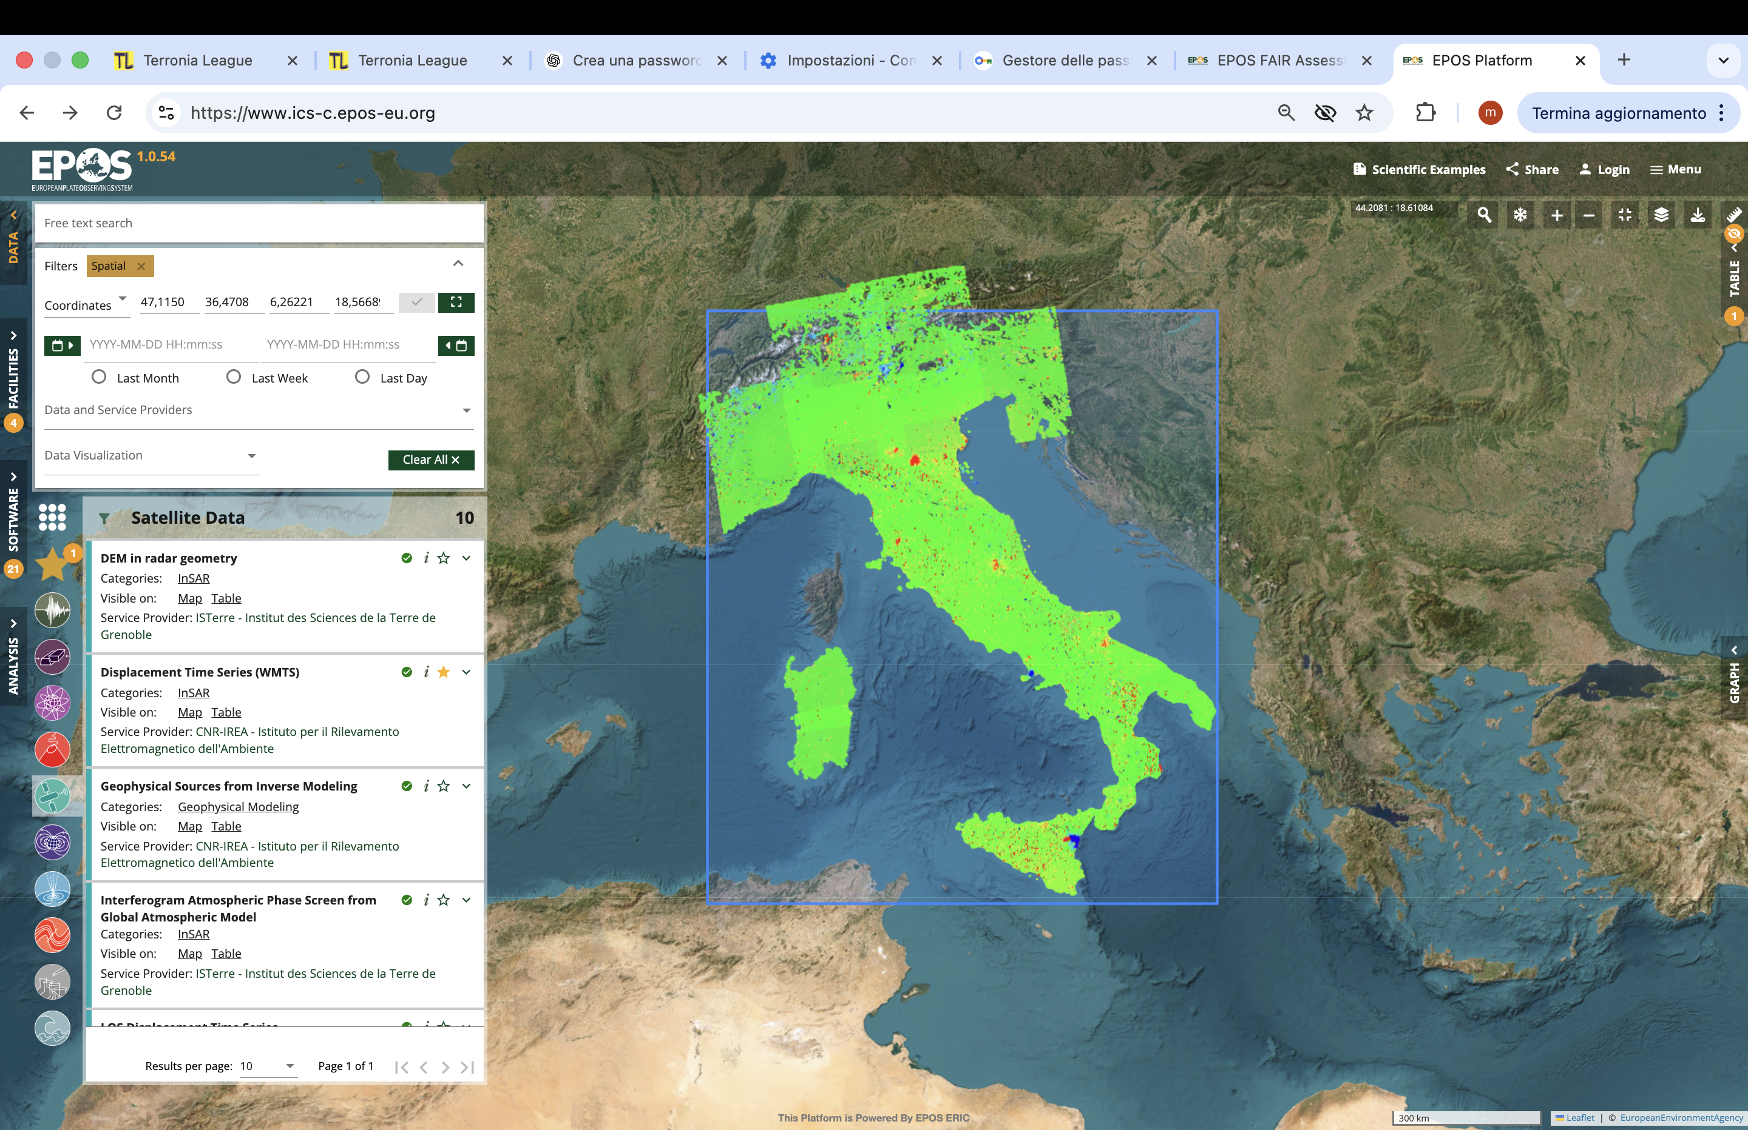
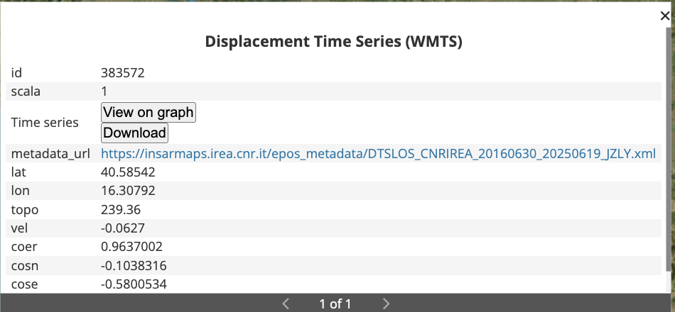
Products and Services
TCS SATD distributes services based on InSAR technology
10 Services
LOS Displacements Time Series
Spatial Coherence
Wrapped Interferograms
Displacements Maps
…..
Global Coverage (Sentinel-1 images)
Medium spatial resolution (>30 m)
Centimeter-to-millimeter accuracy
Quasi real-time data availability

Slide 6
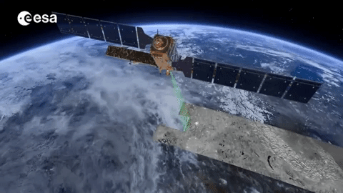
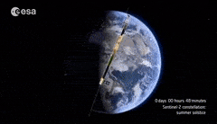
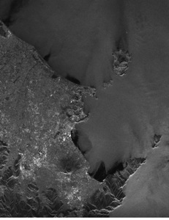
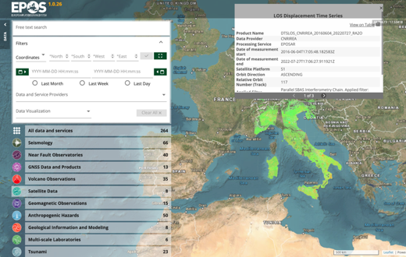

Data Infrastructure
Sentinel-1 revisit time: 6/12 days
TCS Services
EPOS Platform
>6
Campi Flegrei
[cm/year]
<-6

Slide 7
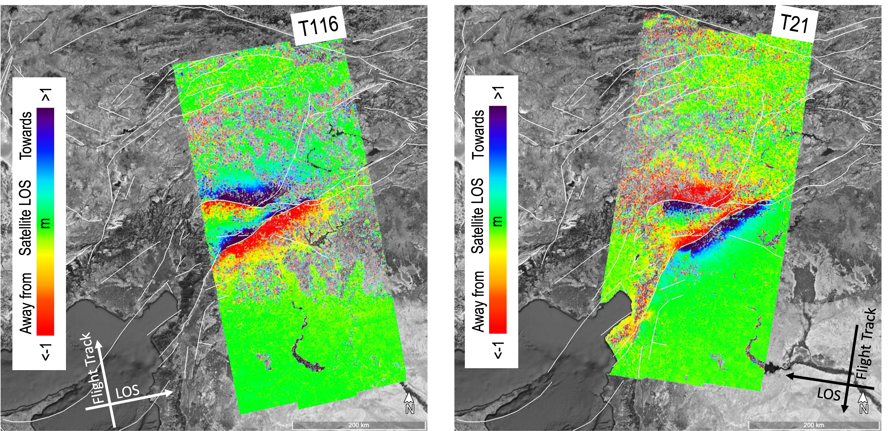


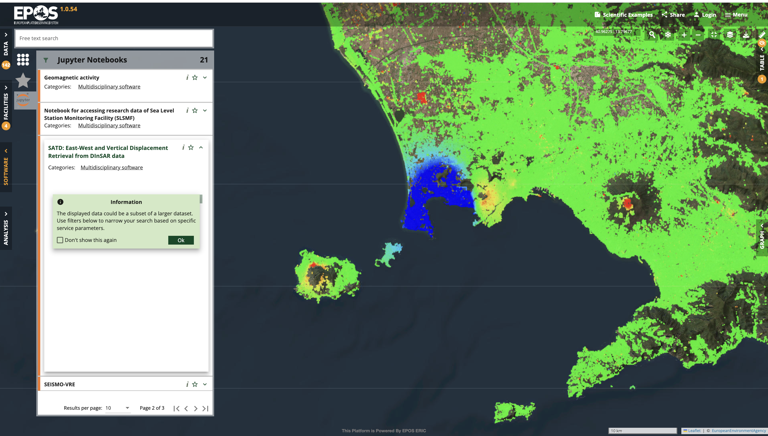
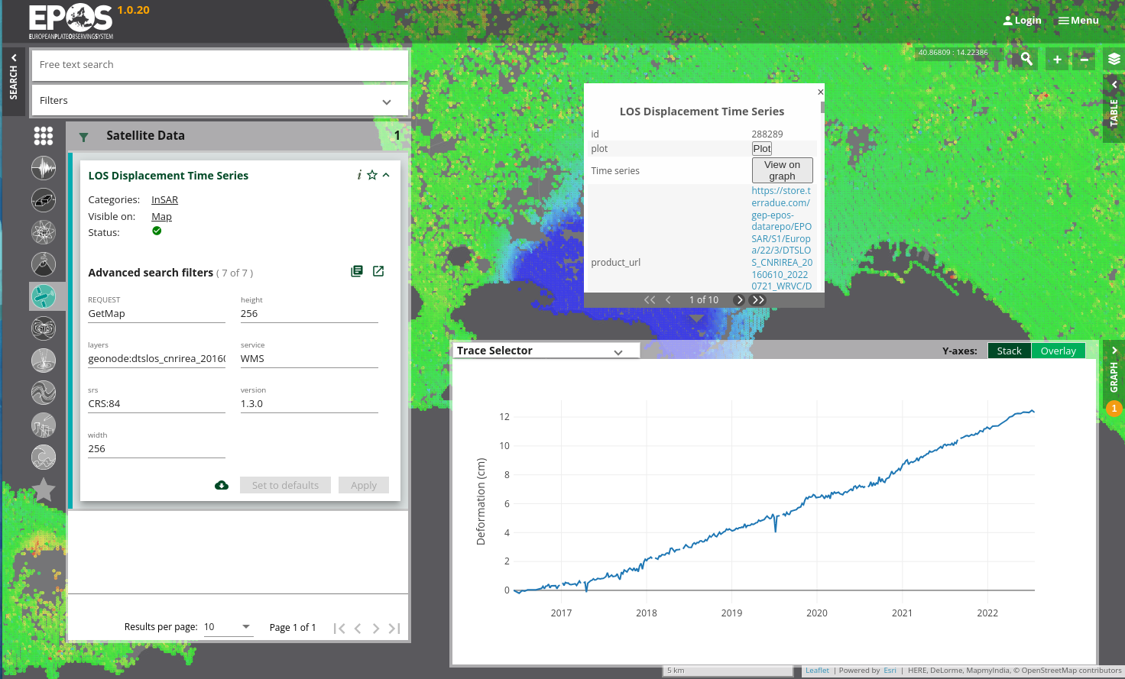
Future Developments
New TCS Services
New TCS Members
ICS-D
EPOS Platform User Experience

Slide 8
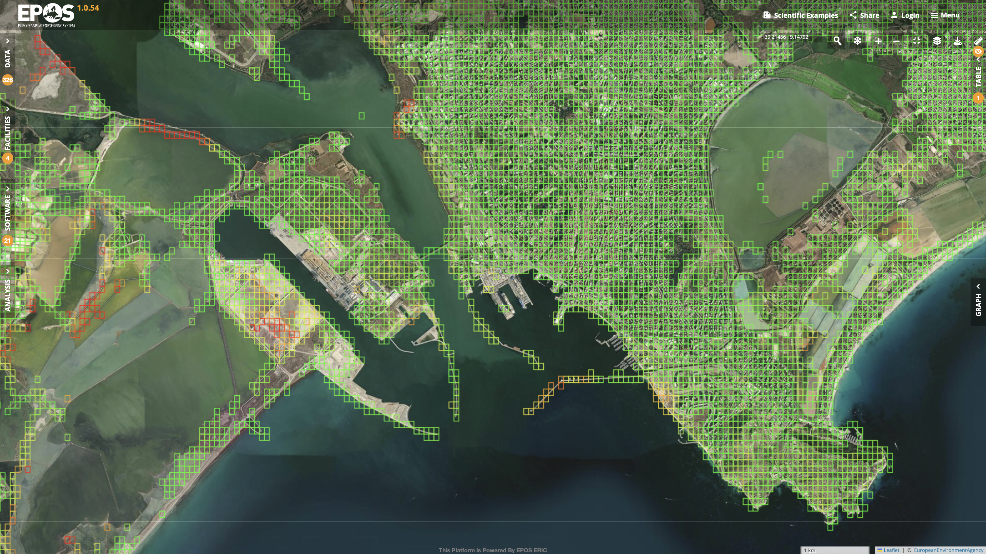


Slide 9
Thank you!

