Slide 1

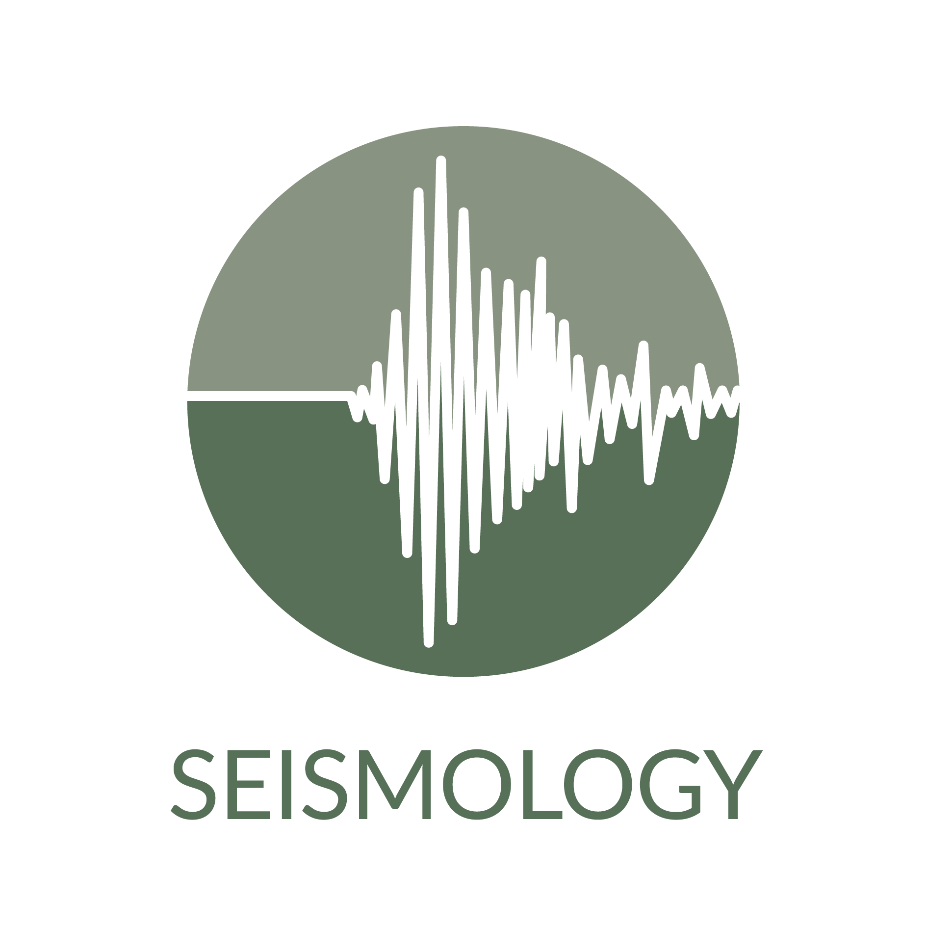
Beyond Access: Scaling Up the Integrated Seismological Backbone of EPOS
Notes:
Add logos of the of the 3 pillars…

Slide 2



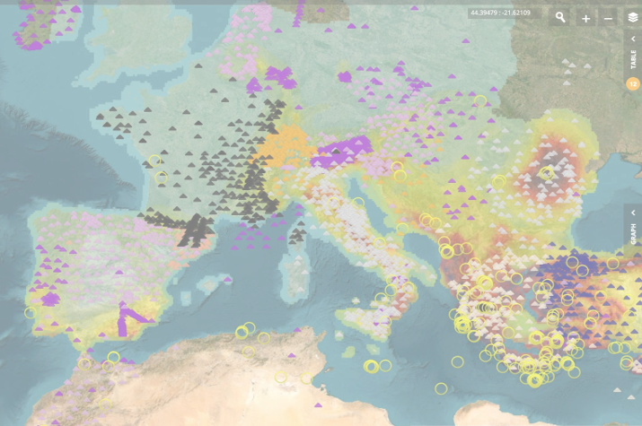
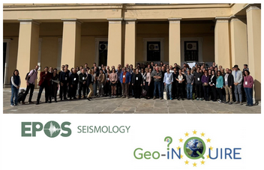
EPOS Seismology in a nutshell (3 nuts)
ORFEUS - EMSC&AHEAD - EFEHR and a global community of contributors and users
EPOS TCS Seismology facilitates and enhances seismological research through the development and maintenance of infrastructure, data services, data products, and collaborative initiatives
EPOS-Seismology + Geo-INQUIRE Workshop November 2025 Athens, Greece
From seismic waveform data collection, to earthquake catalogue compilation, to earthquake hazard and risk assessment, and back
https://www.ics-c.epos-eu.org/
Notes:
Add a screenshot from station, earthquakes, hazard map! EPOS portal
Recall that among the users and contributors there are also other EPOS TCS!
180 participants to the EPOS-S event
2025 confirmed something fundamental:
Operational stability is no longer sufficient. Interoperability, scalability, and computational readiness are now expected.
TCS-Seismology is no longer simply a data provider. It is becoming infrastructure for integration.

Slide 3
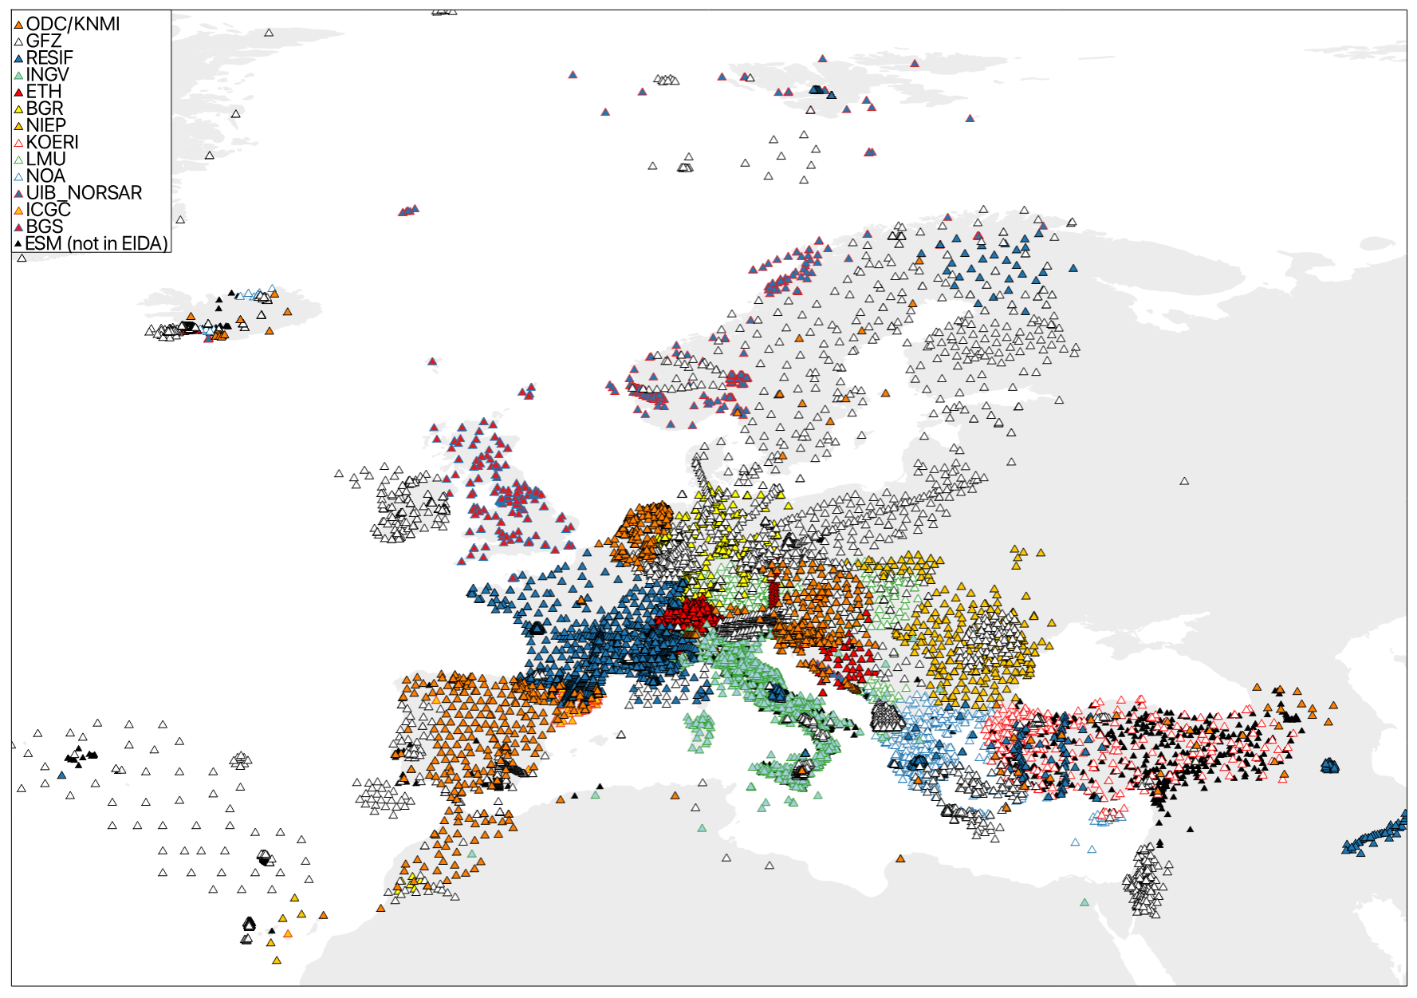
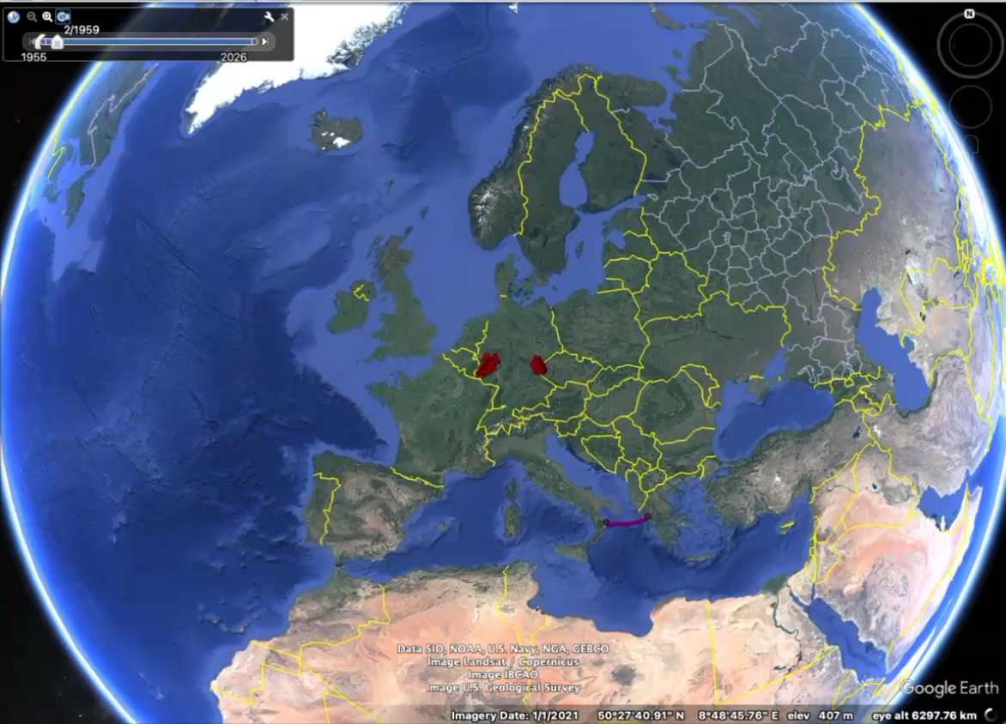
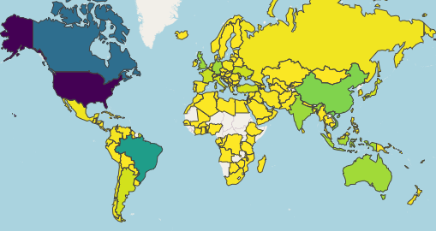
ORFEUS Waveform services
Global contributors and users of waveforms and strong motion products
Observatories and Research Facilities for European Seismology
Since 1986
60+ Participants
32k + stations today, ~9k added 2025
Latest EIDA node joining: BGS (UK) in 2024
Integration of new nodes from Spain and Portugal being prepared
100k+ Unique User in 2025; 1.2G+ Requests served with 650+ TB shipped
https://www.orfeus-eu.org/data/eida/stats/
Schaeffer, J., Pedersen, H., Bienkowski, J., Evangelidis, C., Petrakopoulos, V., Quinteros, J., Strollo, A., ORFEUS-EIDA Technical Committee and Management Board (2024): Data Delivery Indicators
in EIDA: Designing a Consistent Metrics System in a Distributed Services Environment. - Data Science Journal, 23, 51. https://doi.org/10.5334/dsj-2024-051

Slide 4
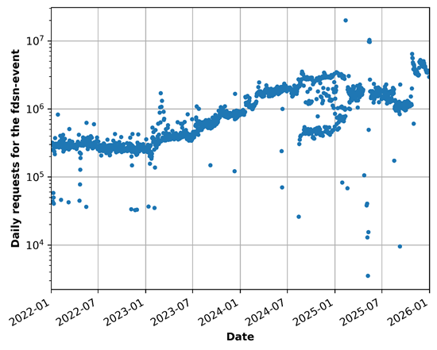
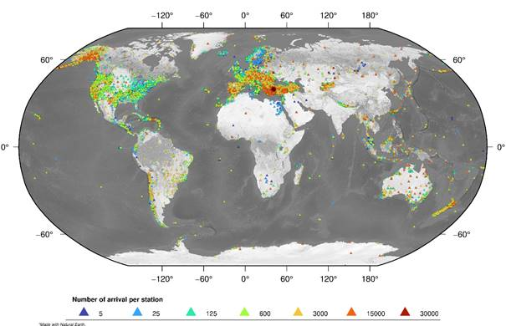
EMSC and AHEAD Seismological products
Global contributors and users of event parametric data
European-Mediterranean Seismological Centre
Since 1975
70+ Members
116 contributing networks, 4 added in 2025: IGF-Poland;
SVOC-Yemen; IESAS-Taiwan; UNA-Costa Rica
141 417 Earthquakes (10% relocated by EMSC) published in 2025
279 303 felt reports associated to EQ, median collection time 7 min
3M/day (up from 1.5M in 2024) daily average # requests served
63 countries with more than 10 000 users (up from 49 in 2024)
https://www.emsc-csem.org/
Notes:
Note that this goes from Historical parametric data to modern digital age parametric colleciton

Slide 5
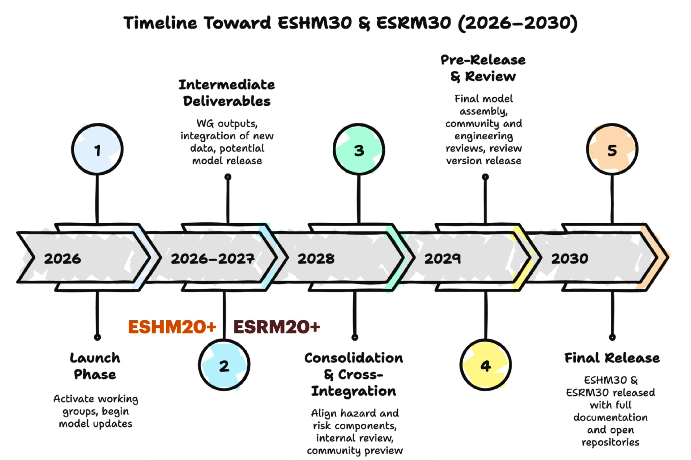
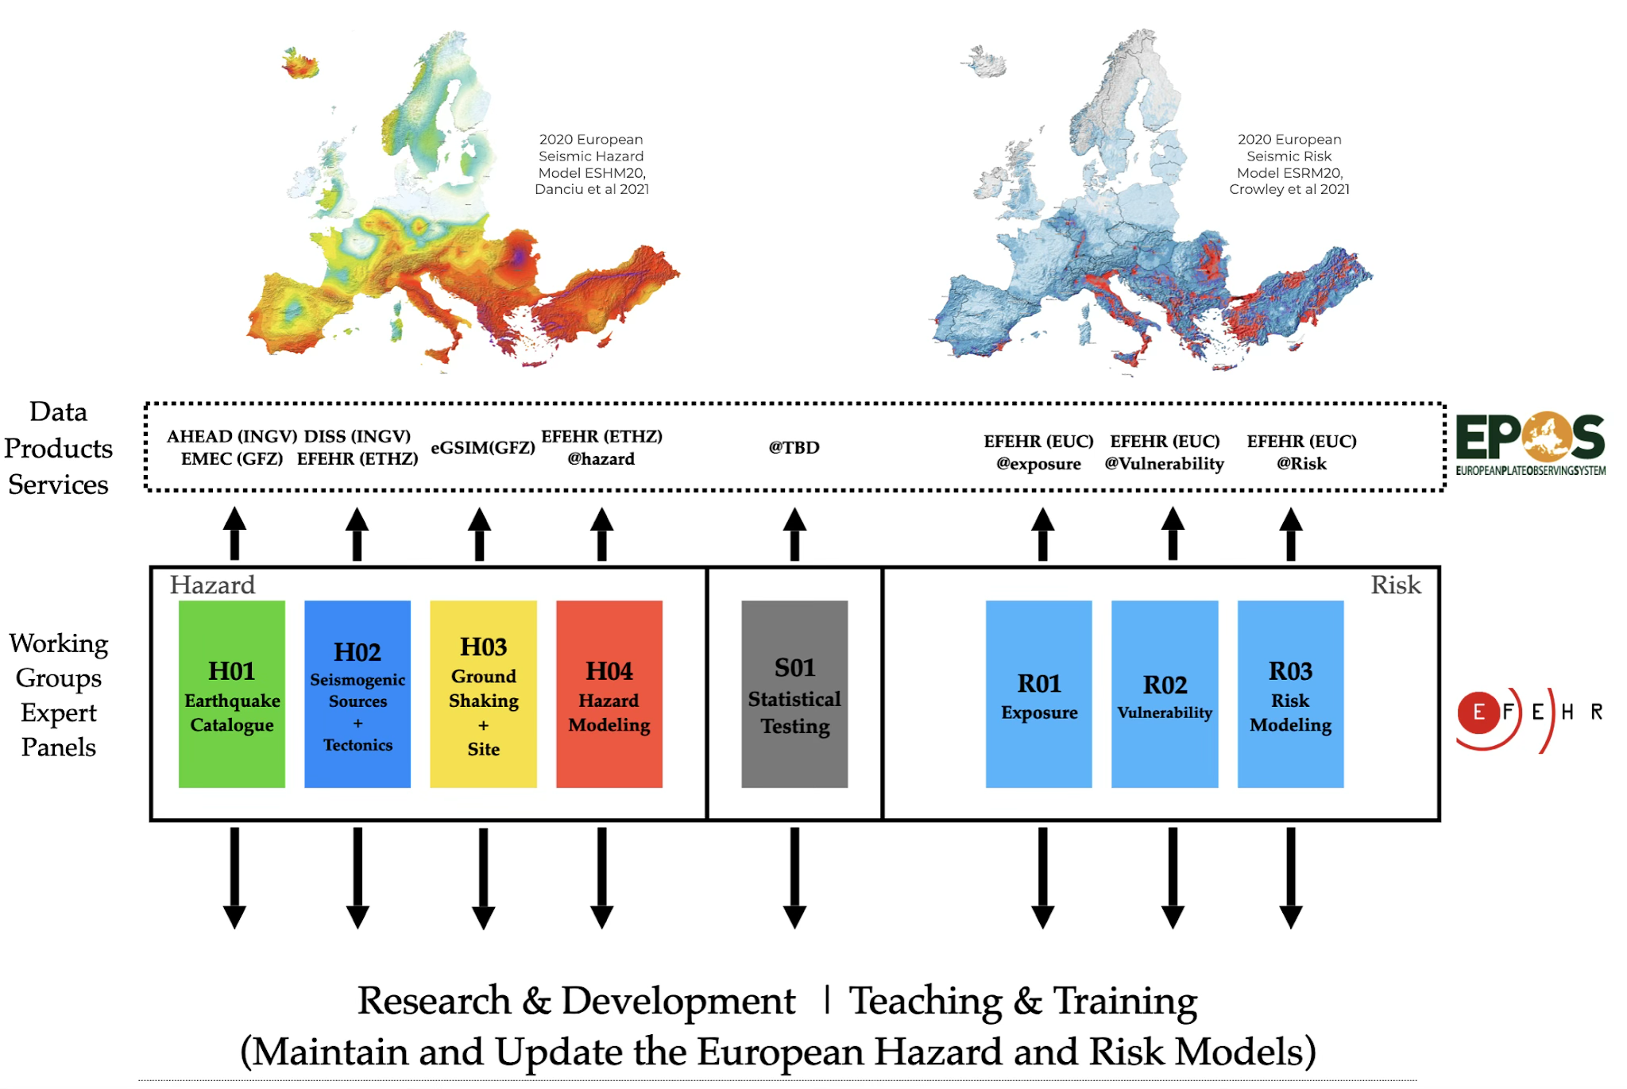
EFEHR Earthquake Hazard and risk products
Advancing earthquake hazard and risk assessment in the Euro-Med area
European Facilities for Earthquake Hazard and Risk Since 2018 - 47 Members
Next Generation of Seismic Hazard and Risk Models
Aspirational timeline 2030
In-kind contribution of the research community,
Cross-border harmonization of datasets and procedures
Advance science and incorporate new datasets (strain rate)
Built upon the operational services (developed within Geo-INQUIRE, and many with EPOS - support)
Engage stockholders - coordination with insurance, cat-modeling, engineering and decision makers
https://efehrcms.ethz.ch/en/home/
Notes:
If we get data about usage and access and number of users can update otherwise will stay like this

Slide 6

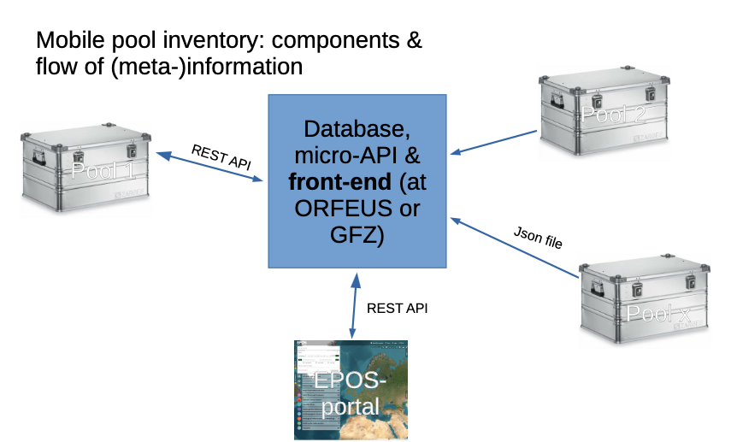
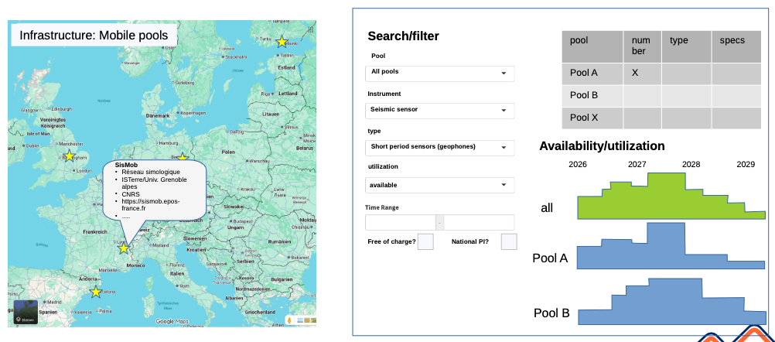

EPOS-ON activities
New services being developed and integrated
Coordinated inventory of mobile instrument pools → integration into facilities, supports rapid deployment across TCSData products and services for rapid post-event assessment
WSM 2025 release → structured integration of stress field products
Structured services for earthquake forecasting & rapid infographics → bridge research and societal layers
Reinforce EPOS Seismology’s role as both data backbone and operational enabler.

Slide 7


EPOS Seismology in 2026 and beyond
Integration, new standards and services, scaling up, AI, cloud services
Continue the started integration of new data types (e.g. DAS and other FOS technologies)
Adoption of the new standards (formats and services) developed within FDSN (ORFEUS, EarthScope and other global domain organizations are the driving forces)
Controlled vocabularies: AI driven approaches being tested for Seismology in the FDSN global seismological context
Shakemap service (ORFEUS-EFEHR) integrating felt reports (EMSC)
Continue with training activities as new formats, services, technologies are adopted
Scaling up the global federated services towards global cloud services integration
Enhance global data/services resilience, foster open science and FAIR culture
AI and decision ready datasets through new EU projects to start and to prepare!
Notes:
Good bye Geo-INQUIRE and welcome EARTH-AID, integration prepared in Geo-I with new data, standards and services will be starting point of EARTH-AID
2025 confirmed something fundamental:
Operational stability is no longer sufficient. Interoperability, scalability, and computational readiness are now expected.
TCS-Seismology is no longer simply a data provider. It is becoming infrastructure for integration.

Slide 8
Thank you!
The EPOS-Seismology consortium
Anastasia Kiratzi, Margarita Segou, Carlo Cauzzi, Angelo Strollo, Rémy Bossu, Paivi Mantyniemi, Laurentiu Danciu, Fatemeh Jalayer, Roberto Basili, Adrien Oth, Irene Molinari and all data and service providers

