Slide 1


TCS Multi-Scale Laboratories
A network of Earth scientific laboratories enabling research on rock properties and processes controlling subsurface to surface behaviour
K. Elger, R. Pijnenburg, S. Dominguez, D. Maestrelli

Slide 2
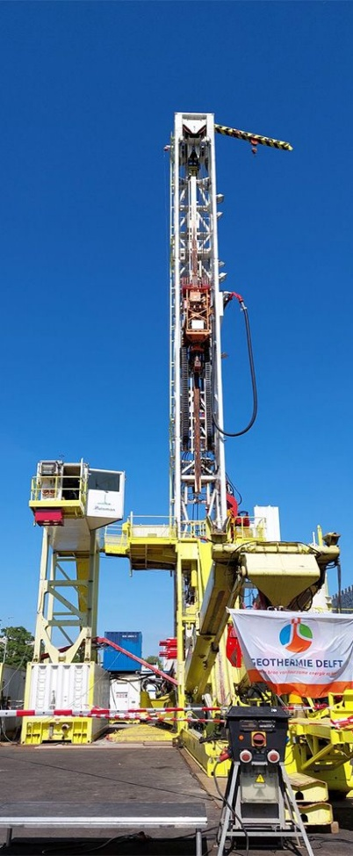
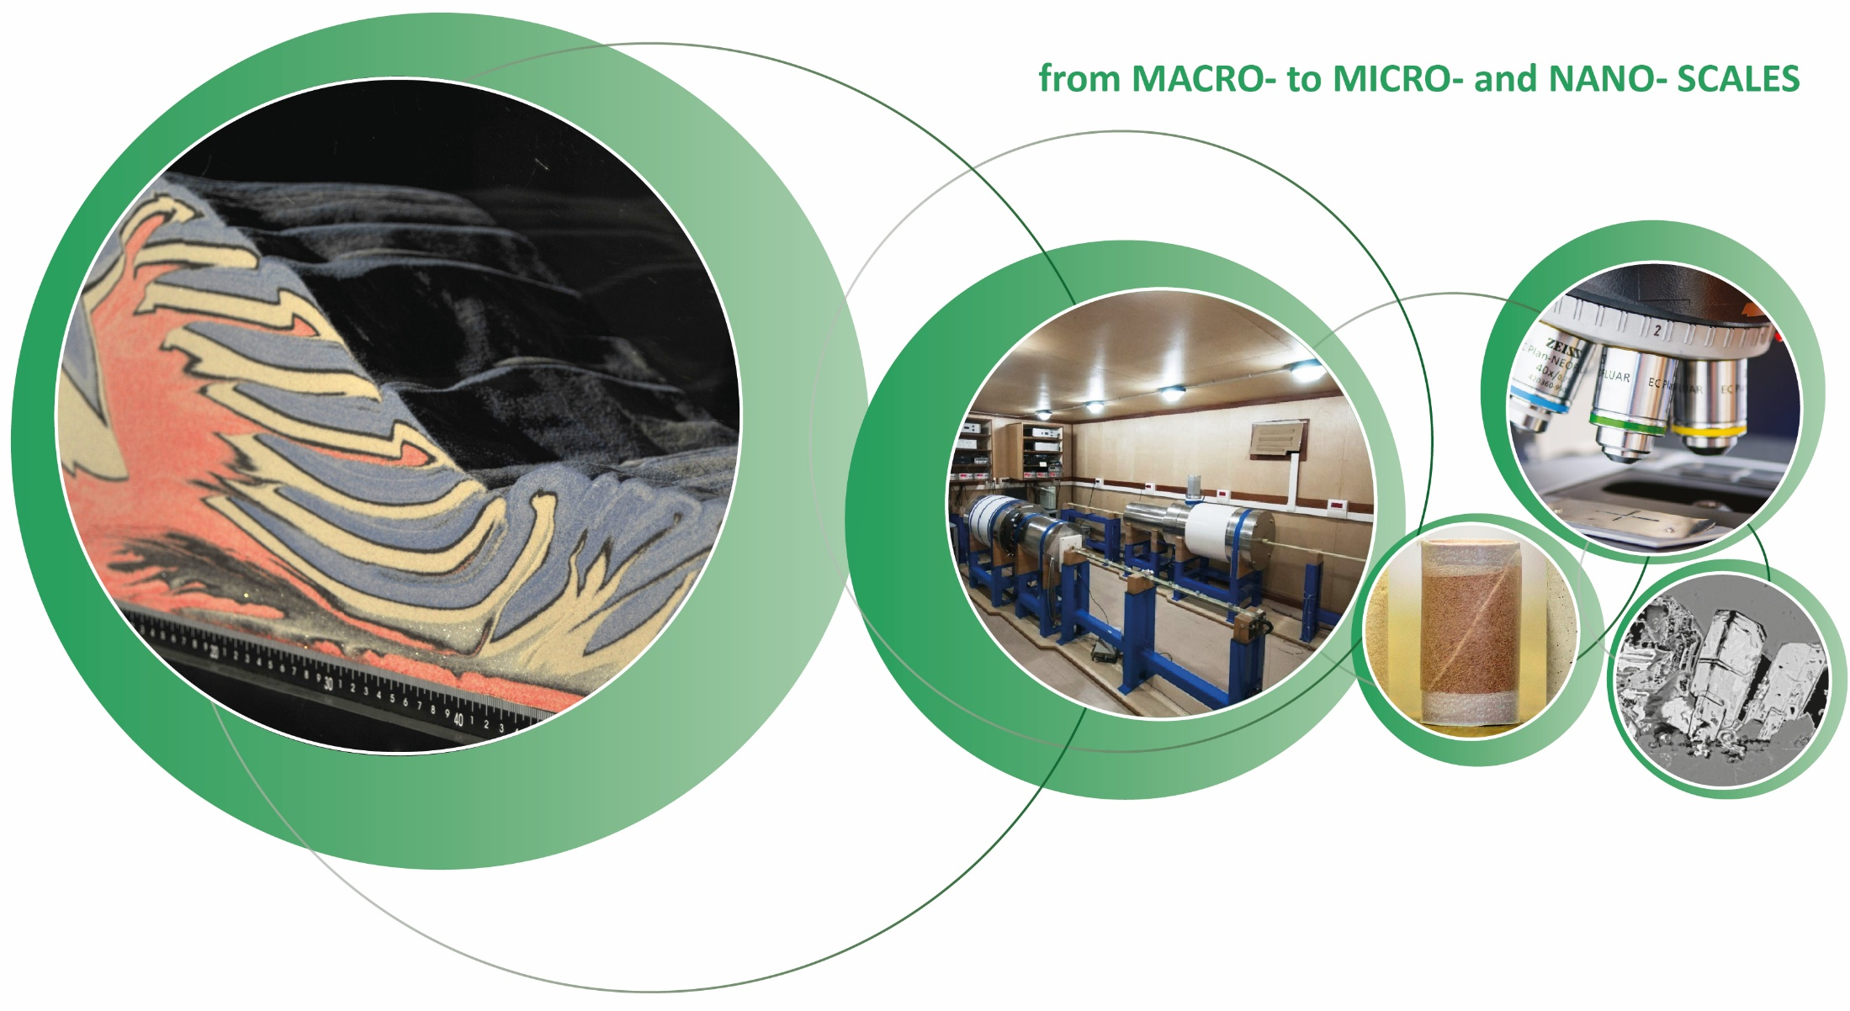

Large-scale behaviour – controlled at small scale
from the FIELD SCALE to MICROSCOPY
Subsurface response during energy production?
Porosity?
Reservoir heterogeneity?
Subsurface storage?
Deformation behaviour?
Earthquakes?
Governing processes?
Efficiency?
The assessment of subsurface behaviour requires Multi-scale understanding
The assessment of subsurface behaviour requires Multi-scale understanding

Slide 3
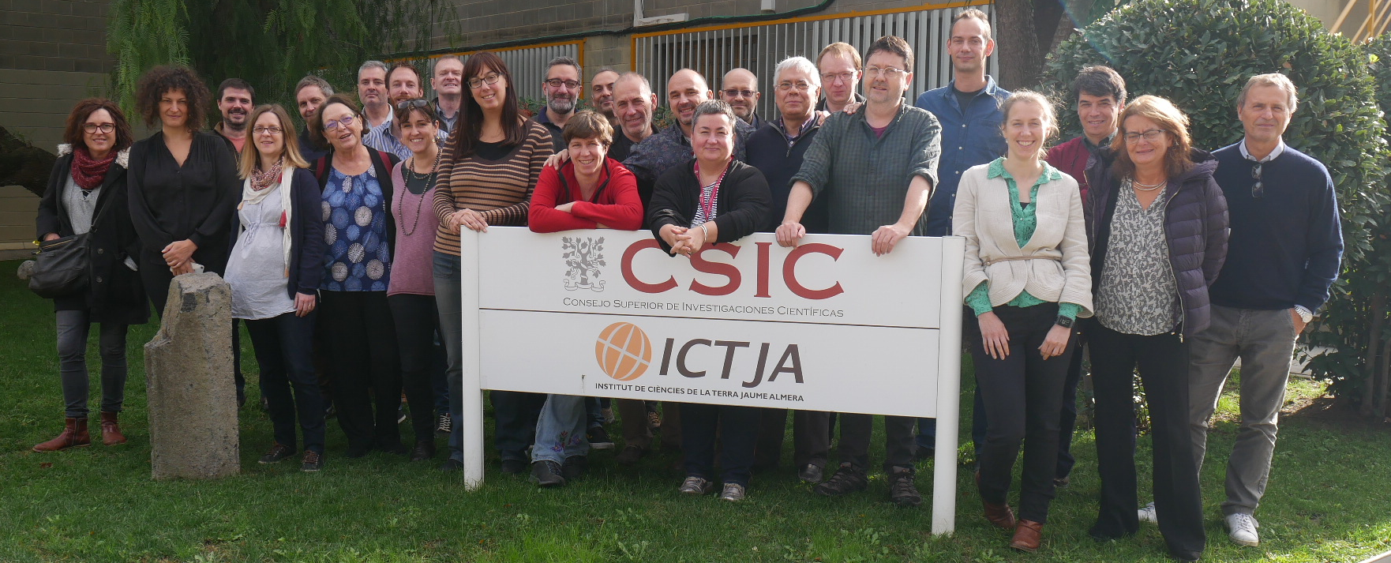
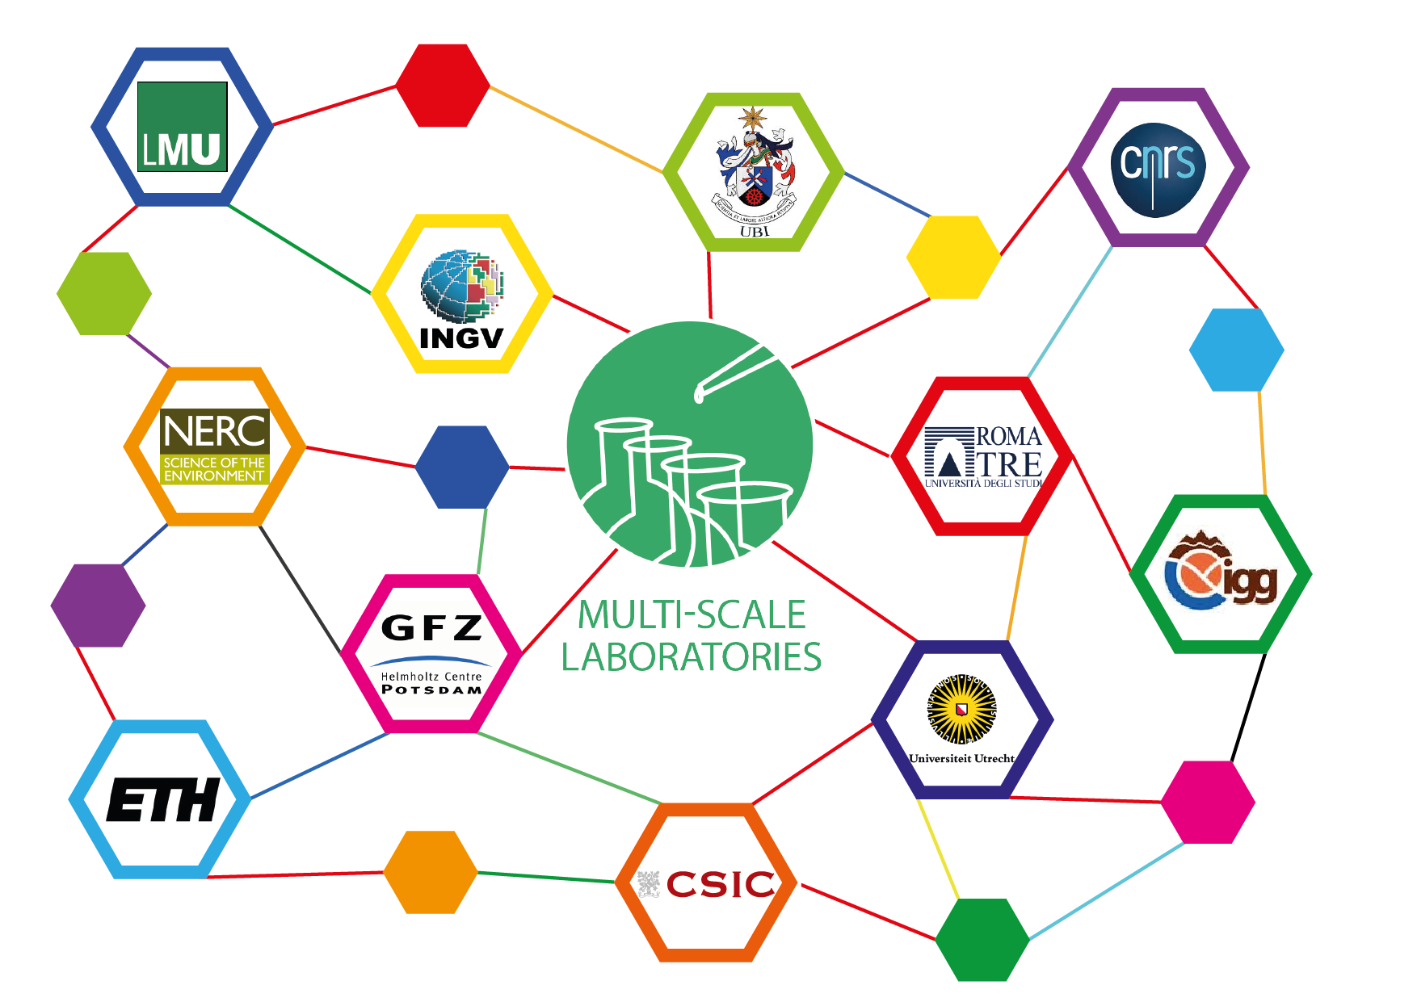
The MSL community today
A coherent, enthusiastic and well-organized network of solid Earth Science laboratory researchers
  Consortium of 11 members from 8 countries,
  6 subdomains:
      Analogue Modeling
      Paleomagnetism
      Rock & Melt Physics
      Geochemistry
      Microscopy and X-ray tomography
      (NEW) Field Scale Laboratories
MSL Community Meeting 2018 in Barcelona

Slide 4
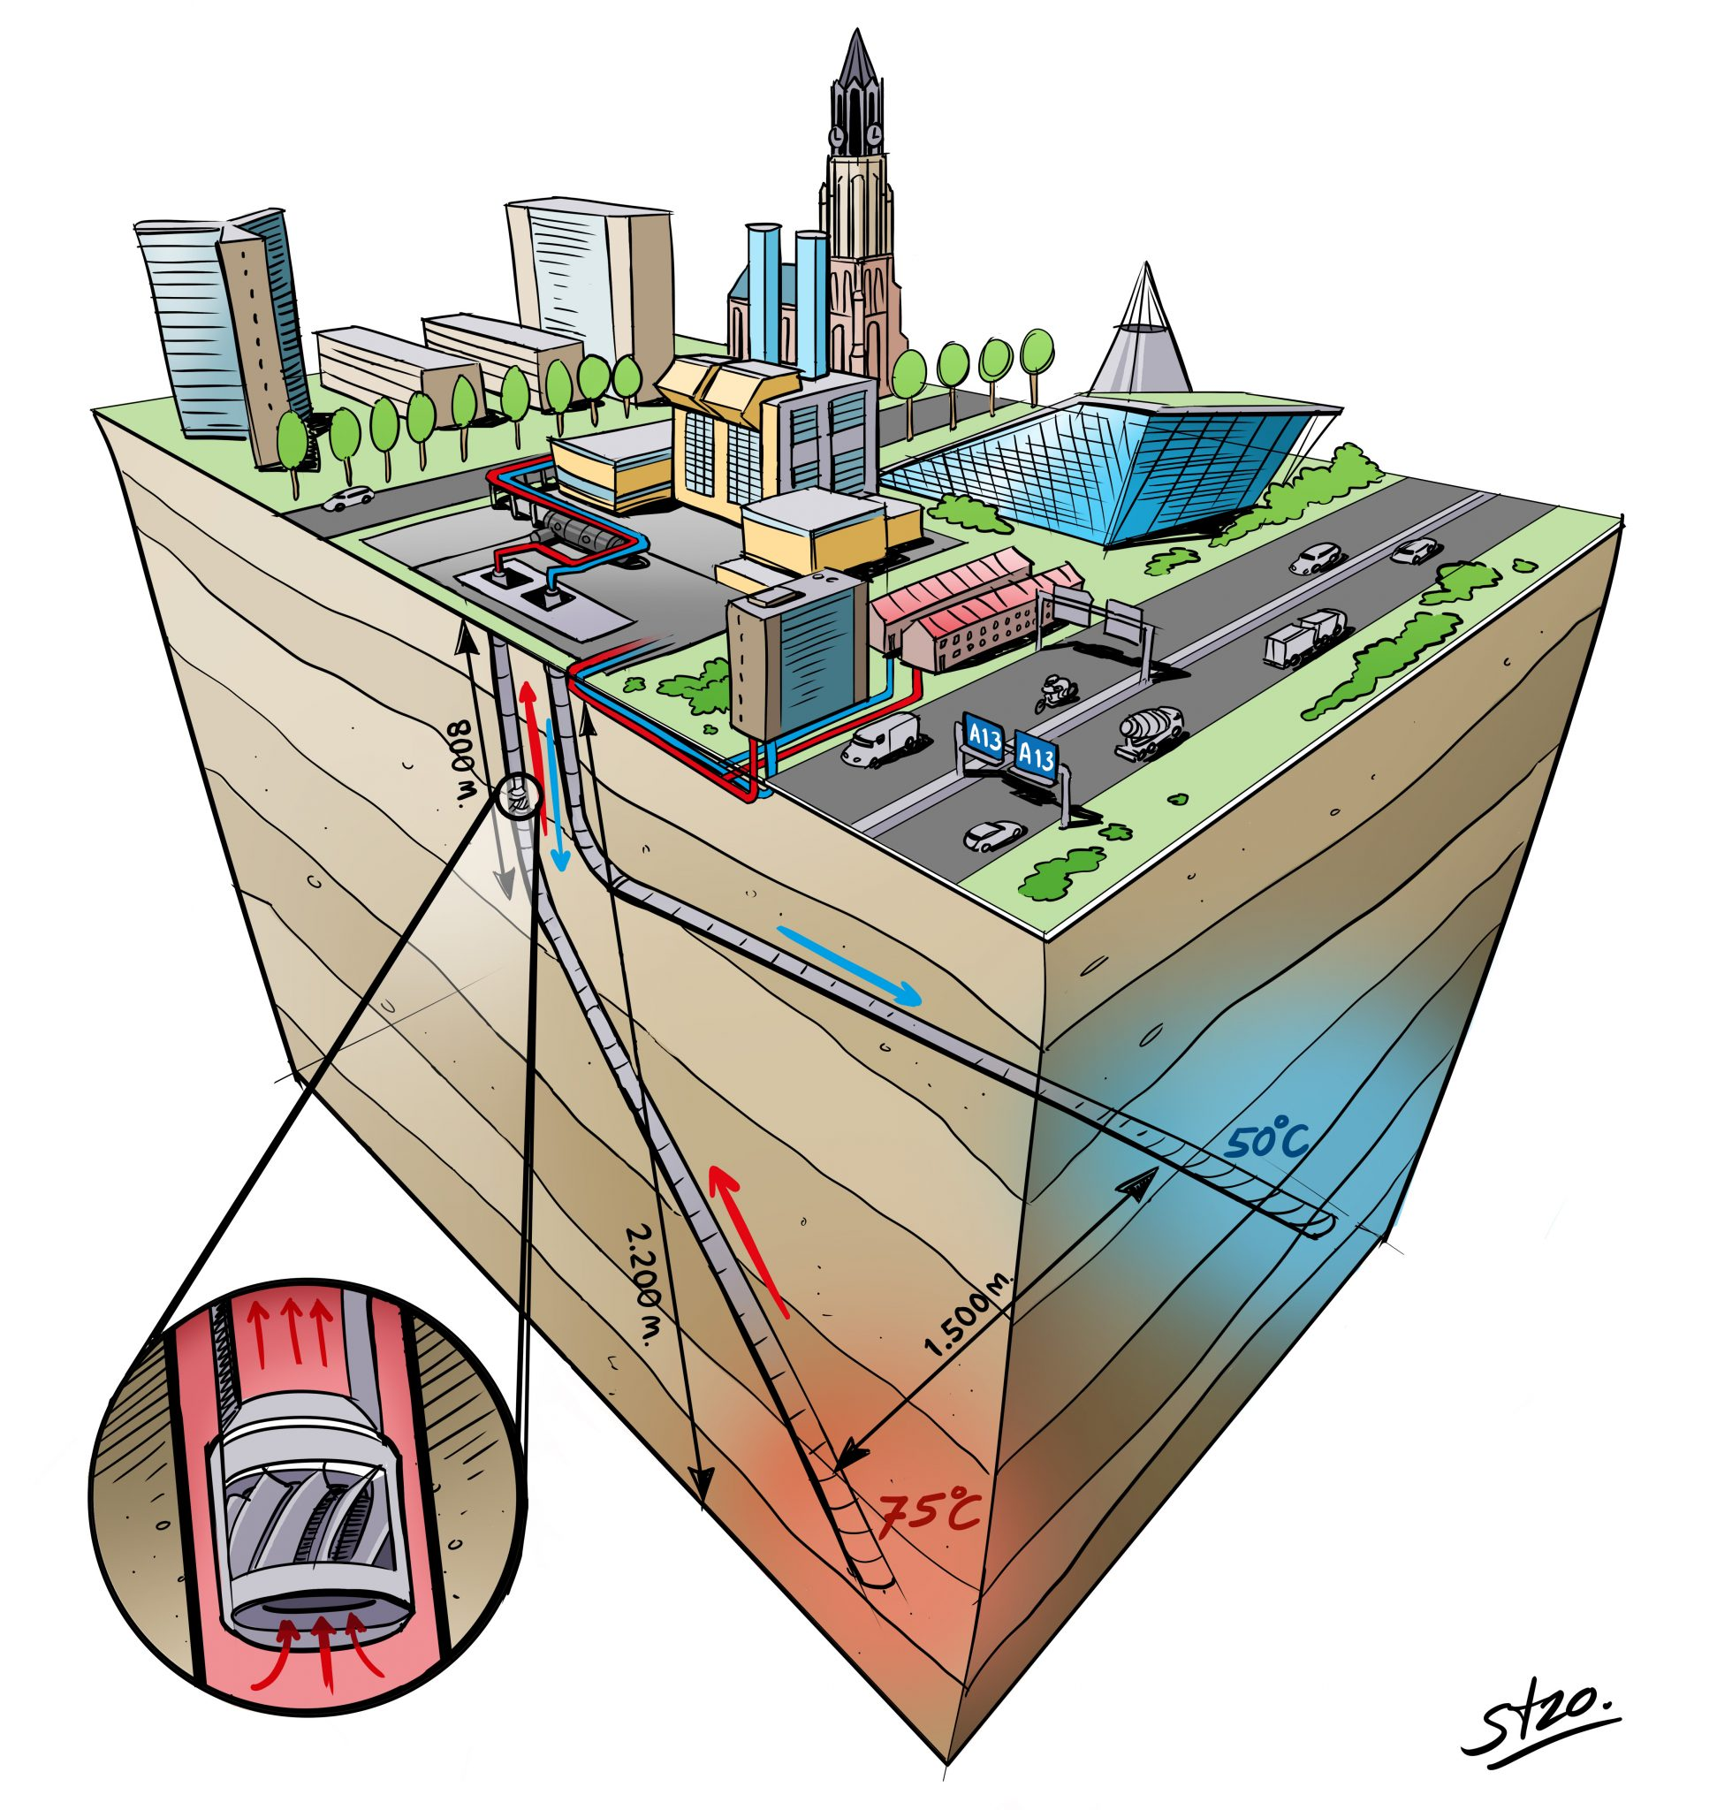
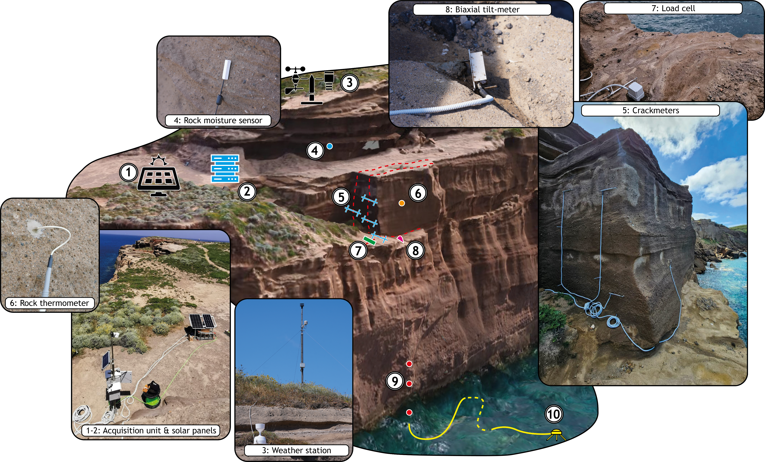
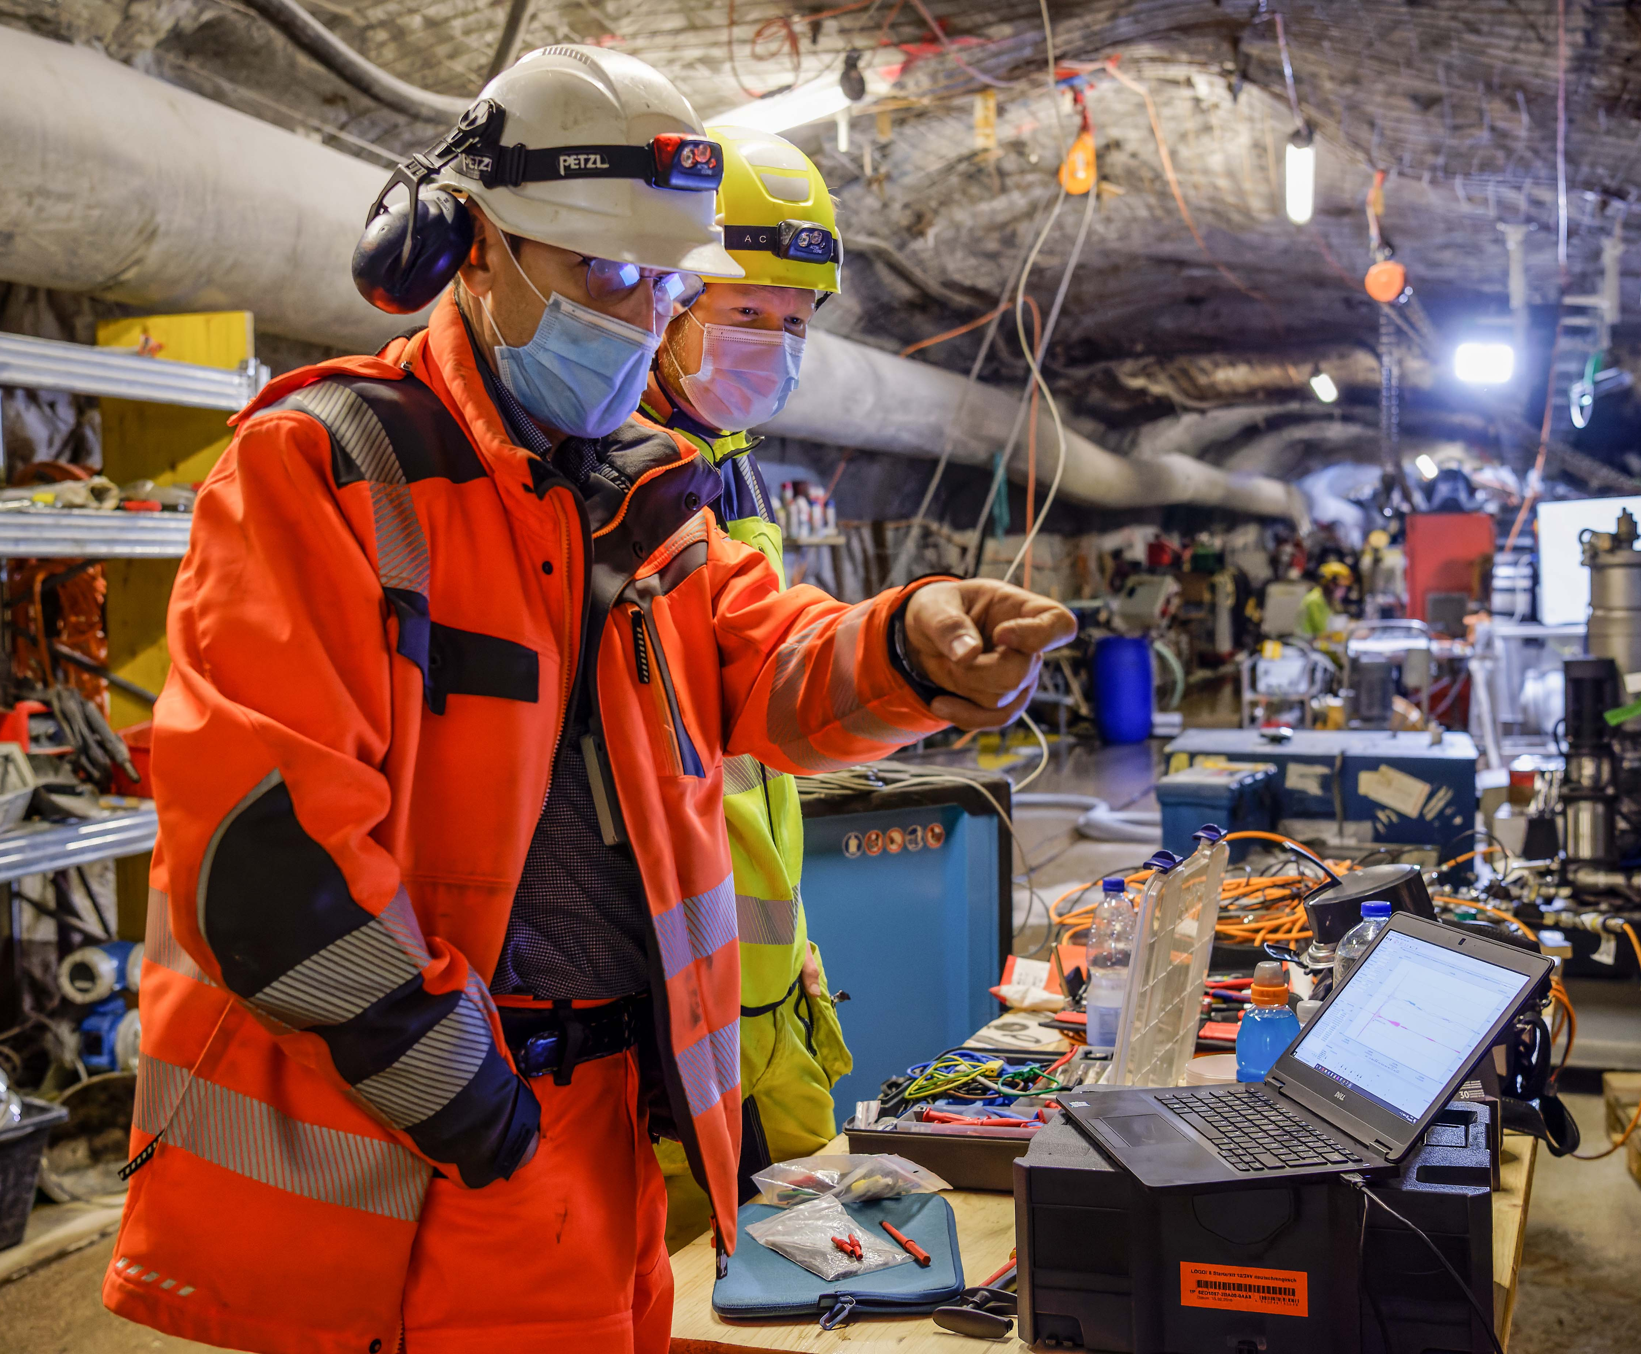
New MSL domain: Field Scale Laboratories
Field-scale testing and monitoring facilities developed to understand changes made to earth systems by human activity
Bedretto lab ETHZ
Geothermal well on TU Delft campus
Sapienza field labs on slope stability
Credit: R. Pijnenburg (UU)

Slide 5
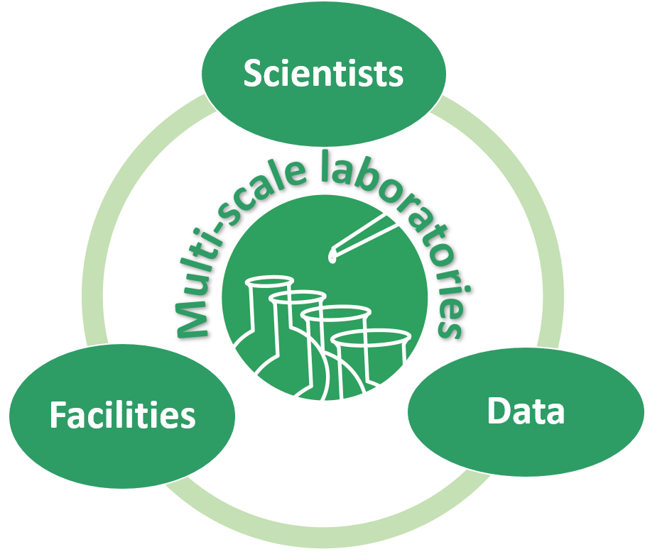
MSL Aims
Provide data, data products and data services on rock properties and processes through EPOS, to support laboratory and multidisciplinary research on the Earth system.
Facilitate discoverability and (trans-)national usage of the Earth scientific laboratories and specialist networks in MSL, within the EPOS framework.
Foster and expand the community of European Earth science laboratories for multi-scale research on rock properties and processes.

Slide 6
MSL Activities
Data sharing
Lab sharing
Community building

Slide 7
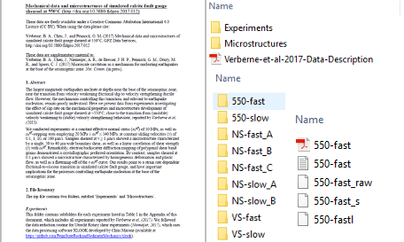


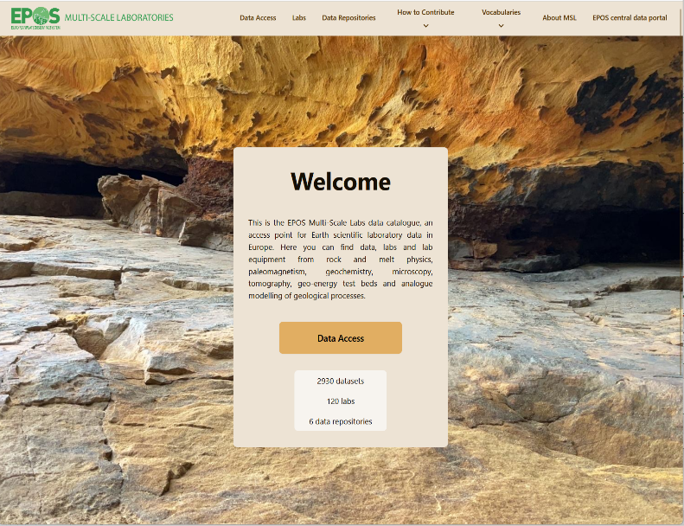
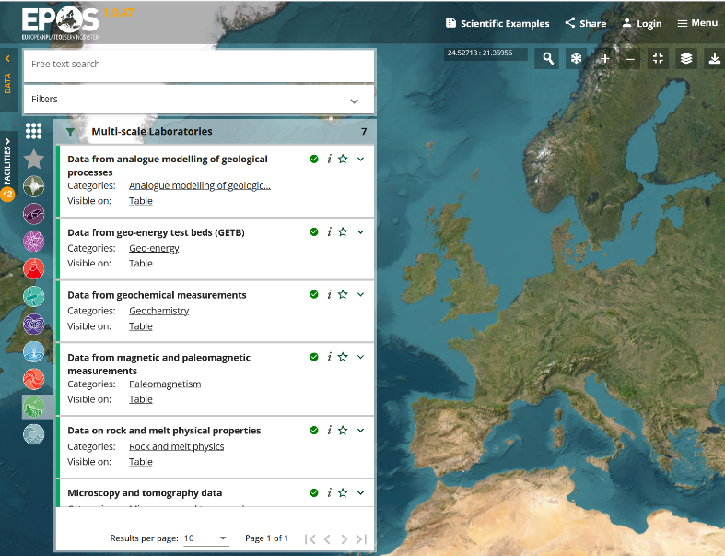
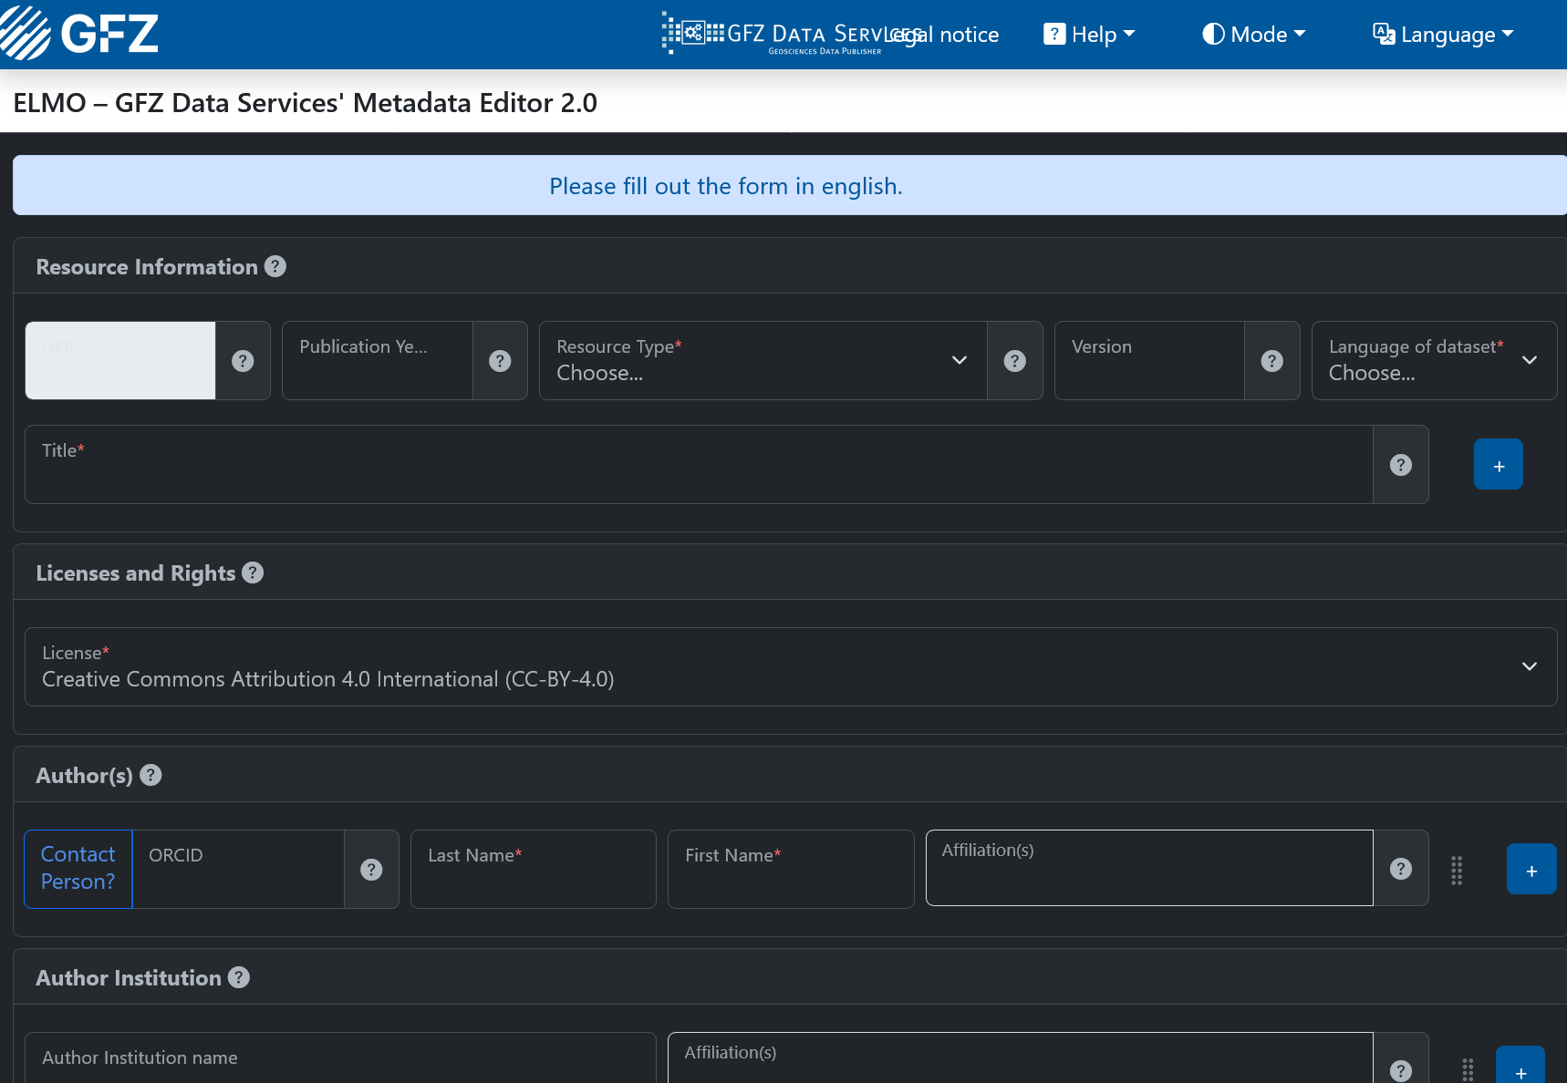
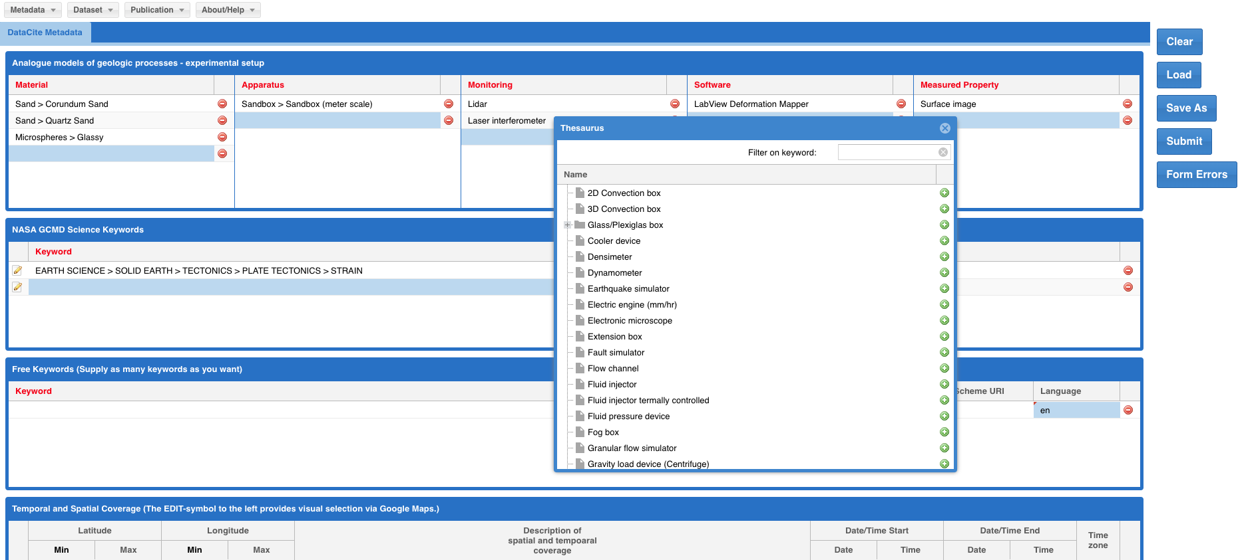
Data Sharing: the MSL Data Publication Chain
The MSL Community developed: (1) a dedicated, rich MSL metadata model,
(2) a bespoke Metadata Editor collecting the information, (3) data publications via MSL repositories (4) automated data harvesting processes to integrate MSL Data in the MSL Portal and (5) in the central EPOS Data Portal
STEP 1
Data are produced in the laboratories and organised in datasets
STEP 2
Dataset description with the MSL metadata model (metadata editor)
STEP 3
Datasets are published with a DOI in a MSL reco-gnised repository
STEP 4
Datasets metadata are harvested by the MSL Portal
STEP 5
Datasets metadata are harvested by the central EPOS Data Portal

Slide 8







Trans-National Access (TNA)
2017
3 pilot calls | TNA procedures developed,
national or institutional (in-kind) funding,
65 labs participated | 55 TNA users
2018
2019
IP
National (Dutch) funded TNA
MSL TNA as a blueprint
2020
2021
EPOS MSL TNA procedures published
2022
EXCITE1 | Microscopy | EC funded
based on MSL TNA procedures
2023
2024
EXCITE2 | Microscopy | EC funded
2025
EPOS ERIC does not provide direct funds for TNA, but acts as a catalyst for attracting national and European funding to support TNA
National (Italy)
funded TNA
2026
Credit: Richard Wessels (UU)

Slide 9
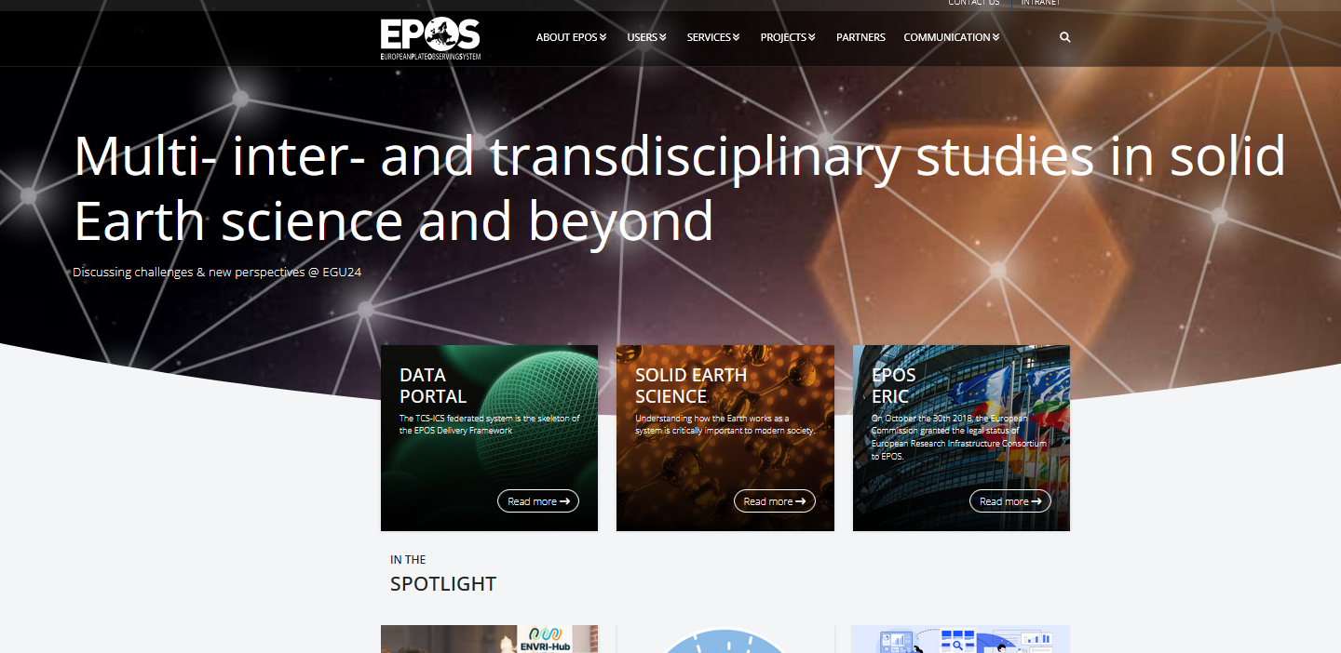
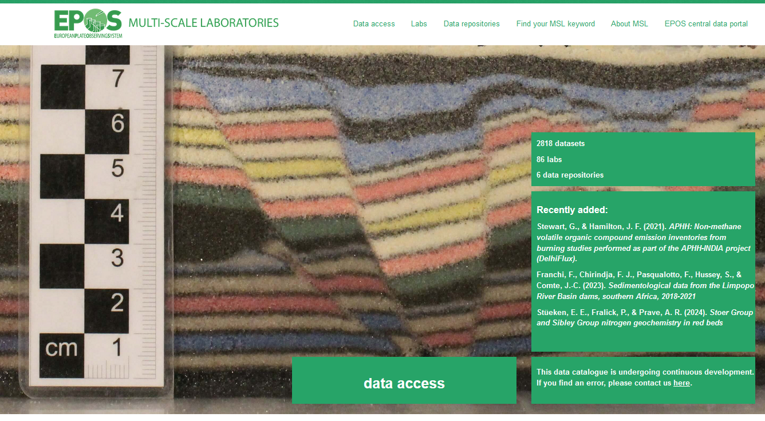
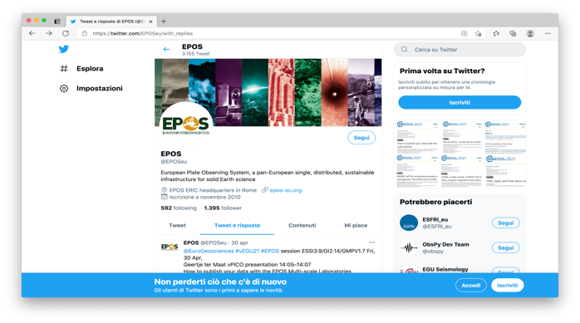
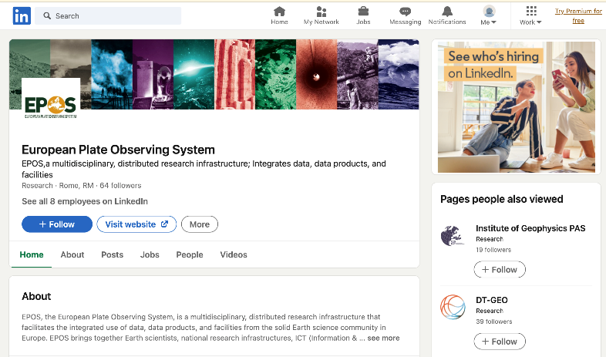
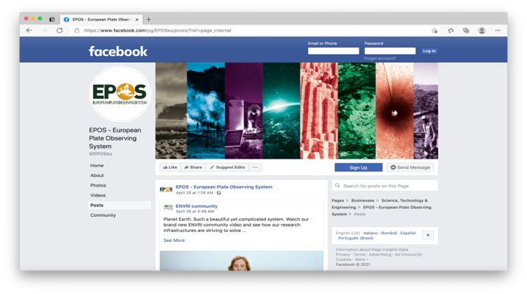
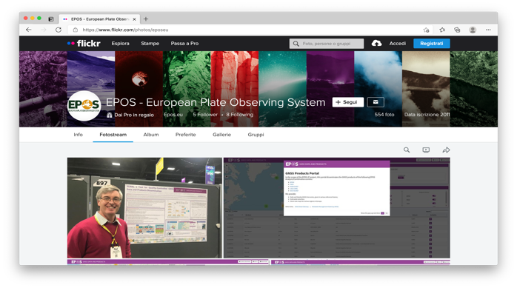
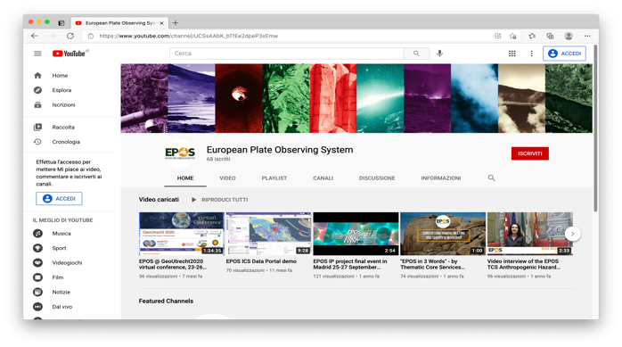

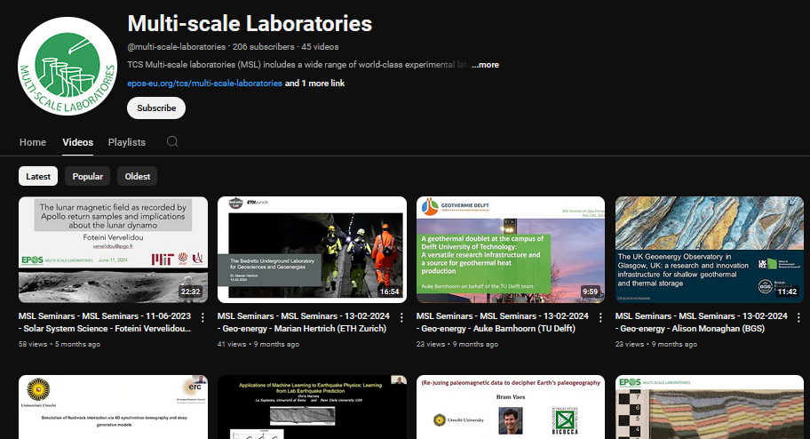
Outreach and Dissemination
EPOS website
MSL website & portal
Social media
+ papers, conference presen-tations and workshops (EGU, AGU) seminar series, MSL Community Meetings

Slide 10
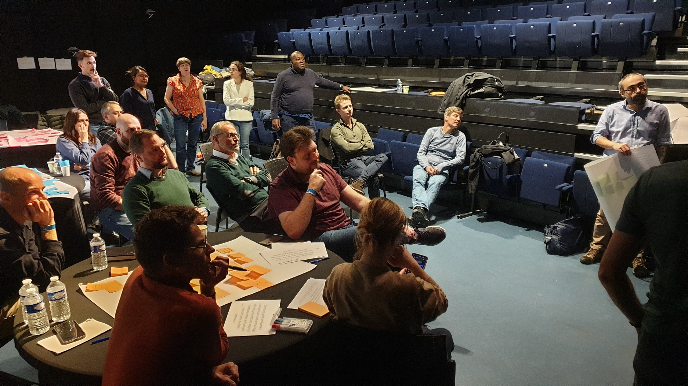
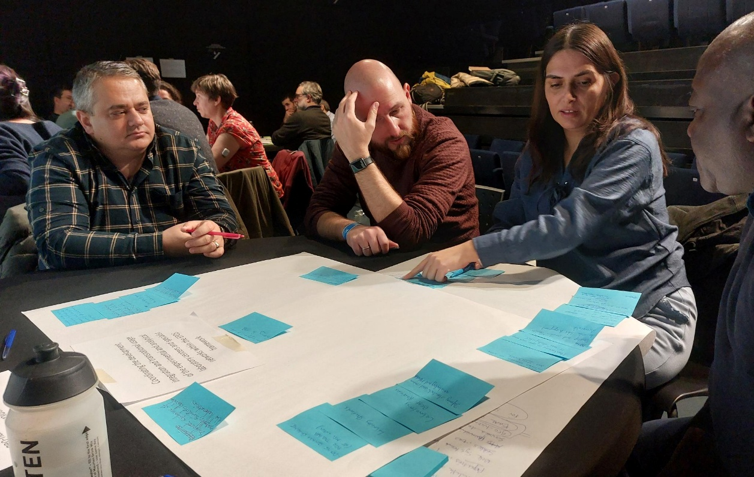
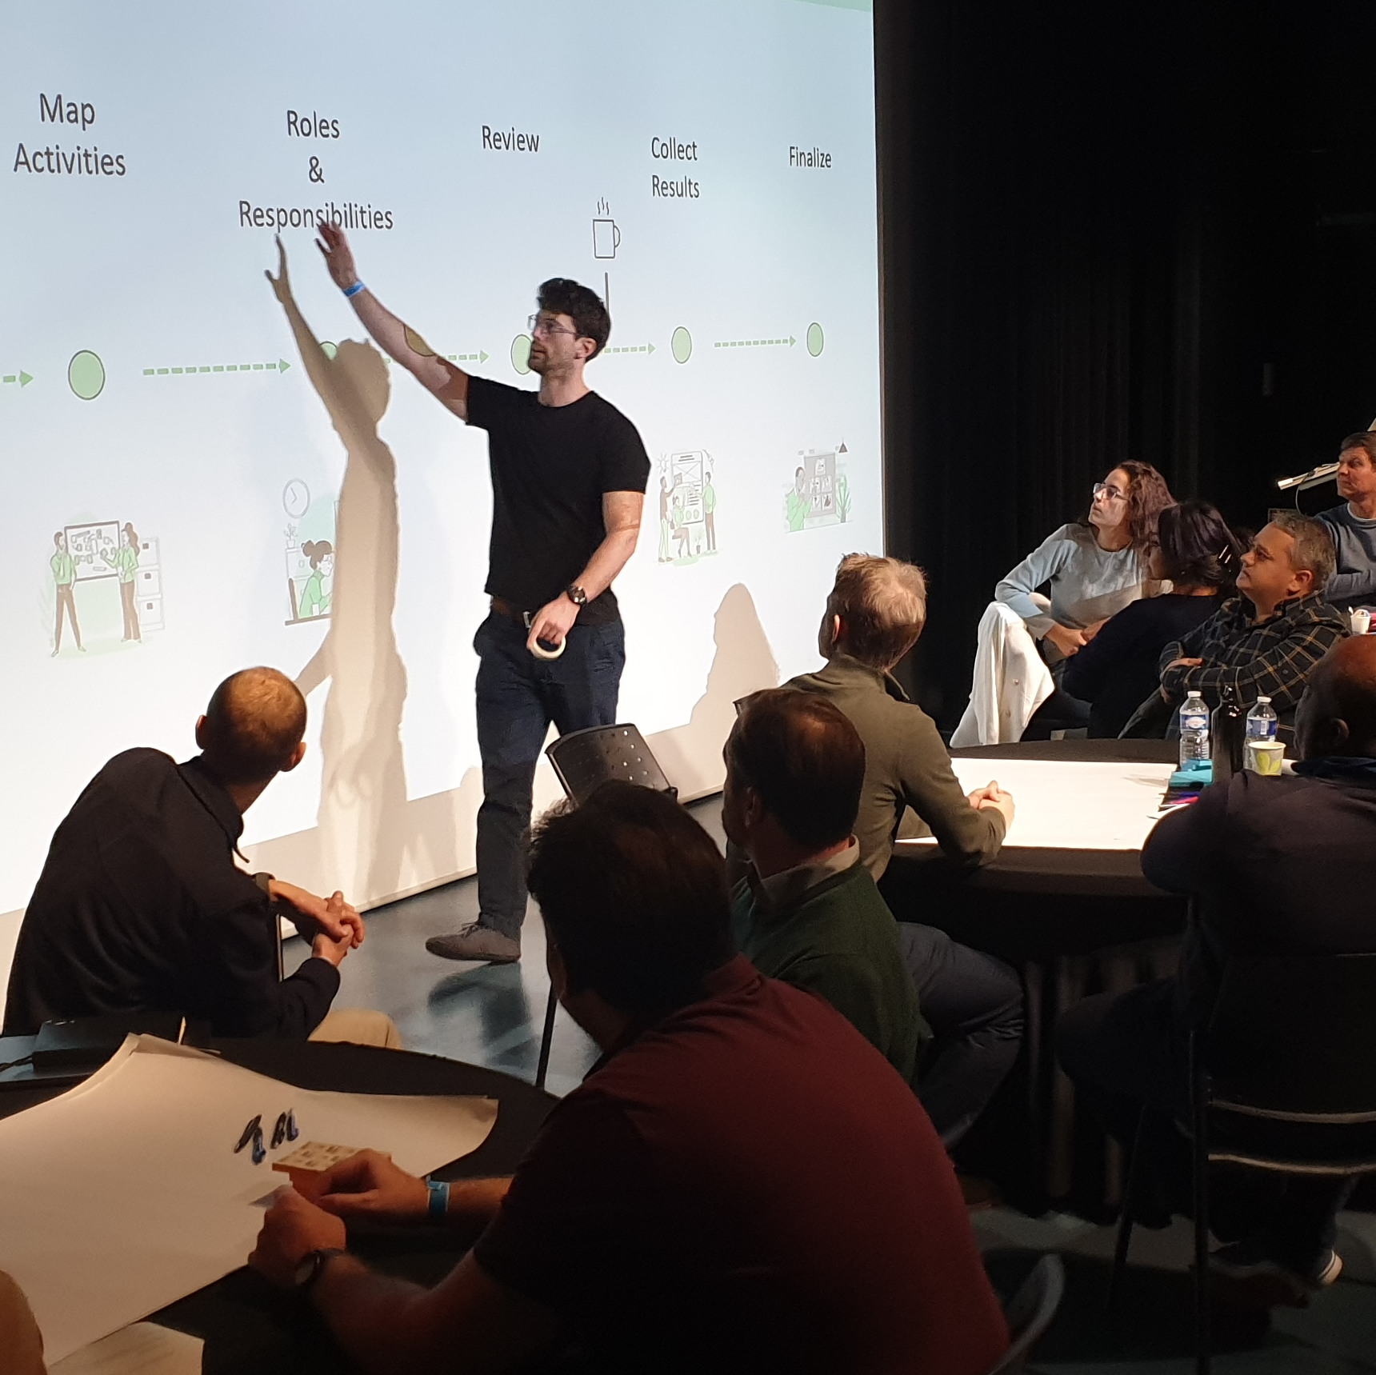
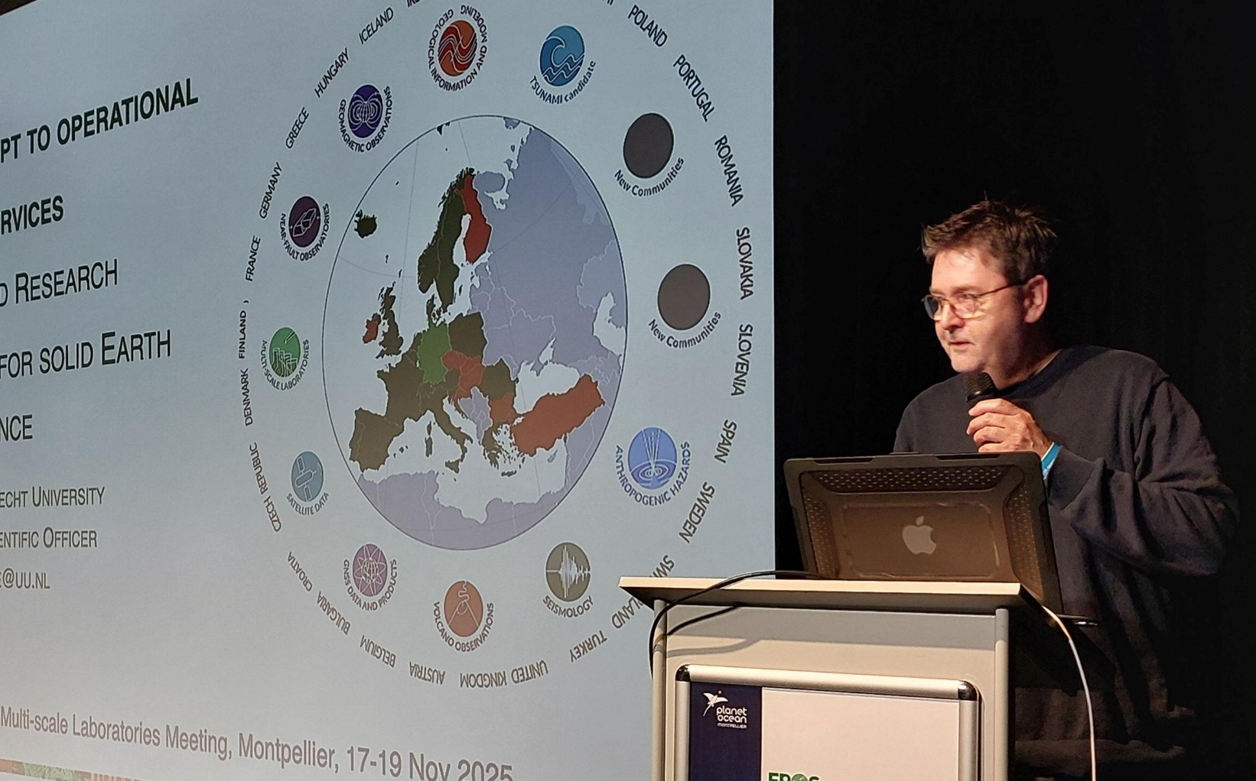
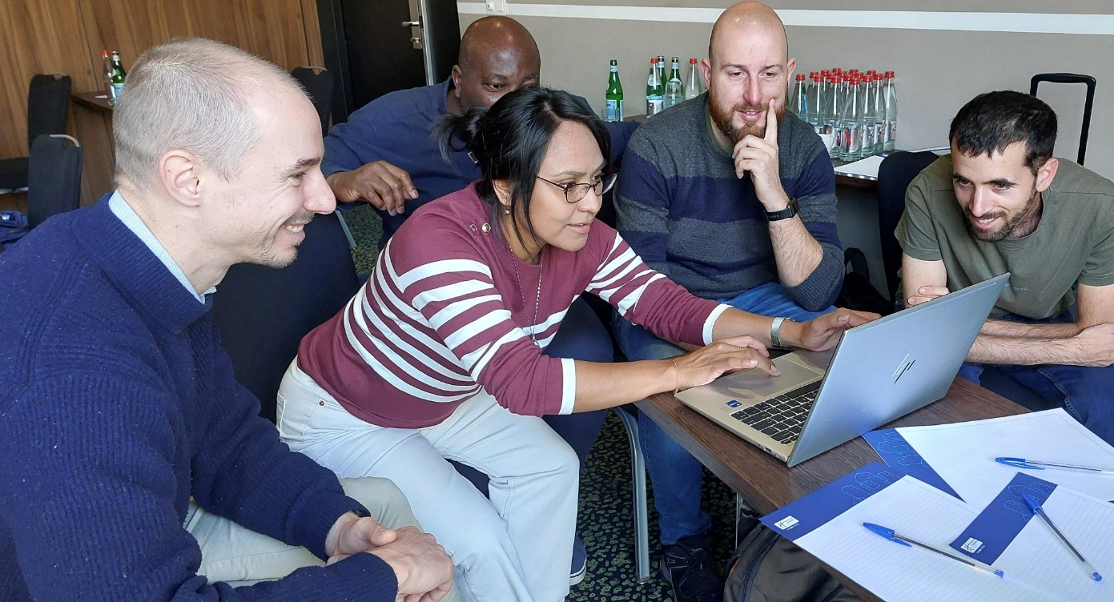
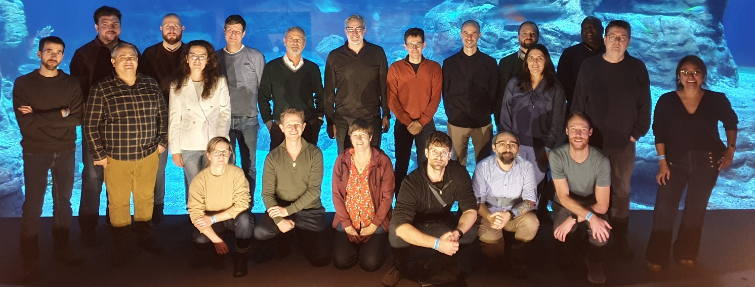
MSL Community Meeting (Nov 2025 Montpellier)

Slide 11
# | MSL activities 2026 | Participants
D1 | Ensure that MSL best practices for data sharing are implemented at the repository in use by me and/or my colleagues | CNR-IGG Repository (R), ETHZ R, CNRS, DataTerra, Digital.CSIC, GFZ Data Services, INGV R
D2 | Take part in a data provider committee, to inform one another on technical developments or needs at/for data repositories, webservices and software | MSL Data Services, BGS, Digital.CSIC, GFZ Data Services, INGV R, MagIC, Yoda Data Services, 4TU.Research.Data
D3 | MSL domain representation and integrating or creating new (domain-specific) data services | All MSL Domains
L1 | Organize TNA provision to MSL labs, through unfunded calls, and/or by seeking funds | U Roma Tre, INGV, CNR,CSIC Géosciences Montpellier, LMU, U Liège, U Rennes, UU
C1 | Identify opportunities for, and actively steer MSL promotion (e.g. at conferences, open days, lab visits or through communication means like video’s, virtual lab visits) | GFZ, U Rennes, INGV, U de Pau, U Roma 1, UU
C2 | Organize the next MSL in-person community meeting | GFZ, UU

Slide 12
MSL Community Meeting (Nov 2025 Montpellier)
Next MSL Community Meeting: 29.9.-2.10.2026 in Potsdam!

Slide 13
Thank you!
Contact:
kirsten.elger@gfz.de
r.p.j.pijnenburg@uu.nl

