Slide 1


TCS Tsunami:
Two Years on a Boat

Slide 2
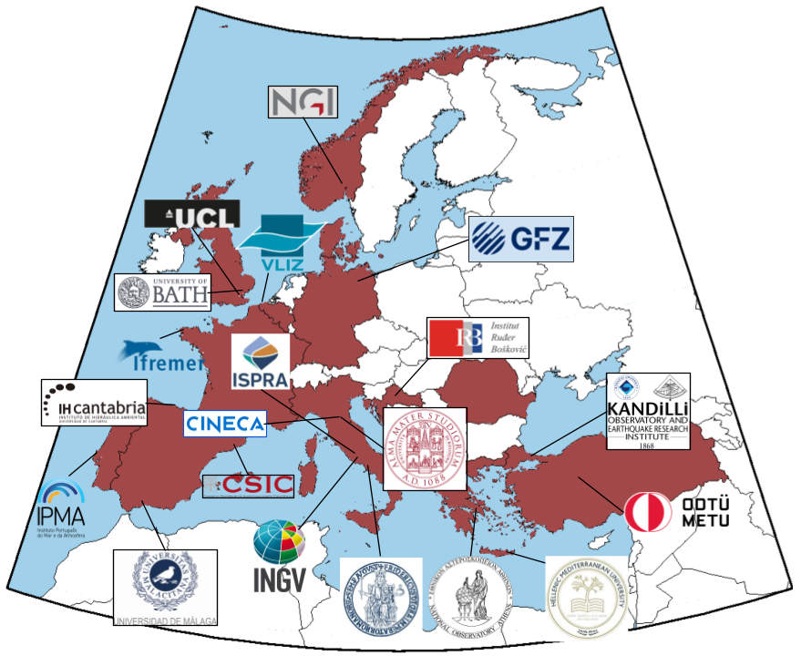




TCS Consortium
Preparatory activity started in September 2018
Candidate Status Granted by the GA in July 2021
Full TCS Status Granted by the GA in December 2023
20 Partner Organizations from 11 countries
2 new Partners joined in 2025:
2 institutions about to join in 2026:
TCS Budget 2026: €223K
Focus on both Scientific and Societal Relevance (DRM)

Slide 3
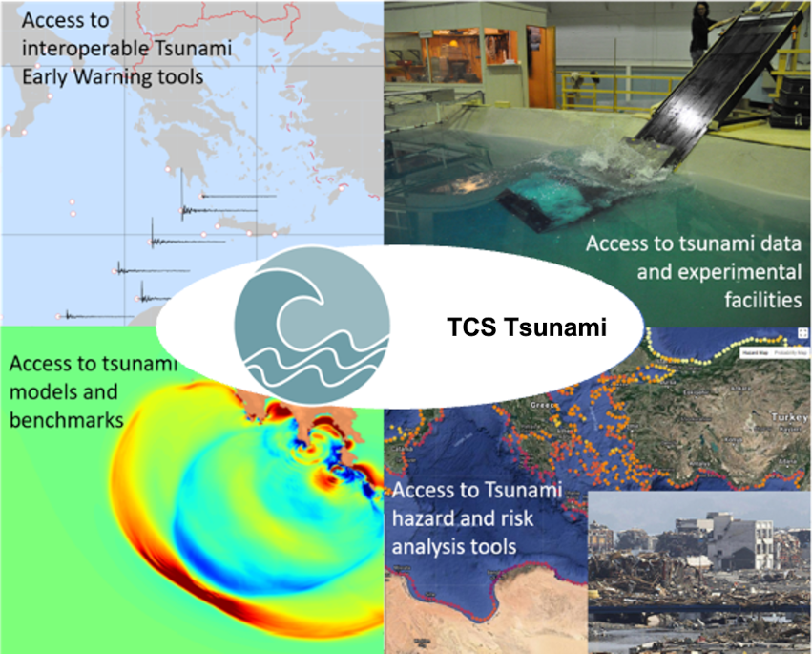
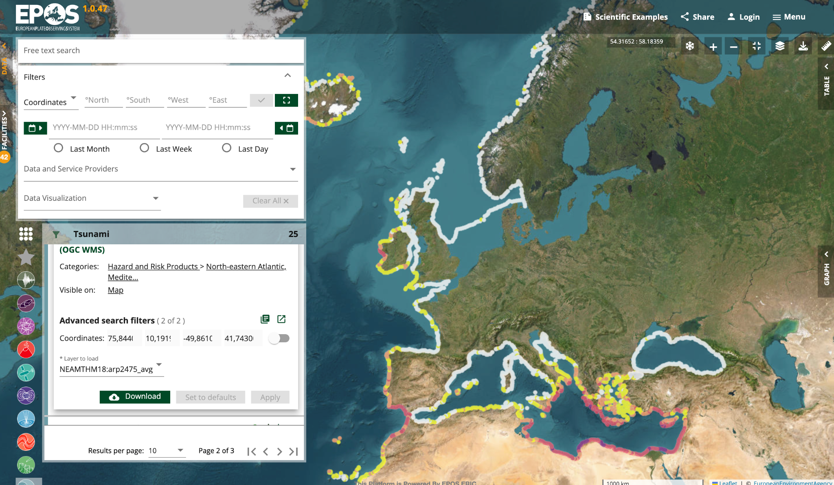
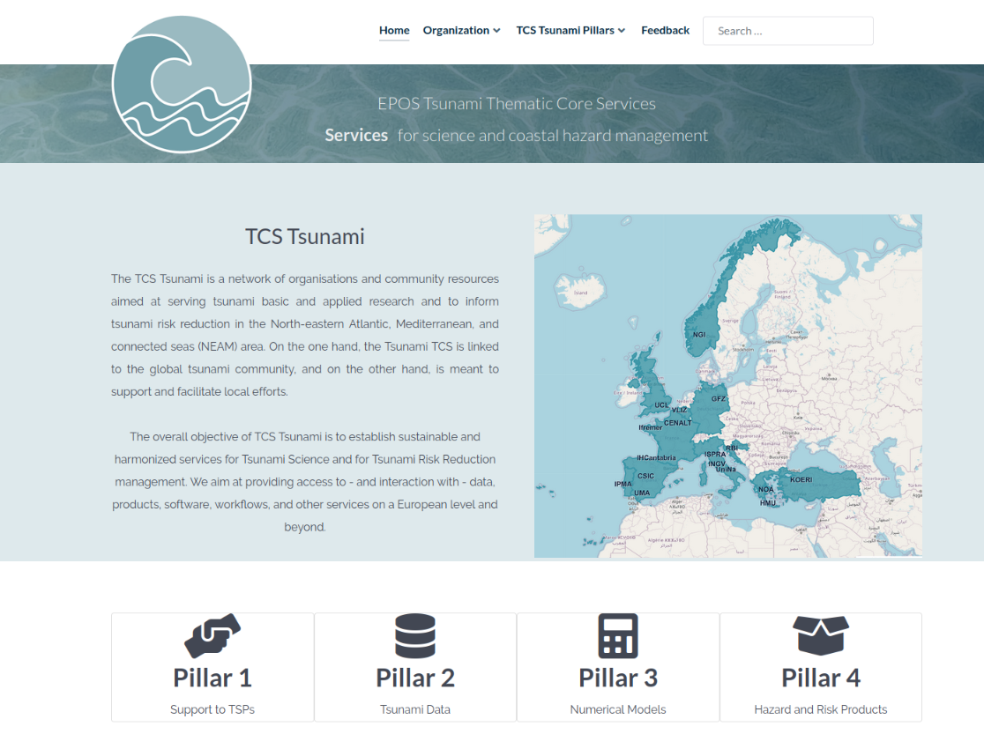
DDSS provision
~25 DDSS
~20 DDSS
Community Portal
https://tsunamidata.org
EPOS ICS-C

Slide 4
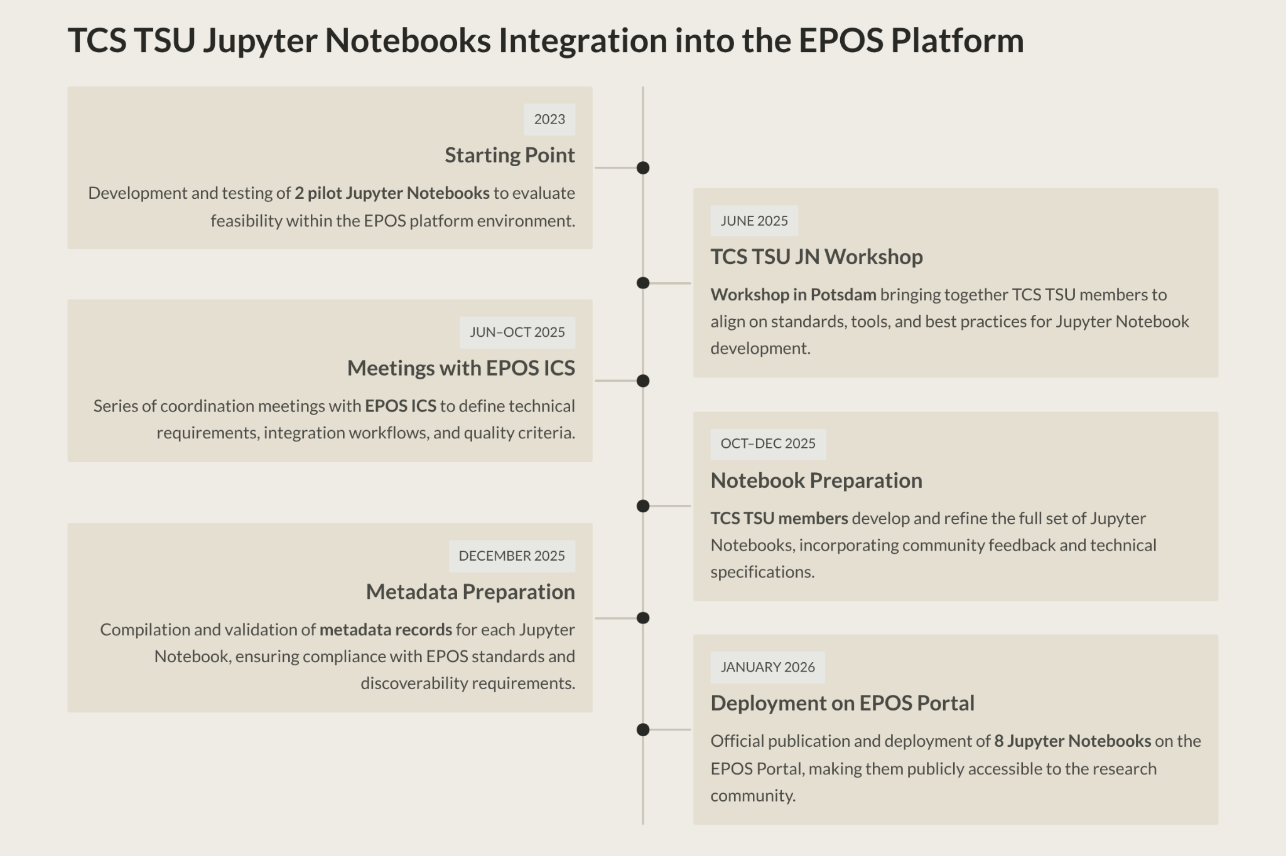
New (type of) services
Jupyter Notebooks over ICS-C

Slide 5
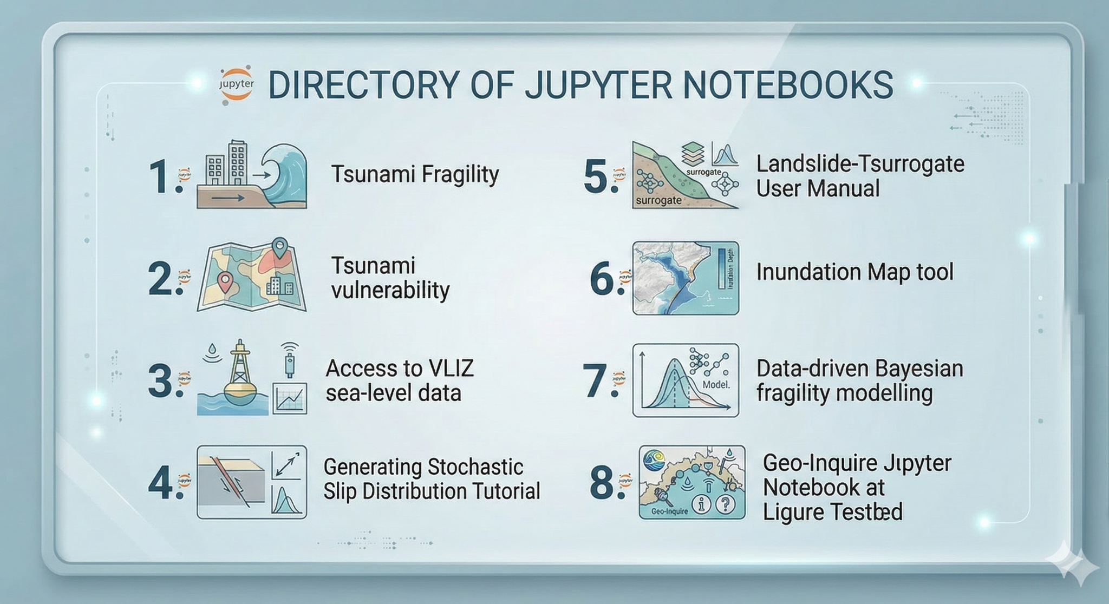
New (type of) services
Jupyter Notebooks over ICS-C

Slide 6
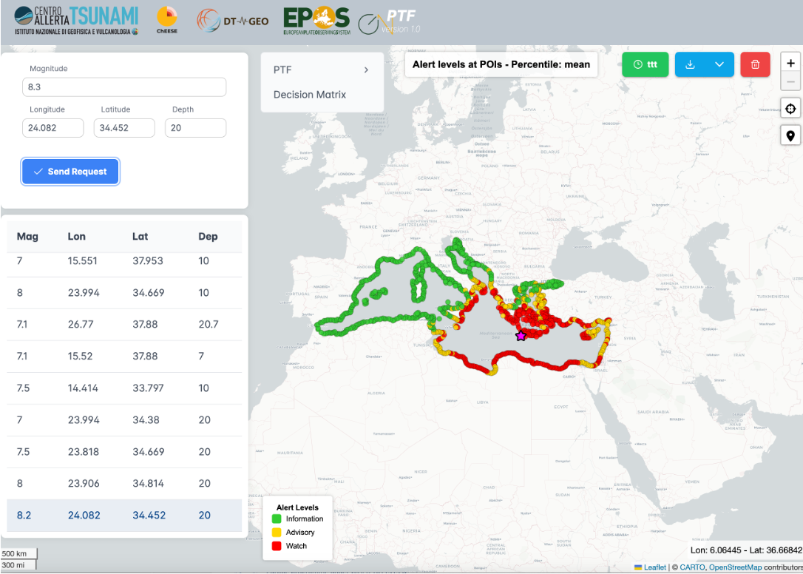

New (type of) services
Web-Apps
Probabilistic Tsunami
Forecasting in
Mediterranean
Prime stakeholders:
Tsunami Service Providers in the NEAM region
developed with
(access restricted)

Slide 7
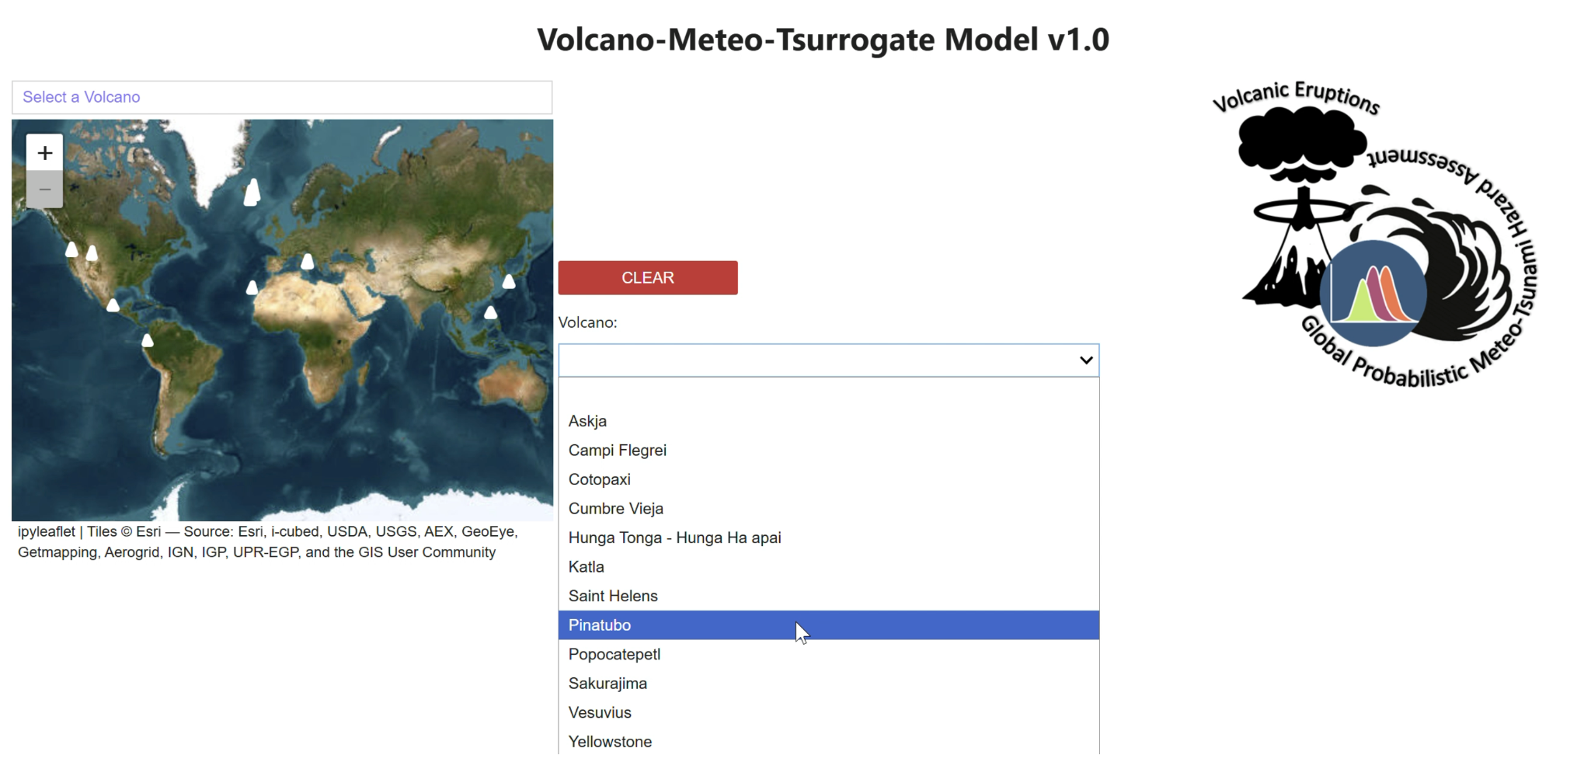
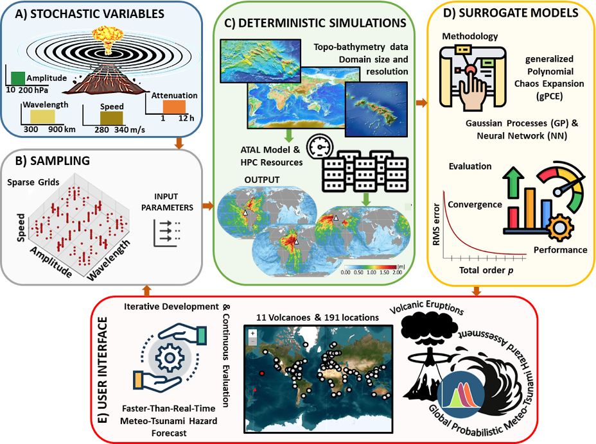
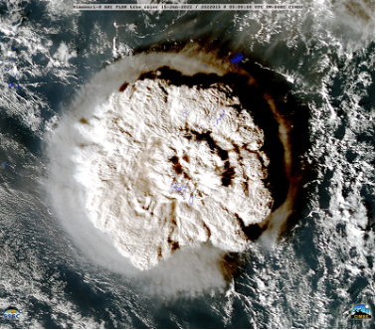
New (type of) services
Web-Apps
Volcano-Meteo Tsunami Surrogate
Web-app based on pre-calculated scenarios and emulation
(to come in 2026)
developed with

Slide 8


Fostering TA provision in EPOS
New (HPC-)software and workflow TA-installations @ INGV (Rome), Uni Malaga, NGI (Oslo) with HPC support by CINECA:
TA2-531-3 HySEA - Earthquake and landslide generated tsunami simulations
TA2-532-1 BingClaw - Model for simulating dynamics of cohesive landslides
TA2-541-3/4/5/6/7/8 - Probabilistic Tsunami Hazard Assessment (PTHA)
15+ TA-projects funded with support for numerical experiment design and HPC resources (CINECA HPC)
Update EPOS TA-framework based on experience and know-how gained with Geo-INQUIRE (e.g., admission, KPIs, …)
TA Program
(MYCA Tasks 10, 23)

Slide 9
Cross-TCS activity
EPOS 2026 Sponsored Research Activity (SRA) entitled:
"Exploring cross-TCS collaboration framework on Multi-Risk Products"
in coop. with TCS SEIS (ETHZ, EUCENTRE, AUTH), AH (IG PAS), GEOM (LTU), VOLC (INGV, CSIC), candidate TCS BED (EUCENTRE)
Initiated during 2025 EPOS Days, this SRA goes in-line with SO2 “Cultivate multidisciplinary research” and SO3 “Enhance and disseminate the EPOS societal value”
Expected SRA outcomes:
Terms of Reference (ToR) for a new EPOS Cross-TCS Multirisk Working Group
List of the existing and planned Risk DDSS elements across TCSs
Mapping key end-users and external stakeholders
Pilot multirisk use-cases implementation plan
Multirisk roadmap report

Slide 10
More on our Meet&Greet Poster
Thank you!

