Slide 1

EPOS Community Values Respect • Integrity • Inclusion

Slide 2
Event code of conduct
EPOS Days bring together researchers, professionals, and collaborators from diverse backgrounds.
Objective: respectful, inclusive, safe and productive environment for everyone.
EPOS is committed to maintaining an environment where participants can contribute and collaborate without barriers.
What we stand for
Mutual respect in professional interactions
Inclusion across cultures, disciplines, and identities
Integrity in communication and collaboration
A safe and supportive atmosphere for discussion and exchange
The well-being of participants supports the quality of our scientific community.

Slide 3
Expected behaviours
Participants are expected to behave in ways that support the smooth running of sessions and activities, avoid disruptive behaviours that interferes with presentations and discussions, and help to ensure, with their conduct, that everyone benefits from the event.
Respect & Non-Discrimination: We value the diversity of perspectives that strengthen scientific collaboration.
0 tolerance for discriminatory and racist behaviours
0 tolerance for harassment and sexual misconduct
Respect of Individual Comfort & Personal/Professional Space

Slide 4
A Shared Responsibility: Building an Inclusive Scientific Community
Maintaining a respectful and inclusive environment is a shared responsibility.
Each participant contributes by:
Engaging respectfully with colleagues
Speaking up when something is not right
Supporting a culture of professionalism & inclusion
Only together we can create a community where scientific exchange can thrive.

Slide 5
Reporting & Support
If concerns arise, participants may report them confidentially to designated event contacts: Karl Stuebe (karl.stuebe@epos-eric.eu +39 379 1015624- and Giovanna Maracchia (giovanna.maracchia@ingv.it)
Support resources are available to:
Provide guidance
Discuss concerns in full confidentiality
Assist in addressing issues when needed
There will be no retaliation for raising concerns. Action will only be taken with the reporter’s consent unless there is a broader risk in general and/or risk to others.

Slide 6
Quiet Room: A space for rest and reflection
A quiet room is available for participants who may need a calm space during the event: Sala Fiuggi on the right side of the auditorium if facing the stage.
This space is intended to support well-being by providing a quiet environment for rest, reflection, or brief breaks away from the conference setting.
Participants may also use the space for quiet personal practices or moments of reflection.
Please help maintain this environment for everyone by keeping the space quiet and respectful.

Slide 7
Quiet Room: guidelines
To ensure the quiet room remains a restorative space for all participants:
No conversations, with others or over the phone, allowed inside the room
Silence your technology, use headphones
Respect others’ need for quiet & personal space
Keep visits brief as possible if others are waiting to use the room
Important: Participants may use the quiet room for many reasons, including:
Managing sensory overload or fatigue
Resting or taking a short mental break
Quiet reflection or personal devotional/spiritual/religious practices done silently
Everyone’s needs are valid, and the space is available to anyone who may benefit from it.

Slide 8
Photography and Videography
Please note that EPOS Days will include photography and livestreaming during selected sessions and event activities. We wish all participants are comfortable and informed about how we are going to use images and recordings:
Event documentation
EPOS communications and outreach
Reporting and promotional materials
If you prefer not to appear in photographs or video recordings, please let us know at communication@epos-eric.eu or kindly inform Karl Stuebe or Federica Tanlongo during the event.

Slide 9
Practicalities for the next days
The event starts at 9 every day with a walkthrough of the day’s agenda by the ED
We are many and settling down will take some time: we kindly ask you to be on time as much as possible as a courtesy to the morning speakers
We envisaged long breaks to allow for networking, rest, and also reading your emails.
Have you confirmed your attendance to social events? Please communicate any variation to the secretariat ASAP!

Slide 10
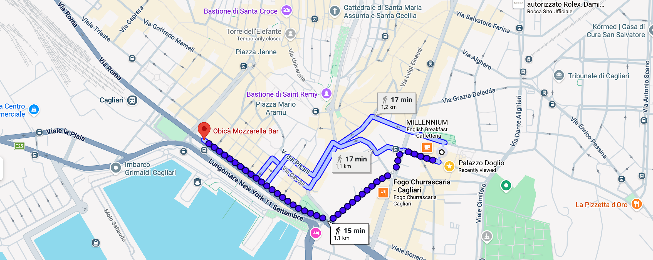
Social events: Social Dinner
Tuesday 19.30-22.00 - Obicà Mozzarella Bar – via Roma 143
Bring your badge!

Slide 11
Social events: Cagliari Walking Tour
Cagliari walking tour: On Wednesday afternoon – from 3.00 PM
Participants will be divided into smaller groups, and assigned to a guide
Tours will starting at intervals to avoid queues
If you have major issues with the timing of your assigned group, contact the secretariat ASAP to be reassigned
The city tour will take about two hours: don’t forget to wear comfortable shoes!

Slide 12
Enjoy the programme!

