Slide 1

Introducing EPOS and the EPOS Days
Gaetano Festa
Chair of the EPOS ERIC Service Coordination Committee

Slide 2

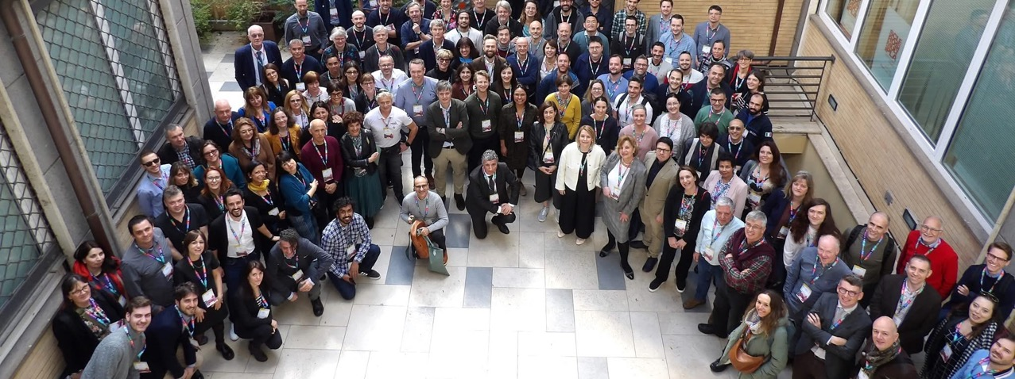
Welcome to the
EPOS Days 2026!
As a tradition … The EPOS Community meets every year…
  To bring the EPOS Community together
  To make EPOS known to researchers, potential contributors, new potential partners, users and learn about them

Slide 3
186 | Registered Participants
+35% | Participation compared to previous edition
5 | Continents
130 | Parallels covered
24/26 | European Countries / EPOS Countries
14 | National “EPOS”
30 | Early Career Researchers
EPOS Days 2026 edition

Slide 4
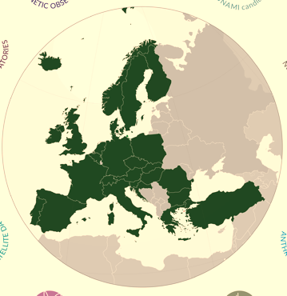
EPOS is the reference RI for Solid Earth Sciences in Europe
EPOS brings together countries and aggregates research communities around the paradigm of Open Science
EPOS integrates SCIENTIFIC DATA generated across Europe and across disciplines making them universally accessible
EPOS enables excellent science and innovation
765 Data and Service Providers
172 Research Organisations
26 European Countries
10+1 Scientific Domains
5 International Organizations
EPOS is operated by an ERIC
(European Research Infrastructure Consortium)

Slide 5
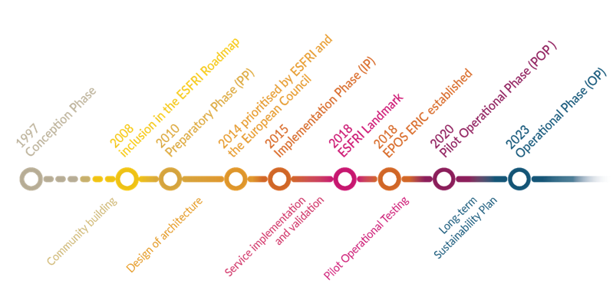
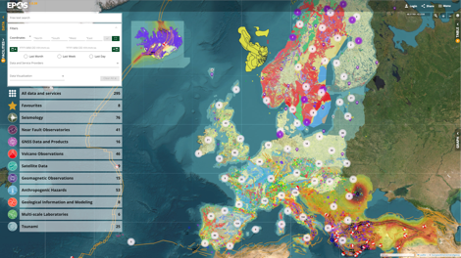
A long journey … to arrive where we are today
EPOS mission: To establish a sustainable and long-term access to solid Earth science data and services integrating diverse European Research Infrastructures under a common federated framework
The EPOS Platform fully operational
Providing open access
to harmonized and interoperable
scientific data and products

Slide 6

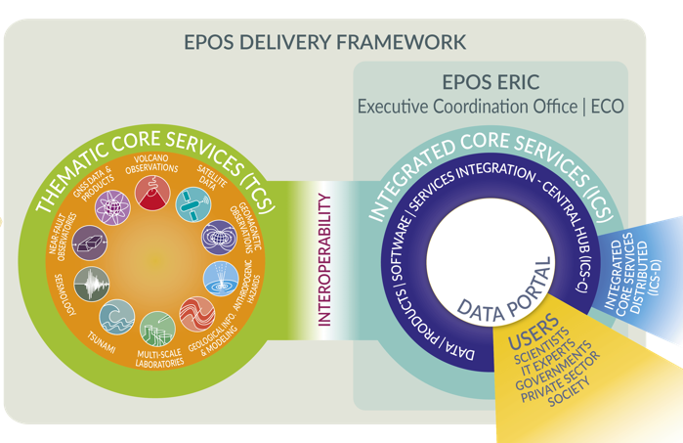
Functional Architecture
EPOS has been built by assembling key elements
to allow the whole system to work as a single, but distributed, sustainable research infrastructure
ICSs integrate data and services and make them FAIRly accessible through a single-access point
DATA Generation
DATA Integration
DATA Access
NRIs generate and manage data for science and society
Users exploit the EPOS Platform to access, visualise, combine, download data from different scientific domains
TCSs provide the governance framework necessary to ensure that data and metadata, from different sources and in different formats, are harmonised and made accessible through services on the Platform

Slide 7
Functional Architecture
EPOS has been built by assembling key elements
to allow the whole system to work as a single, but distributed, sustainable research infrastructure
DATA Generation
DATA Integration
DATA Access
323 Services
765 Data & Service Providers
172 Research Organisations
38,200+ visitors
from 124 Countries
(update: March 2026)
10+1 Scientific Domains
New Communities
International Organizations

Slide 8
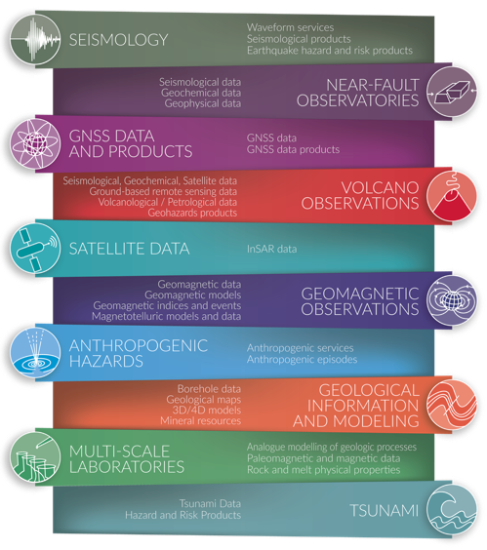
The EPOS Thematic Core Services
Currently, 10+1 different solid Earth science disciplines collaborate across EPOS (Thematic Core Services, TCS)
TCSs are outside the ERIC perimeter, they contribute to the data, product and service provision to EPOS, and they are represented in the Service Coordination Committee
TCSs are technically coordinated with the ICS for platform operation via the TCS-ICS interaction group
Notes:
Content slide

Slide 9










TCS are governance frameworks for community-specific coordination and data integration across different disciplines
TCS Consortium with its own governance
TCS Consortia designed to adopt joint strategies to tackle scientific, technical, financial, legal and ethical issues and best practices for data harmonization
Community Governance Models
Notes:
Content slide

Slide 10

Communities through the EPOS journey
From data protection and embargoing to data sharing and Open Science
Design, implementation, validation, testing, operation of services
Community growth and development of new communities within the EPOS development – different level of maturity of TCS. Cross-TCS best practices for open data
Notes:
Content slide

Slide 11





Examples of Inter- and Cross-Community Projects
EPOS is an enabler (and a brand!) for community projects to be developed and supported within the EU programmes and at National Level.
Italian contribution to enhancing NRI – seismic, geodetic, volcanic, NFOs - and data provision
Dutch contribution building multiscale facilities from micro- to field scale
Contribution for data distribution – GNSS and other disciplines from Belgian institutes – SERVE
Enhancing services (VA and TA) within Land/Sea Ris to foster curiosity-driven research
Consolidation and enhancement of EPOS RI through new services for science, society and private sector
Notes:
Content slide

Slide 12
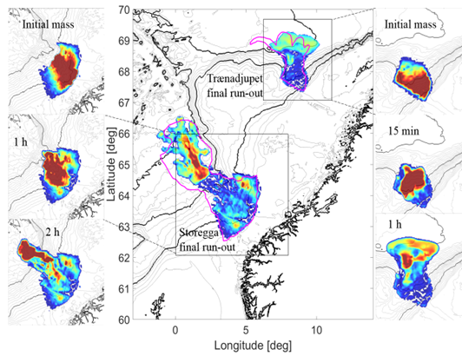
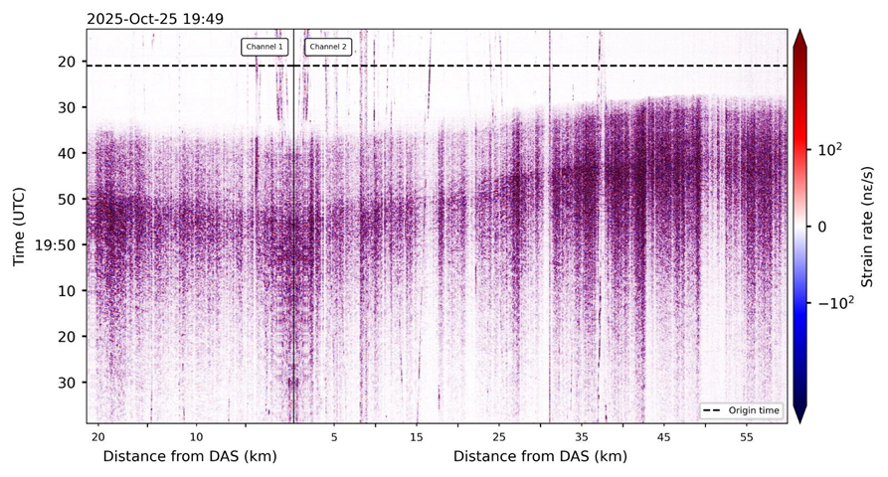
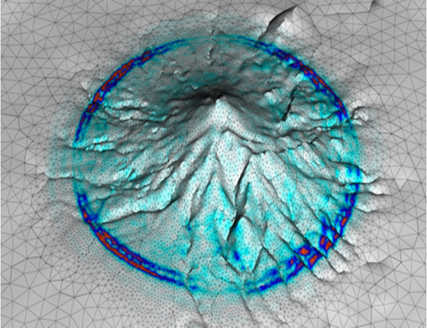
Challenges and Opportunities
The EPOS Platform has a complex structure managing a variety of data-types (time series, maps,…) and formats: TCSs also have developed community portals to handle TCS data and allow specific visualization/ processing operations.
Not all DDSS ready to be integrated: Software and workflows, Simulation Data Lakes, DAS data,…
EPOS and actual scientific challenges: AI-ready data and products, visualization and processing tools on top of data provision, near-real-time monitoring (also in case of a natural crisis), connection to HPC
Data
Types/
formats
Notes:
Content slide – 2 boxes with titles

Slide 13
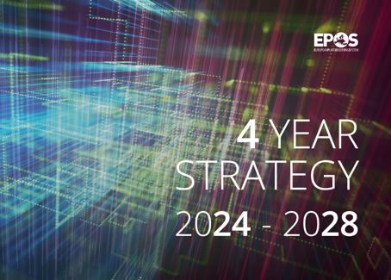
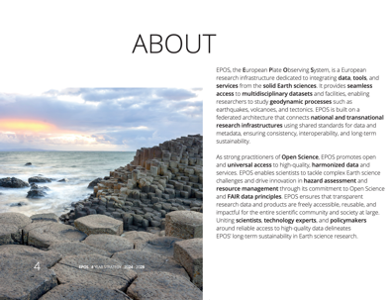
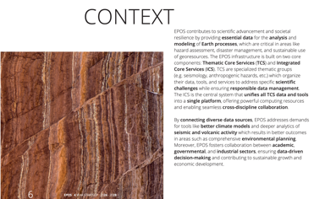
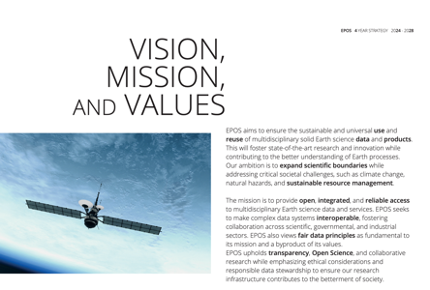
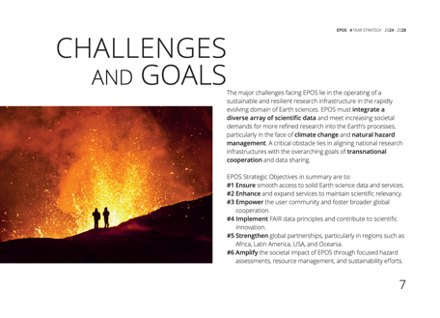
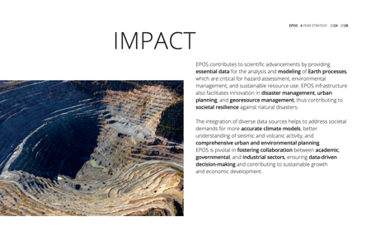
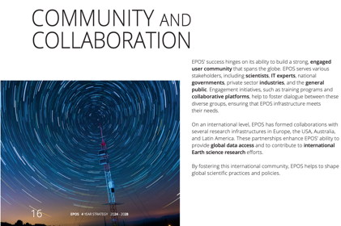
Notes:
Content slide

Slide 14
EPOS Strategy 2024-2028
From a broader scientific perspective to specific and actionable strategic objectives
encompasses the 6 Strategic Objectives (SO) of the EPOS Science Program
designed to complement the research plans of individual TCS
SO1 | Ensuring smooth and seamless access to solid Earth science data and services
SO2 | Enhancing and advancing services for solid Earth science
SO3 | Enlarging, widening and empowering the user community
SO4 | Implementing principles of Open Science and FAIR data management, and contributing to e-science innovation
SO5 | Amplifying and spreading the societal value of EPOS
SO6 | Boosting global cooperation
EPOS ON project is supporting the implementation of the Strategic Objectives

Slide 15
The EPOS Science Program
Accessing to solid Earth science data, products, software, and services to facilitate scientific research
Favouring Multidisciplinary/Transdisciplinary use of solid Earth science DDSS
Advancing in hazard assessment and risk mitigation
Providing products related to the exploitation of geo-resources
Fostering the implementation of services addressing societal challenges
Strengthening the field of computational Earth Science
Driving IT innovation and fostering FAIR data management practices
Enhancing international collaborations and promoting the global dimension of solid Earth science research
Providing training initiatives and ensuring dissemination on solid Earth science
Notes:
Content slide

Slide 16
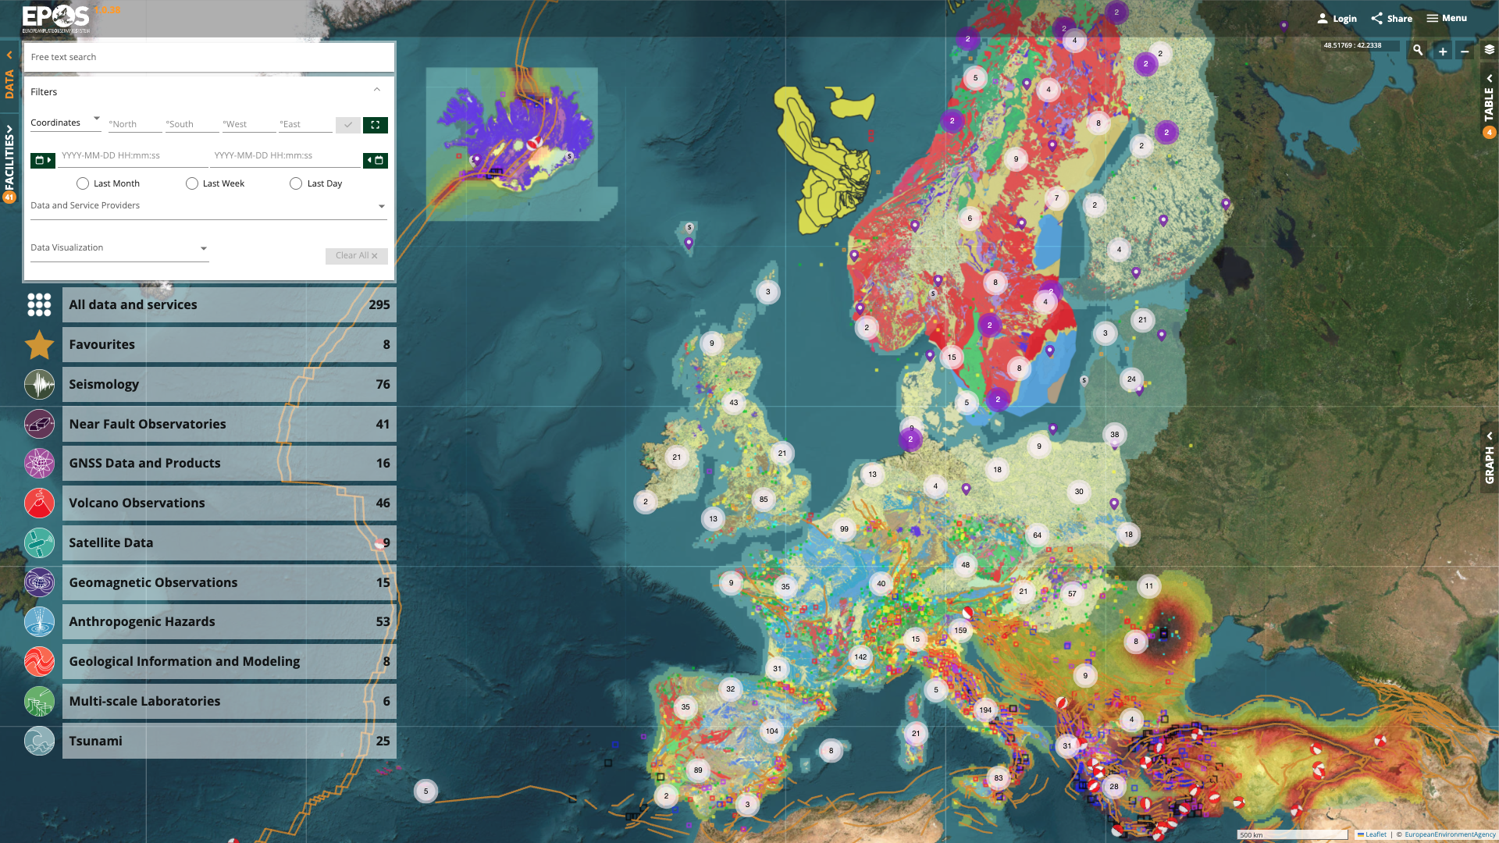
Access to community data and products
Facilitating and enhancing research by providing openly accessible and interoperable data and products across diverse domains within solid Earth science.
Integration of TCS data and services through the EPOS Platform.
Long-term provision of data and services
Engaging data and service providers and National Research Organizations.
Developing the EPOS portfolio by integrating new data and services from existing TCS and emerging ones.
Enhancing the functionalities of the EPOS Platform based on user feedback.
Notes:
Content slide

Slide 17
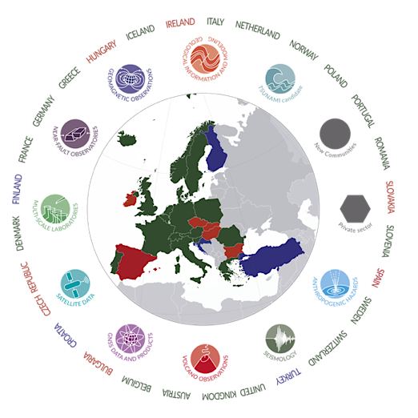
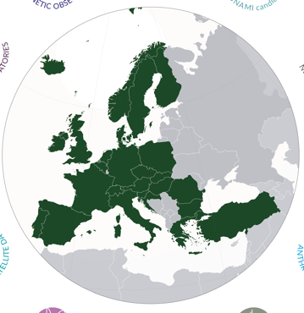
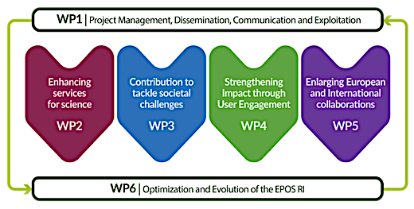
Supporting the implementation of the EPOS Science Program: EPOS ON
A community effort
to support the optimization and evolution
of the EPOS Research Infrastructure

Slide 18

EPOS ON – Strategic Objectives & Actions
Enhancing and advancing services for solid Earth science
Integration of new services (including from new countries and new communities)
Integration of new thematic communities
Roadmap for integration of data generated in collaboration with private sector
Integration of ICS-D Prototypes
EPOS Days 2026 Sessions: Thematic Core Services Day 1
New Services and Communities Day 2
Technical Challenges, Opportunities and Solutions Day 4
EPOS Data Policy Day 5

Slide 19

EPOS ON – Strategic Objectives & Actions
Amplifying and spreading the societal value of EPOS
Integration of services relevant for risk management related to different hazards
Cooperation roadmap with the EU Union Civil Protection Knowledge Network
Methodology for the application of ethical labels to EPOS services
Recommendations for the consolidation of the EPOS ethical guidelines
Identification of how EPOS contribute to environmental impact reduction
EPOS Days 2026 Sessions: Societal Impact and Responsible RIs Day 2
Technical Challenges, Opportunities and Solutions Day 4
EPOS Data Policy Day 5

Slide 20

EPOS ON – Strategic Objectives & Actions
Enlarging, widening and empowering the user community
Recommendations for the improvement of the EPOS User Strategy
Implementing EPOS Training programme
Engagement of early career researchers
EPOS Days 2026 Sessions: Early Career Researchers Day 2 Technical Challenges, Opportunities and Solutions Day 4
EPOS Data Policy Day 5

Slide 21

EPOS ON – Strategic Objectives & Actions
Boosting Global Collaboration
Implementation of the MoUs in place
New collaborations with international initiatives in Europe, Africa, Asia, Latin America, US, New Zealand
EPOS Days 2026 Sessions: International Collaboration Day 3
Technical Challenges, Opportunities and Solutions Day 4
EPOS Data Policy Day 5

Slide 22
EPOS ON – Strategic Objectives & Actions
WP6 - A solid set of recommendations for the optimization and evolution of the EPOS RI
Design and implementation of an IT tool for the integrated management of the EPOS RI
A more efficient mechanism for the interaction between EPOS ERIC and national organizations
EPOS Days 2026 Session: EPOS in the National Landscapes Day 4 EPOS Data Policy Day 5

Slide 23
The EPOS Ecosystem and the EPOS Days 2026 Programme
Day 5: EPOS Data Policy
DATA Generation
DATA Integration
DATA Access
Day 4: Technical challenges, opportunities and solutions
Day 4:
EPOS in National Landscapes
Day 1: Thematic Core Services
Day 2: Early Career Researchers, es
Day 2: New Services and communities
Day 3: International Collaboration
Day 2: Societal Impact and Responsible Research Infrastructures
Day 4: UFG report

Slide 24
Thank you!

Slide 25
EPOS Community Values
Respect • Integrity • Inclusion

Slide 26
Event code of conduct
EPOS Days bring together researchers, professionals, and collaborators from diverse backgrounds.
Objective: respectful, inclusive, safe and productive environment for everyone.
EPOS is committed to maintaining an environment where participants can contribute and collaborate without barriers.
What we stand for
  Mutual respect in professional interactions
  Inclusion across cultures, disciplines, and identities
  Integrity in communication and collaboration
  A safe and supportive atmosphere for discussion and exchange
The well-being of participants supports the quality of our scientific community.

Slide 27
Expected behaviours
Participants are expected to behave in ways that support the smooth running of sessions and activities, avoid disruptive behaviours that interferes with presentations and discussions, and help to ensure, with their conduct, that everyone benefits from the event.
Respect & Non-Discrimination: We value the diversity of perspectives that strengthen scientific collaboration.
0 tolerance for discriminatory and racist behaviours
0 tolerance for harassment and sexual misconduct
Respect of Individual Comfort & Personal/Professional Space

Slide 28
A Shared Responsibility:
Building an Inclusive Scientific Community
Maintaining a respectful and inclusive environment is a shared responsibility.
Each participant contributes by:
  Engaging respectfully with colleagues
  Speaking up when something is not right
  Supporting a culture of professionalism & inclusion
Only together we can create a community where scientific exchange can thrive.

Slide 29
Reporting & Support
If concerns arise, participants may report them confidentially to designated event contacts: Karl Stuebe (karl.stuebe@epos-eric.eu +39 379 1015624- and Giovanna Maracchia (giovanna.maracchia@ingv.it)
Support resources are available to:
Provide guidance
Discuss concerns in full confidentiality
Assist in addressing issues when needed
There will be no retaliation for raising concerns. Action will only be taken with the reporter’s consent unless there is a broader risk in general and/or risk to others.

Slide 30
Quiet Room: A space for rest and reflection
A quiet room is available for participants who may need a calm space during the event. Sala Fiuggi on the right side of the auditorium.
This space is intended to support well-being by providing a quiet environment for rest, reflection, or brief breaks away from the conference setting.
Participants may also use the space for quiet personal practices or moments of reflection.
Please help maintain this environment for everyone by keeping the space quiet and respectful.

Slide 31
Quiet Room: guidelines
To ensure the quiet room remains a restorative space for all participants:
  No conversations, with others or over the phone, allowed inside the room
  Silence your technology, use headphones
  Respect others’ need for quiet & personal space
  Keep visits brief as possible if others are waiting to use the room
Important: Participants may use the quiet room for many reasons, including:
  Managing sensory overload or fatigue
  Resting or taking a short mental break
  Quiet reflection or personal devotional/spiritual/religious practices done silently
Everyone’s needs are valid, and the space is available to anyone who may benefit from it.

Slide 32
Quiet Room: guidelines
Please note that EPOS Days will include photography and livestreaming during selected sessions and event activities. We wish all participants are comfortable and informed about how we are going to use images and recordings:
Event documentation
EPOS communications and outreach
Reporting and promotional materials
If you prefer not to appear in photographs or video recordings, please let us know at communication@epos-eric.eu or kindly inform Karl Stuebe or Federica Tanlongo during the event.

Slide 33
Practicalities for the next days
The event starts at 9 every day with a walkthrough of the day’s agenda by the ED
  We are many and settling down will take some time: we kindly ask you to be on time as much as possible as a courtesy to the morning speakers
We envisaged long breaks to allow for networking, rest, and also reading your emails.
Have you confirmed your attendance to social events? Please communicate any variation to the secretariat ASAP!

Slide 34
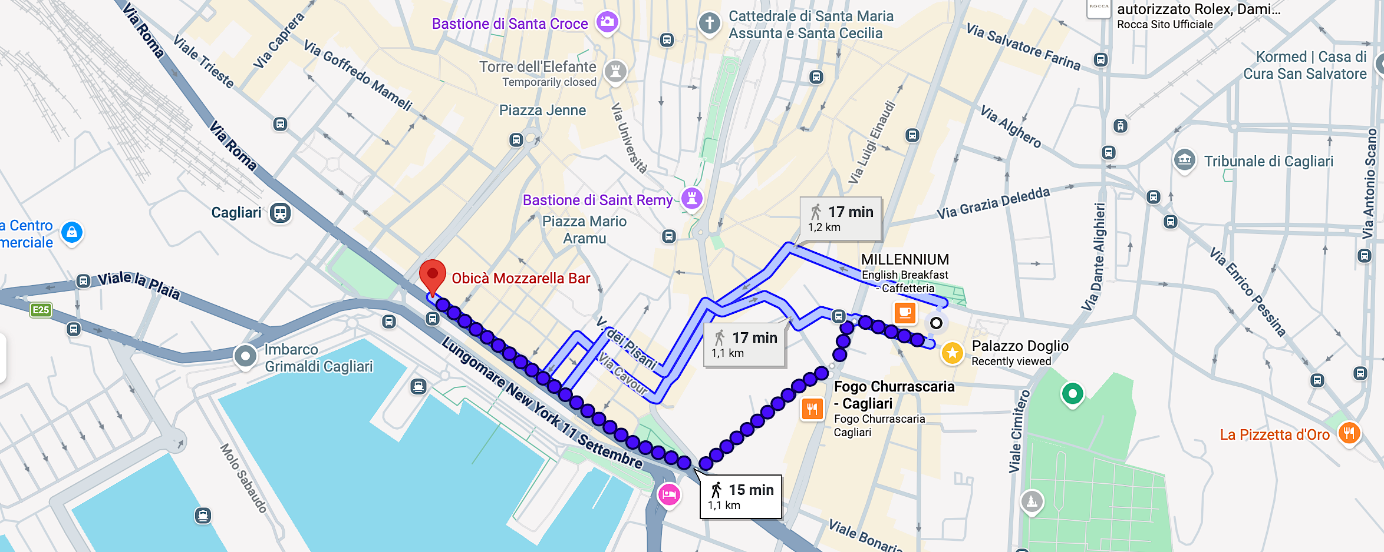
Social events: Social Dinner
Tuesday 19.30-22.00 - Obicà Mozzarella Bar – via Roma 143
Bring your badge!

Slide 35
Social events: Cagliari Walking Tour
Cagliari walking tour: On Wednesday afternoon – from 3.00 PM
  Participants will be divided into smaller groups, and assigned to a guide
  Tours will starting at intervals to avoid queues
  If you have major issues with the timing of your assigned group, contact the secretariat ASAP to be reassigned
  The city tour will take about two hours: don’t forget to wear comfortable shoes!

Slide 36
Enjoy the programme!

