Slide 1


EPOS Platform
Training
Jan Michálek, Juliano Ramanantsoa | jan.michalek@uib.no
23-27 June – EPOS Summer School, Olot, Spain
Notes:
Title slide

Slide 2
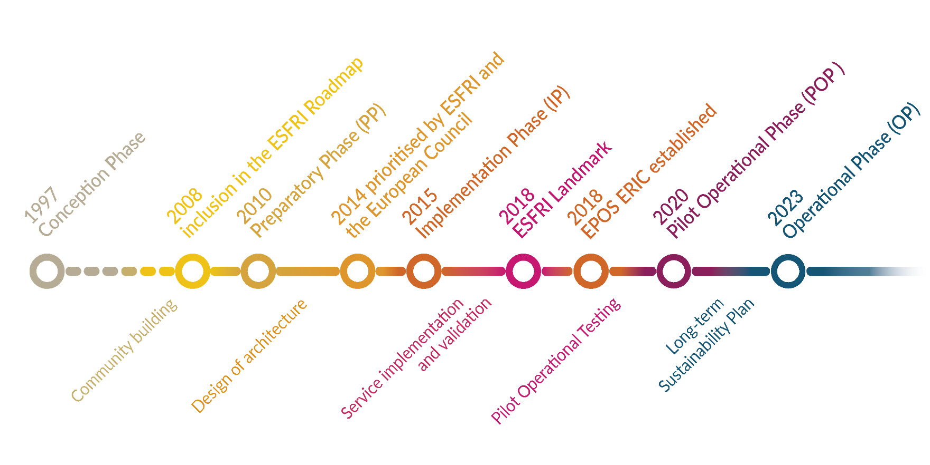
EPOS Timeline

Slide 3
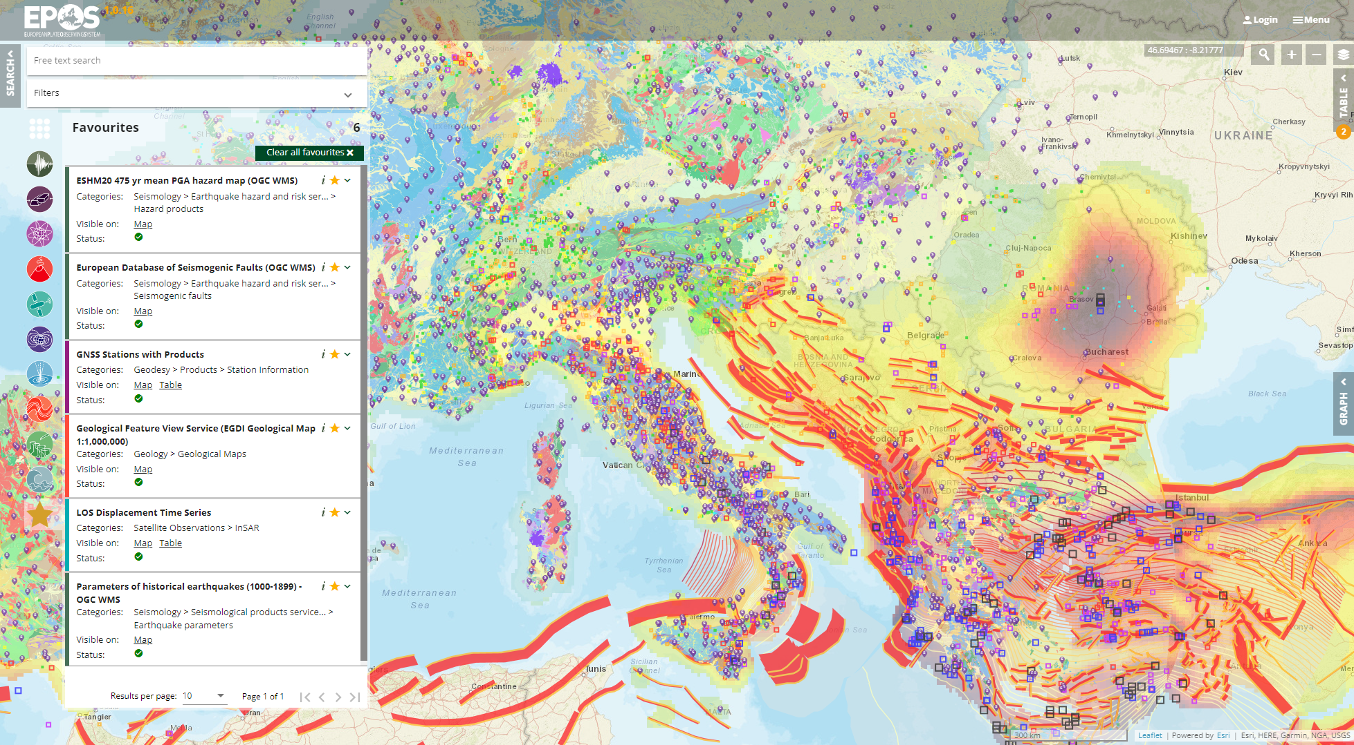




Service discovery, visualisation and data retrieval in the EPOS Platform
~ 400 Data and Service Providers
~ 300 Data Services
>800 Terabytes of Integrated Data
~ 180 weekly visitors
Icons created by Aranagraphics, catkuro, Becris and Prosymbols – Flaticon

Slide 4
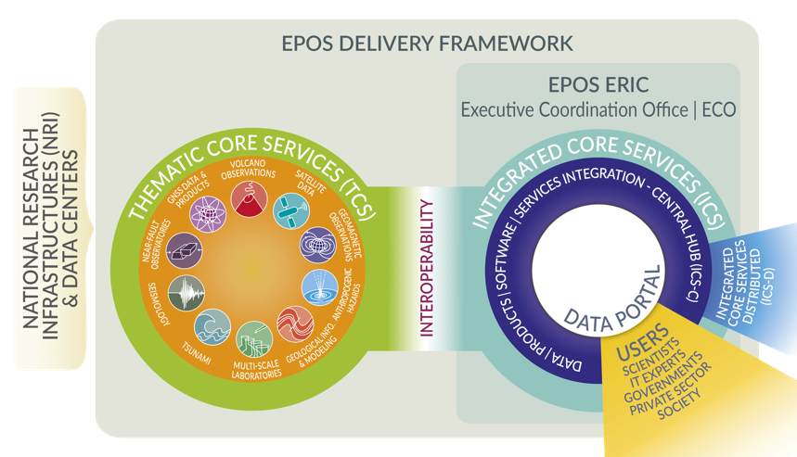

Slide 5
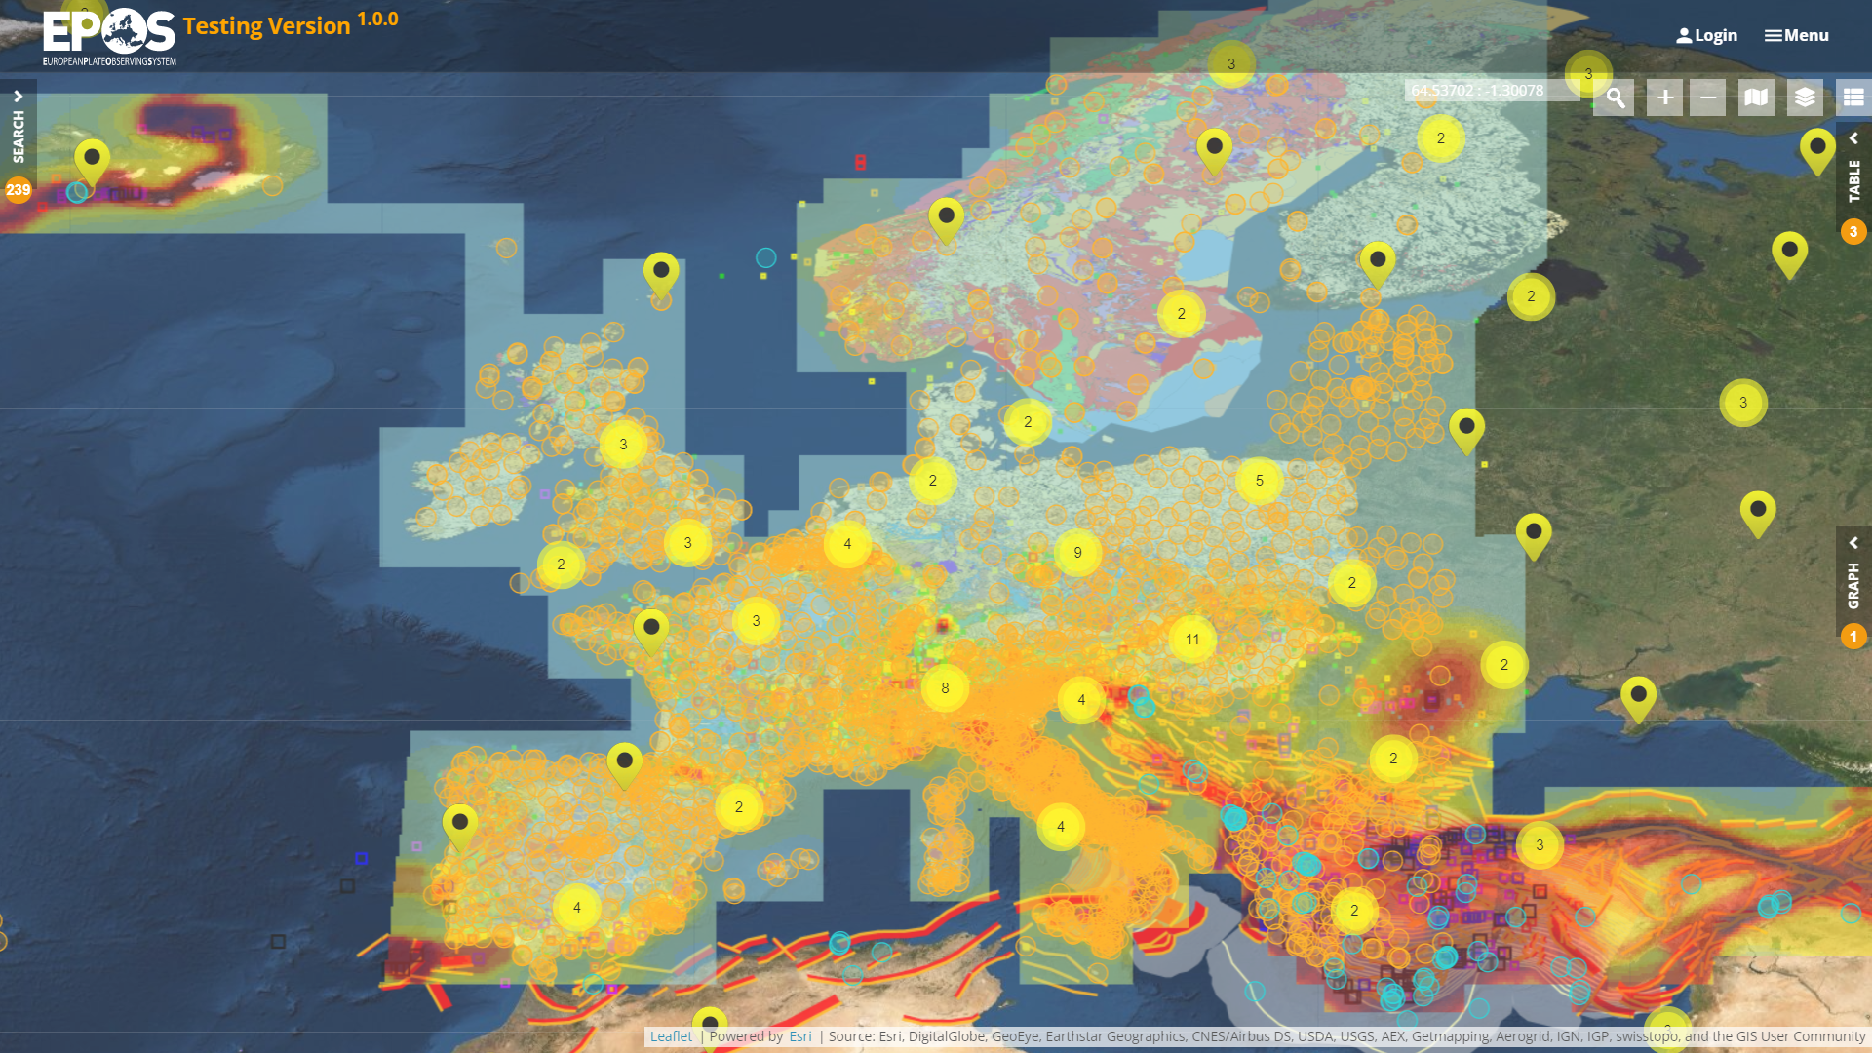











EPOS Technical Architecture
How it works …
GUI
ICS-D
ICS-C
INTEROPERABILITY
INTEROPERABILITY
TCS
TCS
TCS
TCS … Thematic Core Services
ICS … Integrated Core Services
TCS

Slide 6
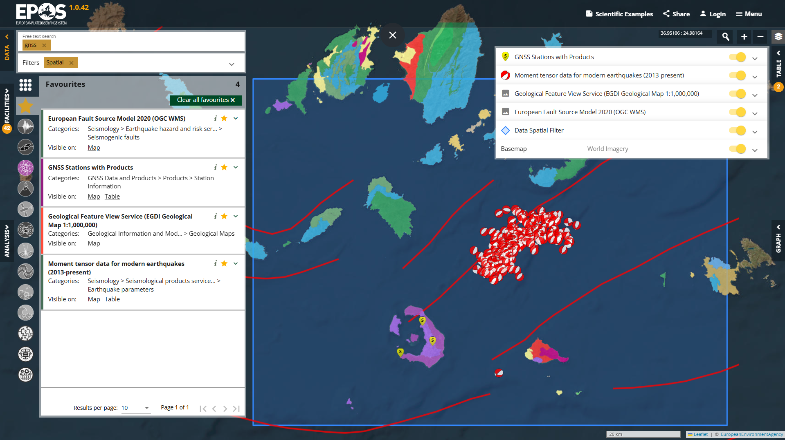
EPOS Data Portal
is truly FAIR!
EPOS Data Portal is the place where FAIR principles and practices are implemented thanks to the adoption of a co-development approach and harmonization actions across communities of developers and data providers.
https://www.ics-c.epos-eu.org/

Slide 7
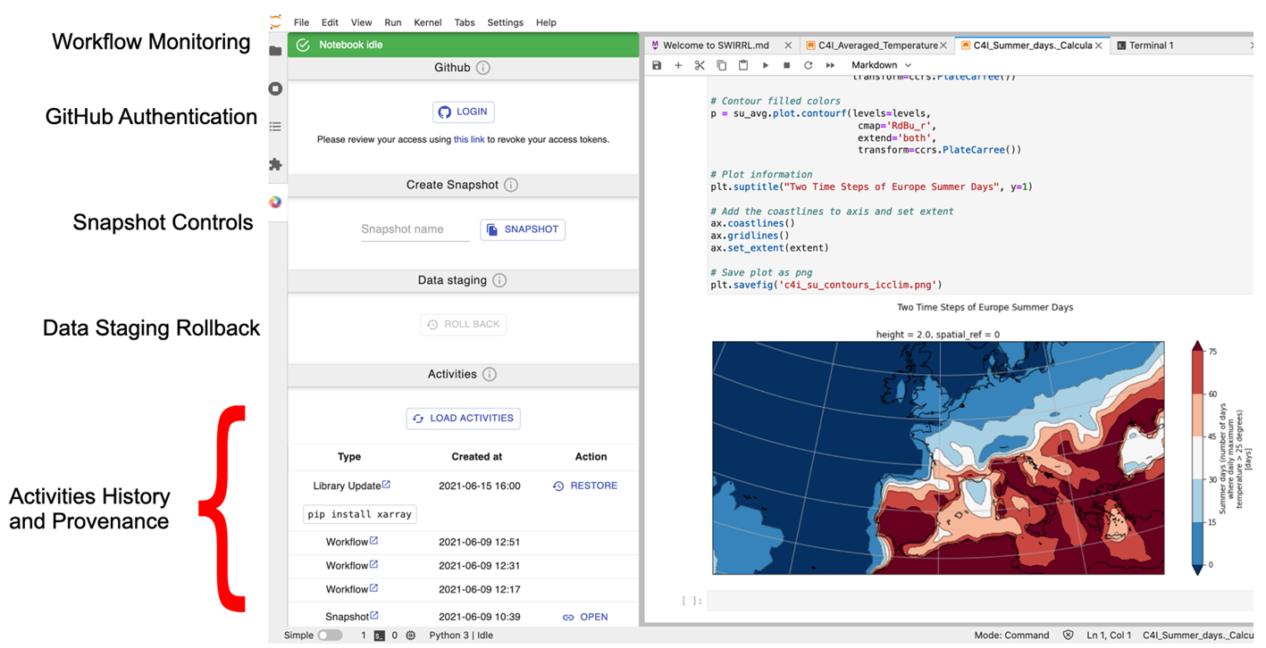
Further developments – distributed services

Slide 8
EPOS Platform
Live demo

Slide 9
EPOS Platform
Link to hands-on training instructions:
https://bit.ly/OLOT25

Slide 10
Try it! ics-c.epos-eu.org

Slide 11

Notes:
Logo only

