Slide 1

The EPOS Data Lifecycle
Valerio Vinciarelli| valerio.vinciarelli@epos-eric.eu
Notes:
Title slide

Slide 2
Overview
Data Lifecycle in Research Infrastructure
Data Management in EPOS
EPOS Data Lifecycle
Notes:
Content slide

Slide 3
Data Lifecycle in Research Infrastructure
Data Provision
Data Access & Reuse
Data Integration

Slide 4
Data Lifecycle in Research Infrastructure
Generation and Collection
Quality
Standardization
Harmonization
Distribution
Storage
Integration
Processing
Policies
Security
Maintenance

Slide 5
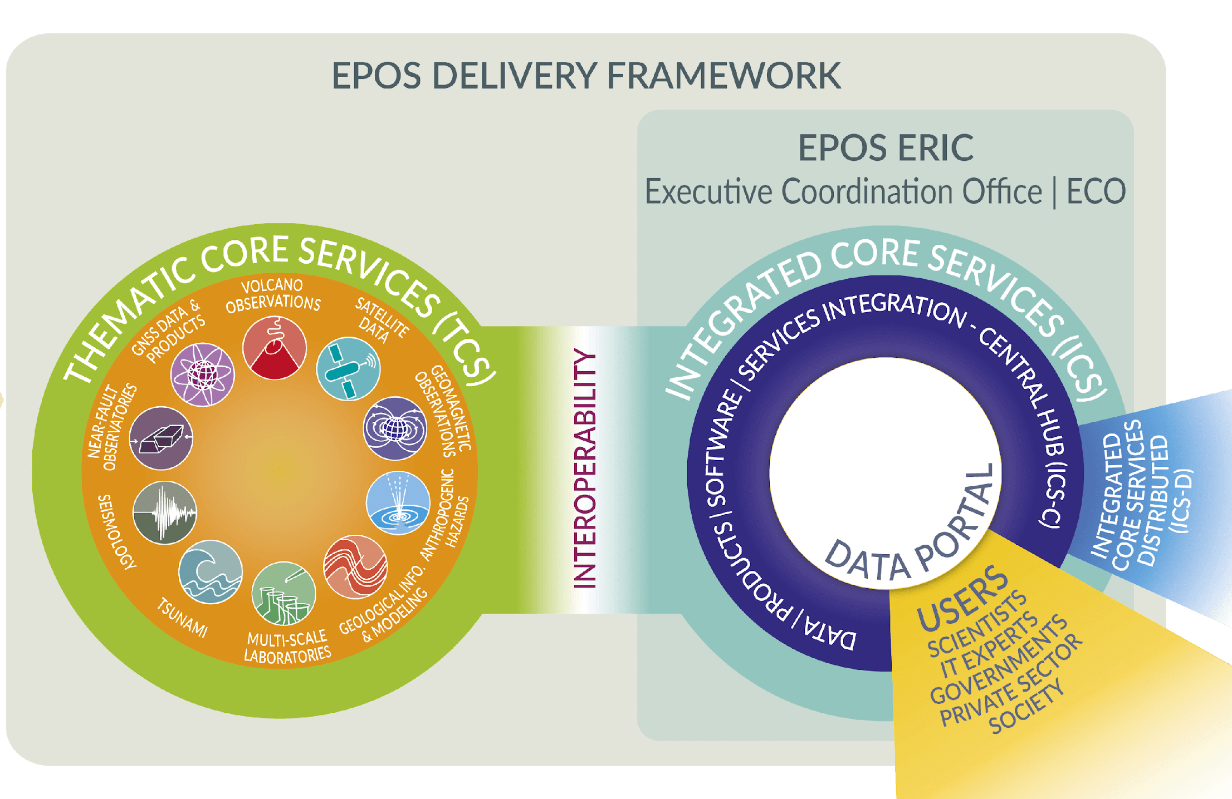
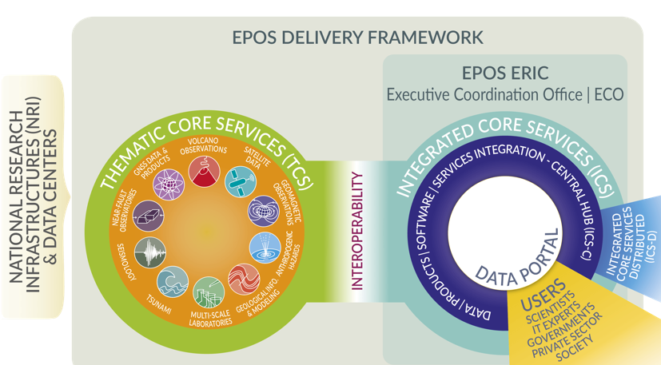
Data Management in EPOS
EPOS
Federated
(Meta)data Management
Data Integration and Access
Services are integrated
to make multidisciplinary data
Findable, Accessible, Interoperable and Reusable through a single, digital platform
515
Data are
generated, managed and stored
in National RIs across Europe
10
298
32,000
Data and metadata, from different sources and in different formats, are harmonised and made available through services, ensuring the adoption of shared standards in line with the FAIR principles
Users exploit the platform to
access, visualise, combine, download data from different domains
Notes:
515 Data Sources (Orgs, Univs, Data Centers, Networks)

Slide 6
EPOS (Meta)Data Lifecycle is a "Multi-level Data Lifecycle"
EPOS
Federated
(Meta)data Management
Data Integration and Access
10
Notes:
515 Data Sources (Orgs, Univs, Data Centers, Networks)

Slide 7
EPOS (Meta)Data Lifecycle is a "Multi-level Data Lifecycle"
EPOS
Federated
(Meta)data Management
Data Integration and Access
10
Raw Data,
Processed Data
and Metadata
Metadata
Notes:
515 Data Sources (Orgs, Univs, Data Centers, Networks)

Slide 8
Generation and Collection
EPOS
Federated
(Meta)data Management
Data Integration and Access
10
Data generated by National Research Infrastructures
Sources: seismometers, GNSS stations, geochemical labs, etc
Metadata generated on ICS side
Metadata collected on ICS side
Notes:
515 Data Sources (Orgs, Univs, Data Centers, Networks)

Slide 9
Storage
EPOS
Federated
(Meta)data Management
Data Integration and Access
10
Data stored by each Research Infrastracture on databases or cloud
Metadata store in a central Metadata Catalogue
Notes:
515 Data Sources (Orgs, Univs, Data Centers, Networks)

Slide 10
Data Quality
EPOS
Federated
(Meta)data Management
Data Integration and Access
10
Ensuring data is accurate, complete, consistent, and reliable by performing validation, cleaning, and verification processes.
Validation and cleaning at community level
Notes:
515 Data Sources (Orgs, Univs, Data Centers, Networks)

Slide 11
Maintenance
EPOS
Federated
(Meta)data Management
Data Integration and Access
10
Maintaining and managing data over time, ensuring they remain relevant, up-to-date, and accessible for users
Data Provision Agreements ensure continuity
Metadata curation over time
Notes:
515 Data Sources (Orgs, Univs, Data Centers, Networks)

Slide 12
Standardization and Harmonization
EPOS
Federated
(Meta)data Management
Data Integration and Access
10
Use of standards when possibile:
  Formats: XML, JSON, MiniSEED, etc
  Metadata: StationXML, QuakeML, etc
  Protocols: OGC, FDSN, RESTful APIs
Aligns formats, vocabularies, units across TCS
Ensures compatibility and reduces inconsistencies
Notes:
515 Data Sources (Orgs, Univs, Data Centers, Networks)

Slide 13
Integration
EPOS
Federated
(Meta)data Management
Data Integration and Access
10
Aggregation of multi-disciplinary resources
Interoperability layer bridges all TCS WebServices APIs
EPOS-DCAT-AP (common language description)
Notes:
515 Data Sources (Orgs, Univs, Data Centers, Networks)

Slide 14
Security
EPOS
Federated
(Meta)data Management
Data Integration and Access
10
Access control, encryption, audit trails
Each NRI can have their own AAI system if required
A TCS could have Federated access to data
Federated access via EPOS AAI
Compliant with GDPR and institutional policies
Notes:
515 Data Sources (Orgs, Univs, Data Centers, Networks)

Slide 15
Processing
EPOS
Federated
(Meta)data Management
Data Integration and Access
10
Data processing/preprocessing in each National Research Infrastructure to generate new Data Products
TCS pipelines transform raw observations to value-added products
ICS supports user-driven processing (e.g., Jupyter Notebooks)
Notes:
515 Data Sources (Orgs, Univs, Data Centers, Networks)

Slide 16
Distribution
EPOS
Federated
(Meta)data Management
Data Integration and Access
10
Making data available to other users, organizations, or systems through appropriate channels, ensuring accessibility
Data/Metadata exposed by mean of WebServices
Metadata exposed by an unique access point and the EPOS Platform
Notes:
515 Data Sources (Orgs, Univs, Data Centers, Networks)

Slide 17
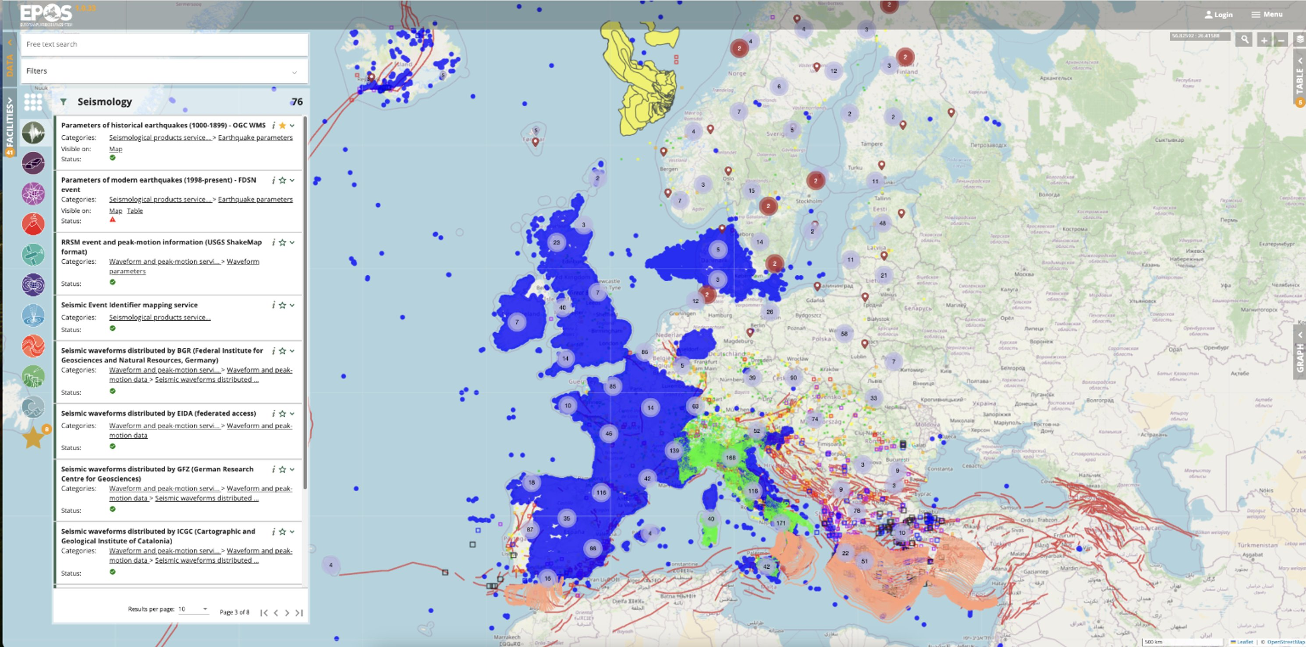
EPOS Platform
Notes:
Whether we're publishing seismic data or training an ML model, the idea of a lifecycle helps us plan, act, and maintain data meaningfully.

Slide 18

Thank you for your attention!
valerio.vinciarelli@epos-eric.eu
www.epos-eu.org/on | social media #EPOSon
Notes:
Thank you slide

Slide 19
Notes:
Content slide

Slide 20
Notes:
Content slide: tables

Slide 21
Content slide
Notes:
Content slide – 2 boxes

Slide 22
Notes:
Content slide – 2 boxes with titles

Slide 23
Notes:
Title slide for large pictures, tables, maps, plots…

Slide 24
Notes:
Empty slide for large pictures, tables, maps, plots…

Slide 25
Notes:
Section title slide

Slide 26
Thank you for your attention!
yourname.surname@email.something
www.epos-eu.org/on | social media #EPOSon
Notes:
Thank you slide

Slide 27
Notes:
Logo only

Slide 28
Policies
EPOS
Federated
(Meta)data Management
Data Integration and Access
10
Open data policy: 'as open as possible'
Managed by EPOS ERIC and its technical bodies
EPOS Data Policy describes how data have to be distributed
Notes:
515 Data Sources (Orgs, Univs, Data Centers, Networks)

Slide 29
Guidelines for using the template /1
Text boxes in this template are set to «do not autofit»:
  this is done on purpose and it means that you are supposed to use the default options for titles, subititles and contents.
    we have set the defaults for optimal readbility. If your content is not fitting in the slide, it means that you need two slides or your audience will struggle with reading!
    Please do not change the settings of the template just to add more text in a slide!
Please never make any changes to the slide master or the template in general on your own!
  If you feel there’s something wrong with the template just let us know!

Slide 30
Guidelines for using the template /2
As usual with PPT templates, this one includes several layouts: make sure you use the appropriate one:
  Title slide: only at the beginning of your presentation
  Section header: when you want to divide different parts of the presentation
  Content slides: you have different ones depending on the kind of content you need to use.
    Do not forget to use the layout without the footer (with or without title) in case you need to put in the slide big pictures, maps, videos etc that would (partly) overlap with it
    Prefer the provided table slide as format is already set. If you add the table in a second moment, please check that the font is Calibri

Slide 31
Guidelines for using the template /3
You should always use the official template font, which is Calibri (regular for the text and bold for titles).
  If functional to what you are communicating, you may use other colours in the content box (provided they offer enough contrast to be readable in different luminosity conditions) but please try to use the template colours for titles (forest green for sections and black for cover and slide titles)
    There might be exceptions to this rules, e.g. if you need to highlight something in the title (see the /3 indicator in this slide’s title)
    The Author(s) | Contacts | Date – Occasion box in the slide title is the only instance of a golden (sub)title

Slide 32

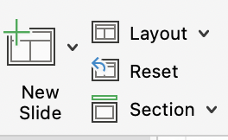

Guidelines for using the template /4
Templates work best when you create your slide from scratch!
  If you need to copy into the template one or more slides that come from another presentation with a different template/theme, please:
    Copy-and-paste the slide(s) in the slide sorter
    Click on the near the slide (if you have more than one you’ll need to repeat the action) and select the «use destination Theme»
    Check if the theme was applied correctly or needs some tweaks
      You can adjust any part of the transferred slide manually but you may want to try the «Reset» command on the new slide pane:

Slide 33
Guidelines for using the template /5
Before you go….
Should you need any help with the template or have any suggestion to improve it or these guidelines, please contact communication@epos-eric.eu and let us know!

