Slide 1
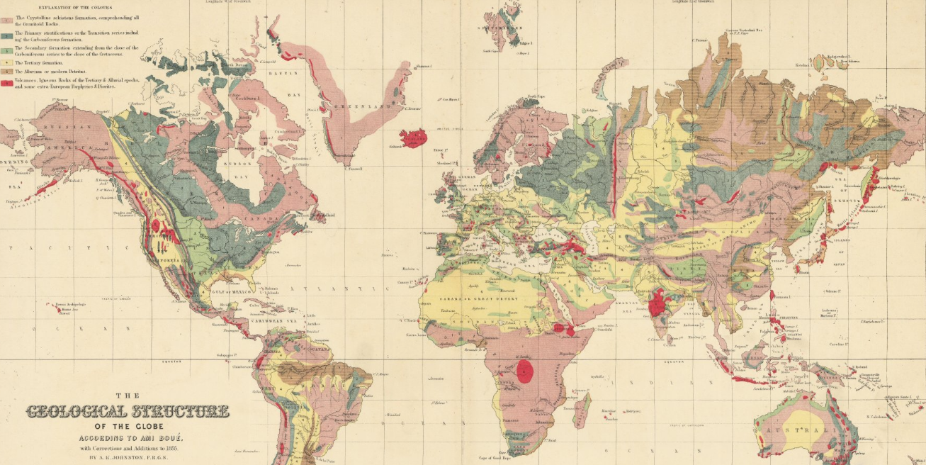


The "Where" matters:
Visualizing and presenting geoscientific data
beyond the spreadsheet
Boué (1841)
Dr Eloi González-Esvertit (GEO3BCN-CSIC, Spain)
egesvertit@geo3bcn.csic.es

Slide 2
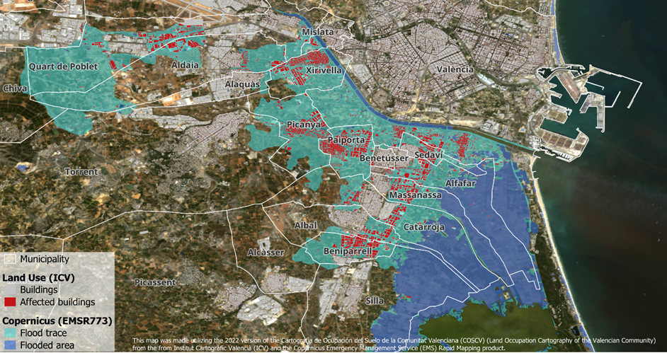
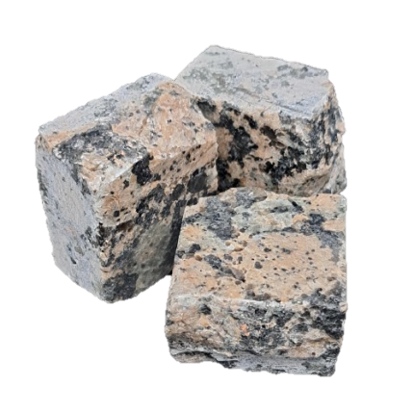

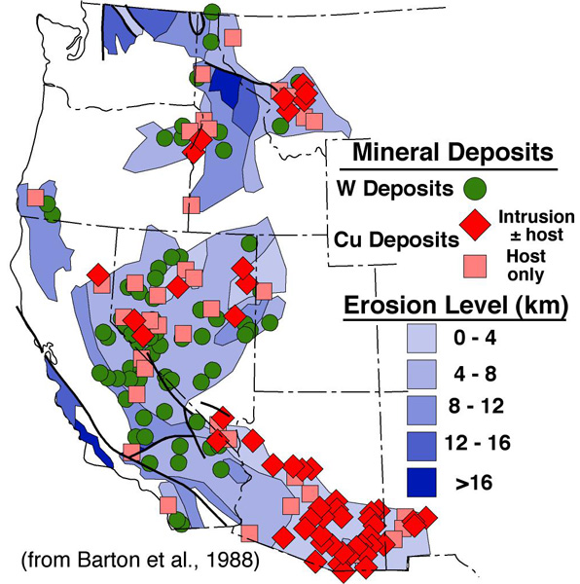
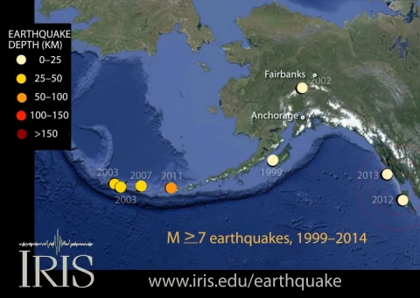
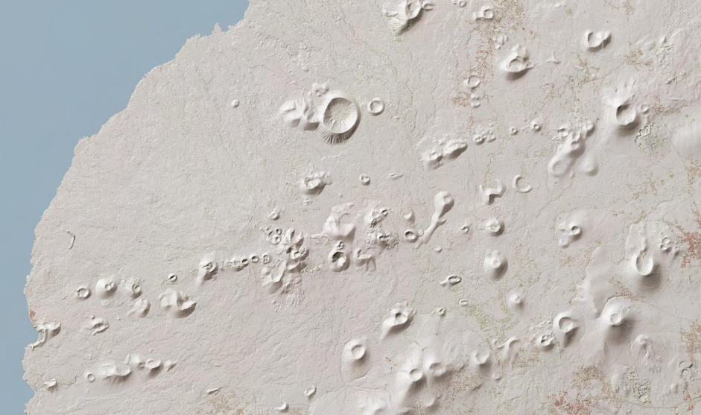



WHY THE “WHERE” MATTERS SO MUCH?
Most geoscientific data has a spatial component
Hand samples
Flood extents
Ore deposits
Earthquakes
Volcanoes
Sediment cores

Slide 3
THE PHYLOSOPHY BEHIND MAPS
To address geoscientific problems, we make maps
Cartography is the science (and art) of making maps
Maps are always simplifications of reality, which makes them helpful when making decisions or explaining patterns
Maps are designed by us, “people”, who have (not always good) intentions and interests, so we must create them responsibly
Geographic Information Systems (GIS)
“A system for
capturing, storing, checking, integrating, manipulating, analyzing and displaying
spatial data”
From: Designing Better Maps: A Guide for GIS Users by Cynthia A. Brewer

Slide 4
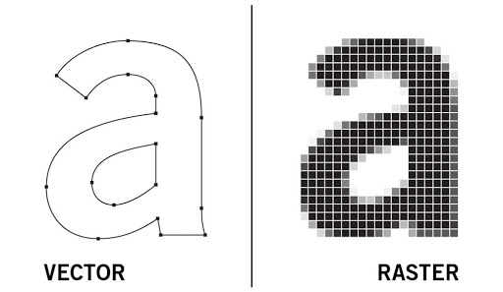
KNOW YOUR DATA (AND ITS POTENTIAL)
Data types
Vectors are composed of coordinates
Rasters are composed of pixels
defined borders
continuous surface
From: MIT Geographic Information Systems course

Slide 5
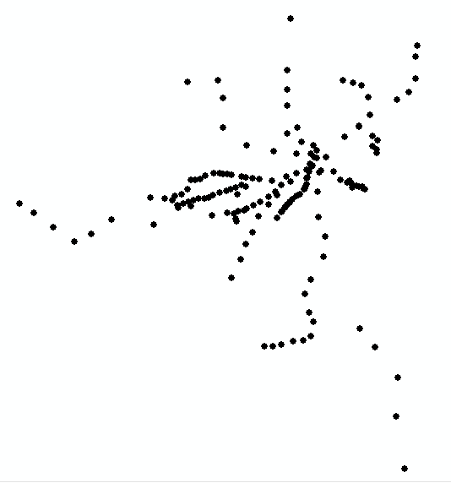
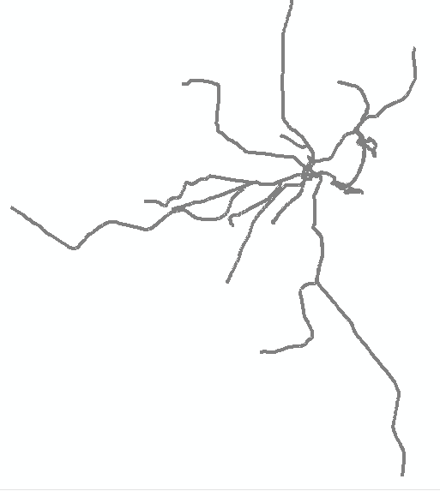
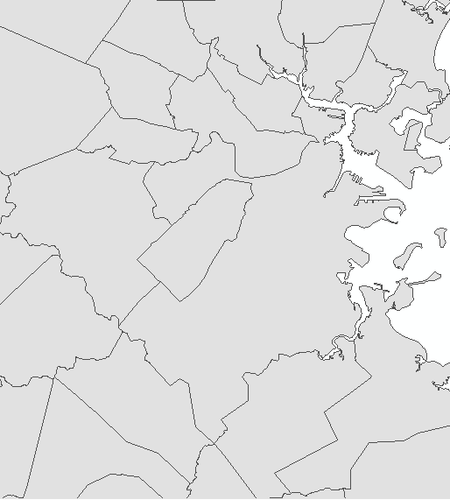
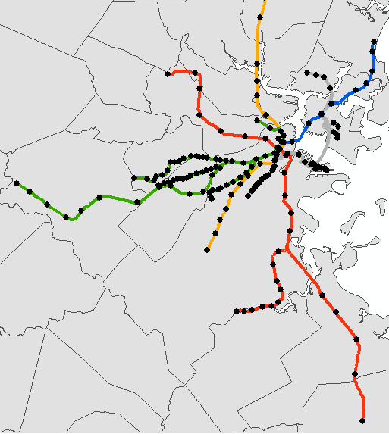
KNOW YOUR DATA (AND ITS POTENTIAL)
Data types: vector layers
Points
Lines
Polygons
Combined
From: MIT Geographic Information Systems course

Slide 6
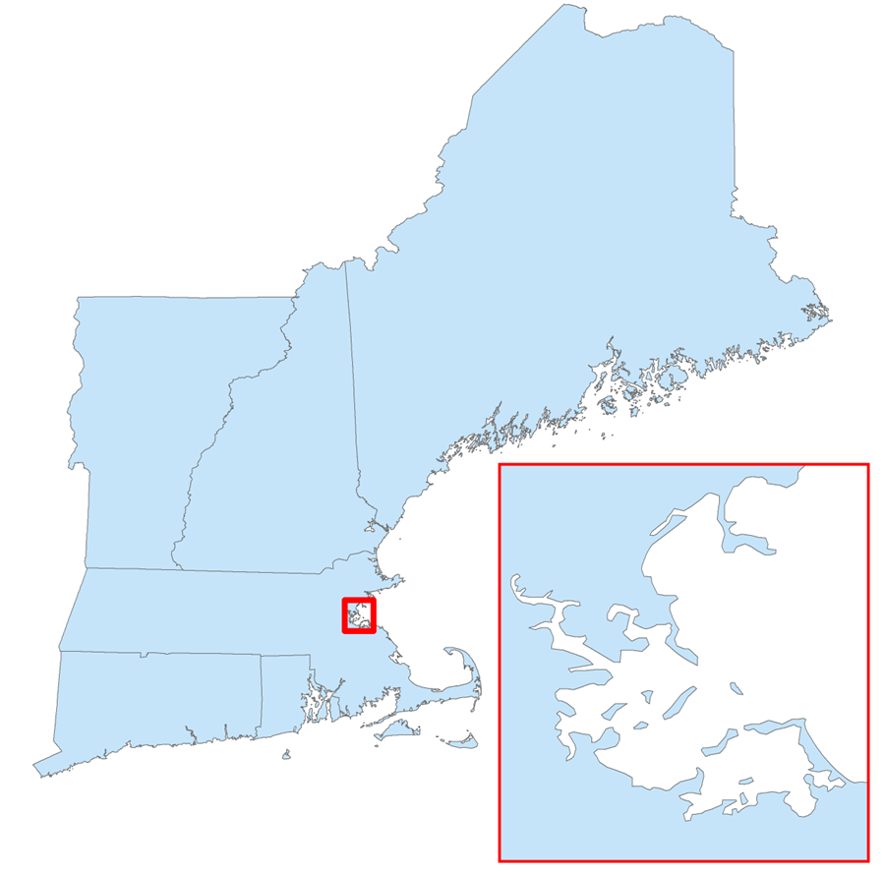
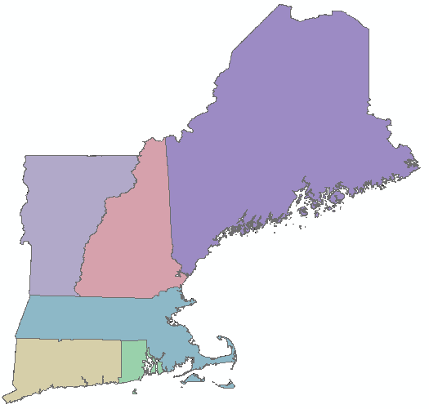
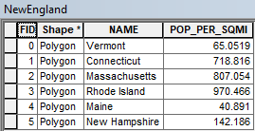
KNOW YOUR DATA (AND ITS POTENTIAL)
Data types: vector layers
Frontend
geometry
Backend
database
From: MIT Geographic Information Systems course

Slide 7
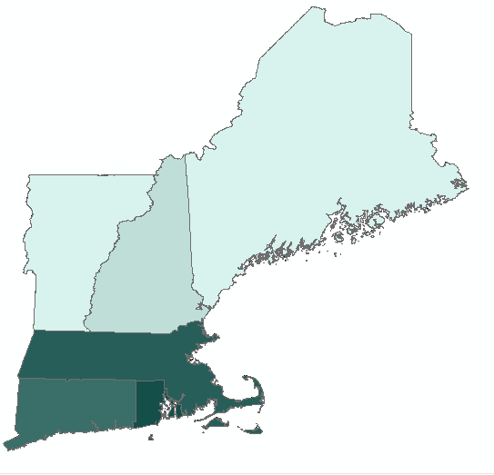
KNOW YOUR DATA (AND ITS POTENTIAL)
Data types: vector layers
Frontend
geometry
Backend
database
From: MIT Geographic Information Systems course

Slide 8
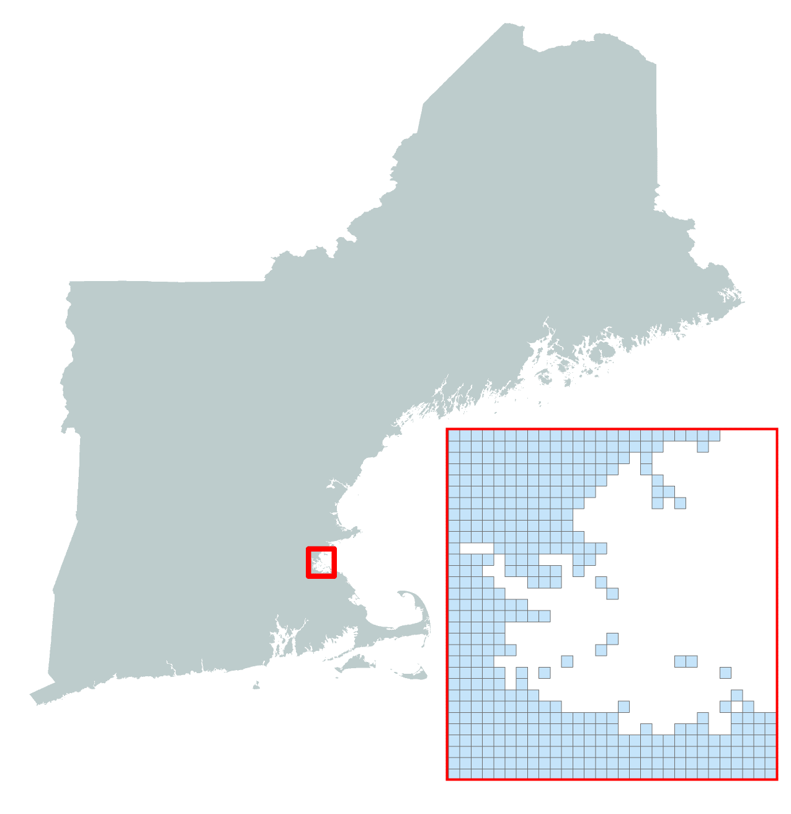
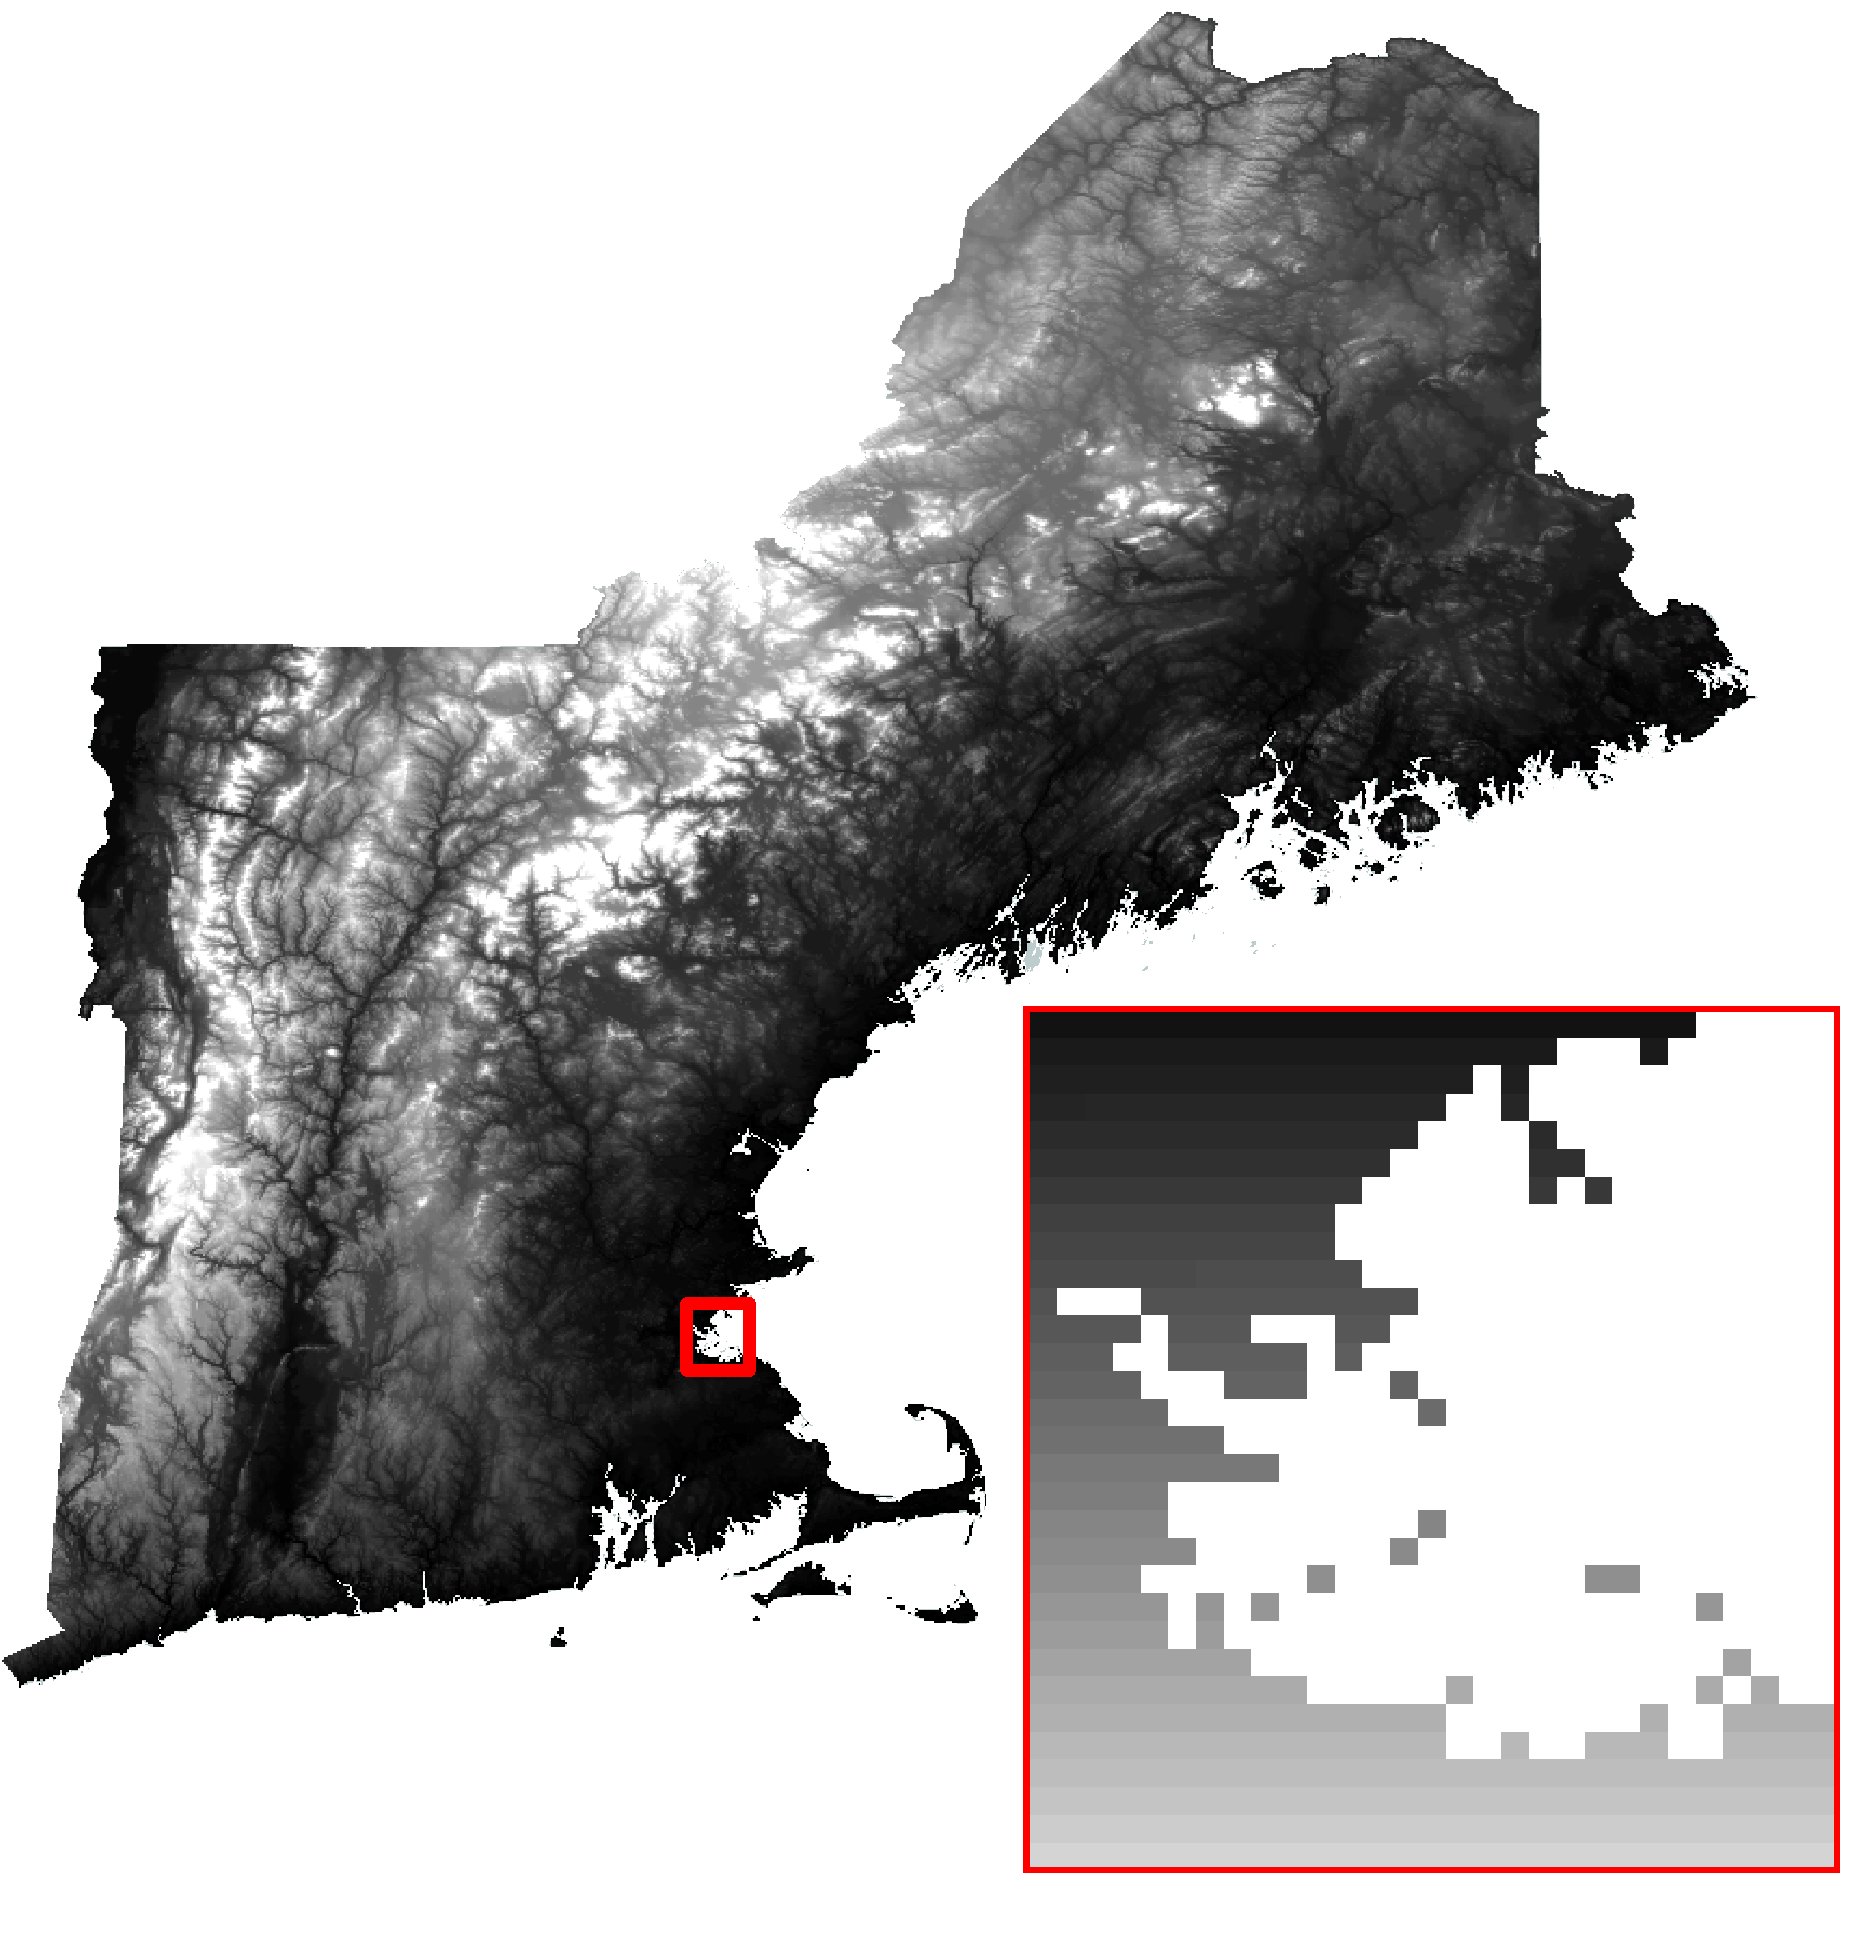
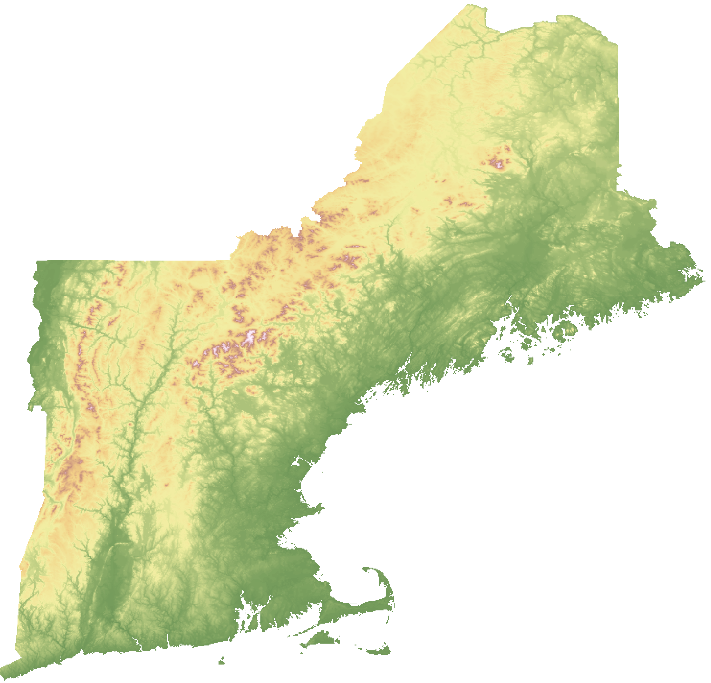
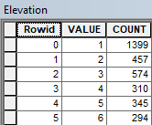
KNOW YOUR DATA (AND ITS POTENTIAL)
Data types: raster layers
Frontend
Cell matrix
Backend
database
From: MIT Geographic Information Systems course

Slide 9
THREE PHASES
A GIS does not come with its own data. We need to get ours by looking around
1
Open data portals and repositories:
Data obtention
2
GIS / Mapping Softwares:
Data analysis
3
GIS / Mapping Softwares:
Data presentation & visualization
From: Designing Better Maps: A Guide for GIS Users by Cynthia A. Brewer

Slide 10
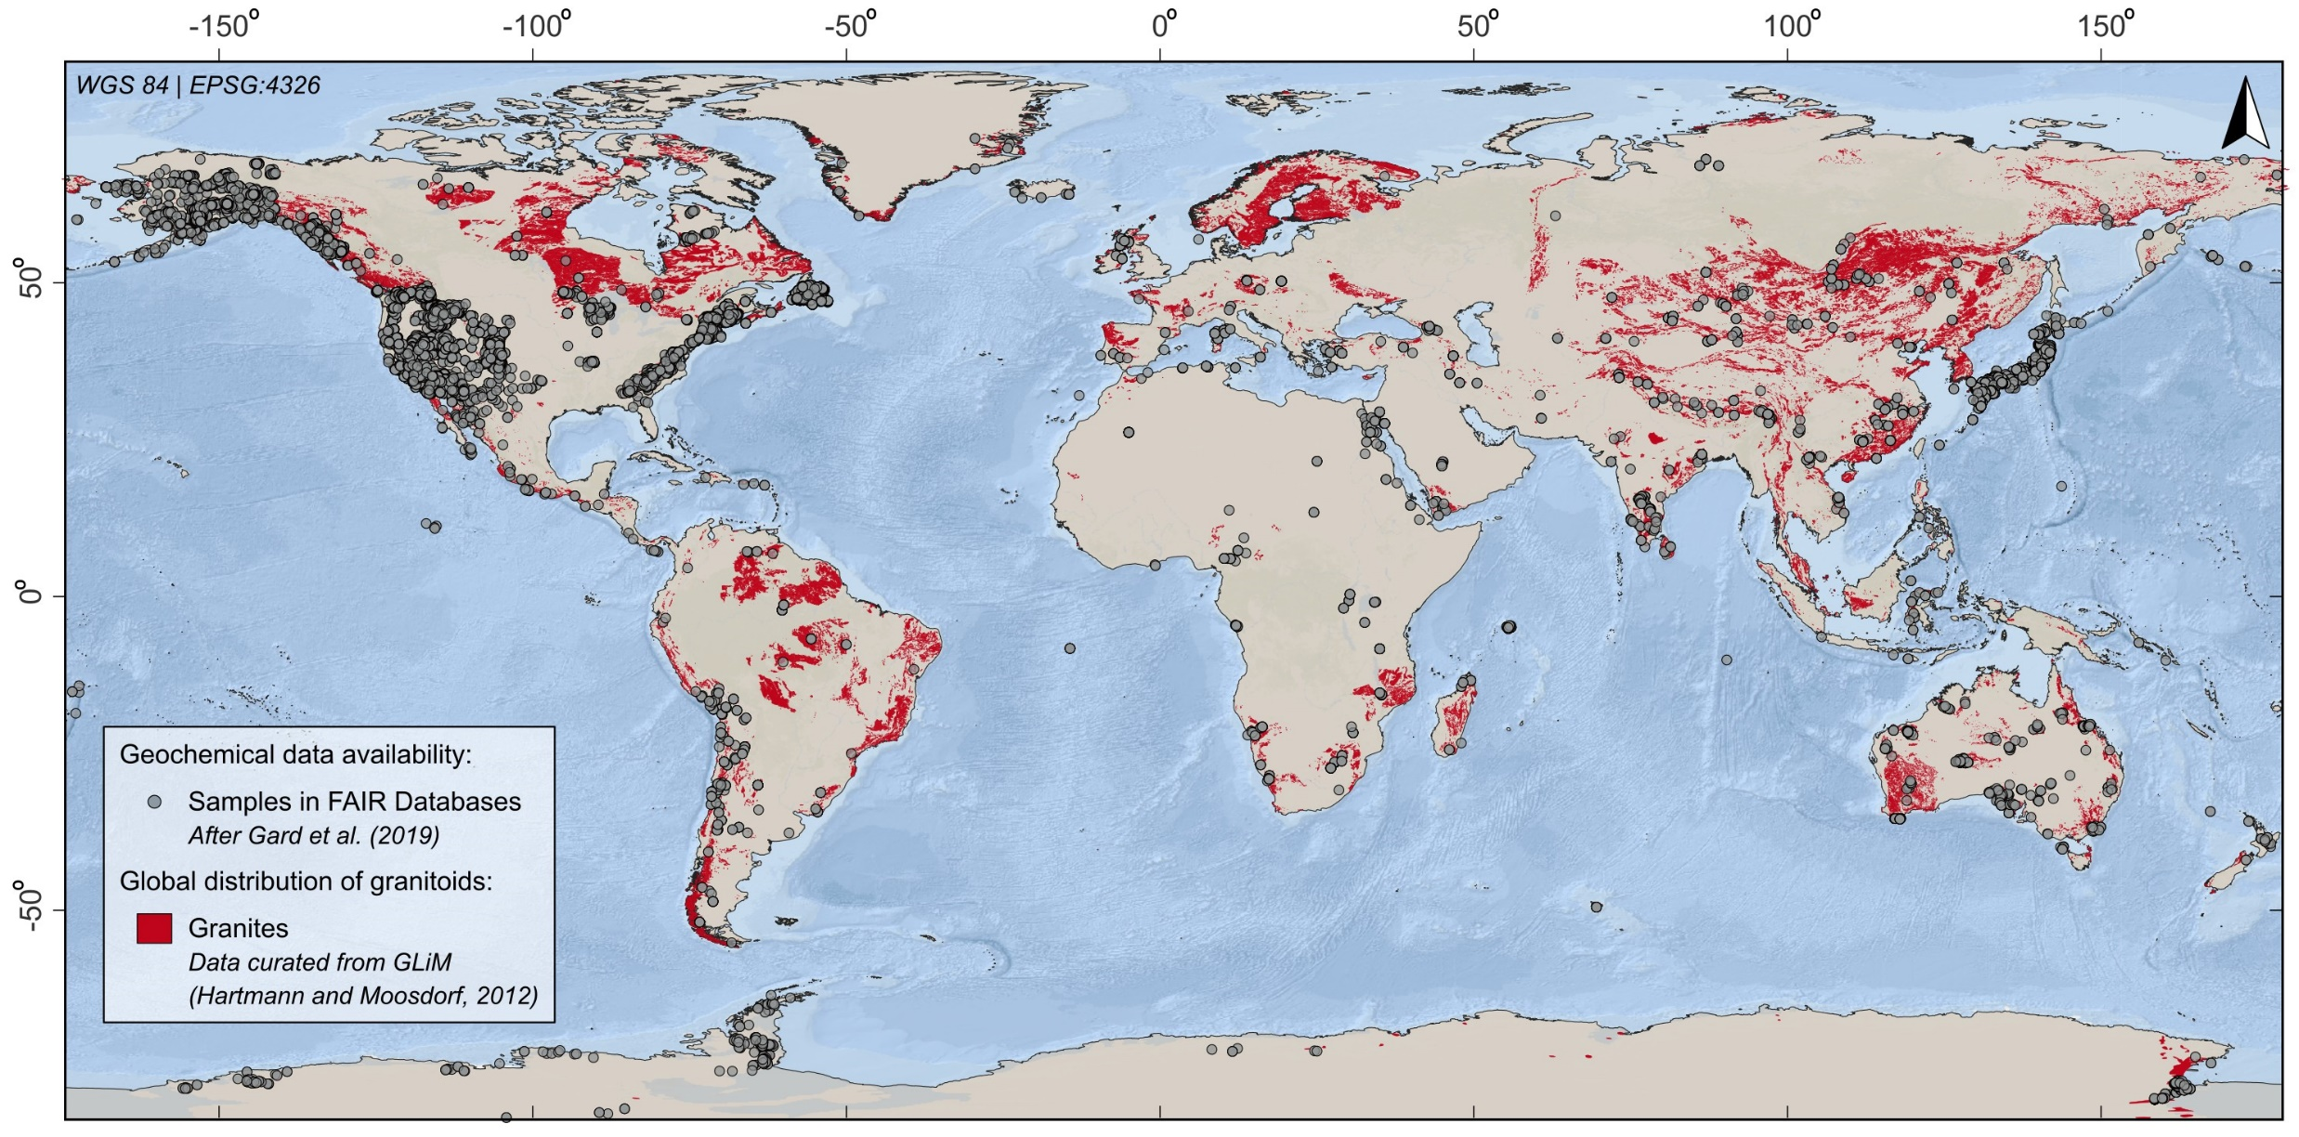
PHASE 1: Data obtention and preparation
Where comes the data from? Open data portals (i.e., platforms where data is published openly and in a standardized manner)
Example 1: Mapping the extension and geochemical data of granites
González-Esvertit et al. (2025): ESR – Basemap: ESRI ® Ocean

Slide 11
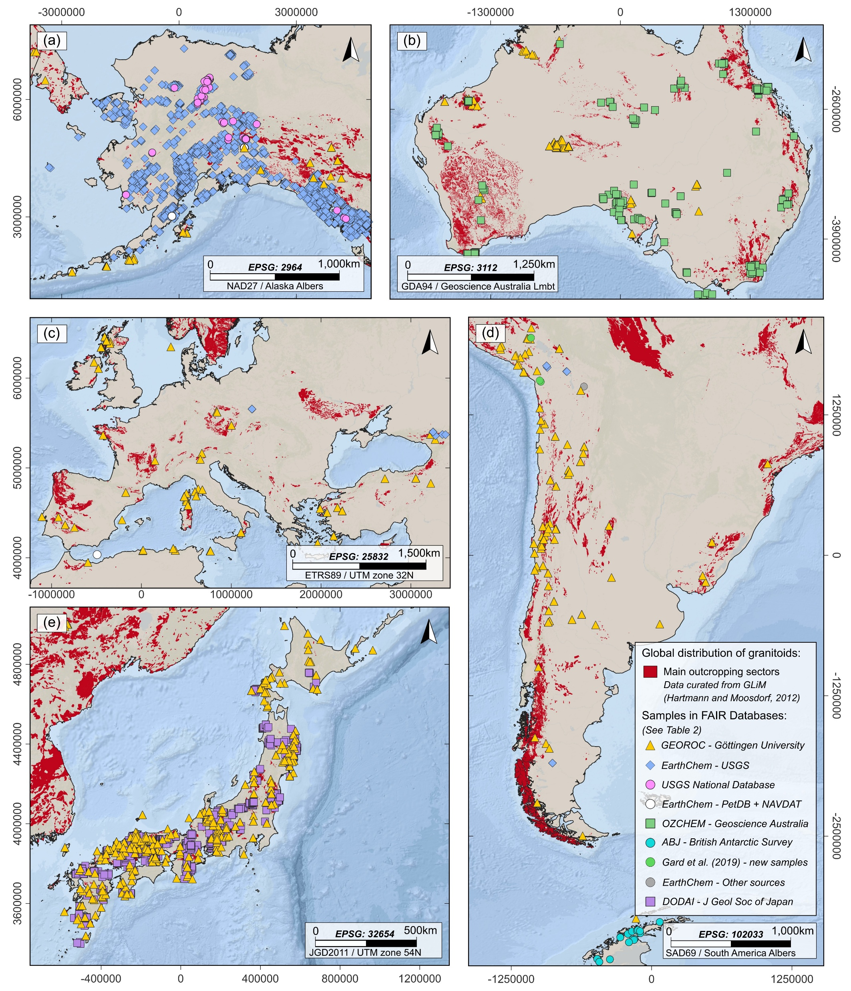
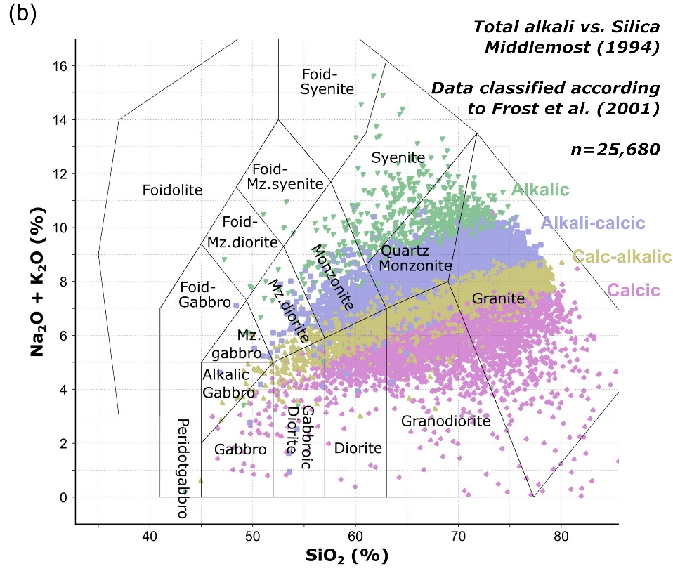
PHASE 1: Data obtention and preparation
Open data portals: care must be taken (!)
Example 1: Geochemical data of granites
González-Esvertit et al. (2025): ESR – Basemap: ESRI ® Ocean

Slide 12
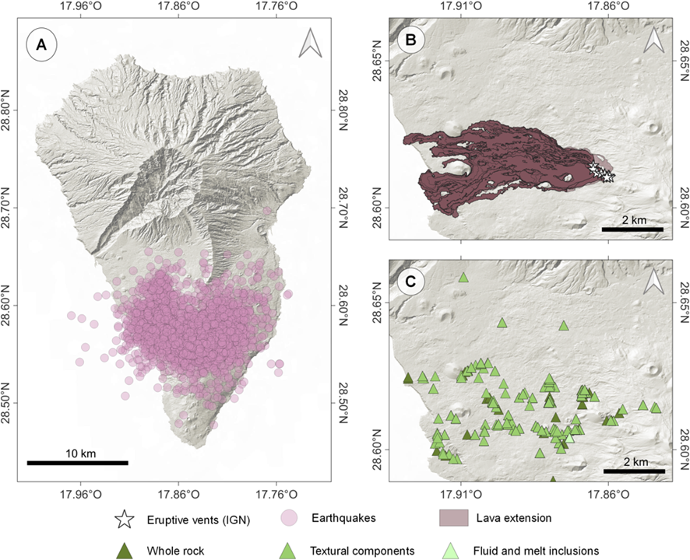
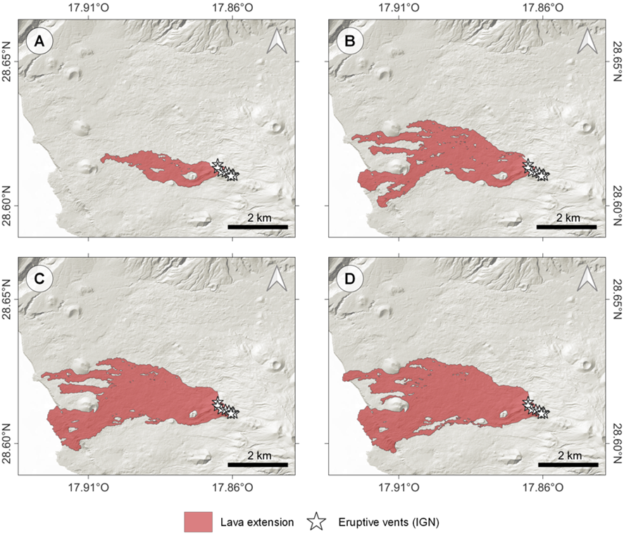
PHASE 1: Data obtention and preparation
Open data portals (i.e., platforms where data is published openly and in a standardized manner)
Example 2: Multidisciplinary data for integrated evaluation of a volcanic eruption – Needs careful source selection
Time-dependent (!)
Sept 27th, 2021
Oct 21st, 2021
Nov 19th, 2021
Dec 13th, 2021
BSc thesis Carles Dols [University of Barcelona]

Slide 13
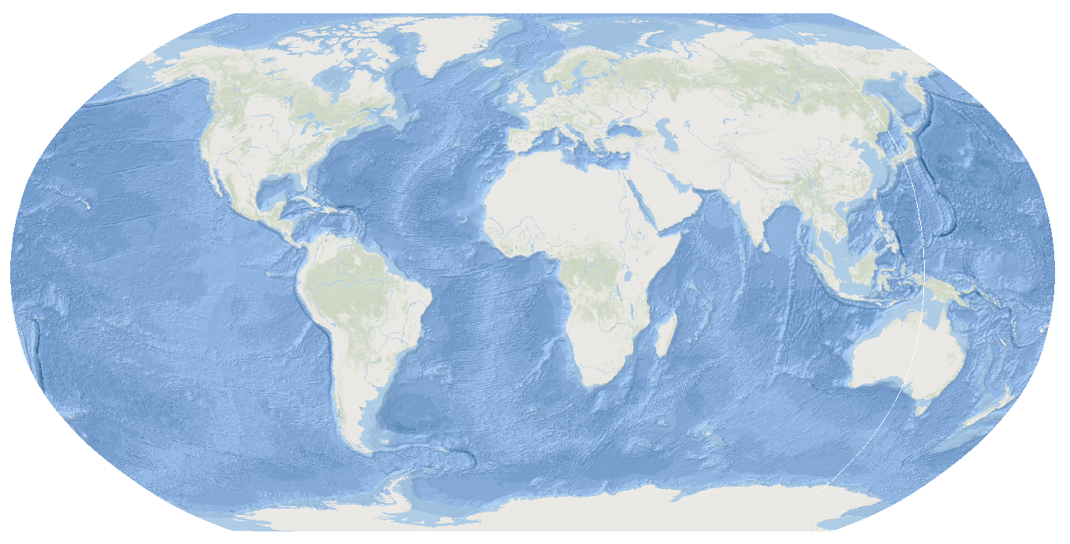
PHASE 2: Geographic data analysis
Every process during data analysis must have: (1) a reason, (2) an input, and (3) an output
Example 3: Time-independent; Global MOHO (crust-mantle boundary) depth
González-Esvertit et al. (in prep.)

Slide 14
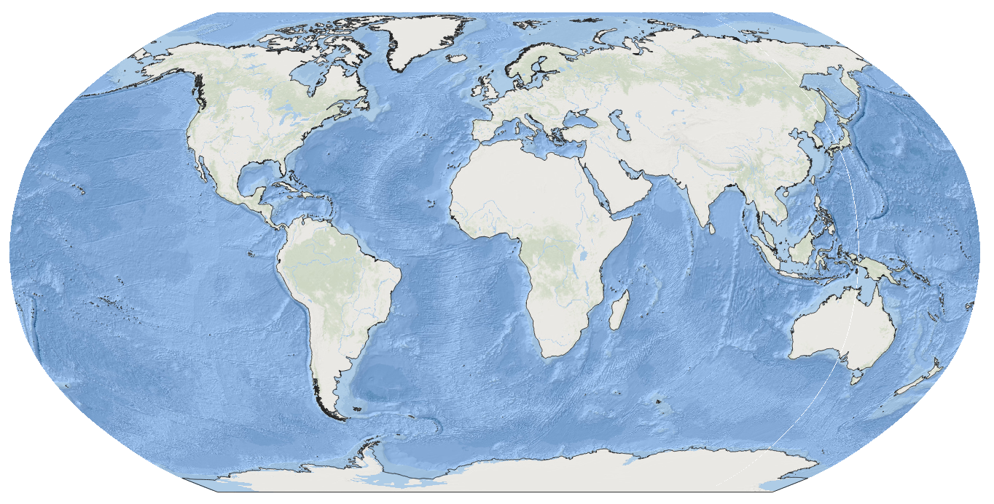
PHASE 2: Geographic data analysis
Every process during data analysis must have: (1) a reason, (2) an input, and (3) an output
Example 3: Time-independent; Global MOHO (crust-mantle boundary) depth
González-Esvertit et al. (in prep.)

Slide 15
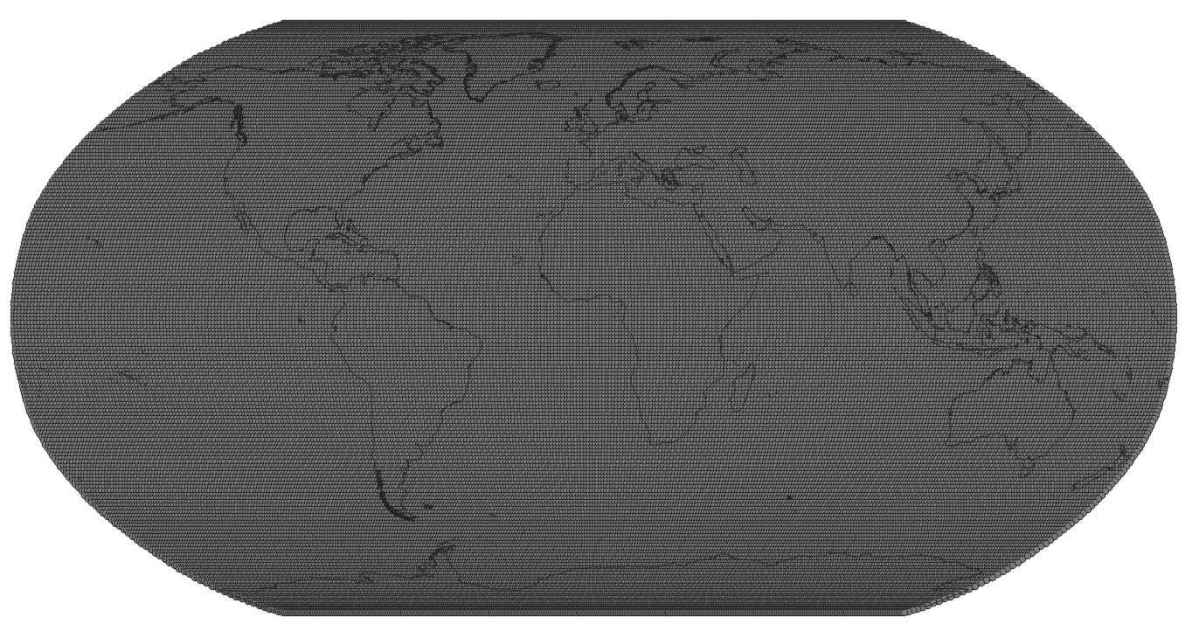
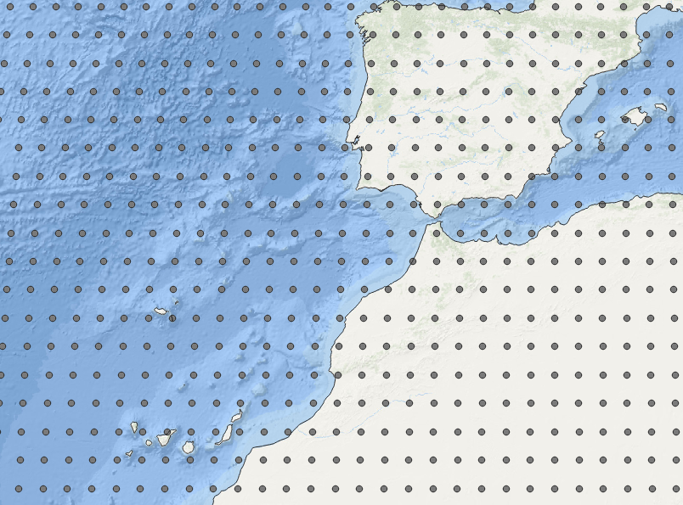
PHASE 2: Geographic data analysis
Every process during data analysis must have: (1) a reason, (2) an input, and (3) an output
Example 3: Time-independent; Global MOHO (crust-mantle boundary) depth
Depth to Moho boundary obtained by global non-stationary kriging of USGS GSC database of crustal studies
González-Esvertit et al. (in prep.)

Slide 16
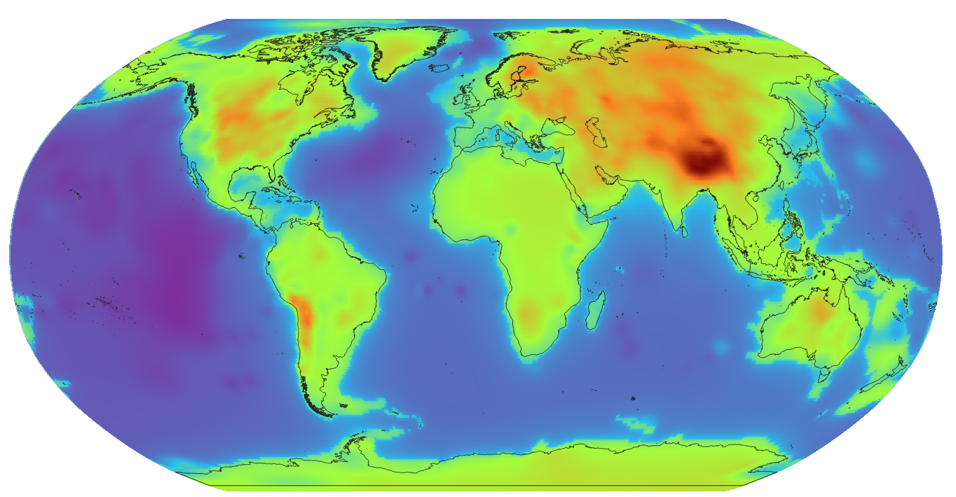
PHASE 2: Geographic data analysis
Every process during data analysis must have: (1) a reason, (2) an input, and (3) an output
Example 3: Time-independent; Global MOHO (crust-mantle boundary) depth
+53 km
González-Esvertit et al. (in prep.)
11 km

Slide 17
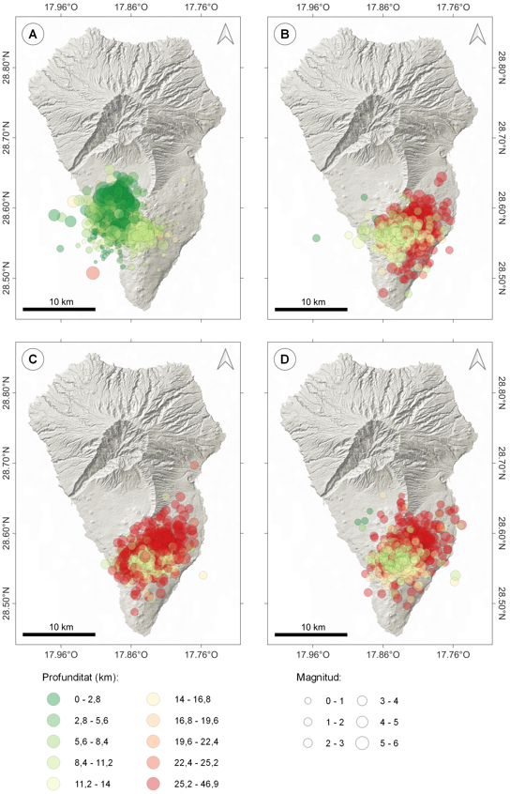
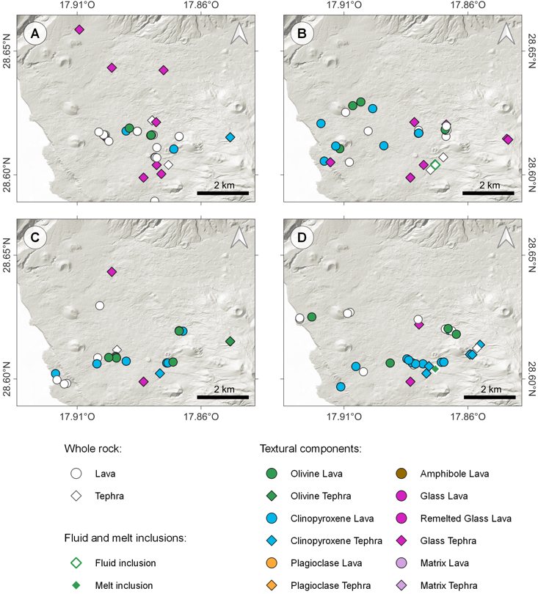
PHASE 2: Geographic data analysis
Every process during data analysis must have: (1) a reason, (2) an input, and (3) an output
Example 4: Time-dependent; Temporal evolution of volcanic crises
Sept 27th, 2021
Oct 21st, 2021
Sept 27th, 2021
Oct 21st, 2021
Nov 19th, 2021
Dec 13th, 2021
Nov 19th, 2021
Dec 13th, 2021
BSc thesis Carles Dols [University of Barcelona]

Slide 18
PHASE 3: Visualization and presentation
Maps are for the audience
Who wants the map?
  e.g., experts (detailed), students (contextual), the community (interactive)
Where will it be seen?
  e.g., 8 x 11 paper (static small, room for main points)
  e.g., 30 x 40 poster board (static large, room for detail)
  e.g., web map (interactive, users control navigation of map)
What is its purpose?
  e.g., to show a variable through time (time series)
  e.g., to show change over time (change detection)
  e.g., to combine multiple variable into an index to pick best/worst (sustainability/risk/vulnerability mapping, site selection)
EACH QUESTION DESERVES A WELL-THOUGHT ANSWER BEFORE MAPPING

Slide 19

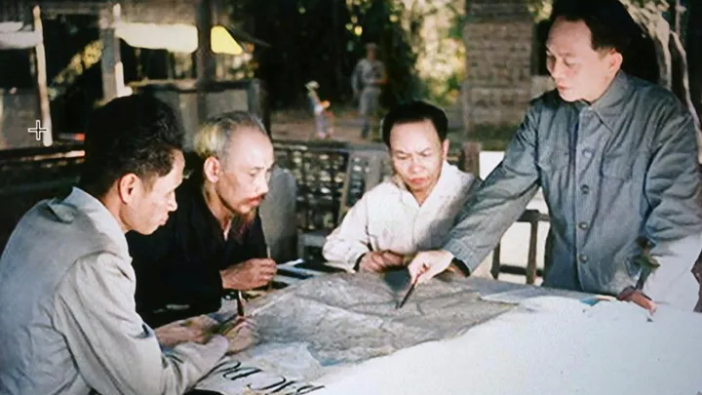
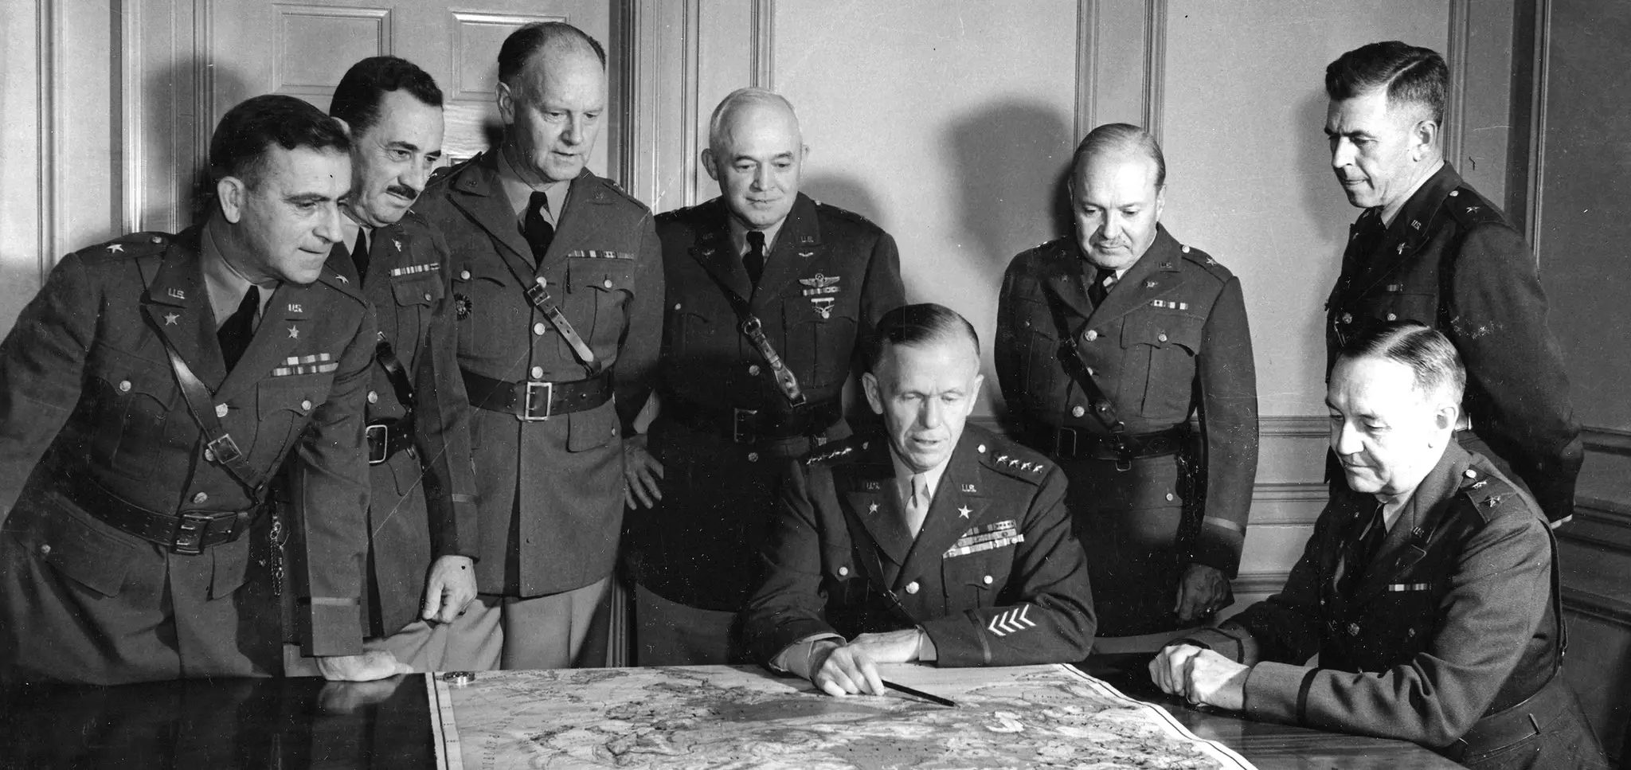
PHASE 3: Visualization and presentation
Responsibility: maps are weapons
In the past, only those in power had the technology and data to create maps…
Ho Chi Minh and Vo Nguyen Giap prepare to lead the Viet Minh against the French at Dien Bien Phu on May 7, 1954
Gen. George C. Marshall, seated at center, with members of his general staff, November 1941. © New York Times
US Army Map-Chart division, 1942

Slide 20
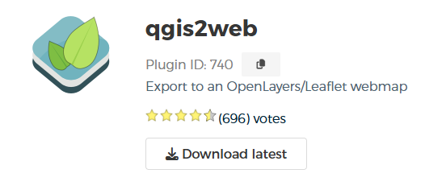
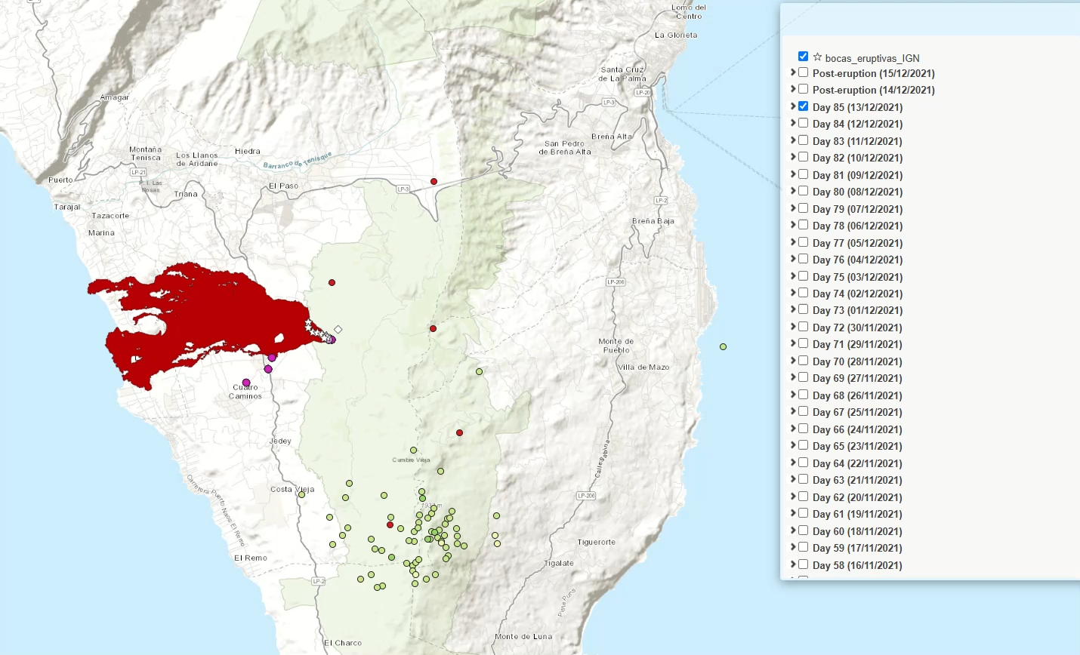
PHASE 3: Visualization and presentation
Interoperability: make maps interactive!
BSc thesis Carles Dols [University of Barcelona]

Slide 21
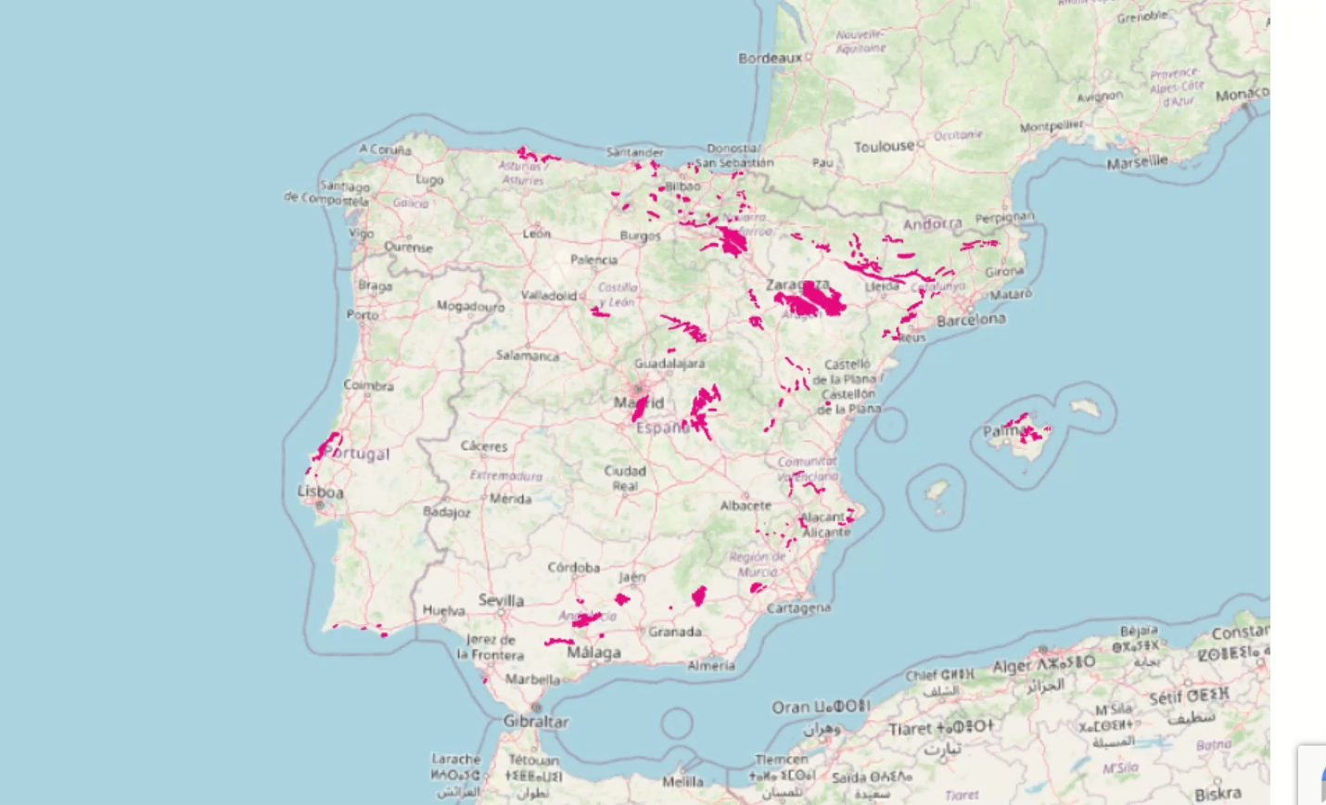
PHASE 3: Visualization and presentation
Interoperability: make maps interactive!
González-Esvertit et al. (2023): ESSD – Basemap: OSM Std

Slide 22
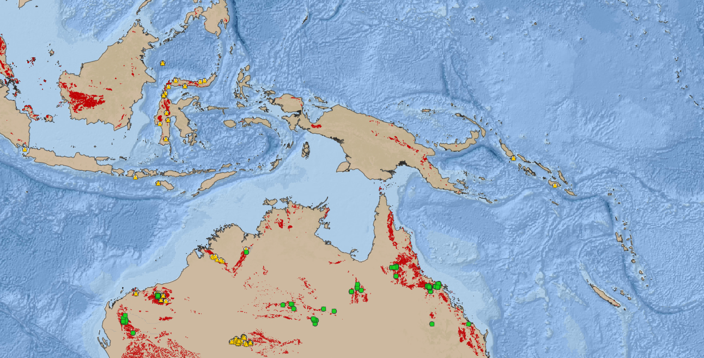
TAKE-HOME MESSAGES
Understanding and geolocating your data it's fundamental to deriving meaningful insights and interpreting phenomena
Every step of GIS analysis must have a reason and should consider data types and input/output formats
Creating maps involves
responsibility

Slide 23
YOUR TURN: SHARE YOUR EXPERIENCE!

Slide 24
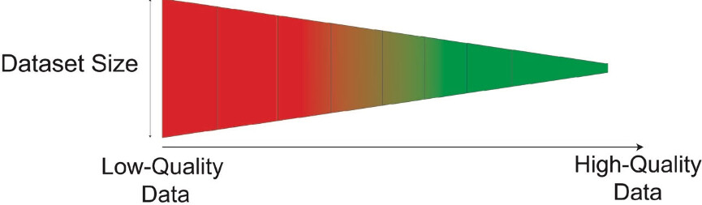
YOUR TURN: SHARE YOUR EXPERIENCE!
When you see a map in a presentation or a paper, what's one thing that always helps you understand it better, or one thing that usually confuses you?
How important is the “where” of your data?
Can you draw your own “equilibrium” line for your research?
Equilibrium

