Slide 1
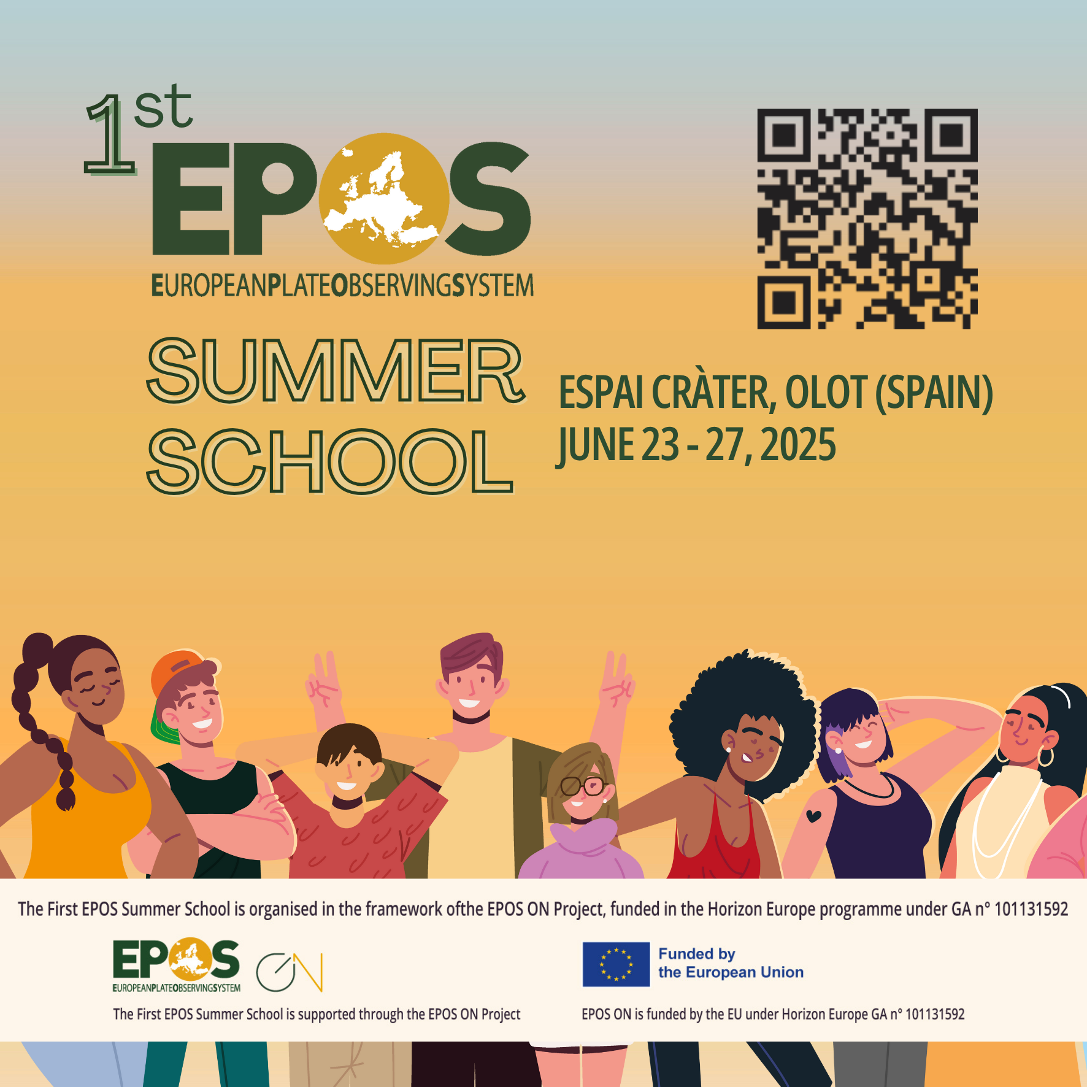
Introducing EPOS
Federica Tanlongo| federica.tanlongo@epos-eric.eu
Notes:
Title slide

Slide 2
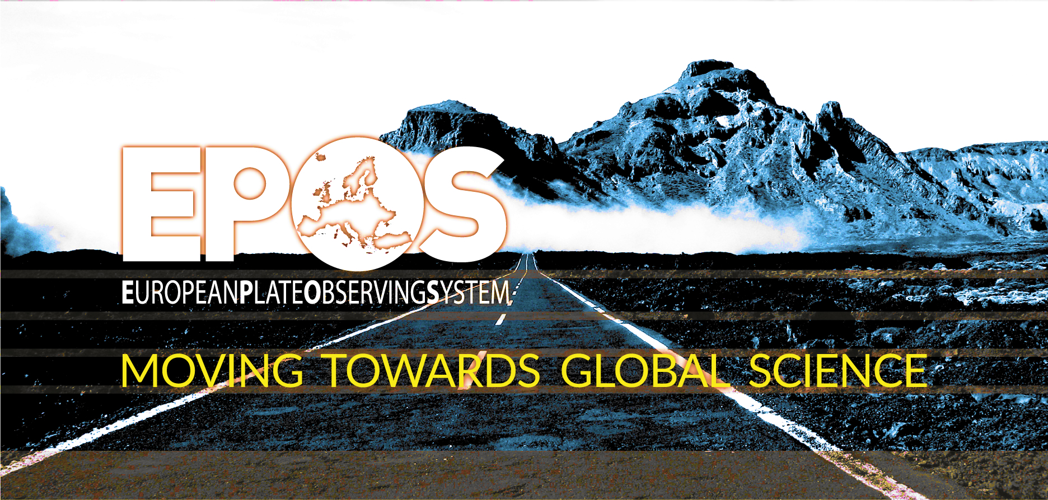
The EPOS vision: To ensure sustainable and universal use and re-use of multidisciplinary solid Earth science data and products fostering state-of-the-art research and innovation.
Notes:
I would like to introduce EPOS starting from its vision to ensure sustainable and universal use and re-use of multidisciplinary solid Earth science data and products to foster state-of-the-art research and innovation, and its vision to do so by integrating diverse research infrastructures in Europe under a common federated approach…

Slide 3
The EPOS vision: To ensure sustainable and universal use and re-use of multidisciplinary solid Earth science data and products fostering state-of-the-art research and innovation.
…And mission: To establish a sustainable and long-term access to solid Earth science data and services integrating diverse European Research Infrastructures under a common federated framework
Notes:
I would like to introduce EPOS starting from its vision to ensure sustainable and universal use and re-use of multidisciplinary solid Earth science data and products to foster state-of-the-art research and innovation, and its vision to do so by integrating diverse research infrastructures in Europe under a common federated approach…

Slide 4
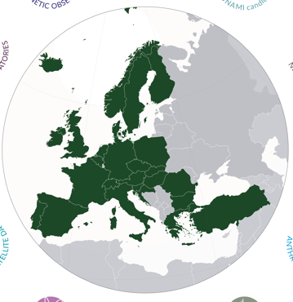
EPOS - European Plate Observing System
Designed and established as the only European Research Infrastructure for solid Earth science (operated by an ERIC)
Brings together European Countries and aggregates research communities around the paradigm of Open Science
Integrate the fragmented scientific Data generated across Europe and across disciplines making them universally accessible (EPOS Platform)
Enable excellent science
Support scientists in developing tool for societal safety against natural and anthropogenic hazards and addressing global challenges
515 Data and Service Providers
172 Research Organisations
26 European Countries
10+ Scientific communities
5 International Organizations
ORFEUS, EMSC, EGS, ESA, EUREF

Slide 5
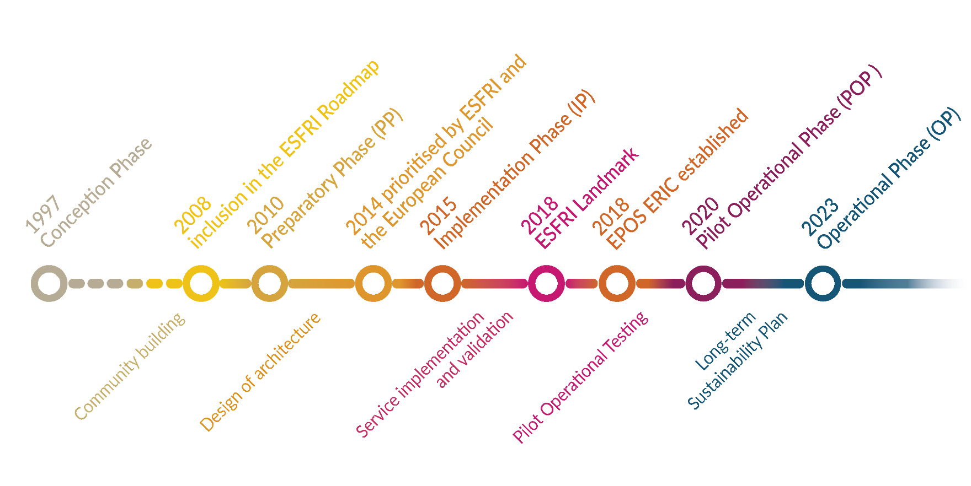
A long journey…
Notes:
The journey to reach this (moving) target has been a long one, with the initial conception of the infrastructure dating back to the mid nineties and the shift to full operation atb the beginning of 2023…

Slide 6
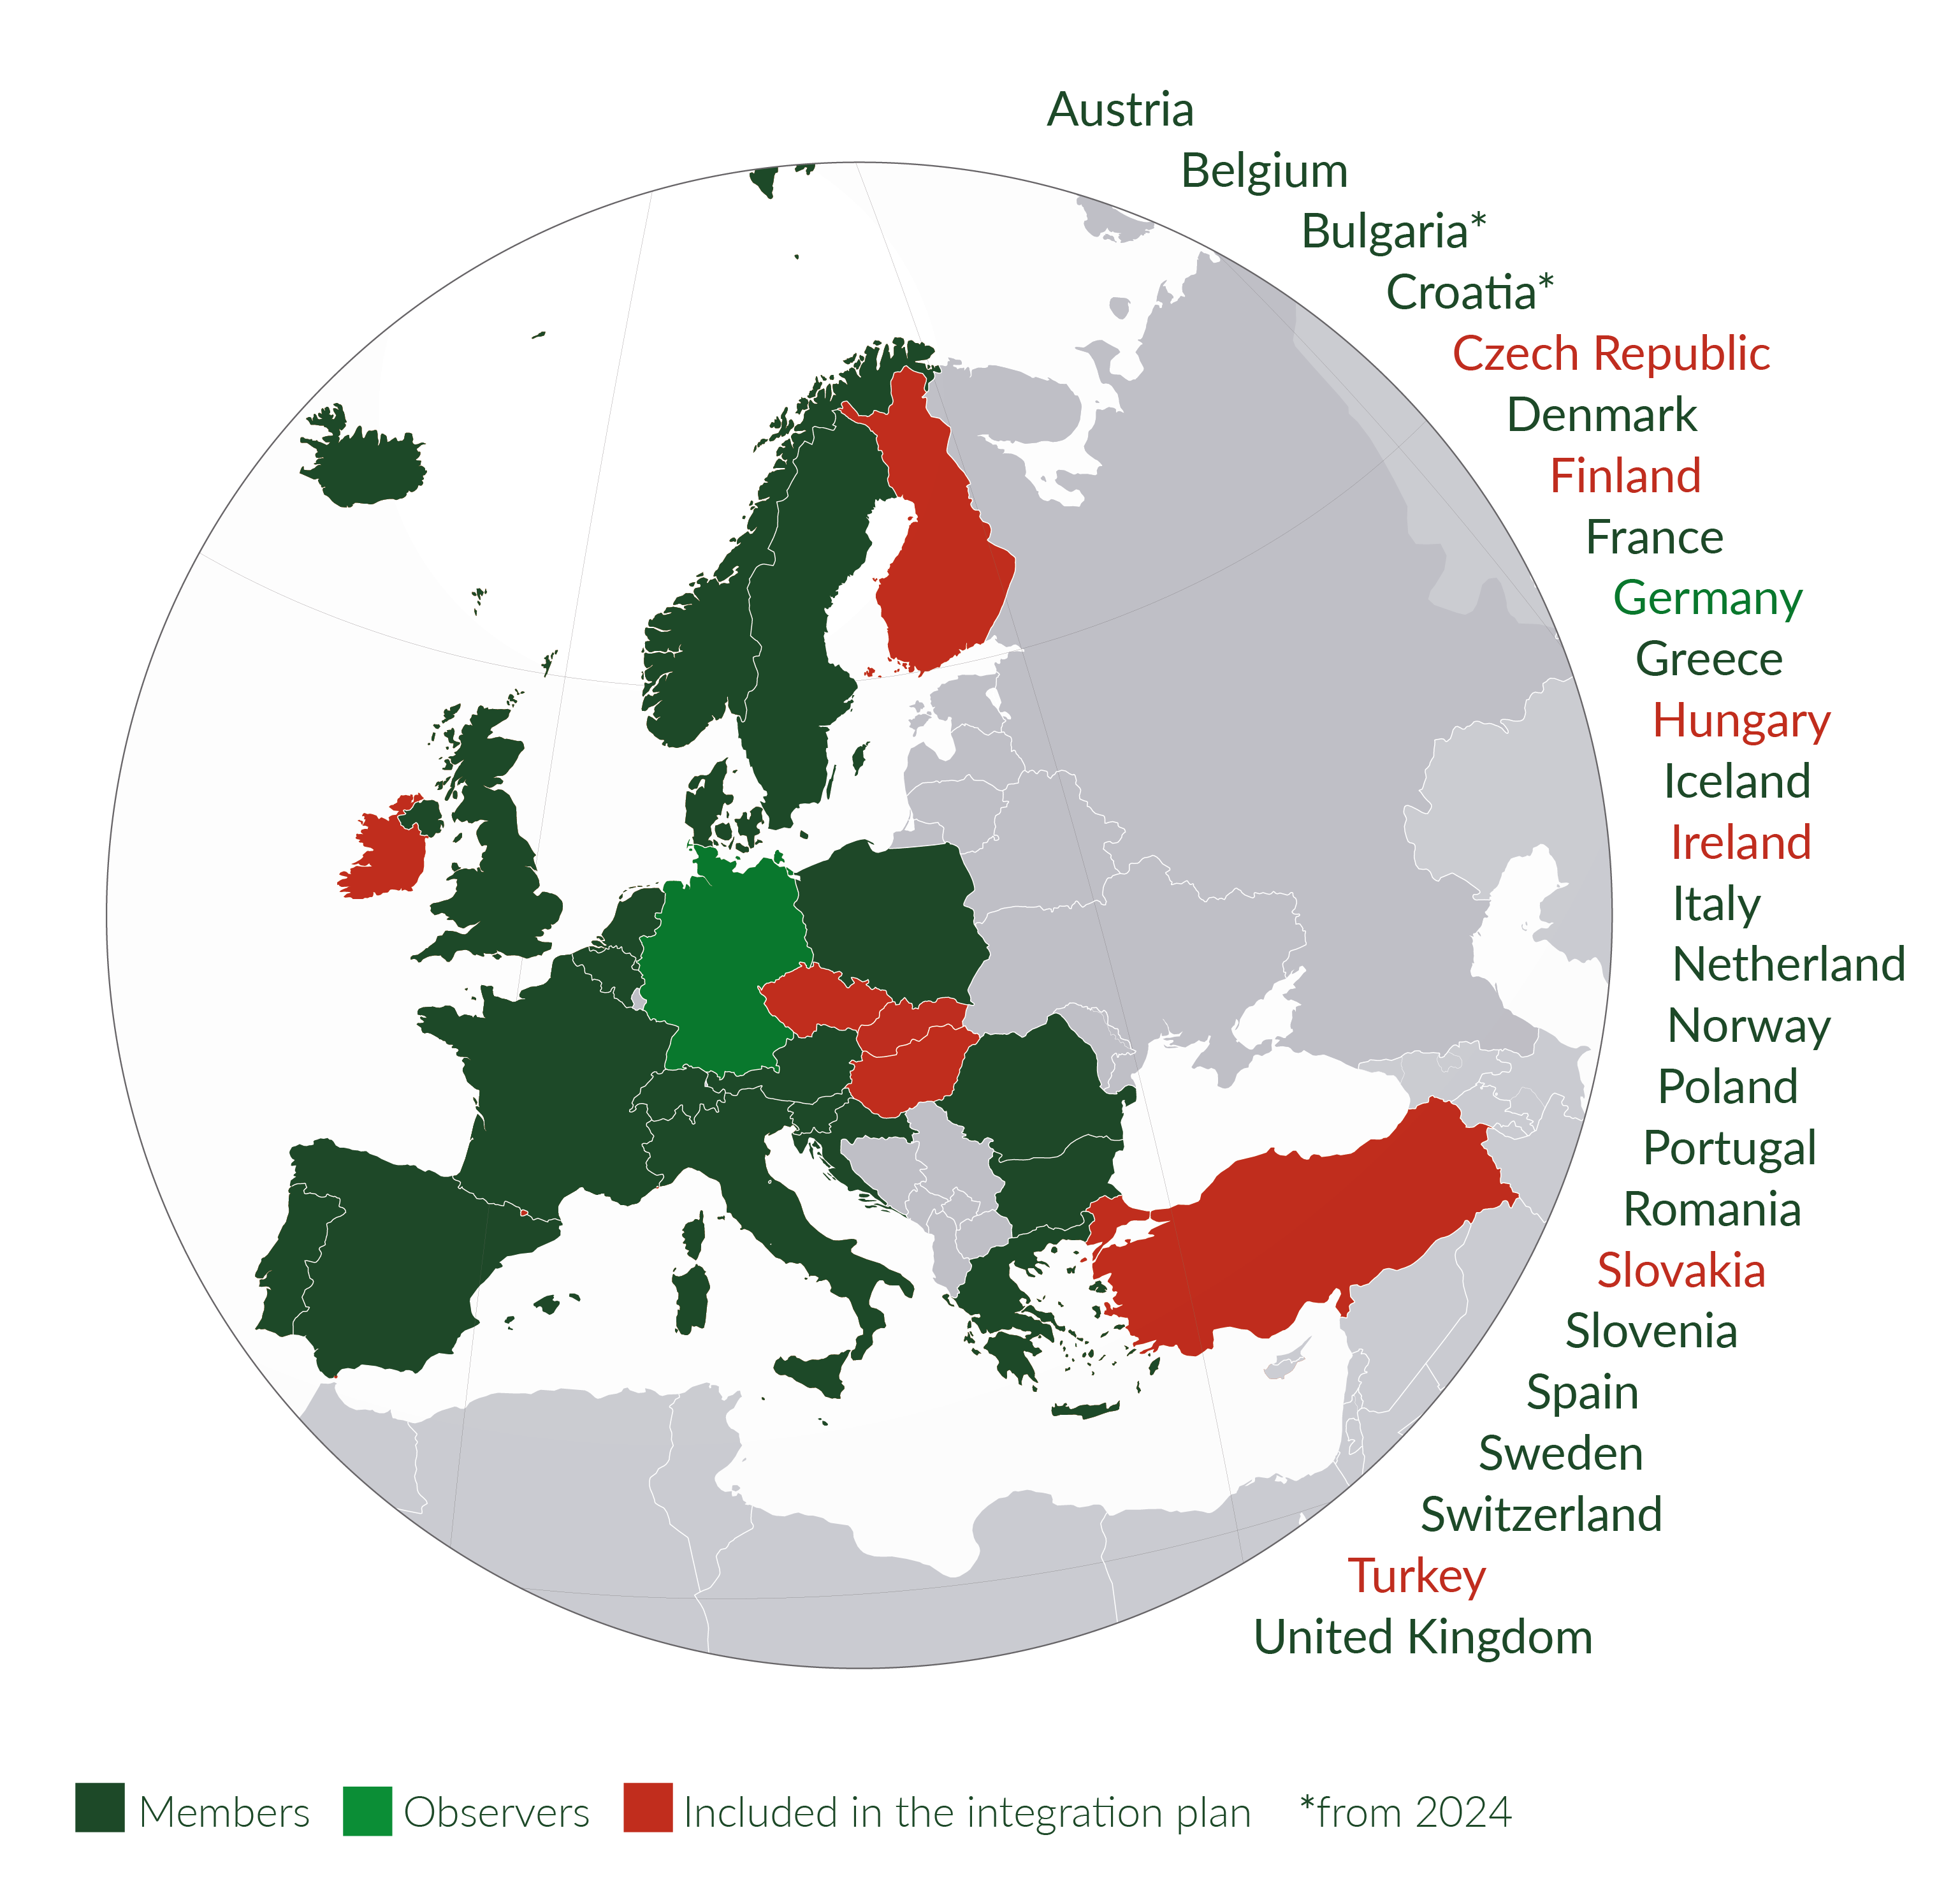
A pan-European infrastructure…
Operated by an ERIC joined by 20 countries
The General Assembly, composed of ministry representatives of Members* is the decision body
The Legal Seat is in Italy (INGV, Rome)
Overall, EPOS ERIC ensures joint strategies to achieve scientific and technological innovation across all stakeholders involved, and tackles sustainability with harmonized approaches
*List of ERIC Members:
https://www.epos-eu.org/epos-eric/epos-eric-members
In green country members (dark) and observers (light) of the ERIC
In red, countries not in the ERIC, but still participating to the EPOS Delivery Framework

Slide 7












…with a global vision
EPOS fosters international collaborations to serve the interest of science and society at global level
Europe
USA
Australia
New Zealand
Promote Open Science and FAIR principles at the global level to enable equitable and inclusive research
Activate a global network of collaborations to capitalize on joint investments and expertise
Federate research platforms to maximize the benefits of integrating multidisciplinary DATA to excellent science and innovation for responding to societal needs at global level

Slide 8
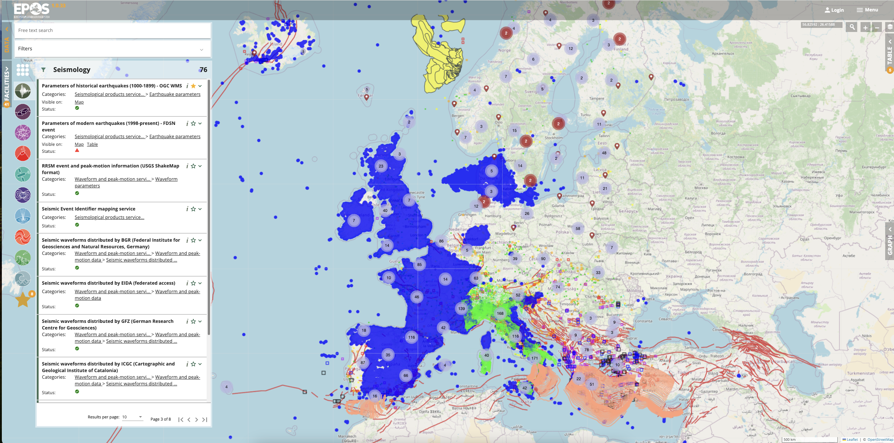
… And a single access point:
The EPOS multi-disciplinary Platform
One-stop shop platform enabling any user to openly access to standardized, interoperable, quality-controlled data from 10 different disciplines and >500 data sources around Europe
EPOS Platform is open source
The code is available to any user
https://epos-eu.github.io/epos-open-source
https://www.epos-eu.org/dataportal

Slide 9
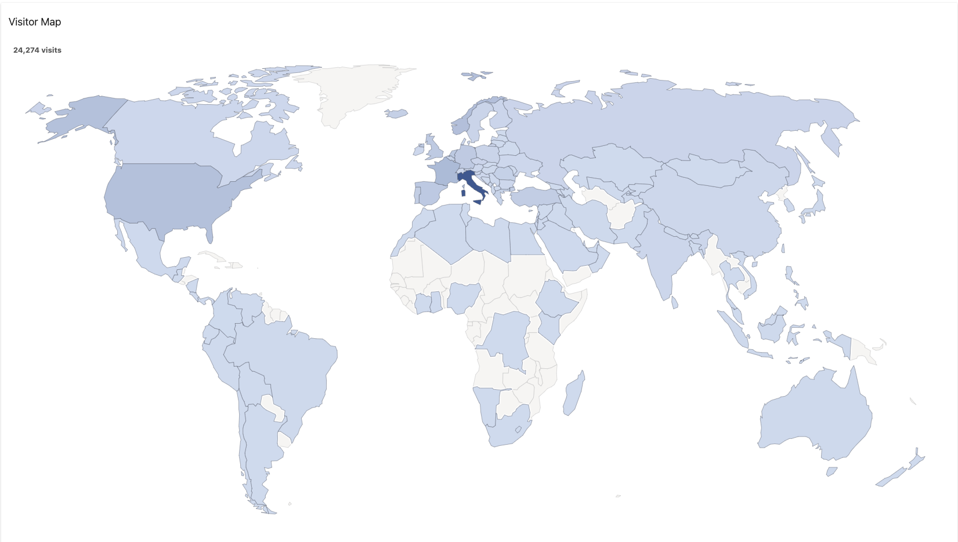
… And a single access point:
The EPOS multi-disciplinary Platform
One-stop shop platform enabling any user to openly access to standardized, interoperable, quality-controlled data from 10 different disciplines and >500 data sources around Europe
EPOS Platform is open source
The code is available to any user
https://epos-eu.github.io/epos-open-source
Global access to the EPOS Platform
26,056 visitors from 122 Countries
updated on September 19th 2024
https://www.epos-eu.org/dataportal

Slide 10
Thematic Core Services
EPOS is the reference RI for solid Earth science in Europe
10 solid Earth science domains are harmonized across EPOS into the Thematic Core Services (TCS)
TCS are transnational governance frameworks enabling community-specific integration and coordination across different domains in solid Earth science
TCS are designed to:
operate under a common governance at TCS level and within EPOS (Consortium Agreement)
provide the community-specific data /products / services
foster discussion and development of best practices for data harmonization and interoperability
ensure joint strategies to tackle scientific, technical, financial, legal and ethical issues
Inclusive and adaptive governance model
to manage the diverse scientific communities’ interests and operations
++

Slide 11












Geodesy and National Data Providers
In some countries, national (and sometimes regional) participation in EPOS is organised through participation to “national nodes”
Depending on the country, national nodes can take different forms:
  single existing organisations appointed at the ministry level,
  Joint Research Units
  Consortia
  Nationally funded projects…
They have a key role in involving and engaging with data providers and ensure the provision of quality-controlled data from authoritative national sources
Data ownership remains with the data provider, and the same apply to data curation responsibilities. Through EPOS, data are distributed and made discoverable across disciplines. Proper citation of data and service providers is part of the EPOS’ data policy

Slide 12
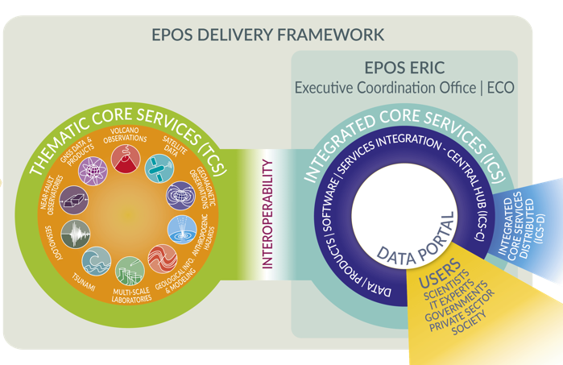
From Strategy to Practice: collaborating in the EPOS ecosystem
DATA Integration
DATA Access

Slide 13

From Strategy to Practice: collaborating in the EPOS ecosystem
EPOS has been built by assembling key elements
to allow the whole system to work as a single, but distributed, sustainable research infrastructure
DATA Integration
DATA Access
NRIs and other organisations generate and manage data for science and society

Slide 14
From Strategy to Practice: collaborating in the EPOS ecosystem
EPOS has been built by assembling key elements
to allow the whole system to work as a single, but distributed, sustainable research infrastructure
DATA Integration
DATA Access
NRIs and other organisations generate and manage data for science and society
TCS provide the governance framework necessary to ensure
that data and metadata, from different sources and in different formats,
are harmonised and made accessible through services on the Platform

Slide 15
From Strategy to Practice: collaborating in the EPOS ecosystem
EPOS has been built by assembling key elements
to allow the whole system to work as a single, but distributed, sustainable research infrastructure
DATA Integration
DATA Access
ICS integrate data and services and make them FAIRly accessible through a single-access point
NRIs and other organisations generate and manage data for science and society
TCS provide the governance framework necessary to ensure
that data and metadata, from different sources and in different formats,
are harmonised and made accessible through services on the Platform

Slide 16
From Strategy to Practice: collaborating in the EPOS ecosystem
EPOS has been built by assembling key elements
to allow the whole system to work as a single, but distributed, sustainable research infrastructure
DATA Integration
DATA Access
ICS integrate data and services and make them FAIRly accessible through a single-access point
NRIs and other organisations generate and manage data for science and society
users exploit the EPOS Platform to
access, visualise, combine, download data from different scientific domains
TCS provide the governance framework necessary to ensure
that data and metadata, from different sources and in different formats,
are harmonised and made accessible through services on the Platform

Slide 17

EPOS Added Value
            designed and operated as the only pan-European RI focused on solid Earth Science
based on a federated approach to data integration that builds upon and promotes the role of national agencies and data providers
community-driven effort: scientists, IT experts, users and decision-makers participate in the infrastructure co-design and co-development since the conception phase
allows optimizing resources for data provision at national and EU level, avoiding fragmentation and duplications of efforts and resources
increases opportunities for leveraging funds for national research communities at European level
links existing European and global data sharing initiatives to multiple disciplines in solid Earth science and beyond
increases the impact of the data by making them globally accessible
Facilitates multidisciplinary and cross-disciplinary research

Slide 18
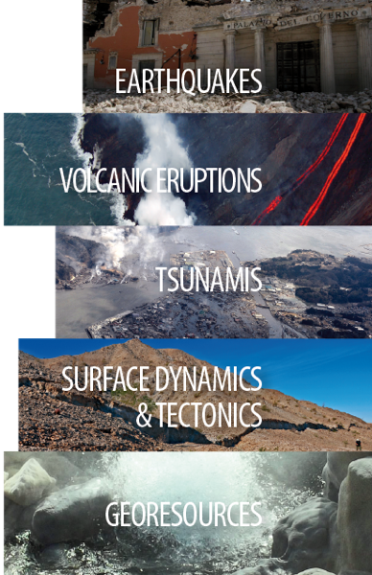
A key pillar of the fifth freedom is the empowerment of our research infrastructures. By facilitating access to laboratories, digital platforms, and cutting-edge equipment across Europe, we equip our research community to take on complex, multidisciplinary challenges vital to our collective future.
[Enrico Letta - Much More than a Market - Speed, Security, Solidarity. Empowering the Single Market to deliver a sustainable future and prosperity for all EU Citizens, April 2024]

Slide 19

Thank you for your attention!
Any questions?
federica.tanlongo@epos-eric.eu
Notes:
Thank you slide

Slide 20
Notes:
Logo only

