Slide 1
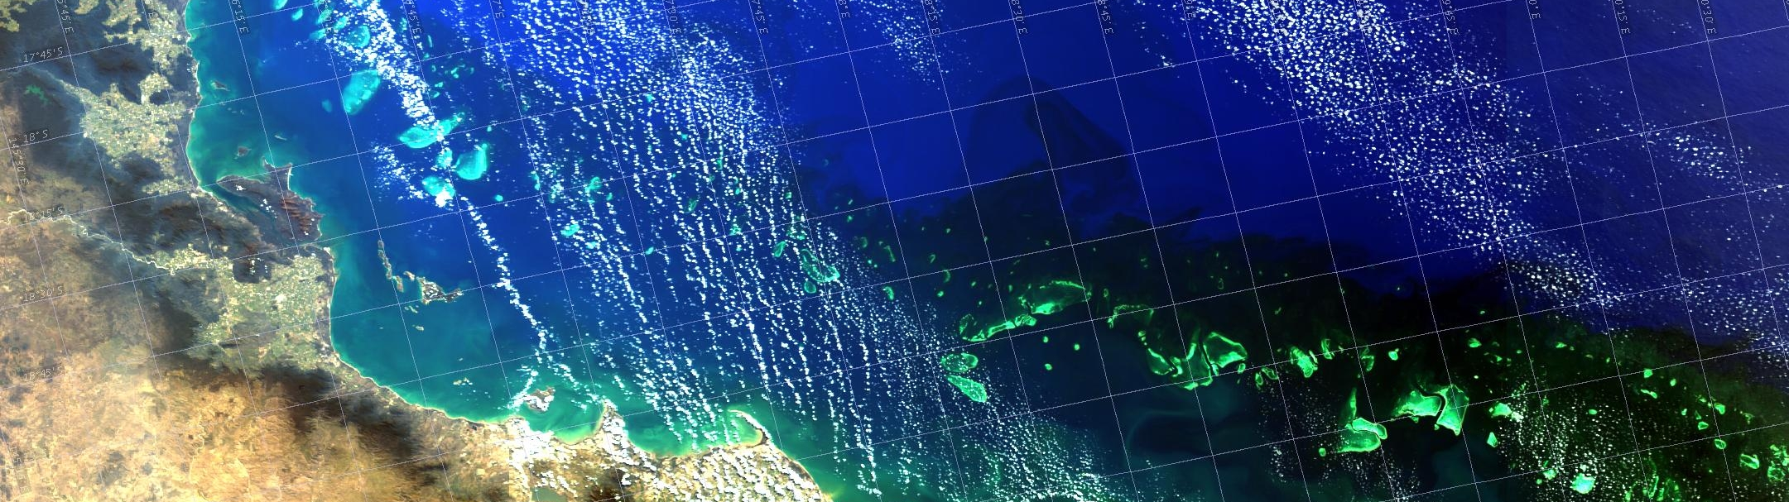


Innovation Beneath the Surface – With AuScope’s Downward Looking Telescope
On Behalf of the AuScope team:
Dr. Anusuriya Devaraju
Data Architect, CSIRO Mineral Resources

Slide 2

I would like to begin by acknowledging the Traditional Owners of the land/s that we’re meeting on today, and pay my respect to their Elders past and present.
‘Eternal Wisdom, Infinite Innovation’
artwork by Rachael Sarra, working with Gilimbaa.
Notes:
Source: https://my.csiro.au/Working/Diversity-and-Inclusion/Indigenous-engagement/Resources
‘Eternal Wisdom, Infinite Innovation’ artwork by Rachael Sarra, working with Gilimbaa.
NOTE: Please do not use the RAP artwork for any other purpose than this acknowledgement slide.
All other uses need to be approved by the Indigenous Engagement team (OfficeofIndigenousEngagement@csiro.au)

Slide 3

Discover AuScope
Source: AuScope – Building Australia’s Downward Looking Telescope, https://youtu.be/_5OVUXh5tq8?si=Dfu7BkqmJW35CVAp

Slide 4
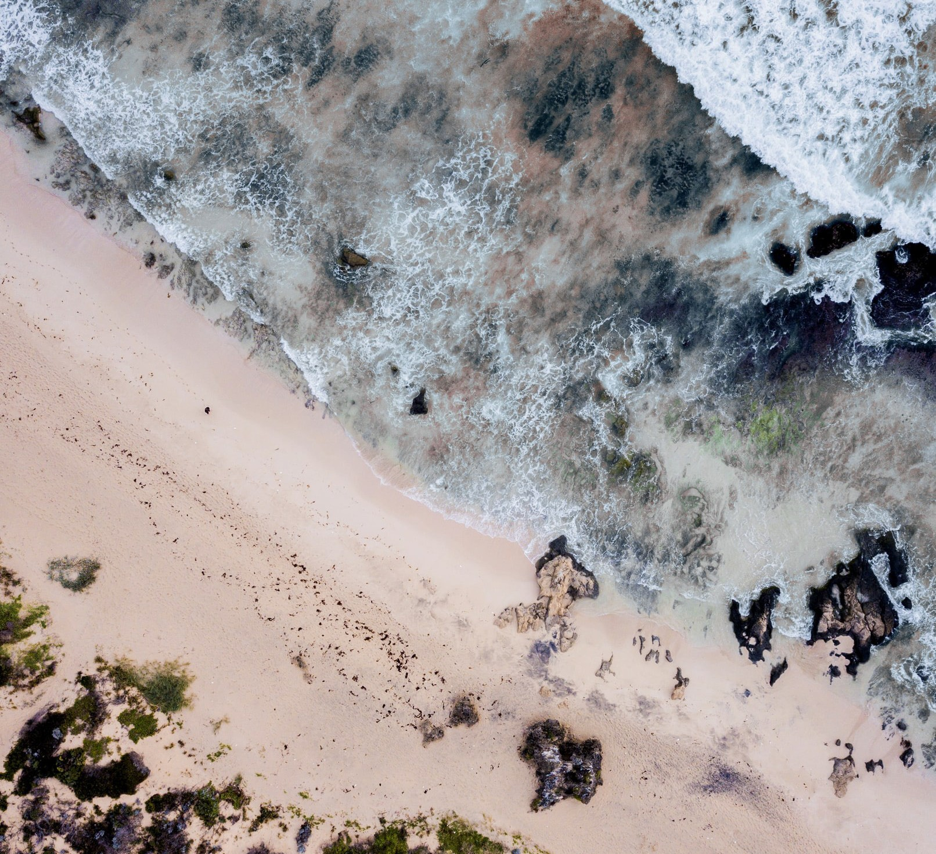
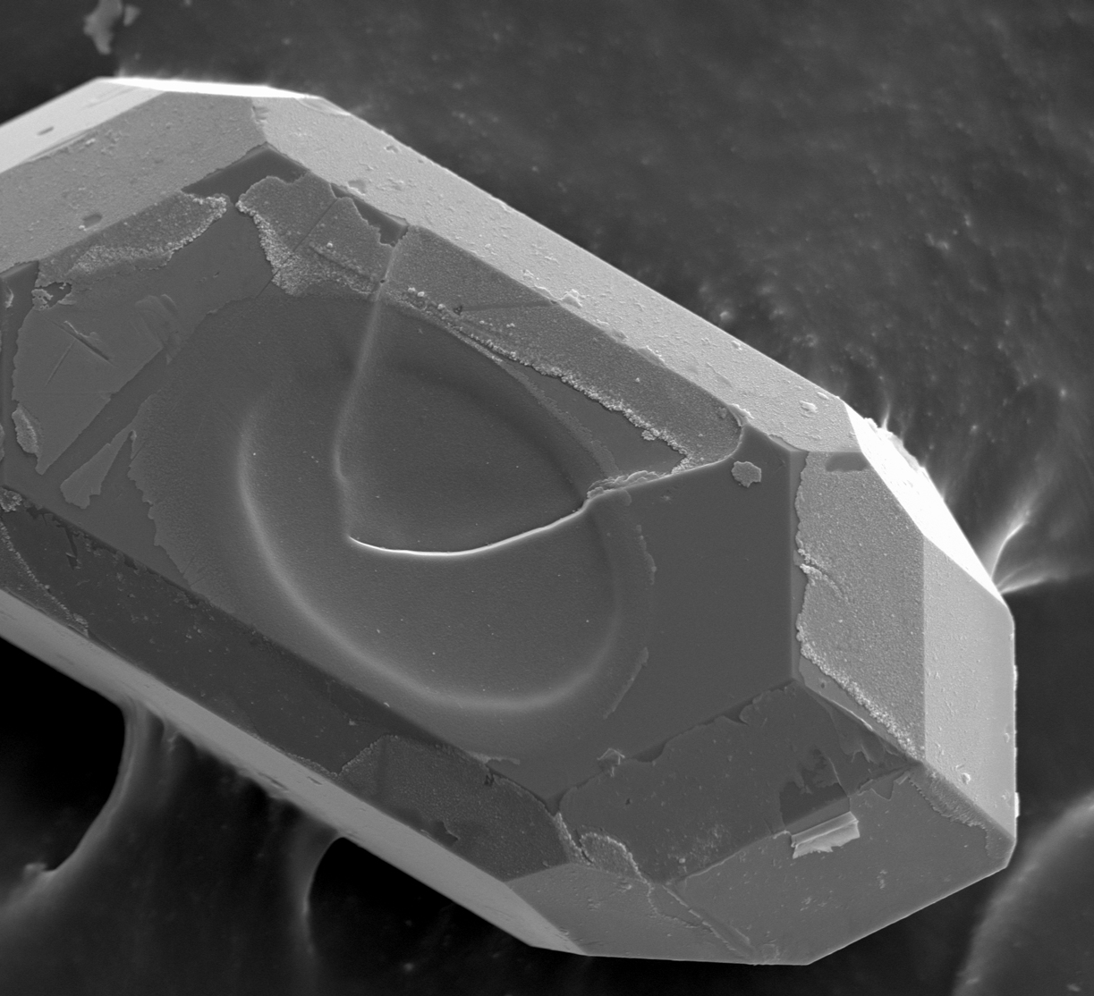
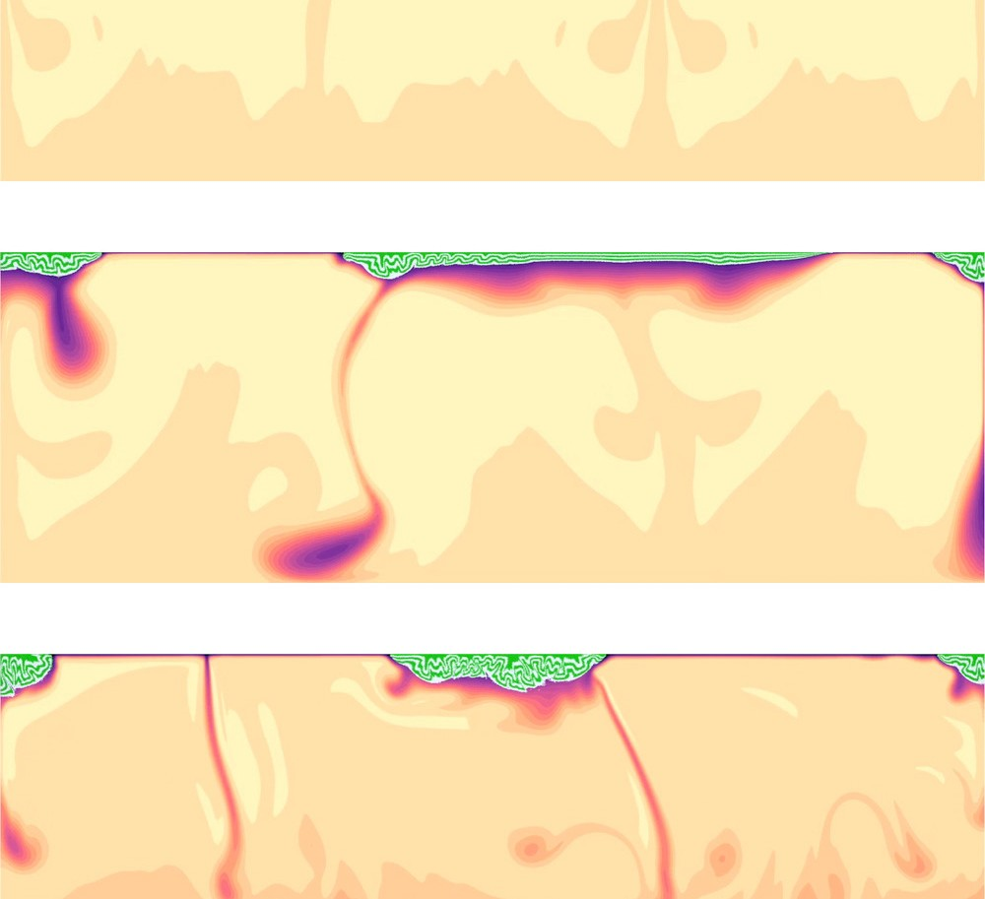
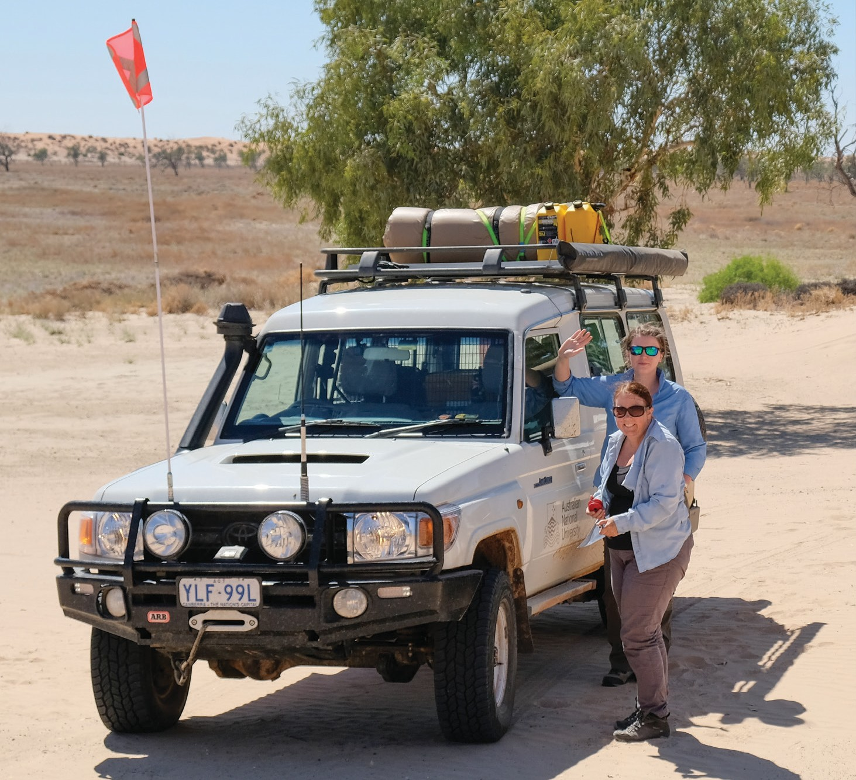
Overview
Australia’s leading research infrastructure provider
Operating since 2007, funded by the Australian Government via the National Collaborative Research Infrastructure Strategy (NCRIS).
Deliver instruments, services, data, analytics and expertise for tackling national geoscience challenges:
More about AuScope - https://www.auscope.org.au/
Food and Water
Minerals
Energy
Geohazards

Slide 5


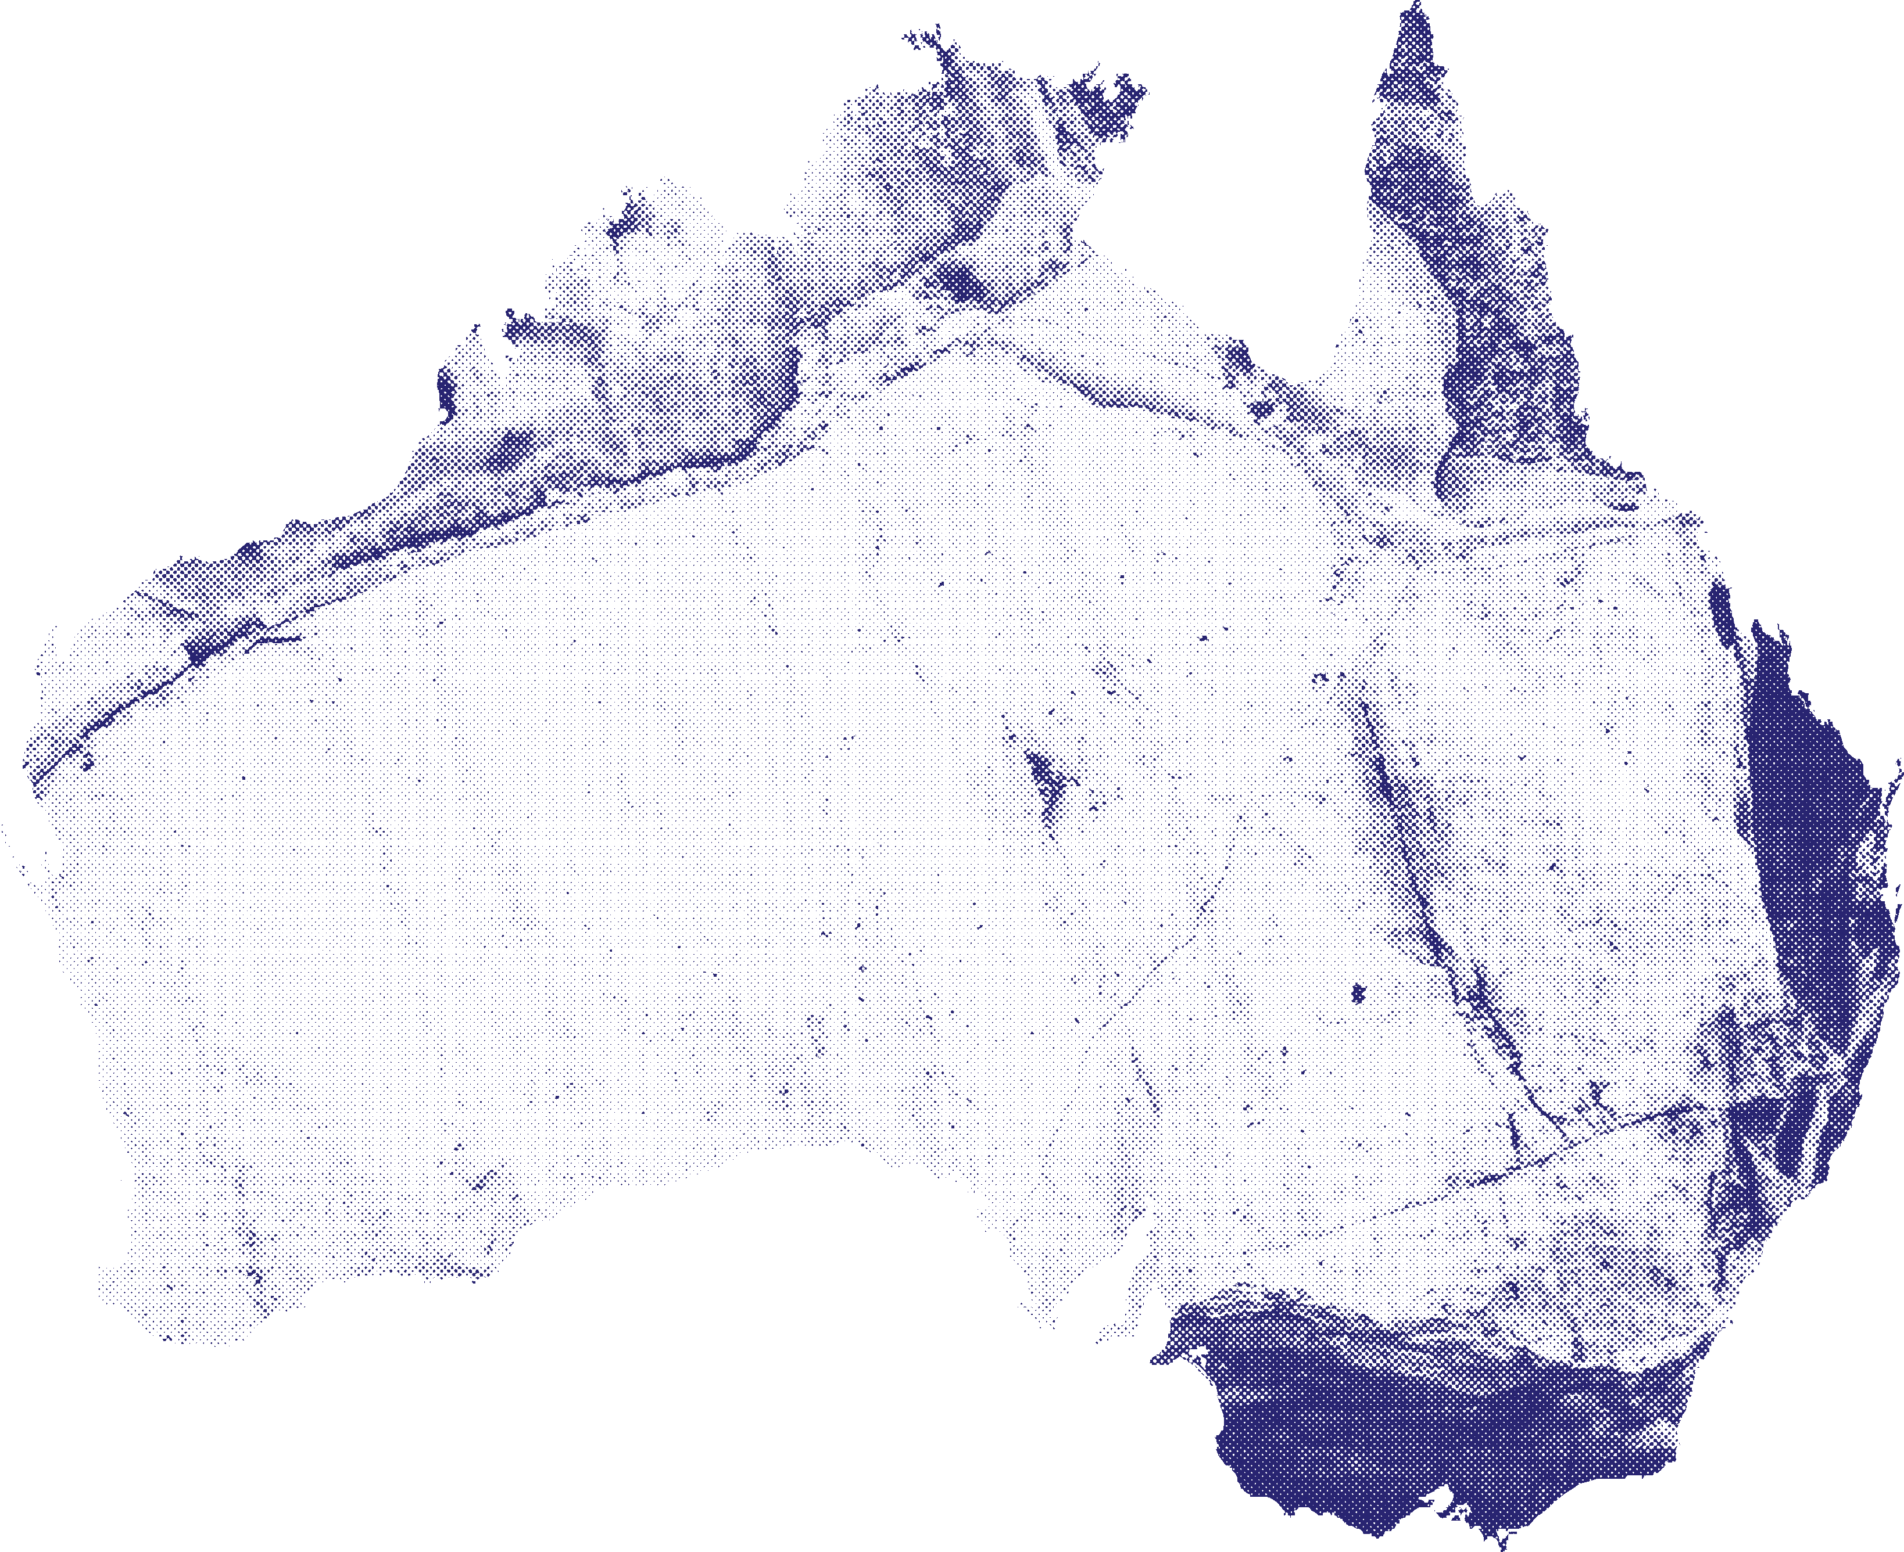




































Partners and Collaborators

Slide 6
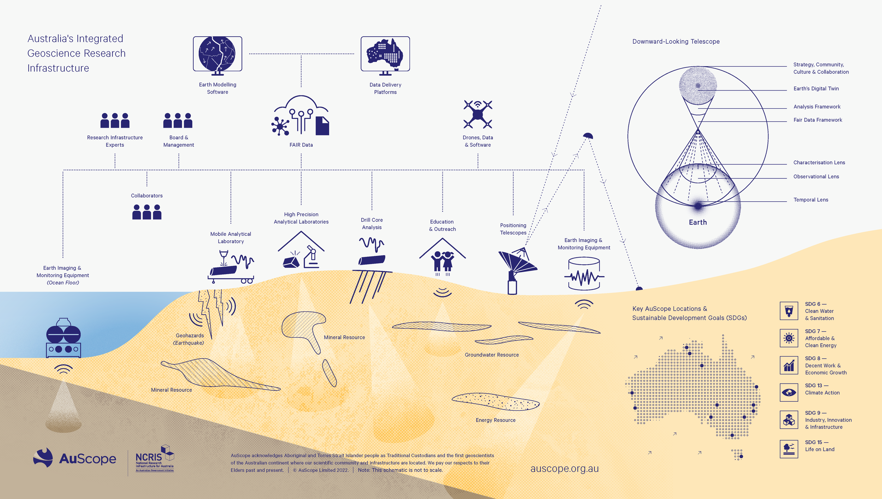
Connected With Purpose

Slide 7
AuScope Downward Looking Telescope (DLT)

Slide 8
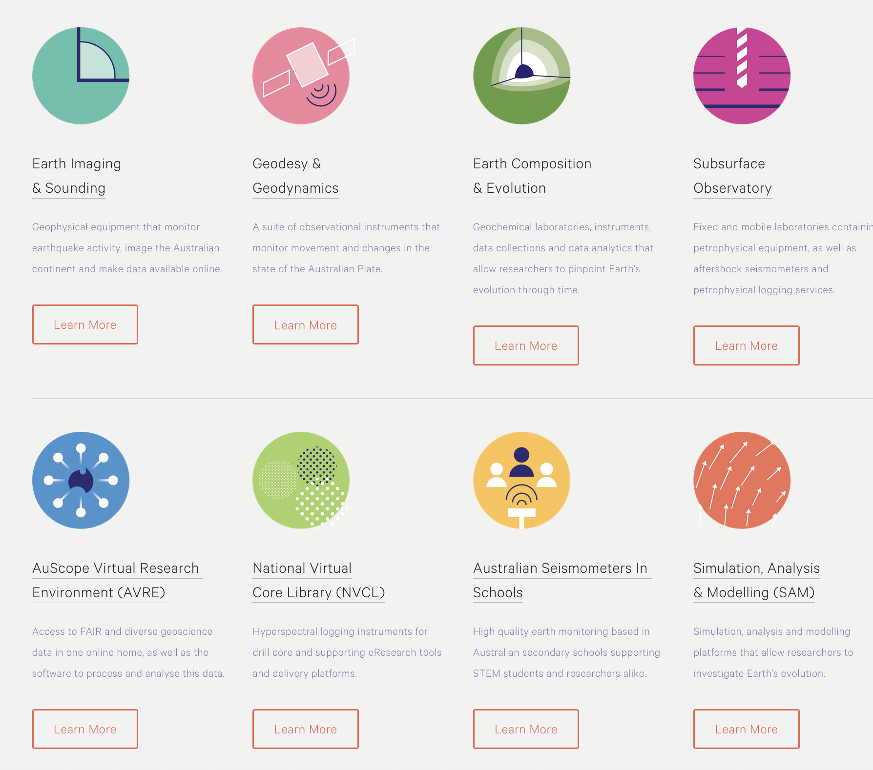
Core Programs
Eight connected programs forming the Australia’s Downward Looking Telescope (DLT).
DLT integrates capability of instruments, services, data and analytics to support the national geoscience community.
source: https://www.auscope.org.au/programs

Slide 9
More to come…
In the next session, we’ll explore AuScope Virtual Research Environment (AVRE)
  Enabling access to high-quality geoscientific data
  Providing tools for data discovery, visualization, and analysis
  Connecting geoscience researchers through shared national platforms

Slide 10
Thank you
CSIRO Mineral Resources
Dr. Anusuriya Devaraju
anusuriya.devaraju@csiro.au
https://people.csiro.au/d/a/anusuriya-devaraju

