Slide 1
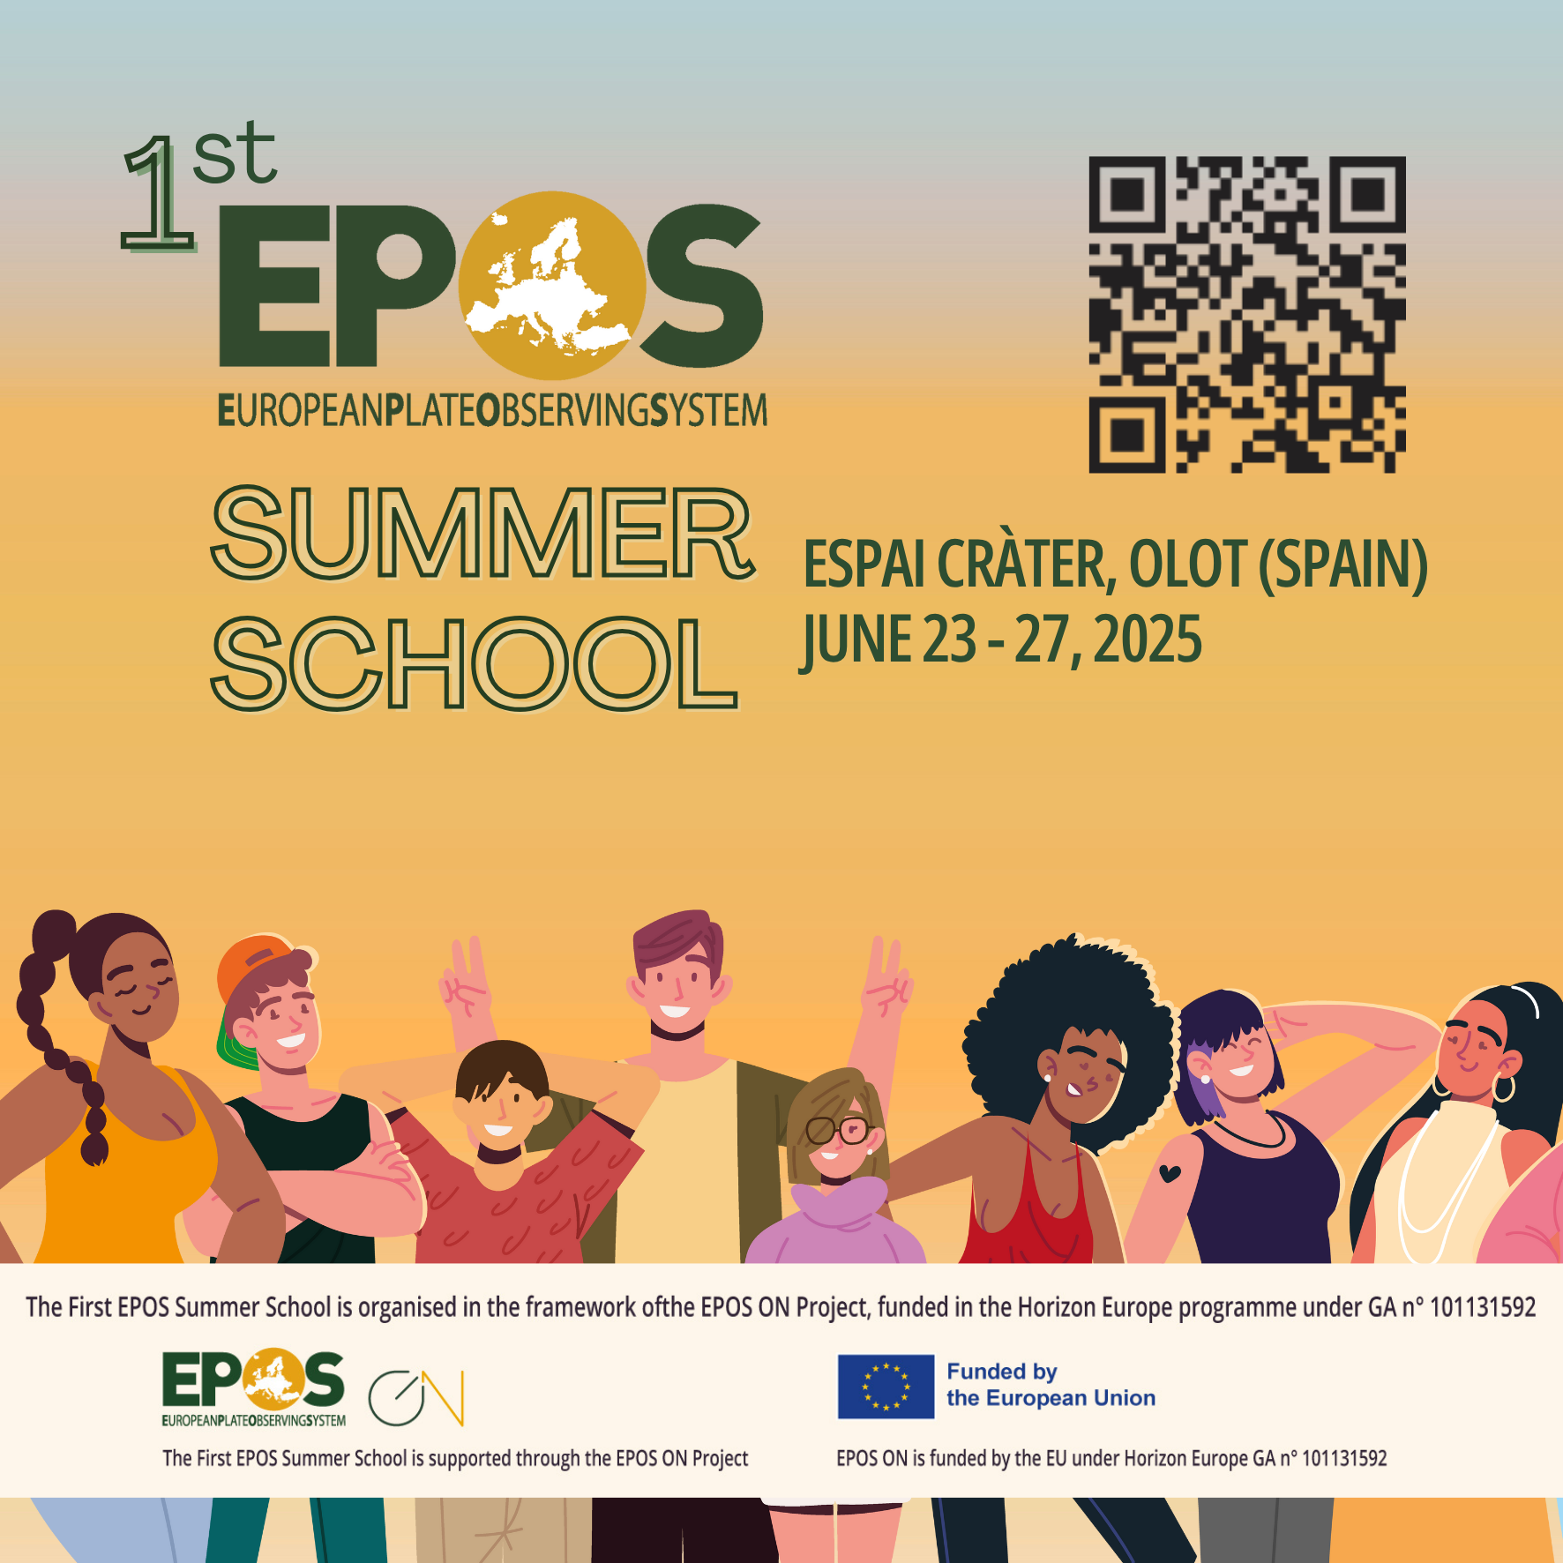
Data, Repositories, Portals:
An interactive session on search strategies
Henning Lorenz| henning.Lorenz@geo.uu.se
Uppsala University, Sweden
Notes:
Title slide

Slide 2
Introduction
We want to explore how searching for scientific data worked so far
for you and your various topics, and
add up the personal (thematic) experience to a “common experience”
of this group to reflect on:
What (kind of) repositories are used most frequently?
What works well, and where are the problems?
Summing up the discussion & final thoughts
Notes:
Content slide

Slide 3
Recapitulation – what is it about?
Data set
=> A collection of data
Data
=> A collection of values that describe something
Sample
=> A piece of (Earth) material
[What was the intention? | What was it used for? | Is this properly documented?]
Have persistent scientific value, but only if properly documented.
Notes:
Content slide

Slide 4
Recapitulation – the ingredients?
Metadata
=> “Information about data”, i.e. data describing data (or the sample)
Repository, Archive
=> A place to store something (“Archiving” is only about storage and preservation)
=> Metadata & content access depend on the repository/archive’s terms and conditions
Portal
=> An online platform that helps users to find and access content
+ PIDs, licenses, etc.
Notes:
Content slide

Slide 5
How do we get there?
Discovery
=> The process of finding content (data, samples, …) that is useful
for the defined purpose/scientific study
Notes:
Content slide

Slide 6
Your experience
What kind of data are you (usually) looking for?
How do you find data for your research? What repositories/portals do you use?
What works for you, and where are the problems?
Do you have a strategy for finding suitable data?
Notes:
Content slide

Slide 7
Group work
You start a research project (define a topic).
How do you find relevant data in the area of interest?
What do you do to access relevant data?
What are the potential problems, if any?
Possible entrances:
re3data.org; national, thematic, general repositories and portals;
general search engines; the AI model of your choice
Notes:
Content slide

Slide 8
Notes

Slide 9
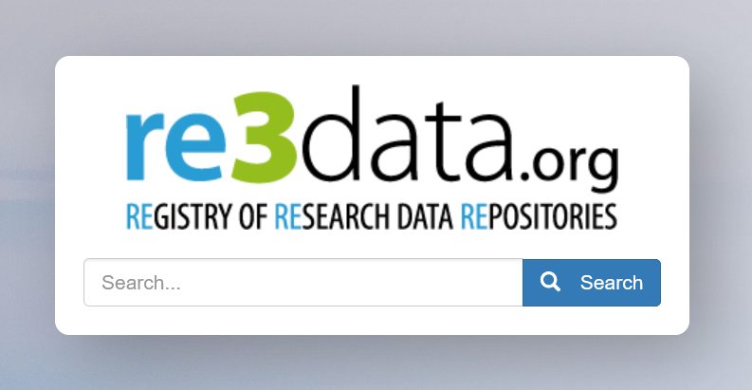
Let’s look at some examples
 | Organisation(s) | National | International
General | RODBUK Cracow Open Research Data Repository Common repository for several universities | Researchdata.se Swedish National Data Service repository + national data portal | Zenodo
Domain (Earth Sciences) | GFZ Data Services | ? | Pangaea Data Publisher
Thematic | ? | ? | EarthChem
Notes:
Content slide: tables

Slide 10
Problems
We don’t know the users’ choices of repositories.
Barriers
  between repositories,
  between thematic areas,
  across geographic/political boundaries,
  between organisations.
Re3data provides a search for repositories, but not for content across repositories.
Notes:
Content slide

Slide 11
Problems
Metadata/Data
  Many repositories lack support for geographic metadata (ISO 19115).
  Metadata schemas are usually generic. More suitable alternatives for a certain data type are not supported.
  Data schemas and standards are neither advertised nor enforced.
Notes:
Content slide

Slide 12
Domain repositories solve many problems
Domain repositories
support and/or enforce relevant metadata and/or data schemas
  according to standards/community standards/best practices (depending on what exists),
  that are well documented and possibly come along with tools that help data curation.
are supported by an open thematic community that is engaged in development and support.
usually provide dedicated user support.
reduce barriers, as data can be found where users look for them.
Notes:
Content slide

Slide 13

Thank you for your attention and your contributions to this interactive session!
henning.lorenz@geo.uu.se
www.epos-eu.org/on | social media #EPOSon
Notes:
Thank you slide

Slide 14
Notes:
Logo only

