Slide 1
Data Regulations Outside the EU
EarthScope

Slide 2
Open Data
National Science Foundation
Public and Accessible
Described
Reusable
Complete
Timely
Managed
https://www.nsf.gov/digital/data#what-is-open-data-704
Notes:
Public - data should be in convenient, modifiable, machine readable, non-propriety formats that can be retrieved, downloaded, indexed, and searched.
Described - described with sufficient information to understand the data's strengths, weaknesses, analytical limitations, security requirements, and how processed. Uses granular metadata that documents data elements, data dictionaries
Reusable - Open data are made available under an open license that places no restrictions on their use.
Complete - Published in finest level of granularity as practical. Derived or aggregate open data should also be published but must reference the primary data.
Timely - Open data available as quickly as necessary to preserve the value of the data. Frequency of release should account for key audiences and downstream needs.
Managed - An NSF point of contact is designated to assist with data use and respond to complaints.

Slide 3
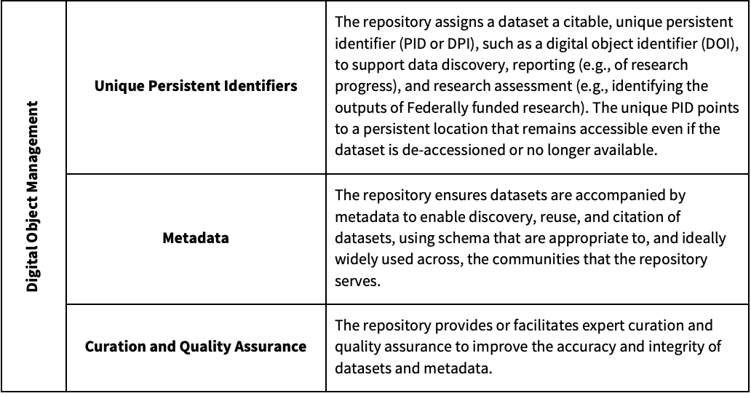
National Science Foundation

Slide 4
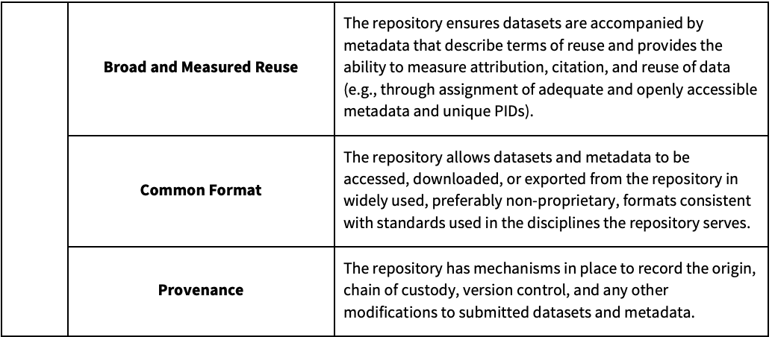
National Science Foundation

Slide 5
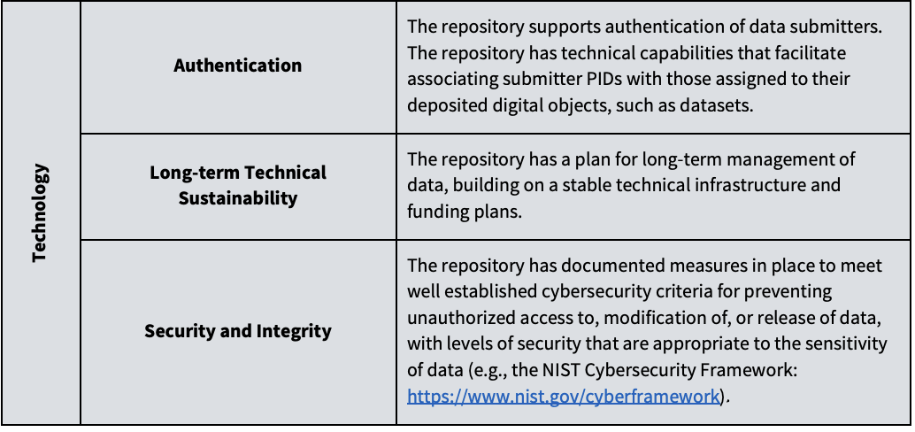
National Science Foundation

Slide 6
National Science Foundation
Desirable Characteristics of Data Repositories for Federally Funded Research

Slide 7
License
CC BY
This license enables reusers to distribute, remix, adapt, and build upon the material in any medium or format, so long as attribution is given to the creator. The license allows for commercial use. CC BY includes the following elements:
BY: credit must be given to the creator.

Slide 8
Privacy
We automatically collect and store only the following information about your visit:
The internet domain (for example, "xcompany.com" if you use a private internet access account or "yourschool.edu" if you connect from a university's domain) from which you access our website.
The IP address (a number that is automatically assigned to your computer whenever you are on the web) from which you access our website.

Slide 9
Privacy
The city you connect from.The type of browser, operating system and device used to access our website.
The date and time you access our website.
The pages you visit and the links and buttons you click on our website.
If you were directed to NSF.gov another website, the address of that referring website.
Anonymous demographic information about our visitors such as gender, age range, areas of interest and language for adults over the age of 18.

Slide 10
Privacy
NSF Privacy Policy

