Slide 1




Data Regulations in Australia
Dr. Anusuriya Devaraju
Data Architect, CSIRO Mineral Resources
Australia’s National Science Agency

Slide 2
Disclaimer: The information presented herein is intended solely as general guidance and is based on my experience in managing and governing research data in accordance with organisational policies and applicable regulatory requirements. It does not constitute legal advice. For advice tailored to your specific circumstances, please consult a qualified legal professional at your institution.
2 | Data Regulations in Australia | Anusuriya Devaraju (2025)

Slide 3
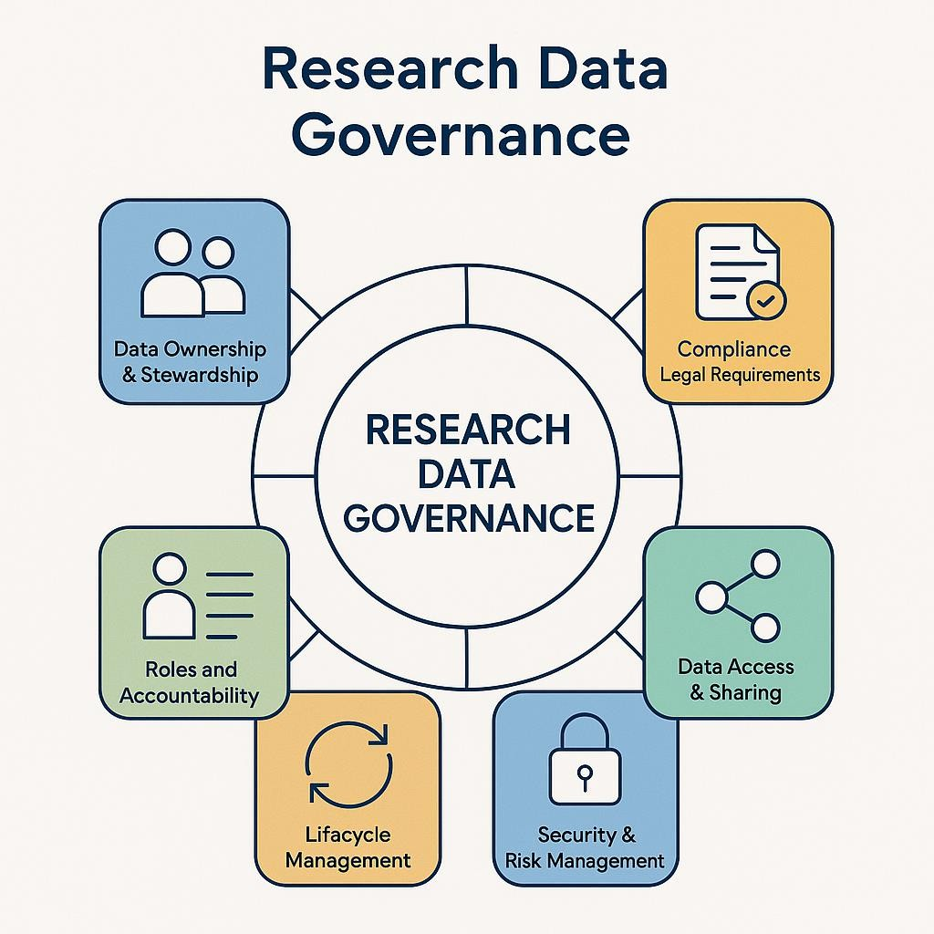
Data Governance & Data Regulation
Data Governance is a framework that sets roles, standards, and processes to ensure data quality, integrity, security, and regulatory compliance.
Data regulation sets the rules; data governance ensures those rules are implemented.
An AI-generated image by OpenAI, representing the components of research data governance.

Slide 4
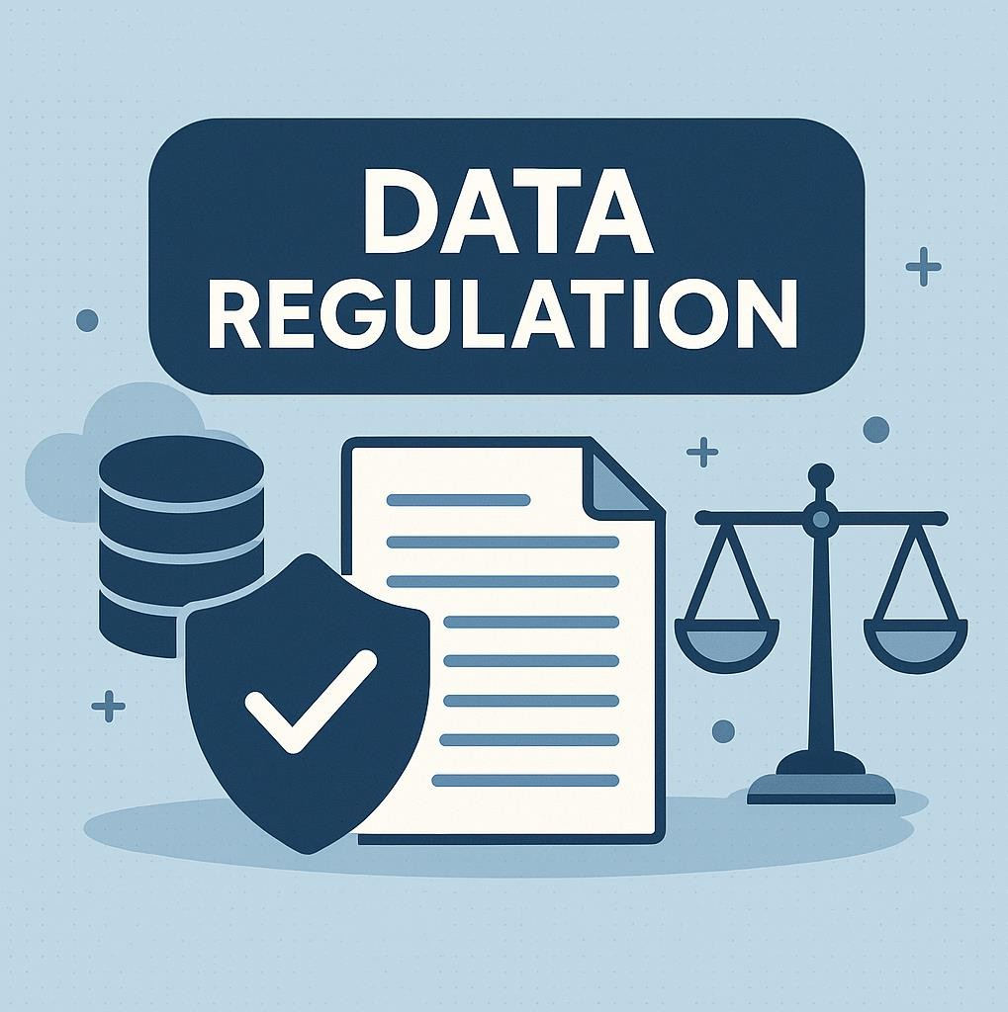
Data Regulation
Policies and laws around data impose how organisations share and govern data, particularly personal information.
Safeguard individuals’ privacy and ensure the responsible handling of personal information.
An AI-generated image by OpenAI, representing data regulation.

Slide 5
Personal Information
*Information or an opinion about an identified individual, or an individual who is reasonably identifiable, whether the information or opinion is true or not; and whether the information or opinion is recorded in a material form or not.
For example:
  Individual information – Full name, Date of Birth, Email, Address, …
  Issued – Social security number, Driver’s license number, Tax number..
  Online – IP address, login credentials, ..
  Finance – Bank account, credit card, transactions..
  Health and biometric
  Recruitment records
*Source: https://www.csiro.au/en/about/policies/privacy

Slide 6
Office of the Australian Information Commissioner (OAIC)
Central authority for data regulation and privacy protection in
Australia.
  Administers the Privacy Act 1988 and enforces the Australian Privacy
Principles (APPs)
  Handles privacy complaints and investigations
  Oversees the Notifiable Data Breaches (NDB) scheme
  Provides guidance to the public, agencies and businesses
  Regulates emerging technologies for privacy impact
  Collaborates internationally on cross-border data protection

Slide 7
Legal Frameworks Governing Data in Australia

Slide 8
Privacy Act 1988 (Cth) (including Australian Privacy Principles)
The central legislation regulating how personal information is
handled in Australia.
Includes the 13 Australian Privacy Principles (APPs) which apply to government agencies and private sector organizations with an annual turnover over $3 million.
  Also covers small business operators, e.g., private health services, credit reporting bodies, contracted service providers for Australian government contracts, employee associations, businesses opted-in to the Privacy Act, etc.
Covers collection, use, disclosure, and storage of personal data.

Slide 9
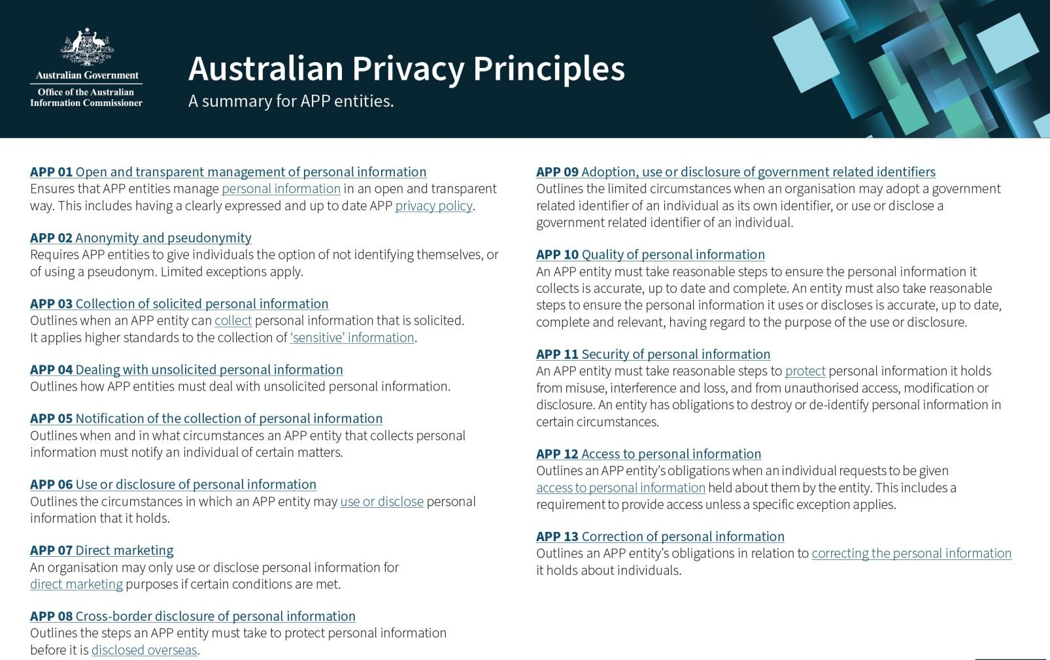
Source: https://www.oaic.gov.au/privacy/australian-privacy-principles/australian-privacy- principles-quick-reference

Slide 10
Notifiable Data Breaches (NDB) Scheme (since 2018)
Triggered when a data breach is likely to result in serious harm.
  A data breach occurs when personal information held by an organisation or
agency is lost, accessed without authorisation, or disclosed unlawfully.
Applies to organisations and agencies covered by the Privacy Act
1988.
The affected individuals and the Office of the Australian Information Commissioner (OAIC) must be notified.
Source: https://www.oaic.gov.au/privacy/notifiable-data-breaches

Slide 11
Data Availability and Transparency Act 2022
Establishes the DATA Scheme, setting best practices for sharing Australian
Government data for the purposes of government service delivery, policy and
program development, and research and development.
Intelligence and law enforcement agencies are excluded from the Scheme to
protect national security and enforcement operations.
The Act allows data sharing by overriding Commonwealth, State, or Territory
laws that would otherwise restrict it.
The Scheme involves three participant roles:
  Data Custodians (who hold the data)
  Accredited Users (who request and use the data)
  Accredited Data Service Providers (who offer services to enable the safe sharing of data)
Data cannot be shared until a data sharing agreement is registered under the
Scheme.
For more information, see Office of the National Data Commissioner.

Slide 12
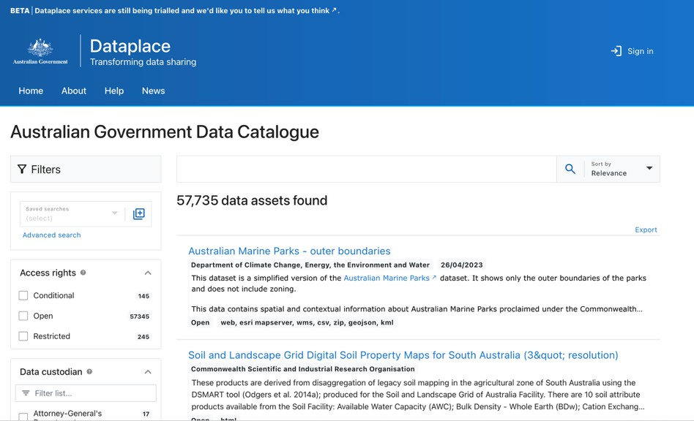
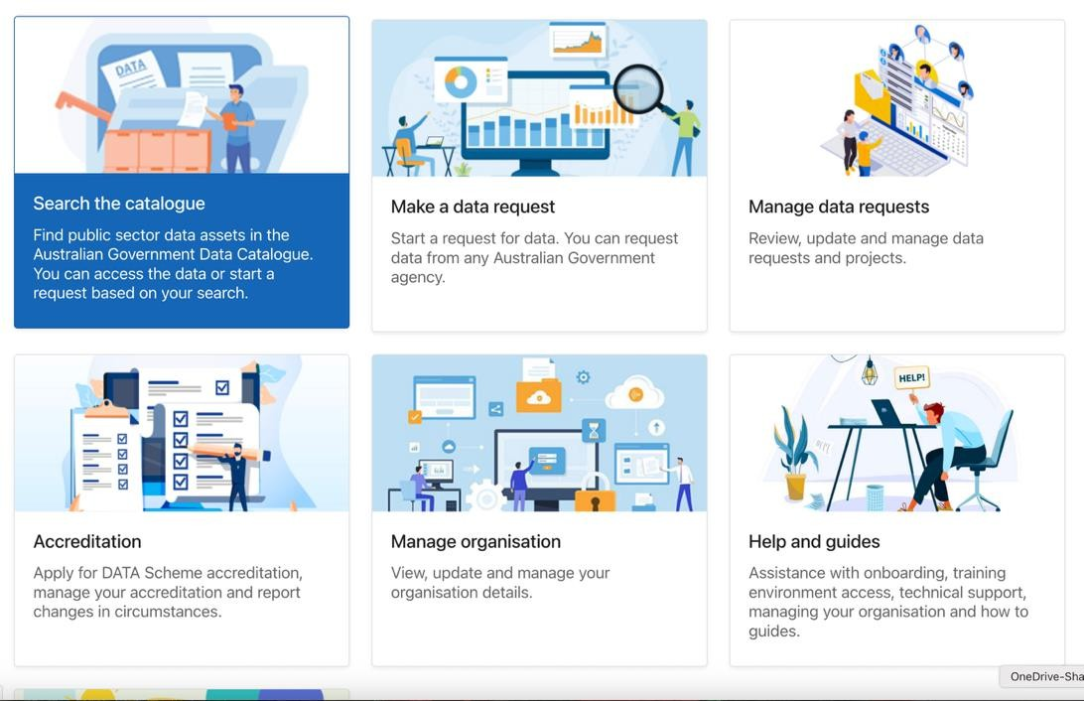
Dataplace
https://www.dataplace.gov.au
A catalogue to find data assets held by Australian government agencies.

Slide 13
State and Territory Data Sharing Legislation
Privacy and Responsible Information Sharing Act 2024 (PRIS Act)
  Jurisdiction: Western Australia (WA)
  Focus: Responsible information sharing among WA government agencies.
  Complementary: It does not replace or override the protections in the Privacy Act, but instead builds on them for a specific context in WA.

Slide 14
Cyber Security Act 2024 (Cth)
Implements four key initiatives from Australia’s 2023–2030 Cyber
Security Strategy:
  Smart Device Security: Sets mandatory cybersecurity standards for internet-
connected products like IoT devices and smart vehicles.
  Ransomware Reporting: Requires critical infrastructure and businesses earning
> A$3M annually to report ransomware payments within 72 hours to the
Australian Signals Directorate.
  Voluntary Incident Sharing: Allows organisations to voluntarily share major cyber incident details with the National Cyber Security Coordinator under protection.
  Cyber Incident Review Board: Establishes an independent board to review
major cyber incidents and share lessons learned.

Slide 15
Conclusions
How to share research data in Compliance with regulatory requirements in Australia:
(This is not an exhaustive list but a solid starting point)
Know the Legal Frameworks: Follow Privacy Act 1988 & Australian Privacy
Principles (APPs), and state laws.
Minimise Data: Share only necessary data, anonymised or de-identified data.
Secure Data Transfer: Encrypt and secure channels.
Protect Cross-Border Data: Comply with APP8, data localisation and storage.
Accountability and Governance: Monitor access, maintain audit trails, and train
qualified staff.

Slide 16
Thank you
CSIRO Mineral Resources Dr. Anusuriya Devaraju
anusuriya.Devaraju@csiro.au
https://people.csiro.au/d/a/anusuriya-devaraju
Australia’s National Science Agency

