Slide 1
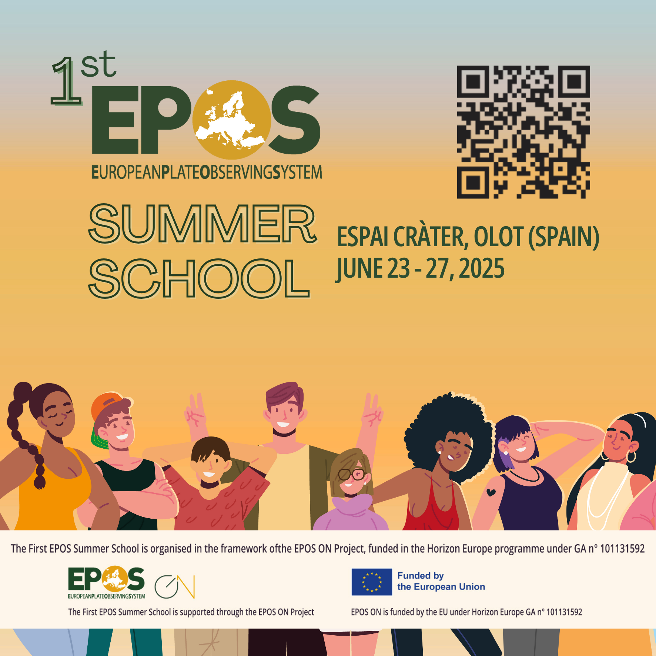
The rules of data sharing introduction to research data sharing regulations in Europe (and elsewhere)
Federica Tanlongo | federica.tanlongo@epos-eric.eu
Notes:
Title slide

Slide 2
Part 1: the EU regulatory framework

Slide 3

A Shared approach
Compared to other world regions, EU tend to have a common approach to regulation and has worked to harmonise the regulations concerning data sharing and reuse.
Useful for cross-border collaboration

Slide 4




The EU regulatory framework
INSPIRE Directive (2007/2/EC) - Establishes an Infrastructure for Spatial Information in the European Community, aimed at making environmental spatial data more accessible and interoperable across Europe. It includes the INSPIRE implementing rules and technical implementations.
Access to Environmental Information Directive (2003/4/EC) - Implements the Aarhus Convention in the EU, ensuring public access to environmental information held by public authorities.
Data Protection Regulation (GDPR - 2016/679) - While not specifically environmental, this regulation governs the processing of personal data and is relevant for environmental data involving personal information.
The Open Data Directive (2019/1024/EU) - Promotes the availability of public sector information (PSI) for reuse, which includes environmental data, and encourages making this data available in open formats.
Regulation (EU) 2022/868 (Data Governance Act) - Establishes a framework for data sharing and governance across the EU, including environmental data, to facilitate reuse, promote research and innovation, and ensure responsible data handling.
Regulation (EU) 2023/138 (High-Value Datasets) - Defines a set of high-value datasets, ensuring their free publication and reusability to boost transparency, innovation, and economic growth across the EU.
Regulation (EU) 2023/2854 (Data Act) - Entered into force on January 11, 2024, and will become applicable on September 12, 2025, fostering digital innovation in the EU and facilitating data sharing and access, including for environmental data.
Regulation (EU) 2024/903 (Interoperable Europe Act) - Establishes measures to enhance cross-border interoperability of digital public services across the EU, promoting seamless data exchange and cooperation among public administrations.
Regulation (EU) 2024/1689 of the European Parliament and of the Council, entered into force on August 1, 2024, which lays down harmonized rules on artificial intelligence (also known as the Artificial Intelligence Act or AI Act).
Database Directive (96/9/EC) - Provides legal protection for databases through copyright and sui generis rights, safeguarding against unauthorized extraction and reuse of substantial parts of databases.
Software Directive (2009/24/EC) - Provides legal protection for computer programs, ensuring that software, including those used for environmental data management, is protected under EU copyright law.

Slide 5

Data strategy in the Digital Single Market
The European Data Strategy aims to make the EU a leader in a data-driven society.
A single market for data will allow it to flow freely within the EU and across sectors.
Data, especially when generated using public funding,
should benefit businesses, researchers, public
administrations and society.
Image by Nuthawut Somsuk
at https://www.vecteezy.com/
Adapted from: Data Governance and Legislative Strategies for FAIR Research - Brizioli, S., Cacciaguerra, S., Colcelli, V., Locati, M., Schirru L., 2024

Slide 6
Data that must not, should be, and must be shared
As open as possible,
as closed as necessary
Sharing
LIMITATIONS for:
Personal data
Data related to public security, defence and national security
Data Governance and Legislative Strategies for FAIR Research - Brizioli, S., Cacciaguerra, S., Colcelli, V., Locati, M., Schirru L., 2024

Slide 7
Data that must not, should be, and must be shared
As open as possible,
as closed as necessary
Sharing
LIMITATIONS for:
Personal data
Data related to public security, defence and national security
Sharing
RECOMMENDED for:
Data generated using
public funding
No re-use limitations, even for commercial purposes
Data Governance and Legislative Strategies for FAIR Research - Brizioli, S., Cacciaguerra, S., Colcelli, V., Locati, M., Schirru L., 2024

Slide 8
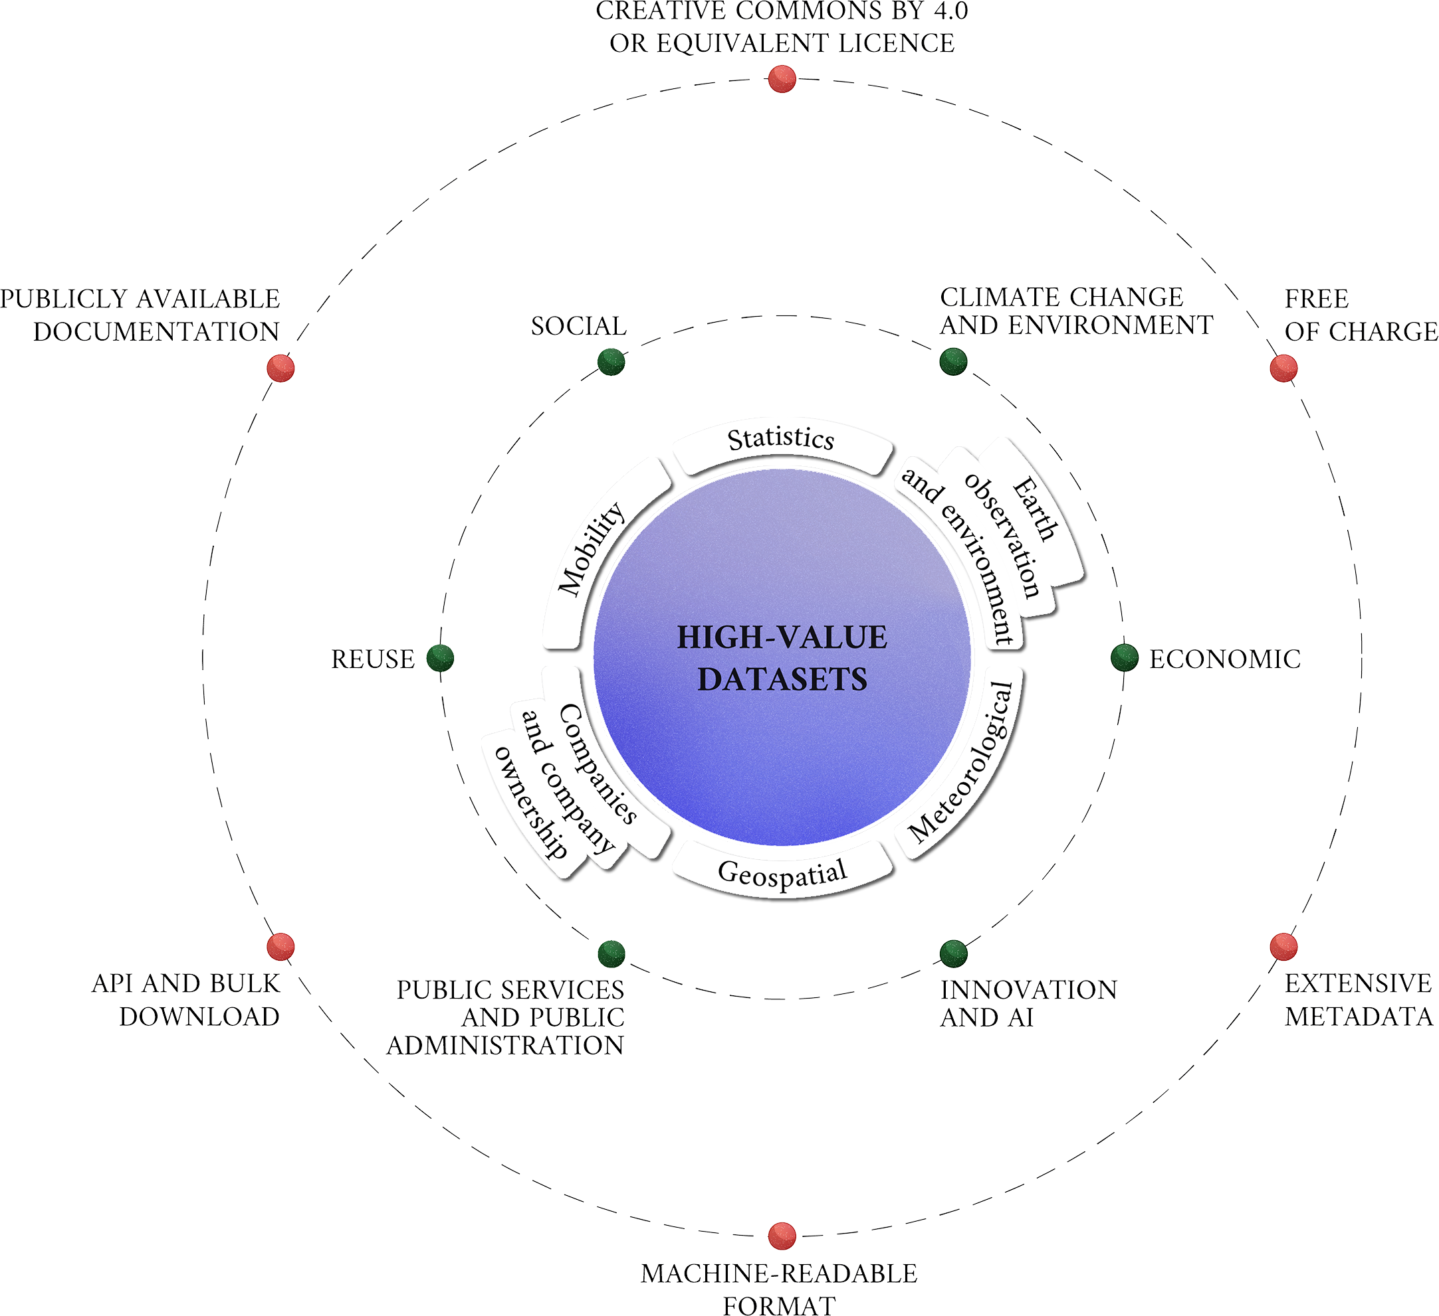
Data that must not, should be, and must be shared
As open as possible,
Sharing is
COMPULSORY for:
as closed as necessary
High-value
Dataset
Sharing
LIMITATIONS for:
Personal data
Data related to public security, defence and national security
Sharing
RECOMMENDED for:
Data generated using
public funding
No re-use limitations, even for commercial purposes
Re-usable dataset that may generate important benefits for society, the environment and the economy, in particular because of their suitability for the creation of added-value services, applications, and new, high-quality and decent jobs for many potential beneficiaries.
Data Governance and Legislative Strategies for FAIR Research - Brizioli, S., Cacciaguerra, S., Colcelli, V., Locati, M., Schirru L., 2024

Slide 9
High-value datasets
CLIMATE CHANGE &
ENVIRONMENT
SOCIAL
COMPULSORY sharing
Domains with high potential for societal impact
High-value
Dataset
REUSE
ECONOMIC
PUBLIC SERVICES & PA
INNOVATION & AI
Adapted from: Data Governance and Legislative Strategies for FAIR Research - Brizioli, S., Cacciaguerra, S., Colcelli, V., Locati, M., Schirru L., 2024

Slide 10
High-value datasets
CC BY 4.0 OR EQUIVALENT LICENSE
CLIMATE CHANGE &
ENVIRONMENT
SOCIAL
FREE OF CHARGE
COMPULSORY sharing
PUBLICLY AVAILABLE DOCUMENTATION
Requirements:
free of charge
open data licence
downloadable in bulk (where relevant) and through application programming interfaces (APIs)
extensive metadata
machine readability
availability of public documentation
High-value
Dataset
REUSE
ECONOMIC
API & BULK DOWNLOAD
EXTENSIVE METADATA
PUBLIC SERVICES & PA
INNOVATION & AI
Adapted from: Data Governance and Legislative Strategies for FAIR Research - Brizioli, S., Cacciaguerra, S., Colcelli, V., Locati, M., Schirru L., 2024
MACHINE-READABLE FORMAT

Slide 11

INSPIRE
INfrastructure for SPatial InfoRmation in Europe)
Directive that requires Member States to establish and operate a network of services related to spatial datasets and to ensure their interoperability.
Applies to
  EU public authorities that create, hold or use spatial data in the performance of their public tasks.
  Third parties accessing the network according to the directive's provisions.
Objective: to make spatial data accessible, interoperable, and useful.
Notes:
INSPIRE is the EU directive that regulates Data Sharing for geospatial information. It has been implemented in phases and basically requires Member States to establish and operate a network of services related to spatial data sets and to ensure that spatial data sets and services can be linked to this national network. The directive aims to harmonize and share publicly-generated spatial data to support environmental decision-making and management.
The INSPIRE directive primarily applies to European public authorities that hold spatial data or use it in the performance of their public tasks. It also applies to third parties accessing the network according to the directive's provisions. Public research organizations within the European Union are generally mandated to adhere to the INSPIRE (Infrastructure for Spatial Information in Europe) Directive if they manage spatial data that are relevant to environmental policies or activities.

Slide 12
INSPIRE principles
Data should be collected once and kept where it can be maintained most effectively.
It should be possible to combine seamless spatial information from different sources across Europe and share it with many users and applications.
Information should be shareable at different levels (e.g. detailed for research, general for strategic purposes).
Geographic information needed for good governance should be readily and transparently available.
It should be easy to find what geographic information is available, and how and under which conditions it can be used.
Notes:
INSPIRE is based on a number of common principles:

Slide 13

INSPIRE in a Nutshell
Application: spatial data in electronic format that falls under the jurisdiction of MS
Environmental Focus: emphasis on spatial data related to environmental policies and activities.
Network Services: MS required to operate a network of services for spatial data, (including discovery, view, download, transformation, and invoke services.)
Harmonization: requirement of documenting data though metadata, expose it through network services, and harmonize it according to common data models.
Relevance to Research:
As a data provider: RPO often generate/manage valuable spatial data and INSPIRE ensures they’re available in a standardized and usable format.
As a user: facilitating environmental research by improving accessibility and interoperability
Sources:
https://wetransform.to/learn-about-inspire/#:~:text=The%20INSPIRE%20directive%20is%20a,access%2C%20find%2C%20and%20process.
https://ec.europa.eu/info/law/better-regulation/have-your-say/initiatives/12111-Open-data-availability-of-public-datasets_en
Picture: adaptation from amonrat rungreangfangsai

Slide 14
INSPIRE standards
INSPIRE dictates standards and specifications for different levels
of the infrastructure:
Metadata: metadata are created for the spatial data sets and services
(corresponding to themes listed in the directive)
Data specification: common data models, code lists, map layers and additional metadata on the interoperability to be used when exchanging spatial datasets
Network services: common interfaces for web services.
Data and service sharing: rights and obligations regarding the sharing of spatial data sets and services between all levels of government.
Spatial data services: specify rules for the interoperability of spatial data services.
Monitoring and reporting: ensure that MS monitor the implementation and use of their infrastructures for spatial information and report to the EC
Source(s): https://knowledge-base.inspire.ec.europa.eu/index_en

Slide 15
Part 2: protecting the data producers’ rights

Slide 16
Making data reusable does NOT imply not protecting IPR

Slide 17
Making data reusable does NOT imply not protecting IPR
Making data/products Open does NOT mean not attributing a work and recognising the data producers’ rights

Slide 18
Making data reusable does NOT imply not protecting IPR
Making data/products Open does NOT mean not attributing a work and recognising the data producers’ rights
Using open licenses does NOT mean that no restrictions apply to the usage of data/products

Slide 19
What is copyright?
One form of IPR (compare with trademark and patents)
Grants a set of exclusive rights to copyright holder:
one cannot copy, distribute, publicly perform, adapt, etc
without permission of the copyright holder.

Slide 20

What is copyright?
One form of IPR (compare with trademark and patents)
Grants a set of exclusive rights to copyright holder:
one cannot copy, distribute, publicly perform, adapt, etc
without permission of the copyright holder.
Notes:
t is important to note that the author of a work may not necessarily be the copyright holder. For example:
Works created in the course of your employment are likely to be owned by your employer, though ownership rules vary by jurisdiction. Common law countries like Australia and the United States typically adhere to some form of a doctrine commonly known as “work-for-hire.” This doctrine generally provides that if you have created a copyrightable work within the scope of your employment, the employer is the owner of, and controls, the economic rights in the copyrighted work. In many civil law countries, such as France and Germany, the law presumes that copyright vests with the employee-author, unless an employment contract dictates or implies otherwise.
Independent contractors may or may not own and control copyright in the works they create in that capacity. That determination most always depends on the terms of the contract between you and the organization that engaged you to perform the work.
For educators and academic librarians taking this course, it is also worth noting: teachers, university faculty, and learners may or may not own and control copyright in the works they create in those capacities — that determination will depend on certain laws (such as work-for-hire in some instances) and on the terms of the employment or contractor agreement, university or school policies, and terms of enrollment at the particular institution.
If you have co-created a single original work that is subject to copyright, you may be a joint owner, rather than an exclusive owner, of the rights granted by copyright law. Joint ownership generally prohibits one author from exploiting a work without the consent of the others, though the United States is a notable exception to this rule.^{[4]} If, on the other hand, you contributed a discrete work to a larger collective work, such as an encyclopedia or anthology, you likely own a copyright on your individual contribution.

Slide 21
What is copyright?
One form of IPR (compare with trademark and patents)
Grants a set of exclusive rights to copyright holder:
one cannot copy, distribute, publicly perform, adapt, etc
without permission of the copyright holder.
Utilitarian rights: gain for one’s work
Moral rights: right to attribution and integrity of the work

Slide 22

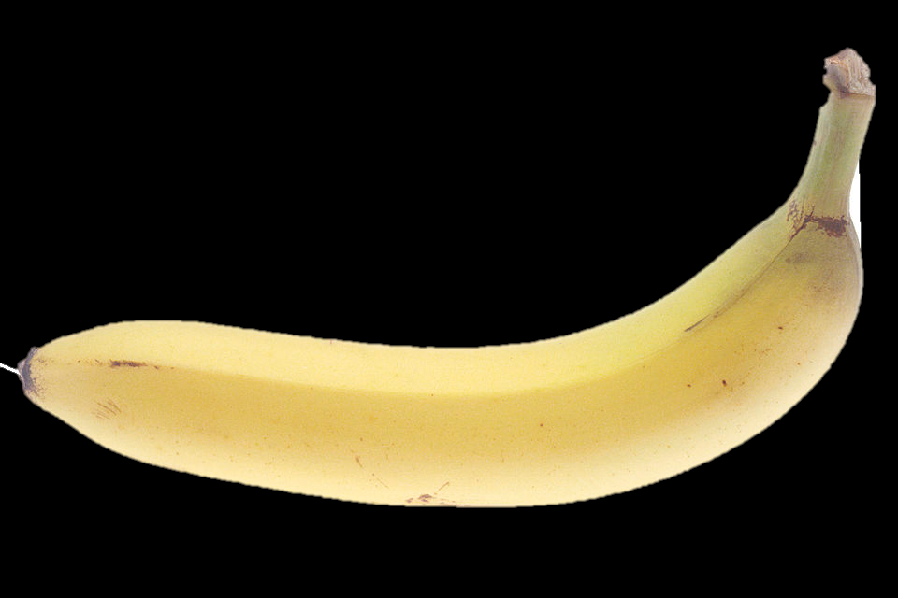
What is copyright?
One form of IPR (compare with trademark and patents)
Grants a set of exclusive rights to copyright holder:
one cannot copy, distribute, publicly perform, adapt, etc
without permission of the copyright holder.
Applies to works (including scientific works) that are original.
Some things (e.g. facts, ideas) are not copyrightable
Is effective regardless the registration of the work
Balances against other public interests

Slide 23
Which copyright law?
Laws of copyright are locally implemented by every country and they can vary sometimes dramatically
Some aspects of copyright law are harmonized through international agreements and treaties, ensuring that some basic standards are enforced everywhere.
  Many countries enact laws that grant protections above what is required.
Berne convention (2024)
  all countries must give foreign works the same protection they give works created within their borders, assuming the other country is a signatory.
  minimum term of copyright: life of the author + 50 years.
International public licenses such as CC are designed to be enforceable everywhere

Slide 24



Licensing: different legal tools for different products
Standard license: A set of predefined re-use conditions in a digital format, preferably compatible with standardised public licences available online.
Allow authors to chose, based on the specific scientific products they need to protect, which conditions should be applied to its use and distribution.
Different licenses adapt to different scientific products.
  IMPORTANT! Not all public licenses are necessarily in line with Open Science (including CCs!)

Slide 25
Licenses:
Raw data and Metadata
Raw data: Public domain
Data and metadata produced by public bodies, including research organisations and cultural heritage institutions, should be distributed without restrictions
In this form, data are not covered by copyright
Metadata and unstructured (raw) data should be licensed using Public Domain licenses such as CC0 (Creative Commons Zero dedication to the public domain) or similar.
Whenever possible, attribution is recommended anyway (“CC0 +credits”)

Slide 26
Licenses:
Raw data and Metadata
Raw data: Public domain
Data and metadata produced by public bodies, including research organisations and cultural heritage institutions, should be distributed without restrictions
In this form, data are not covered by copyright
Metadata and unstructured (raw) data should be licensed using Public Domain licenses such as CC0 (Creative Commons Zero dedication to the public domain) or similar.
Whenever possible, attribution is recommended anyway (“CC0 +credits”)
  Some examples:
Creative Commons 0 (CC0)
Public Domain Mark
Public Domain Dedication
Open Data Commons Public Domain Dedication and license (PDDL)

Slide 27
Licenses:
Datasets and other scientific products
Creative and Academic works: Attribution
This category includes datasets, databases and processed scientific products (e.g. in the geosciences, a seismic risk map);
They are recognized as intellectual creations and therefore subject to copyright.
As a rule, in an Open Science context, we use licenses that ensure attribution to the author and allow the use, modification, and sharing of the scientific product.
The most common licenses are those by Creative Commons, particularly CC BY International 4.0.
More restrictive conditions are acceptable if justified, following the principle of "as open as possible, as closed as necessary."

Slide 28
Licenses:
Datasets and other scientific products
  Some examples:
  Datasets and other scientific products:
Creative Commons Attribution (CC BY)
Open Data Commons Attribution licence
Other content (e.g. documentation)
Creative Commons Attribution (CC BY)
Digital Peer Publishing Licences (DPPL)
GNU Free Documentation Licence (GFDL)
Creative and Academic works: Attribution
This category includes datasets, databases and processed scientific products (e.g. in the geosciences, a seismic risk map);
They are recognized as intellectual creations and therefore subject to copyright.
As a rule, in an Open Science context, we use licenses that ensure attribution to the author and allow the use, modification, and sharing of the scientific product.
The most common licenses are those by Creative Commons, particularly CC BY International 4.0.
More restrictive conditions are acceptable if justified, following the principle of "as open as possible, as closed as necessary."

Slide 29
Licenses: Software
Software: Open Source Licenses
  Comply with the Open Source definition.
  Allow software to be freely used, modified and shared.
  Must be approved by the Open Source Initiative (OSI) through a codified review process.

Slide 30
Licenses: Software
Software: Open Source Licenses
  Comply with the Open Source definition.
  Allow software to be freely used, modified and shared.
  Must be approved by the Open Source Initiative (OSI) through a codified review process.
CC
  Some examples
    MIT license,
    Apache License 2.0,
    Mozilla Public License 2.0,
    GNU General Public License (GPL)
    Common Development and Distribution License
    more on: opensource.org/licenses

Slide 31
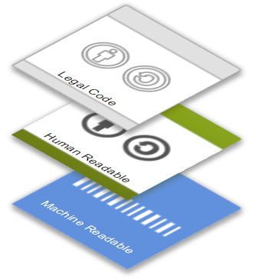
How does a public license work? CC
Creative Commons is a nonprofit organization that enables the sharing and use of creativity and knowledge through free legal tools.
https://creativecommons.org/
Licenses are offered through a three-layer design
Legal Code layer for lawyers
Common Deed or “Human Readable” layer for creators, educators, and scientists
Machine Readable layer for the web
Basili, R. - Building and using databases in Earth Sciences - Creazione e uso dei database nelle Scienze della Terra - Corso di Dottorato in Scienze Della Terra - Sapienza Università di Roma, 2024

Slide 32
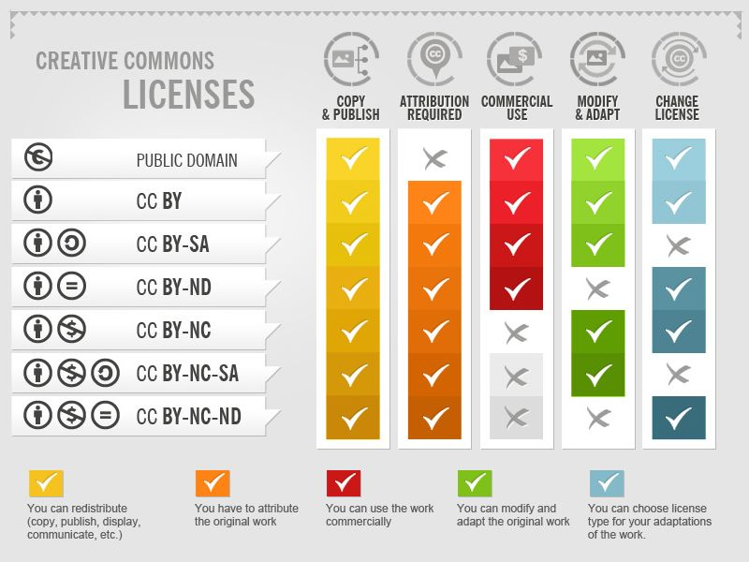
Licenses: conditions
Authors can condition the reuse of a creative work to:
Providing proper attribution (BY)
Redistributing with same license (SA)
Not modifying the original work (ND)
Not using for commercial purposes (NC)
A combination of these conditions
https://creativecommons.org/licenses/
Creative Commons licenses by Foter (CC-BY-SA)

Slide 33



Licenses: conditions …& Open Science compliance
Authors can condition the reuse of a creative work to:
Providing proper attribution (BY)
Redistributing with same license (SA)
Not modifyng the original work (ND)
Not using for commercial purposes (NC)
A combination of these conditions
Creative Commons licenses by Foter (CC-BY-SA)
https://creativecommons.org/licenses/
Notes:
I

Slide 34
Derivative works
Adaptation (…) or derivative work a new work that is created from a copyrighted work and is sufficiently original to itself be protected by copyright.
The definition of what is an adaptation or not can vary depending
on jurisdiction and context
to constitute an adaptation, the resulting work itself must be considered based on or derived from the original.
Collection: provide attribution and licensing information about the individual works that are part of the collection Vs adaptation: new license. Attribution of original work(s) must be provided for both.
This is the part that is sometimes difficult to determine!
Notes:
Copying a CC licensed work and sharing it is pretty simple. Just make sure to provide attribution and refrain from using it for commercial purposes if it is licensed with one of the NonCommercial licenses.
But what if you are changing a CC licensed work or incorporating it into a new work? First, remember that if your use of someone else’s CC licensed work falls under an exception or limitation to copyright (like fair use or fair dealing), then you have no obligations under the CC license. If that is not the case, you need to rely on the CC license for permission to adapt the work. The threshold question then becomes, is what you are doing creating an adaptation?

Slide 35
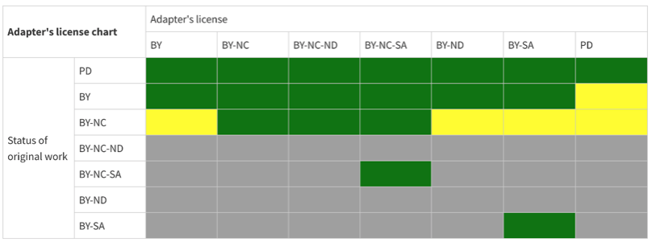
Adapter’s chart
CC Adapters License Chart / CC BY 4.0

Slide 36
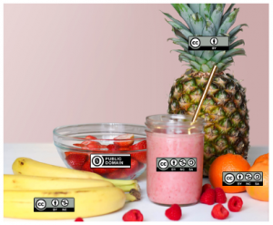
Licenses mixology
CC BY
Adaptation/Remix: CC BY – NC - SA
Attributions: “CC Smoothie” by Nate Angell. CC BY. Derivative of “Strawberry Smoothie On Glass Jar” by Element5 in the public domain, and various Creative Commons license icons by Creative Commons used under CC BY.
Public domain
CC BY – NC
CC BY – NC - SA

Slide 37
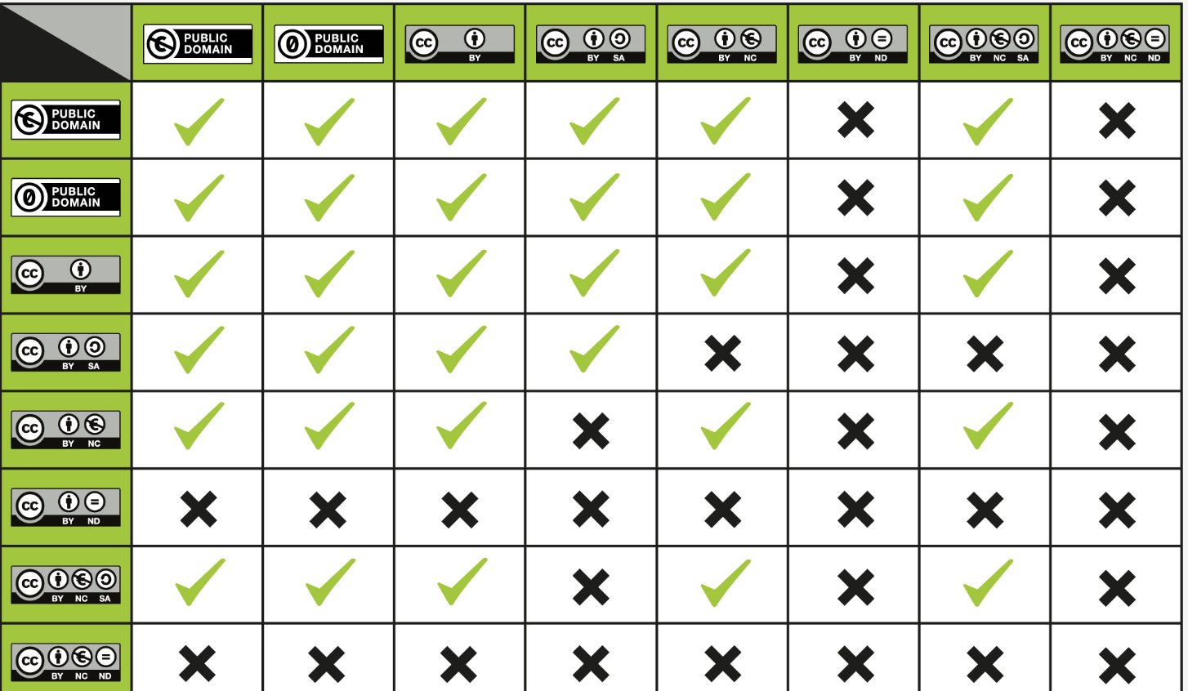
License compatibility chart
When mixing 2 works with different licenses in an adaptation, we generally are safe by selecting the more restrictive of the two
CC License Compatibility Chart / CC BY 4.0

Slide 38
Summarising: Fundamental principles:
Underlying work licensed under ND: we can make and use changes privately but not share adaptations with others
Underlying work licensed under SA: ShareAlike applies to our adaptation and derivative work must be shared with same/ compatible license
Underlying works licensed under different licenses: new license must consider license compatibility.

Slide 39
resources
https://creativecommons.org/faq/
https://certificates.creativecommons.org/cccertedu/

Slide 40

Thank you for your attention!
yourname.surname@email.something
www.epos-eu.org/on | social media #EPOSon
Notes:
Thank you slide

