Slide 1

Castanhao EPISODE: case study of Reservoir-Triggered Seismicity
Helena Ciechowska | hciechowska@igf.edu.pl
Notes:
Title slide

Slide 2



About me
Background in Physics
GeoPlanet Doctoral School
Department of Seismology, IG PAS
TCS AH
Research interests:
Anthropogenic seismicity,
Earthquake swarms. that's me by the way
Notes:
Content slide

Slide 3
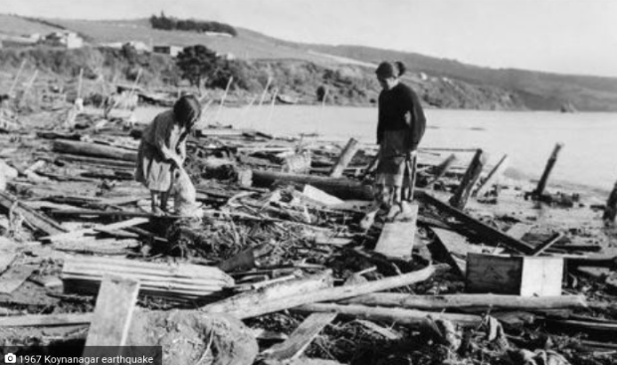
Reservoir-Triggered Seismicity
Anthropogenic origin,
May be caused by reservoir impoundment
and change in pore pressure in underlying
layers,
May cause dam damage and, in turn,
fatalities,
Many factors impacting the activity
- mechanisms not well understood yet.
Koynanagar earthquake, India, Dec. 11, 1967 Credits: pudhari.news

Slide 4
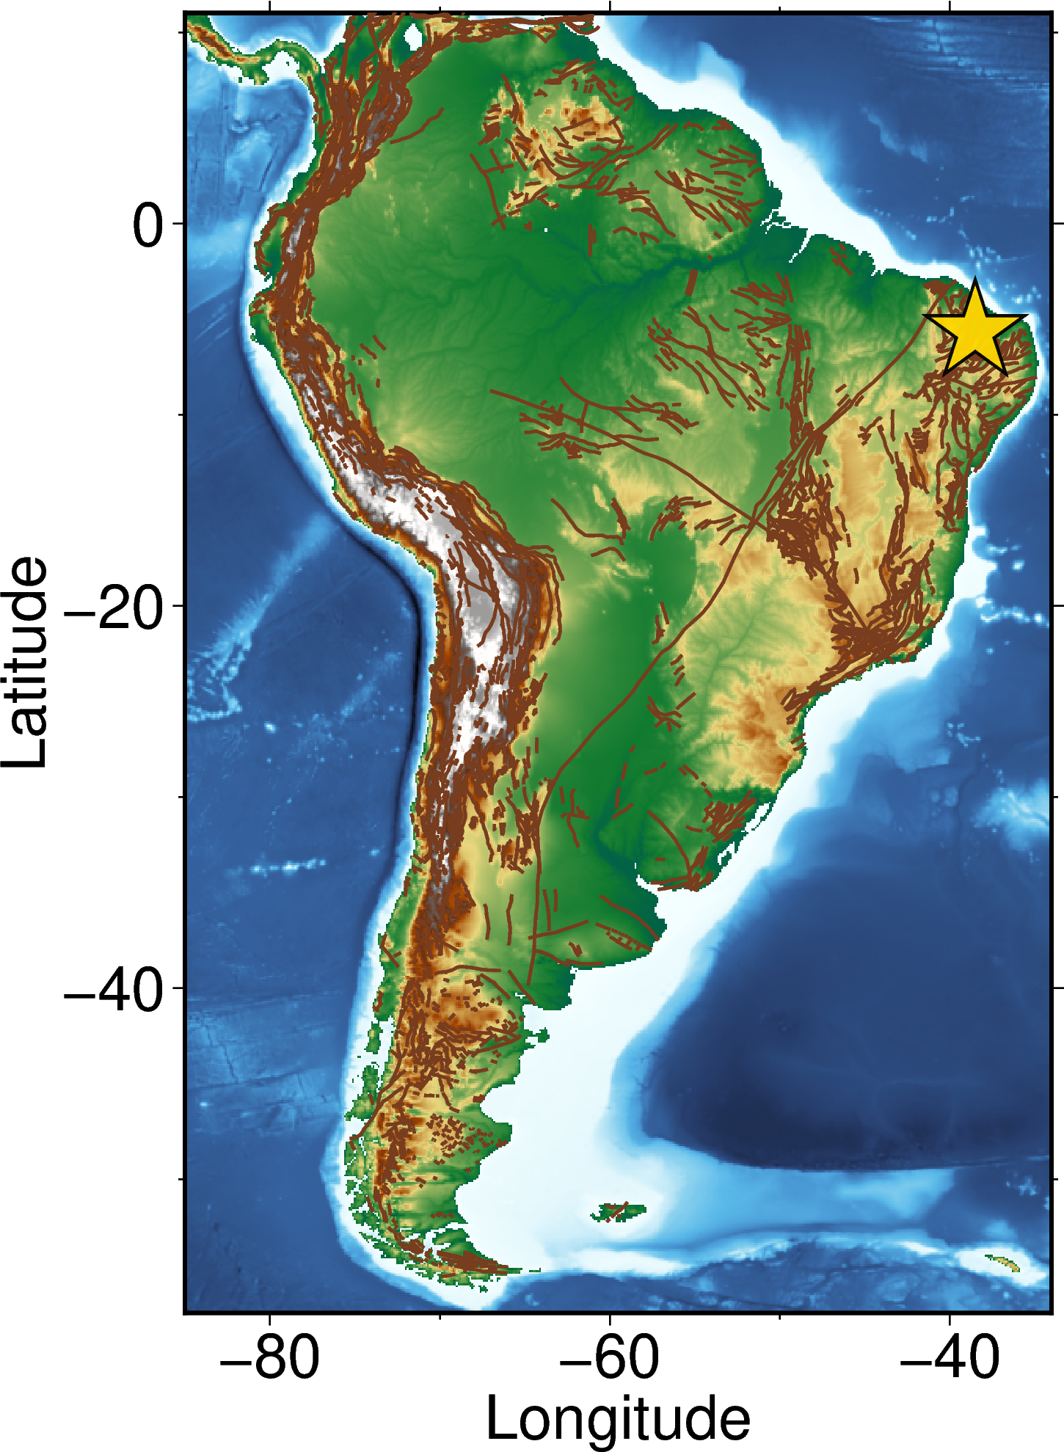
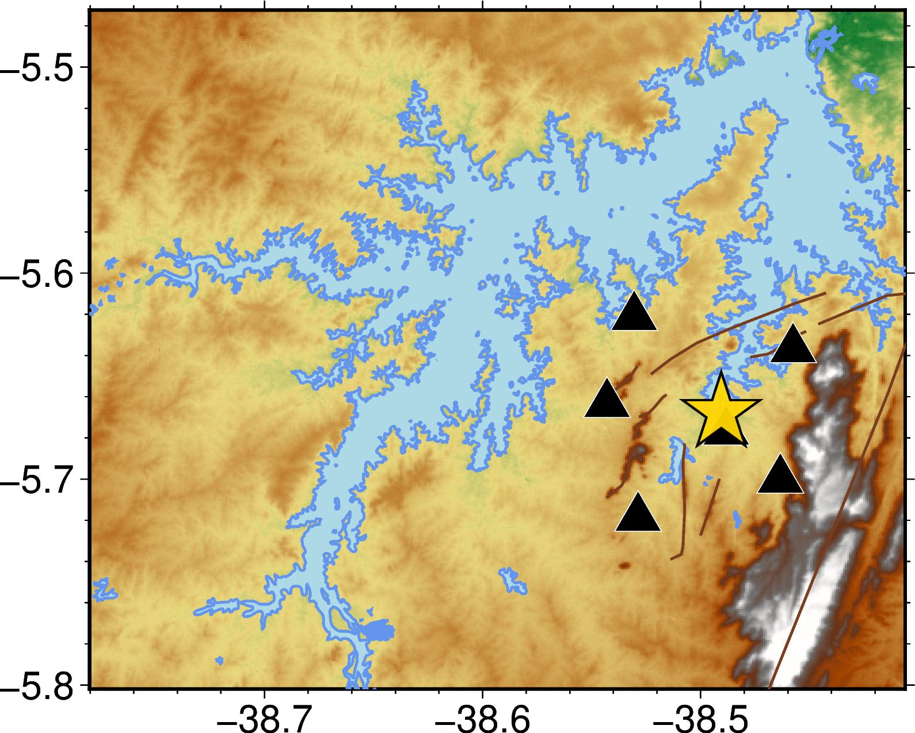
➣
CSGB
CSMY
CSSF
CSMI
CSBF
CSFS
Notes:
Content slide – 2 boxes with titles

Slide 5
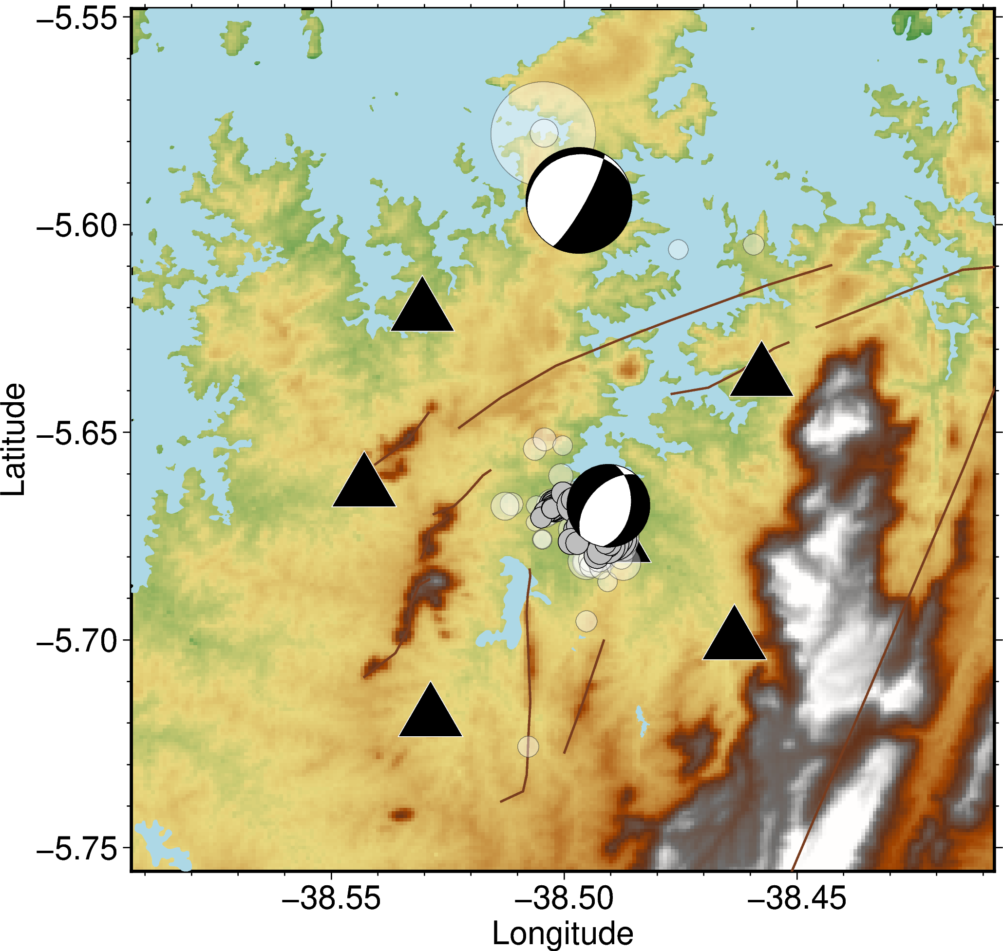
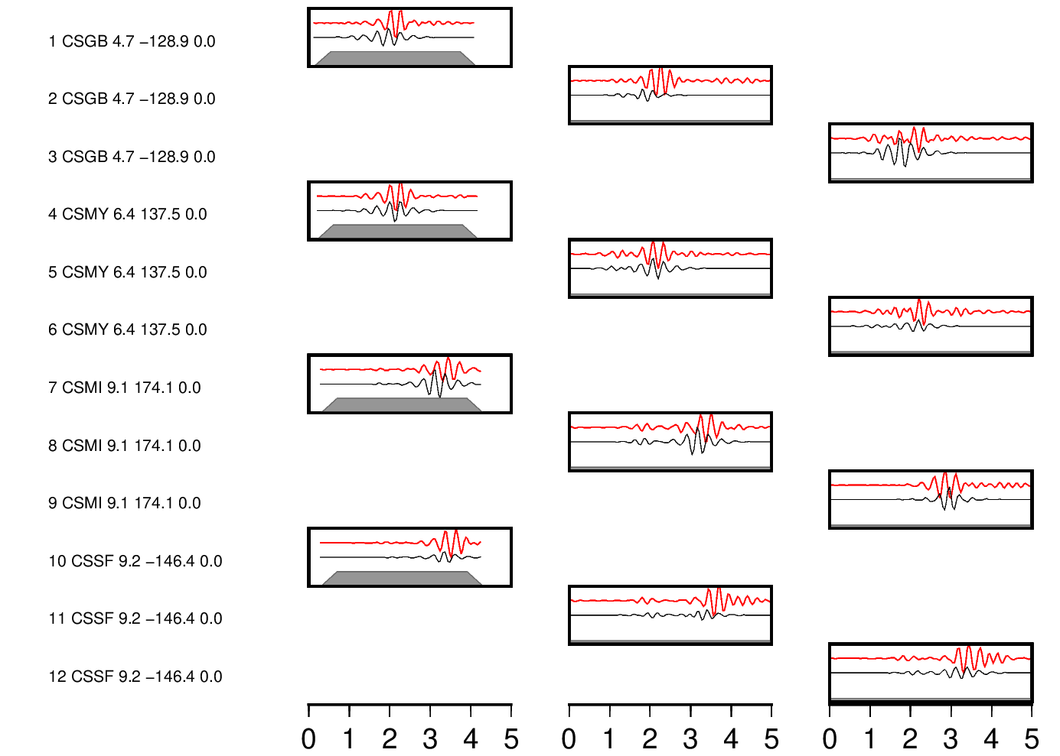
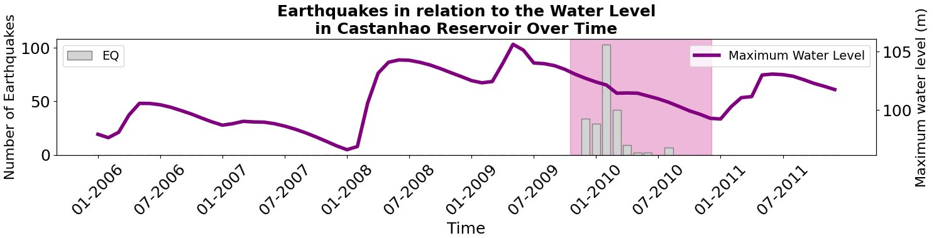
➣
CSGB.HHZ
CSGB
CSMY.HHZ
CSMY
CSMI.HHZ
CSSF
CSMI
CSSF.HHZ
CSFS
CSBF
Time [s]
Notes:
Title slide for large pictures, tables, maps, plots…

Slide 6

Thank you for your attention!
hciechowska@igf.edu.pl
www.epos-eu.org/on | social media #EPOSon
Notes:
Thank you slide

