Slide 1

Seismic data format conversion for spectral analysis purposes
Ljubcho Jovanov | ljubco.jovanov@hotmail.com
Notes:
Title slide

Slide 2
Who am I?
Researcher at the Seismological Observatory in Skopje
Teaching assistant at the Institute of Physics at the Faculty of Natural Sciences and Mathematics in Skopje
Main research domains:
local and regional seismicity
seismotectonics
seismic source parameters
seismic hazard
Notes:
Content slide

Slide 3
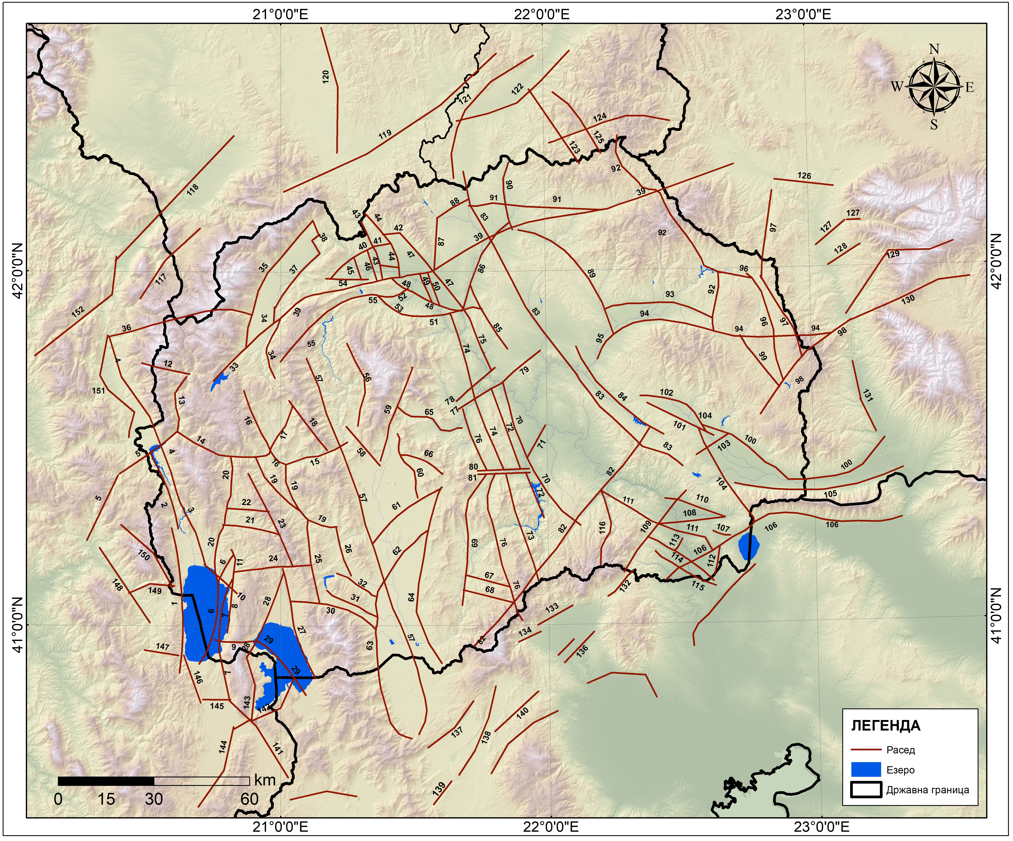
What am I working on?
Classification and parametrization of the faults
Cataloguing the earthquake data
Determination of FPS
Doing spectral analysis of specific events to determine the source parameters (M₀, f₀, L, W, A etc.)

Slide 4
Suggested scientific use case
Developing code/app for conversion of data into different formats:
ex: mseed → seed → sac → saf → json
The code/app can be upgraded to convert different types of data (geodetic, geomagnetic, GNSS etc.)
The result would be beneficial for many researchers who are not familiar with data format conversion.

Slide 5

Thank you for your attention!
ljubco.jovanov@hotmail.com
www.epos-eu.org/on | social media #EPOSon
Notes:
Thank you slide

