Slide 1

"Modelling of Earthquake and Tsunami Scenarios for Risk
Assessment”
Hany Elsayed| heldayed@ogs.it
Notes:
Title slide

Slide 2
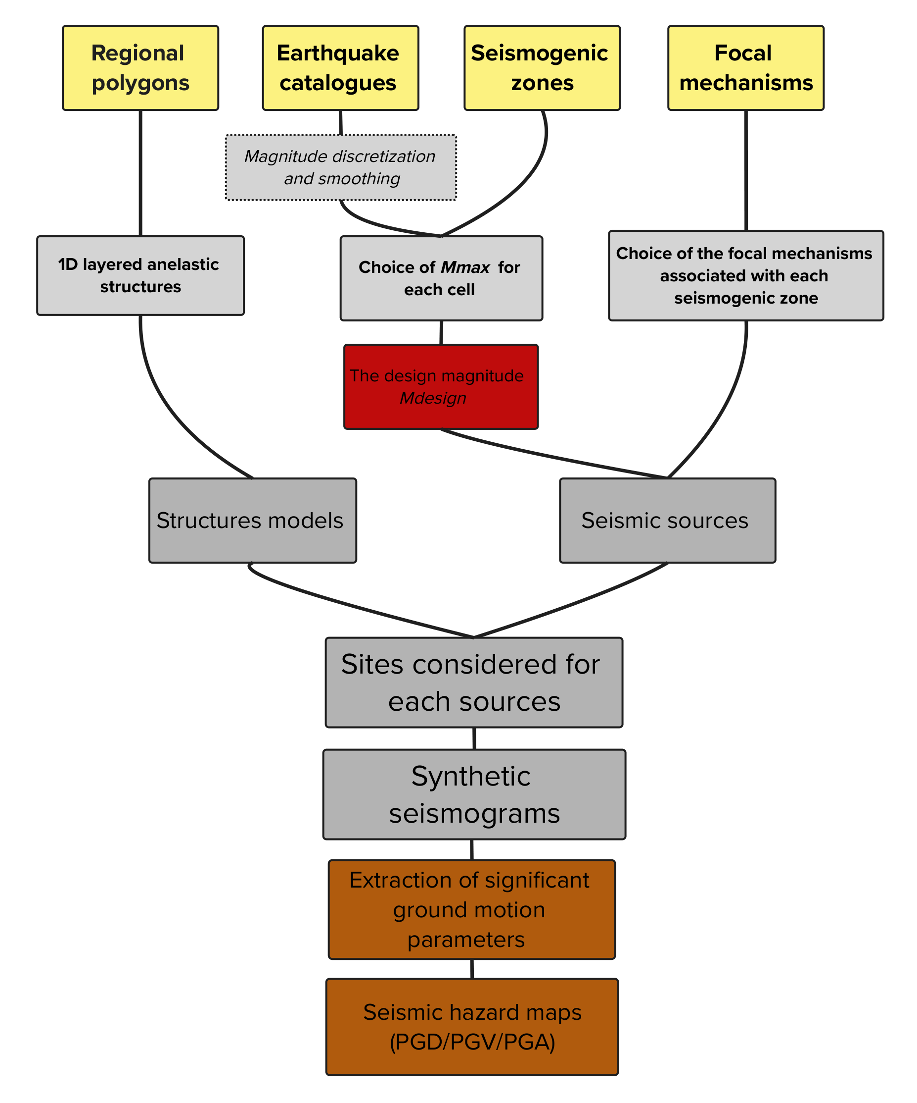
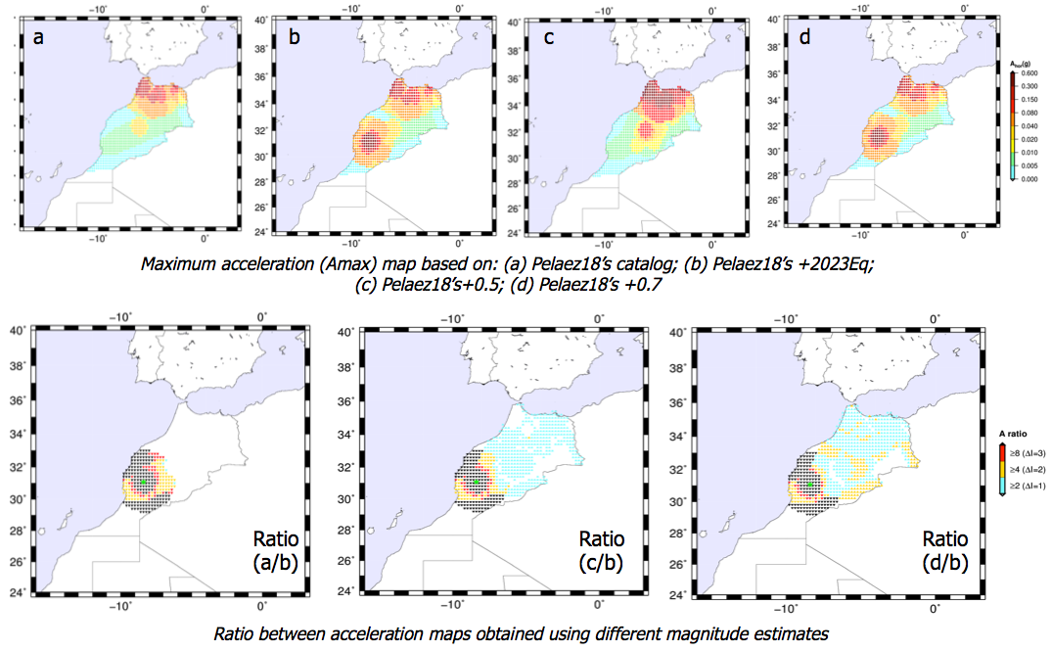
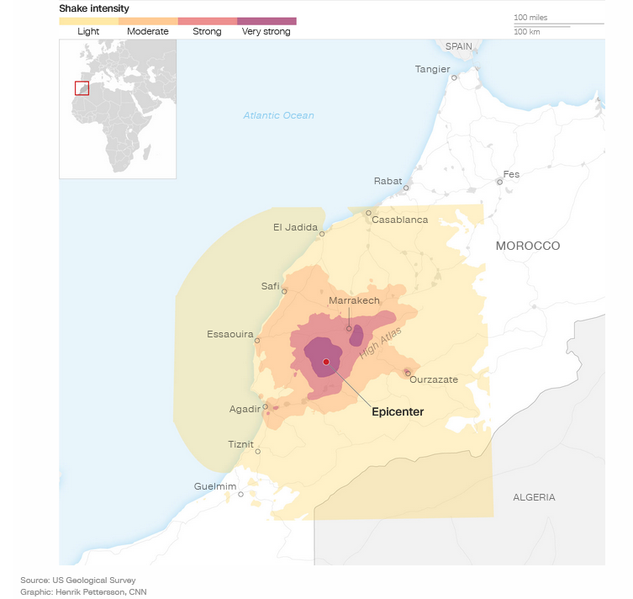
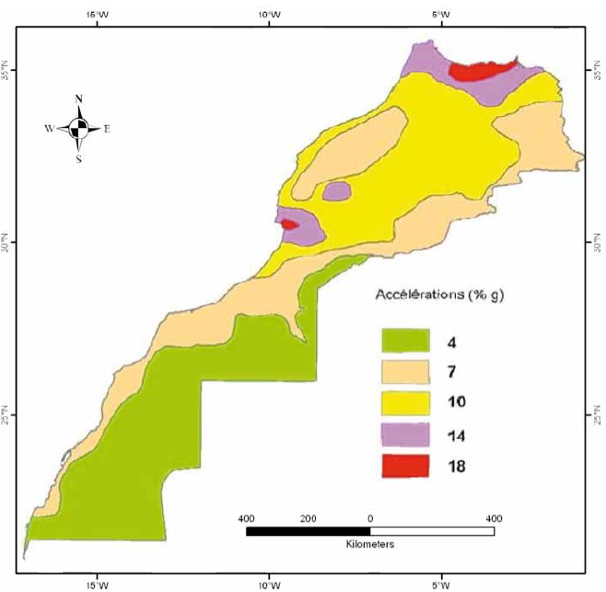
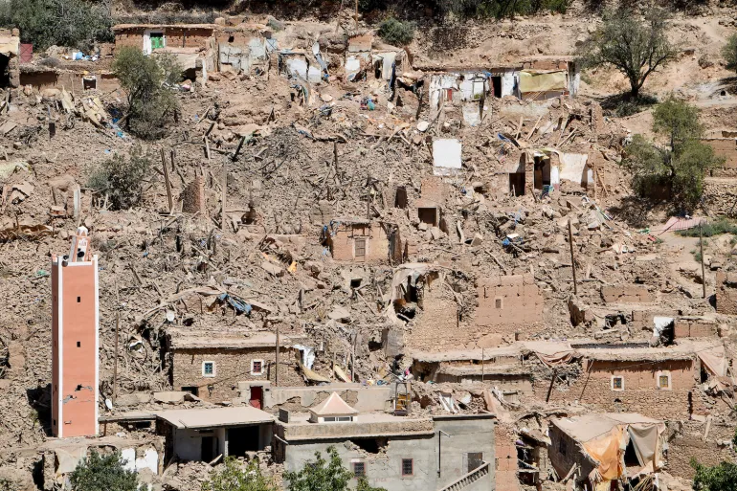
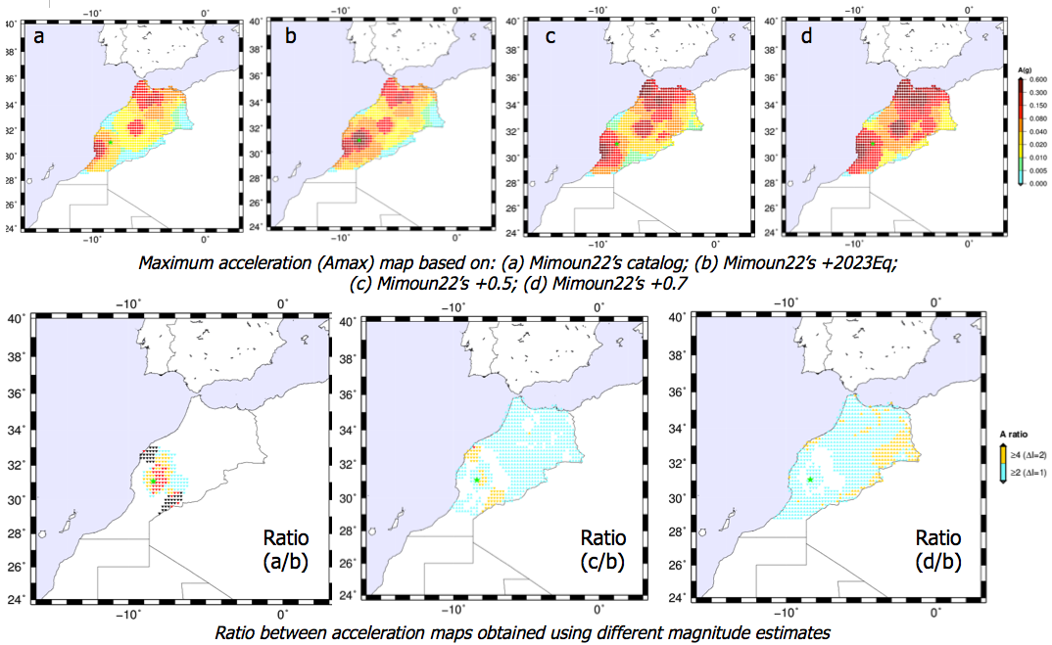
Ground Motion Forecasting for the 2023 Al-Haouz and 2004 Al-Hoceima Earthquakes in Morocco: insights from Maximum Credible Earthquake concept using Mdesign definition
On September 8, 2023, at 11:11 pm local time, a magnitude Mw 6.8 earthquake occurred with a focal depth of 26 km at Morocco’s High Atlas mountain range.
The earthquake resulted in more than 3,000 casualties and damaged or collapsed tens of thousands of structures.
  Testing Pelaez et al. (2018) earthquake catalog
  Testing Mimoun et al. (2022) earthquake catalog
Seismic zoning based on peak ground accaeleration (PGA) values corresponding to the Design Basis Earthquake (DBE) hazard level (Acceleration %g) (Source: RPS 2000, 2011).
Whether the observed earthquake ground motion could have been forecasted?
A schematic diagram of the Neo-deterministic Seismic Hazard Assessment (NDSHA) methodology. Figure modified from Zhang et al. (2025).

Slide 3
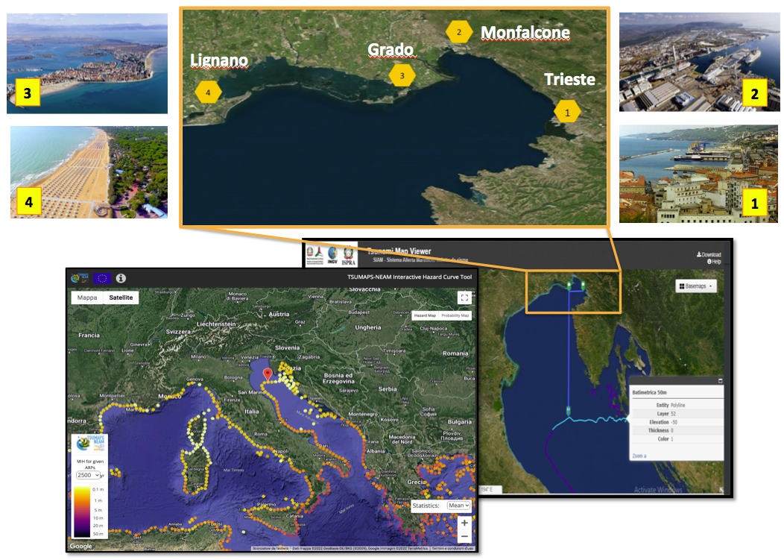
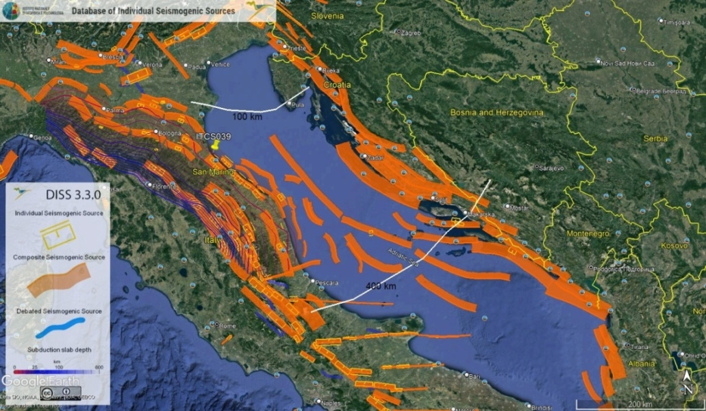
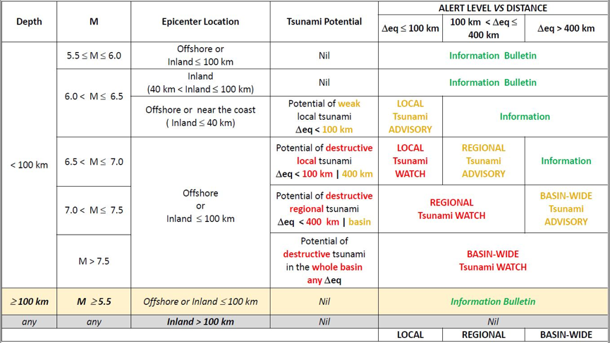
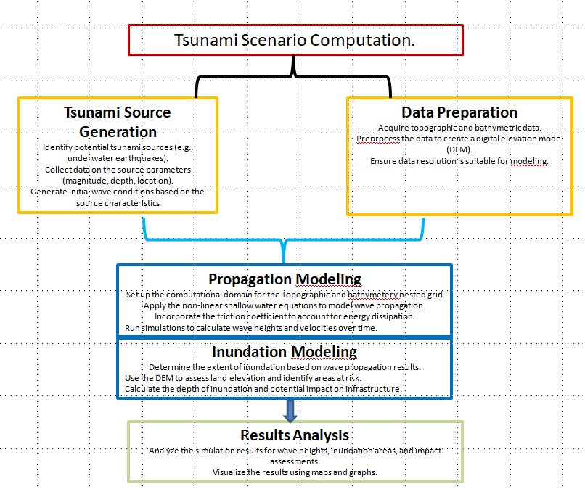
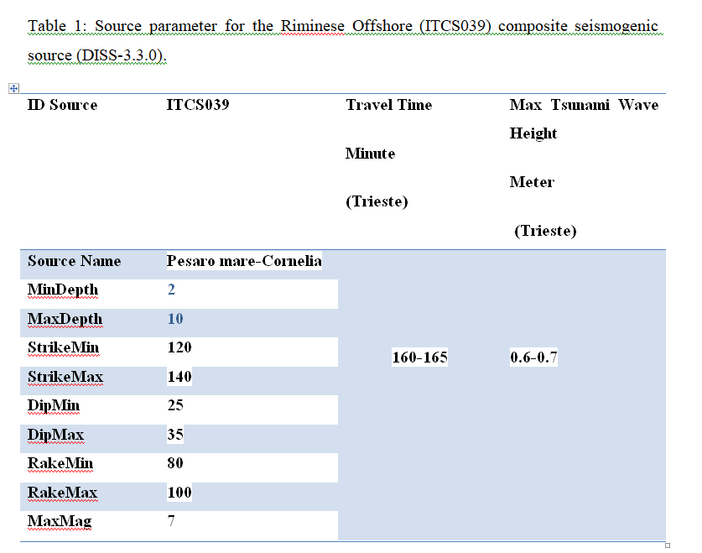
High resolution tsunami hazard scenarios for multi-risk analysis
Motivations:
Site Specific Tsunami Hazard Assessment for FVG
Need for High-Resolution Inundation and Travel Time Maps
Precomputed Tsunami Scenarios for Emergency Preparedness for Future Tsunami Scenarios
Public Awareness and Resilience Building
Economic and Social Impact Mitigation
Tsunamigenic earthquake sources in the Adriatic Sea
Objective and Area of Inaterest (AOI)
The fault rupture parameters for developing earthquake induced tsunami scenarios are defined from DISS-3.3.0 and following the tsunami decision matrix developed by CAT-INGV (Fig. 2).
M_{max}≥6.5 for regional tsunami (100 km < distance ≤ 400) and basin-wide tsunami (distance > 400 km).
Flowchart for Multi-Scenario tsunami simulation.
Notes:
Content slide

Slide 4
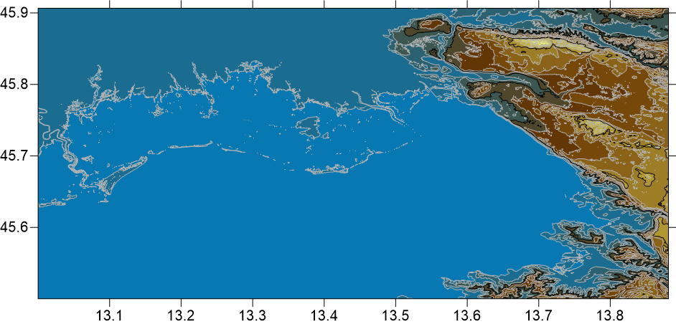
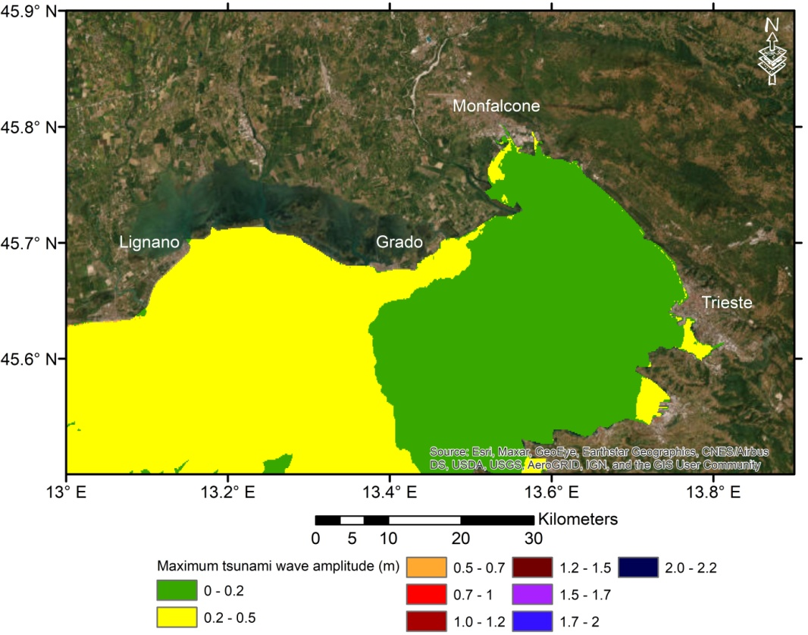
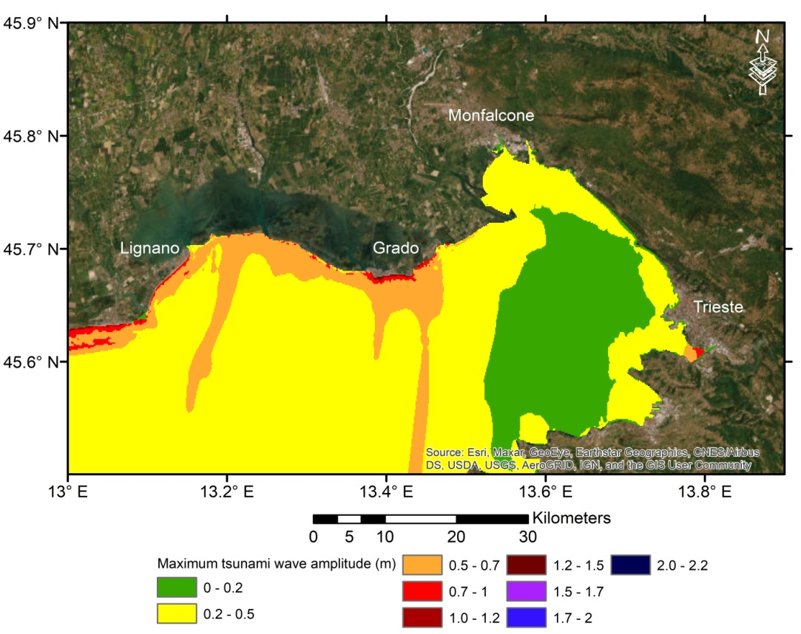
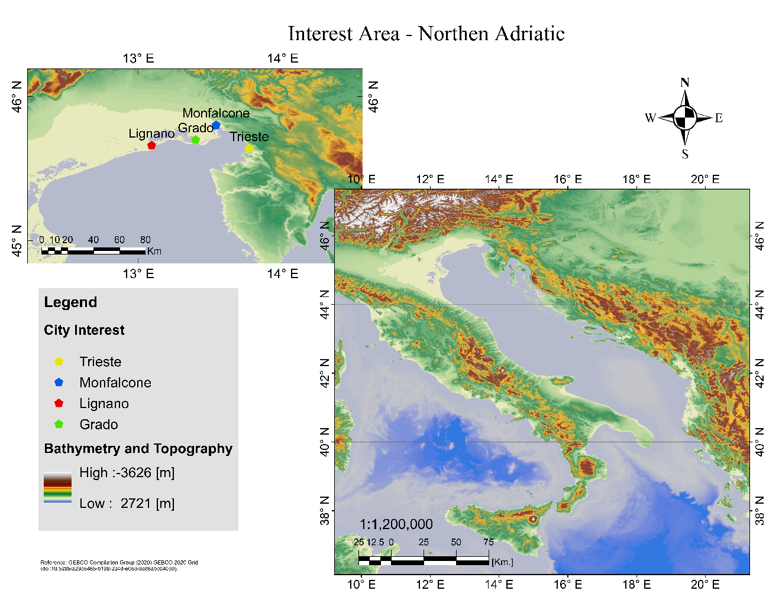
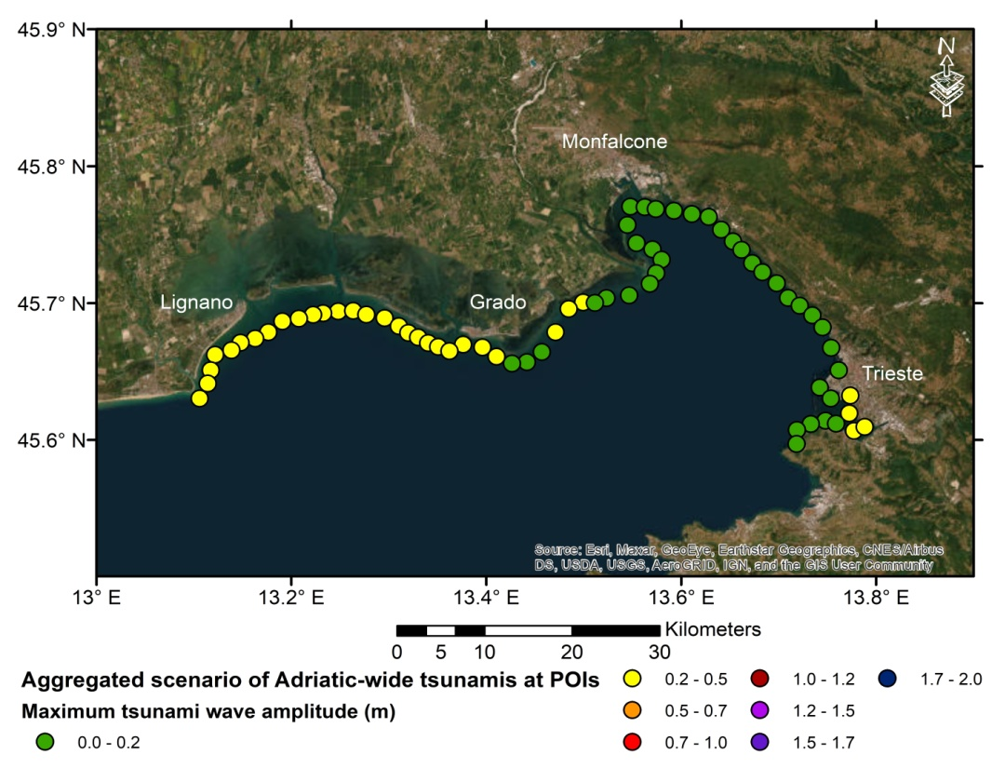
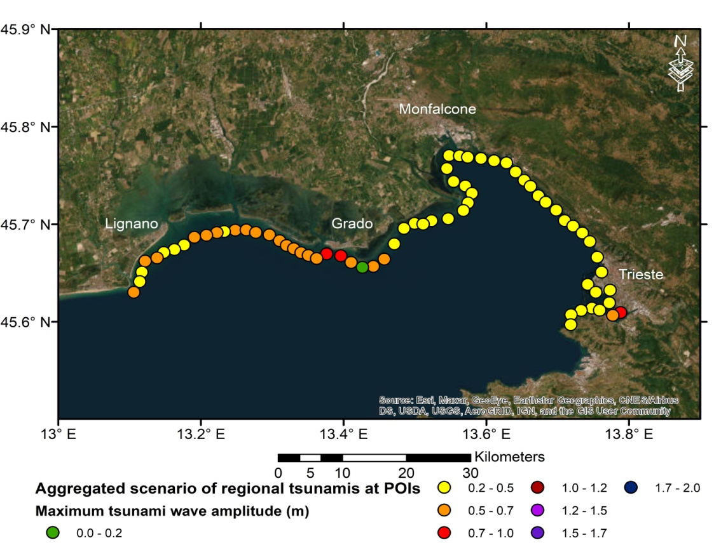
Earthquake Rupture Data and
Bathymetry and Topographic Data
Tsunami Hazard Maps for The FVG Coastal areas computed at MSL
Adriatic-Wide Tsunamigenic Earthquake Sources
Regional Tsunamigenic Earthquake Sources
c
a
a
b
a
b
b
Three nested grids of topographic-bathymetry data were extracted, processed and converted into the format required by the tsunami modelling code (NAMI DANCE):
a) The coarse-domain from GEBCO-2020 (GEBCO Compilation Group 2020). Fig. 3a
b) Medium-domain from the EMODnet portal (https://portal.emodnet-bathymetry.eu/). Fig .3b
c) A fine topographic-bathymetry of about 25m. Fig. 3c
a) Map of the maximum tsunami wave amplitude computed for the Adriatic-wide sources located at distance larger than 400 km from the area of interest (AOI). b) The maximum tsunami wave amplitude computed for the Adriatic-wide sources at the selected POIs.
a) Map of the maximum tsunami wave amplitude computed for the regional tsunamigenic sources. b) The maximum tsunami wave amplitude computed for the regional tsunamigenic sources at POIs.

Slide 5
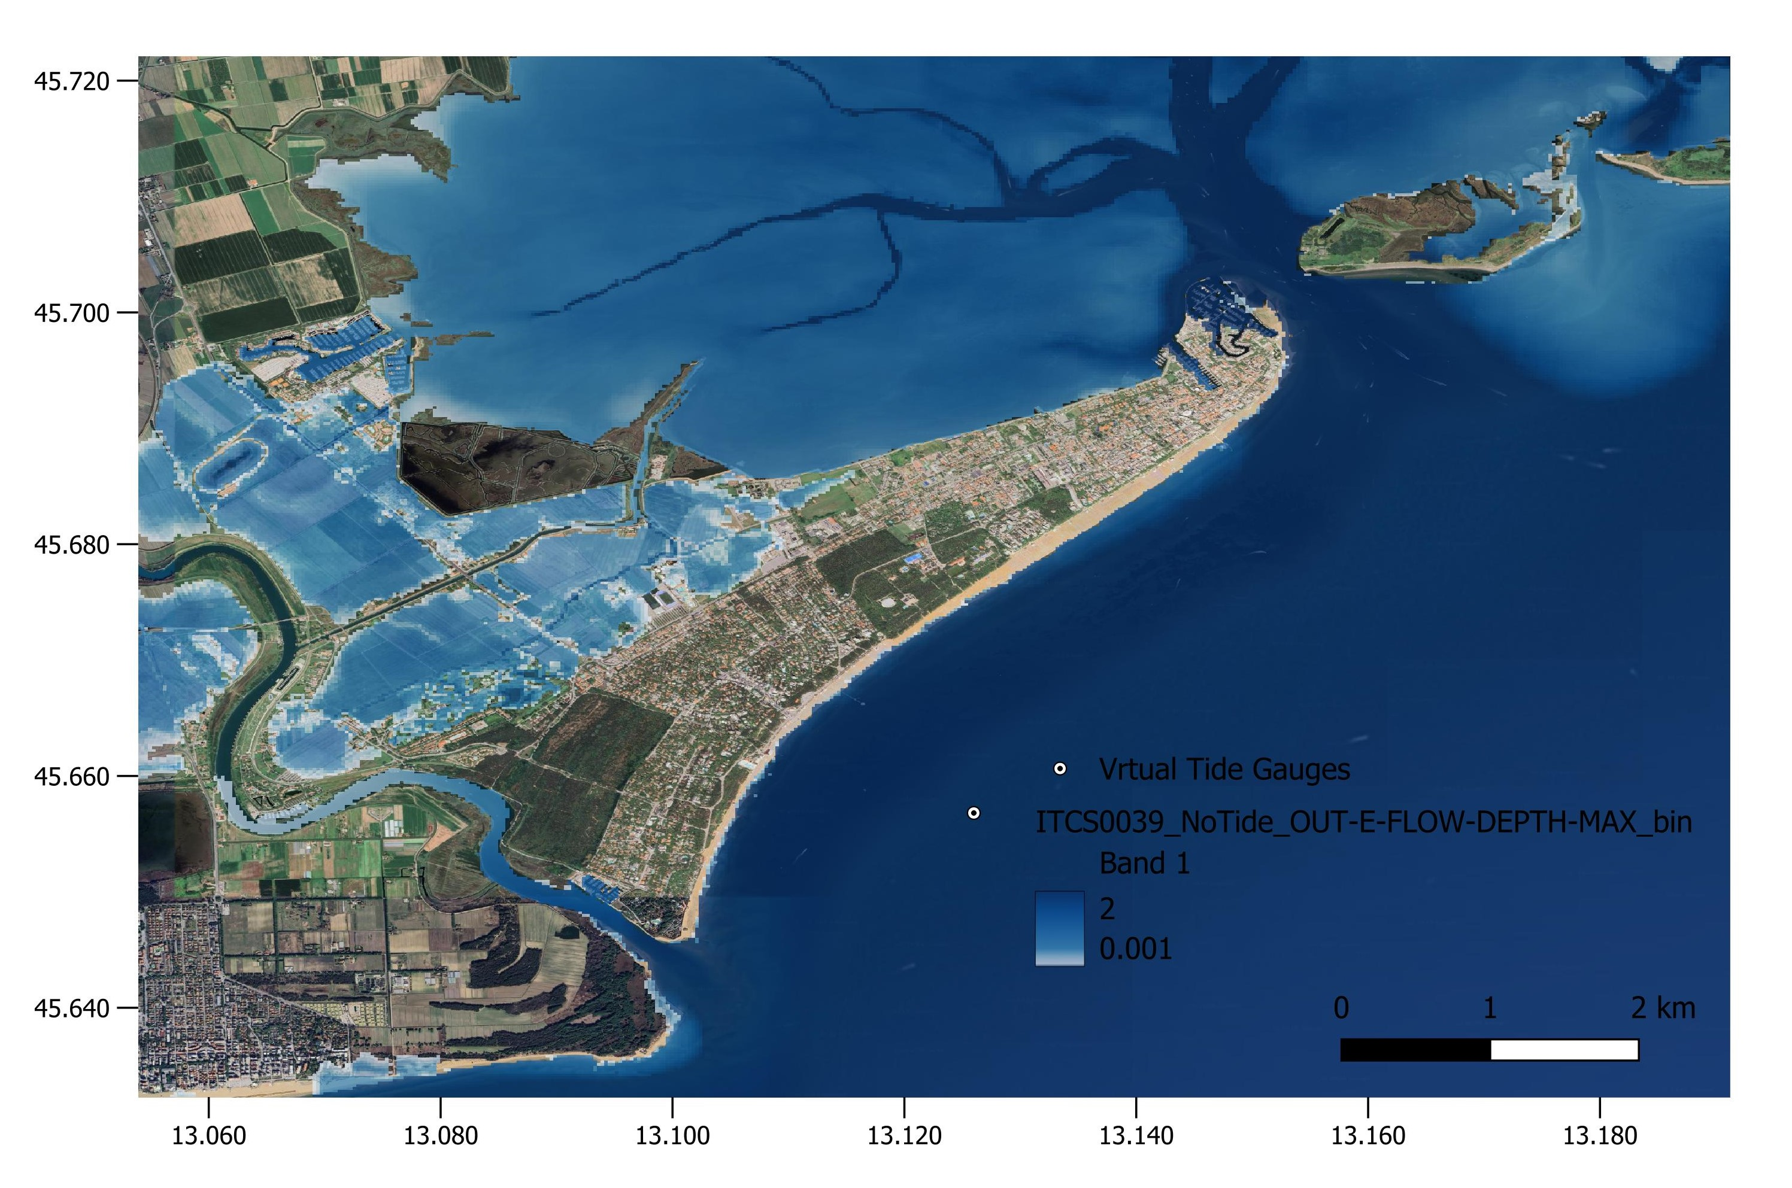
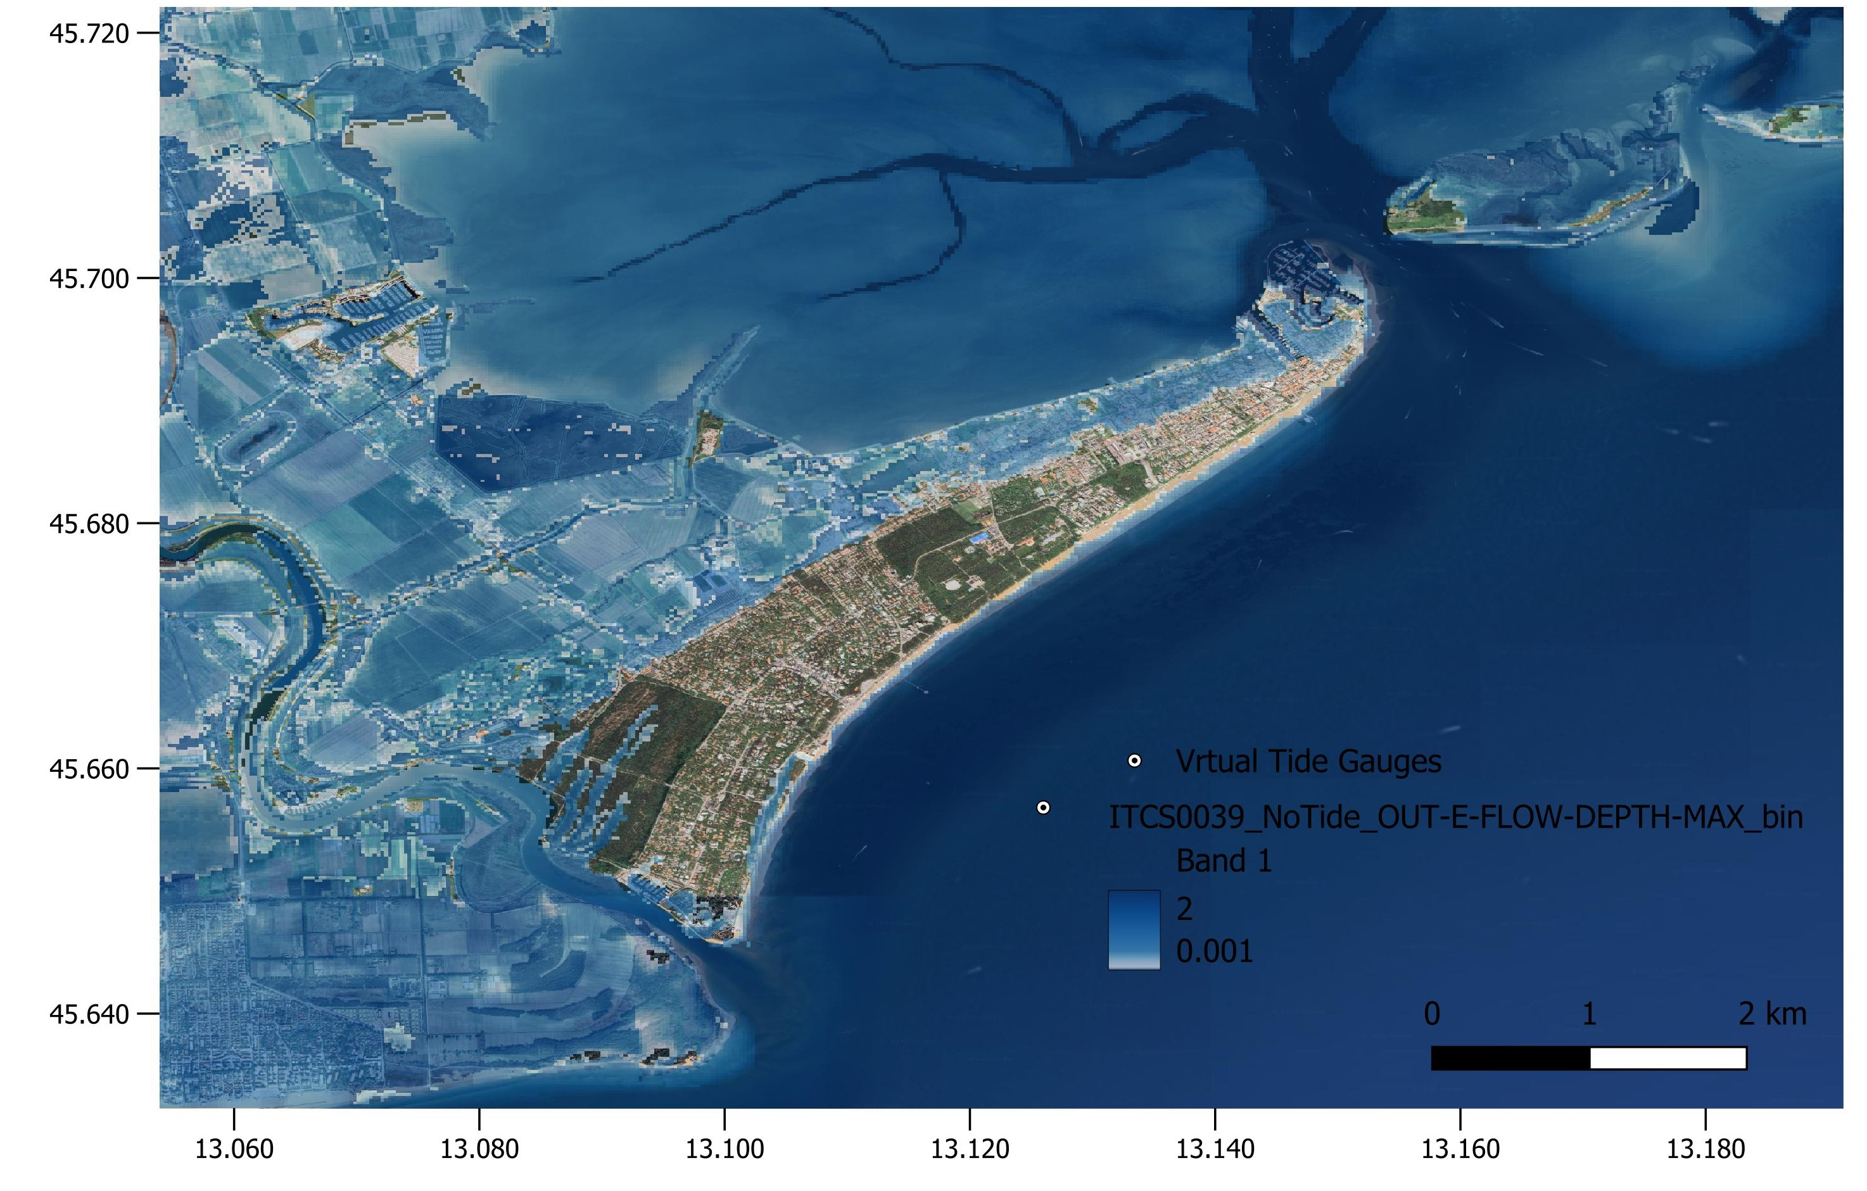
RETURN
Multi Risk sciEnce for resilienT commUnities undeR a changiNg climate
What if we consider SLR, Tide and Sea surges in in Tsunami Modelling for 30 years scenario?
Multi-hazard risk assessment in coastal areas:
Increased or Dynamic Exposure and Vulnerability:
Concentrated Populations;
Infrastructure Exposure: Critical infrastructure (ports, energy, transportation) is heavily concentrated;
Climate Change Amplification: Sea-level rise, intensified storms, and changing weather patterns exacerbate existing hazards.
II. Interconnected Hazards:
Cascading Effects: One hazard (e.g., storm surge) can trigger others (e.g., flooding, landslides, pollution);
Synergistic Impacts: Combined effects of multiple hazards exceed the sum of individual impacts; Complex Interactions: Understanding the interplay between hazards is crucial for accurate risk assessment.

Slide 6

Thank you for your attention!
yourname.surname@email.something
www.epos-eu.org/on | social media #EPOSon
Notes:
Thank you slide

