Slide 1

Evaluating the Impact of Elevation Correction on Ground Magnetic Profiles
Andrei MIHAI | Contacts: mihai.a.andrei@gmail.com
PhD student at the University of Bucharest
Working at the National Institute for Earth Physics, Romania
Domain: Geomagnetism, Seismic Tomography, Near-Fault Observatories, Geology
Notes:
Title slide

Slide 2

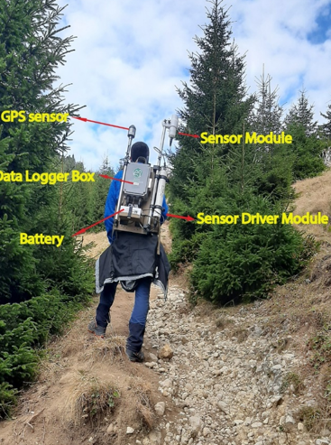
Equipment and Methodology
What I Did
Data interpretation
Magnetic profile plotting
Data processing and diurnal variation removal
Ground magnetic measurements
Study area setup and survey line upload
Base station G-862 Magnetometer
Surveying G-864 Magnetometer
Notes:
Content slide

Slide 3
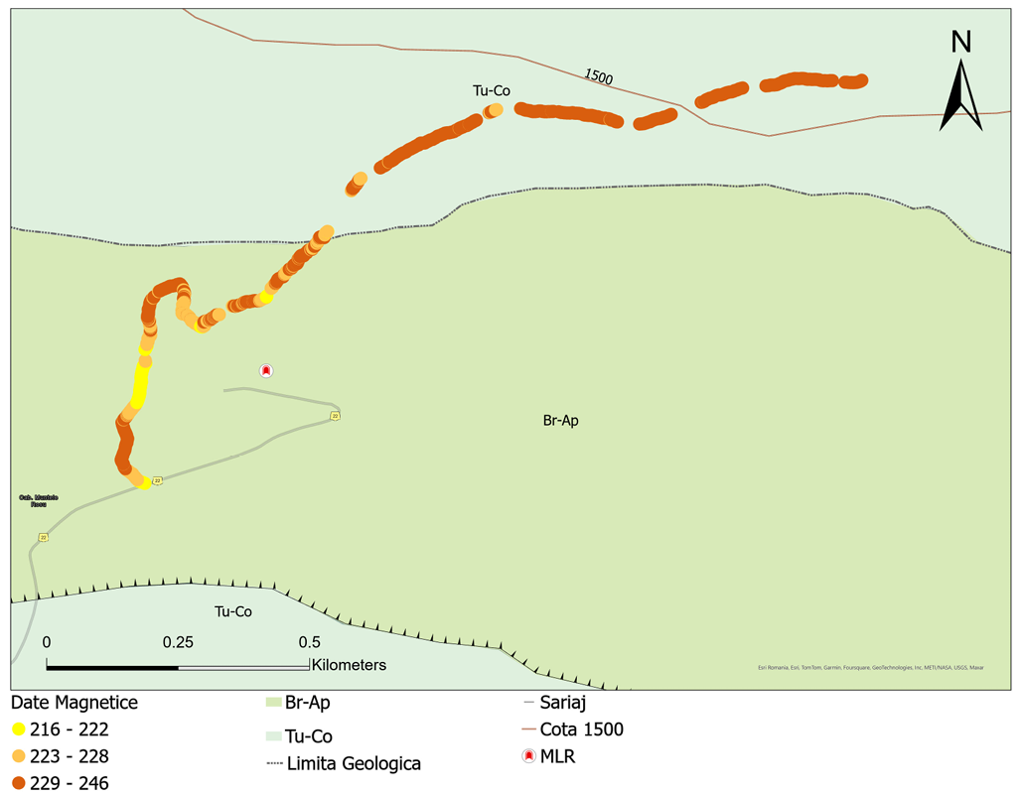
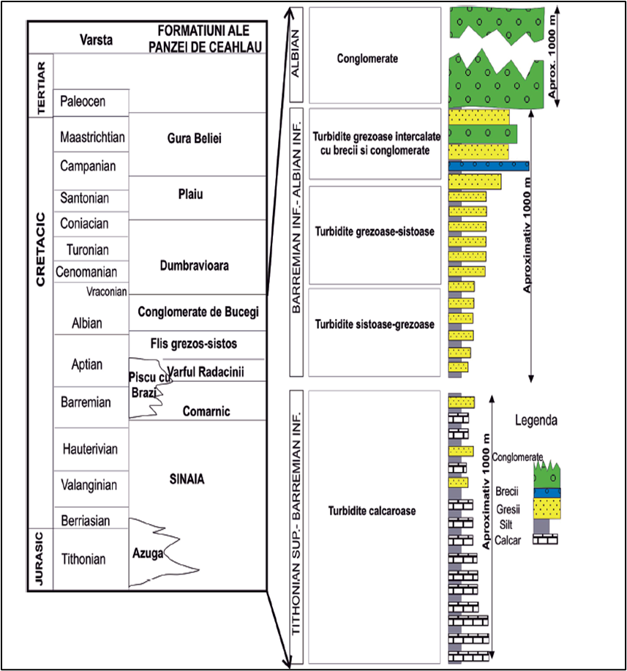
Results
What I Did
The local magnetic profile, approximately 1.6 km long, highlights the transition from calcareous turbidites to sandy and shaly turbidites.
Local lithology (Briceag et al 2008)
Notes:
Content slide – 2 boxes

Slide 4
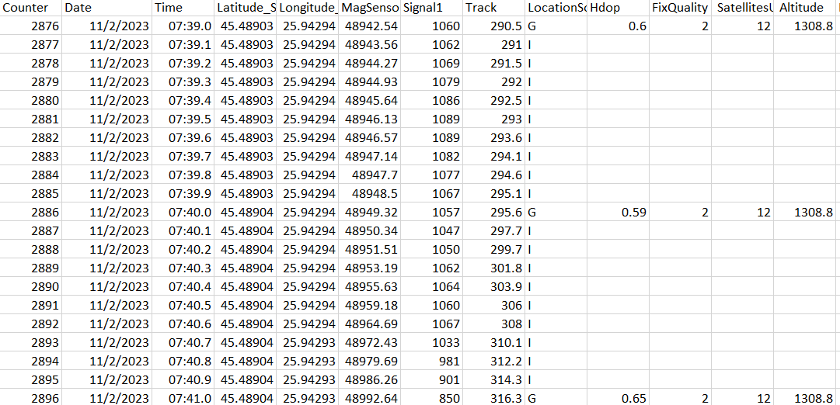
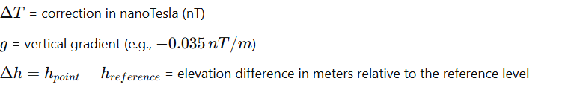
What I Want to Improve
Applying Elevation Correction.
Will the elevation correction significantly change the data?
Some steps
Create a code which:
Interpolate the GPS data recorded at 1 Hz to match the 10 Hz magnetic data, or average the magnetic data down to 1 Hz.
Applying elevation correction ΔT=g×Δh
Compare the new results
1Hz GPS data
Notes:
Content slide – 2 boxes with titles

Slide 5
Thankyou for the attention!
Notes:
Title slide for large pictures, tables, maps, plots…

Slide 6
Notes:
Empty slide for large pictures, tables, maps, plots…

Slide 7
Notes:
Section title slide

Slide 8

Thank you for your attention!
yourname.surname@email.something
www.epos-eu.org/on | social media #EPOSon
Notes:
Thank you slide

Slide 9
Notes:
Logo only

Slide 10
Guidelines for using the template /1
Text boxes in this template are set to «do not autofit»:
  this is done on purpose and it means that you are supposed to use the default options for titles, subititles and contents.
    we have set the defaults for optimal readbility. If your content is not fitting in the slide, it means that you need two slides or your audience will struggle with reading!
    Please do not change the settings of the template just to add more text in a slide!
Please never make any changes to the slide master or the template in general on your own!
  If you feel there’s something wrong with the template just let us know!

Slide 11
Guidelines for using the template /2
As usual with PPT templates, this one includes several layouts: make sure you use the appropriate one:
  Title slide: only at the beginning of your presentation
  Section header: when you want to divide different parts of the presentation
  Content slides: you have different ones depending on the kind of content you need to use.
    Do not forget to use the layout without the footer (with or without title) in case you need to put in the slide big pictures, maps, videos etc that would (partly) overlap with it
    Prefer the provided table slide as format is already set. If you add the table in a second moment, please check that the font is Calibri

Slide 12
Guidelines for using the template /3
You should always use the official template font, which is Calibri (regular for the text and bold for titles).
  If functional to what you are communicating, you may use other colours in the content box (provided they offer enough contrast to be readable in different luminosity conditions) but please try to use the template colours for titles (forest green for sections and black for cover and slide titles)
    There might be exceptions to this rules, e.g. if you need to highlight something in the title (see the /3 indicator in this slide’s title)
    The Author(s) | Contacts | Date – Occasion box in the slide title is the only instance of a golden (sub)title

Slide 13

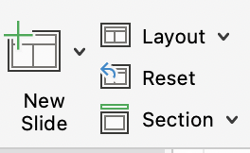
Guidelines for using the template /4
Templates work best when you create your slide from scratch!
  If you need to copy into the template one or more slides that come from another presentation with a different template/theme, please:
    Copy-and-paste the slide(s) in the slide sorter
    Click on the near the slide (if you have more than one you’ll need to repeat the action) and select the «use destination Theme»
    Check if the theme was applied correctly or needs some tweaks
      You can adjust any part of the transferred slide manually but you may want to try the «Reset» command on the new slide pane:

Slide 14
Guidelines for using the template /5
Before you go….
Should you need any help with the template or have any suggestion to improve it or these guidelines, please contact communication@epos-eric.eu and let us know!

