Slide 1

Use case: designing and distributing seismic data quality metrics.
Thomas Benson | GNS Science, New Zealand
t.benson@gns.cri.nz | t.l3enson@gmail.com
Notes:
Title slide

Slide 2
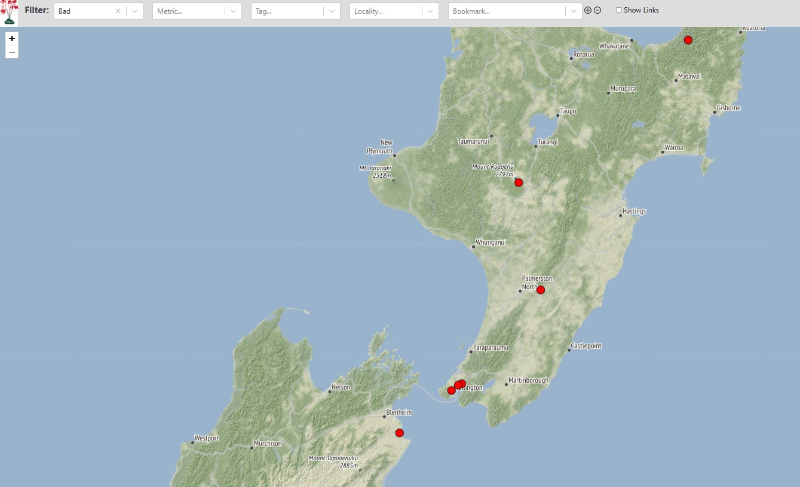
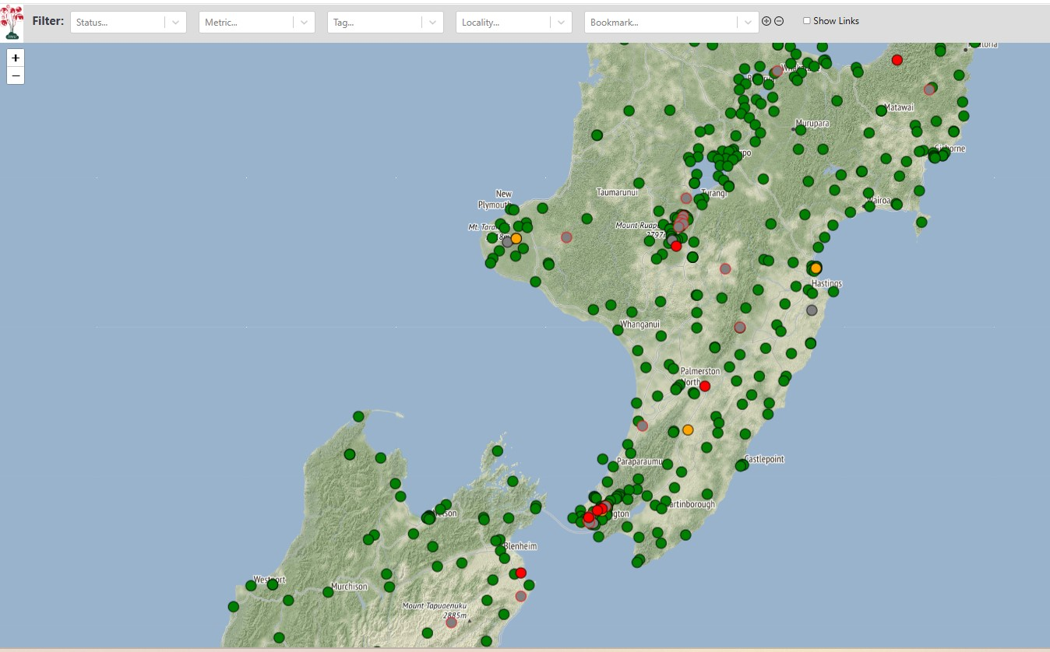
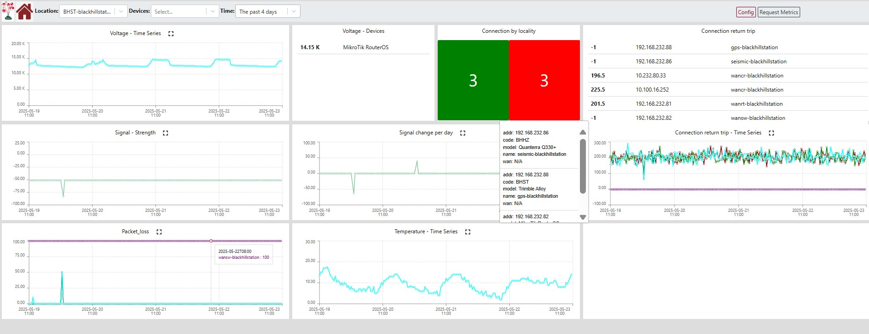
Current State of Site Monitoring: State of Health
The Geonet Programme collects data from 800+ seismic instruments across NZ.
We have some internal state of health metrics and platforms to check that stations are online and producing data.
Also rely on staff in our 24/7 monitoring centre and end user for input on changes in the quality of the data
Limited communication to our end users (Focused on core stakeholders)
Notes:
State of health metrics monitor the state of the connection to the site, signal strength, latency, and packet loss, as well as battery charge, temperature, GPS timing

Slide 3
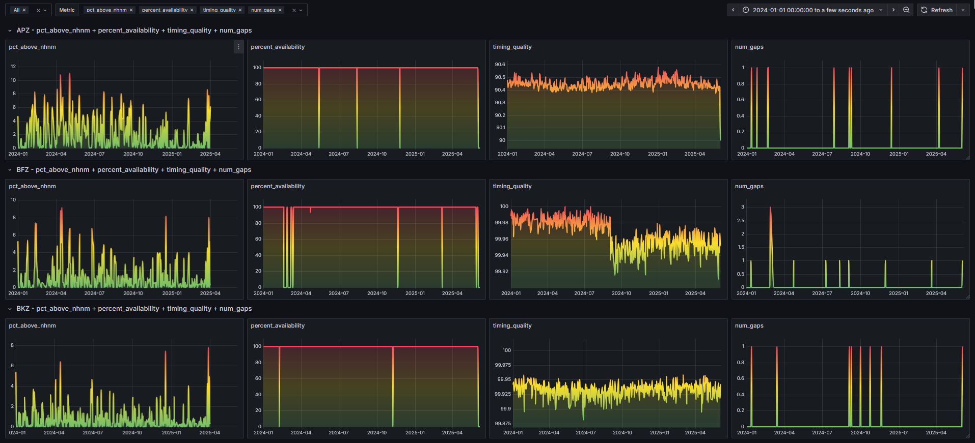
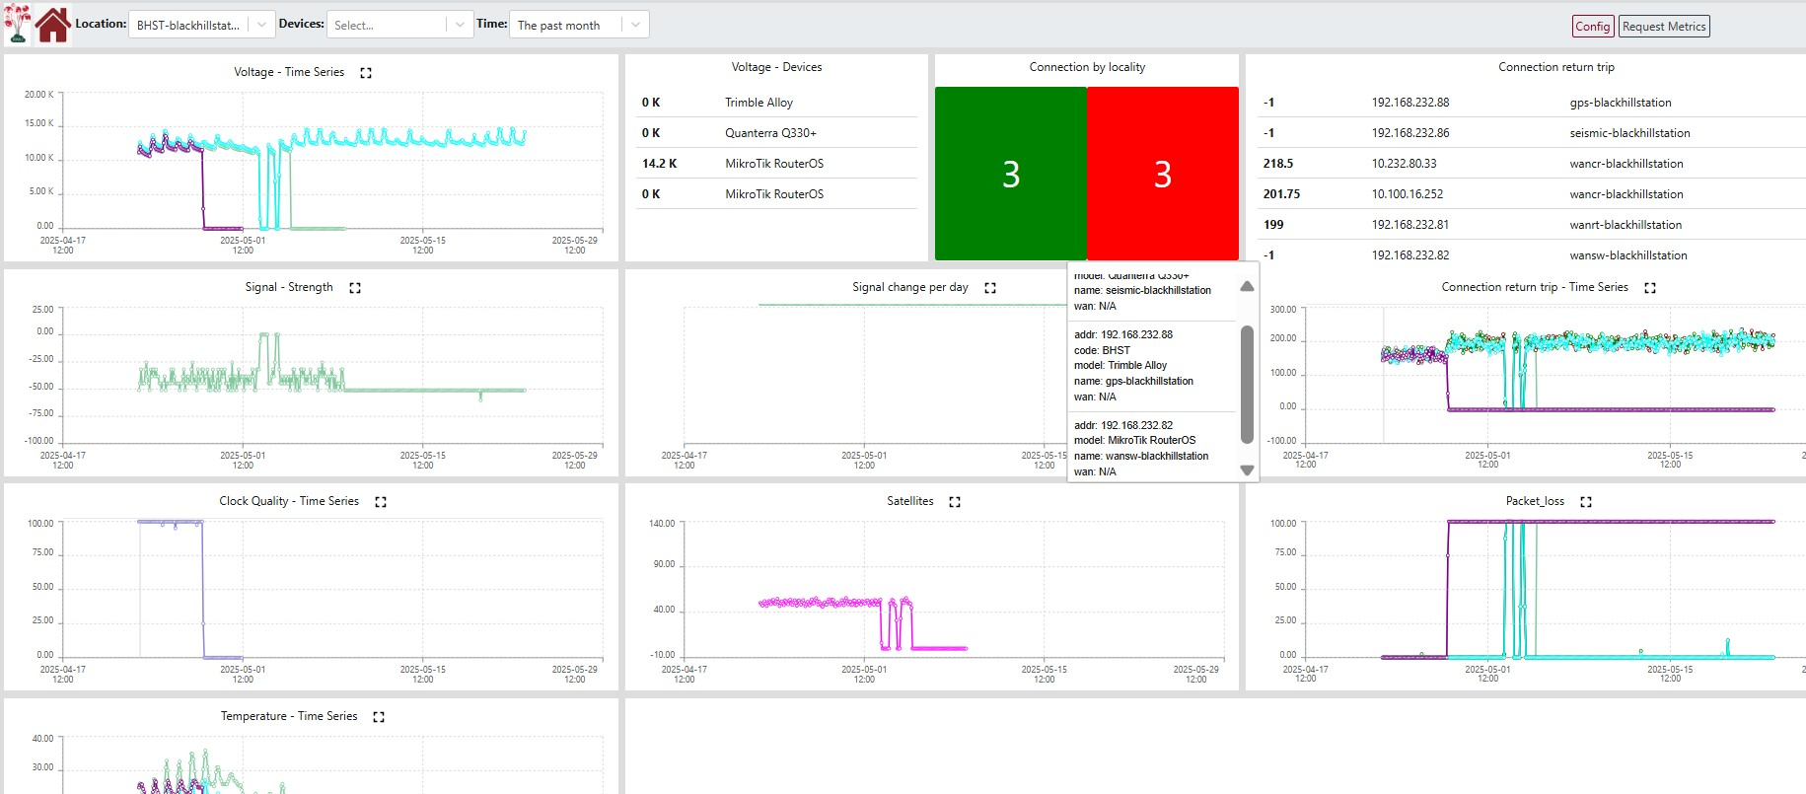
The Solution?
We are in the early stages of developing more advanced metrics to measure the quality of the data coming from a site.
These currently exist as prototypes, private tools, or as log files buried inside collection systems
Notes:
Content slide – 2 boxes

Slide 4
What we need to think about
We want to start small, as we work out who will use this tool, how much, and what metrics will be most useful
Standard methods for distributing seismic data to not include mechanisms for sharing comprehensive data quality metrics
Similar organisations that do distribute metrics use large web platforms/applications that do not suit our initial approach
Ideal mechansims: a lightweight, (text file based?) that can be distributed through existing file browser systems, or a small web application that do not take much time from dev teams to implement
Notes:
I.e. IRIS’ Mustang. We want something like a static file(text,csv etc) we can distribute with existing file based systems i.e. data.geonet (screenshot?)

Slide 5

Thank you for your attention!
t.benson@gns.cri.nz
www.epos-eu.org/on | social media #EPOSon
Notes:
Thank you slide

