Slide 1
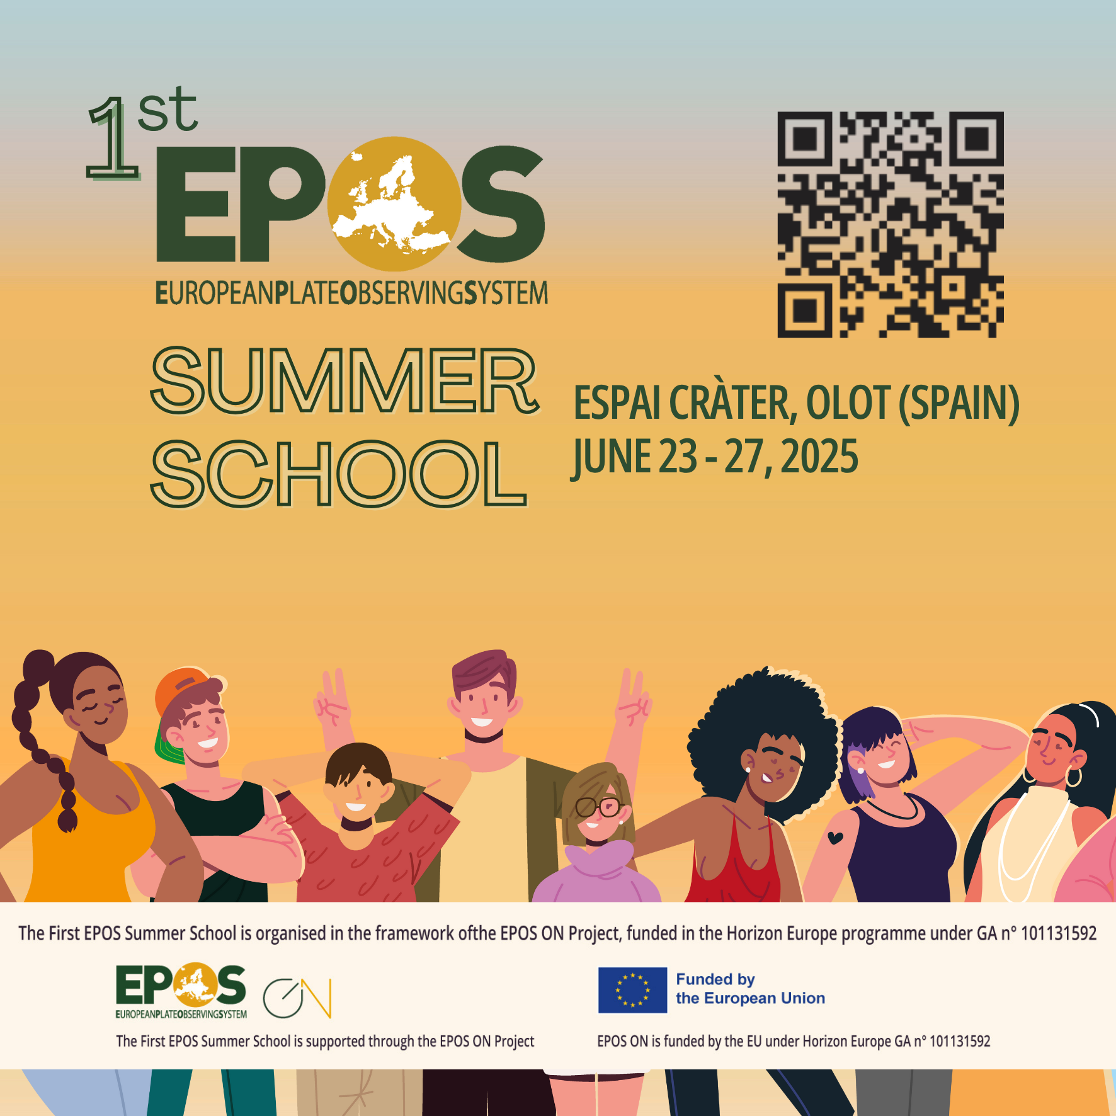

A Case for CARE in Māori/western science plural approaches
Andrea Wolter (a.wolter@gns.cri.nz)
GNS Science, New Zealand
Network development, landslide hazard
Notes:
TB

Slide 2
Research Question: Can GeoNet create a more accessible data platform and data products that adhere to FAIR and CARE principles, working with tangata whenua (Indigenous peoples)?
Co-develop a more inclusive, intuitive data platform with Iwi
Elements of alternative UX, interfaces, etc.
Open data vs. data sovereignty
Case of Geodatabase in Northern Aotearoa NZ
Tena koutou/Thank you for your attention!
a.wolter@gns.cri.nz
Notes:
Te Ao Māori (the Māori worldview) does not separate the Earth into 'disciplines', but rather sees her as an interwoven, holistic, living system. Māori communities in New Zealand have struggled to operate in the colonialist science system that fragments everything into specialities. As a tauiwi (non-Māori), I have learnt from partnering with Iwi (tribes) how important that holistic view is in understanding the natural system and our interactions with it. Iwi members have emphasised how important science knowledge is in complementing their traditional knowledges. But there remains a gap between western science data and the indigenous communities that want to use them. Research Question: Can GeoNet create a more accessible data platform and/or data products that adhere to FAIR and CARE principles, working with tangata whenua (indigenous peoples)? I propose to work with GeoNet colleagues and other government organisations (local councils) in partnership with Iwi to understand how we can create products that are more accessible and useful to them. An example would be a more intuitive online data platform. I hope EPOS can share different approaches to open science, open data, data platforms, etc. I also hope to learn more about data management so that I can more effectively work with indigenous partners in New Zealand to meet their data needst slide

