Slide 1


Probabilistic map for lava flow inundation with QGIS
Martyna Poczatek Stanczyk |
mjpoczatek@transportes.gob.es
Notes:
Title slide

Slide 2
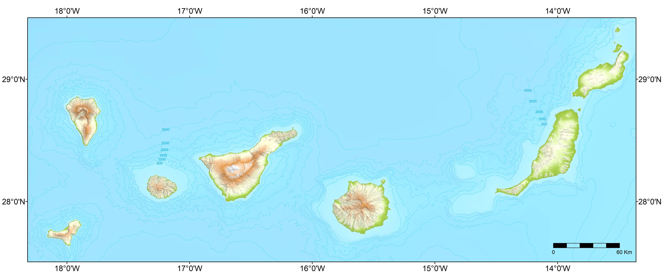
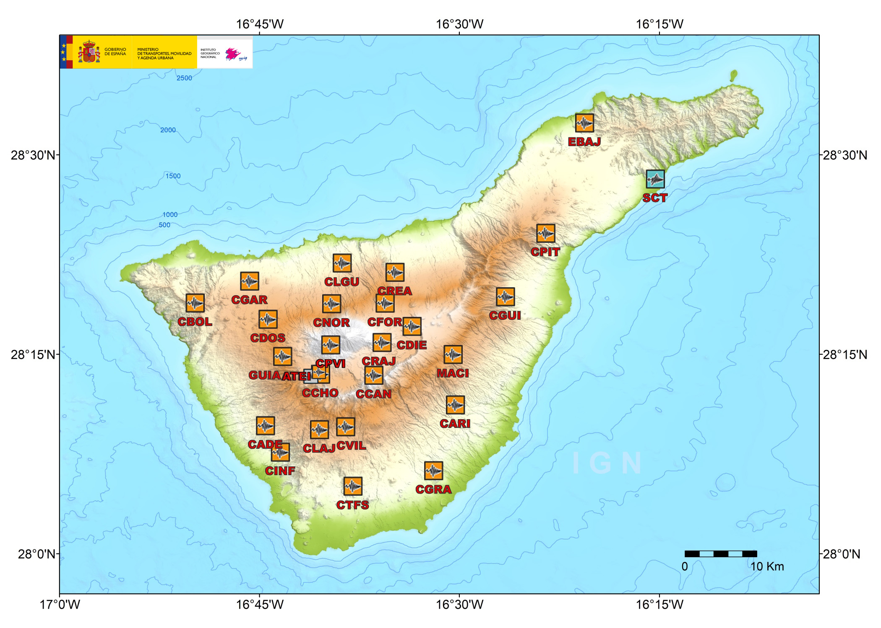
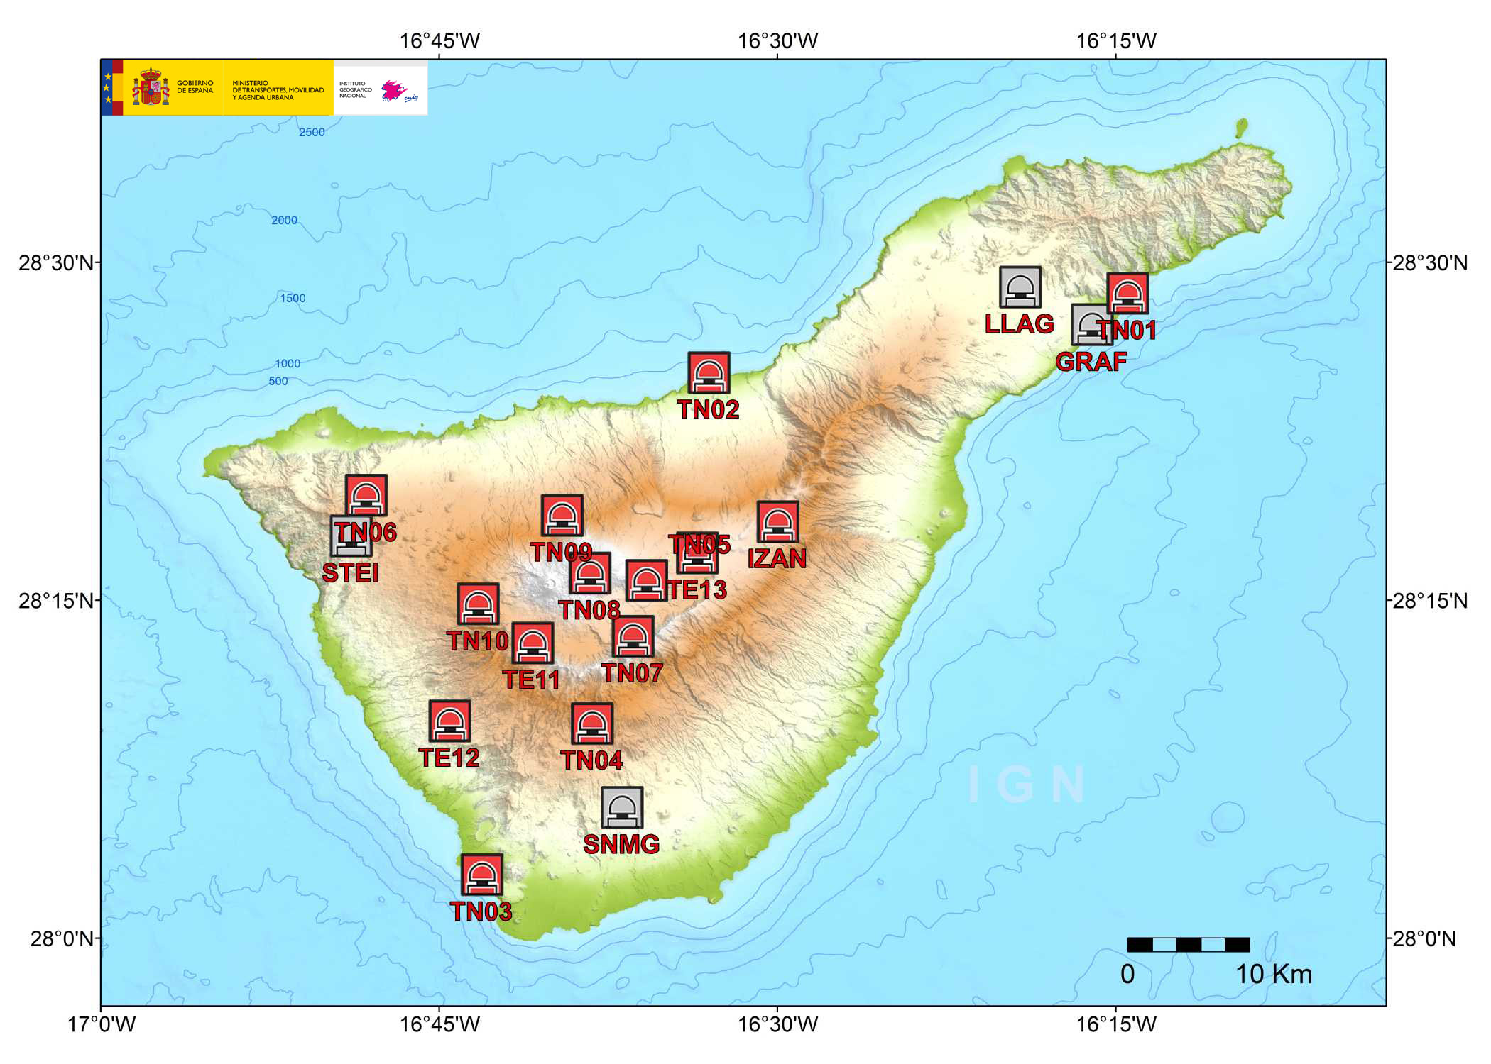
Volcanic Monitoring
WHEN WHERE HOW
FORECAST
NEXT ERUPTION
VOLCANIC MONITORING DATA
SUSCEPTIBILITY
AFECTAD AREA
Notes:
Content slide

Slide 3

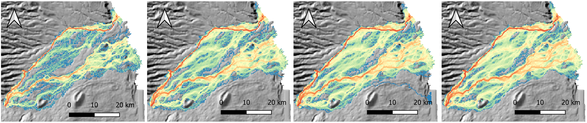
Background and problematics
Q-LavHA
Open-source tolls (QGIS plugin)
Interoperable enviroment Colaboration and Transparency
Mossoux, S.
Challenge lava parameter variability
Numerical simulation of lava flows with FLOWGO
Tests – check the plugin functions
Difficulties: complications in the measurements of the different lava parameters (viscosity, density, temperature…)
Notes:
Content slide

Slide 4
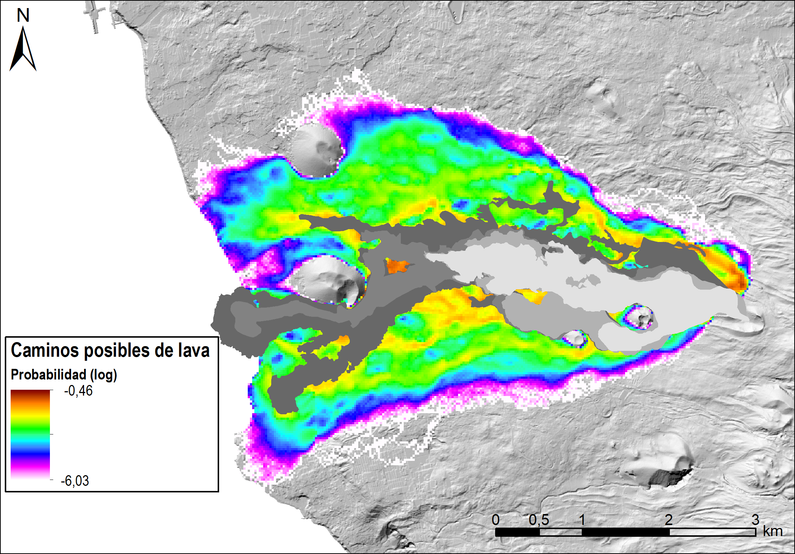
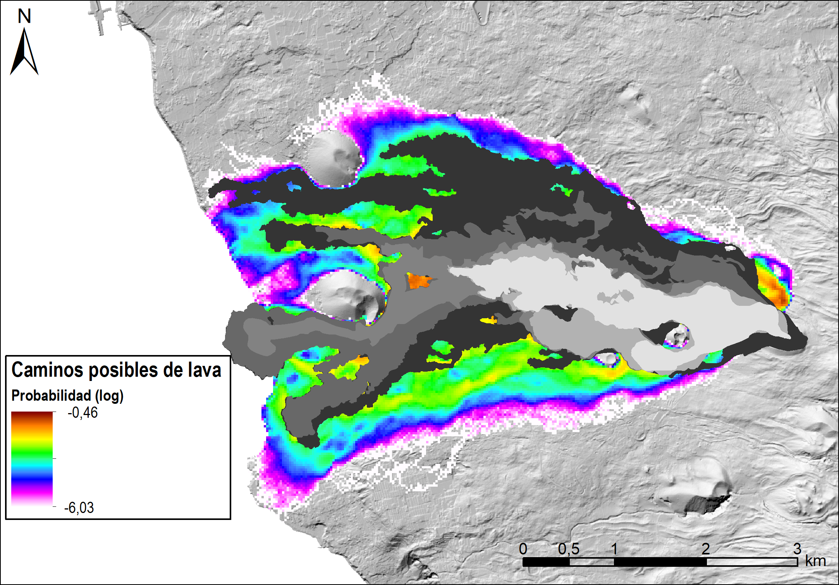
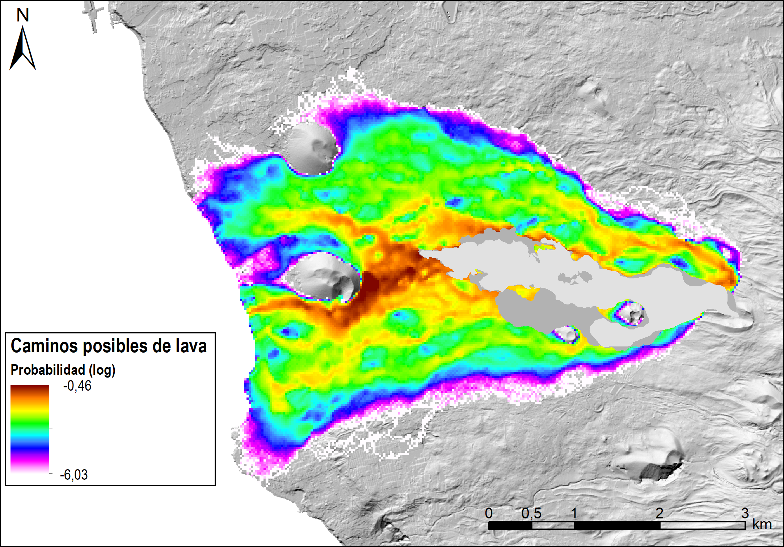
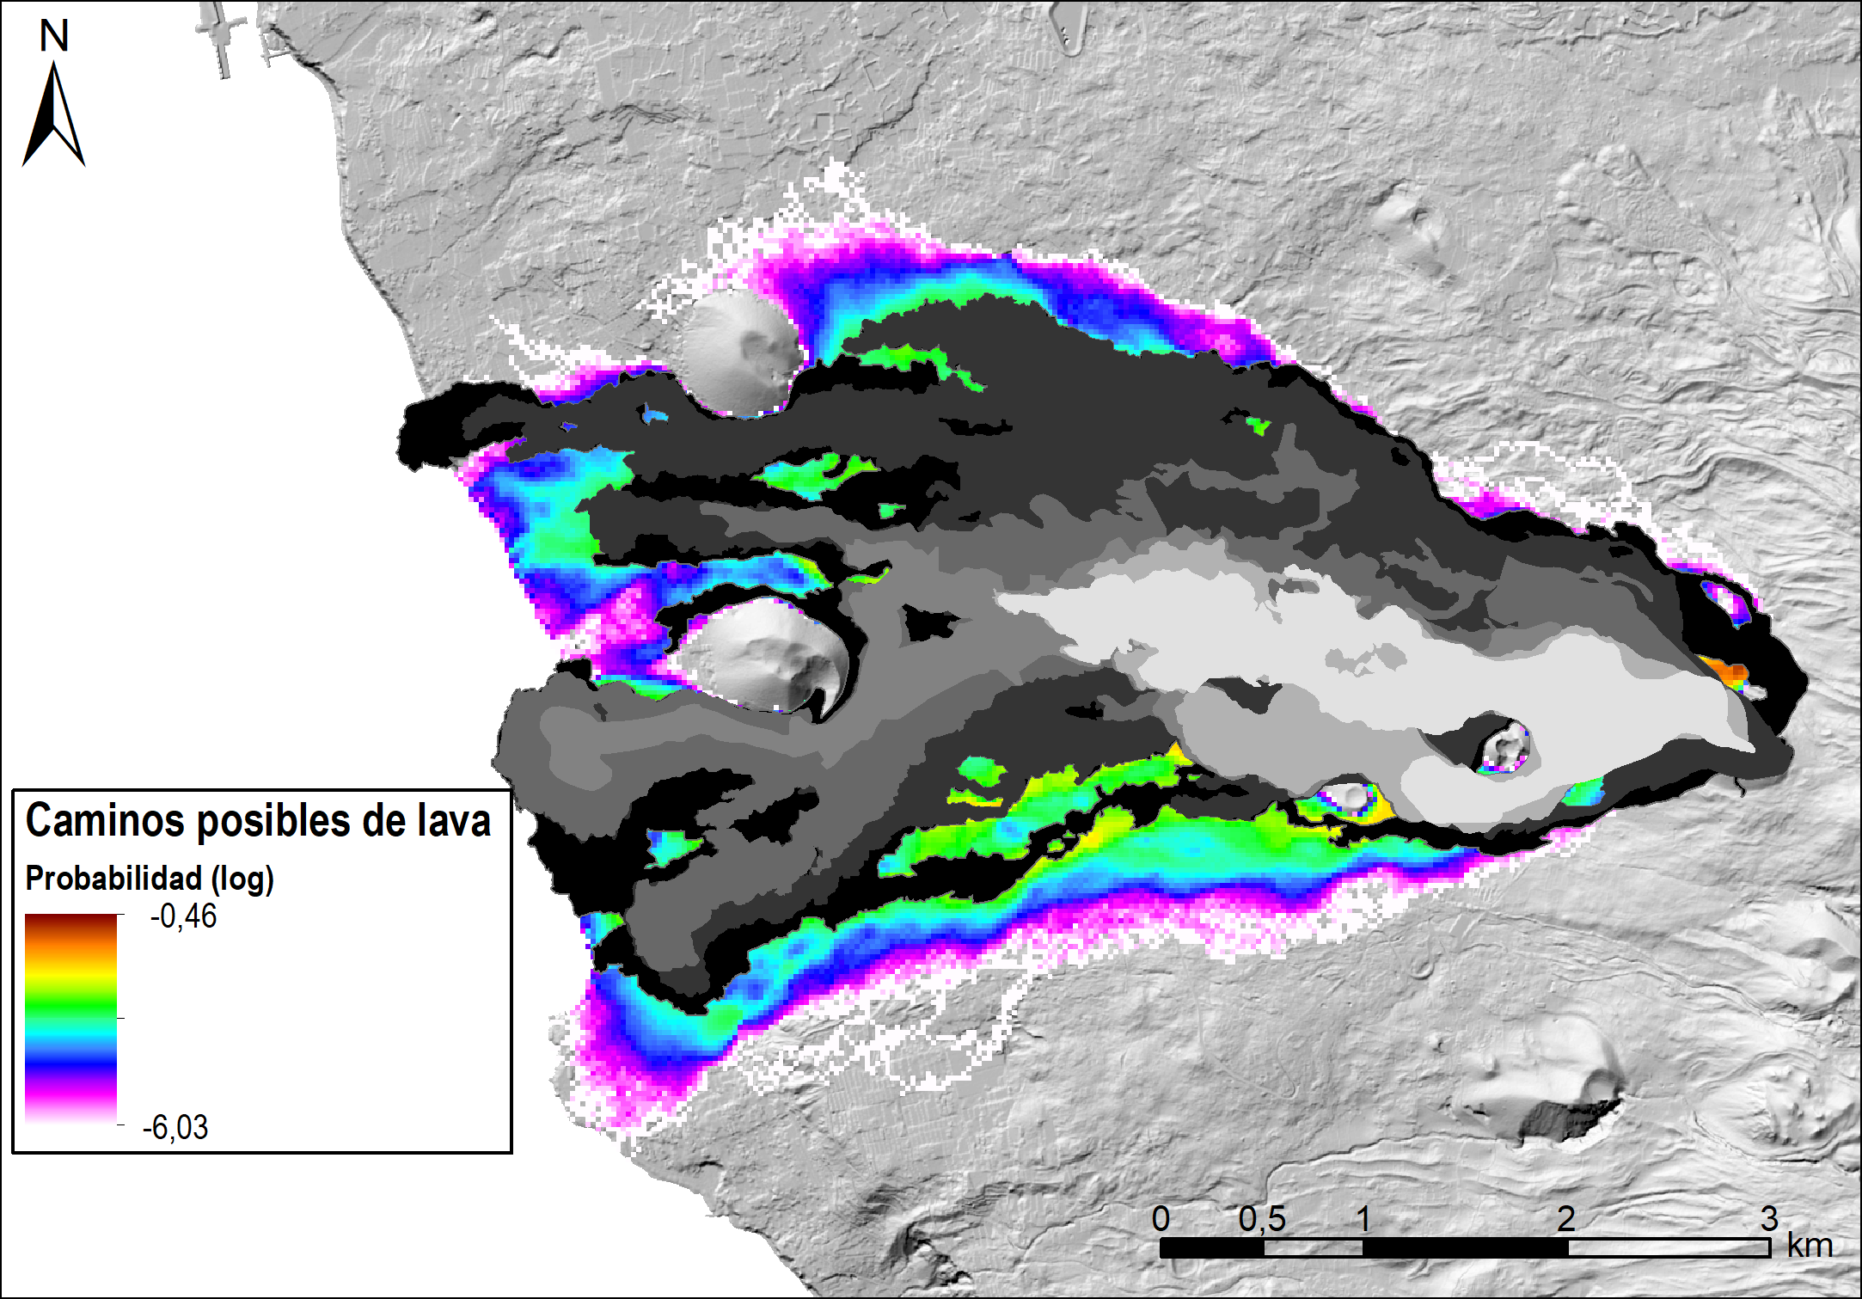
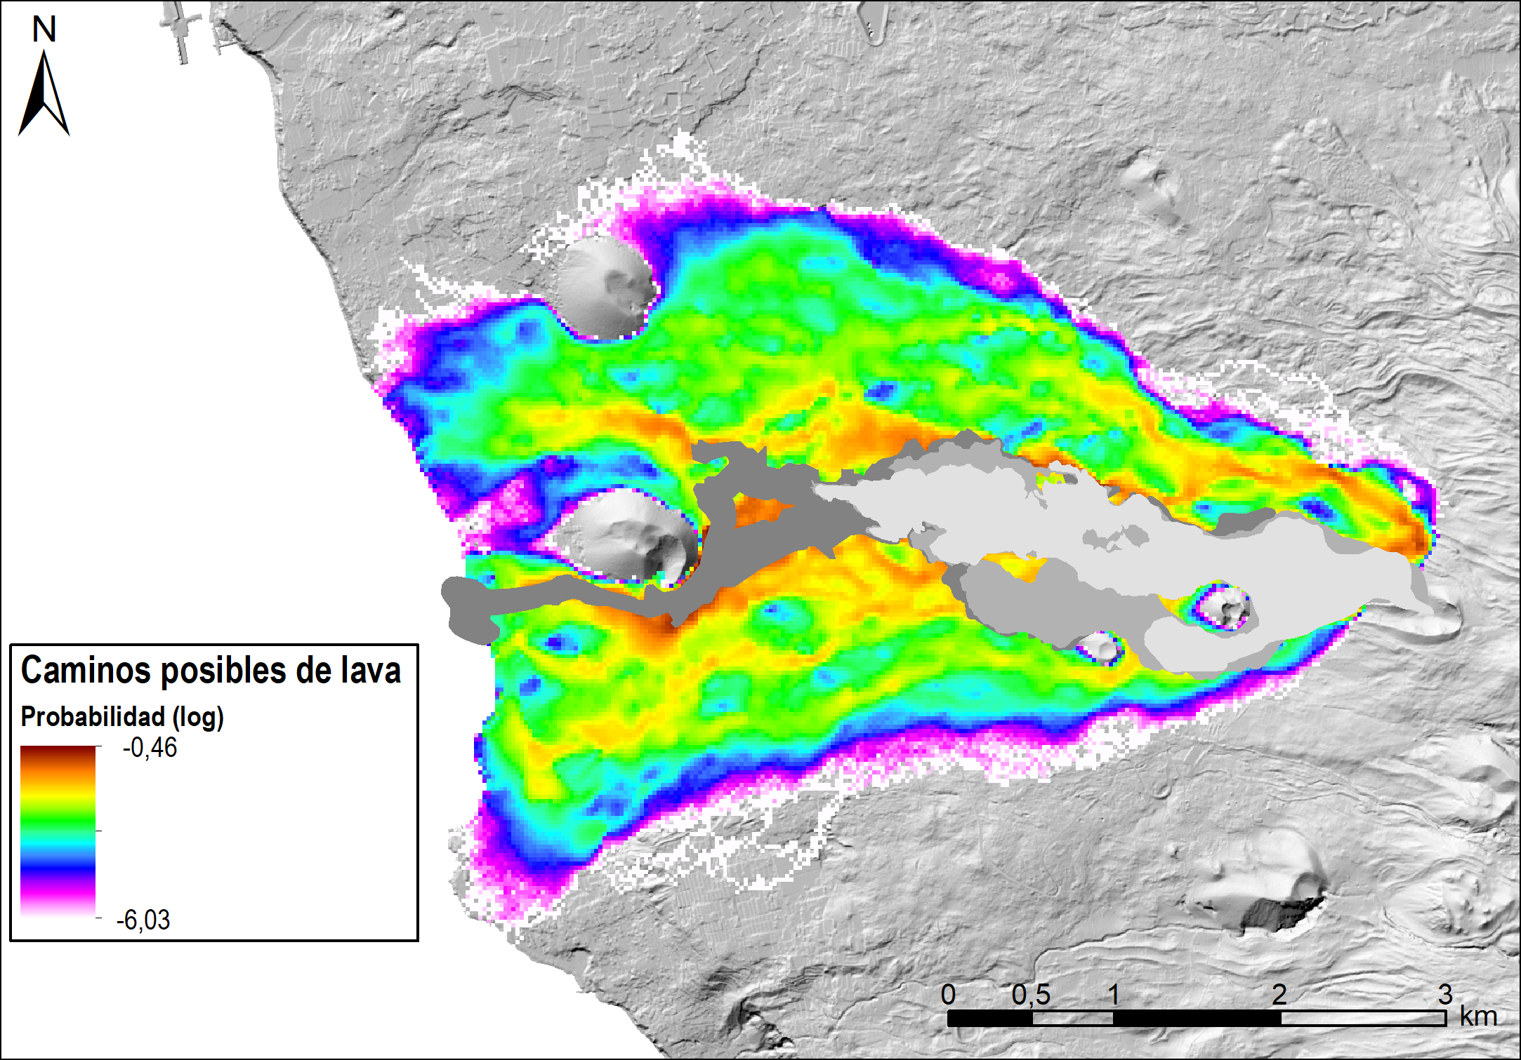
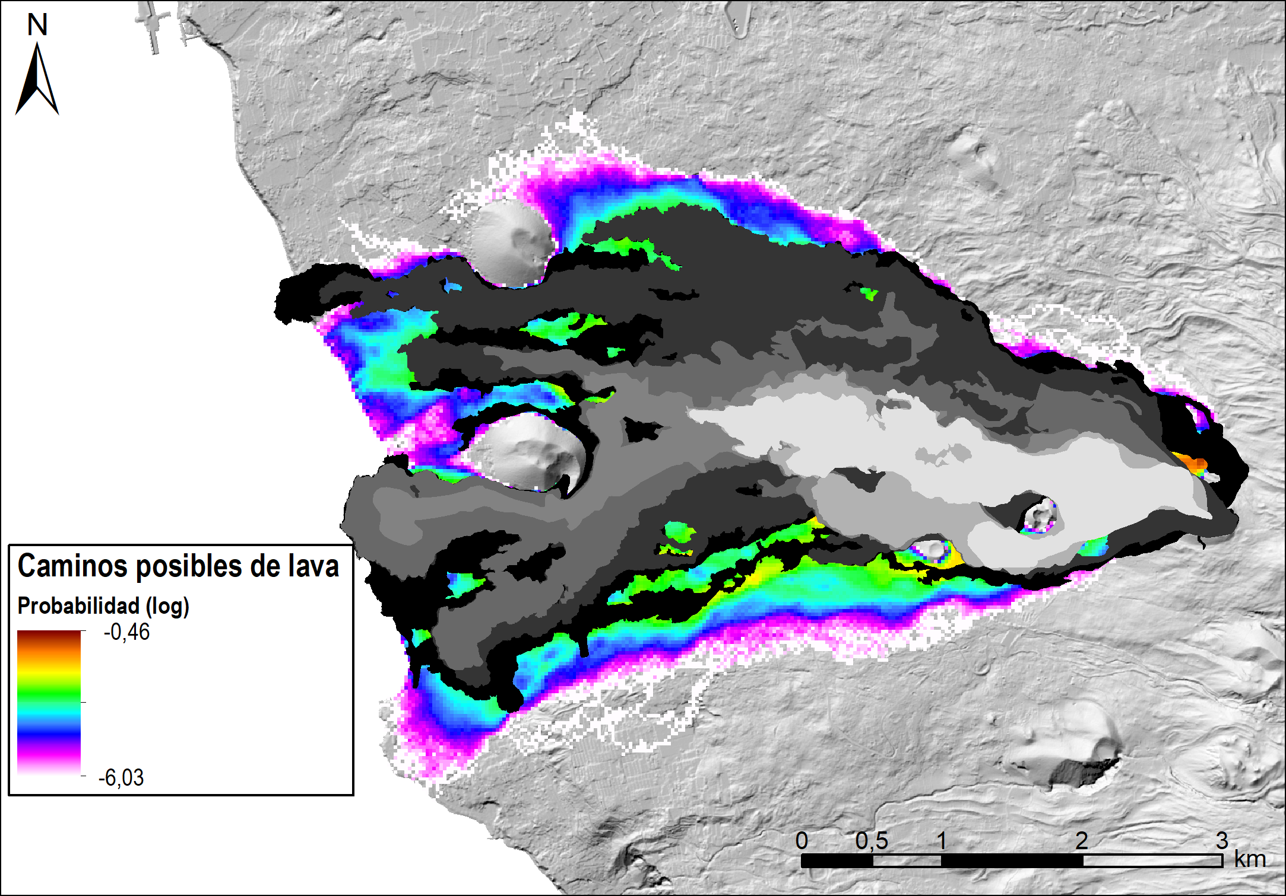
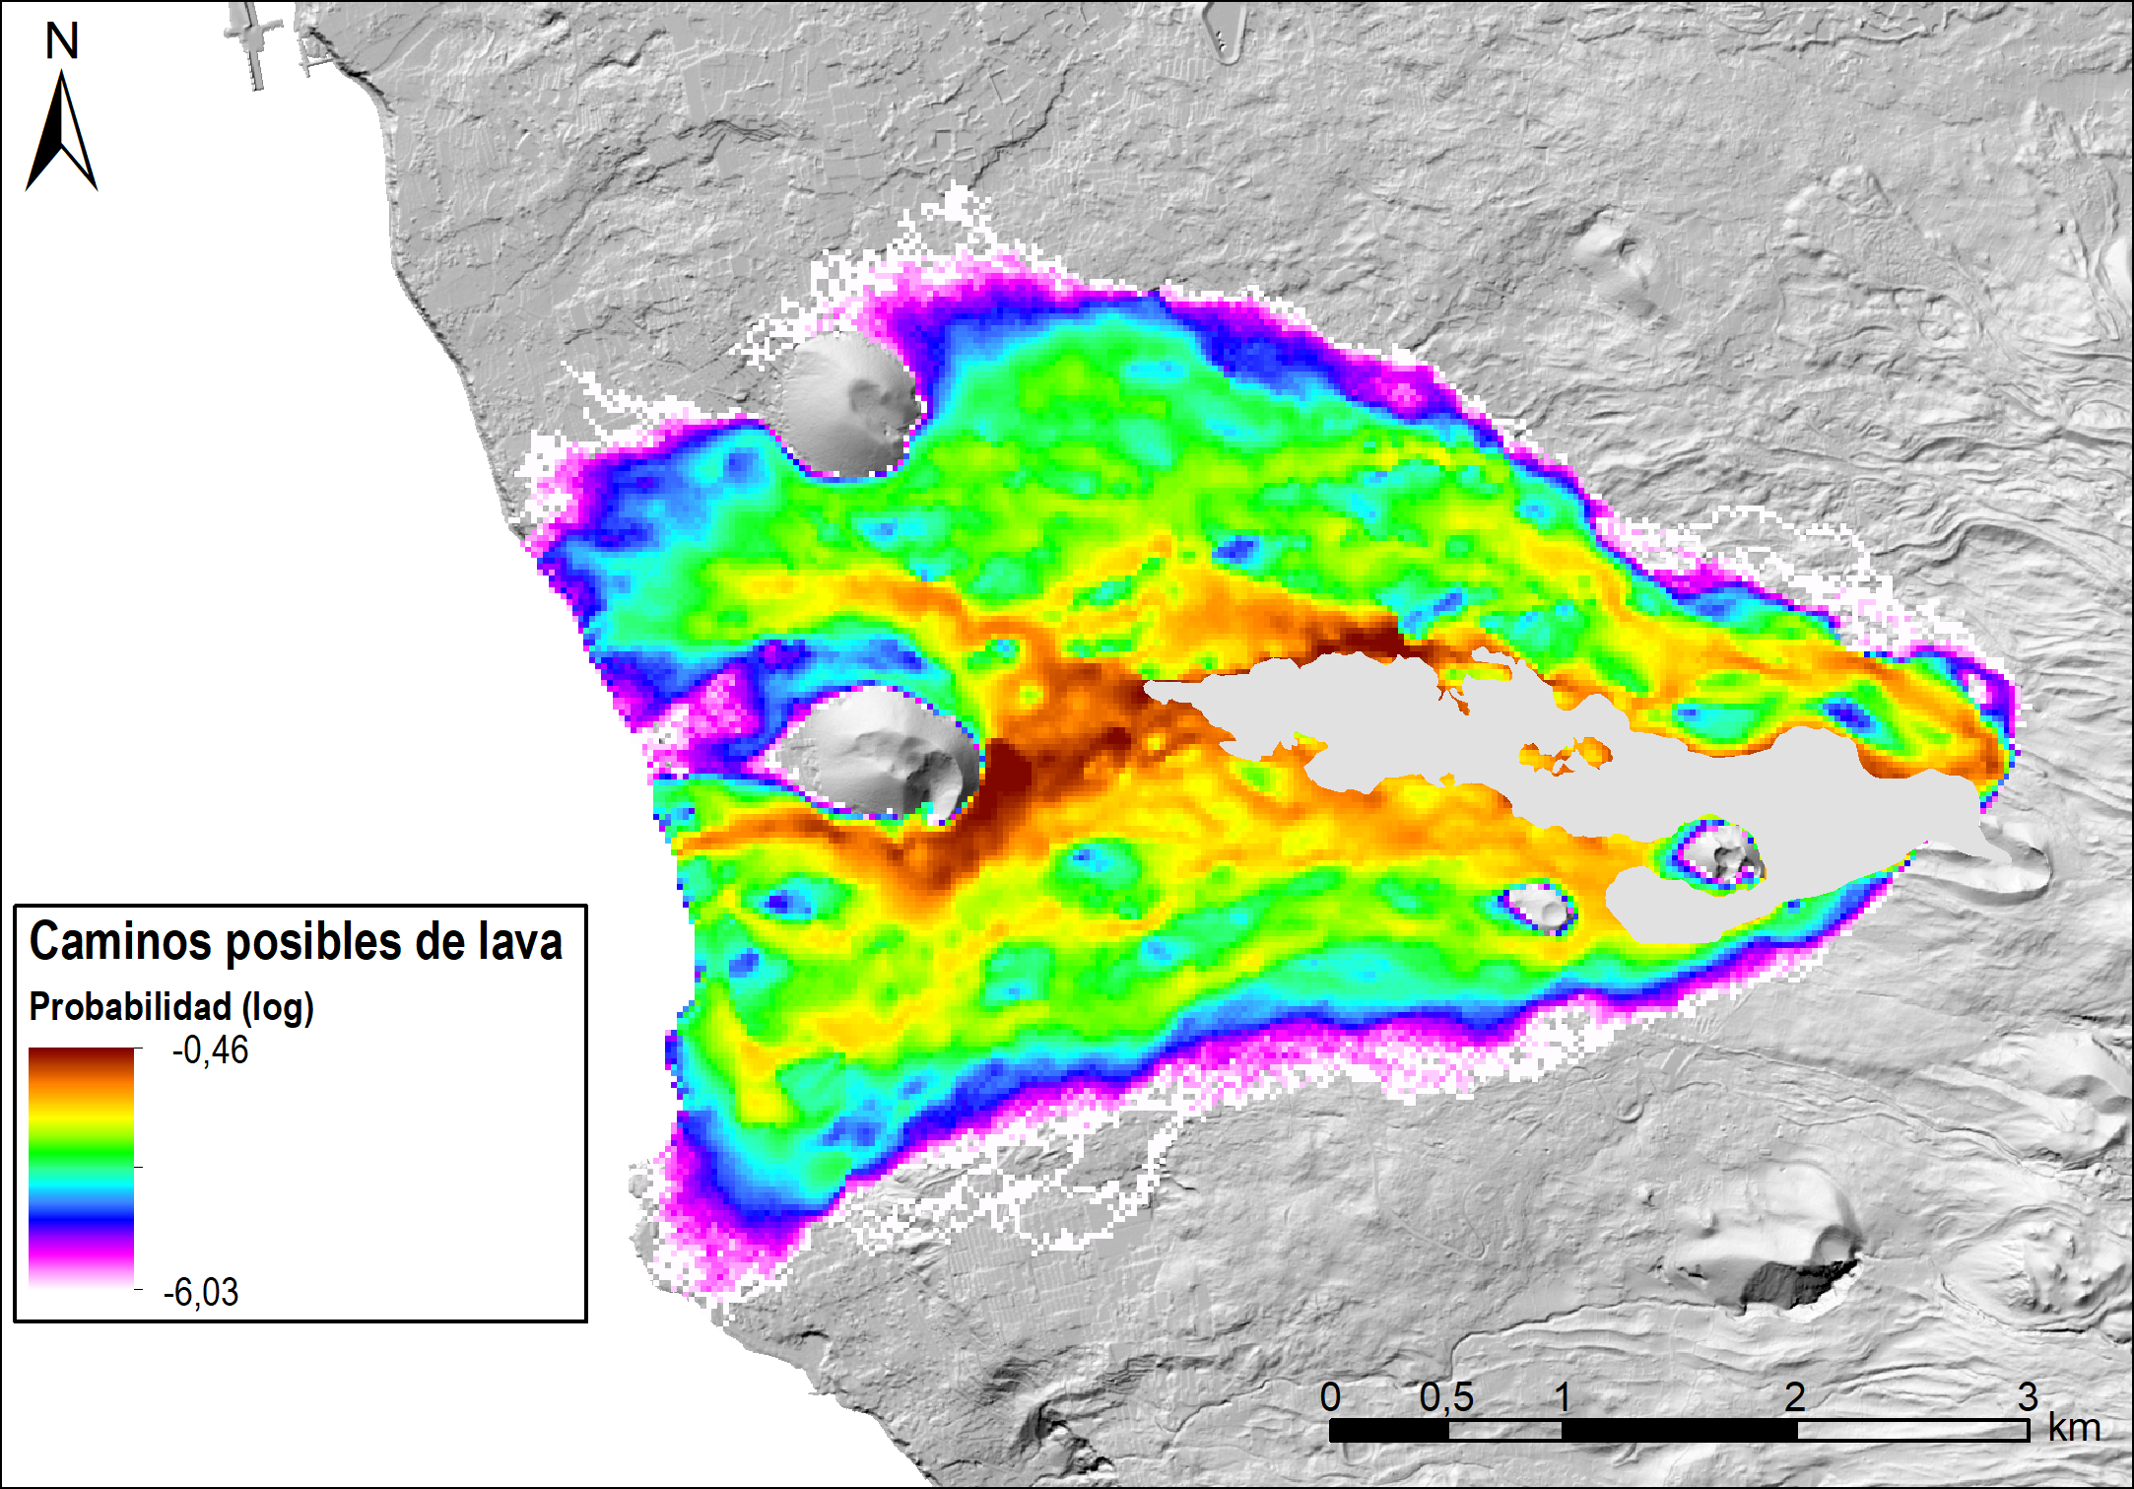
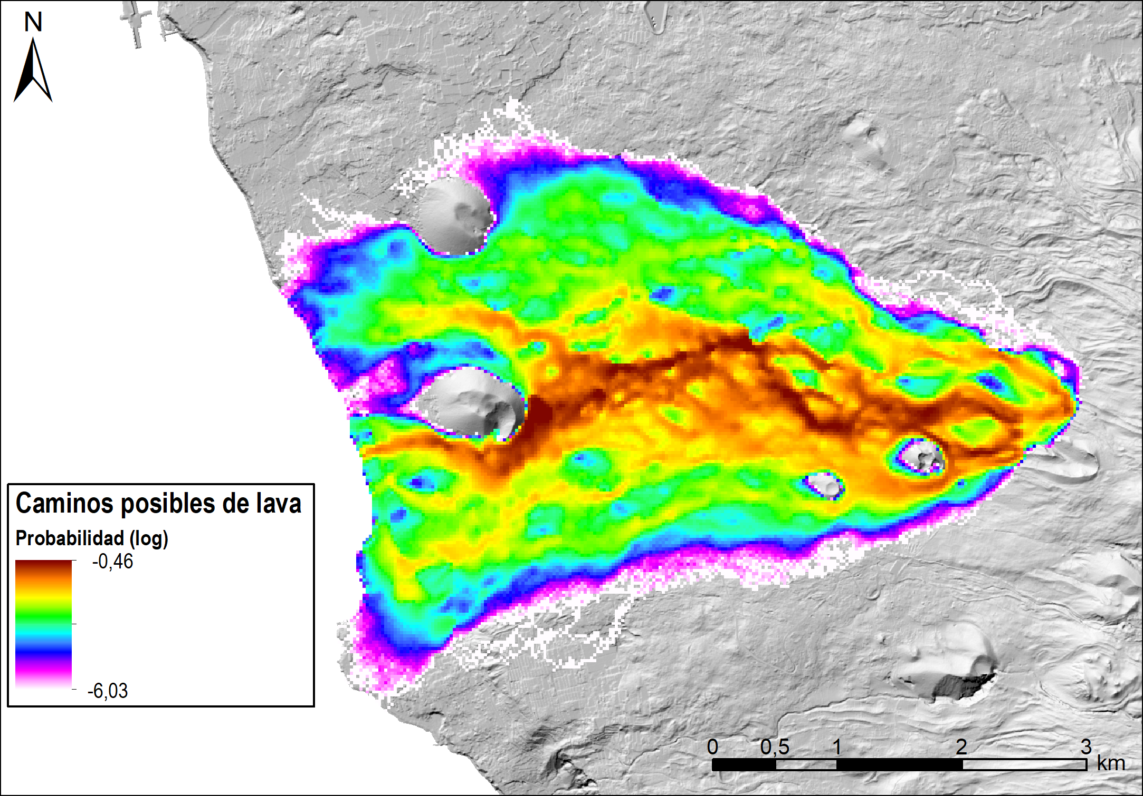


Work in progress
VORIS Felpeto, A.
Main propose: Developing an application for scenarios and volcanic hazard mapping
Ultimate goal: Volcanic Hazard assesment (not risk)
VOLCANIC EMERGENCY
14 dic
9 dic
4 nov
10 oct
29 sep
26 sep
22 sep
Notes:
Content slide

Slide 5

Integration with Jupiter Ecosystem
Decouple GUI & Core Logic Qt-independent Python module
Package Backend as Python Module Make it importable in notebooks
Create Interactive Jupyter Notebooks Results and Interactivity
Notes:
Content slide

Slide 6

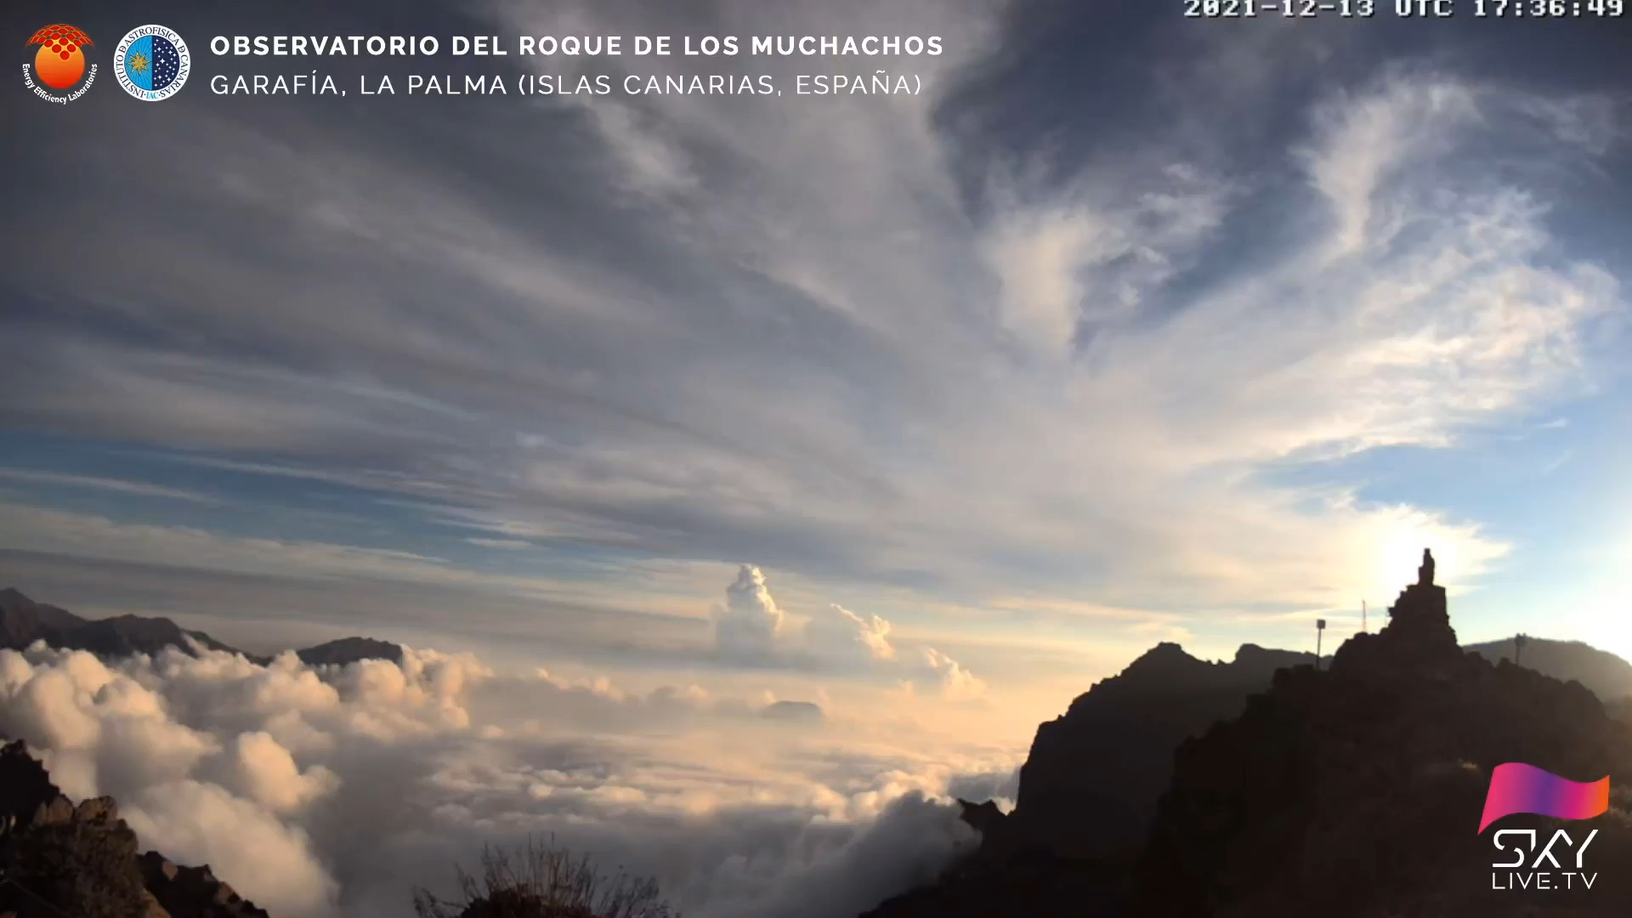
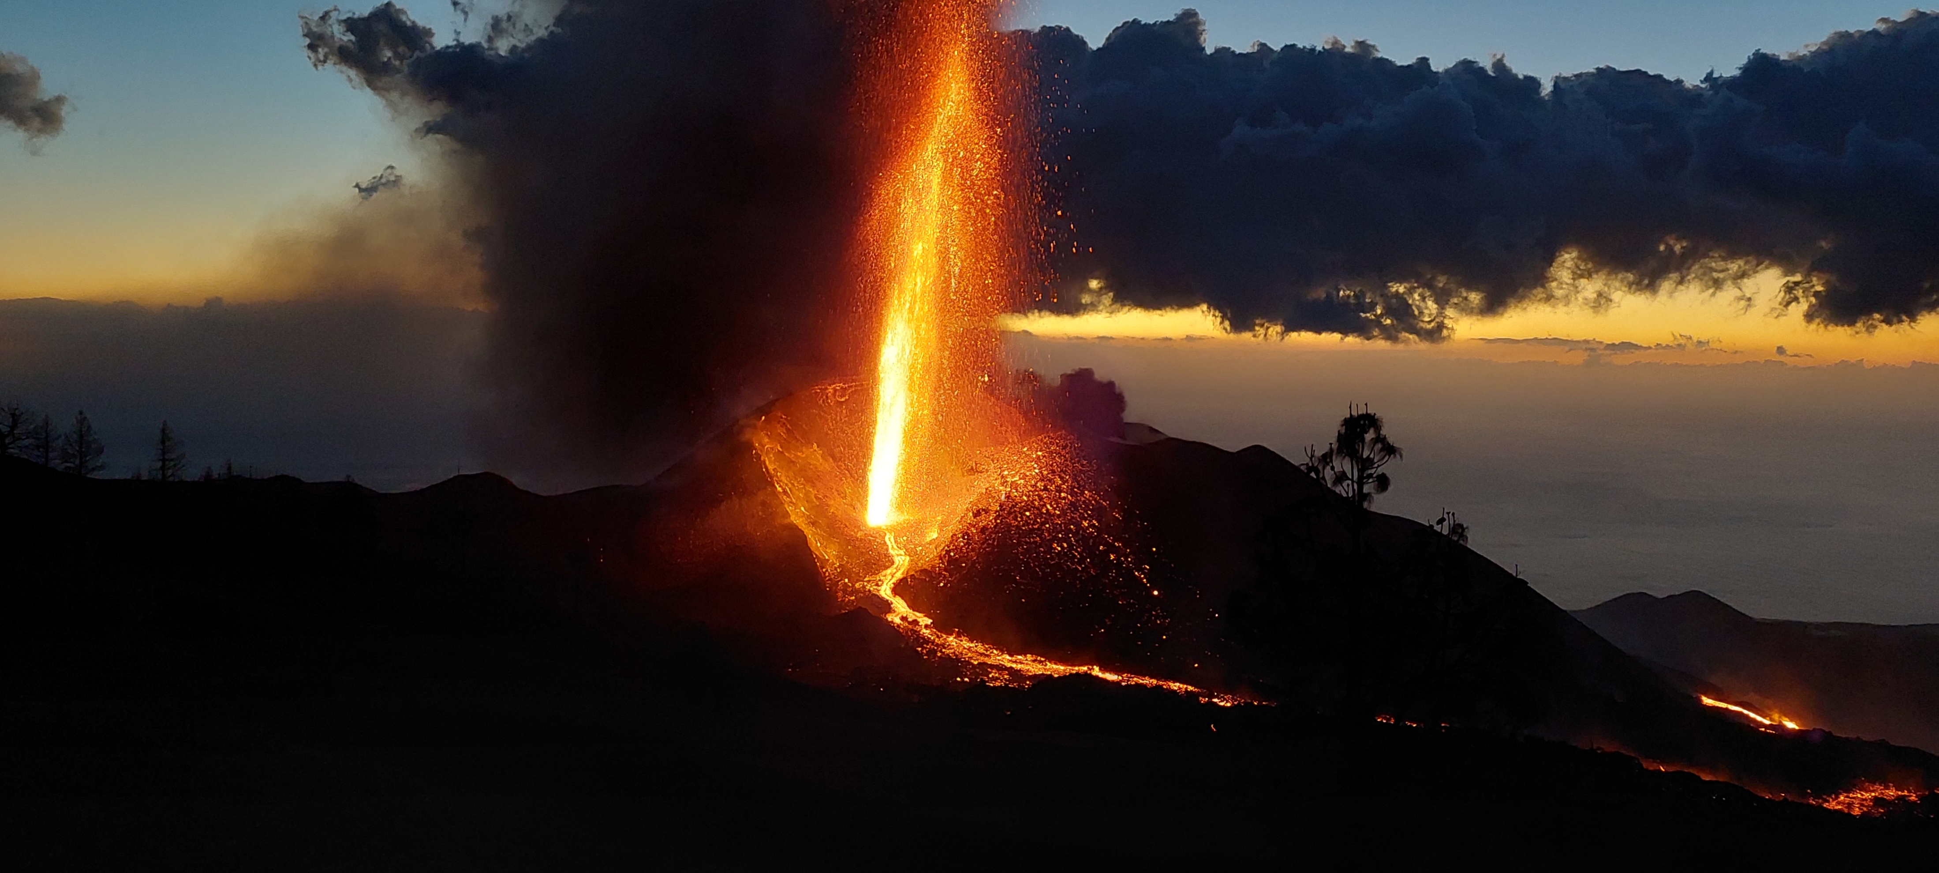
Thank you for your attention!
Mjpoczatek@transportes.gob.es
www.epos-eu.org/on | social media #EPOSon
Notes:
Thank you slide

