Slide 1



Various Gravity Data for the AdriaArray Area
Ema NOGOVÁ| ema.nogova@savba.sk
Pavol ZAHOREC, Juraj PAPČO, Roman PAŠTEKA
+ others
Notes:
Title slide

Slide 2
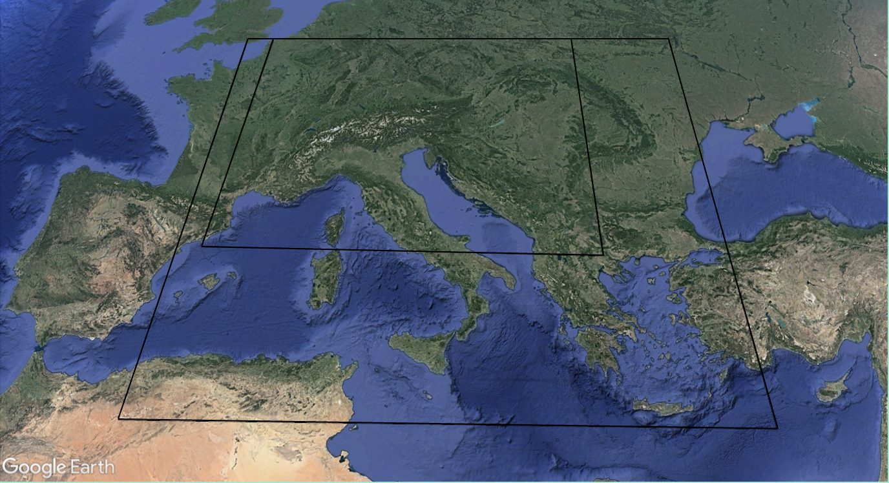
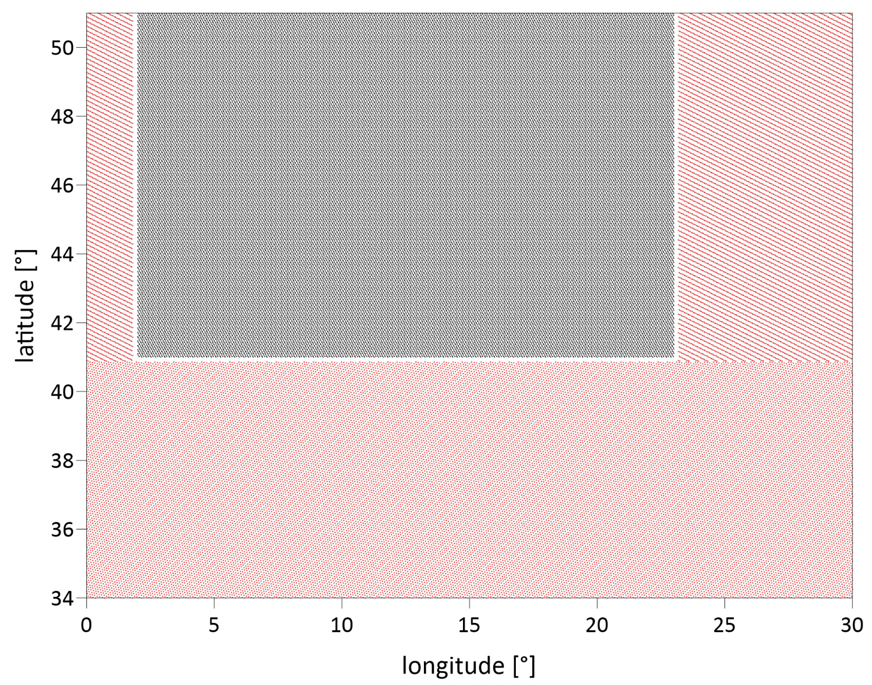

About the data
AlpArray
AlpArray (officially), AdriaArray (not officially)
gravity database, 2x2 km
data: terrestrial + GGM
AdriaArray
terrestrial
GGM
global geopotential models
Notes:
Content slide

Slide 3

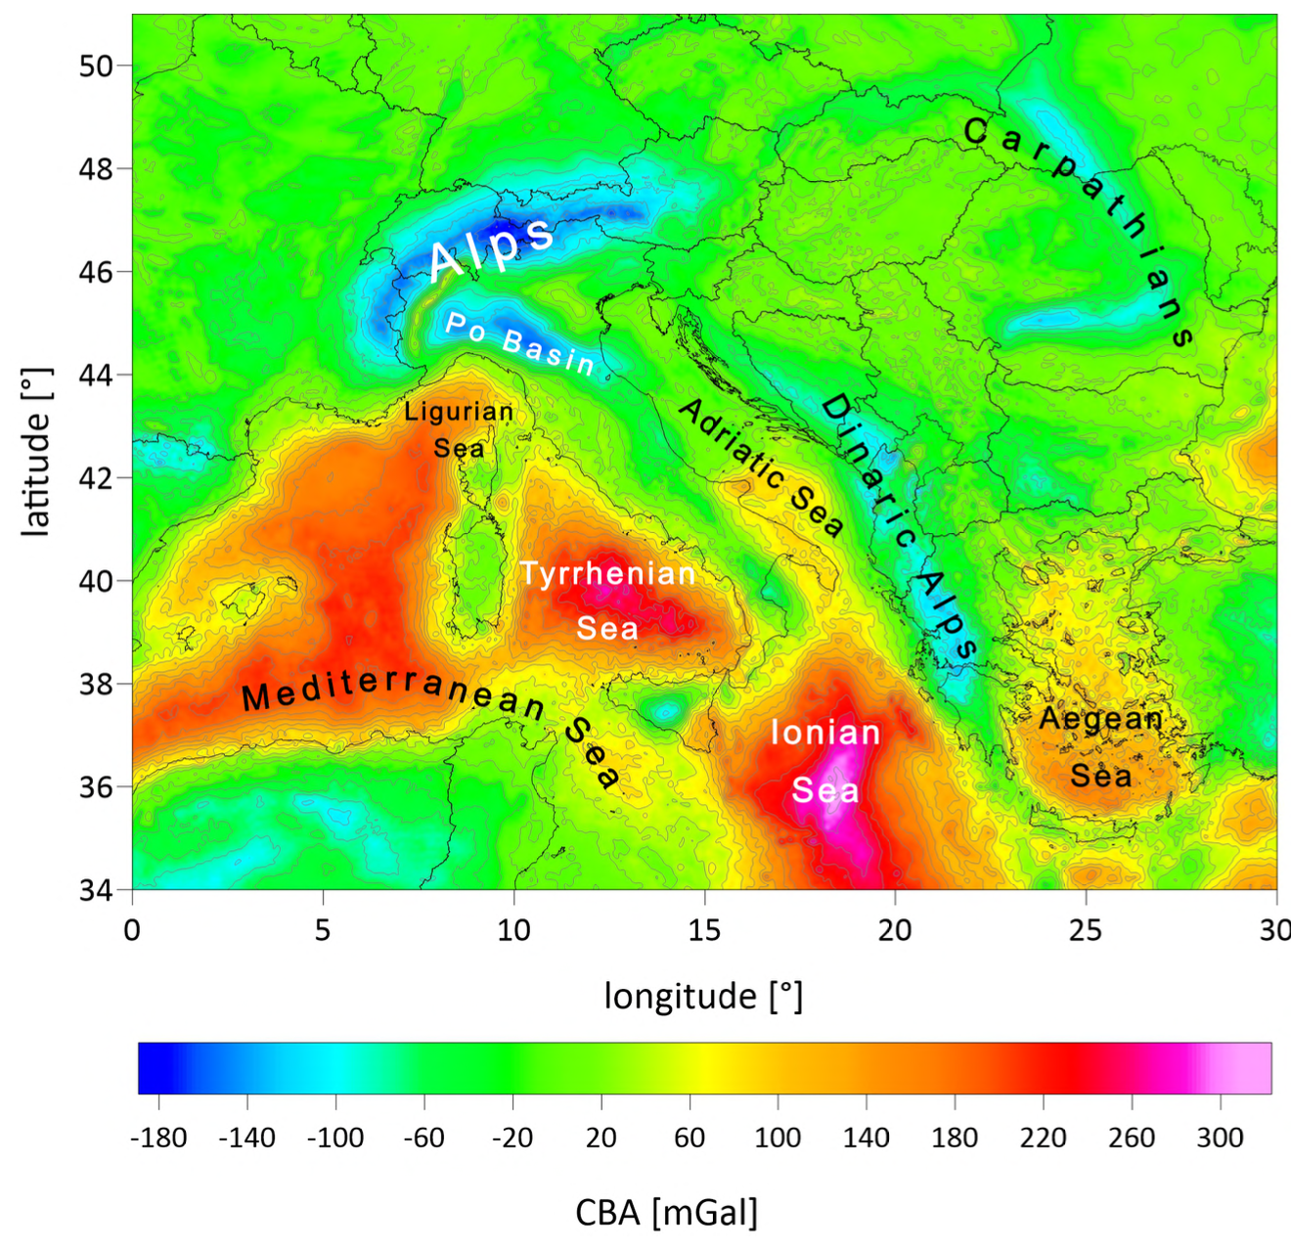
Current status
finished and freely available
useful in many geoscientific
disciplines
not part of EPOS
SIMPLE QUESTION ☺
DATA → EPOS: HOW?
Notes:
Content slide – 2 boxes

Slide 4

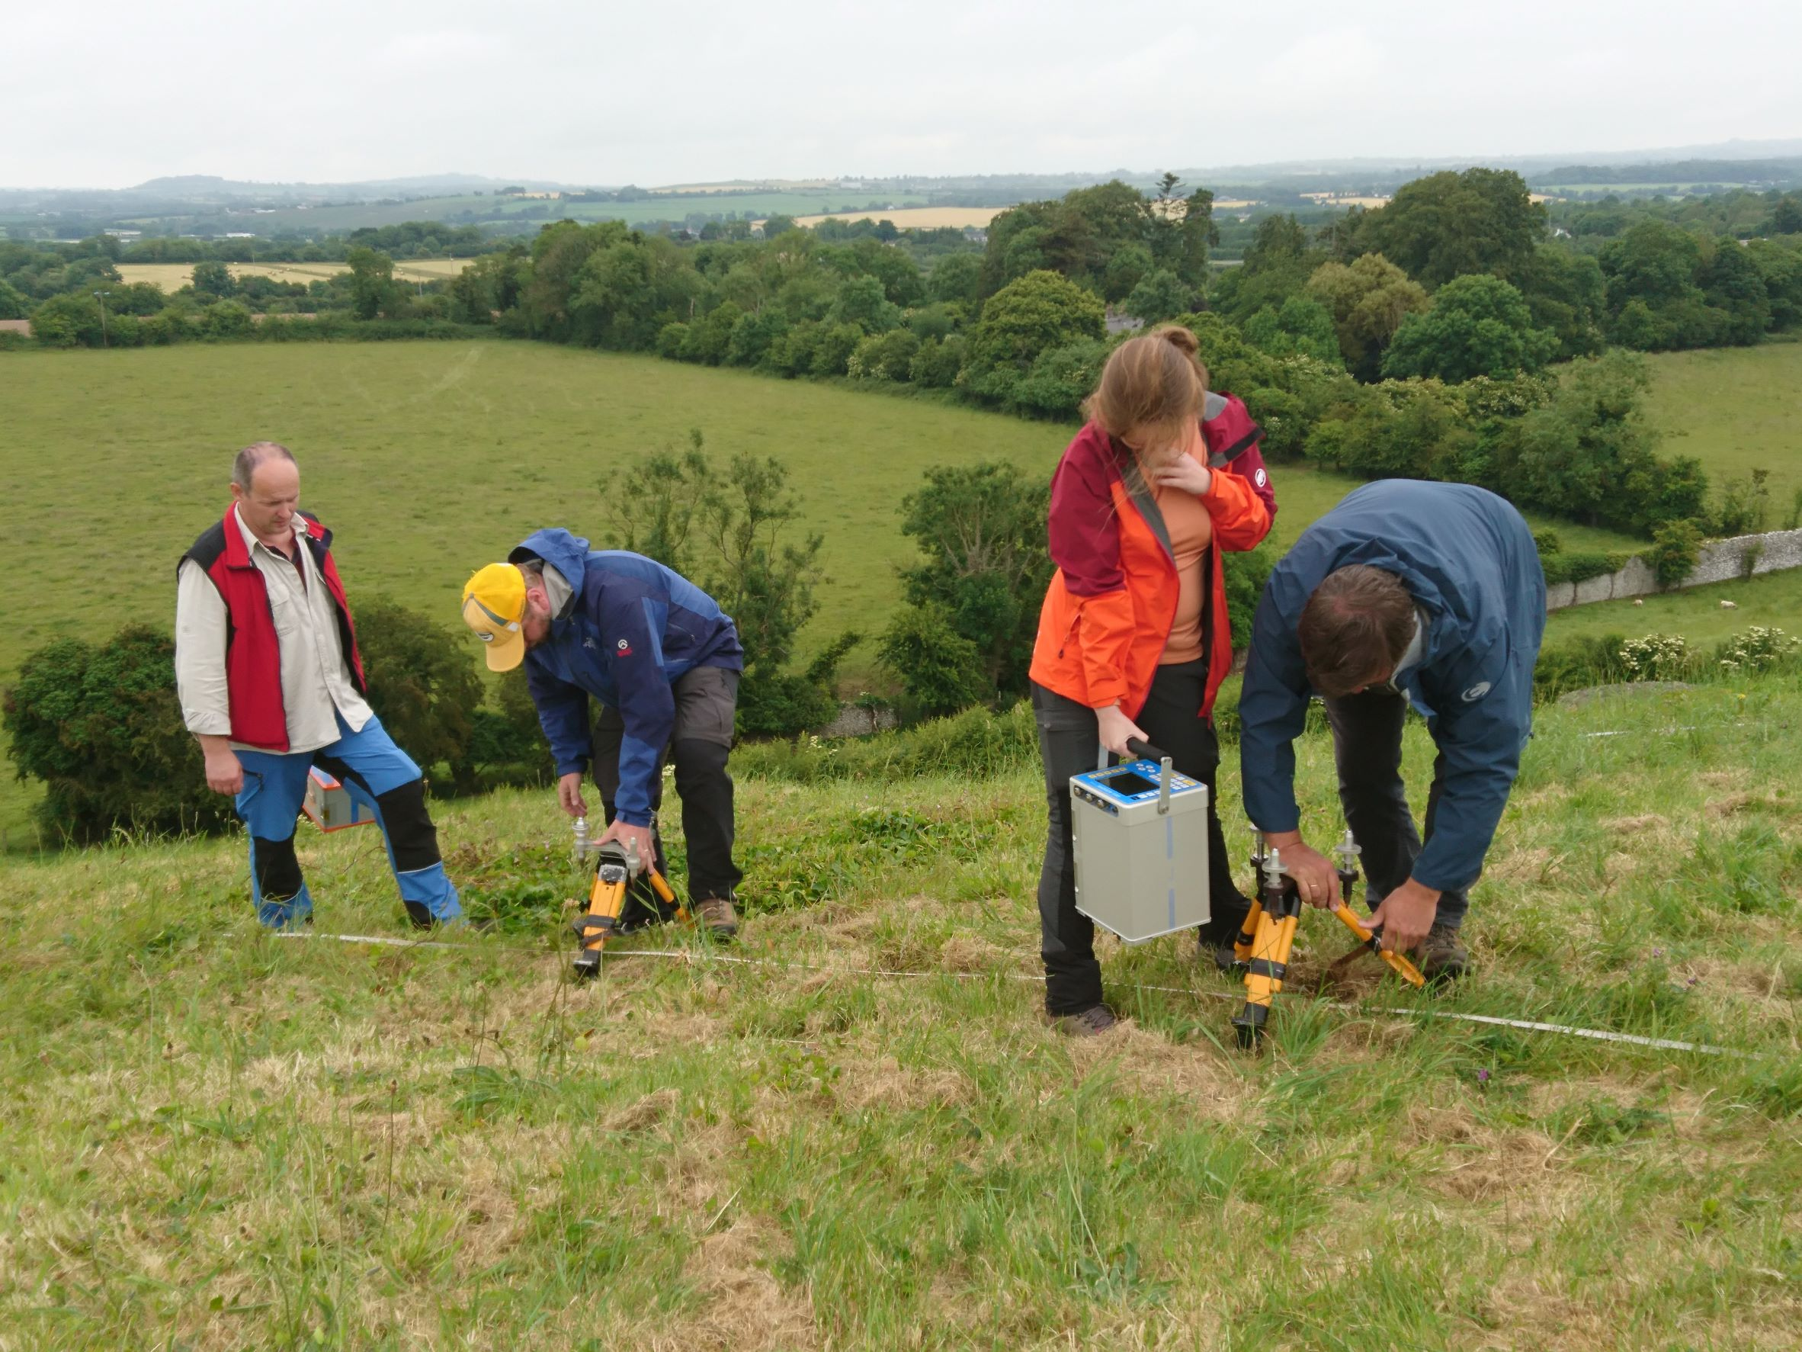
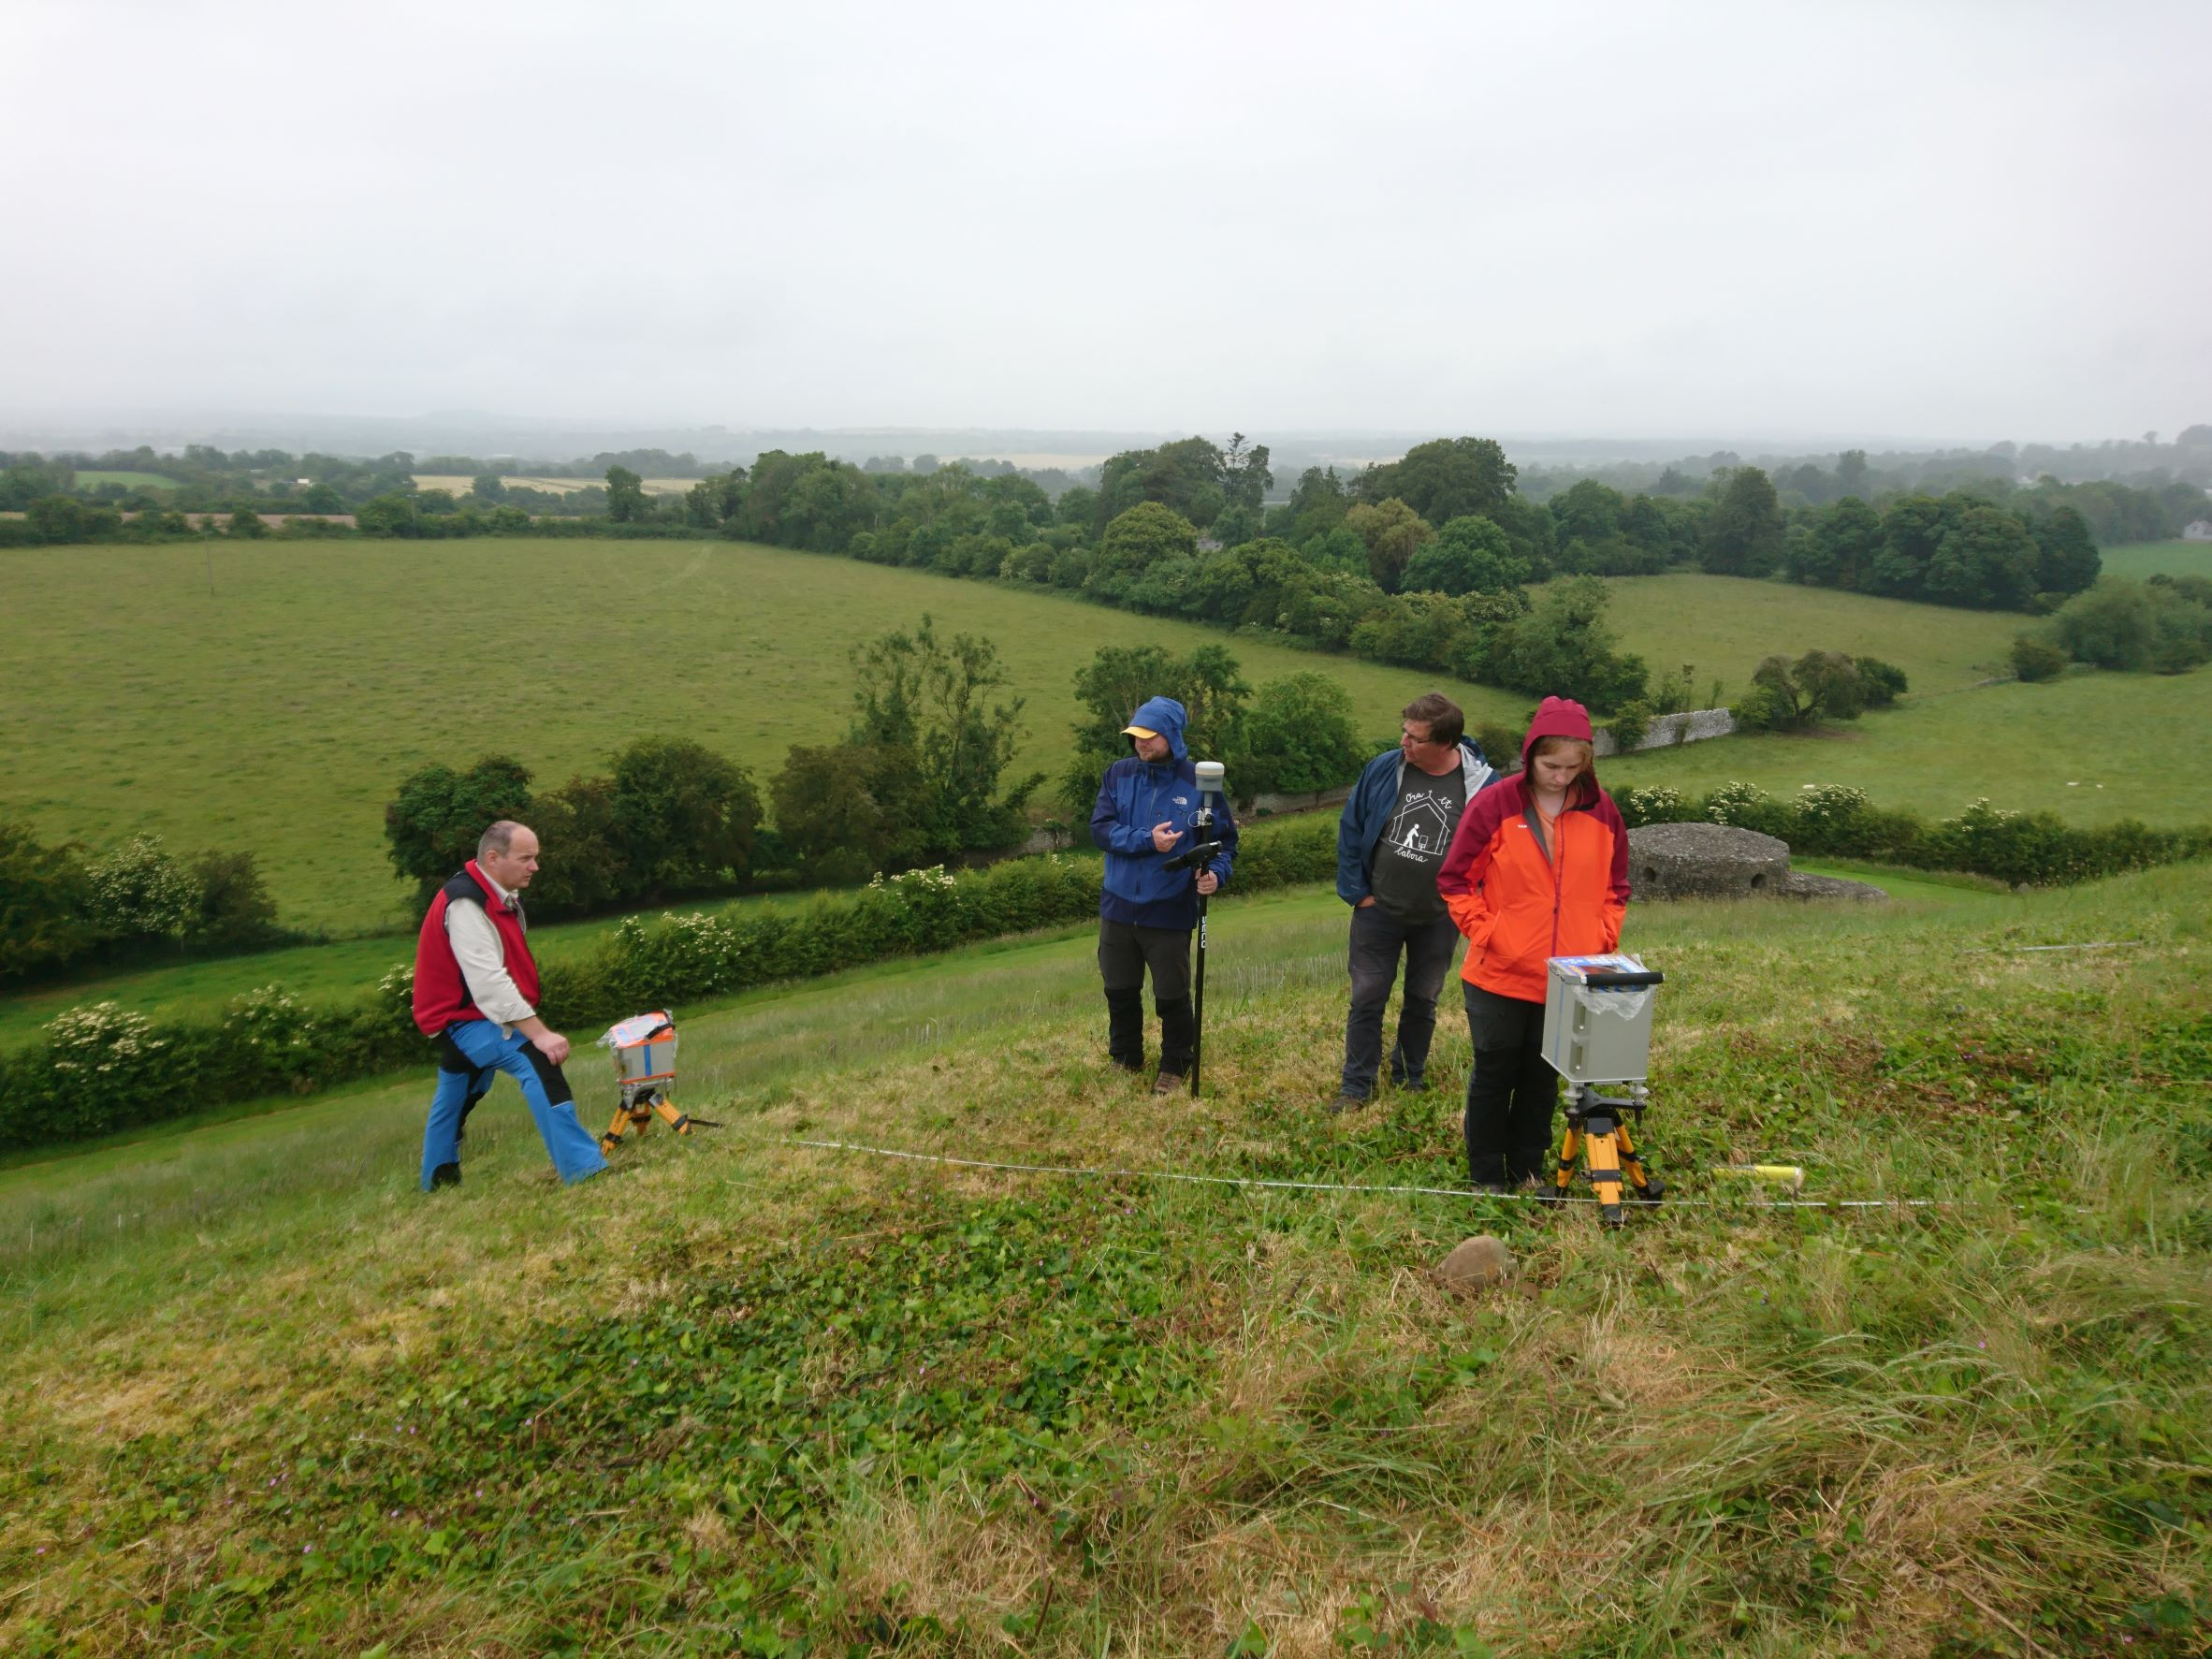
Thank you for your attention!
ema.nogova@savba.sk
www.epos-eu.org/on | social media #EPOSon
Notes:
Thank you slide

