Slide 1



Development of ML Algorithm for Crop Irrigation Optimisation Using Earth Observation Copernicus Data
Amit Kumar Singh | Ph.D. Student in Earth Observation
Sapienza University of Rome, Italy
Notes:
Title slide

Slide 2
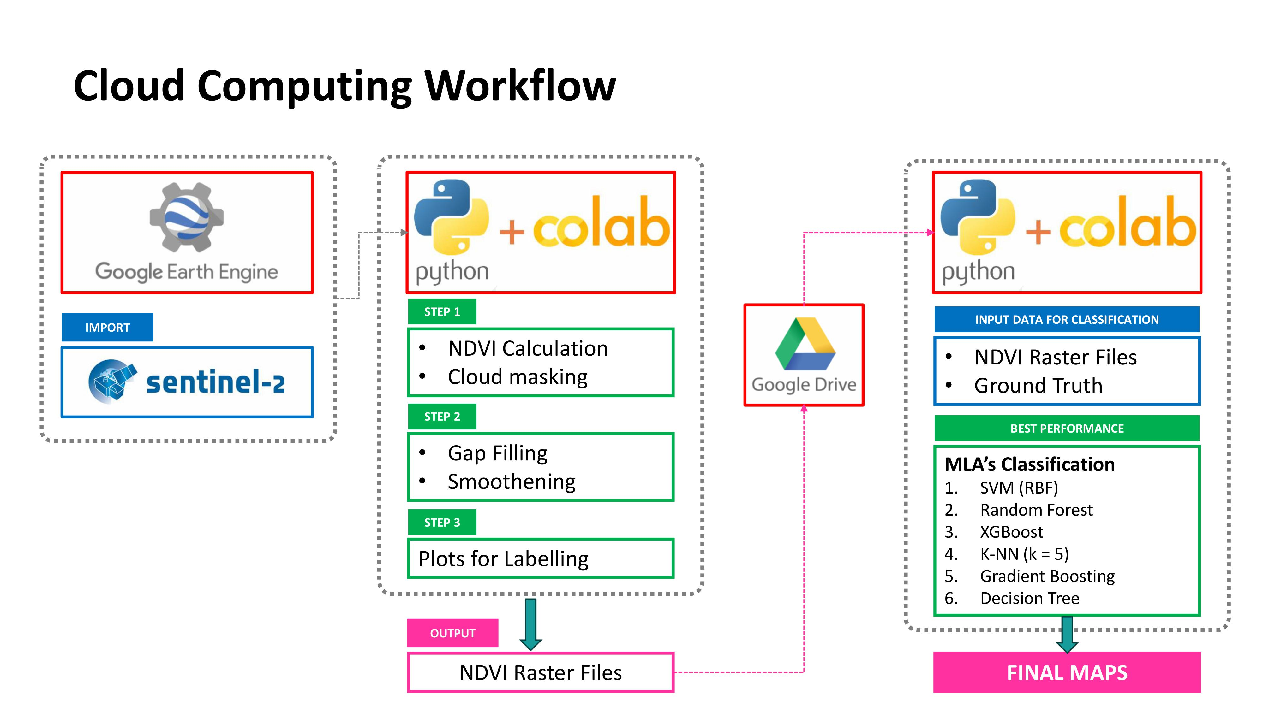

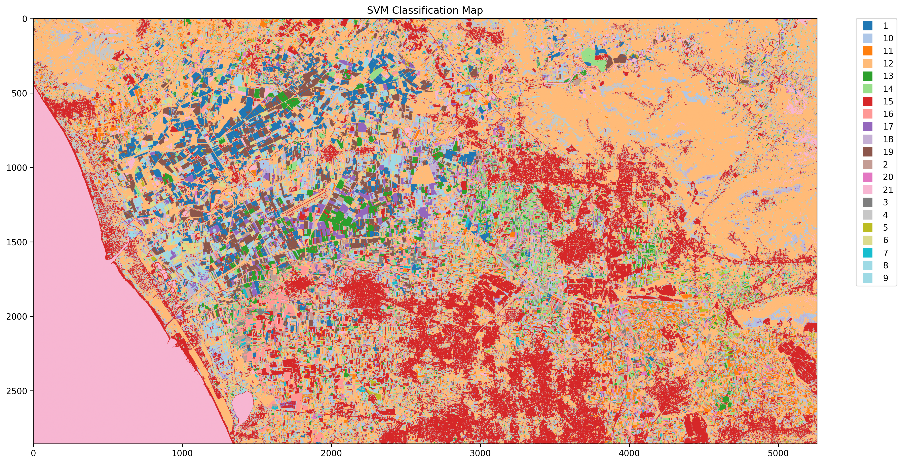
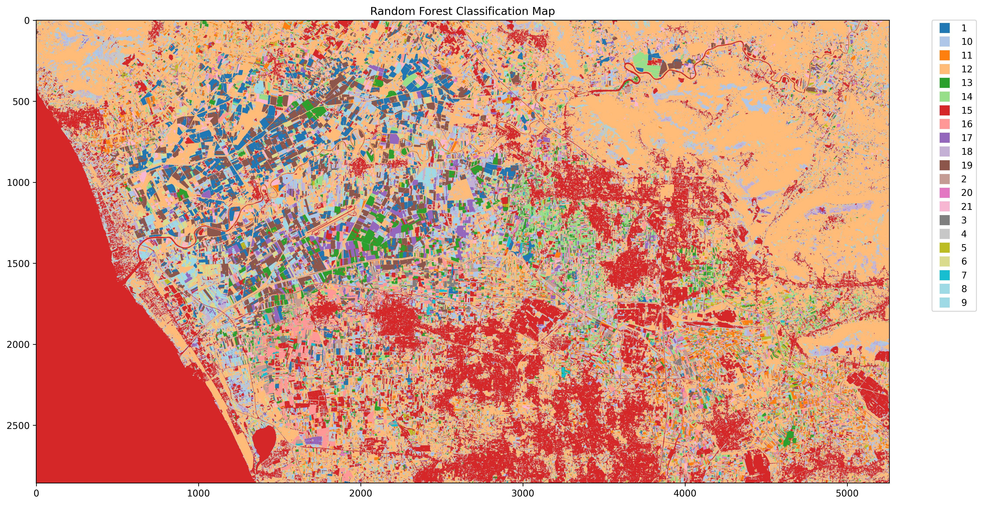

My Research Question:
How can transfer learning be leveraged to develop machine learning algorithms for the accurate detection of irrigated cropland areas using Copernicus Earth Observation data, with minimal reliance on new ground truth datasets?
Objectives:
Expected Outcome:
Transfer Learning to minimize the need for extensive new ground truth collection.
To Develop a ML Algorithm for Detecting Irrigated Cropland Areas
Crop Type Spectral Library
Irrigated Cropland Map Dataset
Notes:
Content slide – 2 boxes

Slide 3




Thank you for your attention!
amitkumar.singh@uniroma1.it
www.linkedin.com/in/amit896689 | www.instagram.com/amitsingh.mmm/
www.epos-eu.org/on | social media #EPOSon
Notes:
Thank you slide

