Slide 1

Retrieving the depth of the seismic bedrock using geological/geophysical information
Alina Coman|National Institute for Earth Physics, Romania|Seismic Site Effects
Notes:
Title slide

Slide 2
Why the seismic bedrock depth?
The seismic bedrock depth marks the interface with soft sediments, causing resonance effects.
It is an important parameter for seismic hazard assessment.
Low seismic wave velocity in sediments above bedrock can significantly amplify ground motion during earthquakes.
Notes:
Content slide

Slide 3
Steps
Retrieve the fundamental frequency of resonance of the site (f0) using 24h ambient vibration signals
Use borehole information to define key parameters (layer’s thickness, Vp, Vs, density, Poisson’s ratio)
Constrain the parameter intervals according to the local geological model
Use HV-Inv algorithm to find the best-fitting curve
Extract the velocity model
Notes:
Content slide – 2 boxes

Slide 4
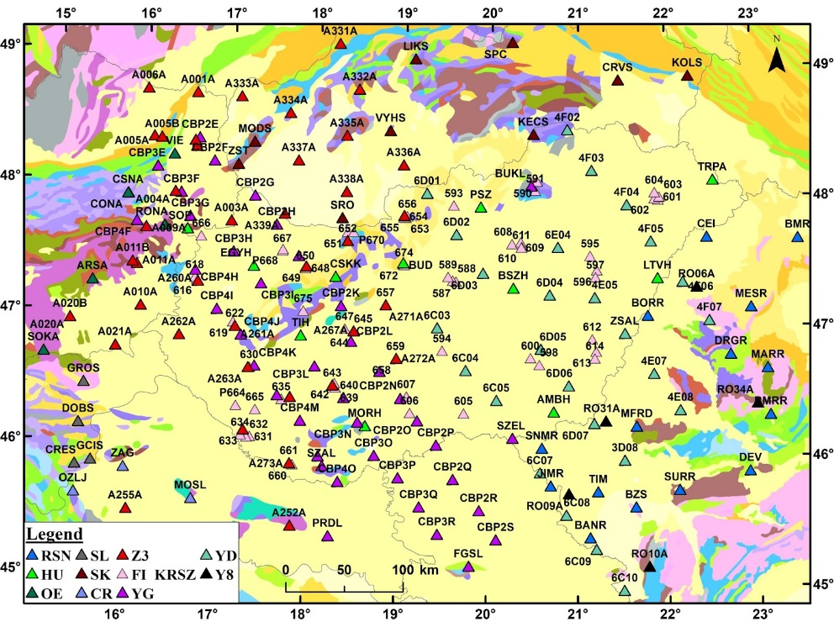
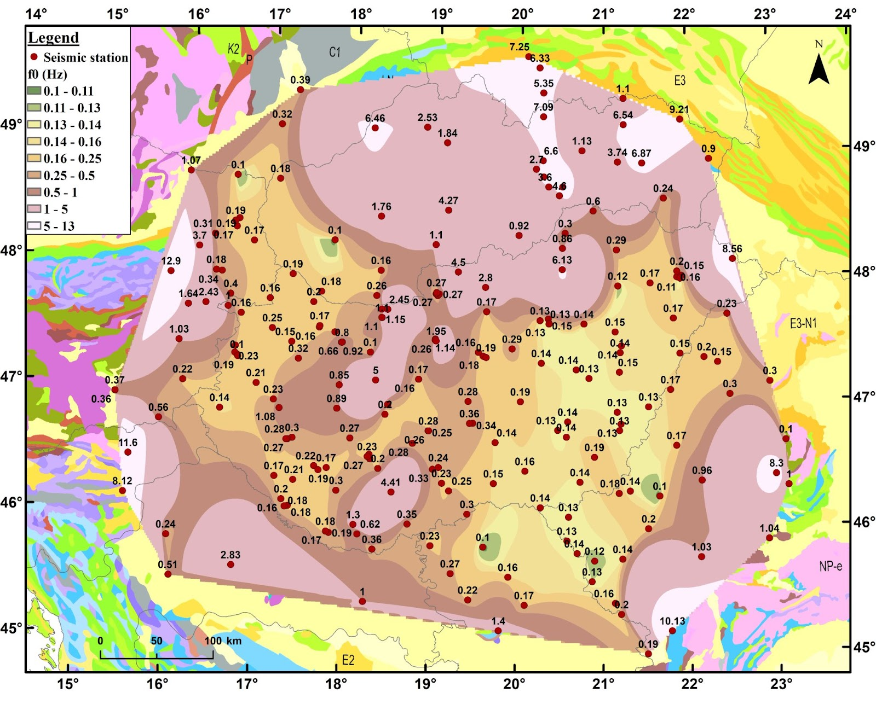

Seismic station locations (left) and corresponding f0 values (right)
(Nakamura, 1989)
Notes:
Empty slide for large pictures, tables, maps, plots…

Slide 5
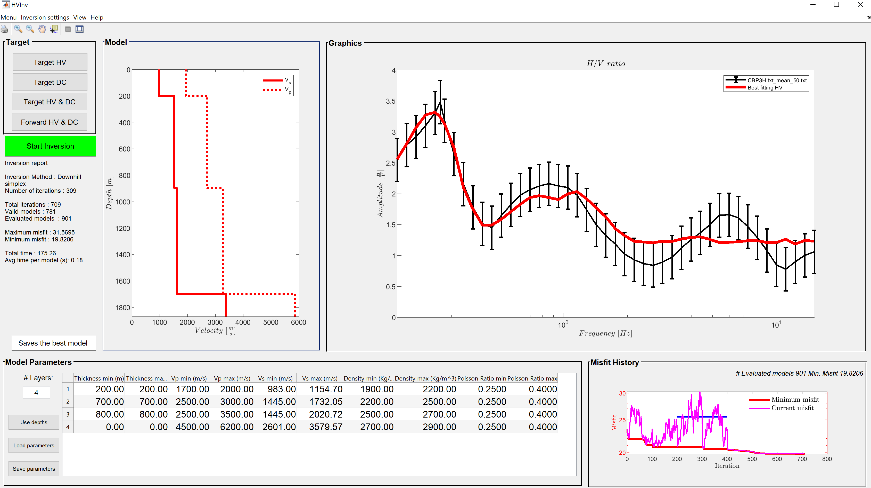
HV-Inv (García-Jerez et. al., 2016)
Notes:
Title slide for large pictures, tables, maps, plots…

Slide 6
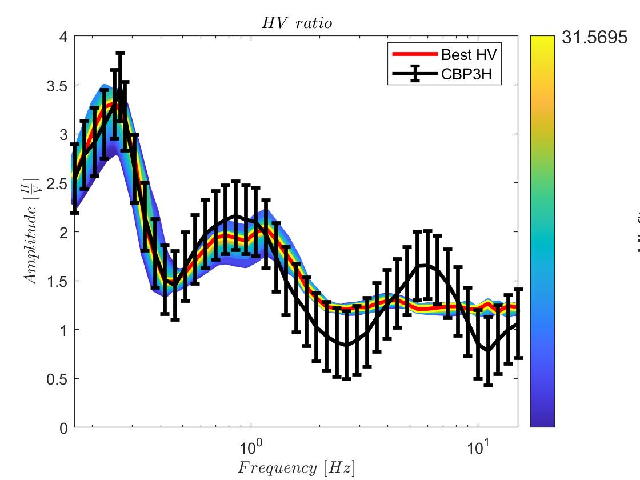
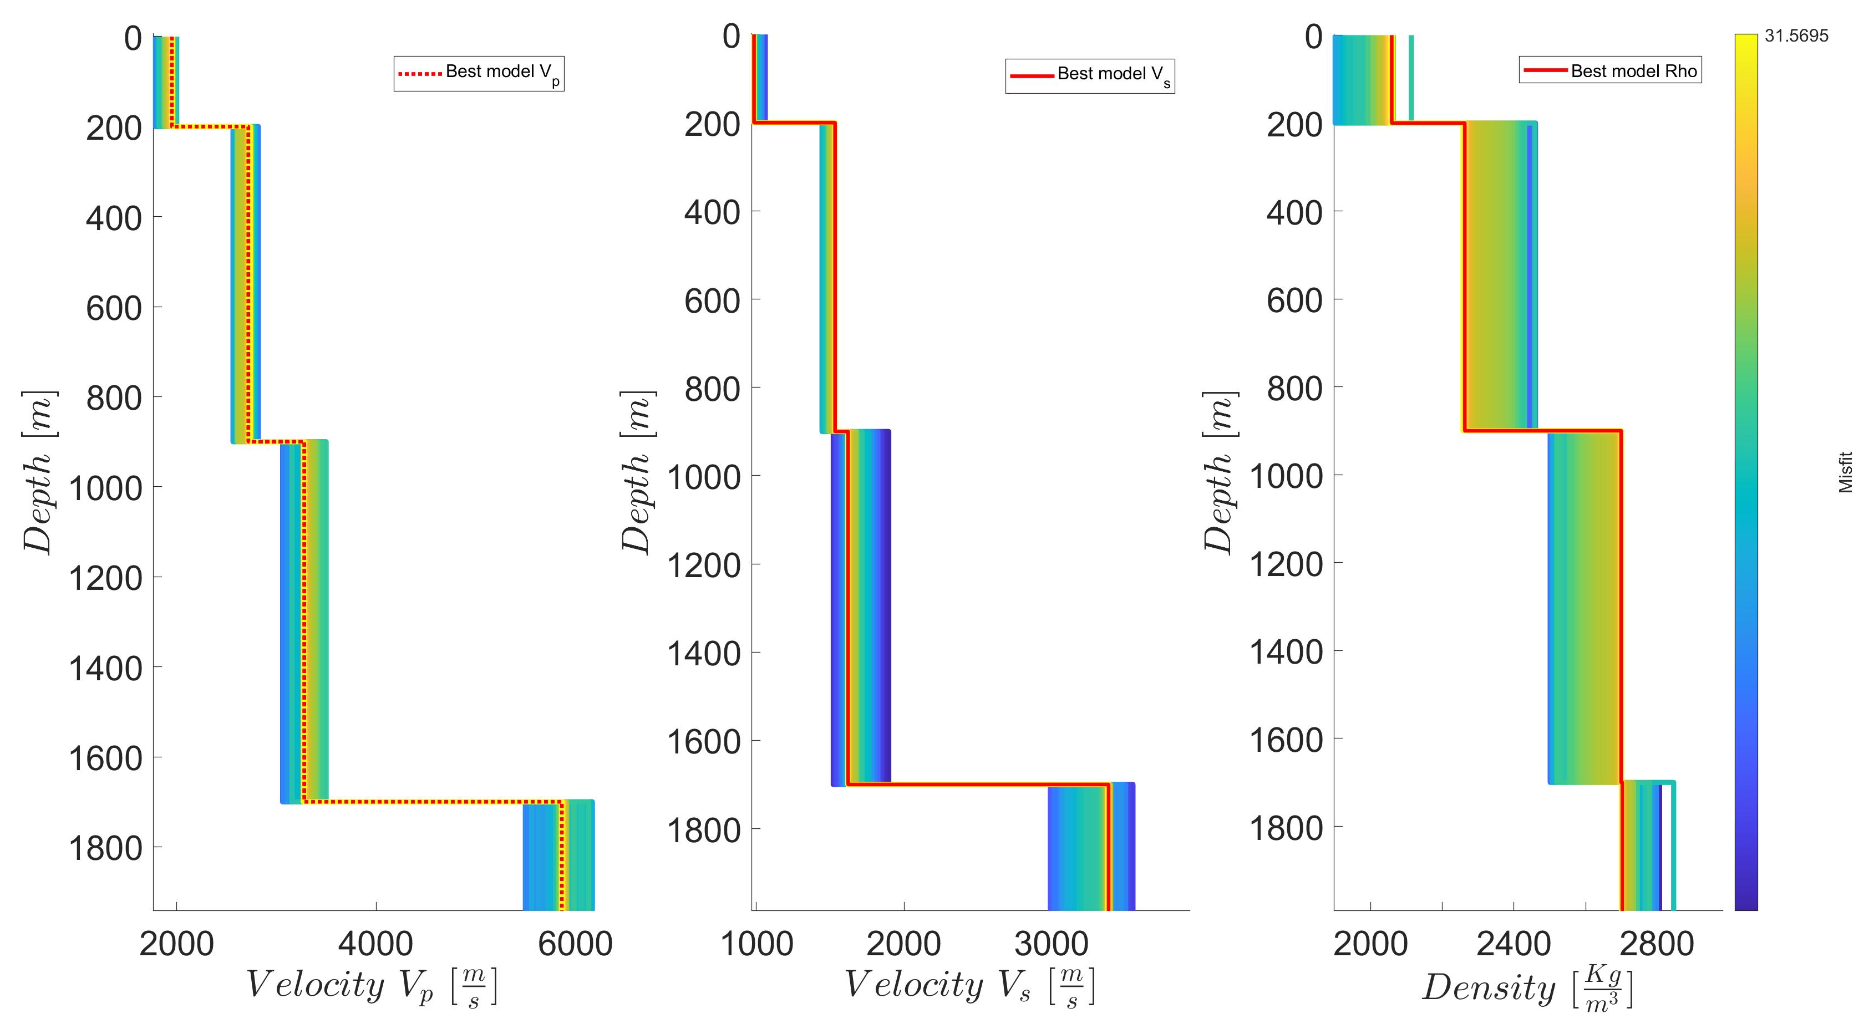
Fundamental frequency of resonance (f0) = 0.25 Hz
Literature depth (Horvath et al.,2015) = 1566.59 m
Obtained depth = 1700m
Notes:
Title slide for large pictures, tables, maps, plots…

Slide 7


Thank you for your attention!
coman@infp.ro
www.epos-eu.org/on | social media #EPOSon
Notes:
Thank you slide

