Slide 1

Application of the Magnetotelluric Method for Investigating Tectonic Structures and Hydrothermal Systems in the Sofia Basin, Bulgaria
Dilyana Hristova, PhD student| dilyana.m.hristova@gmail.com
National Institute of geophysics, geodesy and geography -Bulgarian Academy of Sciences
Notes:
Title slide

Slide 2
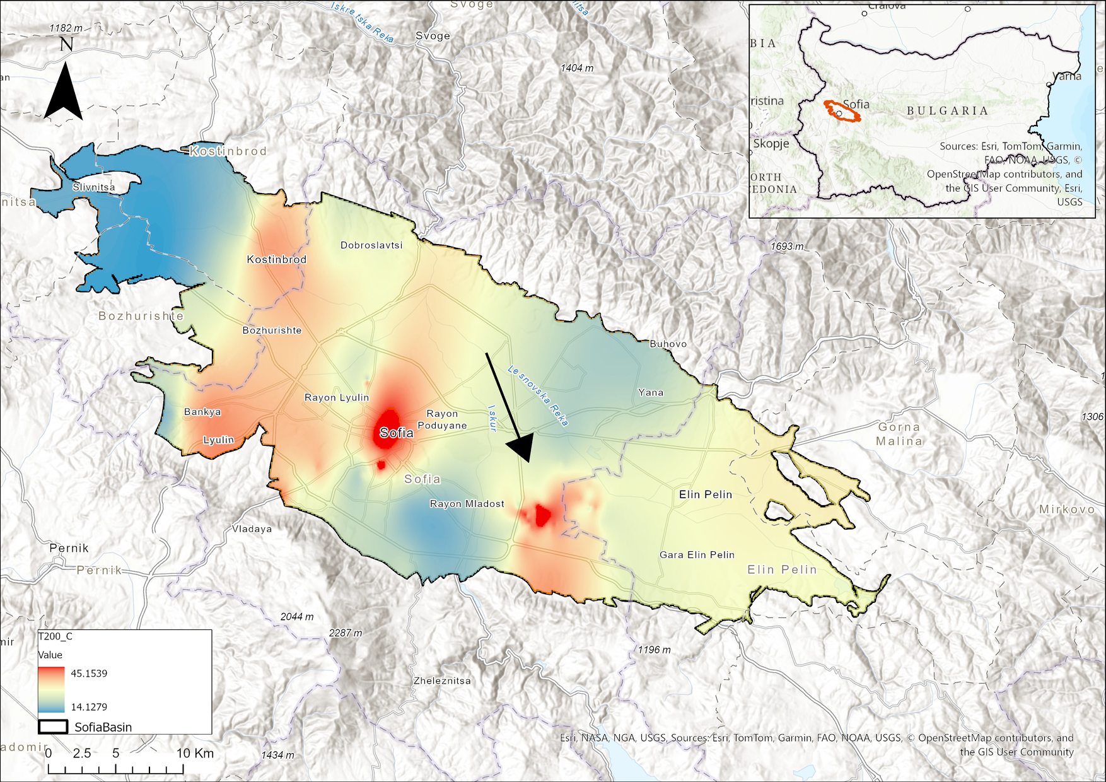
What am I researching and why?
❓ Research Question:
What geothermal anomalies exist in the Sofia Basin, and how can we map them accurately?
🎯 Goal:
To locate and analyze geothermal systems through magnetotelluric and other geophysical datasets.
🌍 Background:
The Sofia Basin has geothermal potential but is underexplored with modern geophysical techniques.
Notes:
Content slide

Slide 3
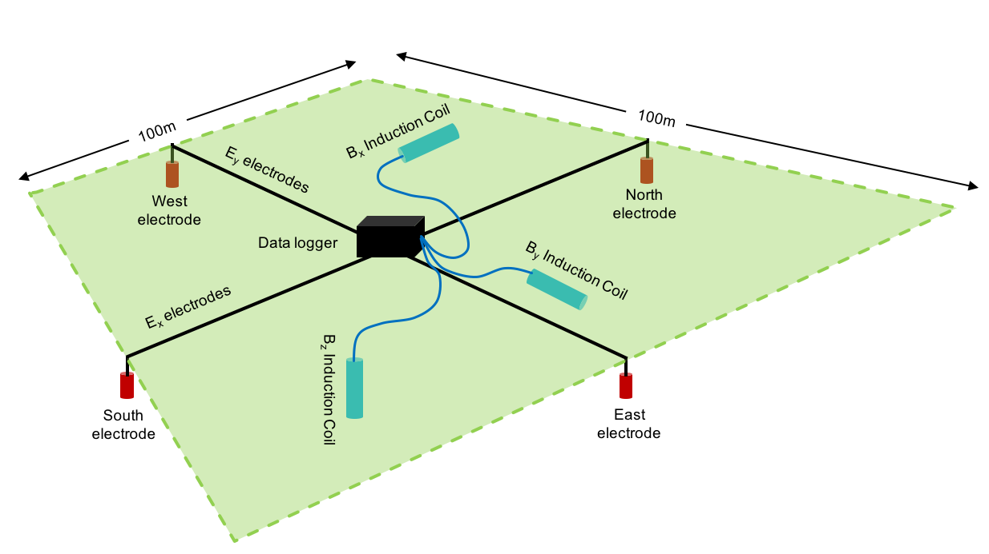
Data and Methodology
📊 Data to be used | 🧪 Method | 🔗 EPOS Portal Use
Magnetotelluric (MT) measurements | MT | Openly available data from EPOS
Seismic and geomagnetic data from the EPOS platform | Geological data | Contribution of new MT data to EPOS following FAIR data principles
Borehole logs, Temperature profile, Geological cross-sections, Drone imagery, Magnetic anomaly maps | Geophysical data | Promoting data interoperability and reuse in geothermal research
Notes:
Content slide: tables

Slide 4
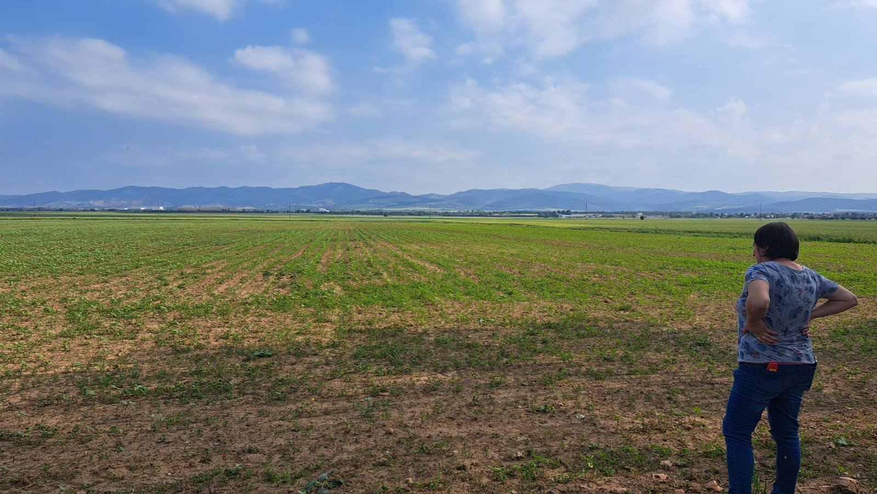
Expected Outcome:
Identification of active geothermal zones in the Sofia Basin
Enhancement of local geothermal models
Contribution to sustainable energy resource assessment
Strengthening the EPOS database with new high-resolution MT data
Notes:
Content slide – 2 boxes

Slide 5

Thank you for your attention!
📧dilyana.m.hristova@gmail.com
www.epos-eu.org/on | social media #EPOSon
Notes:
Thank you slide

