Slide 1

Analyzing Site Effects Using Crowdsourced Felt Reports and EPOS Data
Simon Issartel, French Seismologist,
Euro-med Seismological Centre (EMSC)
Notes:
Title slide

Slide 2
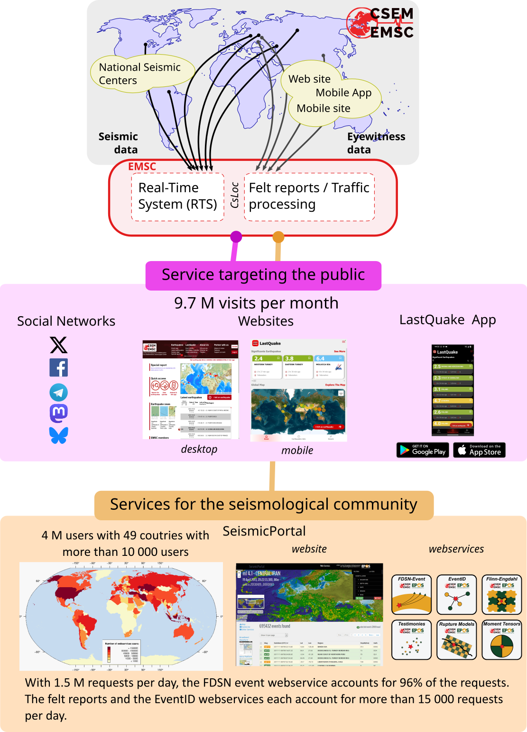
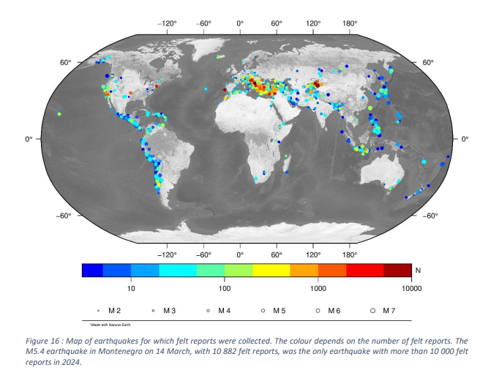
Euro-Mediterranean Seismological Centre
Notes:
Content slide

Slide 3
Site effect, felt reports and geological age
Hypothesus from Bossu et al, 2000
  Site effects are assumed to explain the discrepancies observed between predicted and reported shaking intensities from crowdsourced felt reports.
  Geological formations of similar age produce similar site effects (the younger sediments to be less compacted, and therefore more prone to cause site effects)

Slide 4
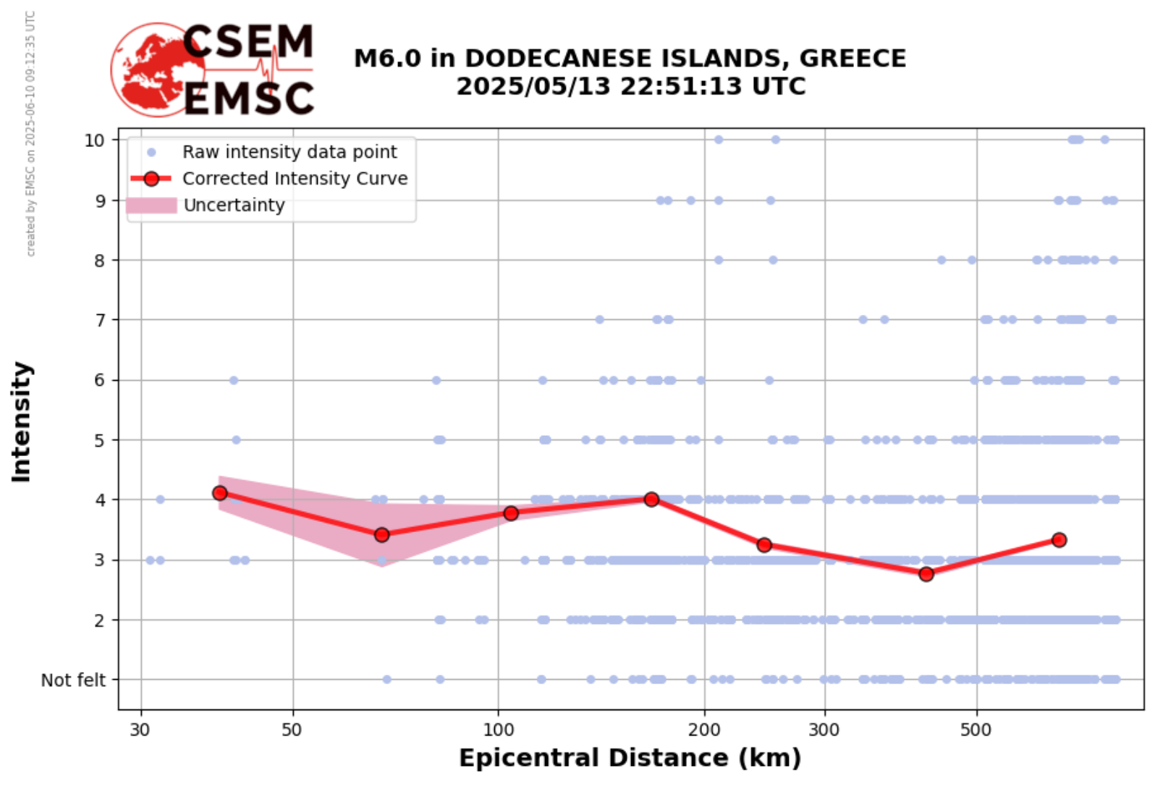
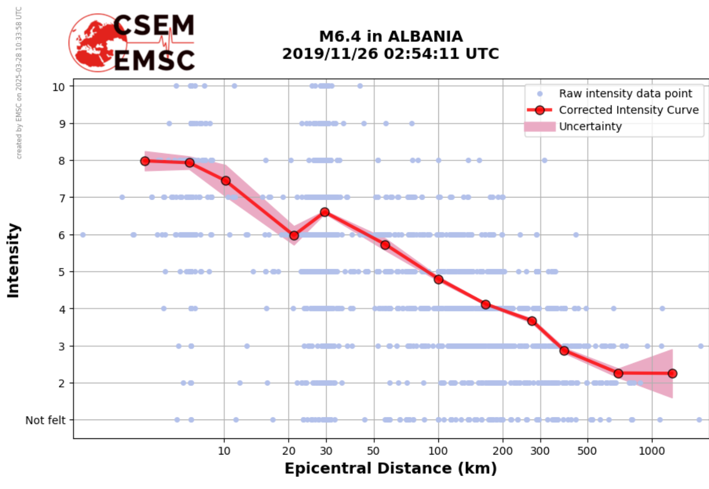
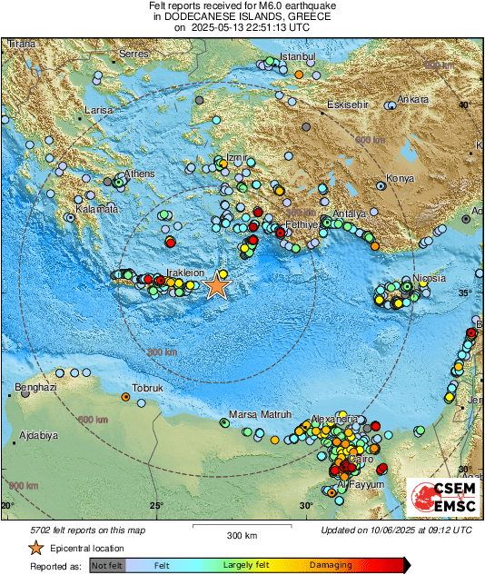
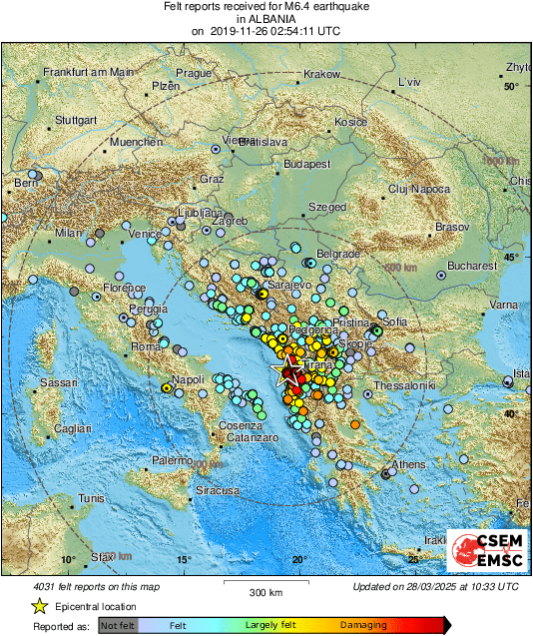
Different types of intensity/distance curves

Slide 5
Goal: Detect how local geology affects felt intensity
Two possible approaches:
  Averaging intensity curves by lithology
  Group earthquakes based on the lithology of the site
  → Average the felt intensity curves to identify significant differences between geological age.
  Detecting site effects through deviation from theoretical curves
  Compare intensity curves built from felt reports with theoretical curves from an Intensity Prediction Equation (based on magnitude and distance)
  → Identify local anomalies and cross-check their location with the geological age map to detect possible site effects.

Slide 6
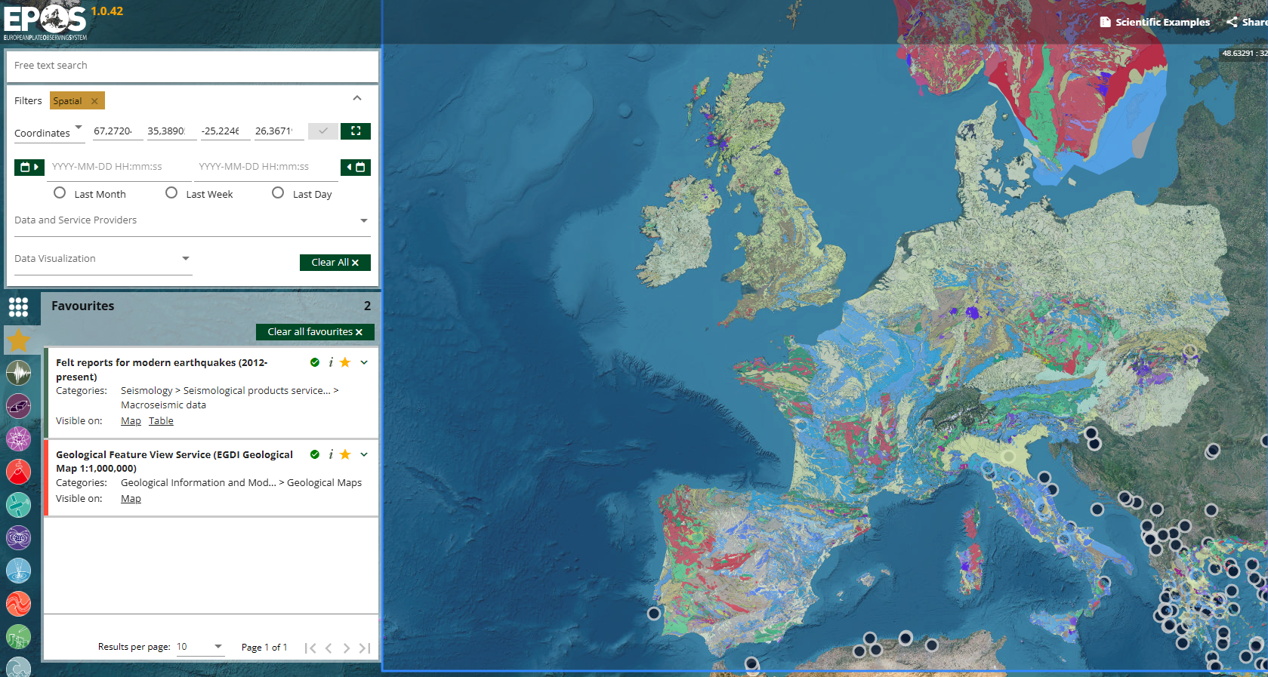
How to Retrieve the Data
From EPOS: select earthquakes with ≥100 felt reports and known geological age

Slide 7
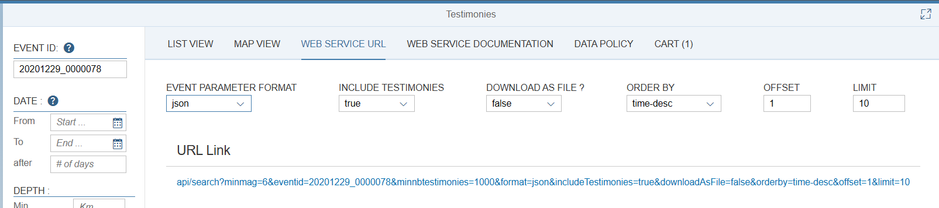
Seismic portal
Using the EMSC seismic portal API, retrieve felt report information for a specific earthquake

Slide 8

Thank you for your attention!
Simon.issartel@emsc-csem.org
www.epos-eu.org/on | #EPOSon
www.linkedin.com/in/simon-issartel-29968717b
Notes:
Thank you slide

Slide 9
Notes:
Logo only

