Slide 1
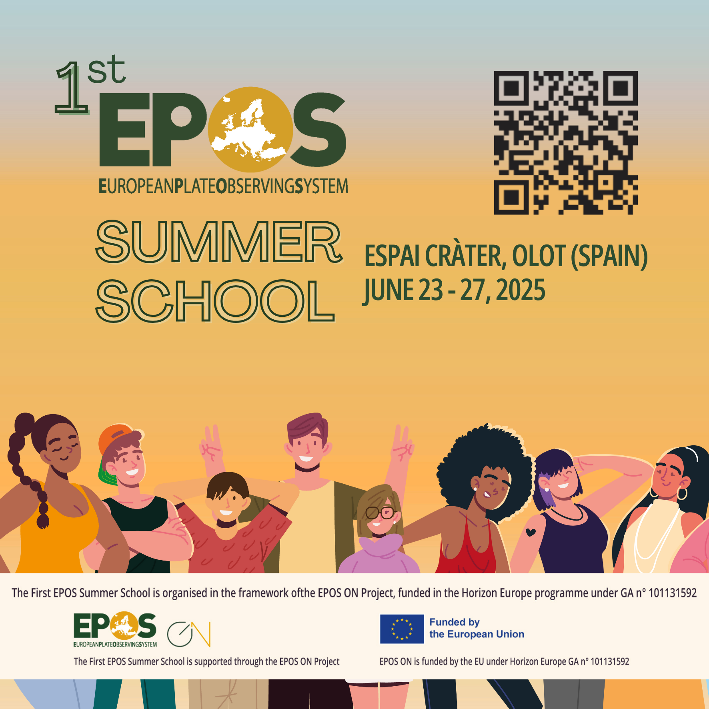
Analogue models: a window on volcanic edifice instability
Marta Rincón| marta.rincon@urjc.es
Universidad Rey Juan Carlos, Madrid, Spain
@falladamente
Notes:
Title slide

Slide 2
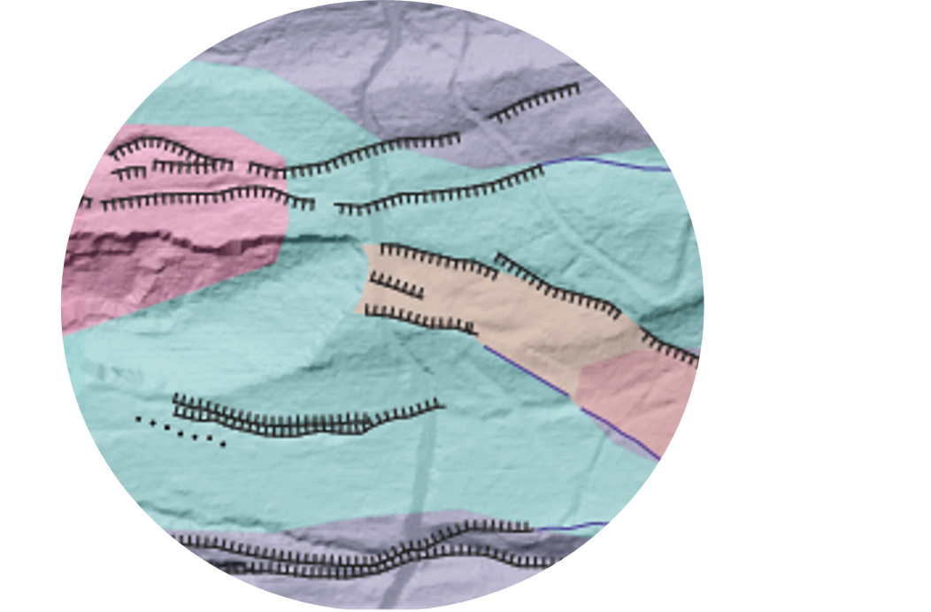
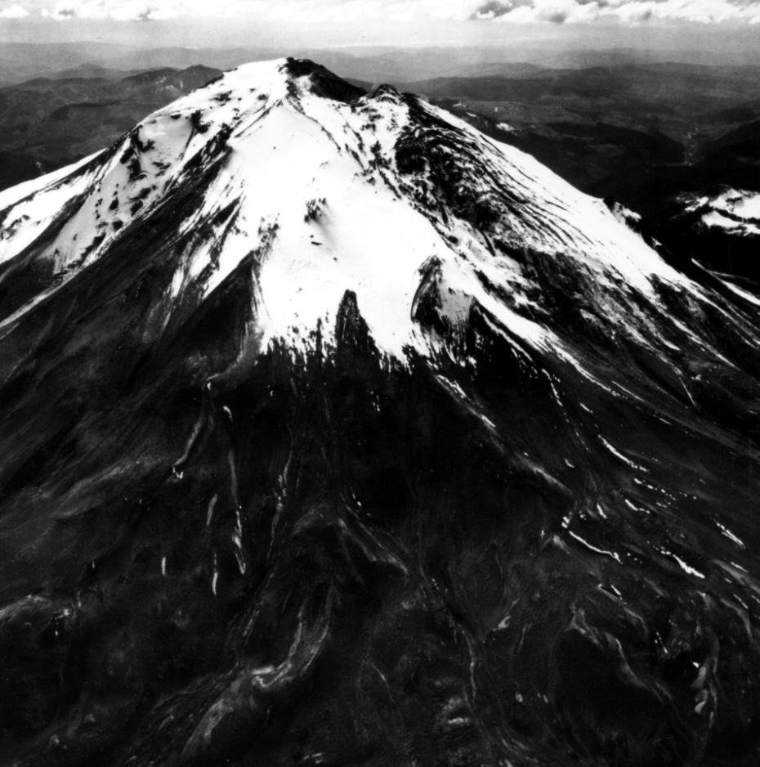
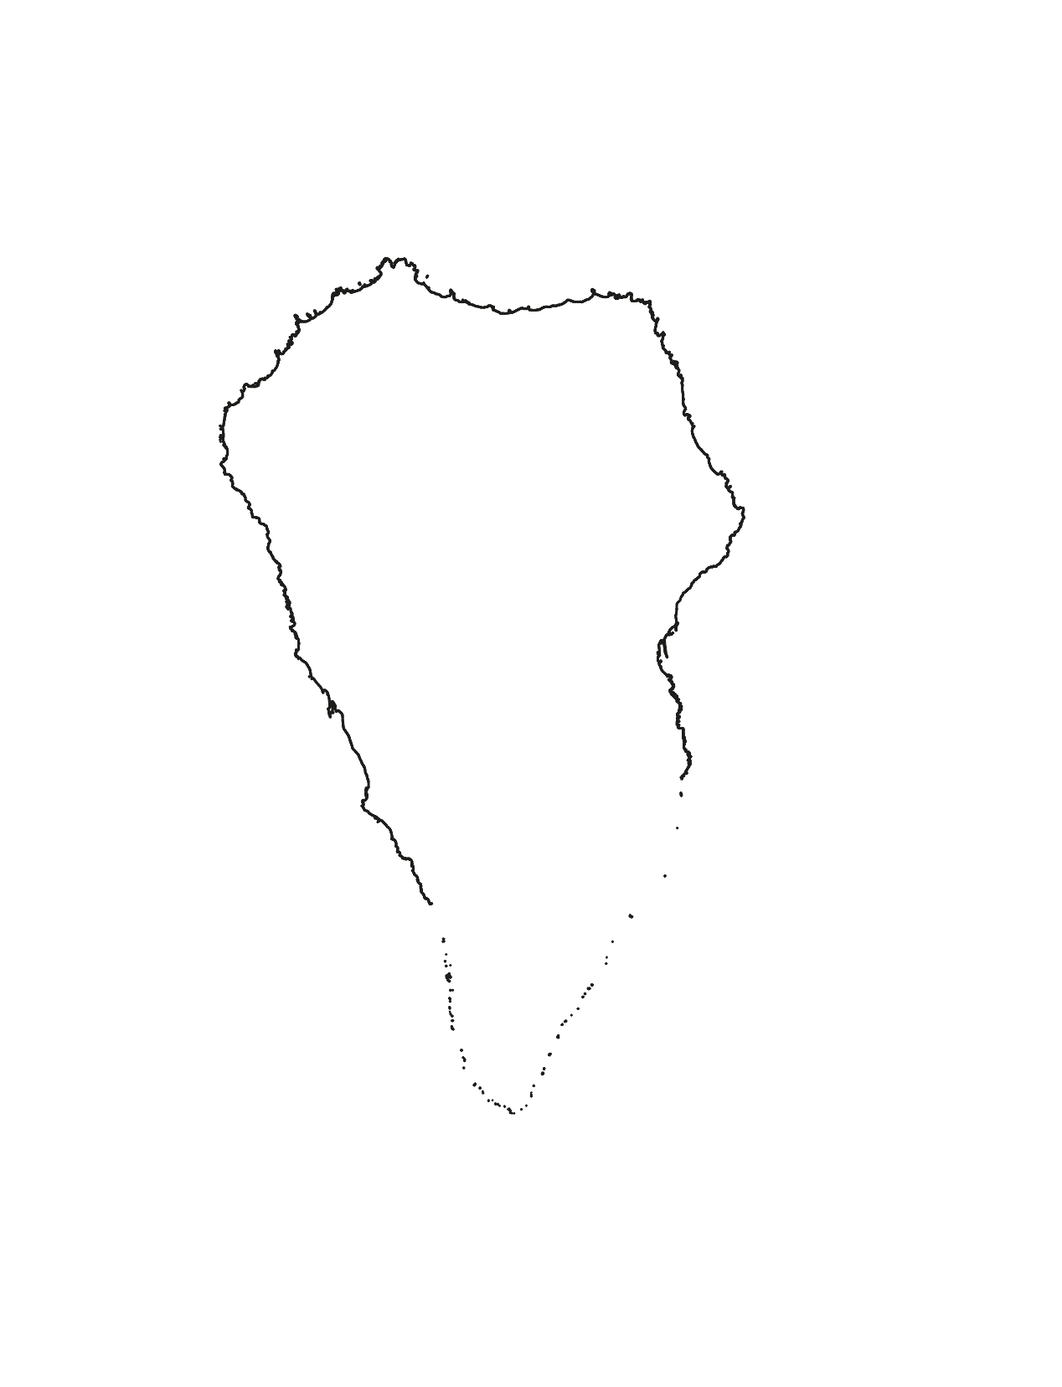
What am I researching?
Volcanic edifices instability
Cartography in detail
Analogue models
LA PALMA
Notes:
Content slide – 2 boxes with titles

Slide 3
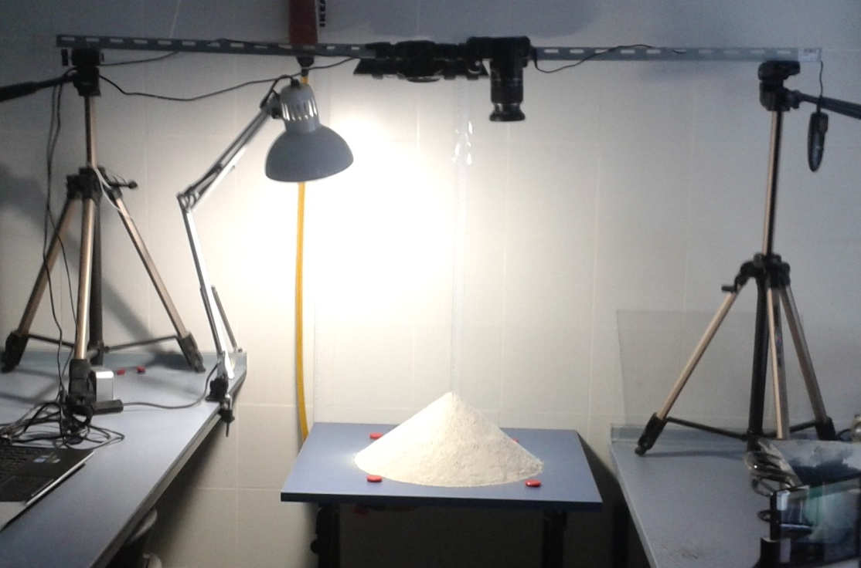
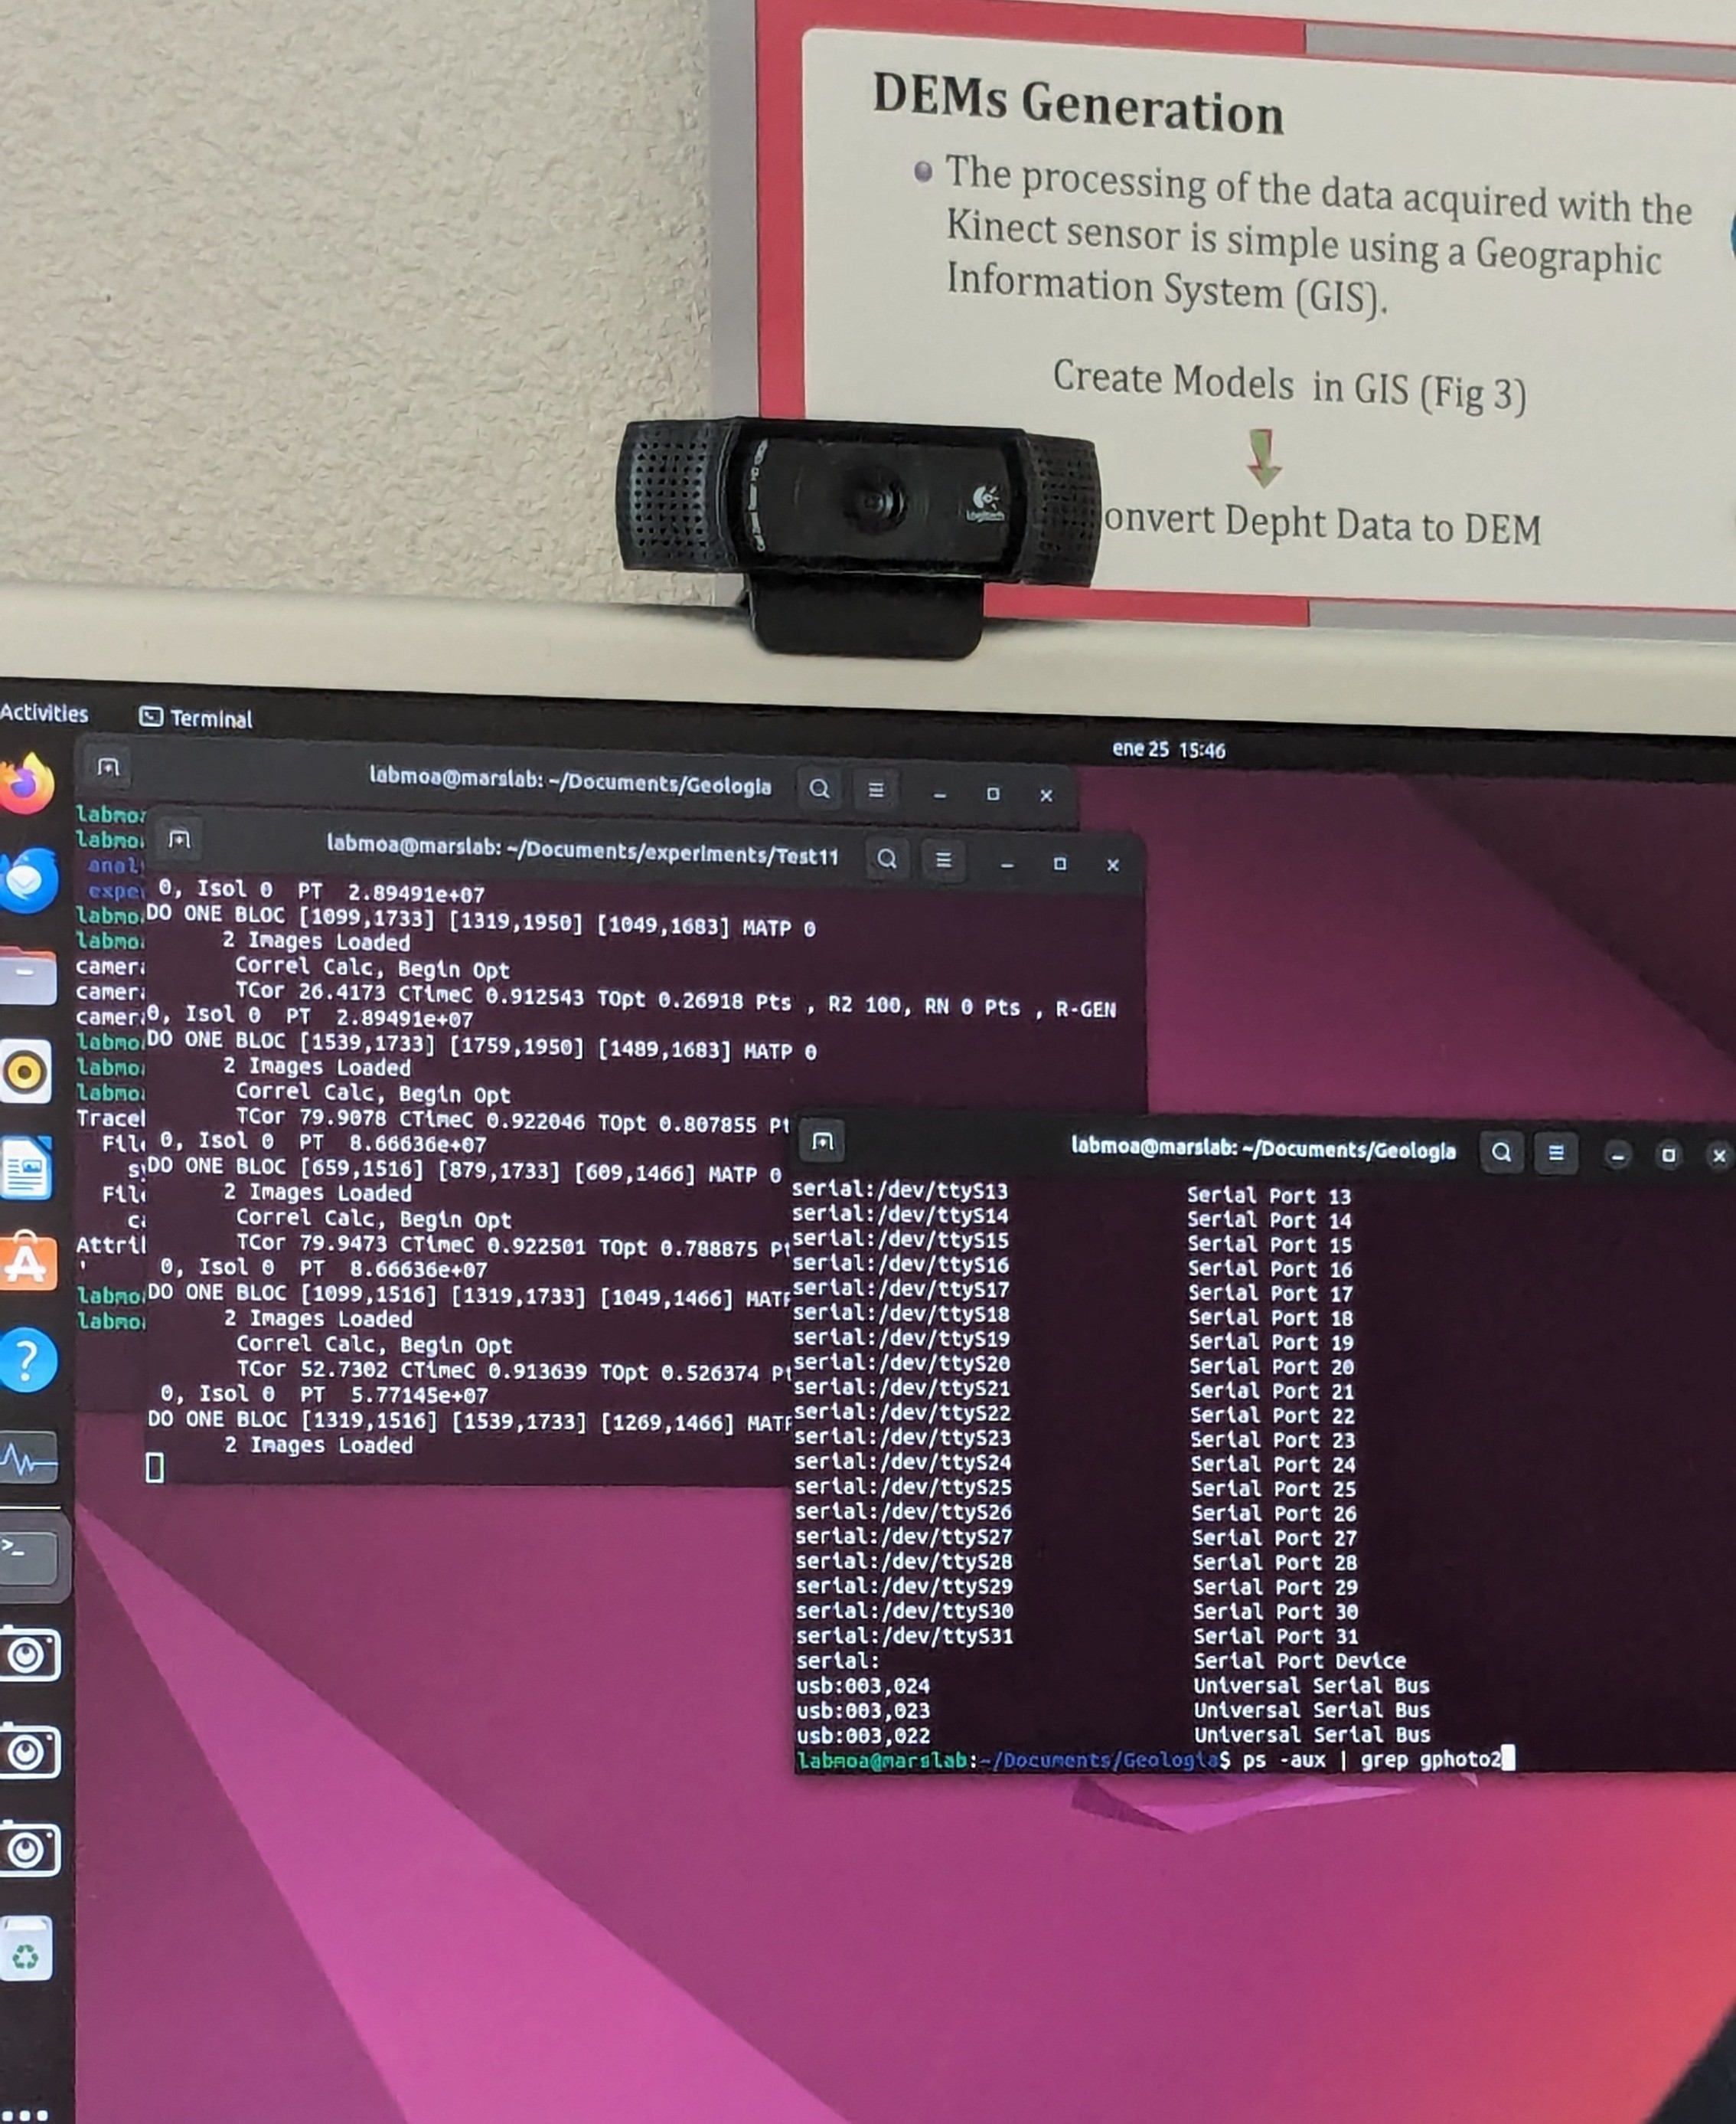
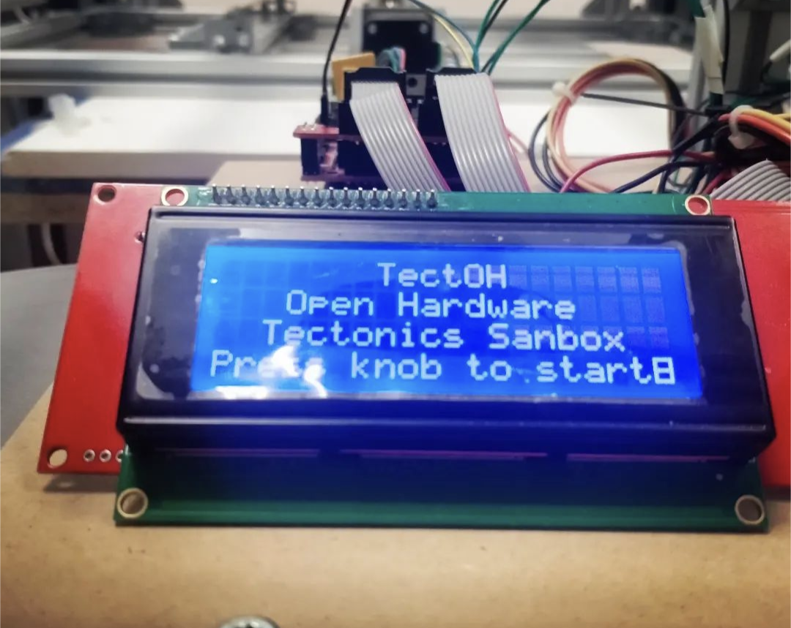

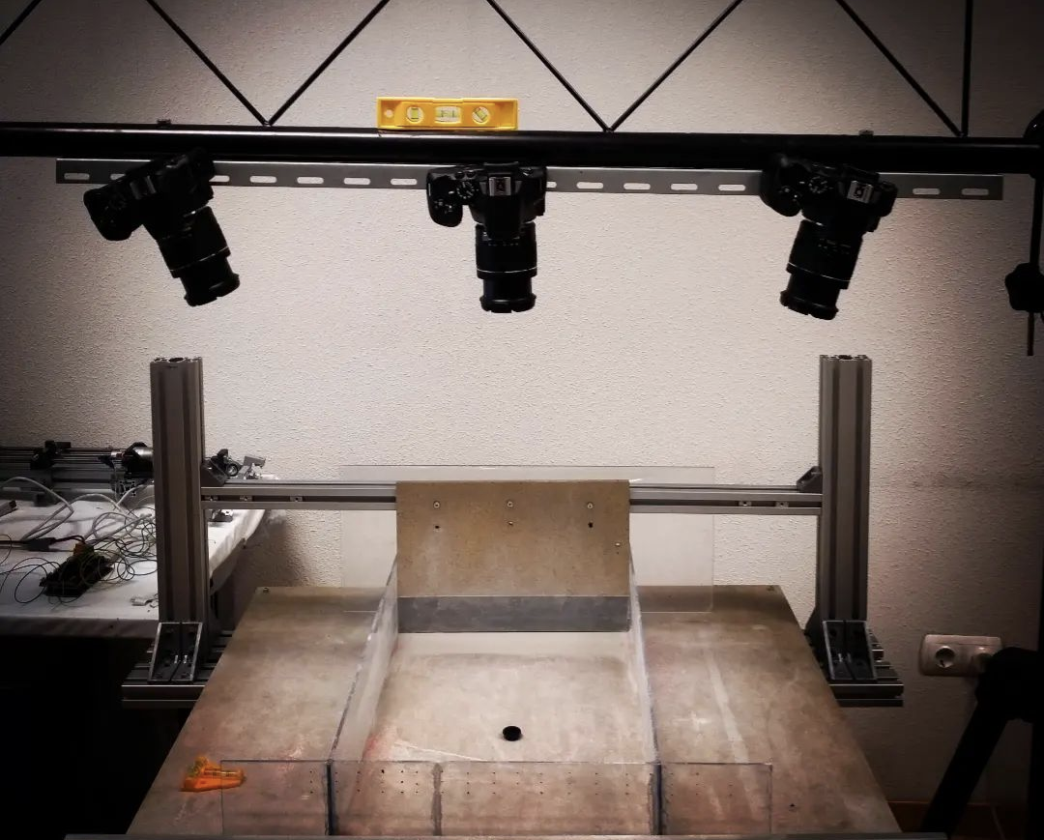
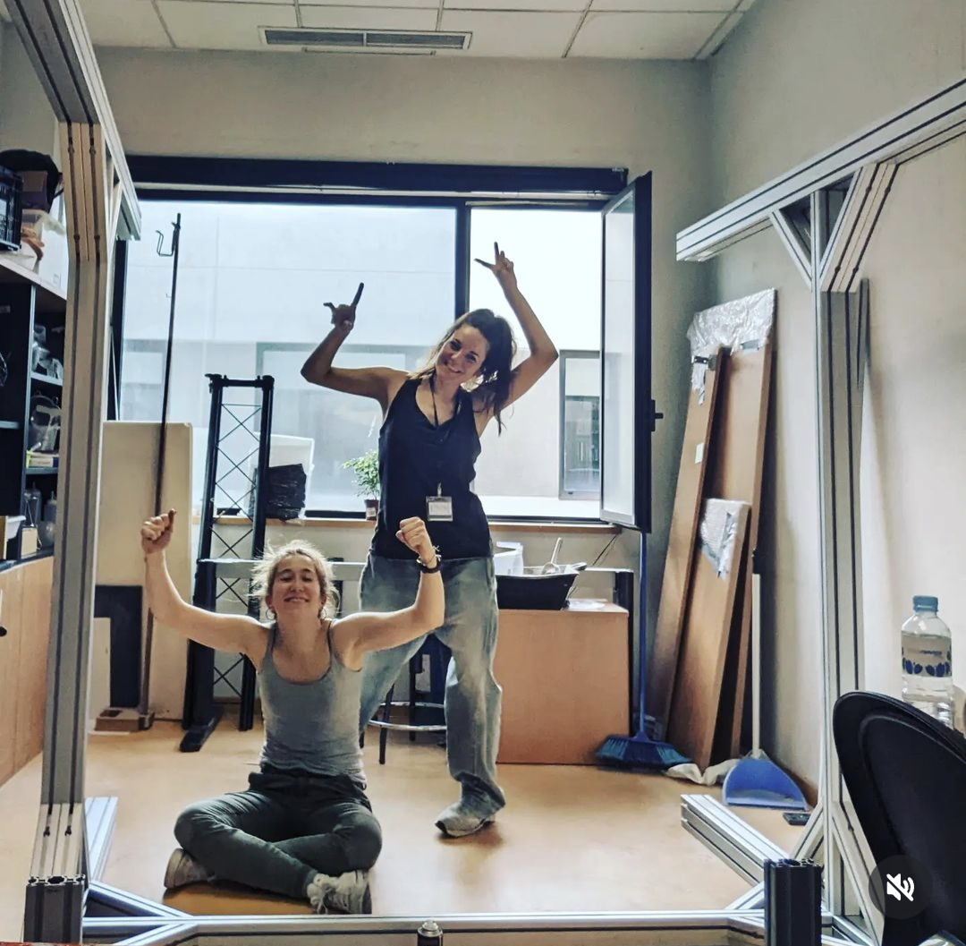
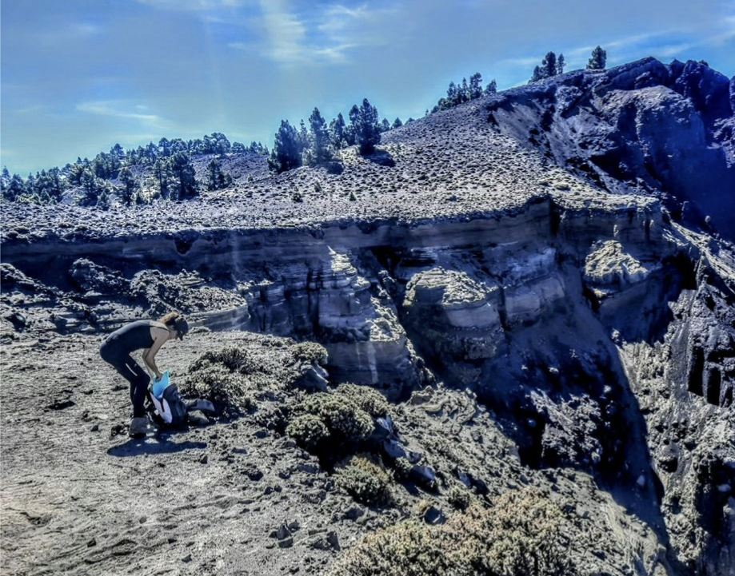
RESEARCH STAGE
Notes:
Content slide – 2 boxes with titles

Slide 4
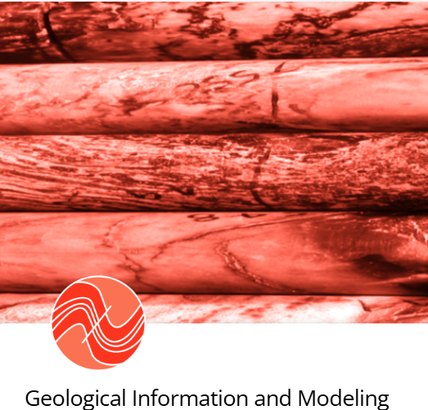

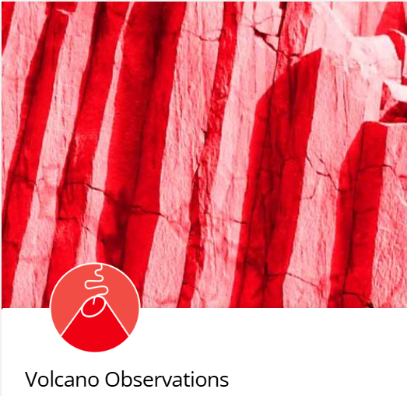
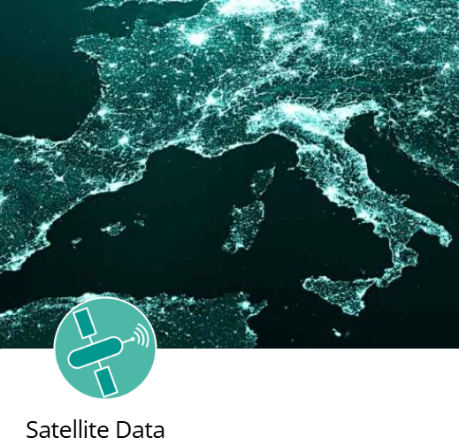
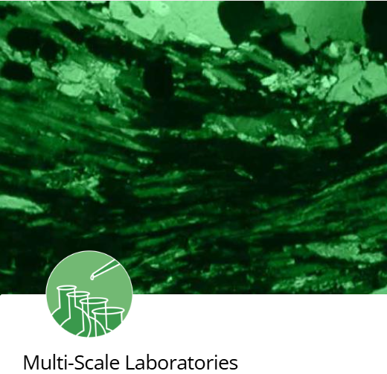
Data and EPOS Portal
Cartography
Petrology eruption Tajogaite 2021 Tajogaite
Analogue Models Data
Notes:
Content slide – 2 boxes with titles

Slide 5
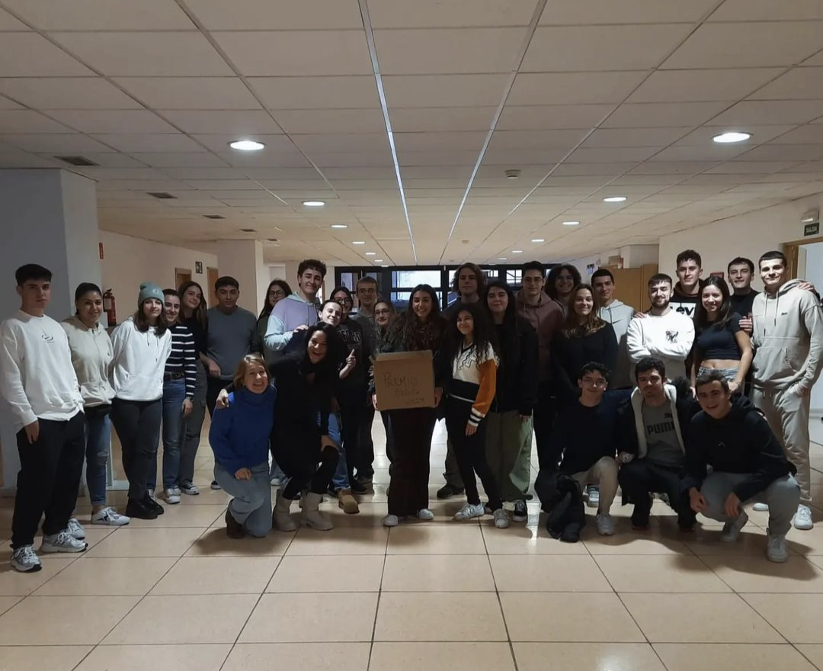
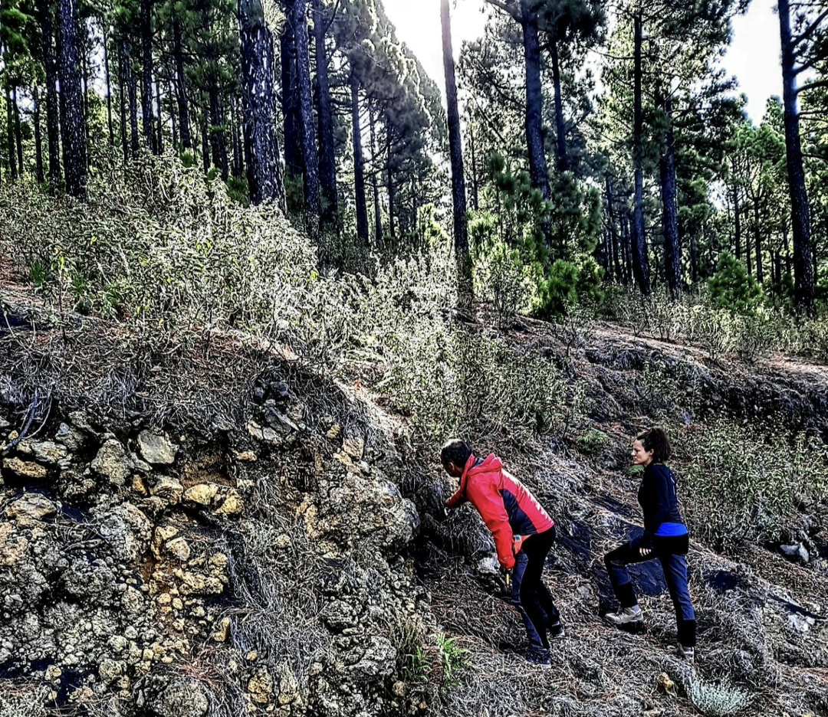
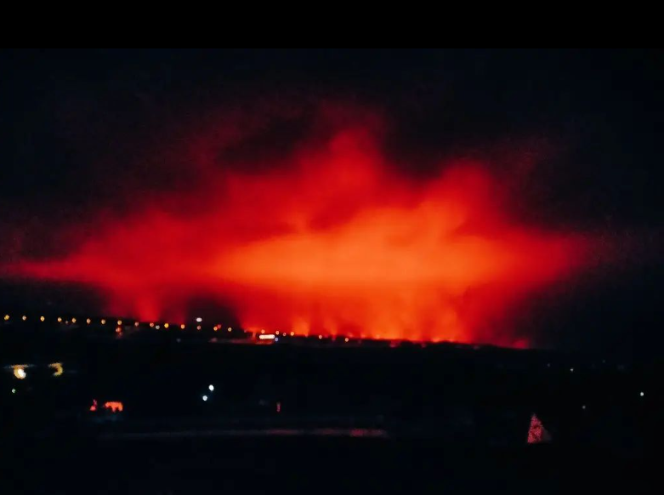
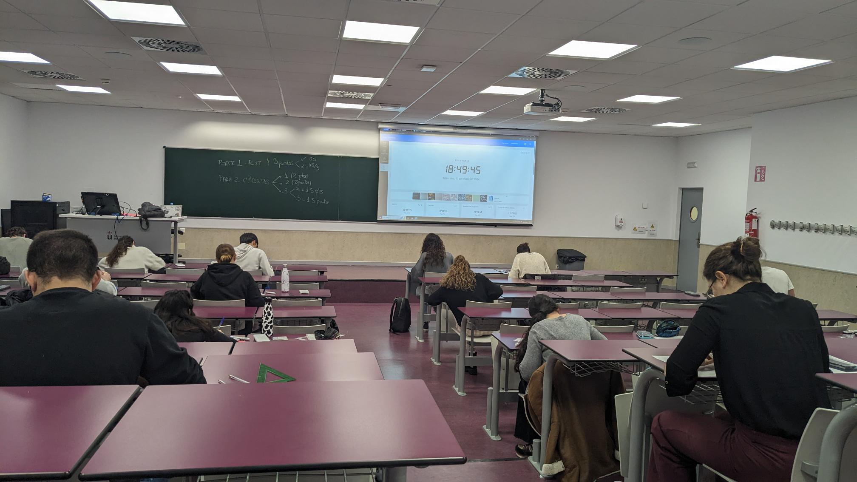
Expected Outcomes / Resultados Esperados
By combining EPOS resources with analogue modeling and cartography:
  I hope to improve volcanic risk assessments and contribute to open, collaborative science. I also plan to transfer this knowledge to my students and colleagues, and apply it in innovative teaching
Notes:
Content slide – 2 boxes with titles

Slide 6

Thank you for your attention!
marta.rincon@urjc.es
www.epos-eu.org/on | social media #EPOSon
Notes:
Thank you slide

