Slide 1

Building an open, freely available and continuously updatable 3D fault model of the Alborán Sea
Nathalia H Mattos | Beatriu de Pinós Postdoctoral Fellow (01/03/25 – 28/02/28) - Institut de Ciències del Mar – CSIC, Spain
Project: Advancing the understanding of the SEISmogenic poTential of large active strike-slip faults by means of multi-scale data analysis AND 3D modelling - SEISTAND-3D
Scientific Domain: Tectonics / Geodynamics
Notes:
Title slide

Slide 2
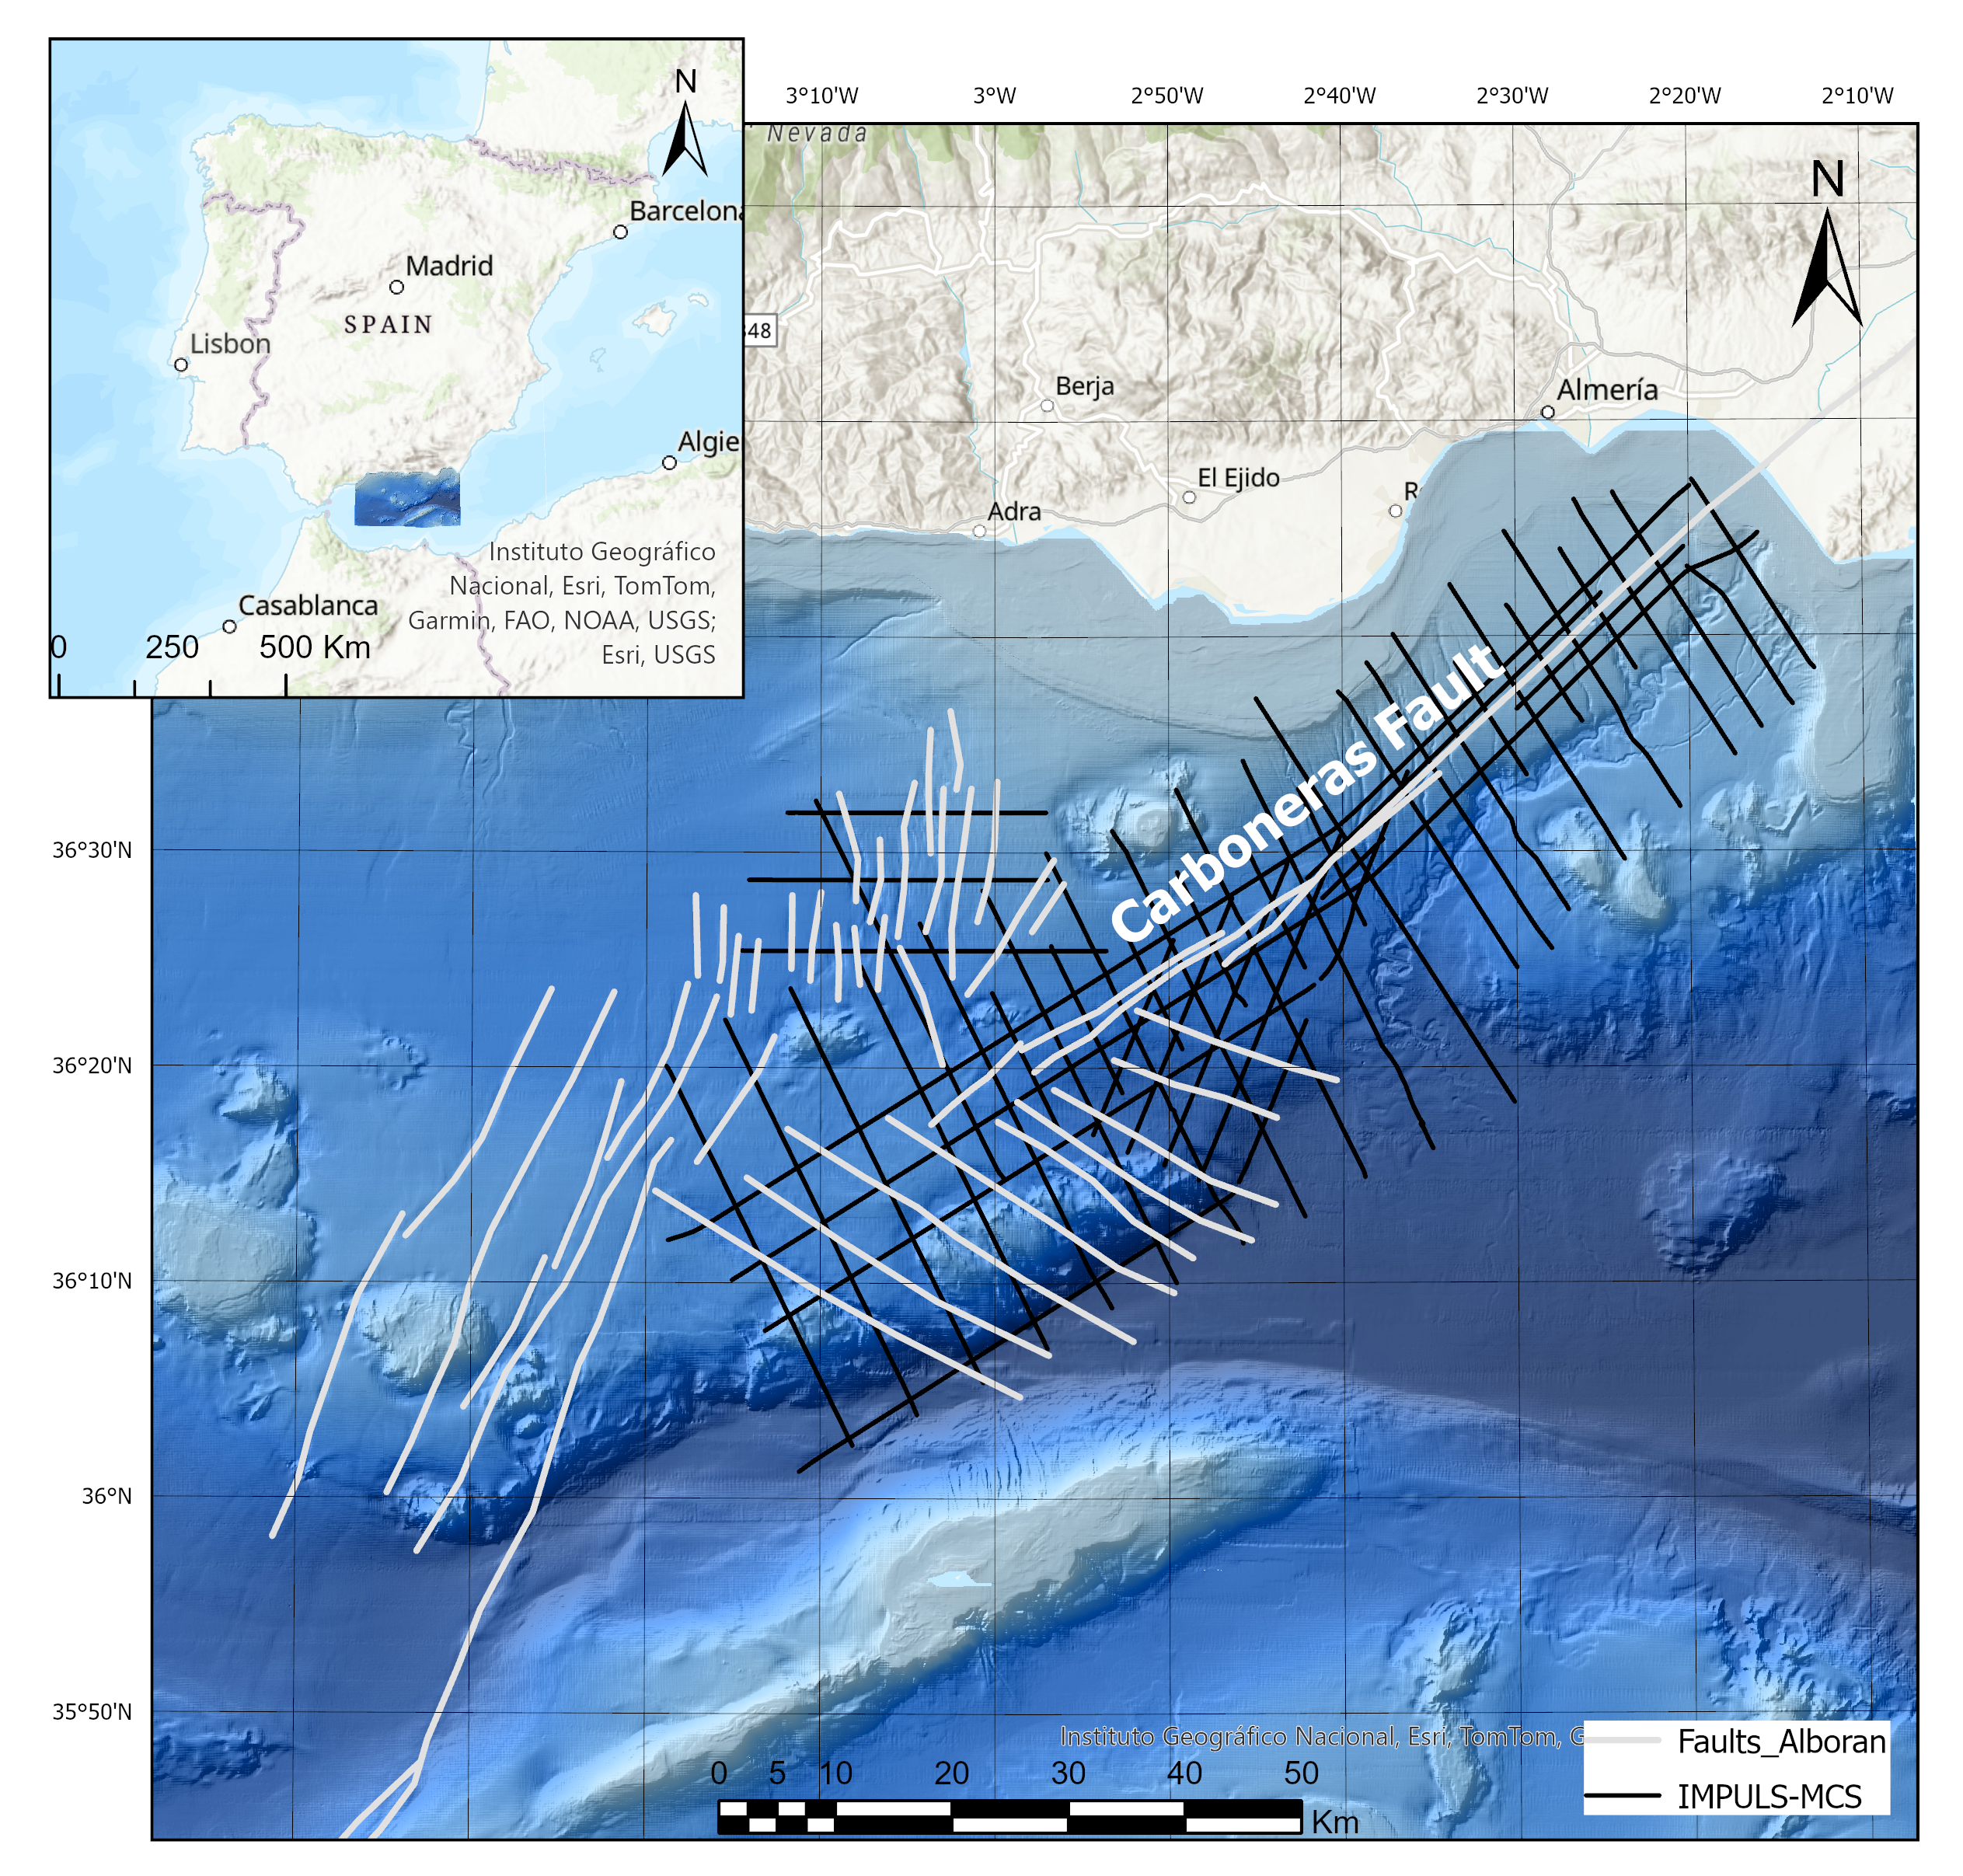
Research Question
“Silent” active faults in the Alborán Sea
  Strike-slip faults that do not always show obvious signs of movement
  Their complex 3D architecture and how they evolve are still largely enigmatic
  Capable of generating significant earthquakes and tsunamis
How can we better understand these faults to improve seismic and tsunami hazard assessment?
Notes:
Content slide – 2 boxes

Slide 3
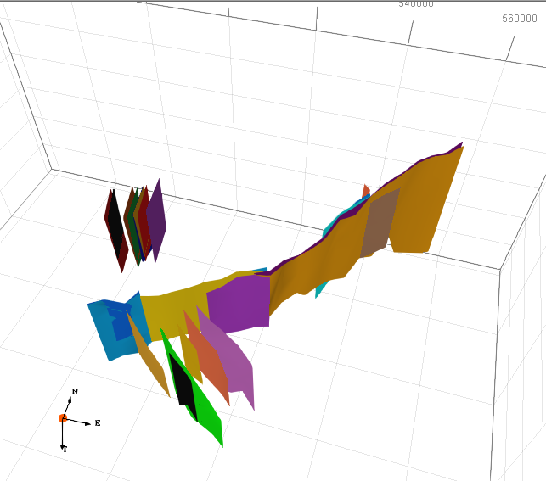
Use case: 3D fault model of the Alborán Sea
Development of an open, available, and continuously updatable 3D fault model of the Alborán Sea from seismic interpretation
Kinematic and geometric information for all the faults.
Input for earthquake rupture scenarios, stress inversion, and physics-based earthquake simulators
Initial 3D fault model of the Alborán Sea: Carboneras Fault

Slide 4
Research stage and expected outcomes
Research stage: Data interpretation and integration, initial 3D fault framework in the Carboneras Fault Zone
EPOS:
  Datasets sharing - 3D fault and seismic horizons meshes (ASCII), kinematic and geometric information (.csv)
  Integration with relevant seismic and geological datasets (e.g., seismic catalogues)
Outcome:
  Provide a detailed, open-access 3D fault model of the Alborán Sea as a platform for collaborative research

Slide 5

Thank you for your attention!
mattos@icm.csic.es
www.epos-eu.org/on | social media #EPOSon
Notes:
Thank you slide

