Slide 1

Flood Risk Mapping and Early Warning in the Niger-Benue Confluence Region Using Google Earth Engine
Idris Halima Ohunene| National Space Research & Development Agency, Nigeria
Notes:
Title slide

Slide 2
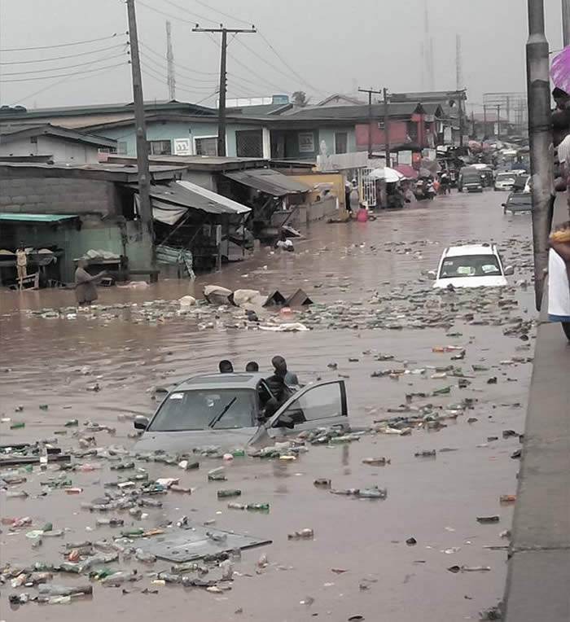
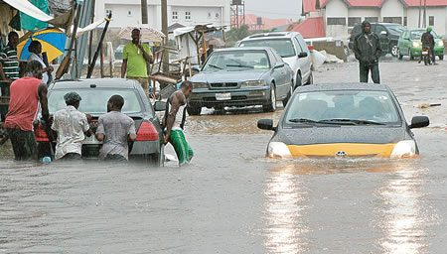
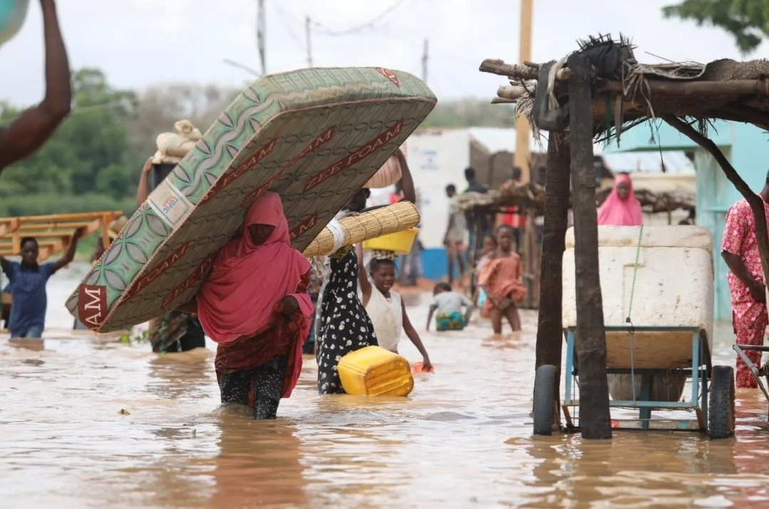
The Problem & Goal
Frequent floods in the Niger-Benue confluence area threaten lives and infrastructure.
Challenge: Little ground data, limited early warning capacity
Goal: Use satellite imagery and cloud tools to support flood risk monitoring and alerts
Notes:
Content slide

Slide 3
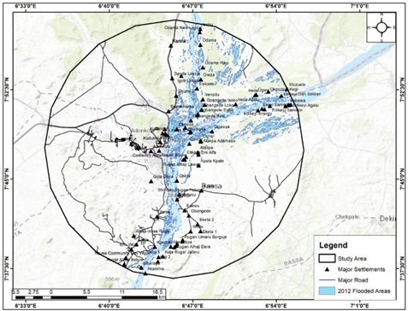
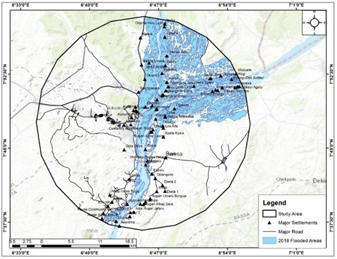
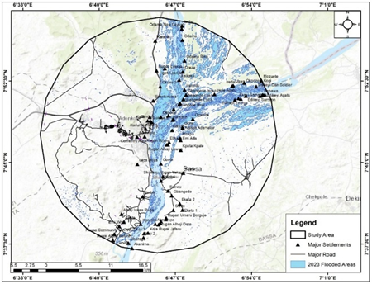
How I Do It?
Tool: Google Earth Engine (no downloads, works in the cloud), QGIS
Data: Sentinel-1 (radar) + Sentinel-2 (optical)
What I create:
Water maps
Flood frequency layers
Risk zones based on elevation/ population
Fig 1: 2012 Flooded Areas
Fig 2: 2018 Flooded Areas
Fig 3: 2023 Flooded Areas
Notes:
Content slide – 2 boxes

Slide 4
What’s Next / EPOS Link
I want to improve this work using EPOS tools:
For sharing, reproducibility, and integration
I’m also hoping to connect with others working on geohazards or early warning
Long-term goal: Scalable early warning tools for vulnerable communities in Africa
Notes:
Content slide – 2 boxes with titles

Slide 5


Thank you for your attention!
halima.idris@nasrda.gov.ng | halimaidriso@gmail.com
www.epos-eu.org/on | social media #EPOSon
Notes:
Thank you slide

