Slide 1

Seismicity and Seismic Hazard Assessment of the Western Arid Regions of South Africa: a neotectonic perspective.
Hlompho Malephane | hrmammile@yahoo.com
Notes:
Title slide

Slide 2
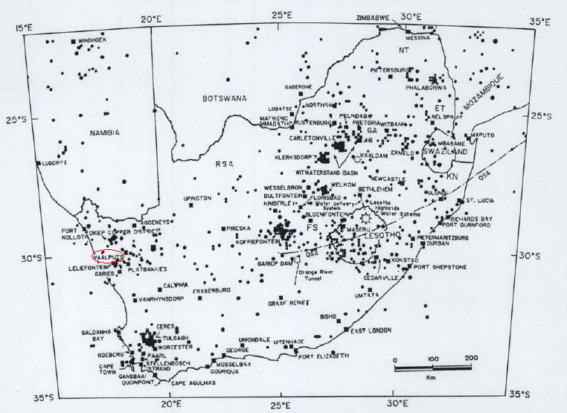
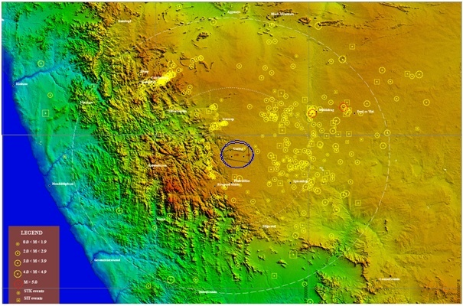
Why?
South Africa plans expanding a nuclear waste site.
Stable region but lacks data and detailed seismic study.
Can we understand risk better using seismic + satellite data?
Notes:
Content slide

Slide 3
Stakeholders
University of the Wiwatersrand (Wits) | South African Nuclear Energy Corporation (Necsa) | Council for Geoscience (CGS) | European Plate Observing System (EPOS) | University of Vienna (Uni Wien)
Started | Support/Collaboration | Collaboration | Collaboration | Prospective Collaboration
Notes:
Content slide: tables

Slide 4
How?
Earthquake data (local + global) collection.
Add fault lines + satellite information.
Use EPOS tools to build a hazard model.
Notes:
Title slide for large pictures, tables, maps, plots…

Slide 5
Intentions
Access open, FAIR data and practical training.
Build a reproducible model to support infrastructure planning.
Finish my PhD and connect with researchers across domains.

Slide 6

Thank you for your attention!
hrmammile@yahoo.com
linkedin.com/in/hlompho-malephane
www.epos-eu.org/on | social media #EPOSon
Notes:
Thank you slide

