Slide 1



Fingerprinting of critical minerals using data mining
Hedaya Alyousif | Uppsala University
Smart Exploration Research Center

Slide 2
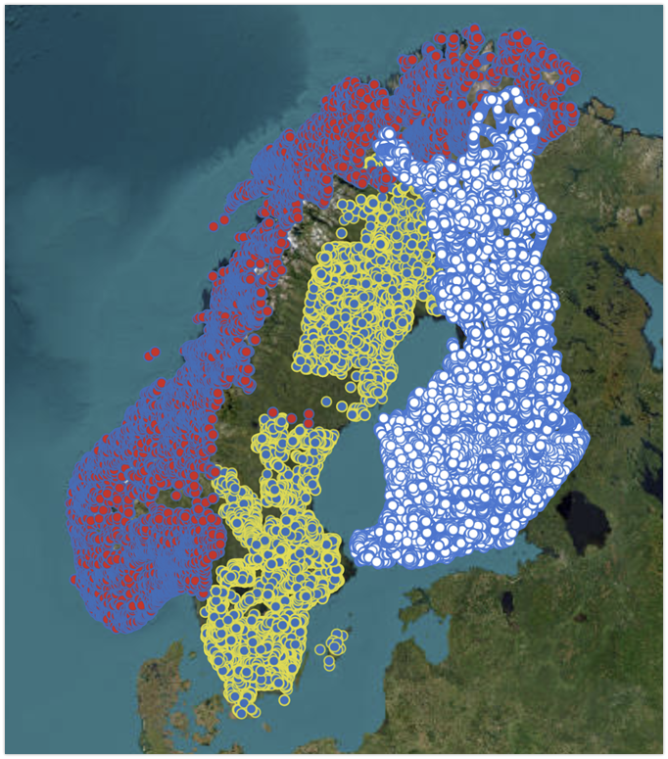
Research Objective
To develop algorithms that can identify the presence of critical raw minerals using data mining techniques and geoscientific data
To apply these algorithms to datasets from the geological surveys in Nordic countries (Sweden, Norway, Finland, Denmark, Iceland & Greenland).
Notes:
Content slide

Slide 3
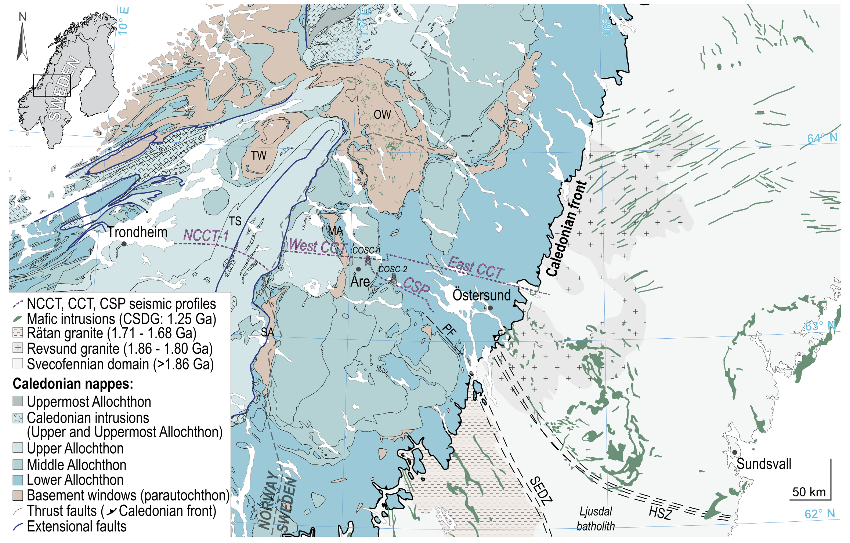
Current State of Research
Starting with a limited dataset from two wells in Sweden
Trying to identify rock types using unsupervised and supervised algorithms
Available data:
  Petrophysical data from well logging
  Geochemical from core scanning

Slide 4
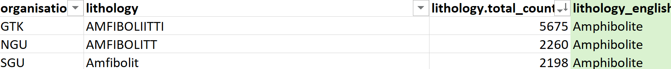
Current State of Research
Working on harmonizing the datasets from the Nordic geological surveys.

Slide 5

Thank you for your attention!
hedaya.alyousif@geo.uu.se
www.epos-eu.org/on | social media #EPOSon
Notes:
Thank you slide

Slide 6
Notes:
Logo only

