Slide 1

Automatic Focal Mechanism Computation for Small-Magnitude Earthquakes in NE Italy
Fatemeh Abdi, Angela Saraò, Monica Sugan, Andrea Magrin, Giovani Messuti, and Matteo Picozzi
contact: fabdi@ogs.it
Notes:
Title slide

Slide 2

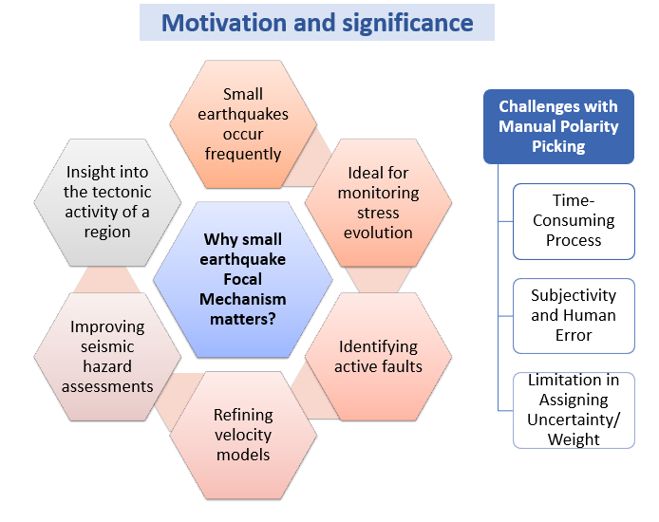
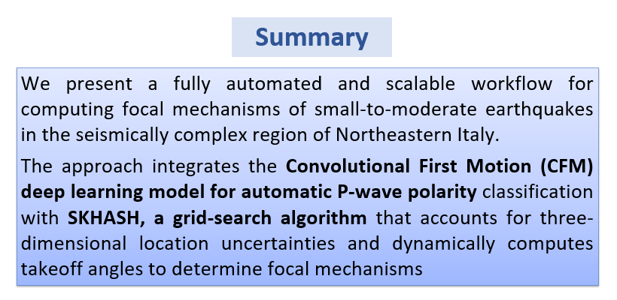
Notes:
Content slide

Slide 3
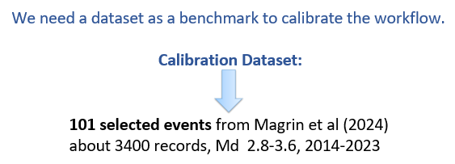

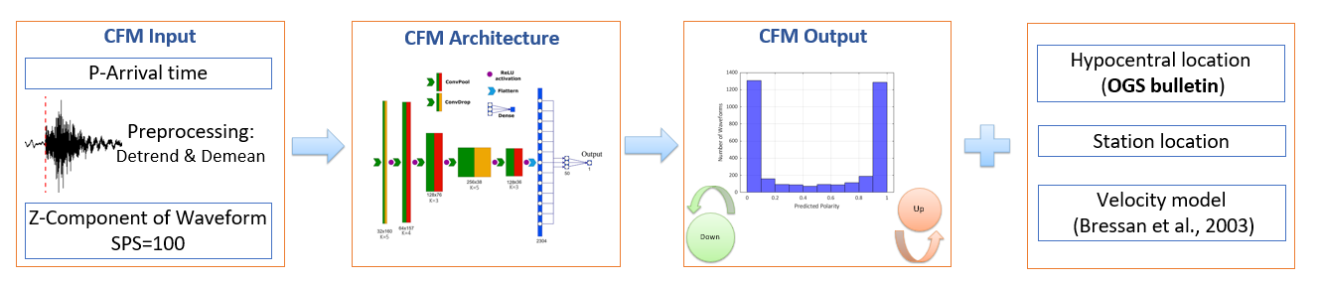
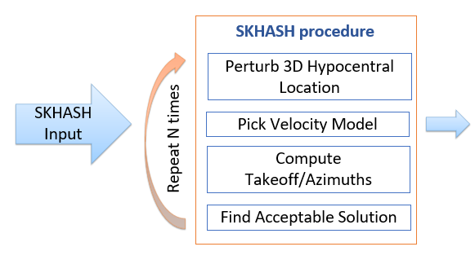
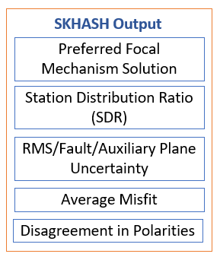
Notes:
Content slide: tables

Slide 4

Notes:
Content slide: tables

Slide 5
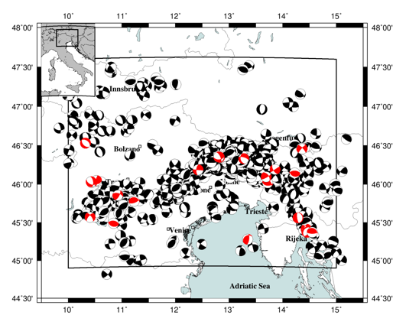
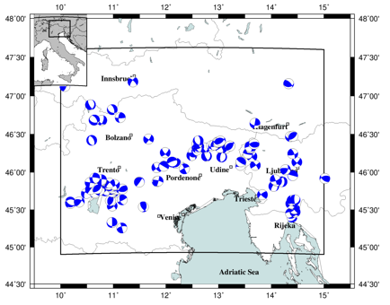
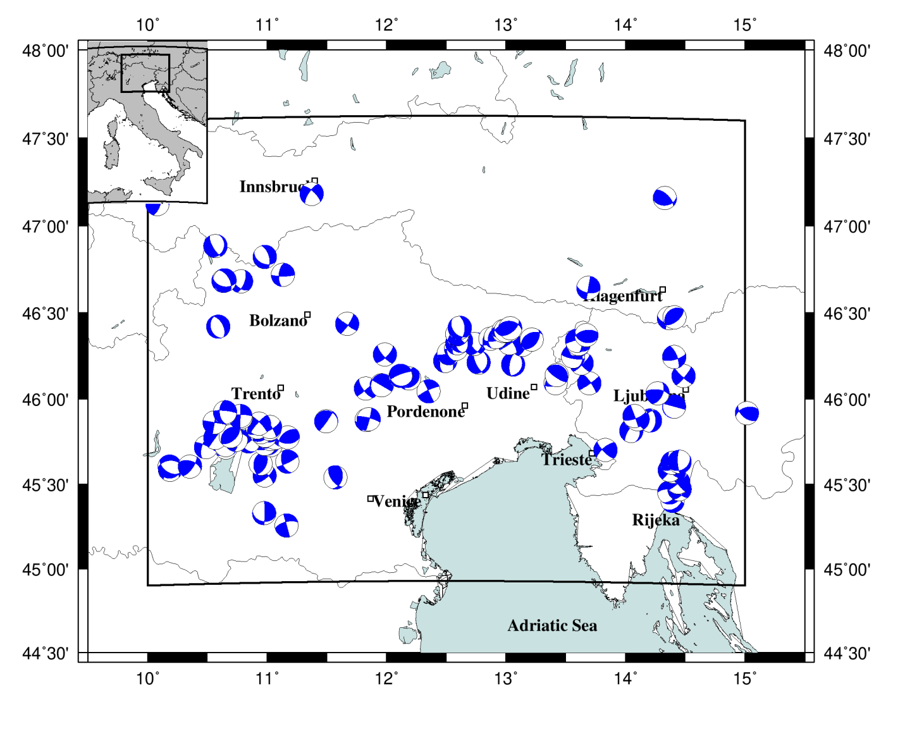
101 calibration events
Notes:
Content slide: tables

Slide 6

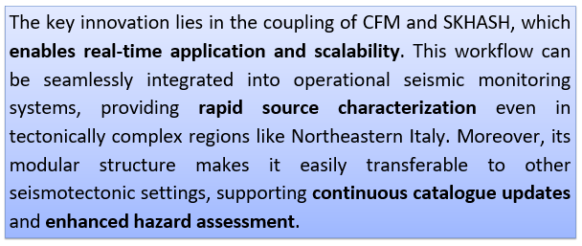
Notes:
Content slide: tables

Slide 7

Thank you for your attention!
fabdi@ogs.it
www.epos-eu.org/on | social media #EPOSon
Notes:
Thank you slide

Slide 8
Refrences:
Bressan, G., Bragato, P.L., Venturini, C. (2003). Stress and strain tensors based on focal mechanisms in the seismotectonic framework of the Friuli–Venezia Giulia region (north-eastern Italy), Bull. Seism. Soc. Am., 93.
Magrin A., Sugan M., Snidarcig A., Romano M.A., Guidarelli M., Santulin M., Di Bartolomeo P., Saraò A. (2024). Focal mechanism solutions of 162 earthquakes occurred between 2014 and 2023 in the Southeastern Alps. Zenodo.
Messuti, G., Scarpetta, S., Amoroso, O., Napolitano, F., Falanga, M., & Capuano, P. (2023). CFM: a convolutional neural network for first-motion polarity classification of seismic records in volcanic and tectonic areas. Frontiers in Earth Science, 11.
Skoumal, R. J., Hardebeck, J. L., & Shearer, P. M. (2024). SKHASH: A Python Package for Computing Earthquake Focal Mechanisms. Seismological Research Letters, 95(4), 2519–2526.
Sugan M., Saraò A., Magrin A., Snidarcig A., Bressan G., Renner G., Romano M.A., Guidarelli M., Santulin M., Di Bartolomeo P., Restivo A. (2024). Focal mechanisms of the Southeastern Alps and surroundings (2.0). Zenodo.
Notes:
Content slide – 2 boxes

