Slide 1

A multidisciplinary approach for the study of major earthquakes in the broader area of the Aegean
Evdokia Papadopoulou|epapadoas@geo.auth.gr
PhD student in the Department of Structural, Historical and Applied Geology at the Aristotle University of Thessaloniki, Greece
Notes:
Title slide

Slide 2
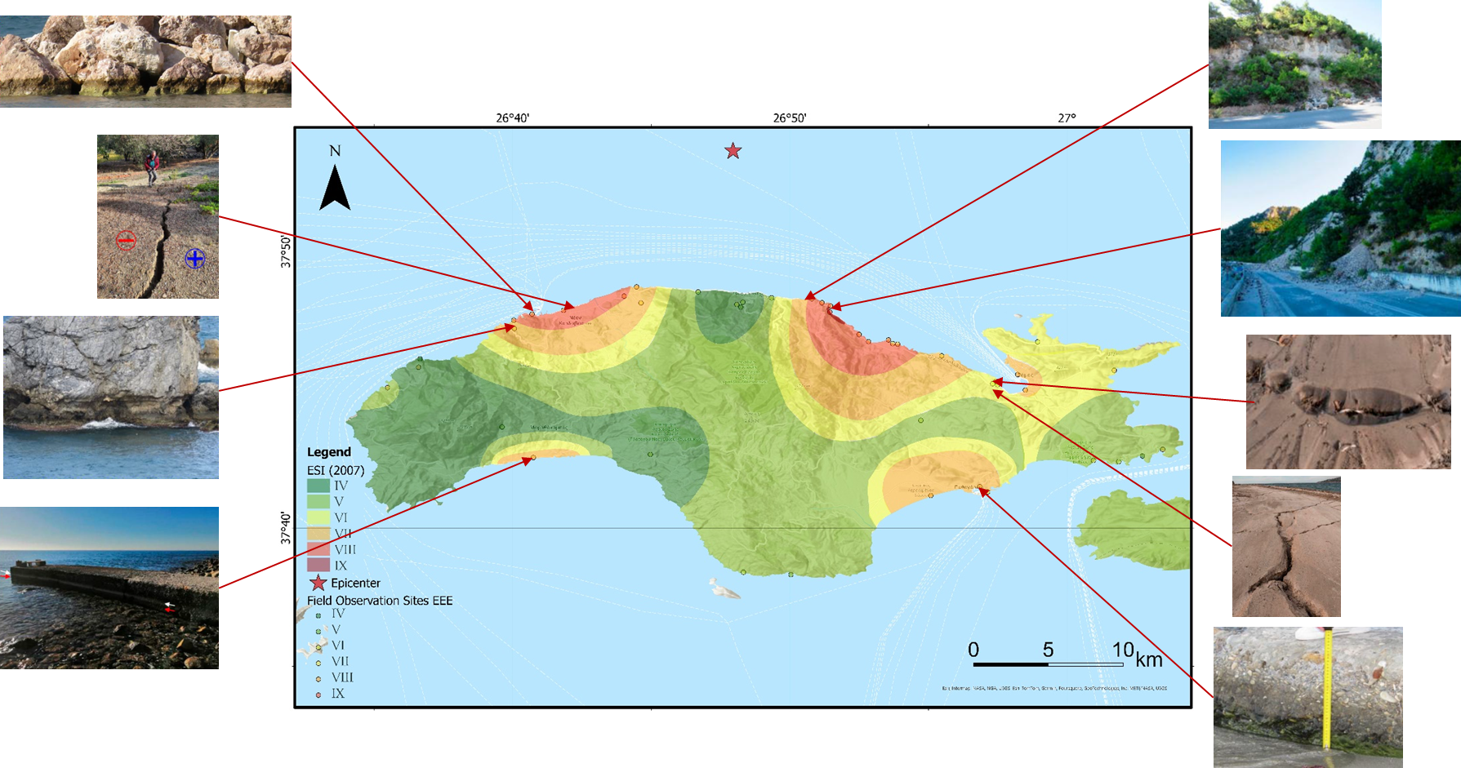
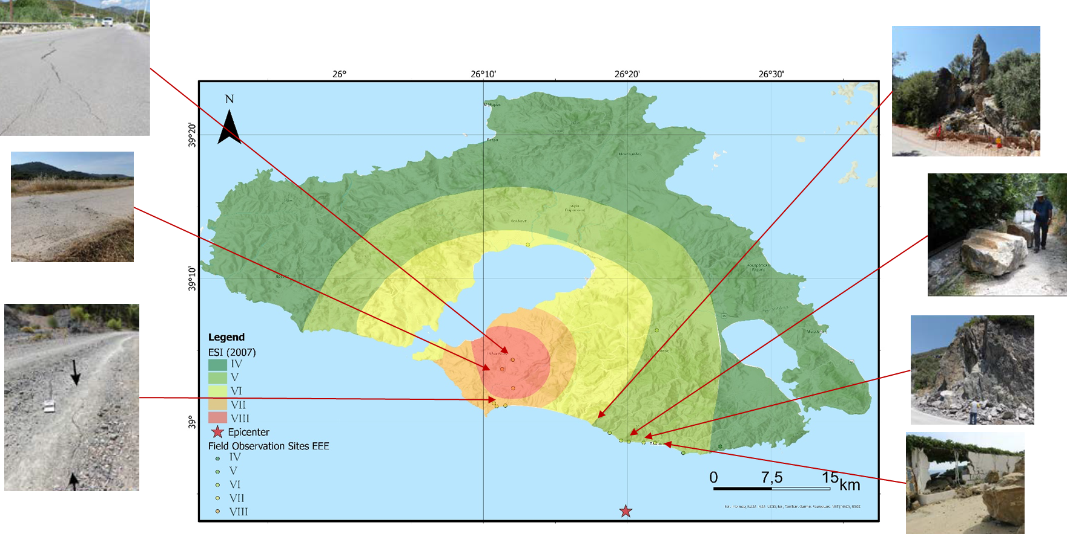
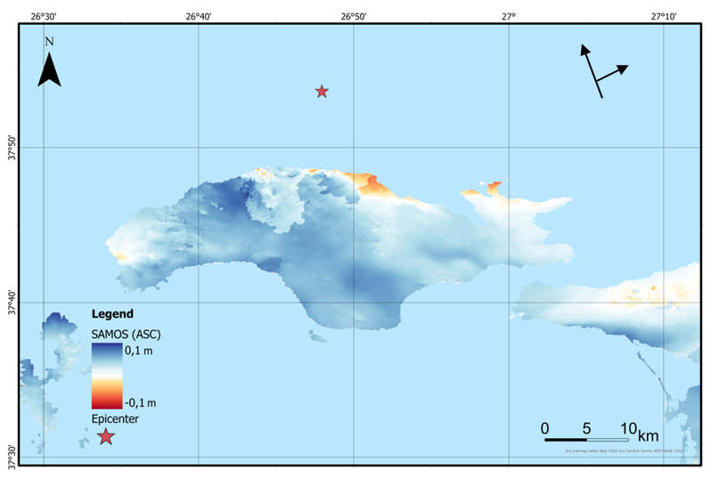
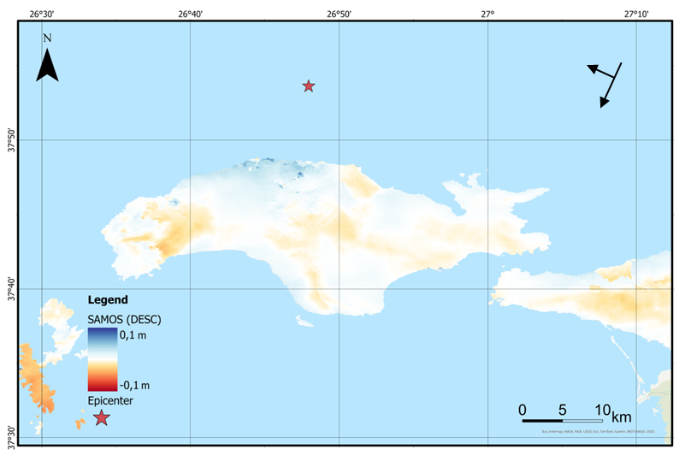
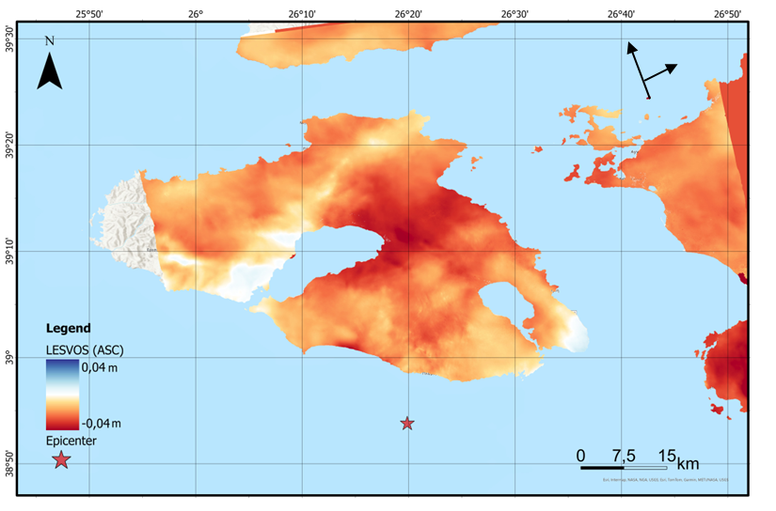
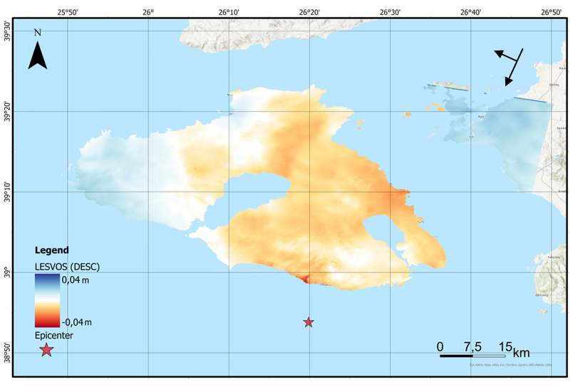
Isoseismal Maps: Co-seismic environmental effects of the 2017 Lesvos and 2020 Samos earthquakes & LOS ground displacement maps
Notes:
Content slide – 2 boxes with titles

Slide 3
Link my methodologies to EPOS Thematic Core Services (TCS)
My Study Component | Relevant EPOS TCS | How to Integrate
Remote Sensing (InSAR) | TCS Satellite Data | Use EPOS SAR data (e.g. Sentinel-1 via EPOS ICS-C or EPOSAR) for co-seismic and post-seismic analysis
Field data (Environmental Seismic Intensity Scale 2007) | TCS Geological Information & Seismology | Validate ESI observations using EPOS databases on macroseismic intensity and historical events
GNSS (crustal deformation)* | TCS GNSS Data and Products | Access EPOS GNSS stations & velocity fields to monitor deformation trends pre/post-event
Notes:
Content slide: tables

Slide 4
Objectives
Seismic Hazard Characterization/Assessment
Use all inputs (deformation, intensity, environmental effects) to define multi-source hazard zones
Apply findings to update regional seismic hazard models or ground motion scenarios
Develop workflows that enable the correlation of geodetic signals with seismic and structural data in order to better understand the temporal and spatial patterns of fault activity
Notes:
Content slide

Slide 5

Thank you for your attention!
epapadoas@geo.auth.gr
www.epos-eu.org/on | social media #EPOSon
Notes:
Thank you slide

Slide 6
Notes:
Logo only

Slide 7
Guidelines for using the template /1
Text boxes in this template are set to «do not autofit»:
  this is done on purpose and it means that you are supposed to use the default options for titles, subititles and contents.
    we have set the defaults for optimal readbility. If your content is not fitting in the slide, it means that you need two slides or your audience will struggle with reading!
    Please do not change the settings of the template just to add more text in a slide!
Please never make any changes to the slide master or the template in general on your own!
  If you feel there’s something wrong with the template just let us know!

Slide 8
Guidelines for using the template /2
As usual with PPT templates, this one includes several layouts: make sure you use the appropriate one:
  Title slide: only at the beginning of your presentation
  Section header: when you want to divide different parts of the presentation
  Content slides: you have different ones depending on the kind of content you need to use.
    Do not forget to use the layout without the footer (with or without title) in case you need to put in the slide big pictures, maps, videos etc that would (partly) overlap with it
    Prefer the provided table slide as format is already set. If you add the table in a second moment, please check that the font is Calibri

Slide 9
Guidelines for using the template /3
You should always use the official template font, which is Calibri (regular for the text and bold for titles).
  If functional to what you are communicating, you may use other colours in the content box (provided they offer enough contrast to be readable in different luminosity conditions) but please try to use the template colours for titles (forest green for sections and black for cover and slide titles)
    There might be exceptions to this rules, e.g. if you need to highlight something in the title (see the /3 indicator in this slide’s title)
    The Author(s) | Contacts | Date – Occasion box in the slide title is the only instance of a golden (sub)title

Slide 10

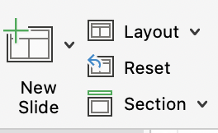

Guidelines for using the template /4
Templates work best when you create your slide from scratch!
  If you need to copy into the template one or more slides that come from another presentation with a different template/theme, please:
    Copy-and-paste the slide(s) in the slide sorter
    Click on the near the slide (if you have more than one you’ll need to repeat the action) and select the «use destination Theme»
    Check if the theme was applied correctly or needs some tweaks
      You can adjust any part of the transferred slide manually but you may want to try the «Reset» command on the new slide pane:

Slide 11
Guidelines for using the template /5
Before you go….
Should you need any help with the template or have any suggestion to improve it or these guidelines, please contact communication@epos-eric.eu and let us know!

