Slide 1


AuScope Geochemistry Network’s Laboratory Catalogue
An AuScope EarthBank Project Activity
Bryant Ware| bryant.ware@curtin.edu.au
Australia |
Notes:
Title slide

Slide 2
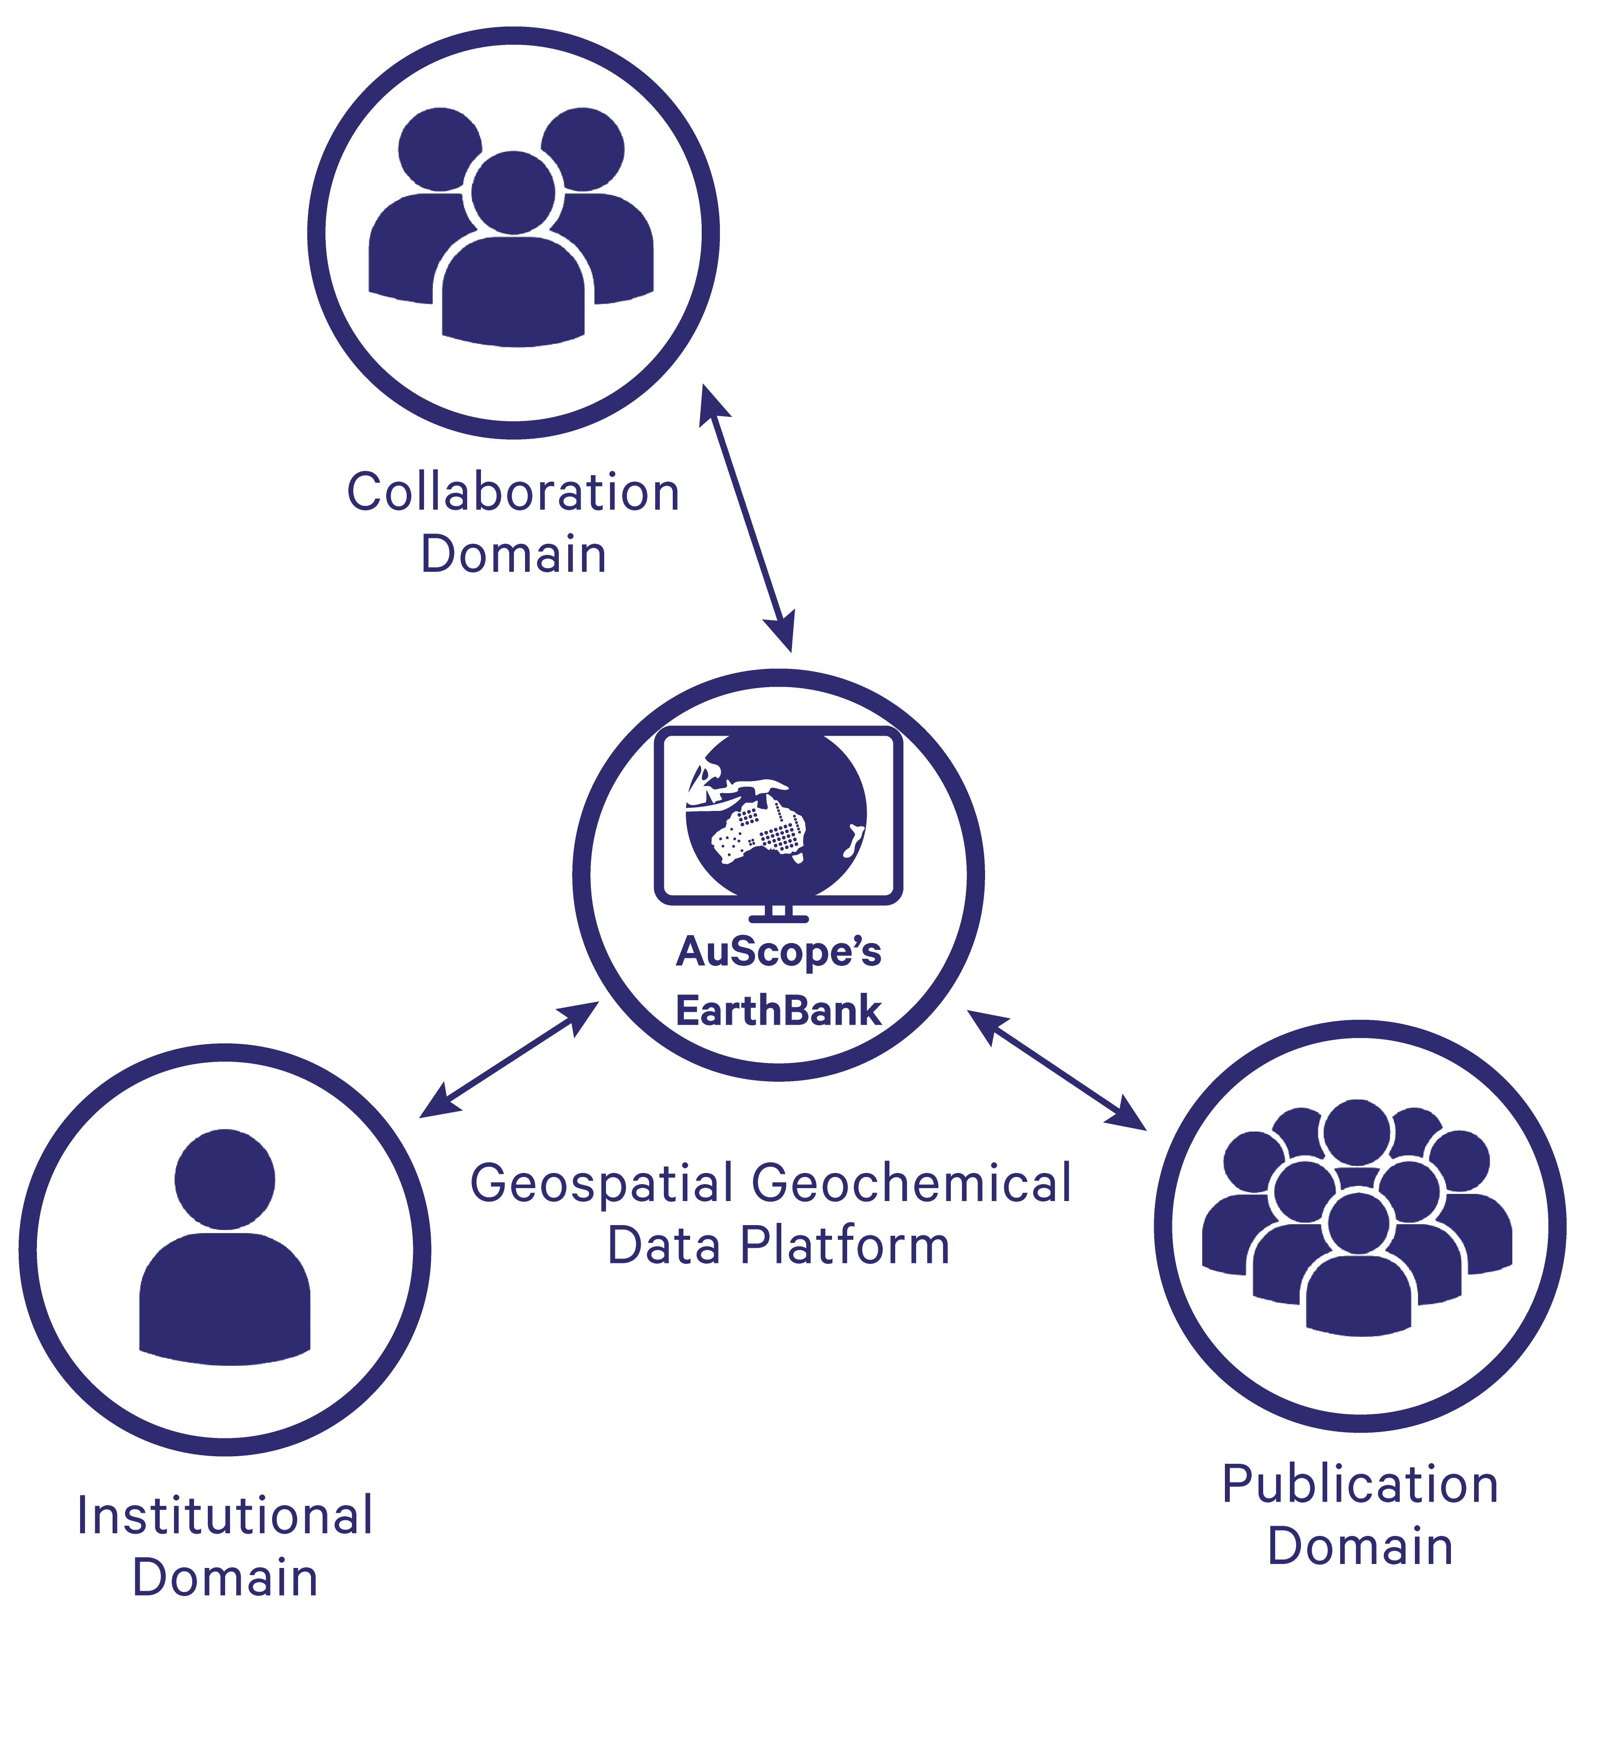
The AuScope EarthBank Project
National digital research infrastructure for Earth & Environmental science collections
Notes:
Content slide

Slide 3
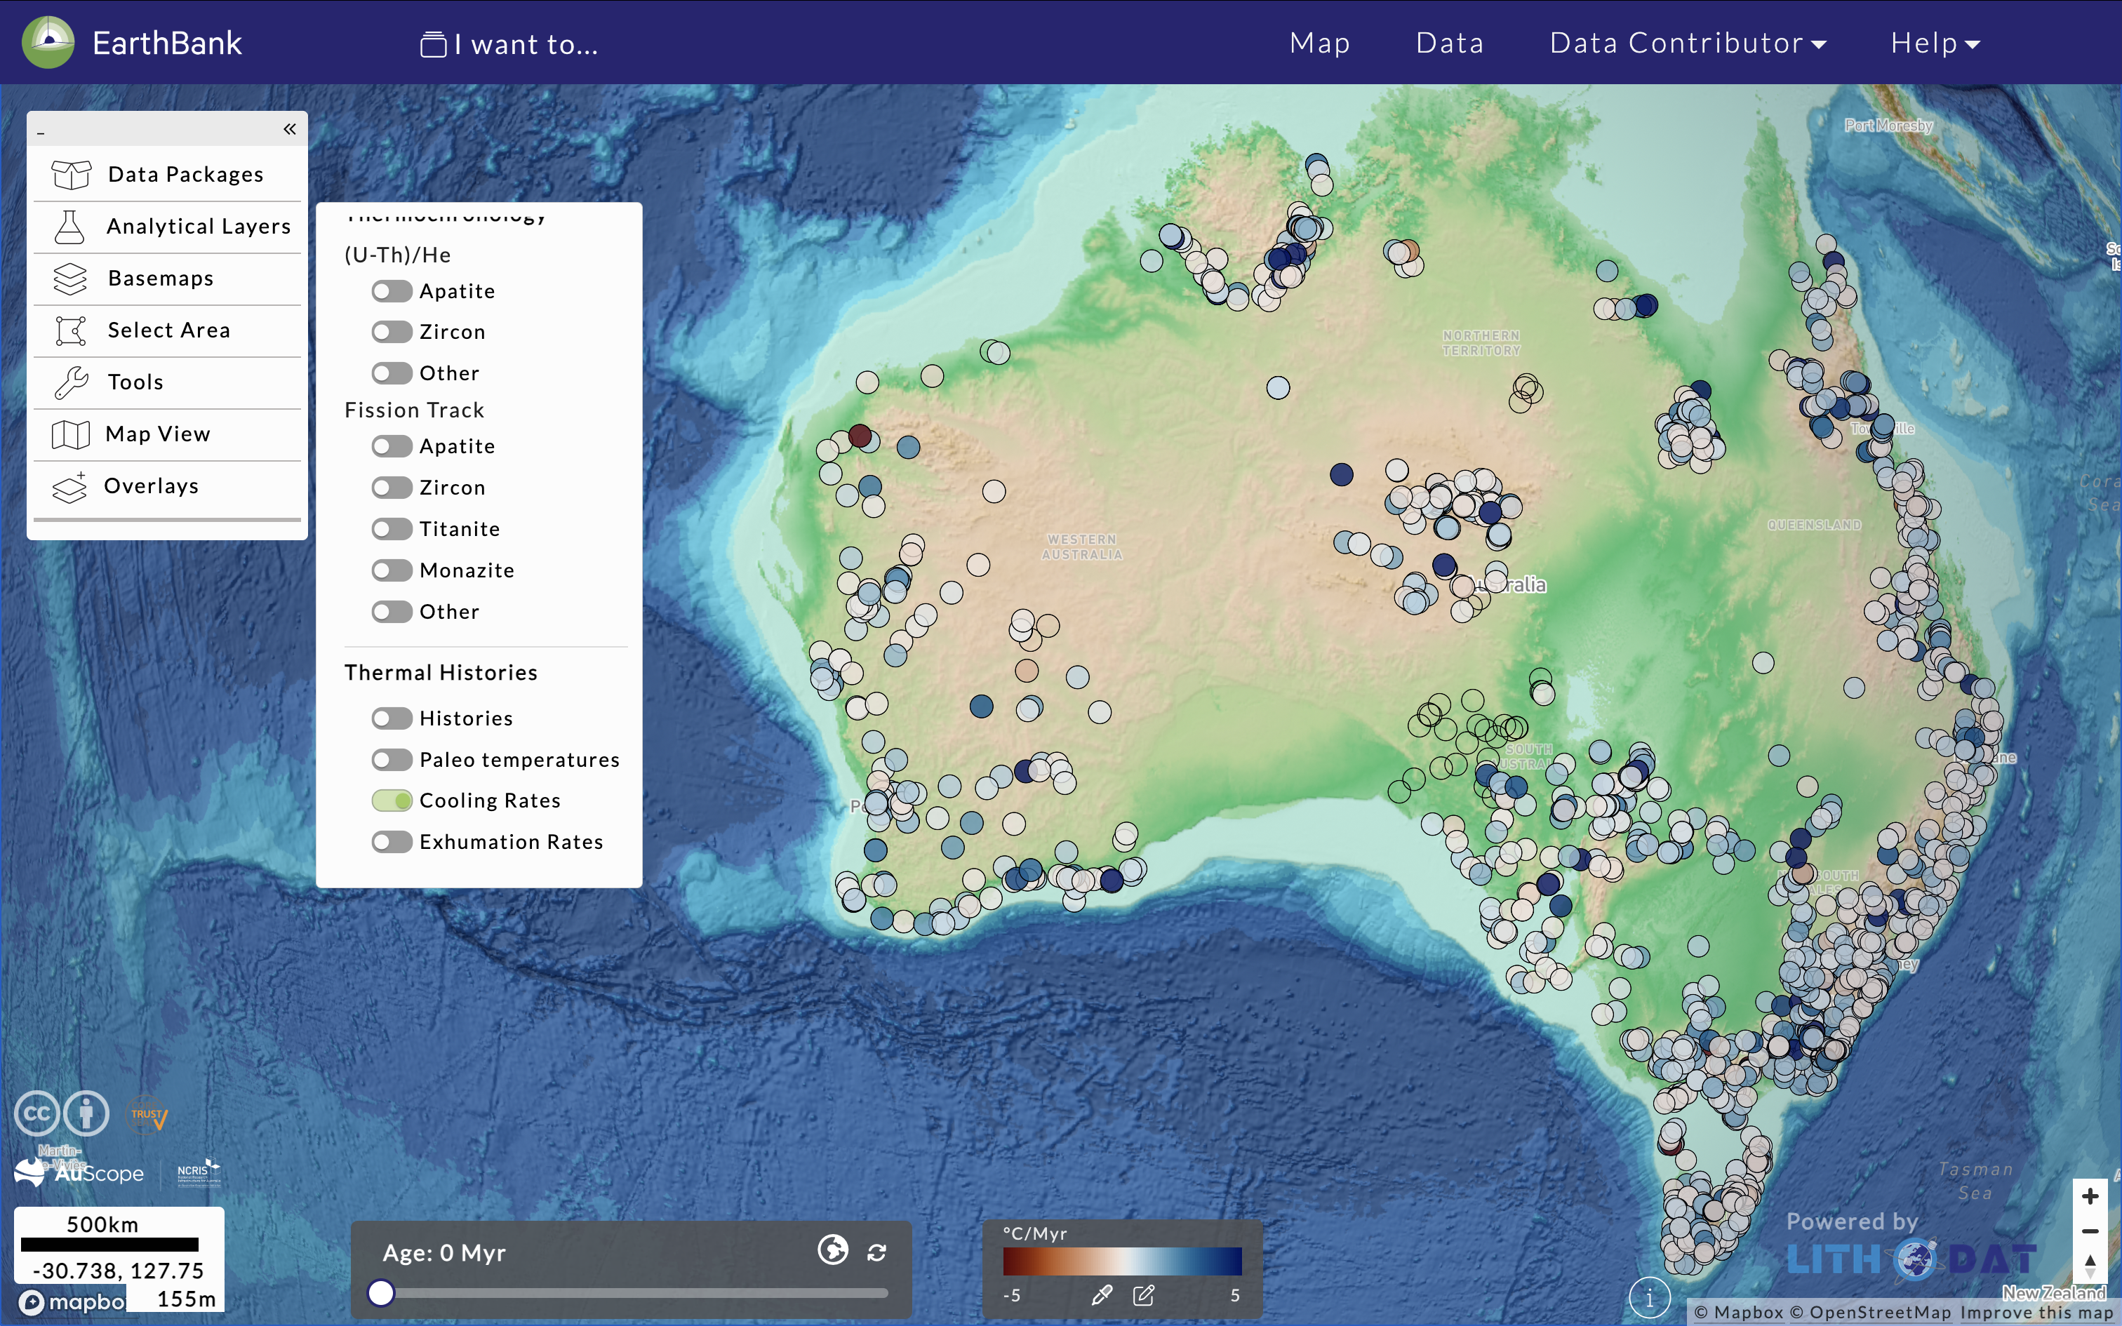
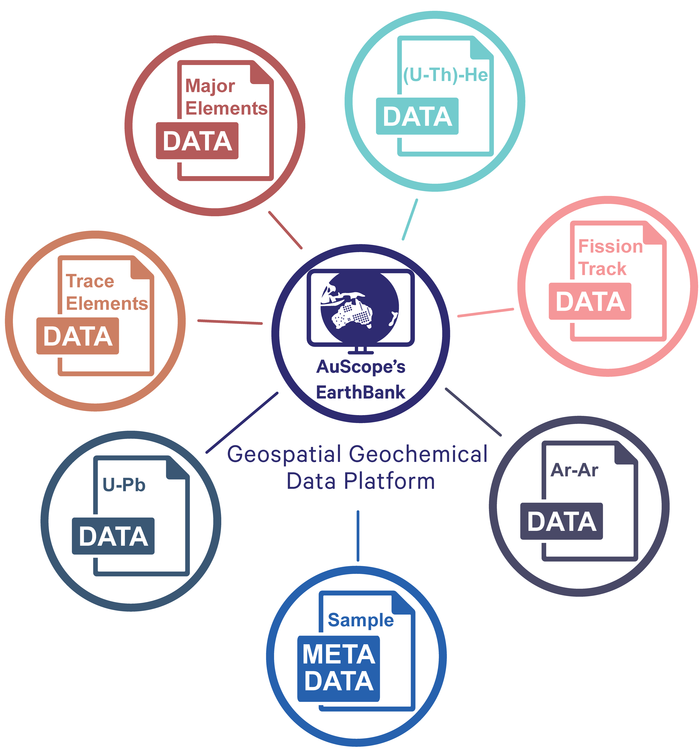
The AuScope EarthBank Project
Project Aims: Data Collections & Access – Managing geochemistry collections through the AuScope EarthBank platform
Notes:
Content slide

Slide 4
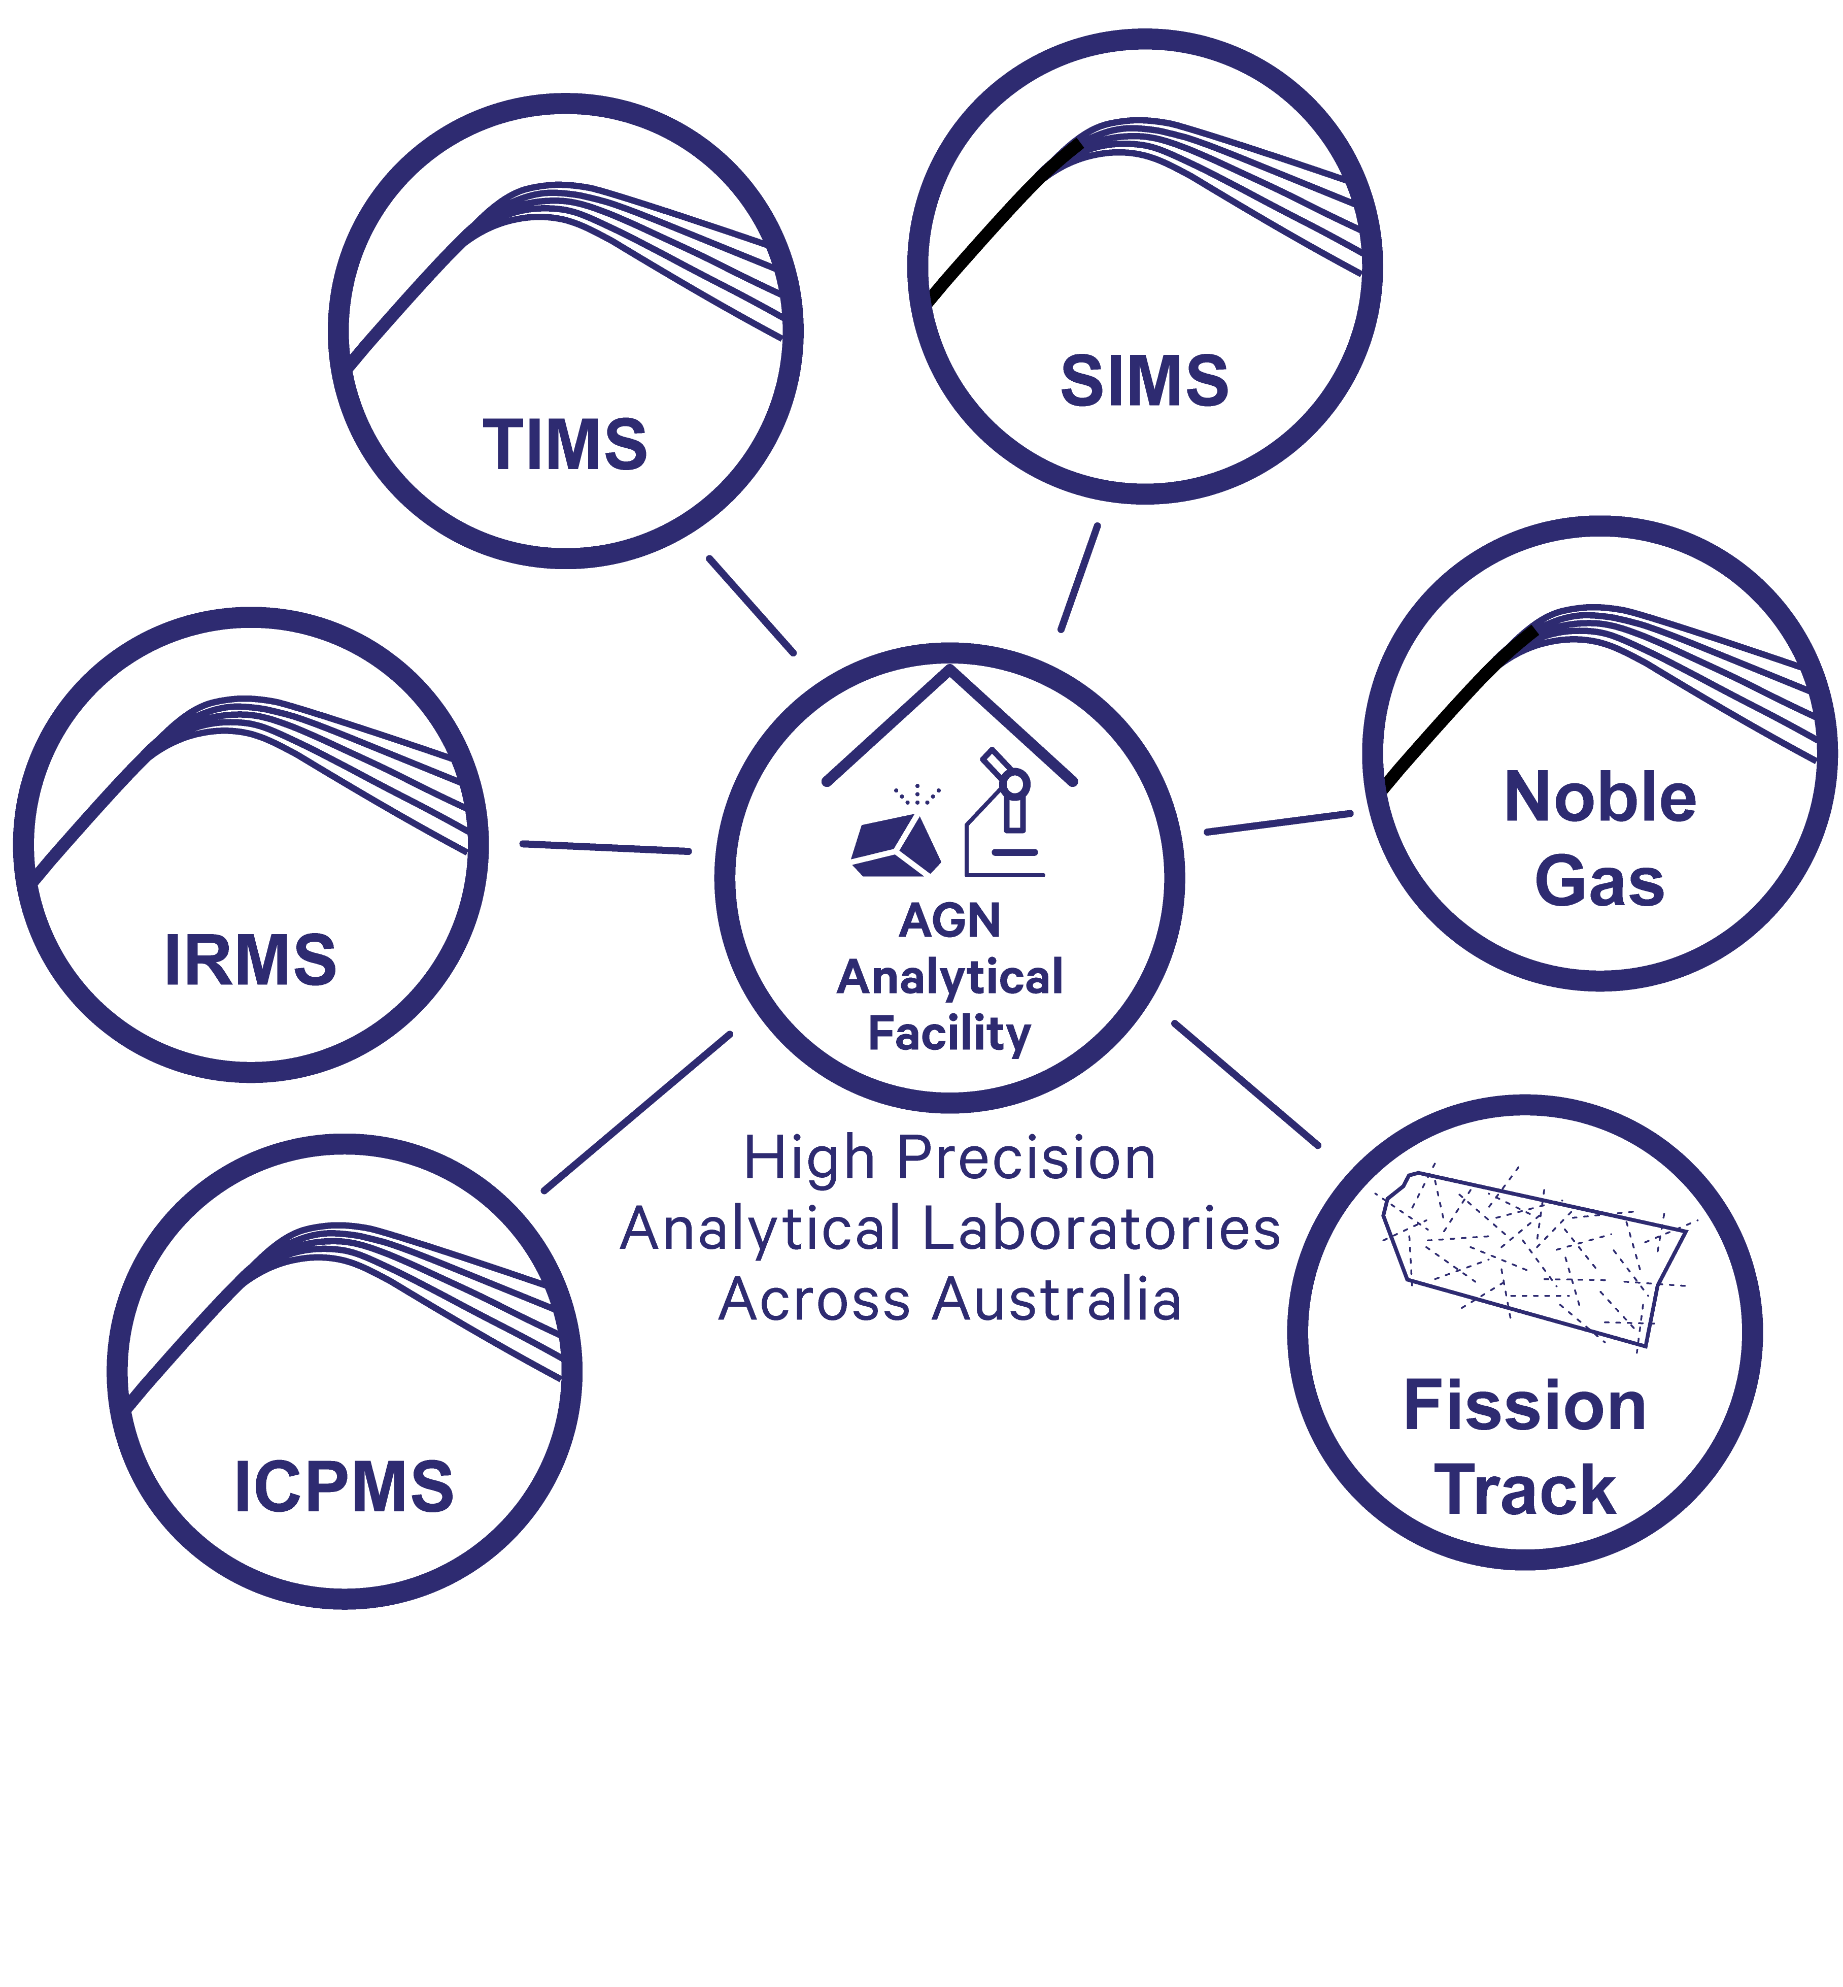
The AuScope EarthBank Project
Project Aims: Analytical Infrastructure & Access - Strengthen analytical infrastructure through instrument renewal & shared lab access
Notes:
Content slide

Slide 5
AuScope Geochemistry Network’s Laboratory Catalogue
Instrument Model | Instrument Make | Institution | Centre/School | Analytical Facility
Argus VI Noble Gas Mass Spectrometer | ThermoFisher Scientific | Curtin University | John de Laeter Centre | Western Australia Argon Isotope Facility (WAAIF)
Element XR | ThermoFisher Scientific | Curtin University | John de Laeter Centre | WA Thermochronology Hub Facility (WATCH)
IMS 1300-HR³ | CAMECA | Curtin University | John de Laeter Centre | Large Geometry Ion Microprobe Facility
Short Description | Commission Date | Replacement Costs
A low-volume multiple collector noble gas mass spectrometer equipped with five Faraday cups and a CDD multiplier, for applying the argon-argon (40Ar/39Ar) dating method to rocks and minerals that contain potassium. | 2012 | $750,000
Provides quantitative multi-element analysis of trace and ultra-trace elements over a wide linear dynamic range, from the ppm to the sub-ppb level of elements ranging from Li to U in a very short amount of time. | 2014 | $800,000
The Curtin CAMECA LGIM is indispensable in the Earth and planetary sciences because it is unrivalled in providing precise, high-resolution stable isotope data. | 2022 | $8,200,000
Notes:
Content slide: tables

Slide 6
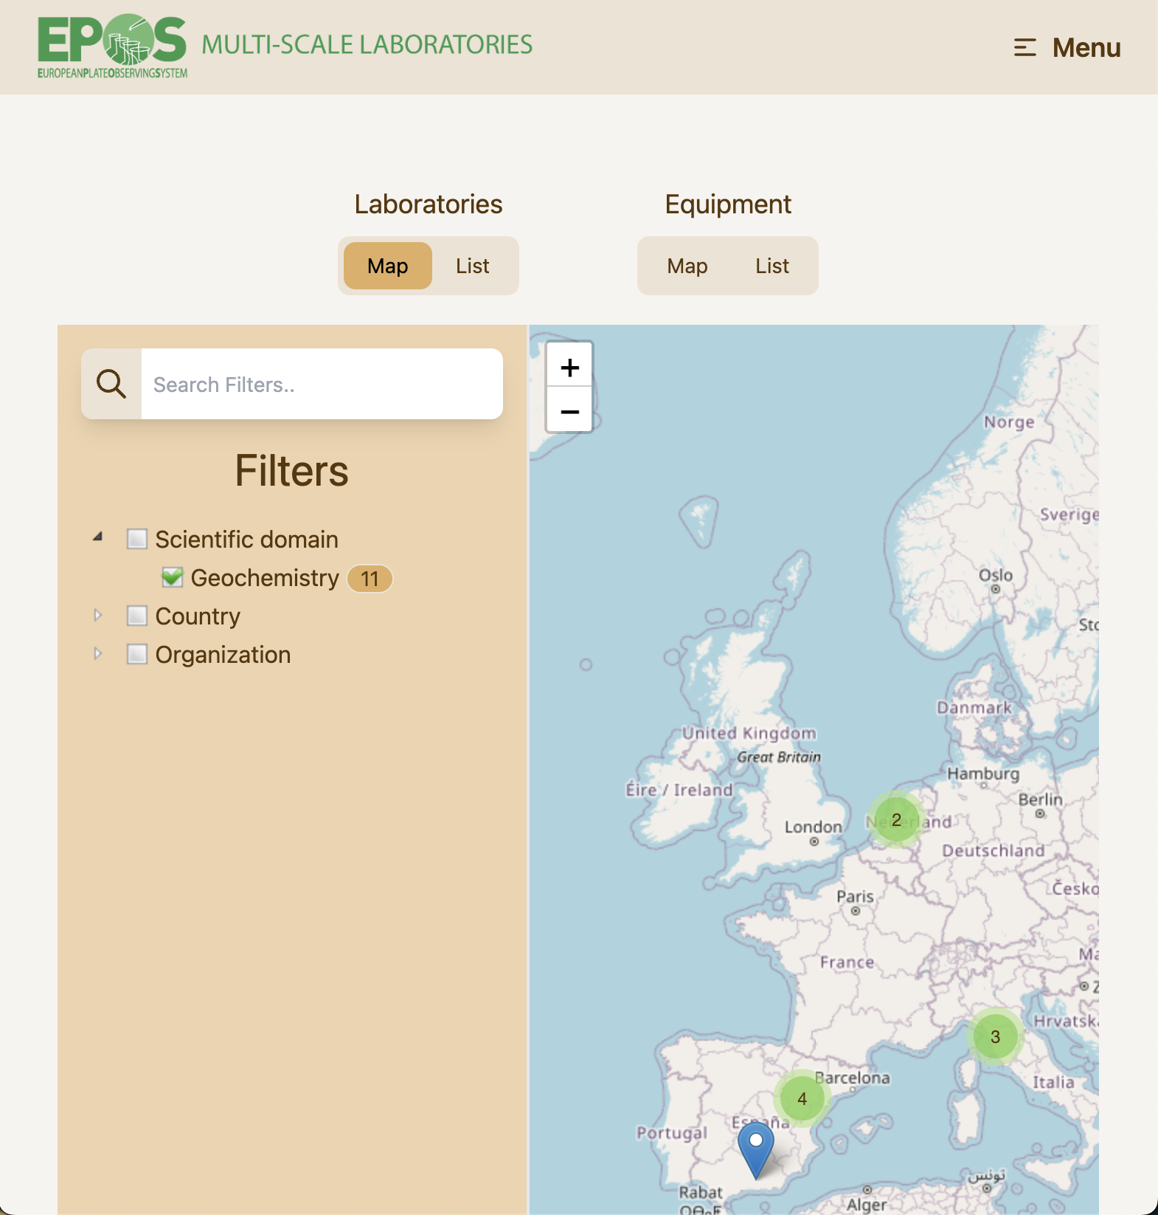
EPOS Multi-Scale Laboratories research facilities
Notes:
Content slide

Slide 7
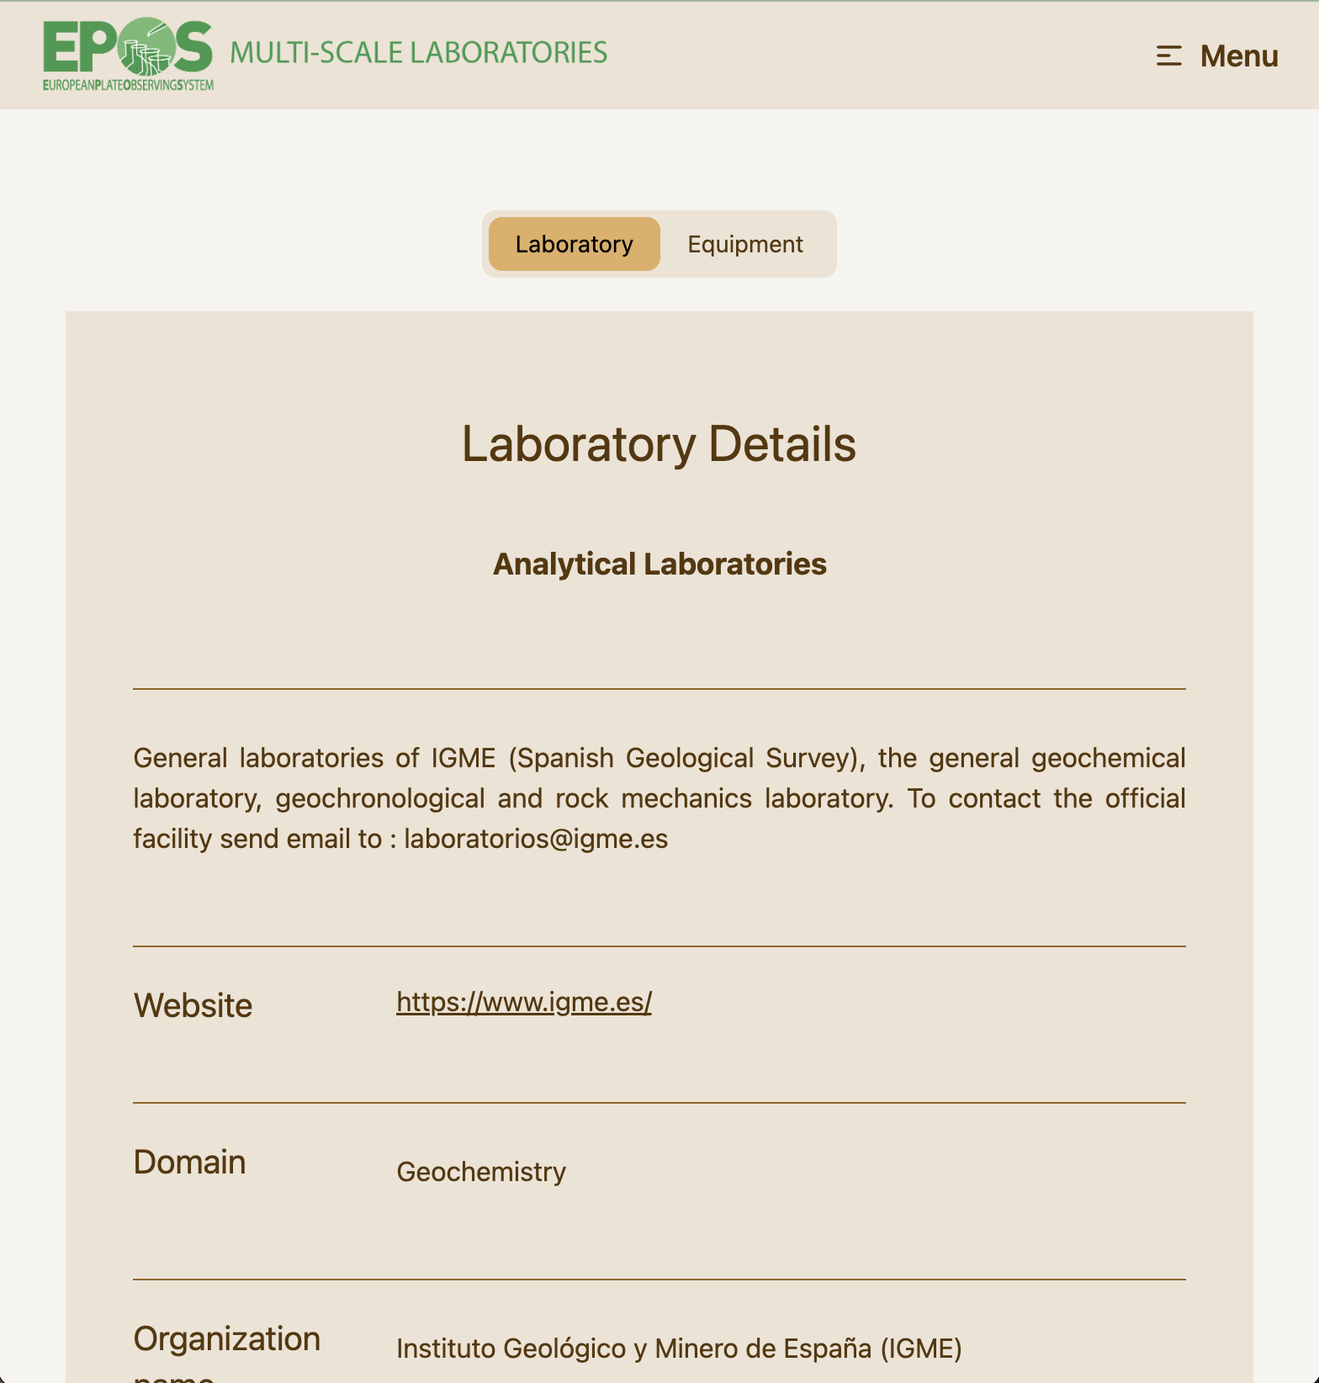
EPOS Multi-Scale Laboratories research facilities
Notes:
Content slide

Slide 8
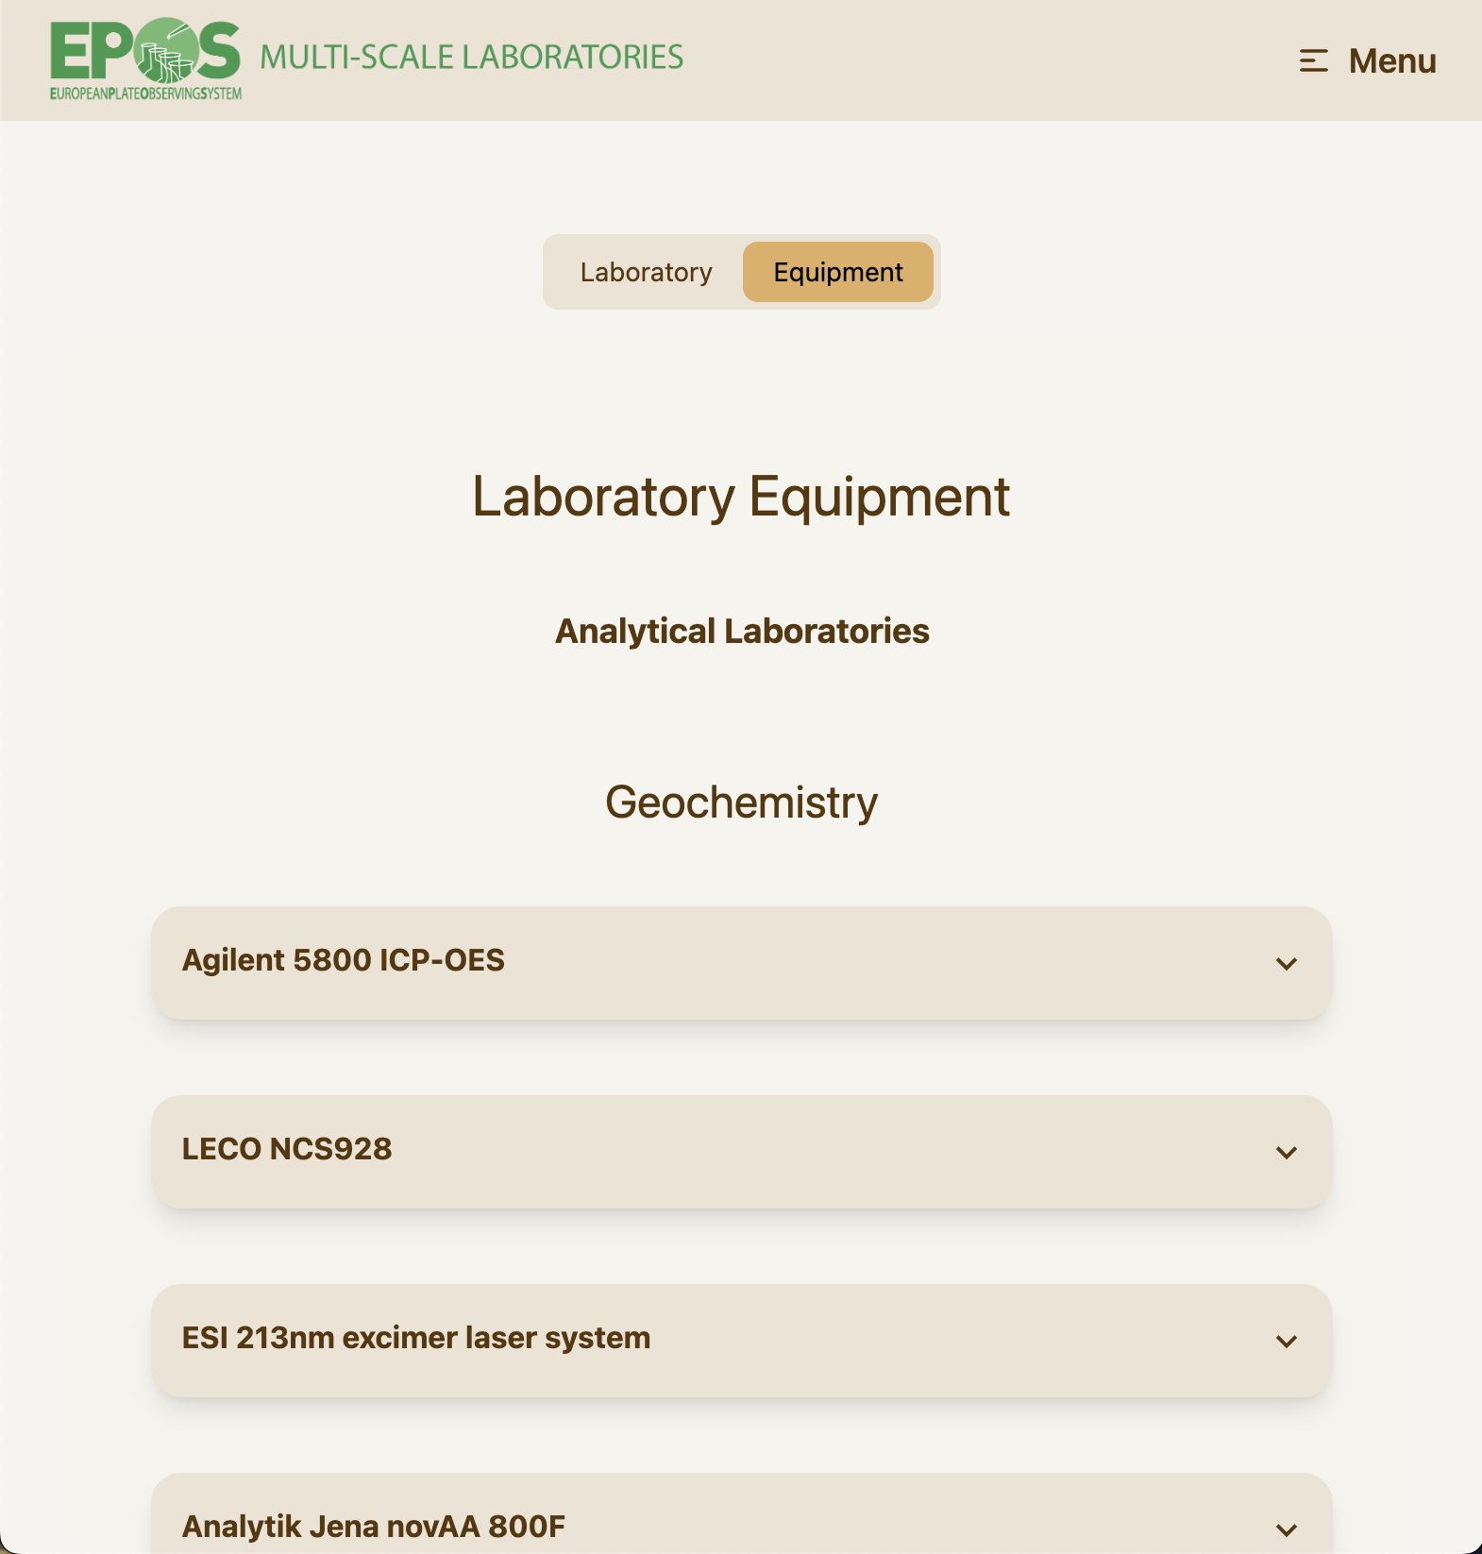
EPOS Multi-Scale Laboratories research facilities
Notes:
Content slide

Slide 9
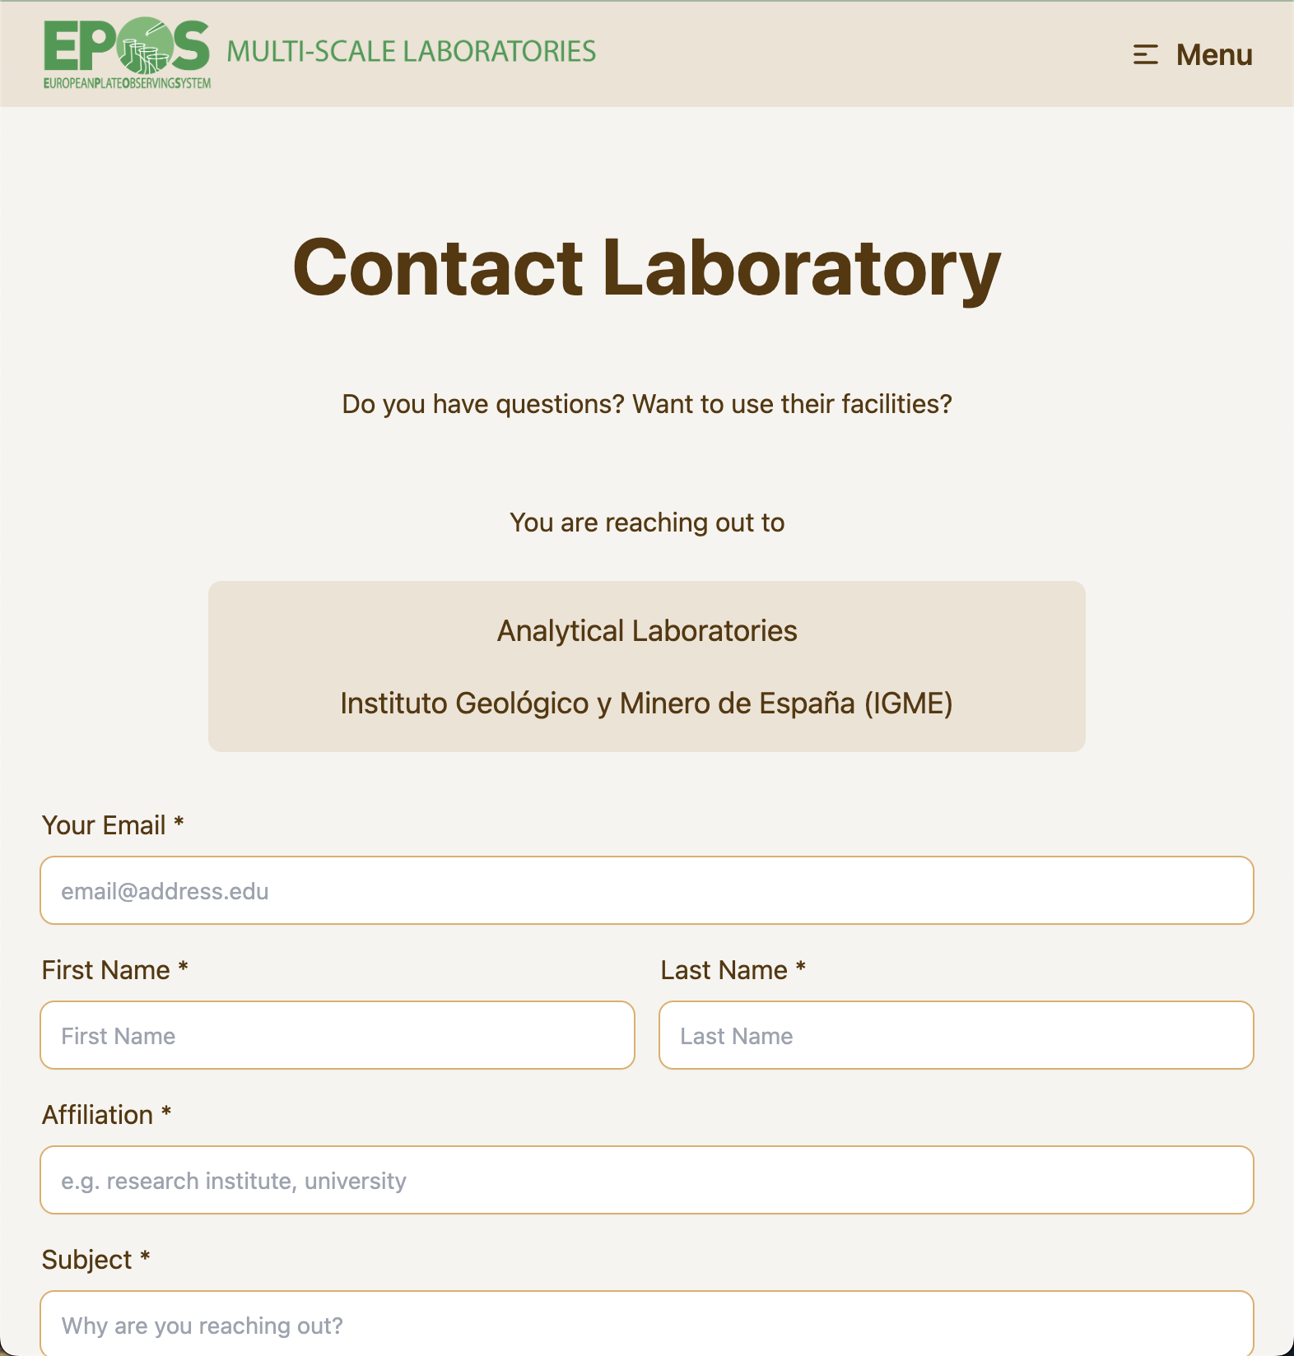
EPOS Multi-Scale Laboratories research facilities
Notes:
Content slide

Slide 10
AuScope Geochemistry Network’s Laboratory Catalogue
Align EPOS and AuScope activities
Improve lab visibility and access
Enhance data reuse and interoperability
Leverage EPOS open-source tools for collaboration
Notes:
Content slide: tables

Slide 11


Thank you for your attention!
bryant.ware@curtin.edu.au
www.epos-eu.org/on | social media #EPOSon
Notes:
Thank you slide

Slide 12
Notes:
Logo only

