Slide 1
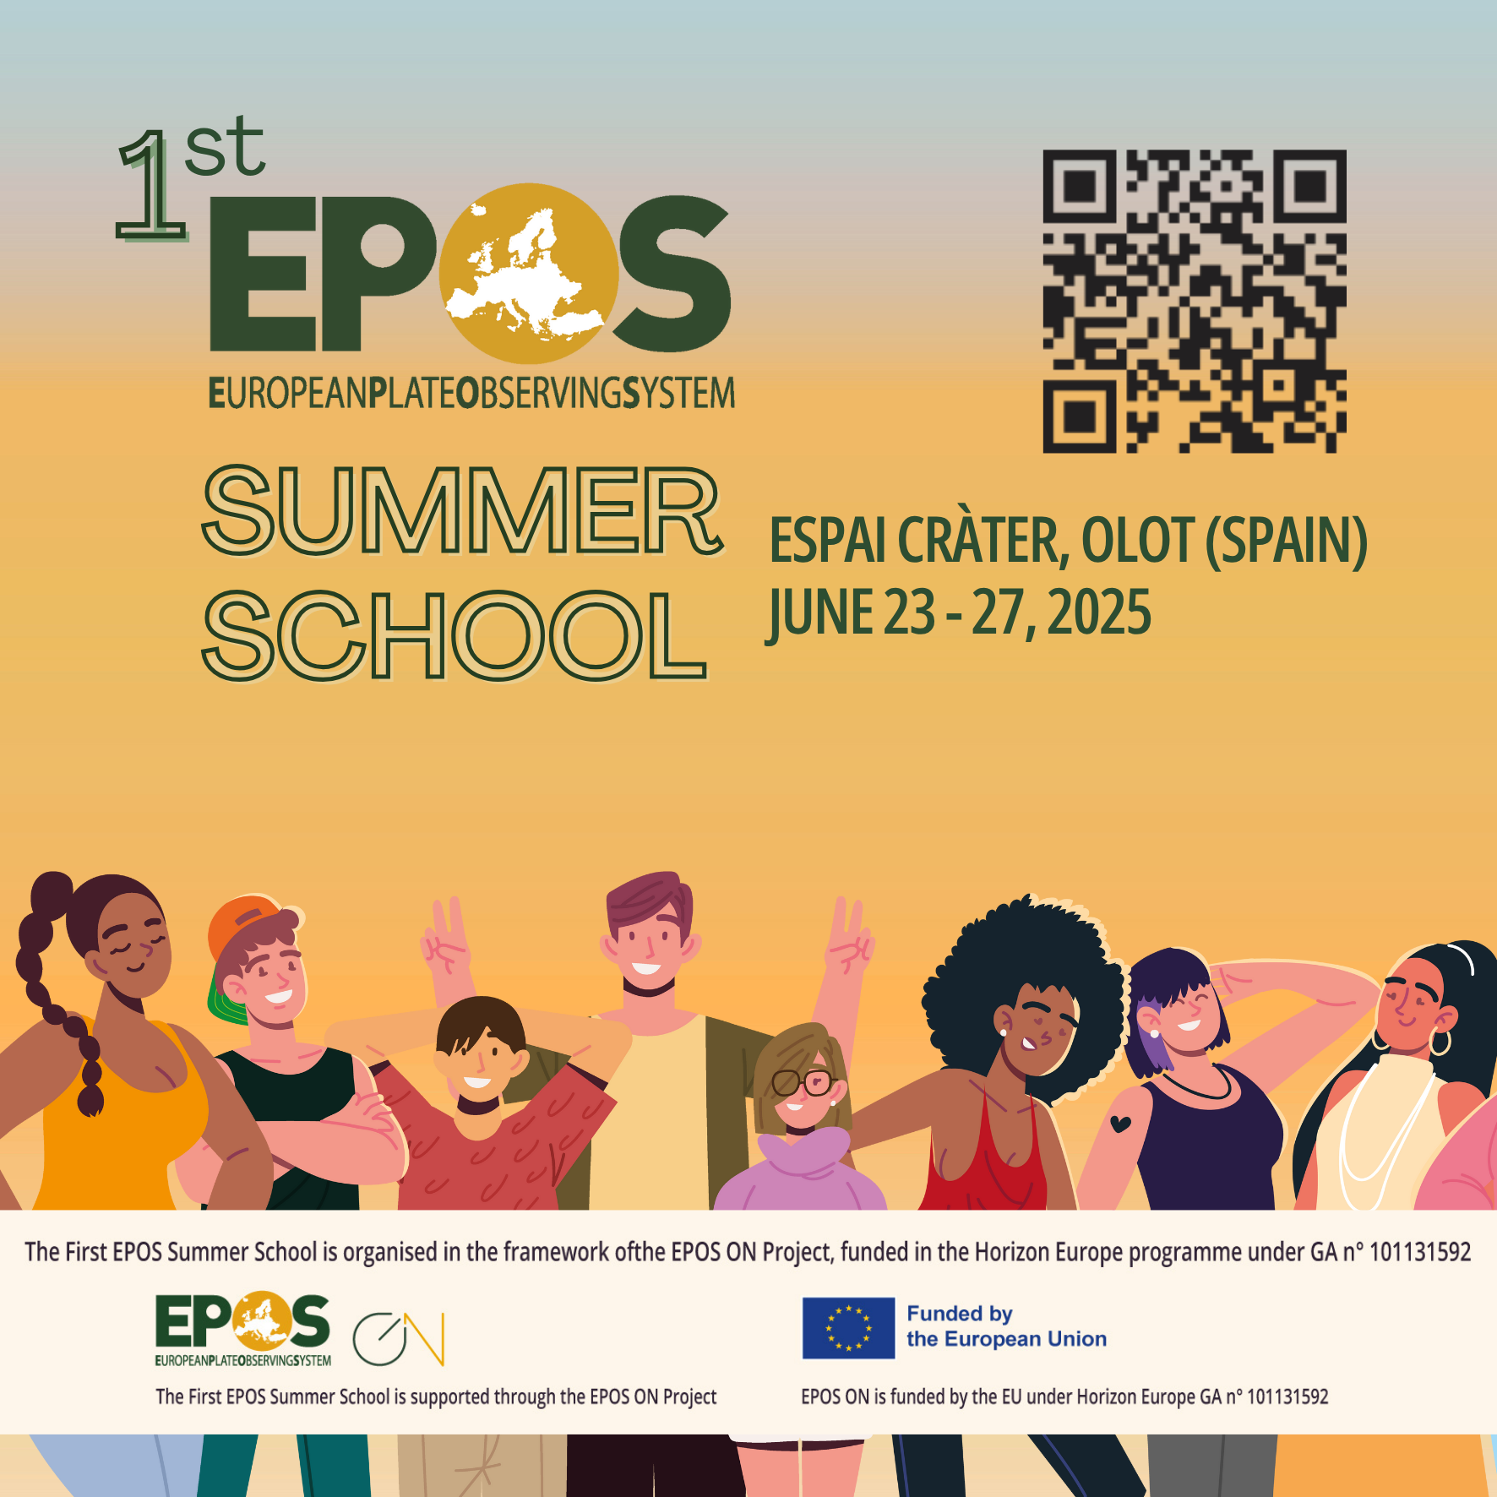
Towards new Thematic Core Service 'Gravimetry’ with EPOS-PL CIBOG experience
Małgorzata Szelachowska | Institute of Geodesy and Cartography, Poland malgorzata.szelachowska@igik.edu.pl
Notes:
Title slide

Slide 2
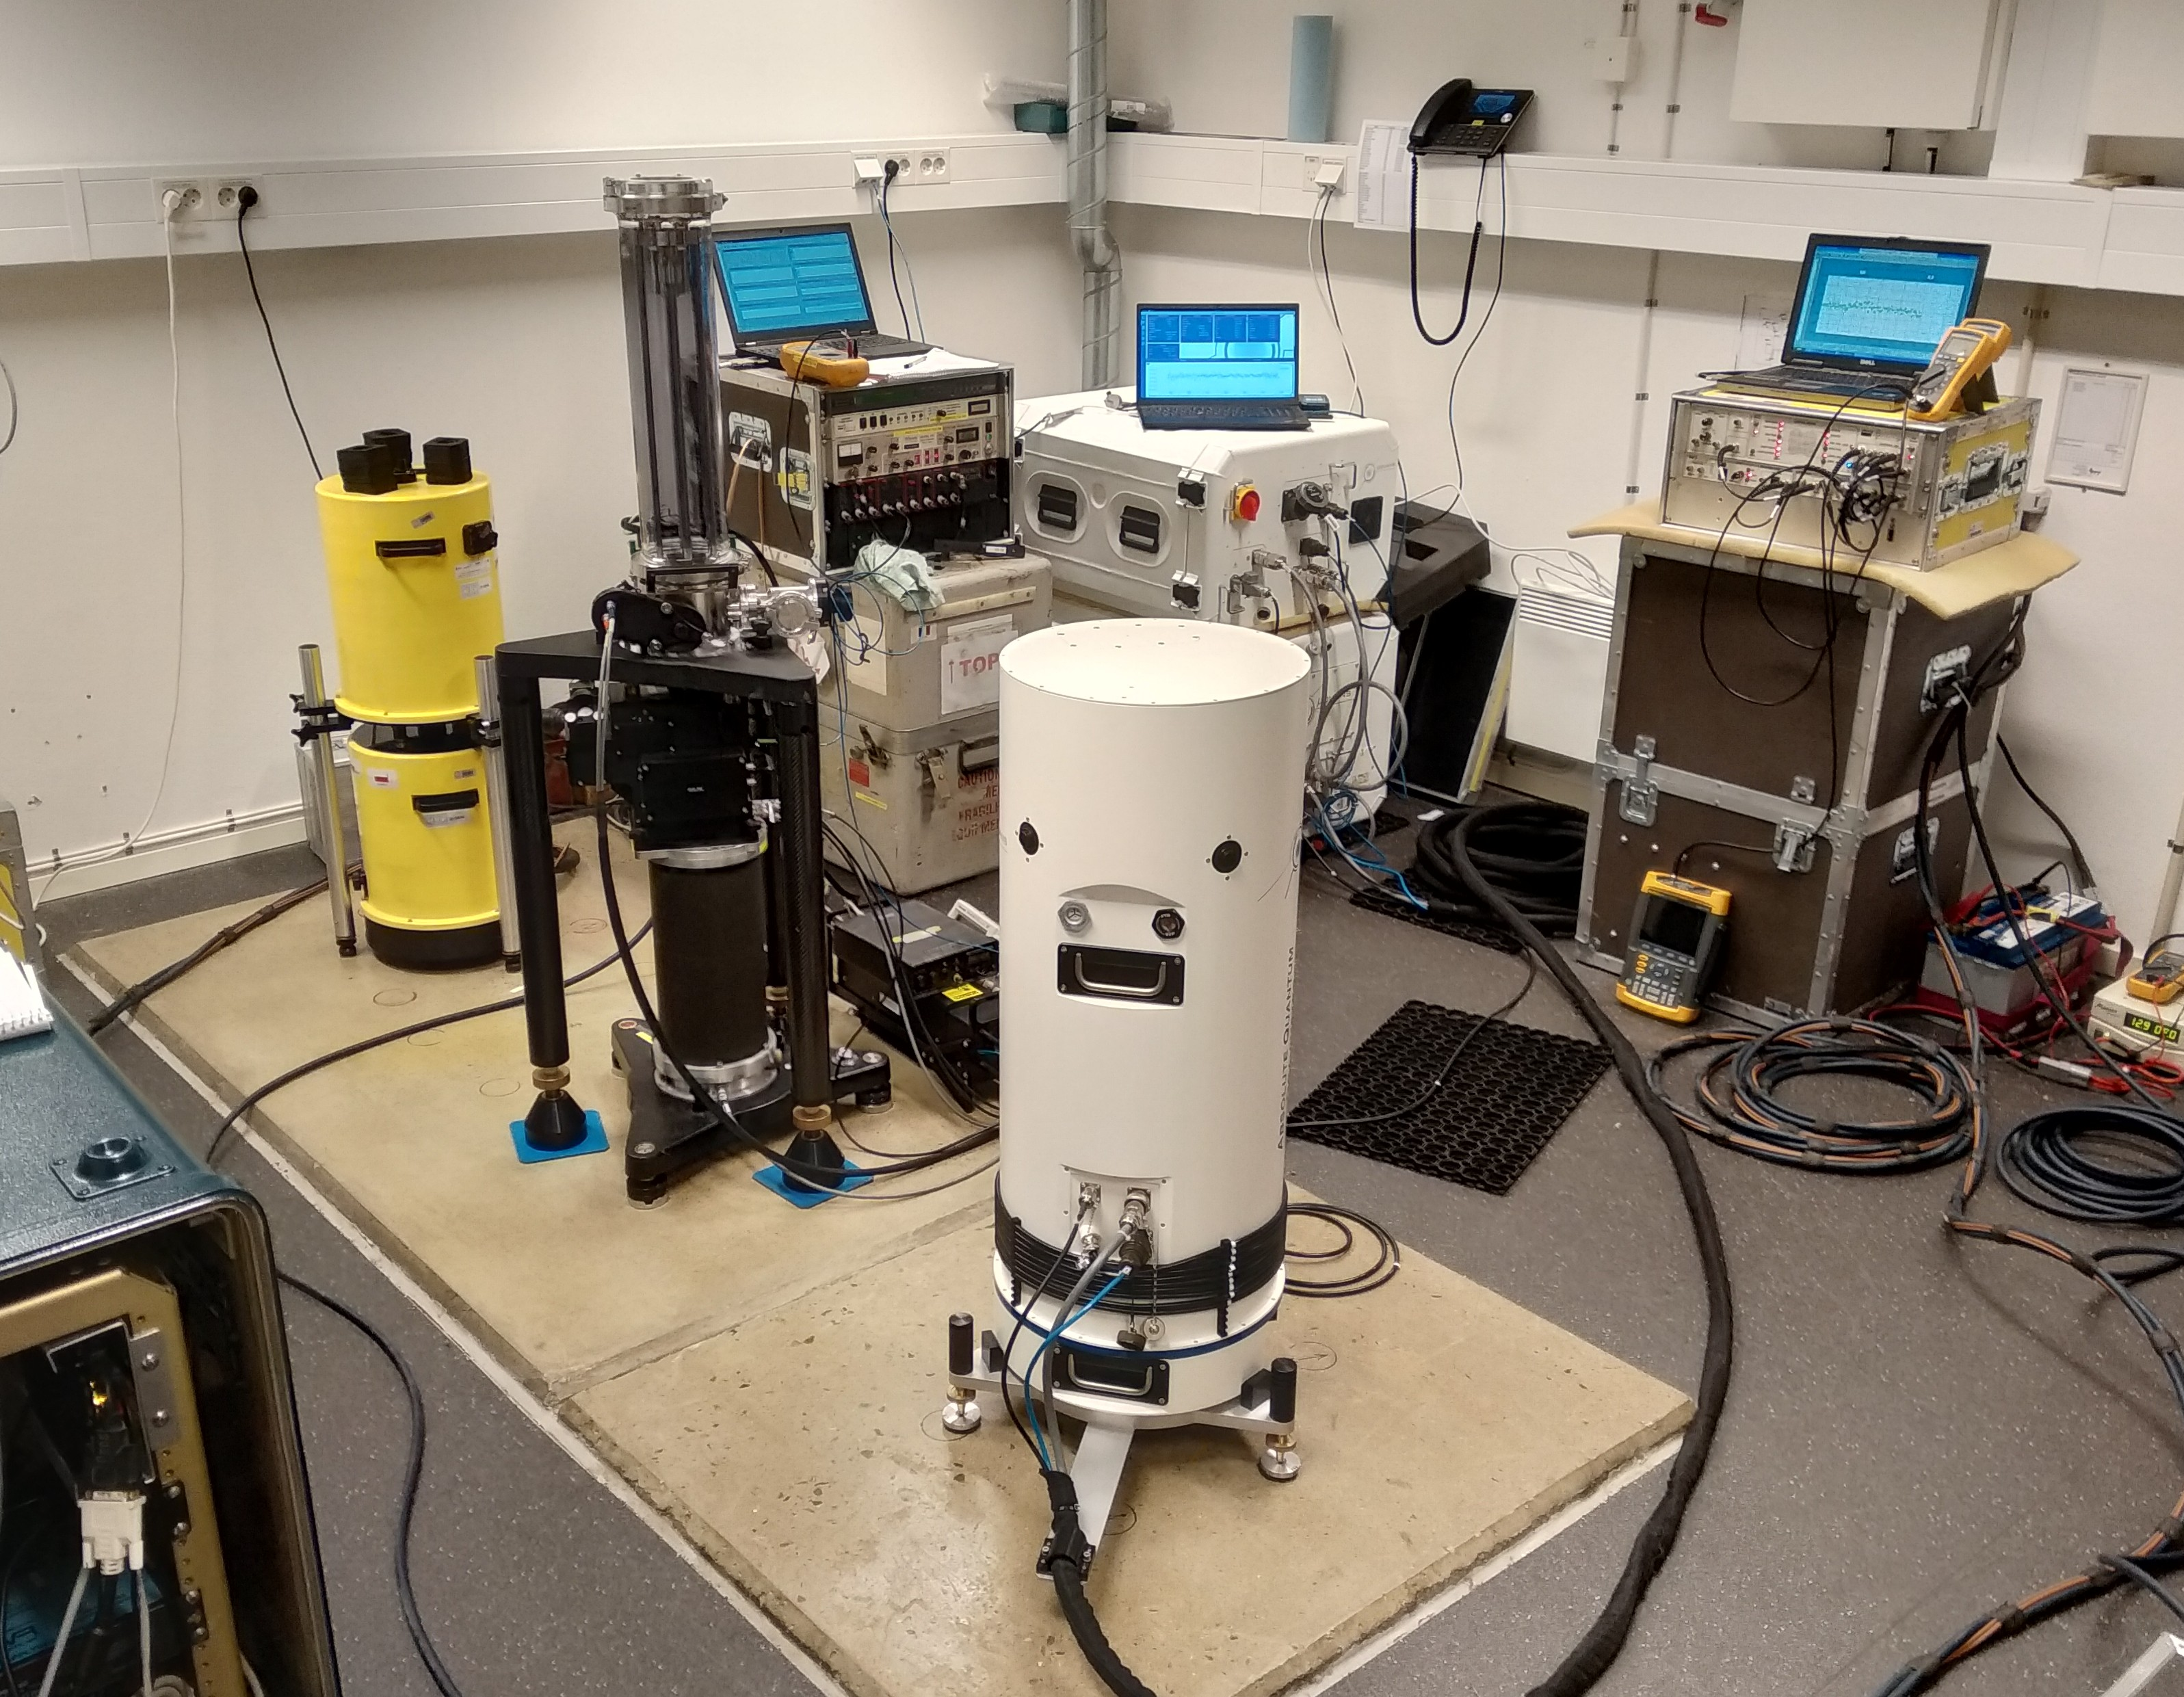
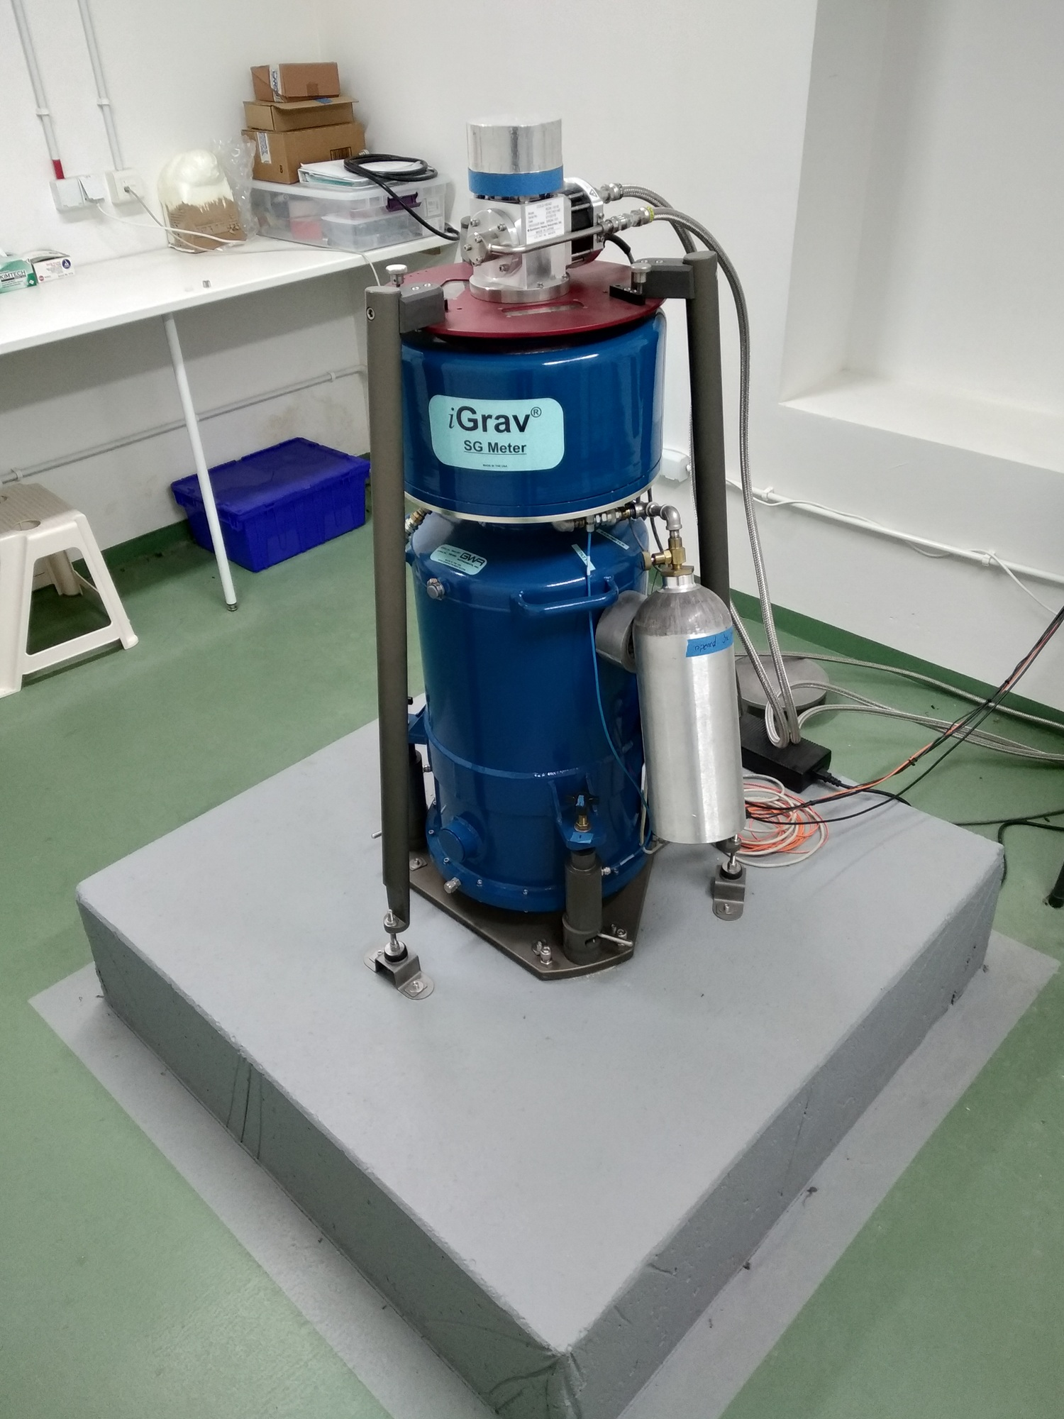
Gravimetry
gravimetry – investigation of gravity field and measurement of gravitational acceleration g, conducted by gravimeters
Example applications of gravimetry
geodesy
geophysical explorations
seismology volcanology
climate studies
archaeology
aerospace
natural hazards
Notes:
Content slide – 2 boxes

Slide 3


EPOS-PL project (2017–2021)
Objective: increasing availability and quality of research infrastructure in Earth sciences at national level and its integration with EPOS program
Research Infrastructure Center for Gravimetric Observations (CIBOG)
Gravity database for absolute, tidal and satellite observations
GRAV-PL ABS – absolute gravity observations
GRAV-PL SAT – processing products of satellite gravity missions
GRAV-PL TIDE – tidal gravity observations
Notes:
Content slide

Slide 4
CIBOG repository
Preparing datasets
unifying reference systems
data processing, e.g. drift reduction, scale factor
data format .tsf (most commonly used for tidal gravity measurements), .txt
unit for gravity nm/s² (µGal, mGal, Volt),
product levels 0-4 (depending on processing stage)
metadata
licences
https://cibog-platform.igik.edu.pl/
Notes:
Content slide

Slide 5
Use case: Towards new Thematic Core Service 'Gravimetry’ with EPOS-PL CIBOG experience
Is CIBOG repository data complied with FAIR principles? Can the repository be improved, developed? How should it be managed?
What should be taken into account when preparing gravimetric data for future (let as hope) TCS Gravimetry?
What should be done to get closer creating TCS Gravimetry?
Notes:
Content slide

Slide 6

Thank you for your attention!
malgorzata.szelachowska@igik.edu.pl
www.epos-eu.org/on | social media #EPOSon
Notes:
Thank you slide

