Slide 1


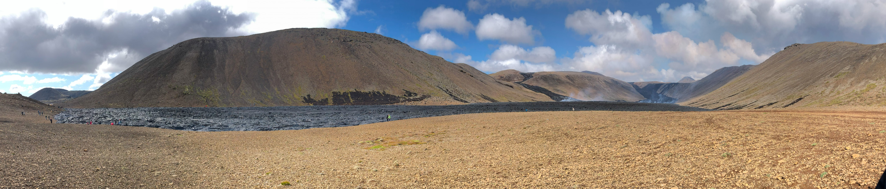
AUTOMATED MAPPING OF LAVA: CLASSIFICATION OF LAVA FLOW FIELDS ON THE REYKJANES PENINSULA
Caroline Montagnino Corona| cmc5@hi.is
Gro B.M Pedersen | gropedersen@vedur.is
University of Iceland & Icelandic Meteorological Office
Remote Sensing & Volcanic Hazards
Notes:
Title slide

Slide 2
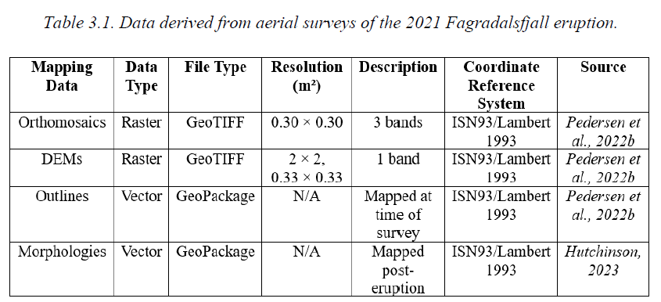
Objective
Goal: Produce fast & efficient, automated mapping methods of lava flows that could be applied to effusive Reykjanes eruptions. ​
Monitoring a lava flow field is important!
Near-real time: infrastructure + community safety
Long-term: constraints for lava flow forecasting (ex. volume, emplacement rate)
+ new thermal data!
Notes:
Content slide

Slide 3
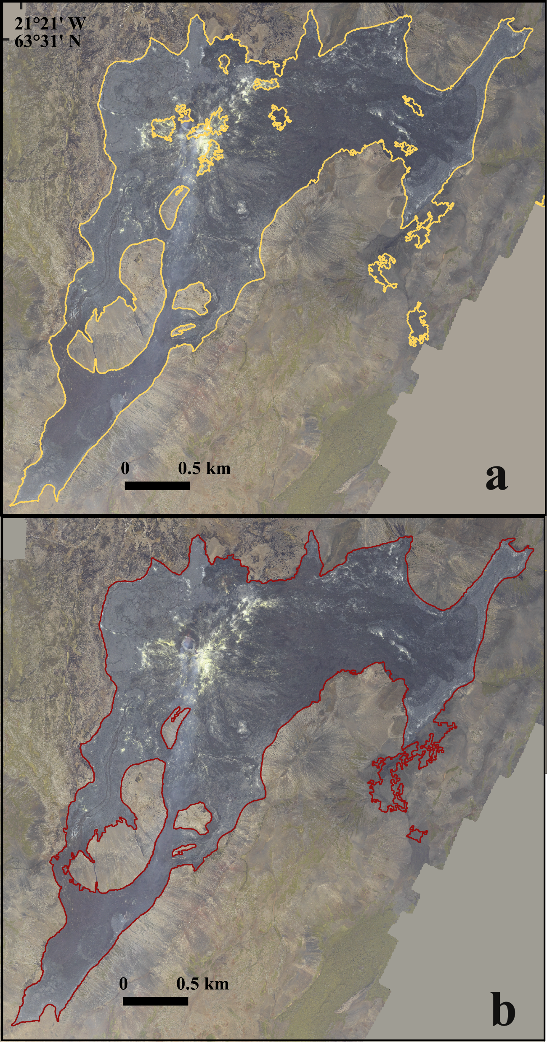
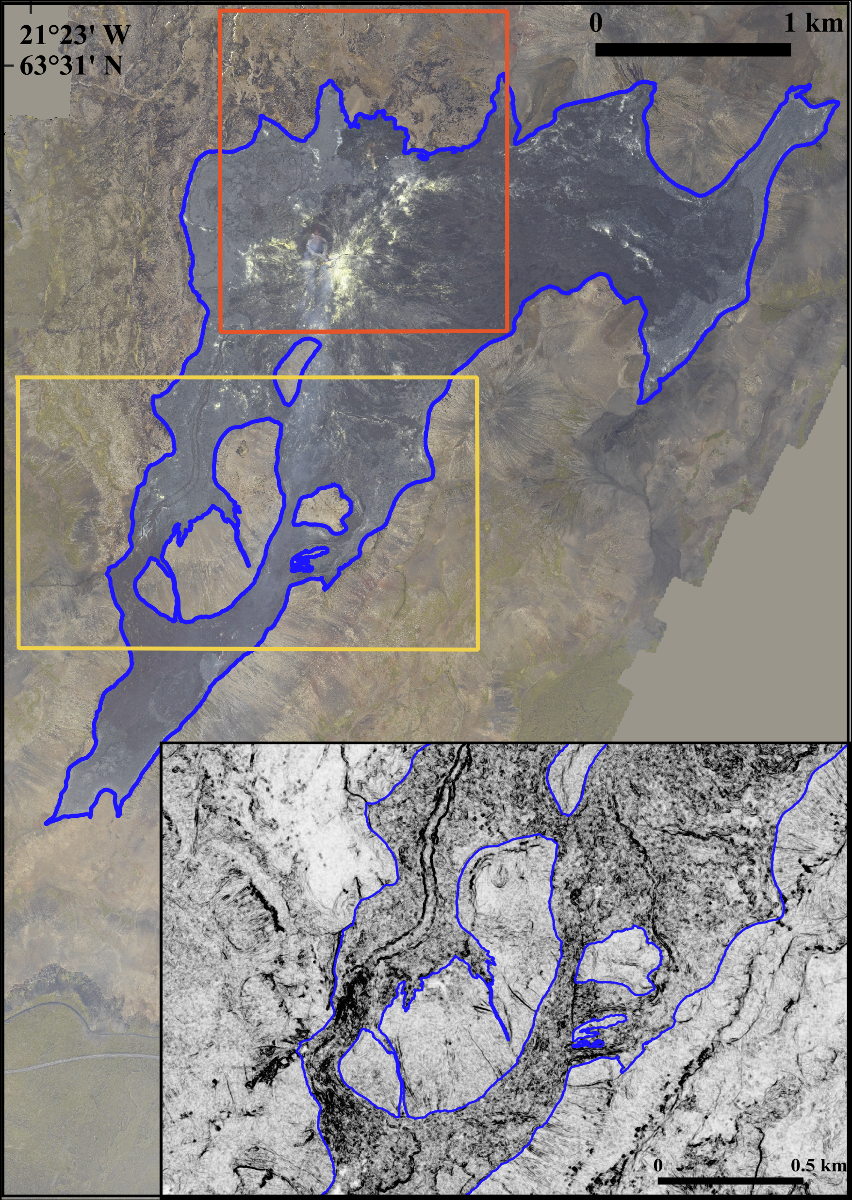
Results from 2021 Lava Flow Field
Conclusions:
Models yield clear outline w/ > 96% accuracy
Workflows are straightforward & easily adjustable
Accessible tools: Python, QGIS, OrfeoToolbox
Expert review will still be required
2021-09-30 survey
Binary
Multi-Class
Notes:
Title slide for large pictures, tables, maps, plots…

Slide 4
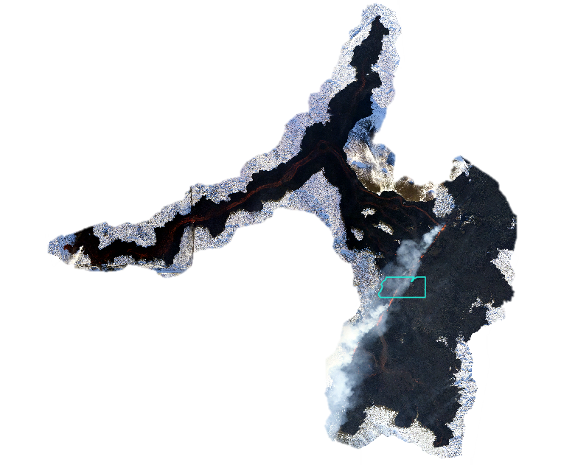
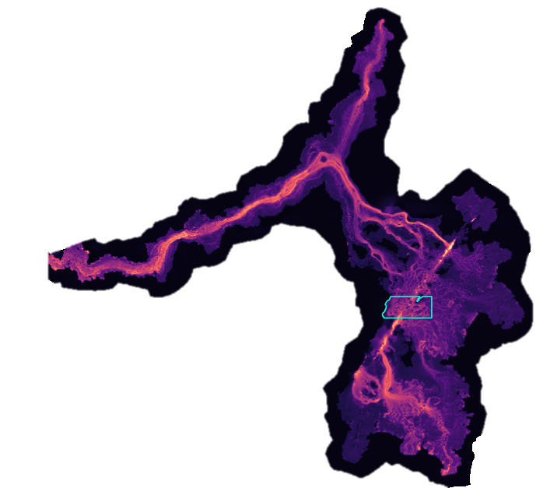
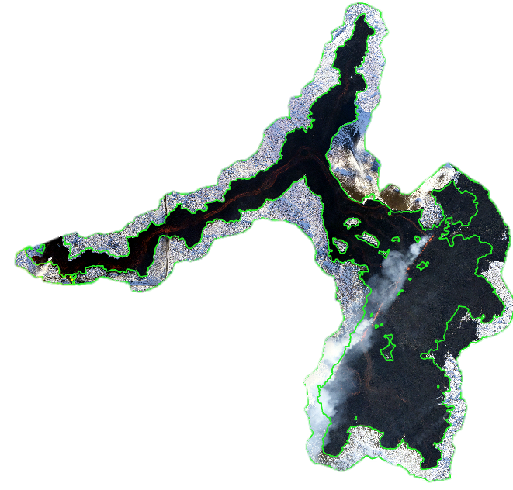
New Data
2024-02-08 data
Svartsengi system: 8 eruptions since Dec. 2024
Addition of thermal aerial surveys
Not yet available on EPOS database- hopefully in the future!
Notes:
Title slide for large pictures, tables, maps, plots…

Slide 5
Proposal
New Objectives:
Incorporate lava morphology classification
Fully automate post-processing
“General model”: train a model on the first survey of an eruption & utilize for all subsequent surveys
Next Steps:
Experiment with different kinds of data ex. thermal, satellite
Improve workflow
Test on effusive eruptions outside of Iceland
Notes:
Content slide: tables

Slide 6


Thank you for your attention!
Link to thesis
cmc5@hi.is | carolinemcorona@gmail.com
www.epos-eu.org/on | social media #EPOSon
Notes:
Thank you slide

