Slide 1

Seismic hazard studies for Northwestern Anatolia
(Upper Mantle Structure of the Marmara Region
Using Teleseismic Tomography and seismic hazard analysis in Marmara Region)
Dr. Hilal YALÇIN | Kadir Has University
hilaldomacyalcin@gmail.com
hilal.yalcin@khas.edu.tr

Slide 2
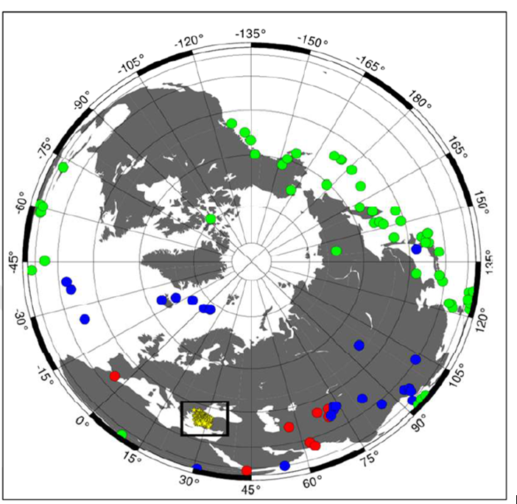
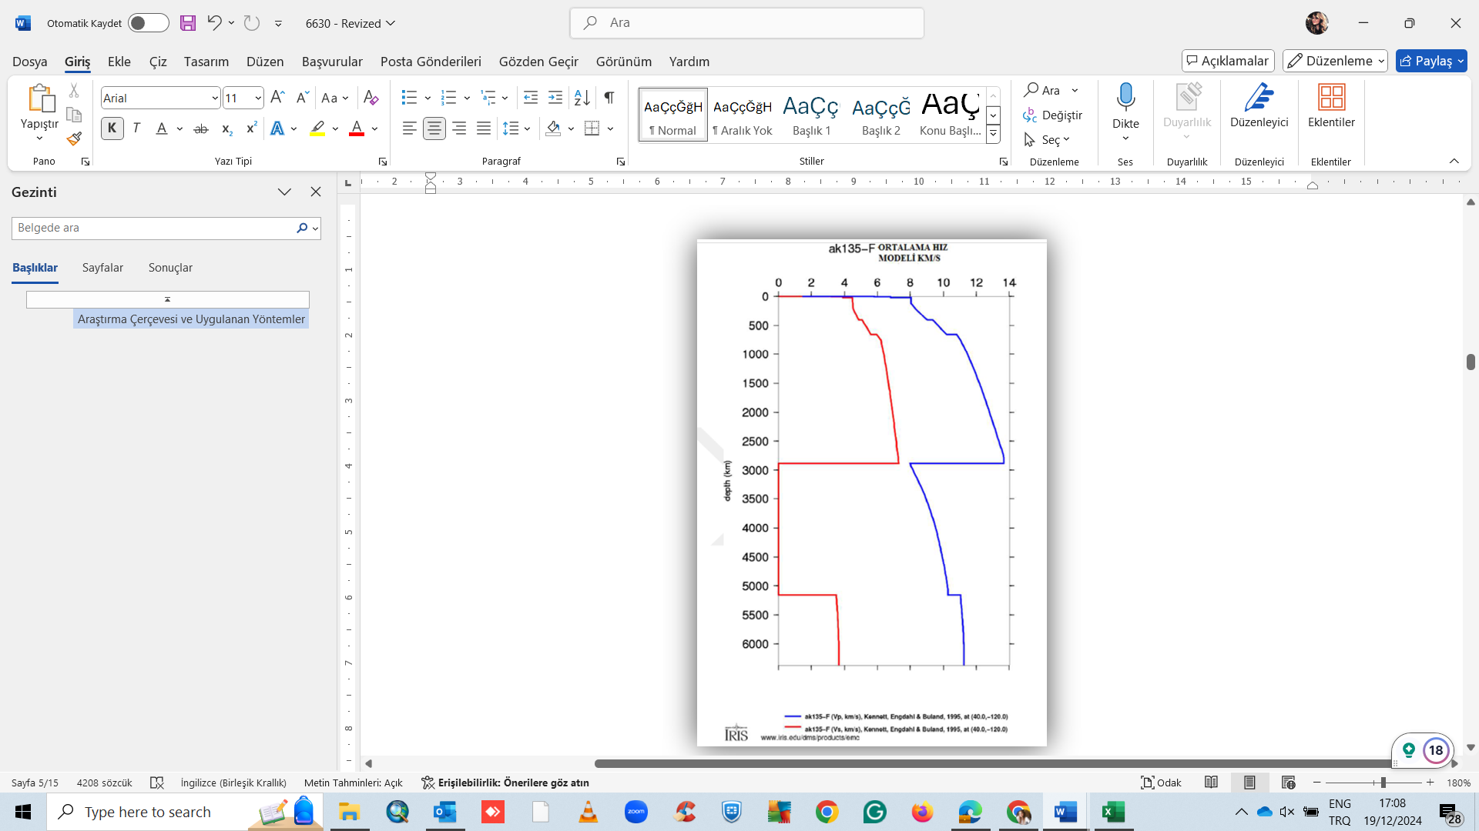
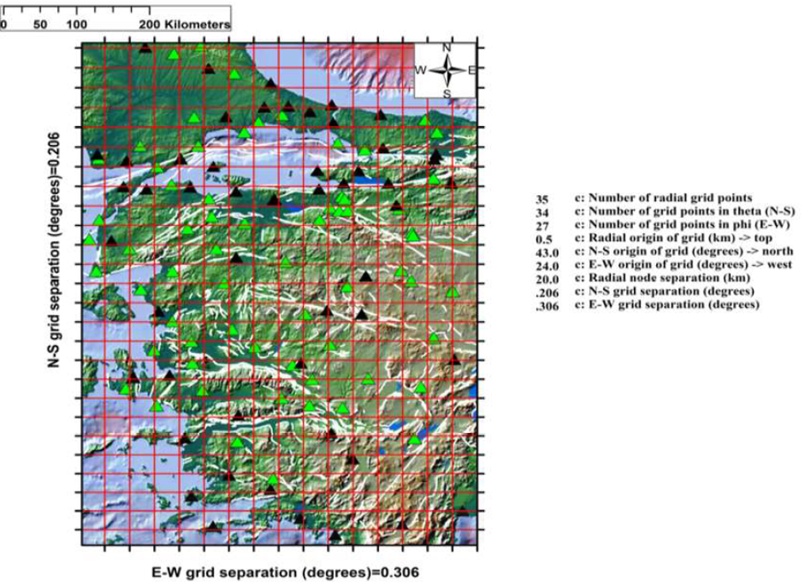
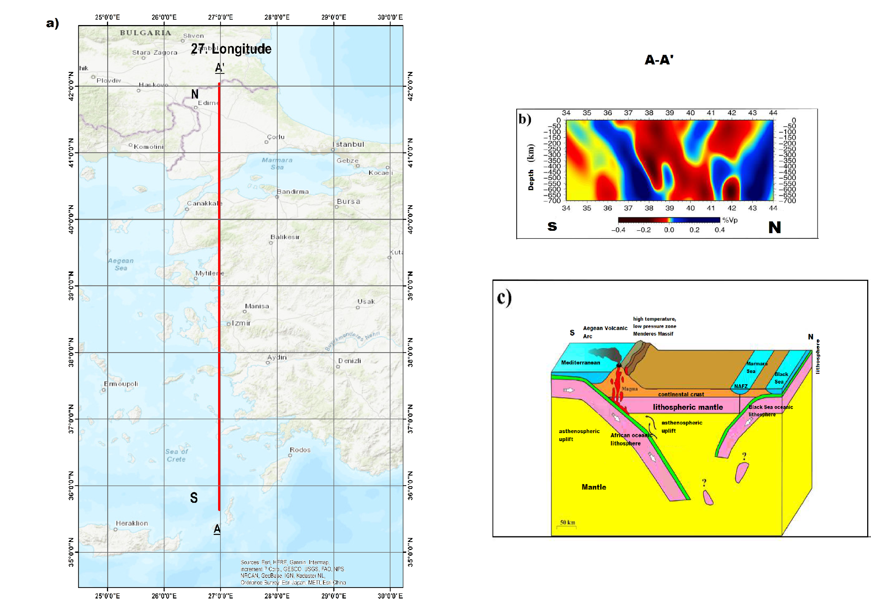
Introduction: Who am I ?
As a researcher with a Ph.D. in Geophysical Engineering, I specialize in seismology, active tectonics, and seismic hazard assessment. My doctoral research focused on the upper mantle structure of the Marmara Region using teleseismic tomography. This work contributed to a deeper understanding of one of Turkey’s most seismically active and socioeconomically critical zones and provided essential insights for reliable seismic hazard models.
Ph.D Thesis: My doctoral dissertation, titled “Upper Mantle Structure of the Marmara Region Using Teleseismic Tomography”, provided new insights into the deep lithospheric processes beneath this tectonically complex and seismically active area. Through detailed seismic tomography, I characterized the velocity structure variations that correlate with fault mechanics along the North Anatolian Fault, critical to understanding the stress evolution and earthquake potential in the region.
During and after my Ph.D., I conducted advanced geophysical analyses on the seismicity and fault geometry in the Marmara region, integrating seismic tomography, velocity anomaly interpretation, and tectonic modeling. I want to developed strong technical skills in seismic data analysis, GIS applications, and programming tools such as Python and MATLAB.

Slide 3
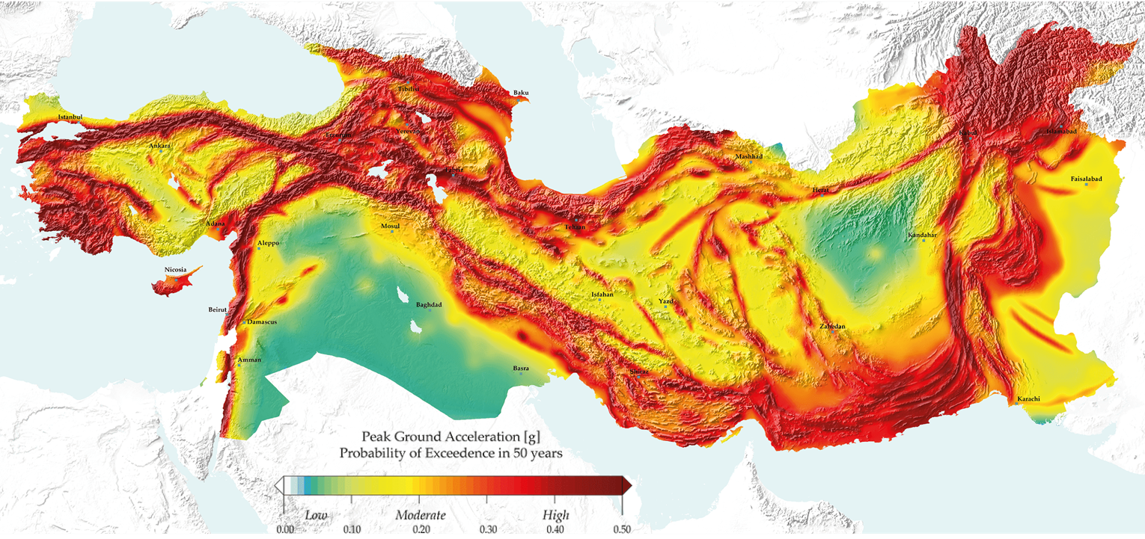
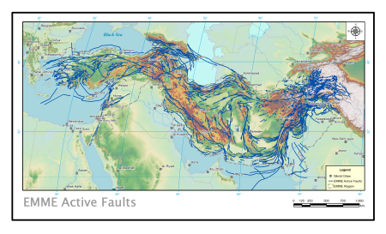
MsC Thesis: This thesis is a regional study developed within the framework of the Earthquake Model of the Middle East (EMME) Project, which originally produced the EMME14 seismic hazard model (2010–2014), covering eleven countries in a highly active tectonic region(From Turkey to Pakistan) . Currently, the project continues with the 2024 update of the Earthquake Model of the Middle East (EMME24), under the title “EMME24 – Model Implementation and Preview”. Within this broader effort, this study specifically focuses on the Turkey–Caucasus region (Turkey, Armenia, Azerbaijan, and Georgia), aiming to provide a more detailed assessment of its seismic hazard. (https://hazard.efehr.org/en/Documentation/specific-hazard-models/middle-east/overview/) Beyond my thesis, I have authored several peer-reviewed publications focused on seismicity and seismic hazard in the Marmara region, including studies analyzing microseismicity patterns, stress regime variations, and frequency-magnitude distribution parameters (b-value) of earthquakes
I have been actively involved in the Earthquake Model of the Middle East (EMME) project, which aims to produce updated, regionally consistent seismic hazard and risk models for from Türkiye to Pakistan.
Currently, I am working as a Project Development Specialist at the Directorate of R&D Resources at Kadir Has University, where I coordinate and develop national and international research proposals, including those funded by TUBITAK and Horizon Europe. My role bridges scientific research and funding strategy, supporting interdisciplinary collaboration and institutional capacity-building.
https://hazard.efehr.org/en/Documentation/specific-hazard-models/middle-east/overview/

Slide 4
Research Question & Objectives
?
Research Question
How does the lithospheric heterogeneity beneath the Marmara Region influence fault behavior and seismic hazard potential, particularly in the context of a potential future Istanbul earthquake?
Can seismic tomography, crust-mantle velocity anomalies, and seismicity patterns be integrated with fault data to improve seismic hazard models?
Objectives
To investigate the upper mantle structure beneath the Marmara Region using teleseismic tomography and identify key lithospheric anomalies associated with active tectonics.
To analyze the fault behavior and seismic hazard implications of the western North Anatolian Fault Zone by correlating deep structural features with surface activity.
To map b-value distributions across 54 seismic zones (based on 1900–2024 earthquake catalog) and interpret spatial variations in relation to tectonic stress and potential rupture areas.
To build a GIS-based active fault database for events with Mw ≥ 5.5 and integrate this with seismicity, tomography, and crustal models to enhance regional hazard assessments.
To assess how integrated models of seismic and fault data can inform probabilistic seismic hazard analysis (PSHA) and decision-making for urban risk in Istanbul and surrounding areas.
Notes:
.

Slide 5
Data & Methods
(What I Want to Do at EPOS Summer School?
Data & Methods Framework for Integrated Seismic Hazard Analysis in the Marmara Region
1. Seismic Data Collection and Catalog Analysis
Data sources: KOERI, AFAD, IRIS, EMSC earthquake catalogs
Events: Mw ≥ 3.5 between 1900 and 2024
Temporal-spatial analyses: Event distributions, focal depths, recurrence intervals
b-value computations: Mapping stress accumulation zones using the Gutenberg-Richter relationship across 54 seismic subzones
2. Fault Database Integration (GIS-Based)
Classification of active faults: Surface-rupturing, blind faults, segmented structures
Correlating Mw ≥ 5.5 events with paleoseismic and structural fault data
Digital mapping of fault zones using ArcGIS/QGIS for spatial analysis
3. Seismic Tomography Results (Teleseismic & Local)
Utilization of local and teleseismic waveform datasets
Velocity anomaly modeling: Vp, Vs, Vp/Vs distributions
Visualization of mantle heterogeneities and identification of structural boundaries associated with faults

Slide 6
4. Integrated Hazard Assessment
Updating input parameters for Probabilistic Seismic Hazard Analysis (PSHA):
  Fault source characteristics (length, slip rate, seismogenic depth)
  Integration of tectonic zoning and tomographic anomalies
  Earthquake scenario modeling (e.g., Mw 7.2 event for Istanbul rupture scenarios)
Outputs:
  Earthquake distribution maps
  3D tomographic cross-sections
  Fault-network and seismicity relationships
  Proposed Hands-On Activities for the EPOS Summer School
Mini-Workshop: Installation and use of seismic tomography software (e.g., FMTOMO or LOTOS) with example datasets
Python Training: Earthquake catalog analysis, b-value calculation, and seismicity visualization
Scenario Simulation: Segment-based rupture modeling for a potential Istanbul earthquake

Slide 7
EPOS & Outcomes
Expected Deliverables:
Updated seismic hazard maps incorporating both surface and subsurface data
Prototype visualization tools or EPOS-ready data layers
Improved seismic hazard forecasting for Istanbul and the broader Marmara region
Prototype outcome: Deploy regional tomographic modeling tool or visual analytics dashboard.
Use EPOS to validate and integrate active fault data
Enable linkage between surface faults and crustal tomography
Expected outcome: Prototype seismic hazard map or EPOS-ready layer
Highly relevant for Marmara and Istanbul seismic risk planning

Slide 8

Thank you for your attention!
Kadir Has University
hilal.yalcin@khas.edu.tr
hilaldomacyalcin@gmail.com
Phone number: +90 5512319956
Burgunderweg , 10a, 55130, Mainz Germany.
www.epos-eu.org/on | #EPOSon
🔗 ResearchGate: https://www.researchgate.net/profile/Hilal-Yalcin-2?ev=hdr_xprf
🔗 LinkedIn: https://www.linkedin.com/in/dr-hilal-y-766a8b3b/
📷 Instagram: https://www.instagram.com/_dr.hilocan_/
🔗 Khas website: https://www.khas.edu.tr/arge-hakkimizda/

