Slide 1

Group 5
Machine Learning for Remote Sensing and Resources
Group Members:
Amit Kumar Singh, Oskar Rydman, Hedaya Alyousif
Notes:
Title slide

Slide 2
Thematic Area:
Spatio-Cluster Analysis of Geophysical Features in the Southeastern Italy Region
Using GNSS, Faults, Tsunami, and Seismic Data for Integrated Risk Insight
Objective:
Integrate multi-source geospatial datasets (GNSS, Faults, Tsunami events, Seismic moment tensors, Geology).
Extract spatial relationships and perform unsupervised clustering to identify geophysically significant zones.
Notes:
Content slide

Slide 3
Data Sources & Features
Data Sources:
GNSS Velocities: EPOS GNSS (INGV)
Faults & Seismogenic Zones: EFSM20
Tsunami Events: ITED & Deposits (ICM-CSIC)
Seismic Moment Tensors: EMSC
Geology: Lithological Units (EPOS GSML)
Features Computed:
Distance to Faults, GNSS, Tsunami events, and Moment Tensors
GNSS density (within 20 km)
Moment Tensor properties: magnitude, depth, mechanism
Dominant Lithology per cell
Notes:
Content slide

Slide 4
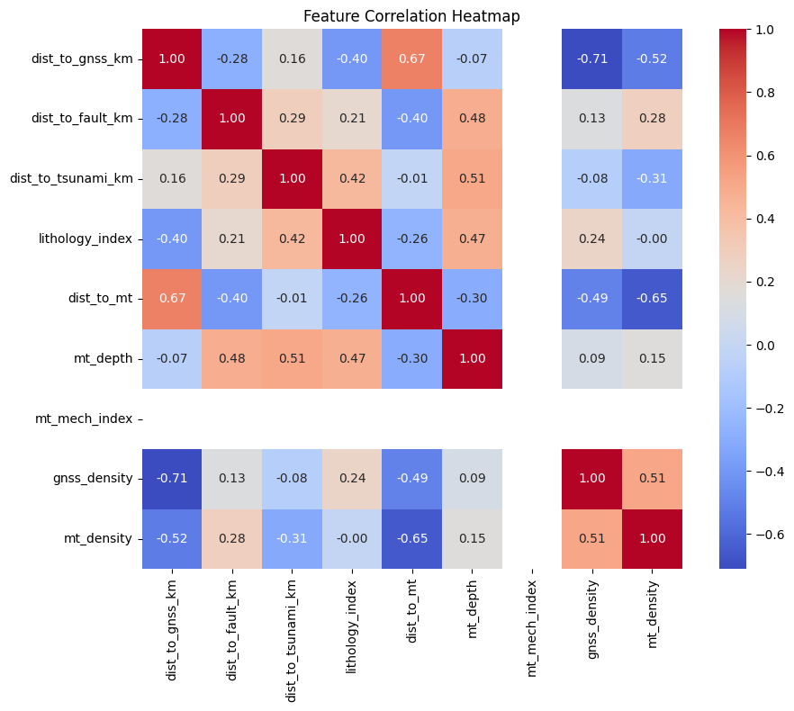
Methodology & Analysis
Grid & Processing:
30×30 grid (0.045° resolution)
Geo-features extracted per cell
Feature normalization (Z-score)
K-Means Clustering (k=5)
Analyses Performed:
Correlation Heatmap – Check feature dependency
Scatter Matrix – Visualize feature clusters
Clustering Output – Spatially distinct geophysical zones
Map Visualization – Interactive OSM overlay
Notes:
Content slide

Slide 5
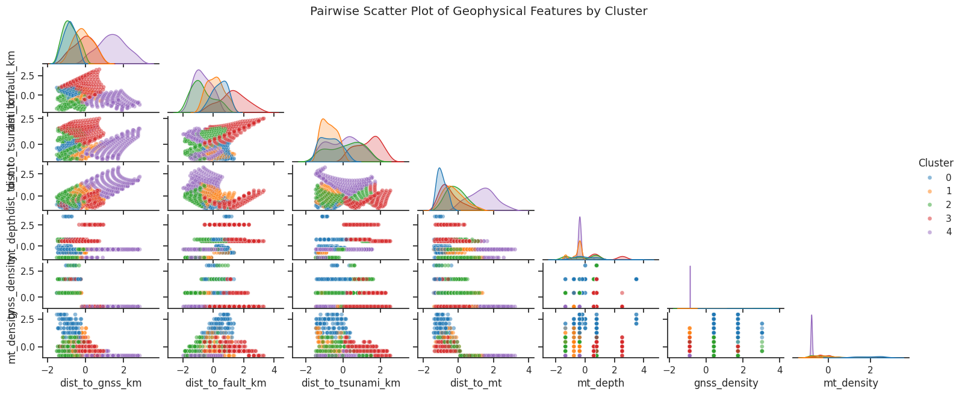
Data Analysis
🔍 Key Observations
Clusters Separate Along Some Features:
dist_to_gnss_km and gnss_density show clear cluster groupings (Cluster 0 and Cluster 4 are quite distinct).
2. Inverse Relationship Patterns:
As dist_to_gnss_km increases, gnss_density decreases (intuitive, as farther from stations means fewer nearby).
Similarly, dist_to_mt and mt_density show inverse trends.
3. Cluster 4 (Purple):
dist_to_tsunami_km vs. mt_density - likely close to tsunami sources but fewer seismic events.
4. High-Density Areas (Bottom Left Clusters):
Clusters 0 and 3 (Blue and Red) appear tightly grouped near origin on several axes - indicating densely instrumented or seismically active areas.

Slide 6
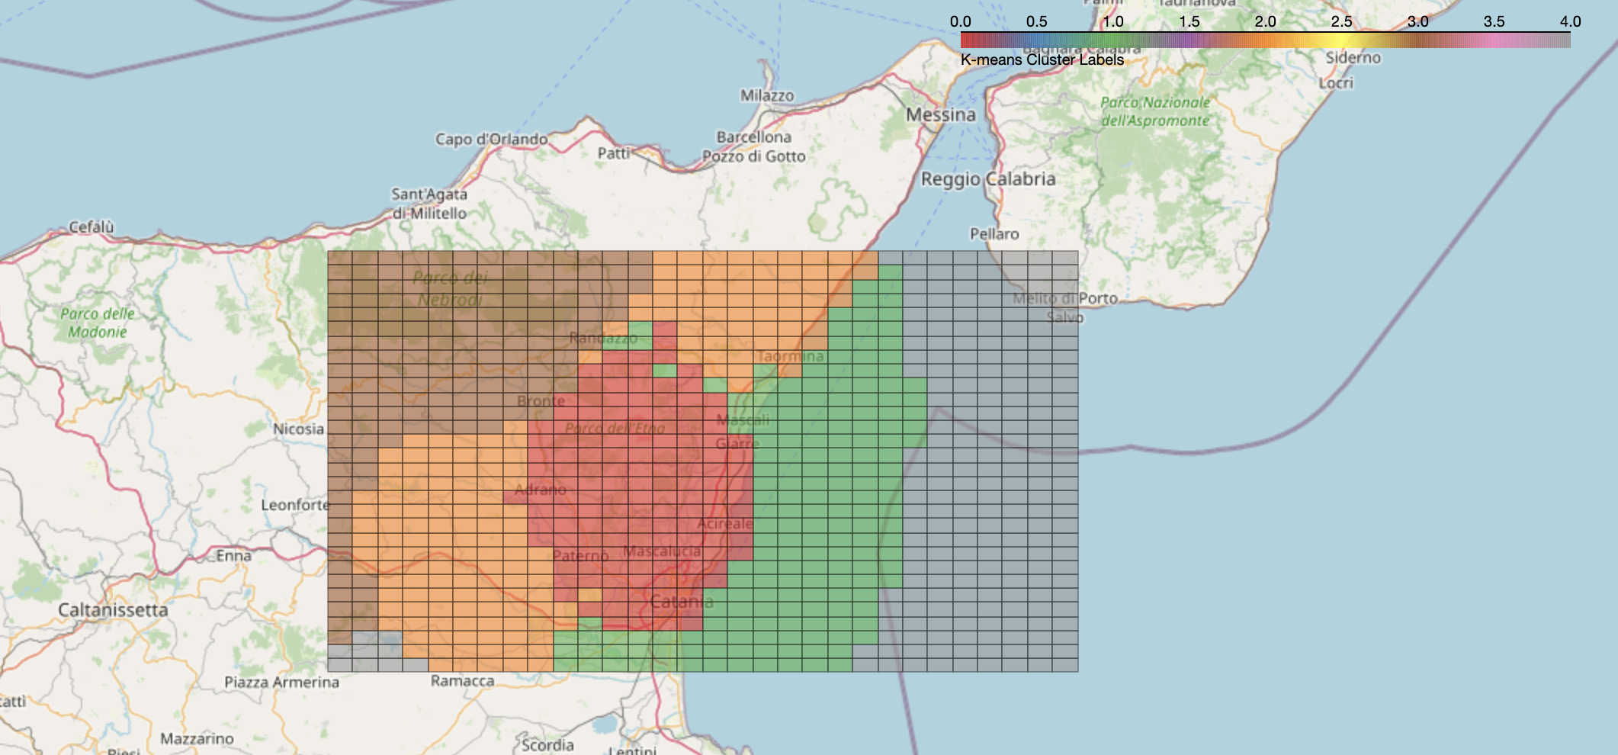
Conclusion & Future Scope
Key Findings:
Cluster zones correlate with seismically active and structurally complex regions.
Geology and proximity to GNSS/faults play a key role in spatial grouping.
Visual analytics enhance understanding of regional tectonic behaviour.
Fig. clustered geospatial overlay on an OpenStreetMap basemap
Future Scope:
Integrate time-series GNSS or InSAR data.
Apply dimensionality reduction (e.g., PCA, t-SNE).
Test supervised models for hazard classification.
Color | Cluster | Likely Interpretation Based on Features
Red (e.g. Cluster 2) | Central region (around Etna) | High seismic activity, low GNSS distance, high GNSS density
Orange (e.g. Cluster 1) | Intermediate zone | Transitional area in terms of geophysical variables
Green (e.g. Cluster 3) | Coastal/NE region | Possibly low seismic density, further from GNSS
Gray (e.g. Cluster 0) | Edge zones | Sparse data or different geological properties

Slide 7

Thank you for your attention!
www.epos-eu.org/on | social media #EPOSon
Notes:
Thank you slide

