Slide 1

Group 6.
Observational seismology:
source, site, society
Authors: Helena Ciechowska, Alina Coman, Ljubcho Jovanov, Simon Issartel
Notes:
Title slide

Slide 2
Aim of the study
to obtain a seismic characterization of the Pertusillo Lake area (Natural and Triggered), in order to assess potential impacts of future strong earthquakes on the important infrastructure in the area

Slide 3
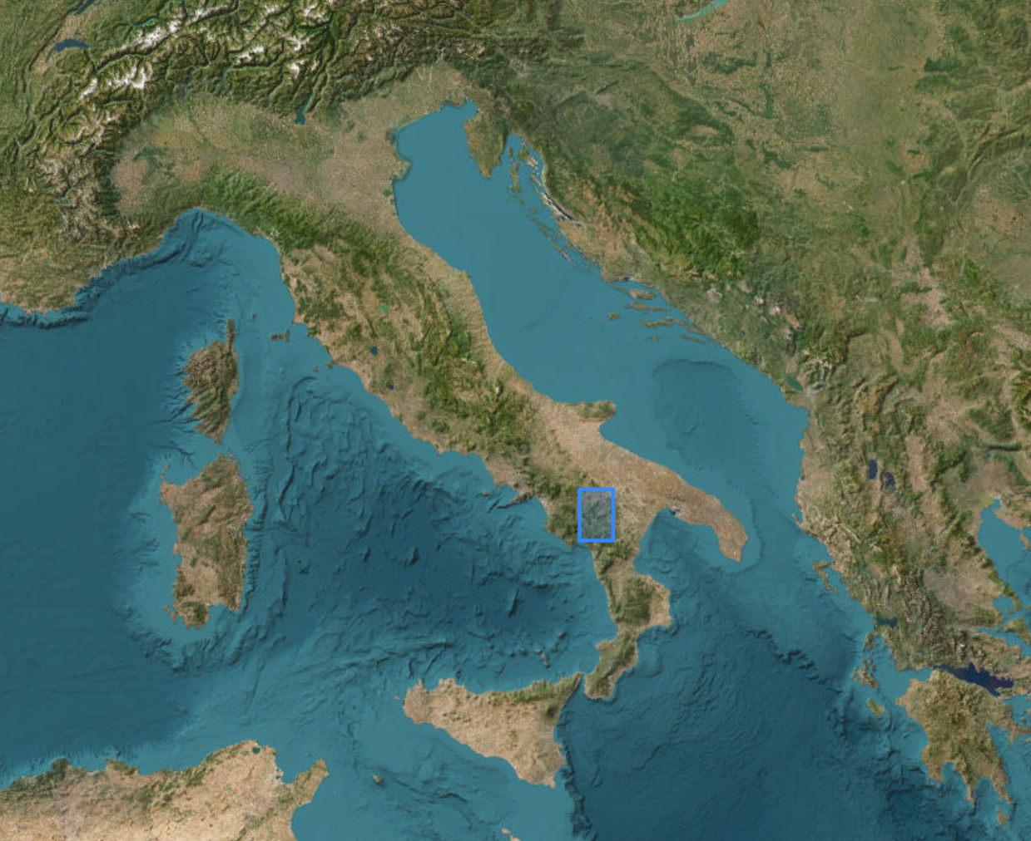
Earthquake Swarm and general seismicity of Southern Italy
Study Area: Pertusillo Lake (Reservoir-Triggered)
more than 1600 triggered seismic events (swarms) (magnitudes up to 2.7 ML) over one year (2005 - 2006)
more than 1000 tectonic earthquakes starting from 1999

Slide 4
Data sets used
European Fault Source Model 2020 (OGC WMS): EPOS (INGV)
Episode VAL D'AGRI: water reservoir : EPOS (INGV)
Geological Maps : EPOS (EGDI)
Moment tensor data for modern earthquakes : EPOS (EMSC)
Felt reports for modern earthquakes : EMSC
Parameters of modern earthquakes - FDSN event : EPOS (EMSC)
Ambient noise measurements: EIDA platform

Slide 5
Results

Slide 6
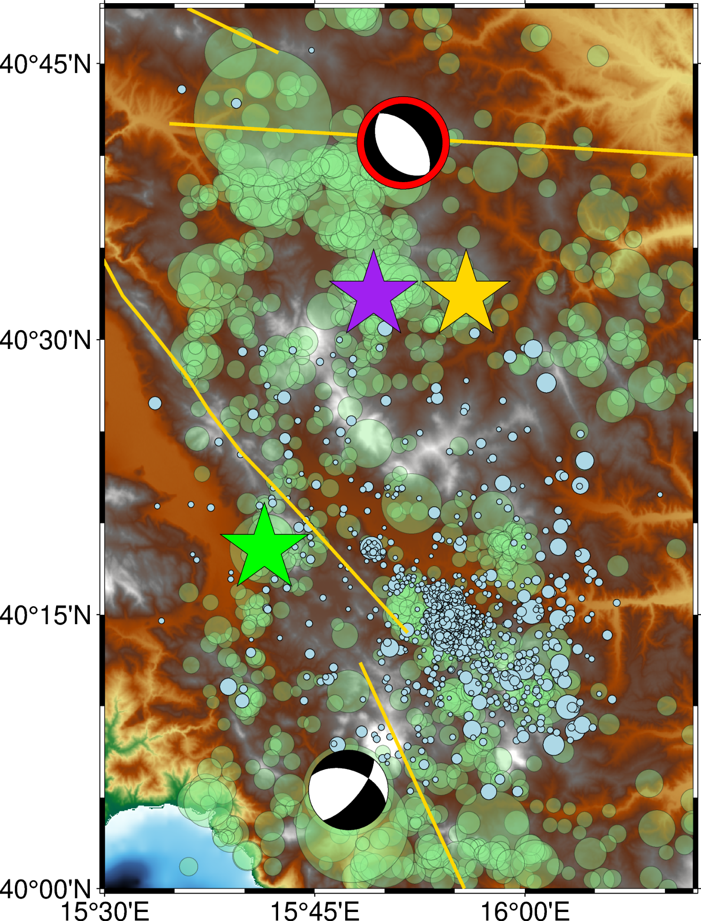
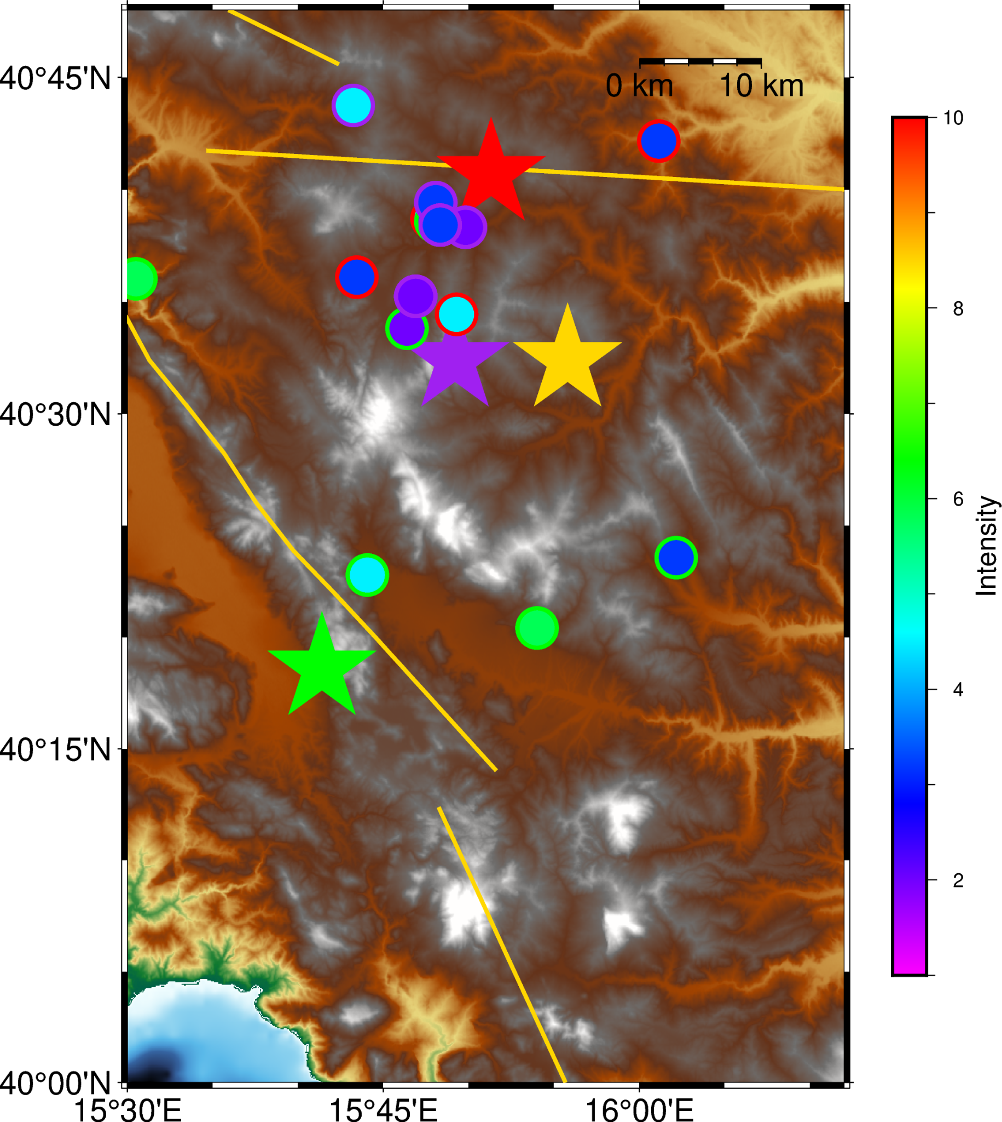
➢

Slide 7
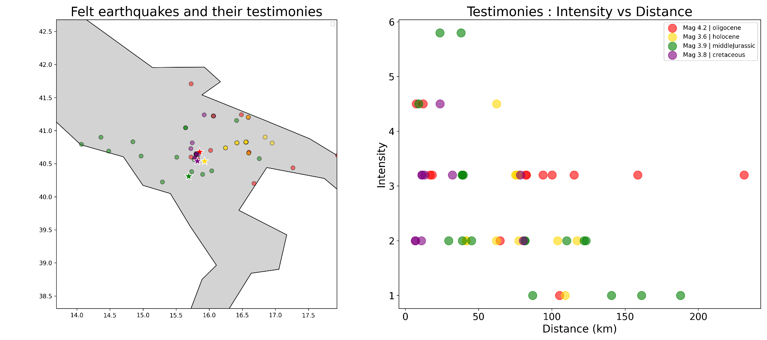

Slide 8
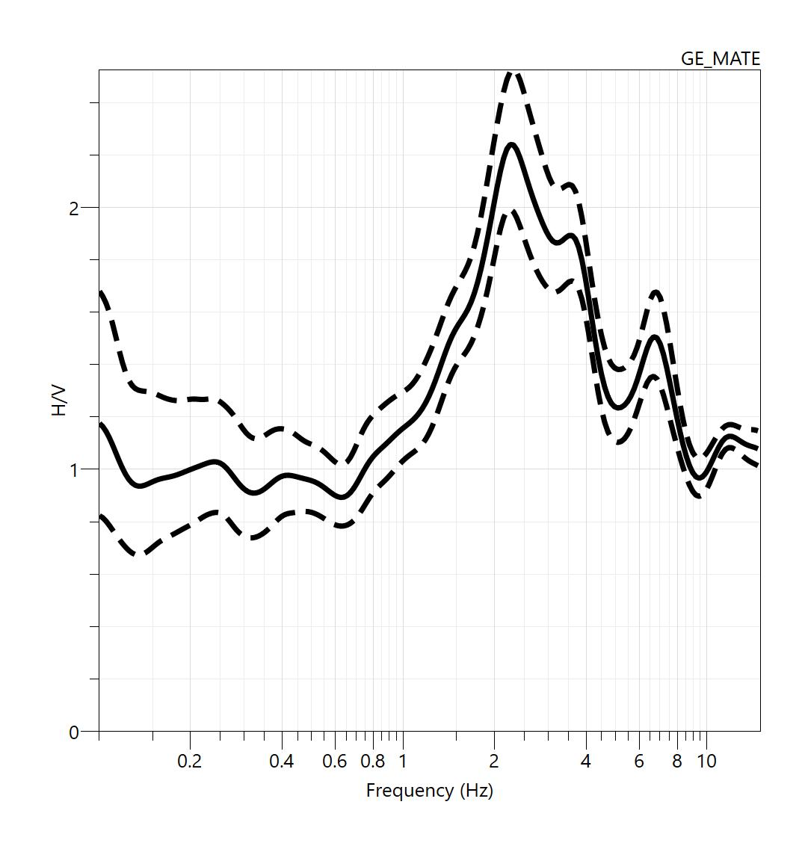

f₀ = 2.3 Hz
Fundamental frequency of resonance (f₀) of the site (GE_MATE - station located in the studied area)

Slide 9
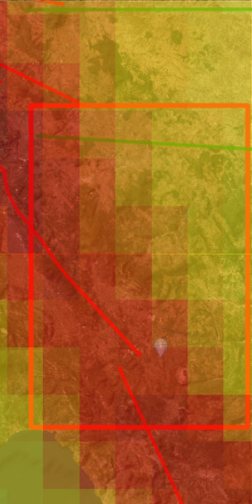
Seismic hazard map

Slide 10
Conclusions
The results provide valuable information for earthquake engineering applications and risk mitigation strategies in the region.

Slide 11
How we used EPOS
Future steps
for downloading the data
for initial visualizing of the earthquake parameters and tectonic settings
sharing our codes and documentation,
obtaining information about the depth of the seismic bedrock of the area,
analyse how the local geological structure may influence the seismic signals as they travel from the source to the free surface,
create an animation for a temporal distribution of earthquakes,
checking/adding the testimonies available on the italian databases.

Slide 12
References
Saccorotti, G., & Roselli, P. (2017). Episode: VAL D’AGRI [Dataset]. In G. Lizurek & P. Urban (Eds.), IS-EPOS Datasets. Institute of Geophysics Polish Academy of Sciences. https://doi.org/10.25171/instgeoph_pas_isepos-2017-016. Accessed on 26-06-2025 through the EPOS Data Portal (https://www.epos-eu.org/dataportal)
Basili, R., Danciu, L., Beauval, C., Sesetyan, K., Vilanova, S. P., Adamia, S., Arroucau, P., Atanackov, J., Baize, S., Canora, C., Caputo, R., Carafa, M. M. C., Cushing, E. M., Custódio, S., Demircioglu Tumsa, M. B., Duarte, J. C., Ganas, A., García-Mayordomo, J., Gómez de la Peña, L., … Zupančič, P. (2022). European Fault-Source Model 2020 (EFSM20): online data on fault geometry and activity parameters [Dataset]. Istituto Nazionale di Geofisica e Vulcanologia (INGV). https://doi.org/10.13127/EFSM20. Accessed on 26-06-2025 through the EPOS Data Portal (https://www.epos-eu.org/dataportal)
Moment tensor data for modern earthquakes (2013-present), provided by EMSC - European-Mediterranean Seismological Centre - FR, https://creativecommons.org/licenses/by/4.0/. Accessed on 26-06-2025 through the EPOS Data Portal (https://www.epos-eu.org/dataportal)
Parameters of modern earthquakes (1998-present) - FDSN event, provided by EMSC - European-Mediterranean Seismological Centre - FR, https://www.emsc-csem.org/policy.php. Accessed on 26-06-2025 through the EPOS Data Portal (https://www.epos-eu.org/dataportal)

Slide 13
Basili R., Danciu L., Beauval C., Sesetyan K., Vilanova S., Adamia S., Arroucau P., Atanackov J., Baize S., Canora C., Caputo R., Carafa M., Cushing M., Custódio S., Demircioglu Tumsa M., Duarte J., Ganas A., García-Mayordomo J., Gómez de la Peña L., Gràcia E., Jamšek Rupnik P., Jomard H., Kastelic V., Maesano F. E., Martín-Banda R., Martínez-Loriente S., Neres M., Perea H., Sket-Motnikar B., Tiberti M. M., Tsereteli N., Tsironi V., Vallone R., Vanneste K., Zupančič P. (2022). European Fault-Source Model 2020 (EFSM20): online data on fault geometry and activity parameters [Data set]. Istituto Nazionale di Geofisica e Vulcanologia (INGV). https://doi.org/10.13127/efsm20 Accessed on 26-06-2025
Nakamura, Y. (1989). A method for dynamic characteristics estimation of subsurface using microtremor on the ground surface, Rep. Railway Tech. Res. Inst. 30, 25– 33.

