Slide 1

Integrated Geophysical Analysis of Ground Deformation and Seismicity at Mount Etna
Applied geophysics group
Dilyana Hristova|Thomas Benson Małgorzata Szelachowska|Ema Nogová
Notes:
Title slide

Slide 2
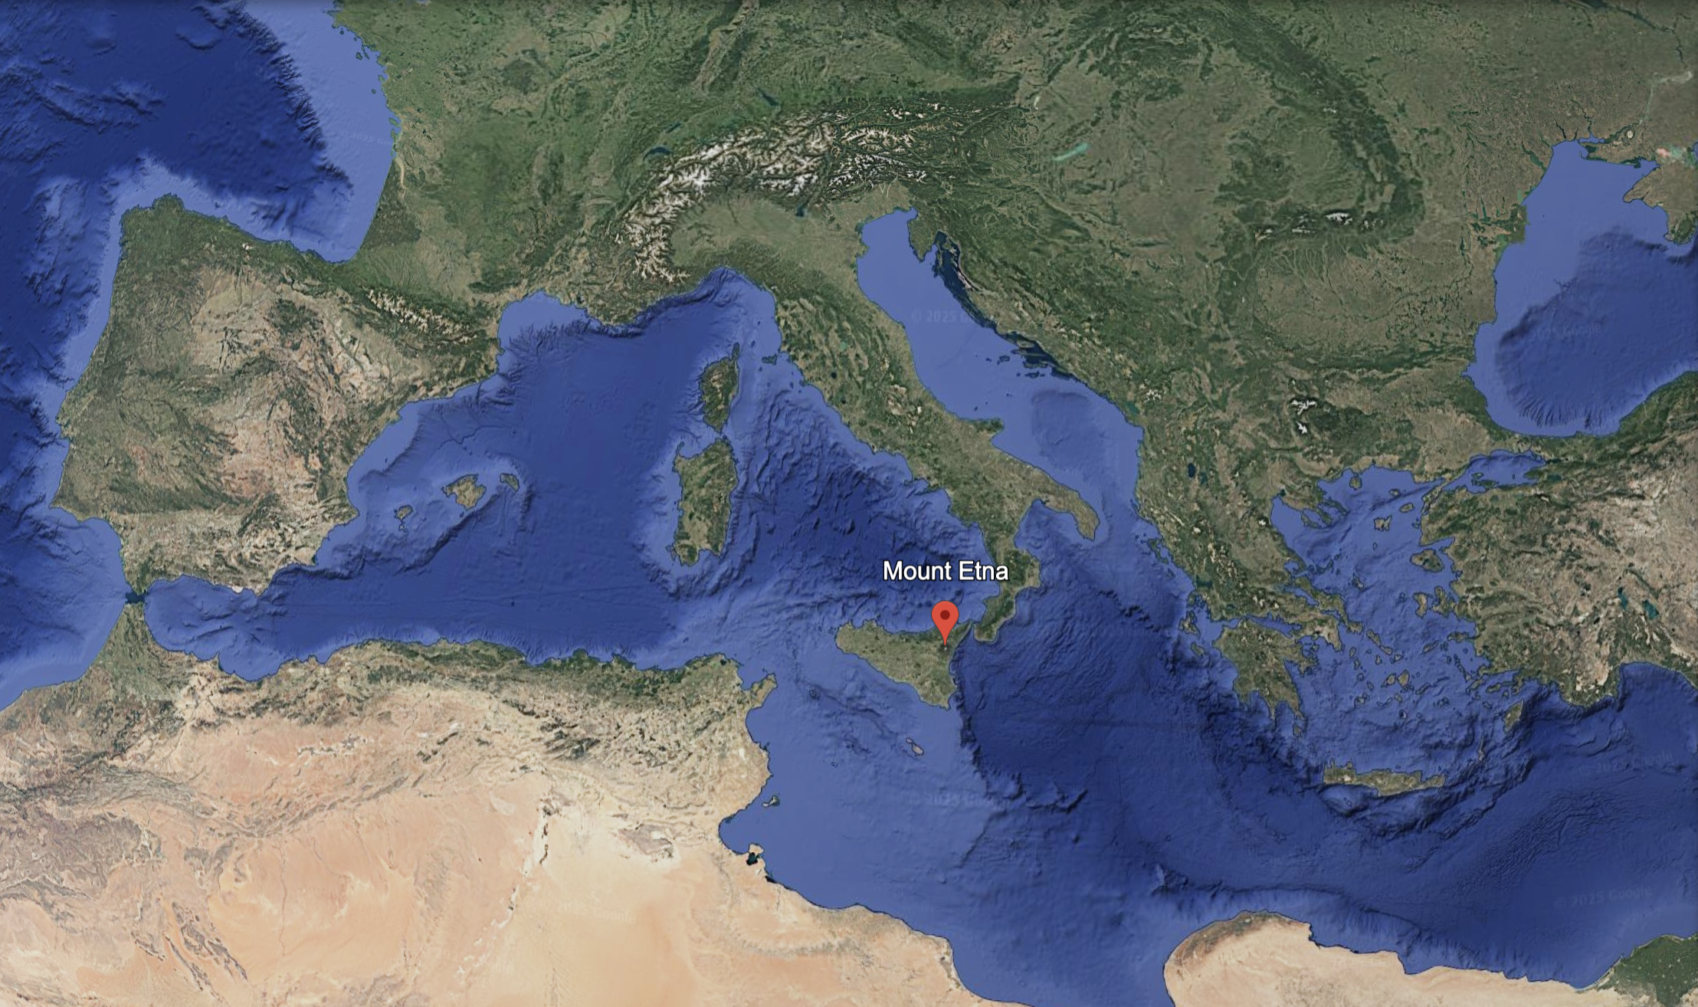
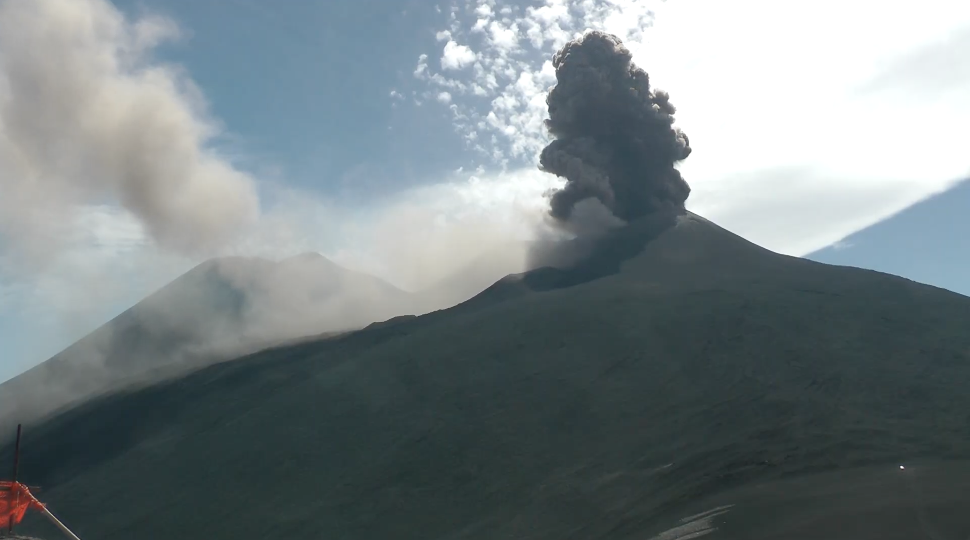
Etna volcano
one of the world's busiest volcanoes
often erupts with lava flows
big, sudden explosions
a great place for scientists to study how magma moves
Notes:
Content slide

Slide 3
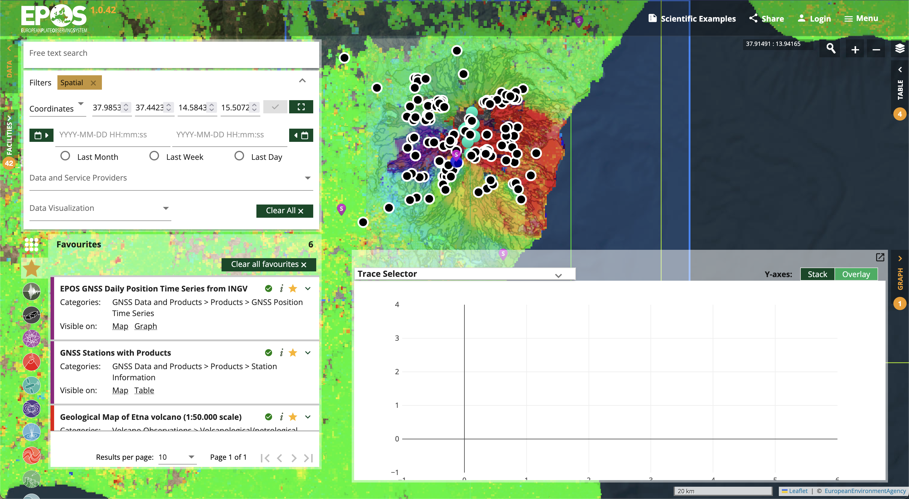
Data used
GNSS (EPOS, INGV)
InSAR images (EPOS, IREA)
seismics (INGV)
more data in EPOS
(we didn’t consider)
Notes:
Content slide

Slide 4

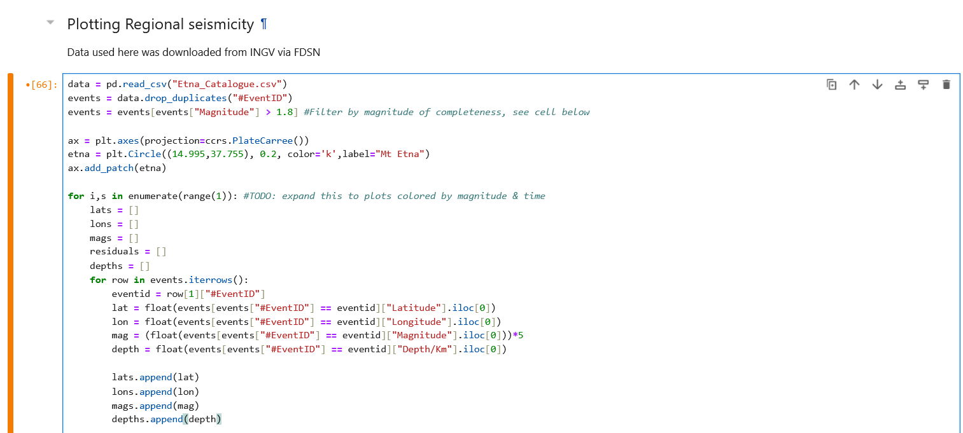
Jupyter notebook
Notes:
Content slide

Slide 5
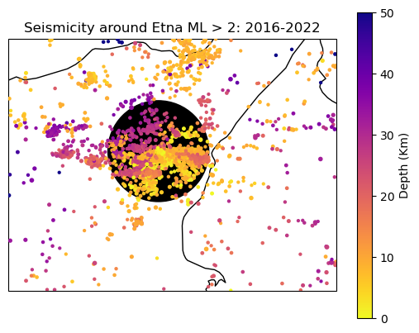
Seismicity
Notes:
Content slide

Slide 6
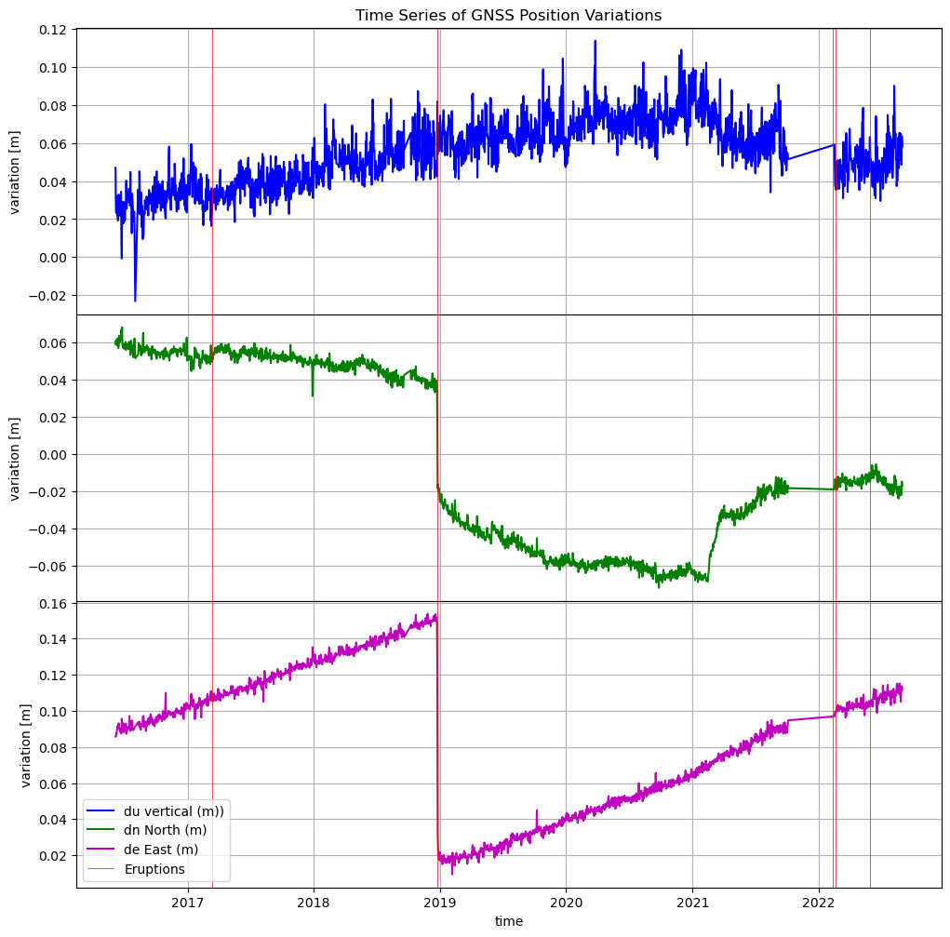
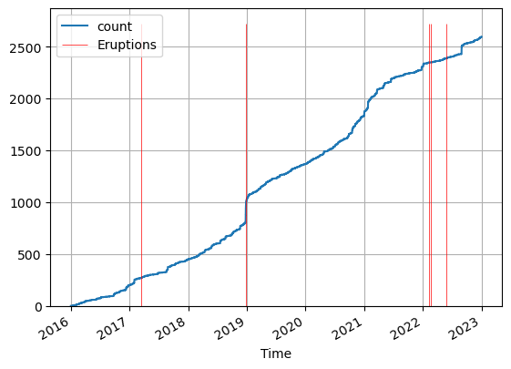
Observable eruptions
cumulative seismicity
displacement from GNSS time series
Notes:
Content slide

Slide 7
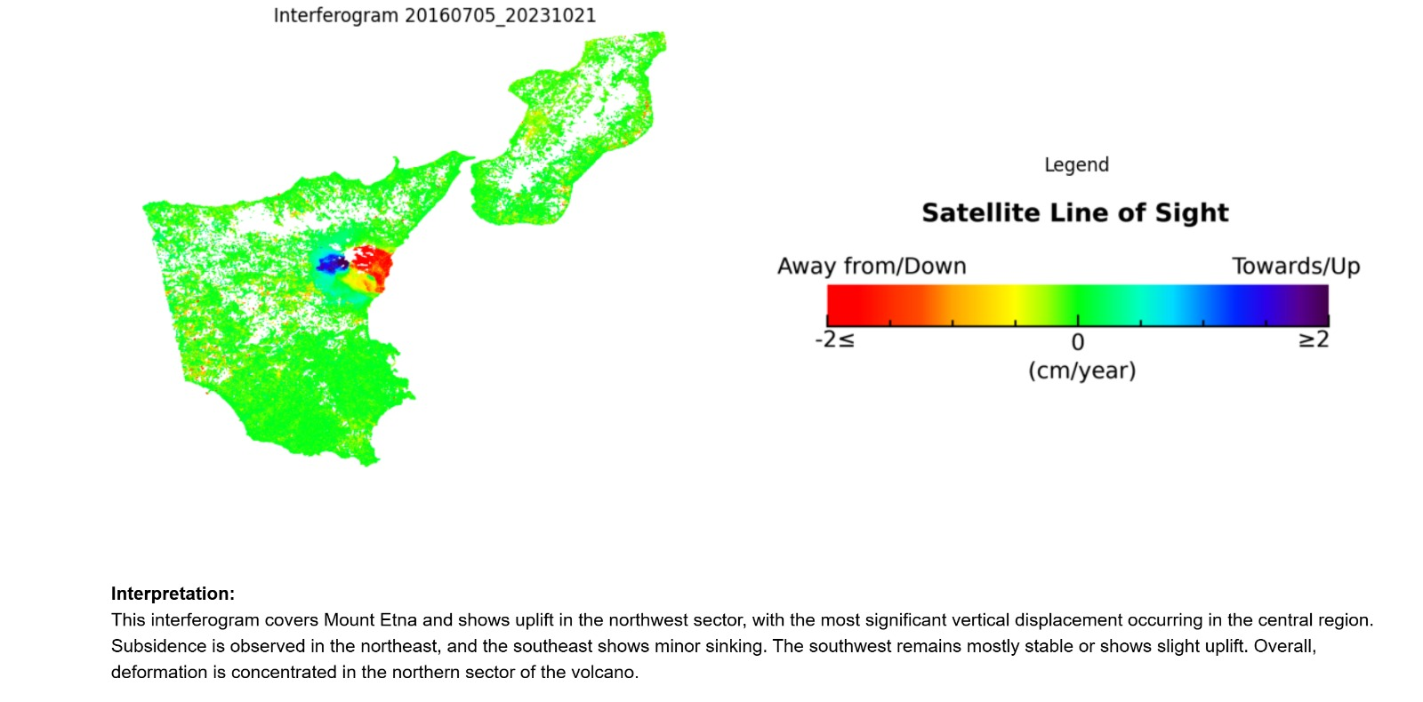
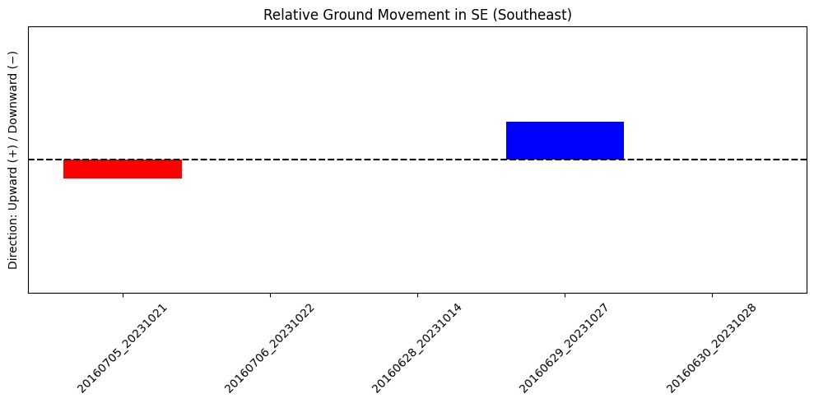
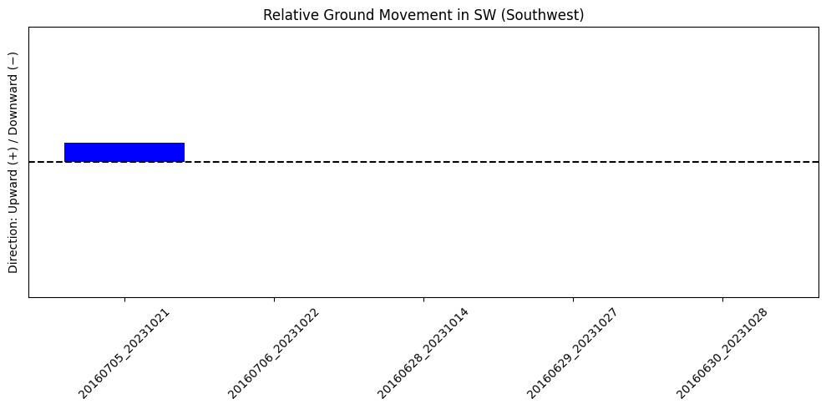
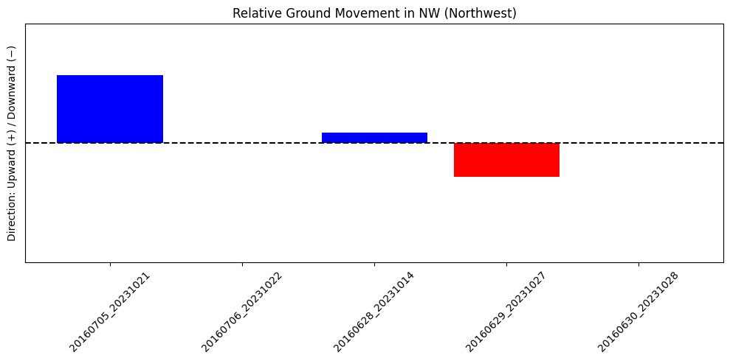
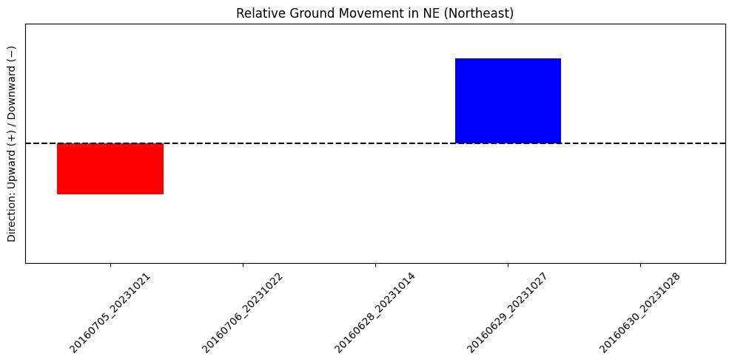
DInSAR

Slide 8


Thank you for your attention!
Notes:
Thank you slide

