Slide 1
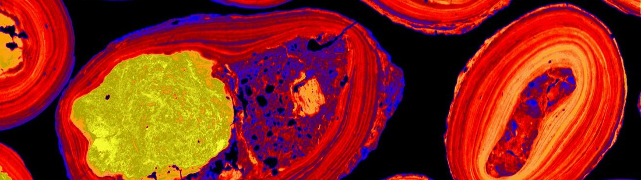


Advancing Australian Geoscience through the AuScope Virtual Research Environment (AVRE) Data and Services
On Behalf of the AuScope AVRE team:
Dr. Anusuriya Devaraju
Data Architect, CSIRO Mineral Resources

Slide 2

Discover AuScope
Source: AuScope – Building Australia’s Downward Looking Telescope, https://youtu.be/_5OVUXh5tq8?si=Dfu7BkqmJW35CVAp

Slide 3
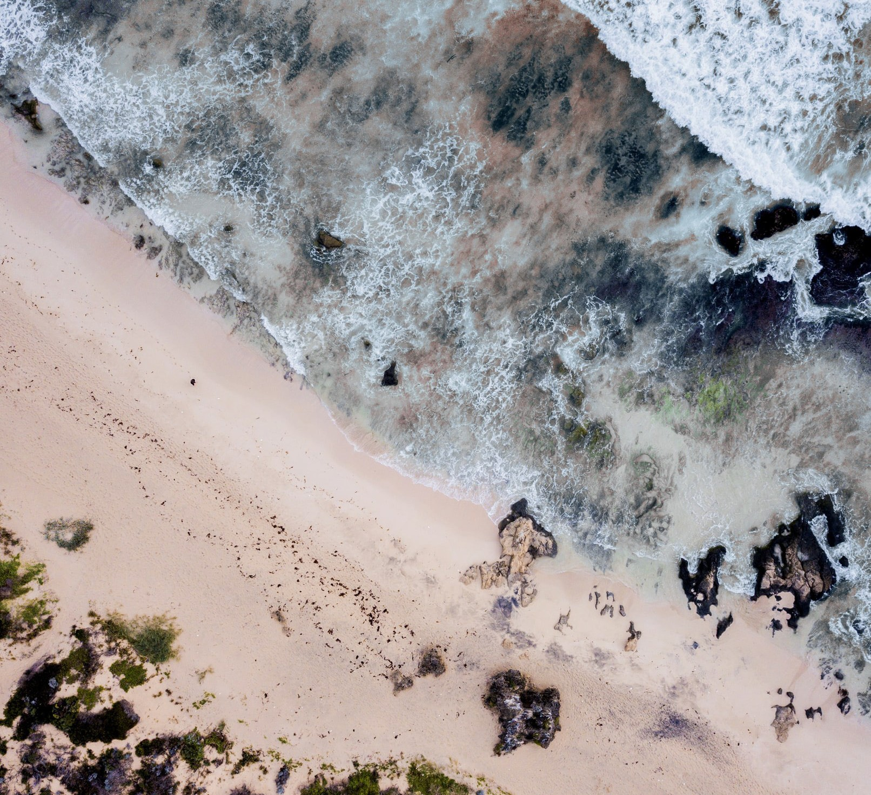
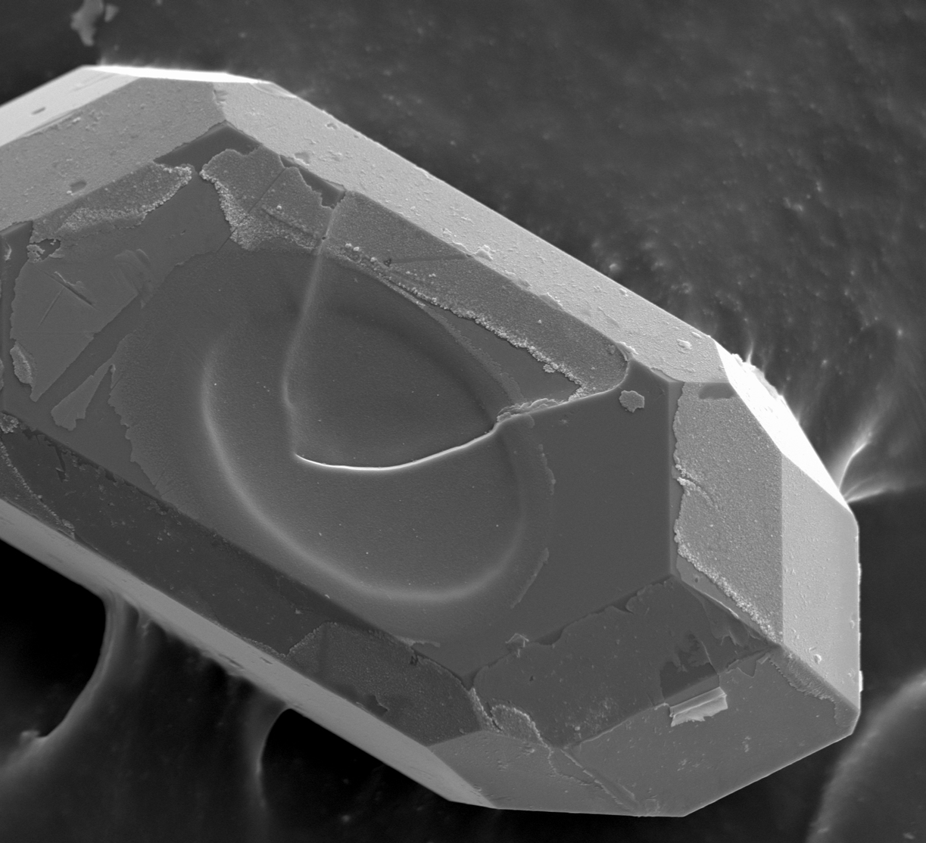
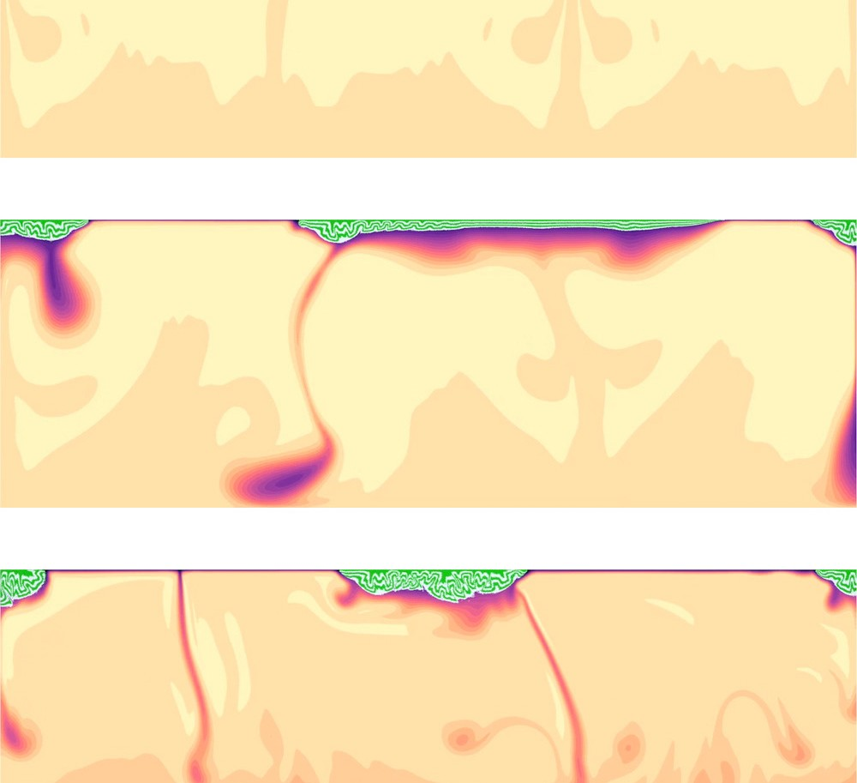
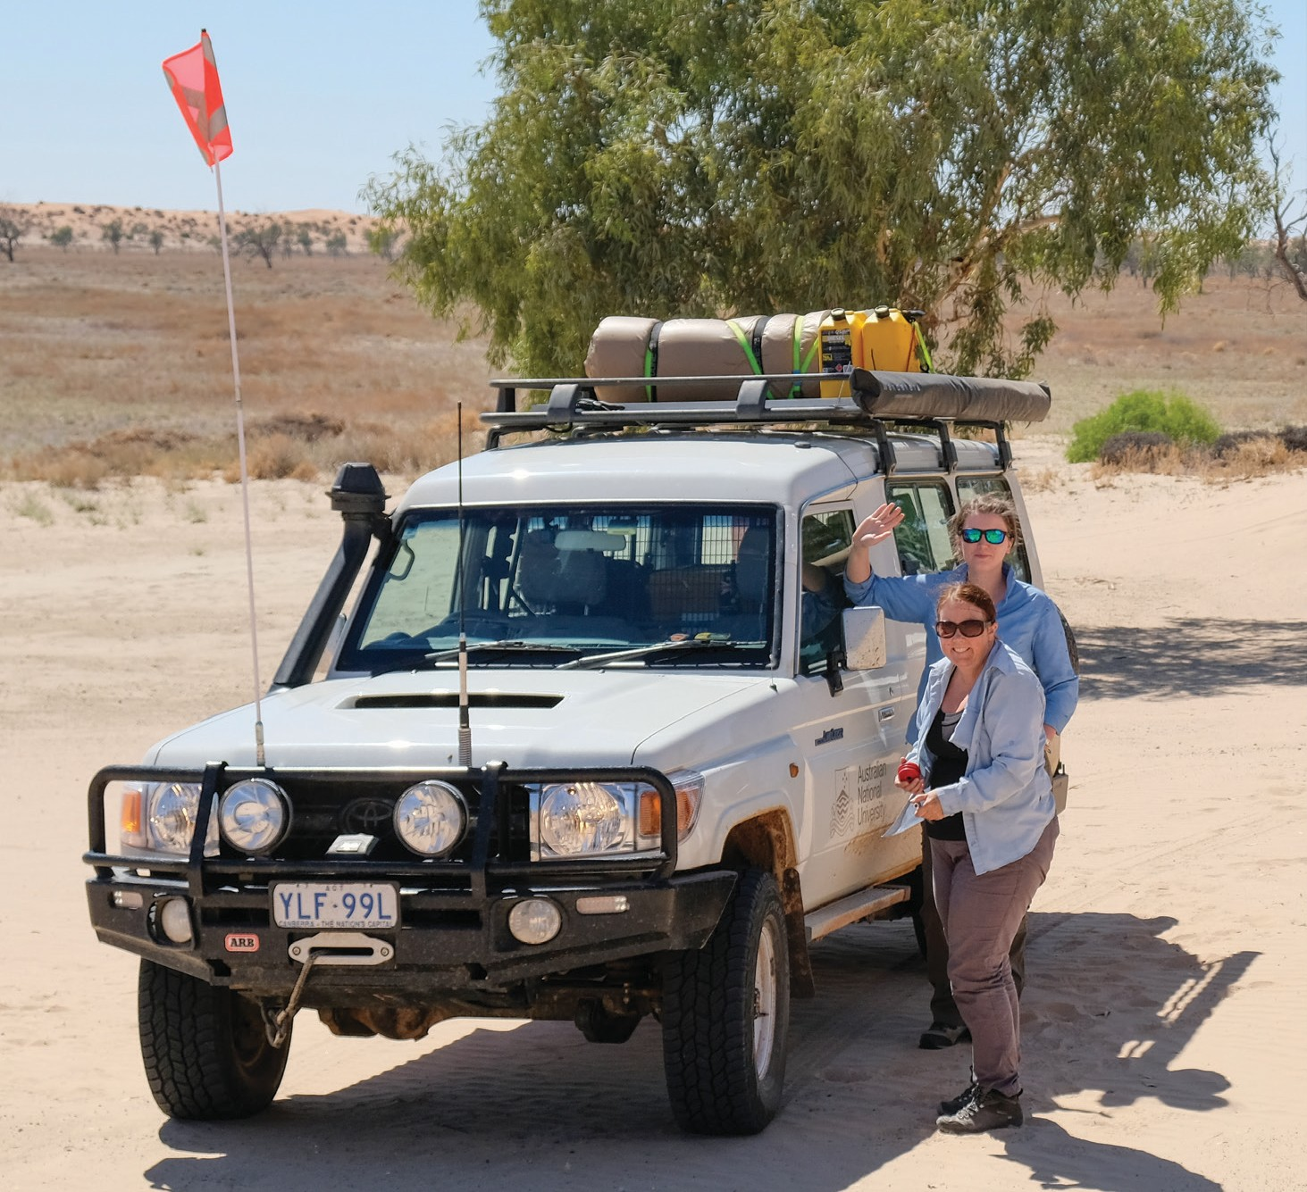
Overview
Australia’s leading research infrastructure provider
Operating since 2007, funded by the Australian Government via the National Collaborative Research Infrastructure Strategy (NCRIS).
Deliver instruments, services, data, analytics and expertise for tackling national geoscience challenges:
More about AuScope - https://www.auscope.org.au/
Food and Water
Minerals
Energy
Geohazards

Slide 4


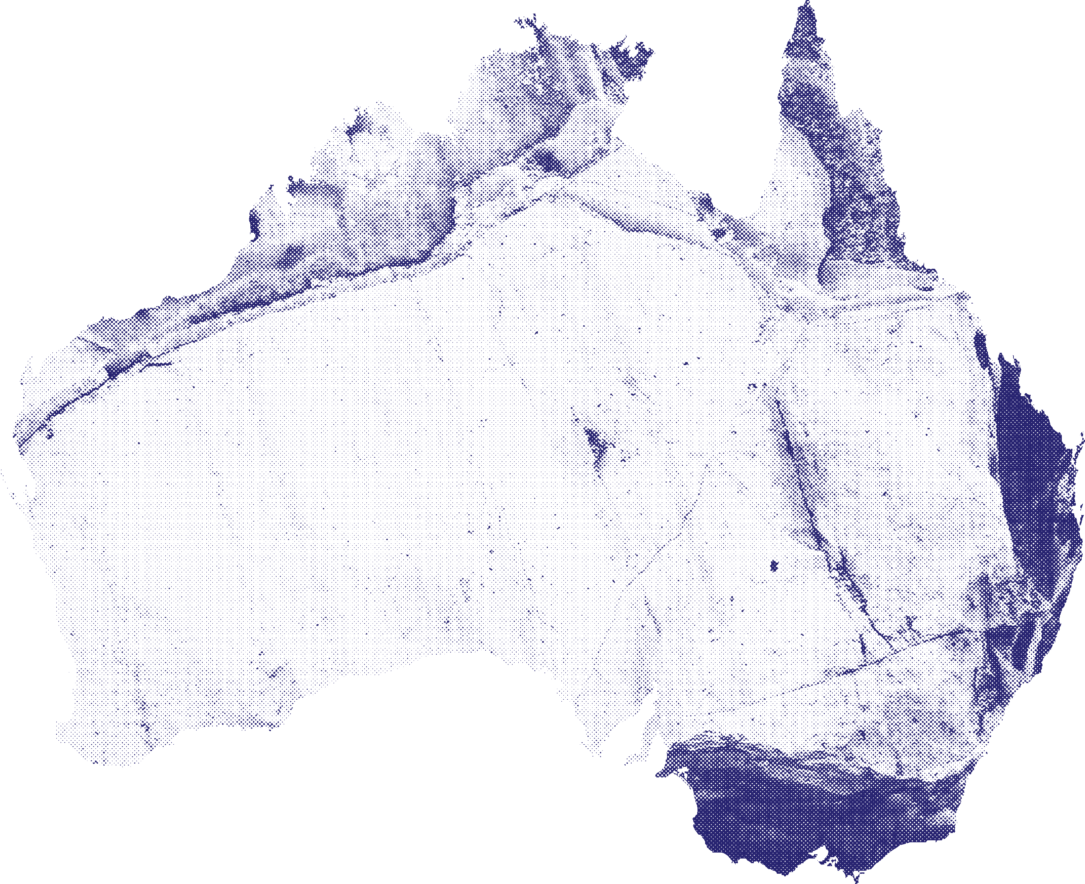




































Partners and Collaborators

Slide 5
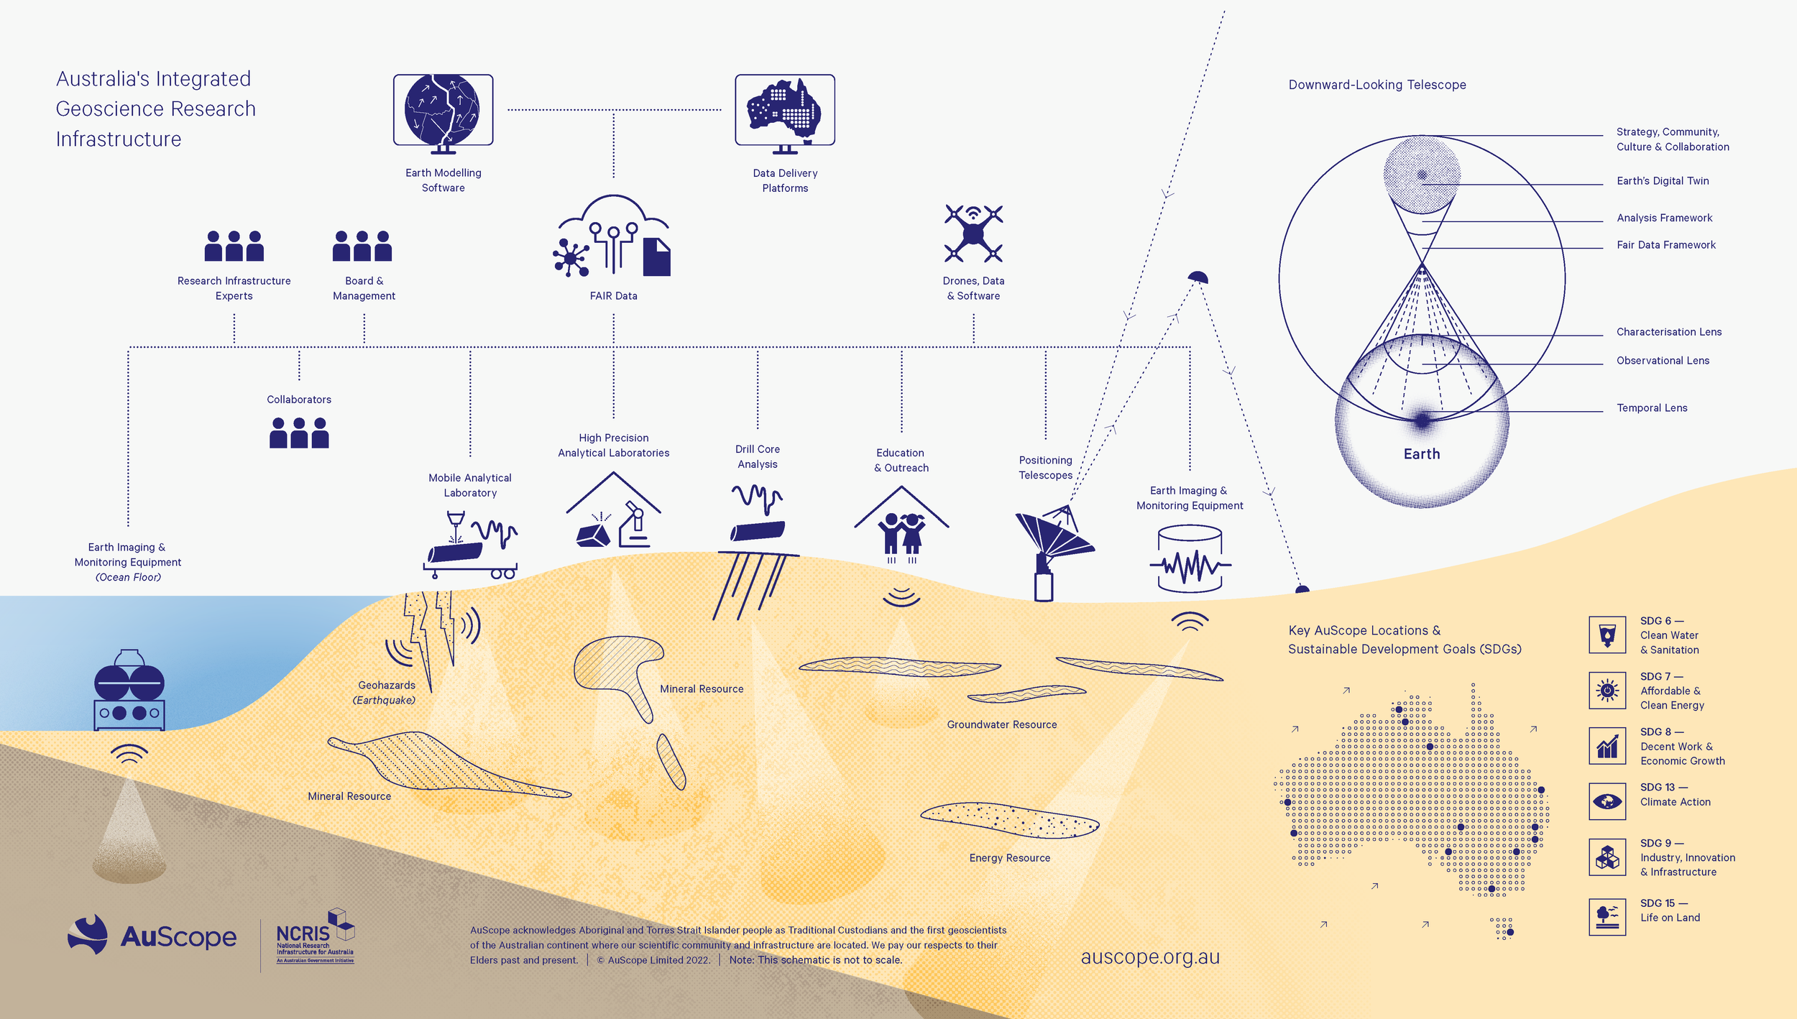
Connected With Purpose

Slide 6
AuScope Downward Looking Telescope (DLT)
Notes:
An integrated and augmented capability, like a telescope that will allow researchers to ‘see’ into Earth rather than out into Space.

Slide 7
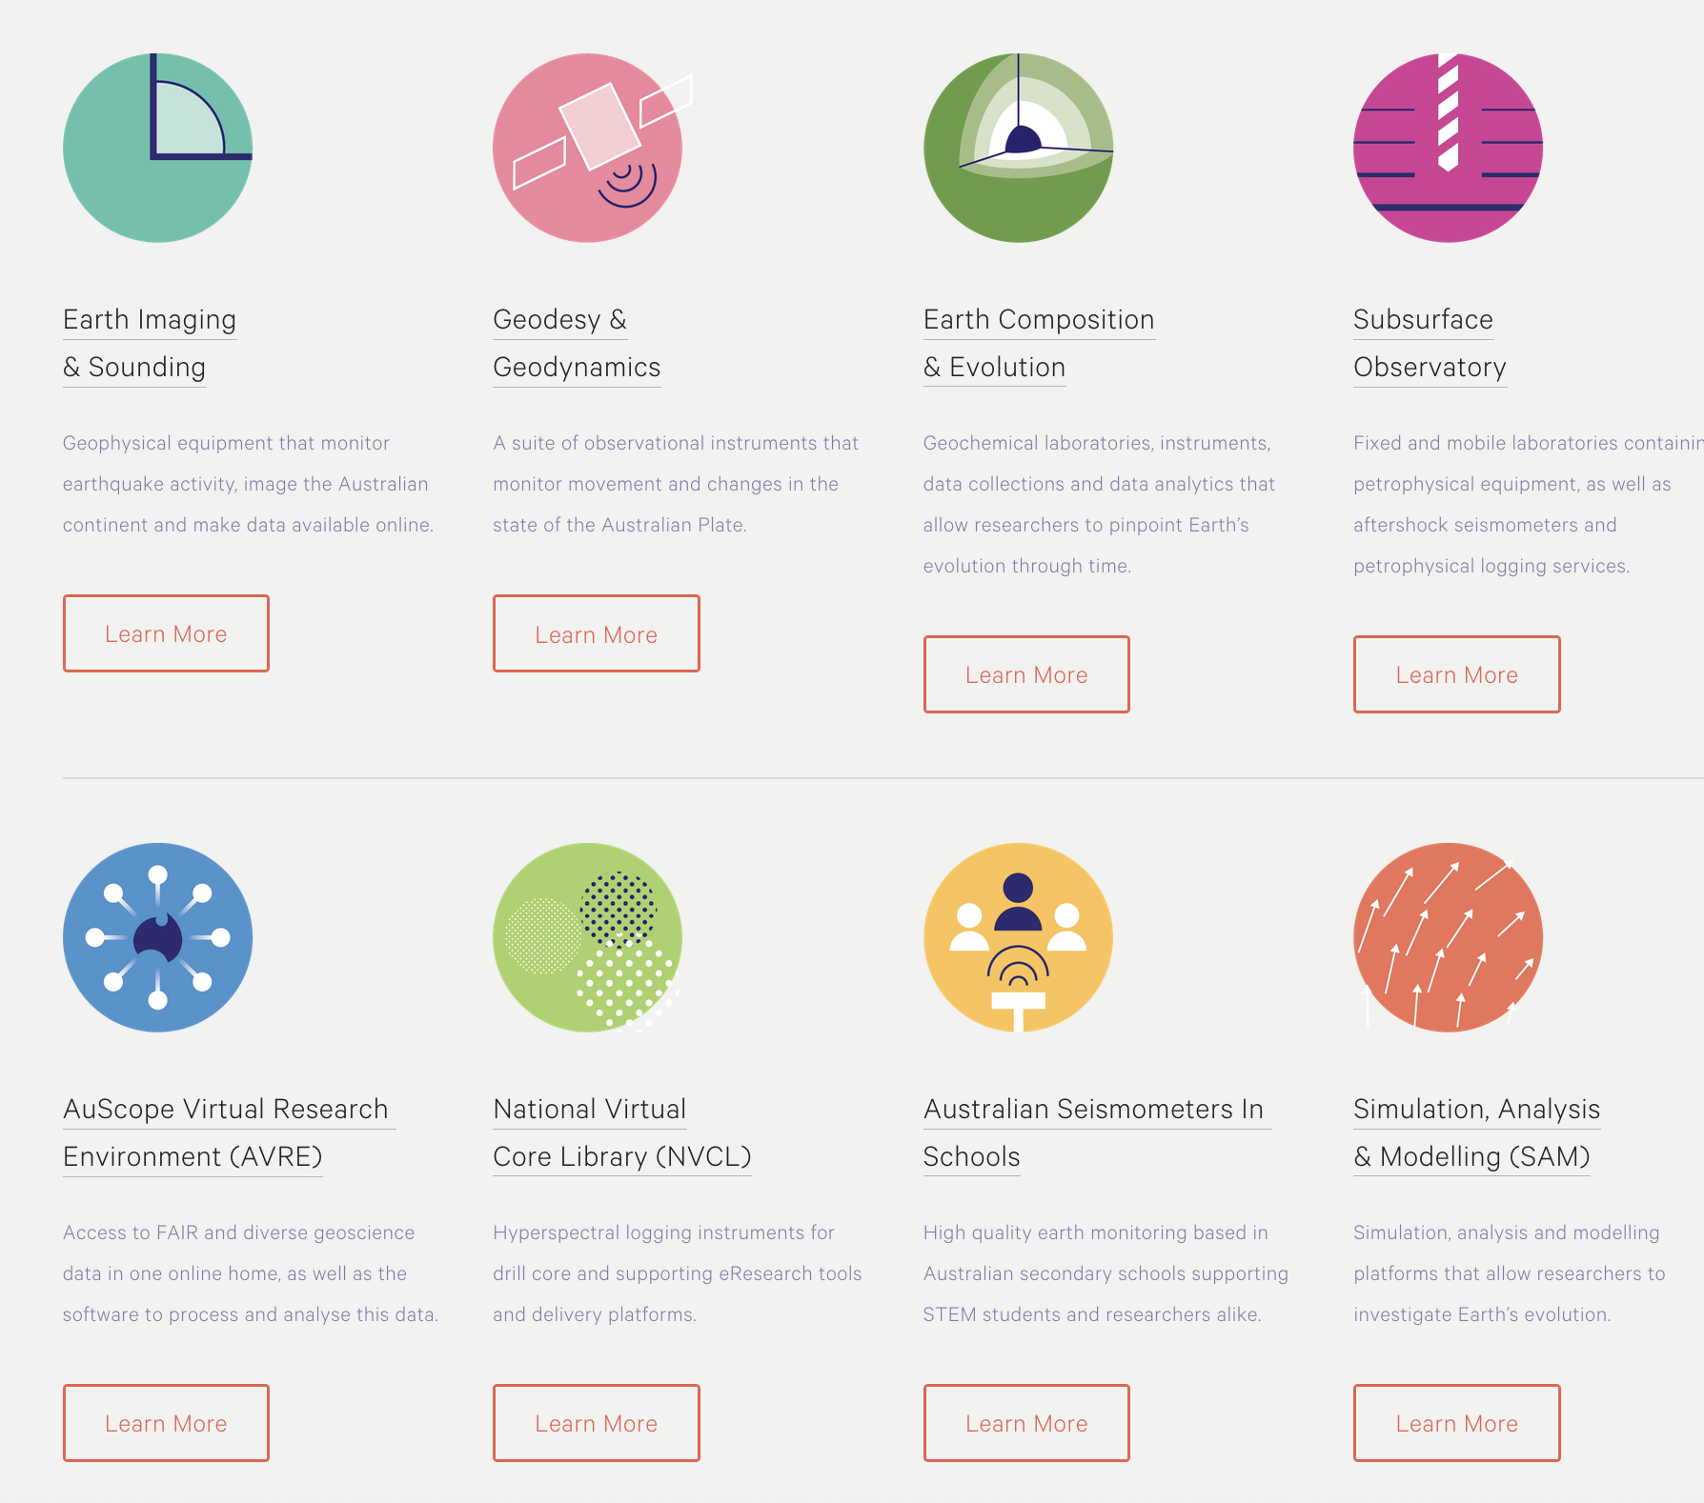
Core Programs
Eight connected programs forming the Australia’s Downward Looking Telescope (DLT).
DLT integrates capability of instruments, services, data and analytics to support the national geoscience community.
source: https://www.auscope.org.au/programs

Slide 8
More to come…
In the next slides, we’ll explore AuScope Virtual Research Environment (AVRE)
  Enabling access to high-quality geoscientific data
  Providing tools for data discovery, visualization, and analysis
  Connecting geoscience researchers through shared national platforms

Slide 9
AuScope Virtual Research Environment (AVRE)
AuScope’s strategic program to deliver an ecosystem of data and tools for geoscience analytics – the foundation for AuScope’s Downward-Looking Telescope.
Adheres to FAIR principles to ensure discovery, access and long-term reuse of data and tools.
Demonstrates a long-standing and successful partnership between AuScope and CSIRO.
Learn more about AVRE - https://www.auscope.org.au/avre

Slide 10
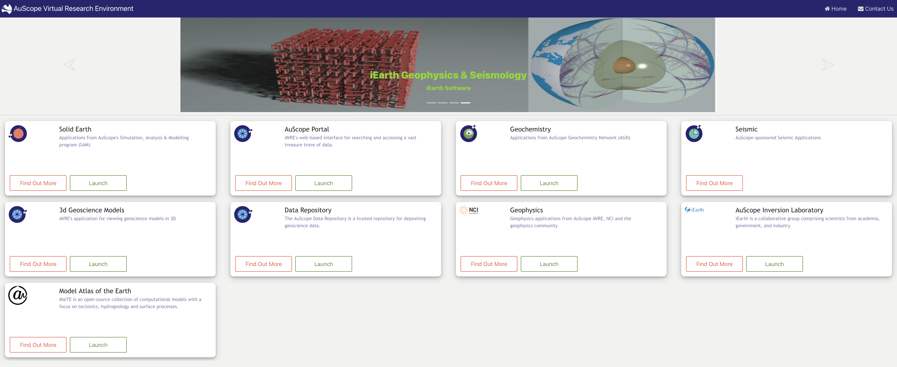
Available Digital Services
source: https://avre.auscope.org.au/

Slide 11
Let’s Explore Selected Data Services
AuScope Portal
AuScope Data Repository
AuScope Sample Repository

Slide 12
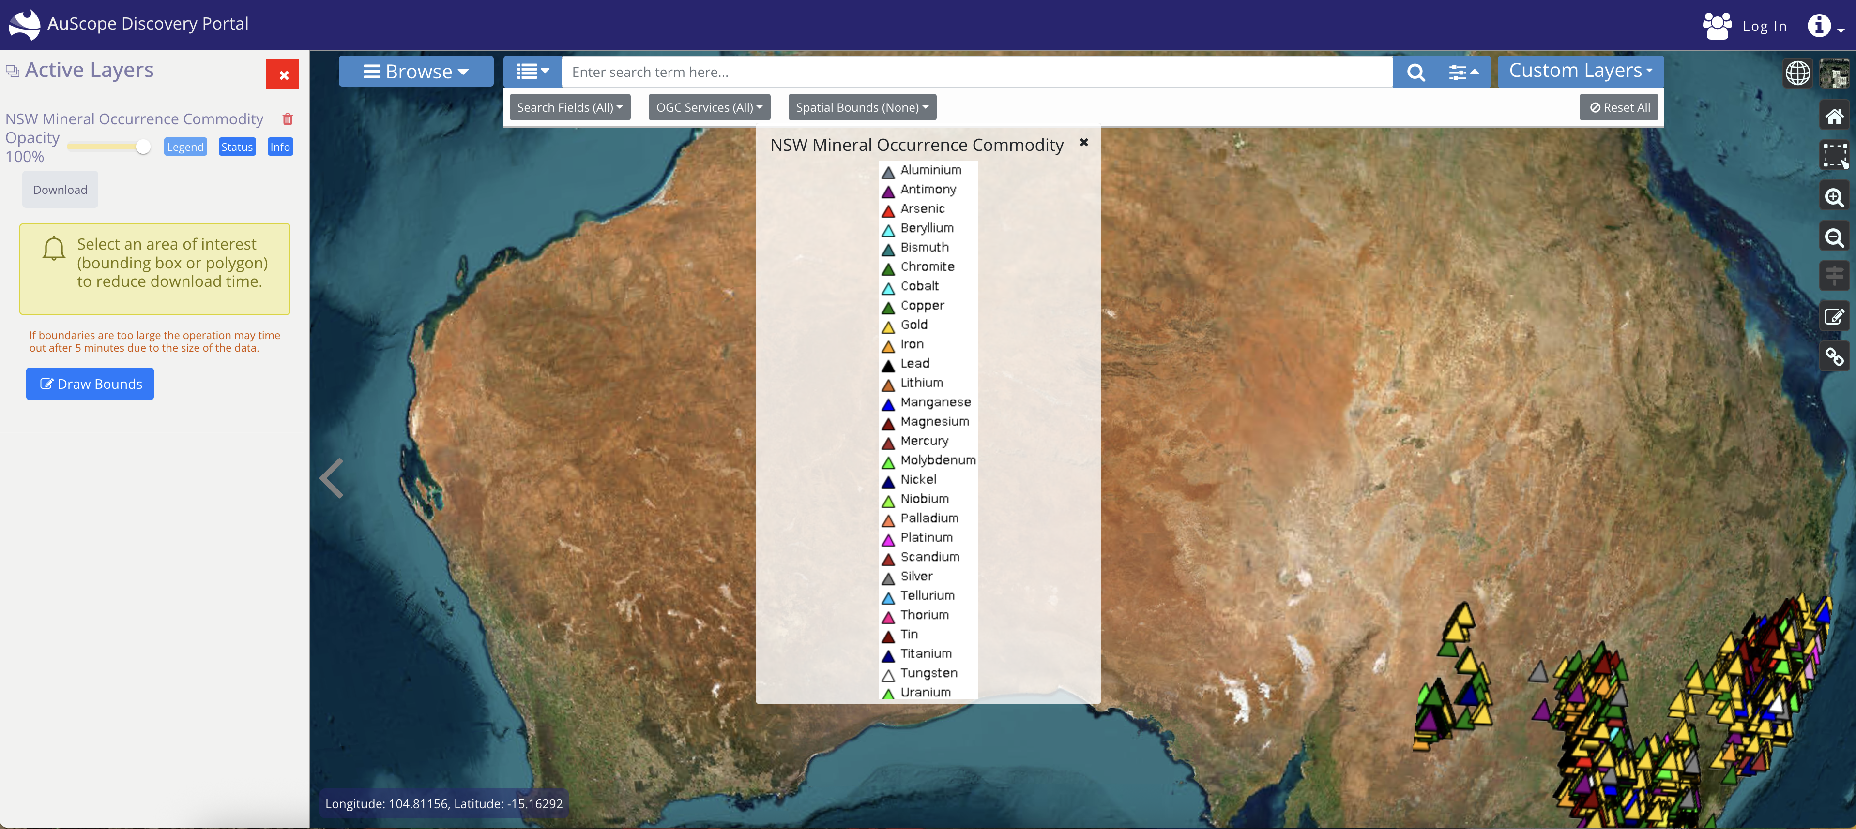
1. AuScope Portal
Aggregates Australia’s diverse geoscience spatial data into a central platform.
https://portal.auscope.org.au/

Slide 13
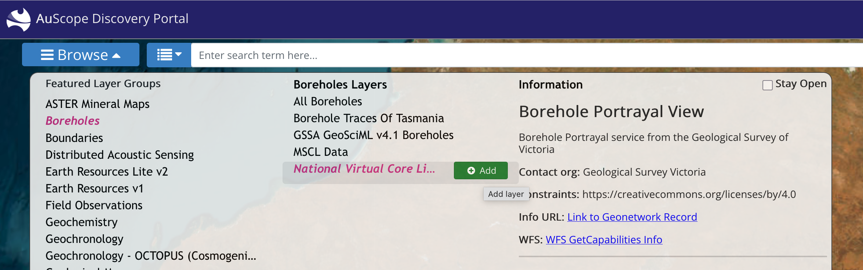
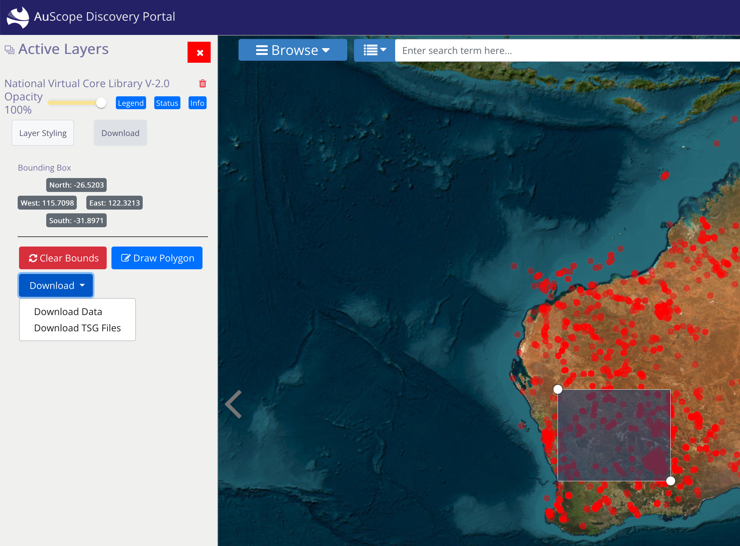
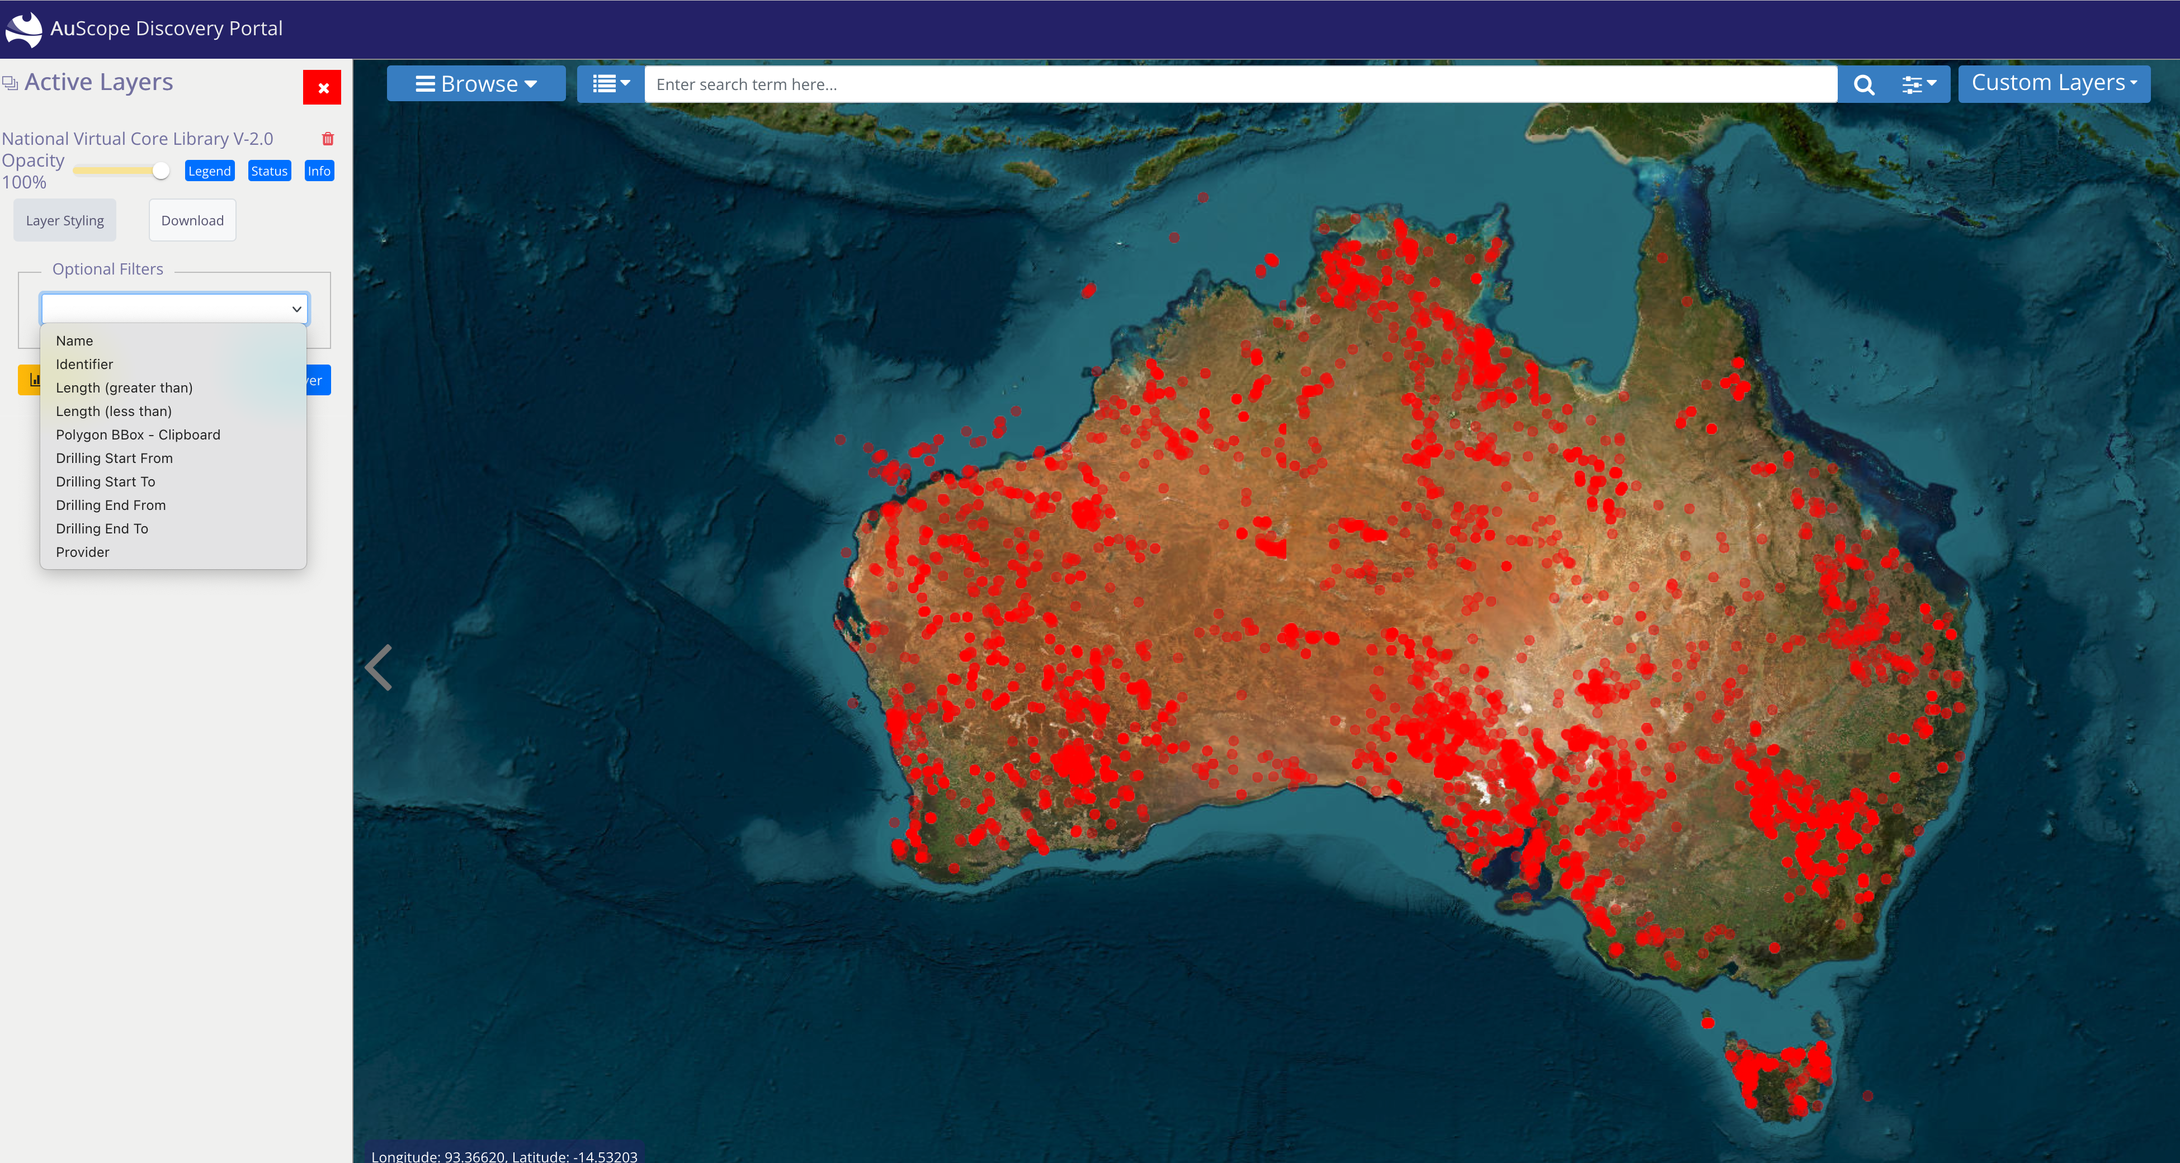
1
Find the data of interest.
3
Select an area to download.
2
Add a layer to display, and filter if needed.
Find and access data in 3 easy steps!

Slide 14
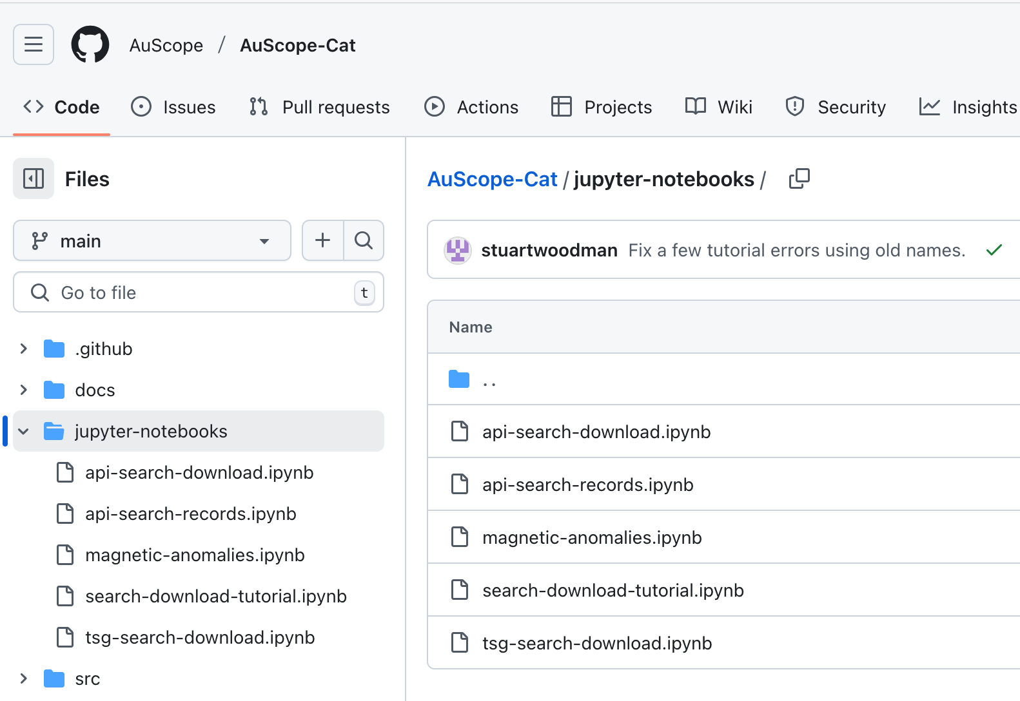
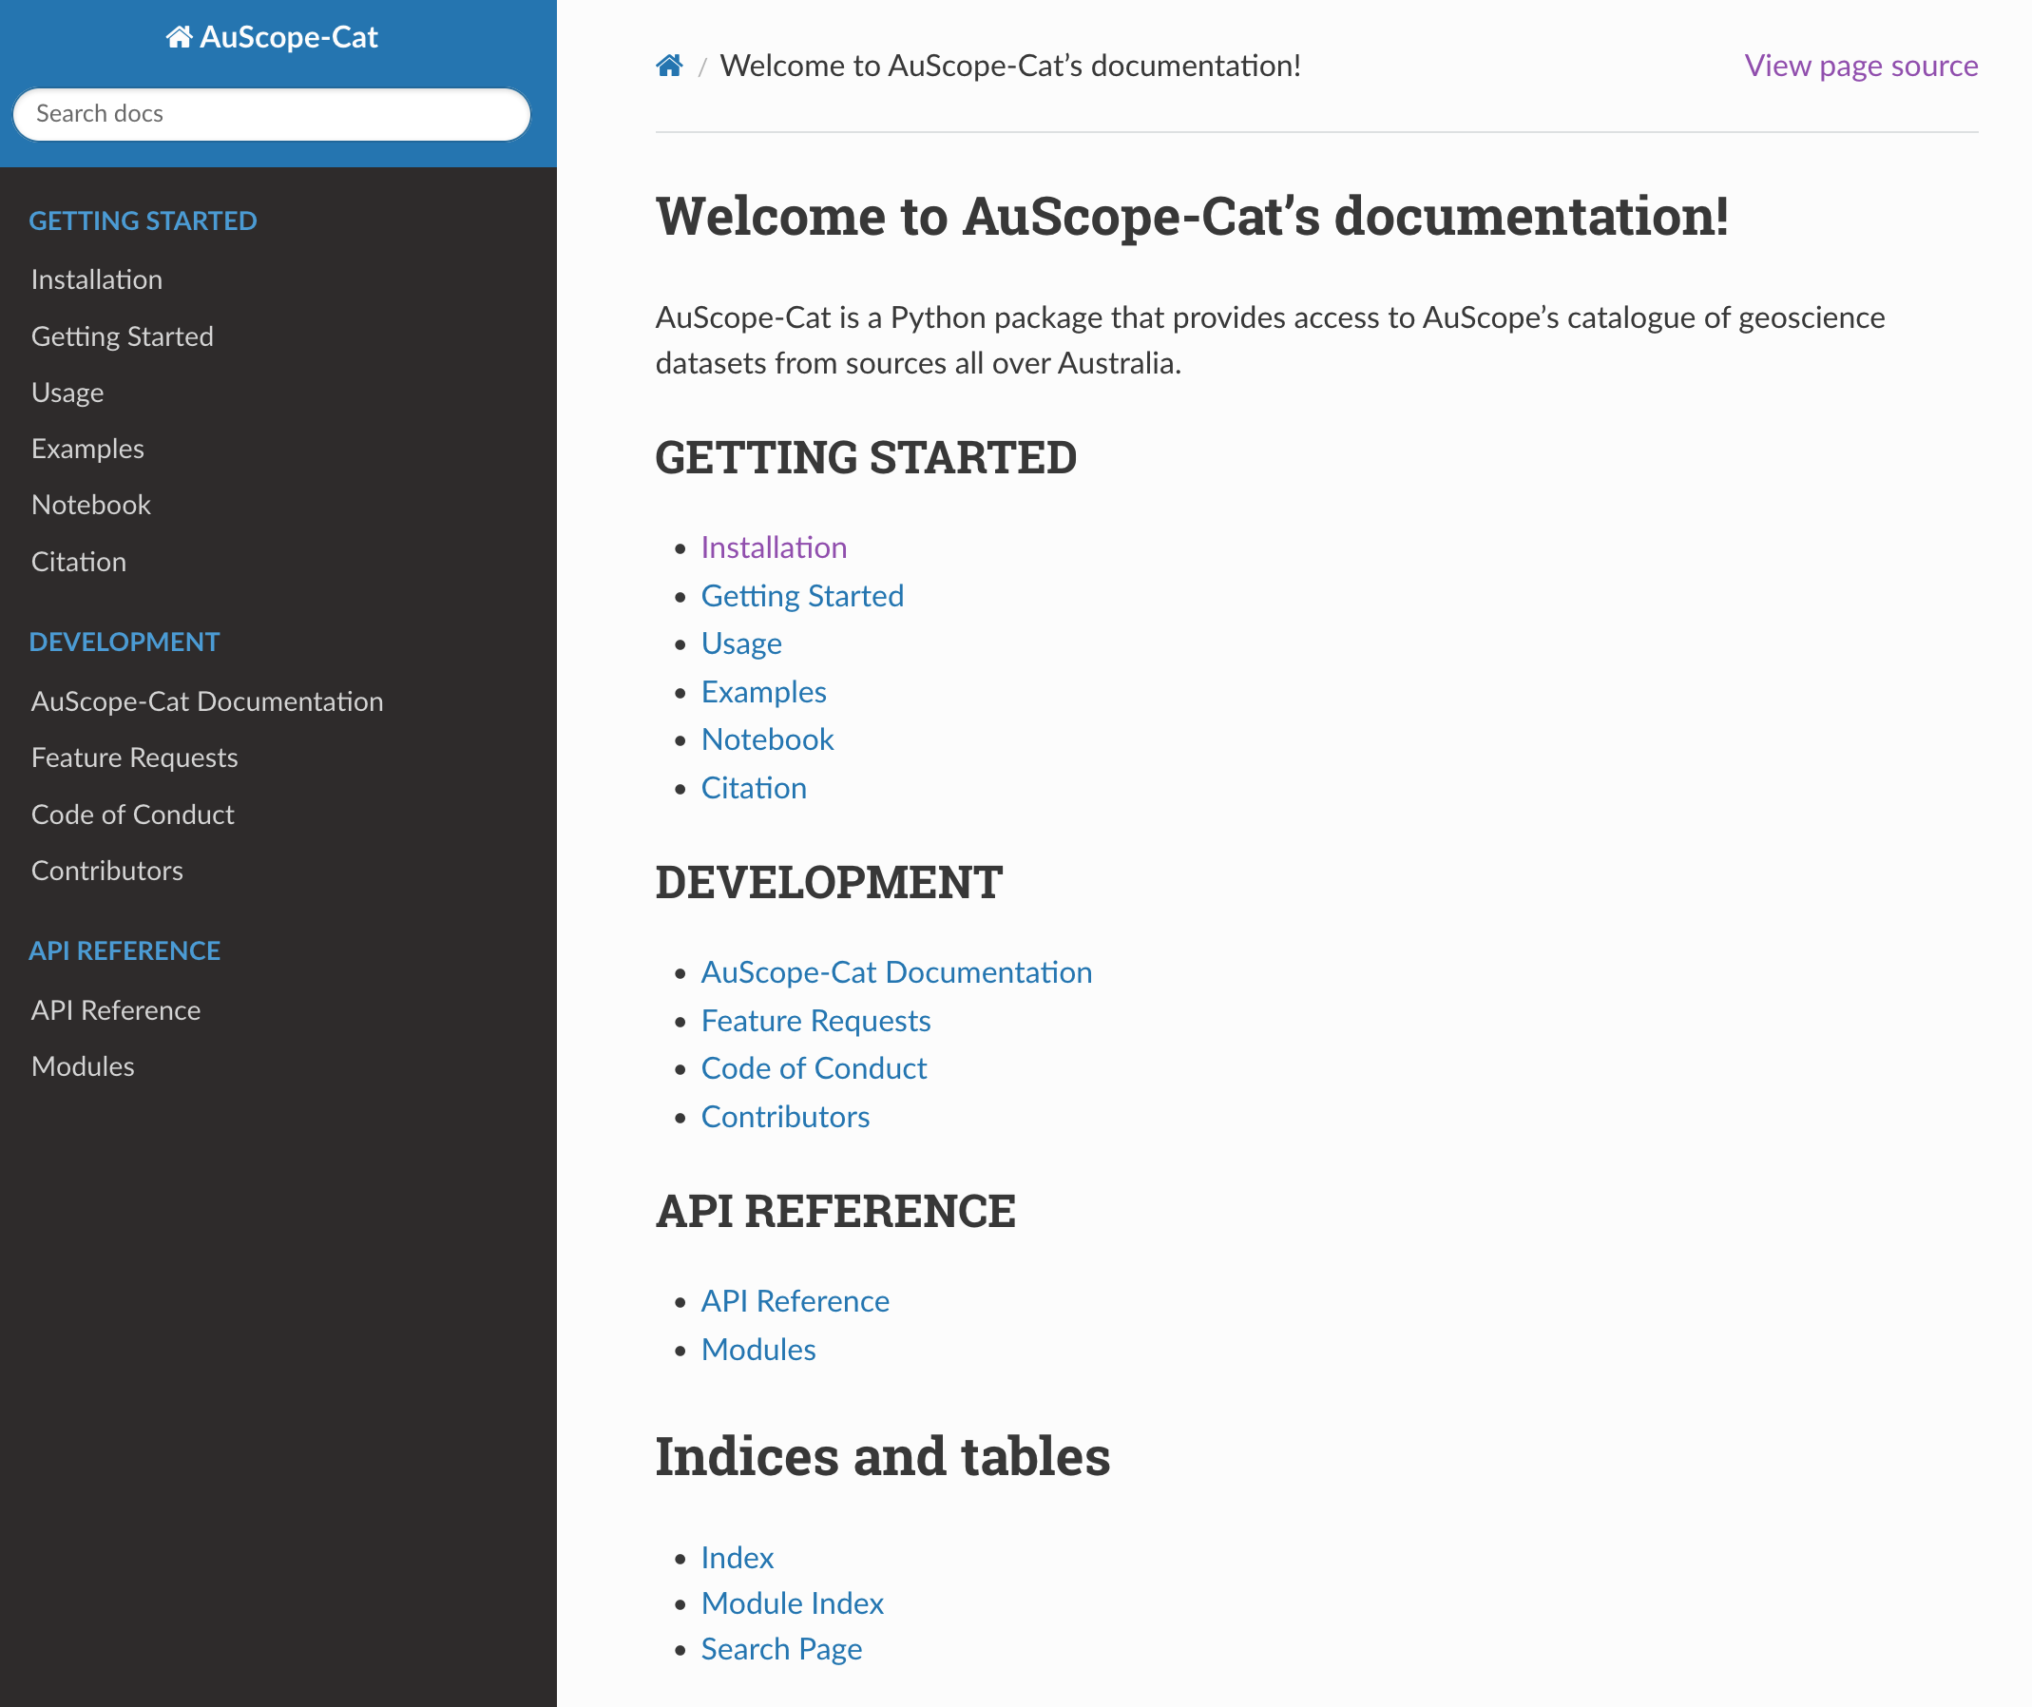
Programmatic Data Access via AuScope-Cat
https://github.com/AuScope/AuScope-Cat
https://auscope.github.io/AuScope-Cat/getting_started/getting_started.html

Slide 15
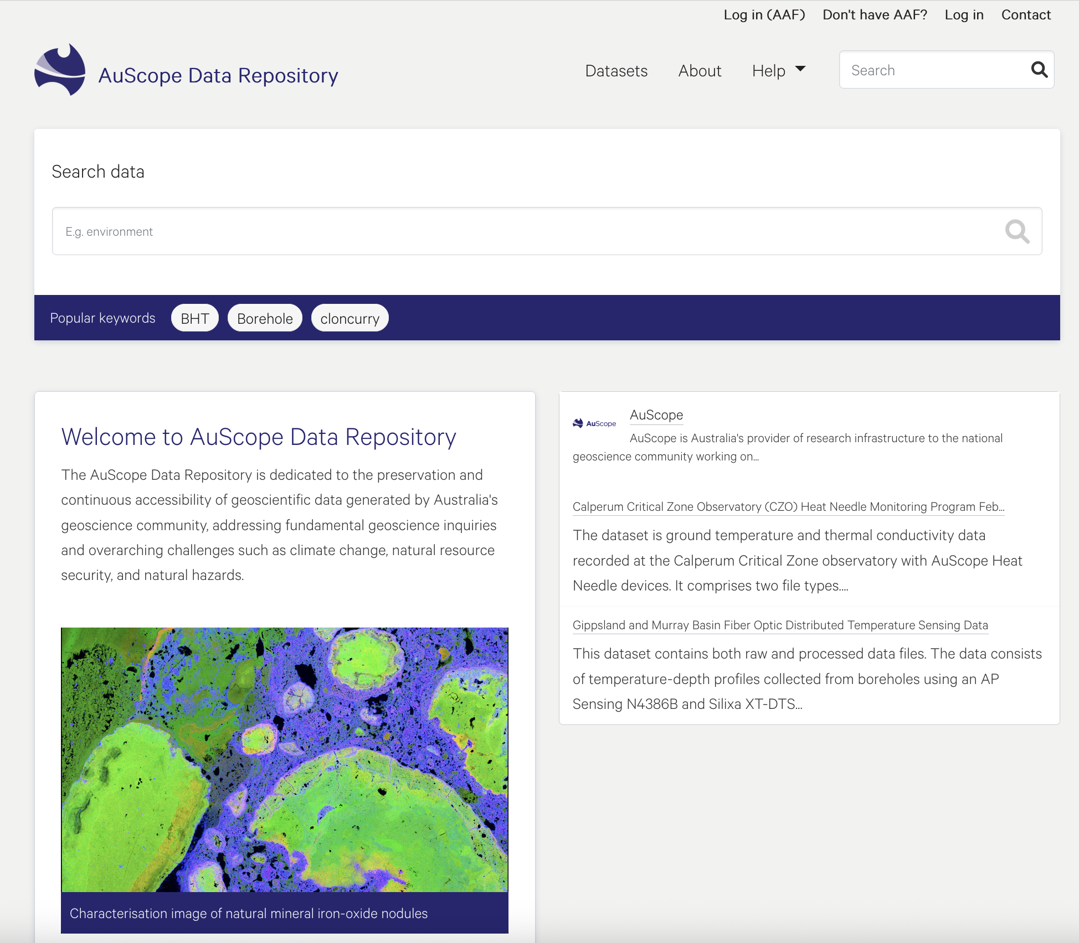
2. AuScope Data Repository
A trusted, domain-specific data repository for the AuScope community (e.g., NCRIS-funded data projects and Australian Geoscience research communities).
Offers long-term preservation and access to Australian geoscience data.
https://repository.data.auscope.org.au/

Slide 16
Repository Guiding Principles
Open access with appropriate attributions
FAIR (Findable, Accessible, Interoperable and Reusable) data for humans and machines
CARE Principles for Indigenous Data Governance
Alignment with community practices (national, international)
Editorial for ensuring high-quality data publication
Interfacing with relevant data services for enhanced data discovery and reuse
Sustainable and secured infrastructure
Educate and engage with the AuScope community
Levels of Curation Supported
Content distributed as deposited
Basic Curation
Enhanced Curation
Data-level Curation

Slide 17
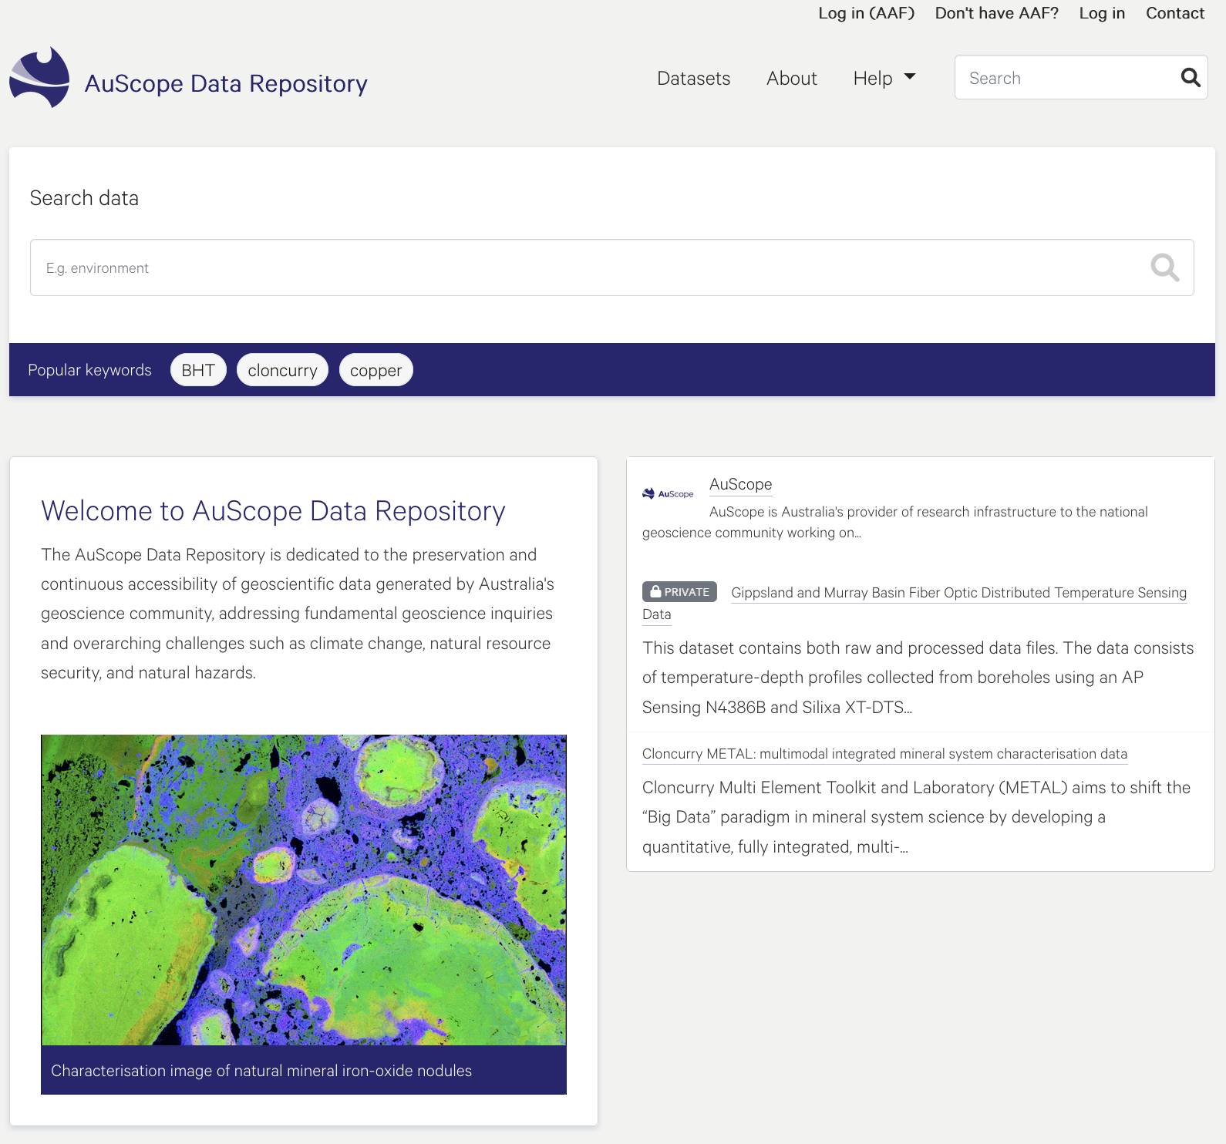
Request a user account if you are not part of Australian education and research community
List all datasets in the repository
Login into the repository via AAF to deposit data
Login into the repository via credentials provided by the repository team (if you don’t have AAF)
Search data by any text(s)
Use the contact form for any enquiries or support
Search data by predefined keyword(s)
Download supporting documents, e.g. user manual and guidelines
The mission of the data repository
The short description of the repository including its aim and scope

Slide 18
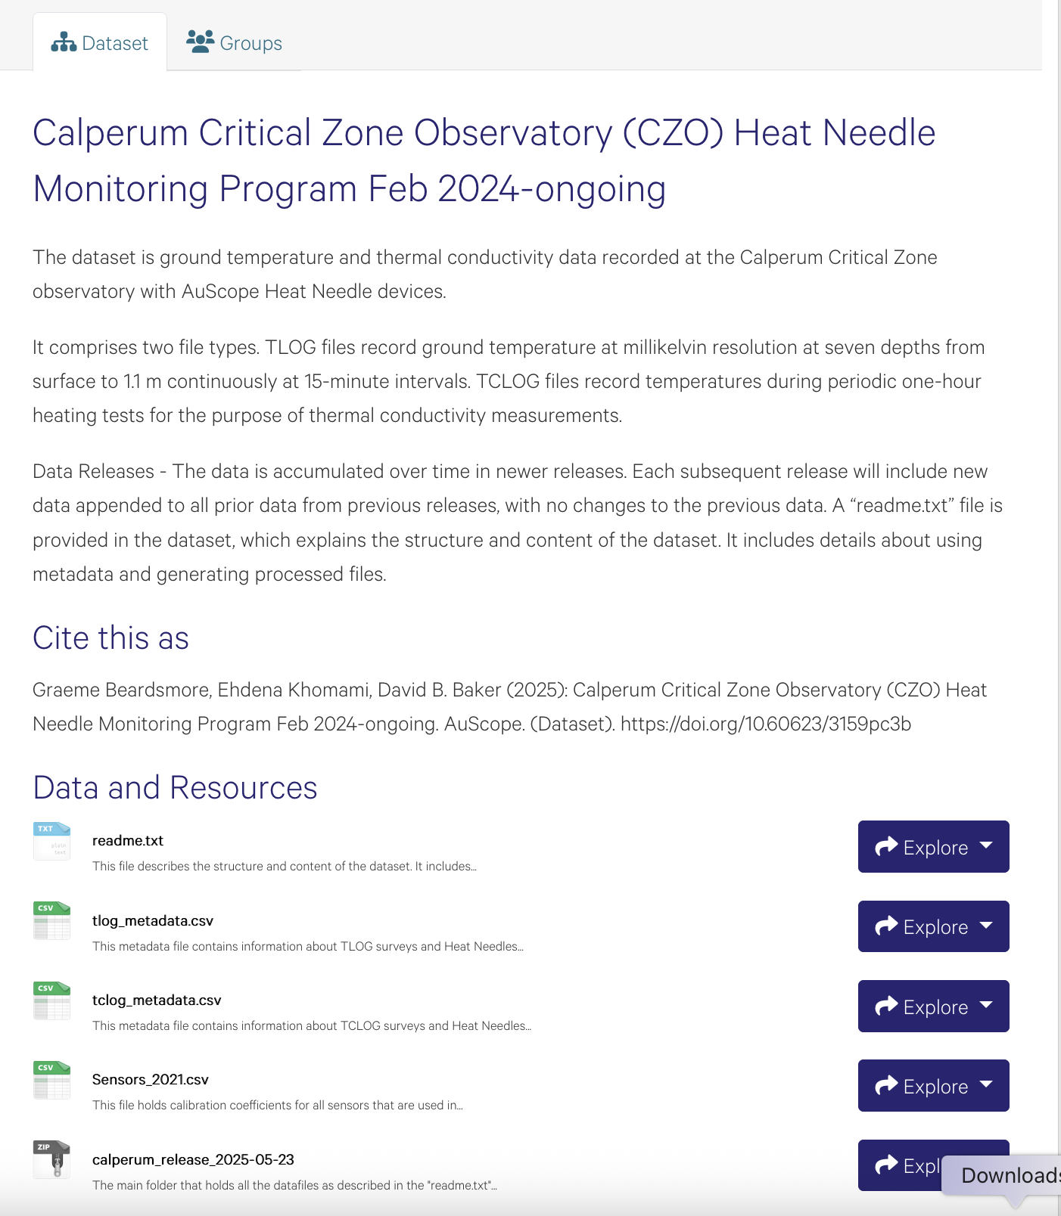
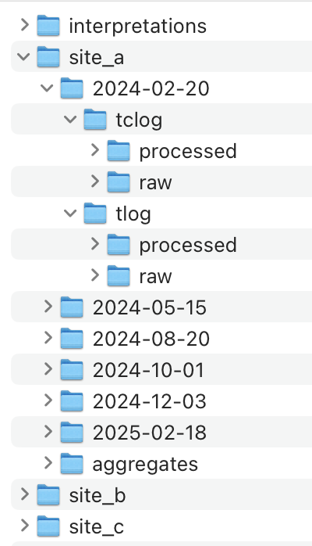
Rich metadata to aid discovery
Descriptive title to ensure clarity and accessibility
Citation to attribute the data creators appropriately
Systematic file organisation to enhance accessibility and traceability
Persistent identifier (DOI) for long term access
Supplementary files (readme, metadata) to ease understanding and reuse of data

Slide 19
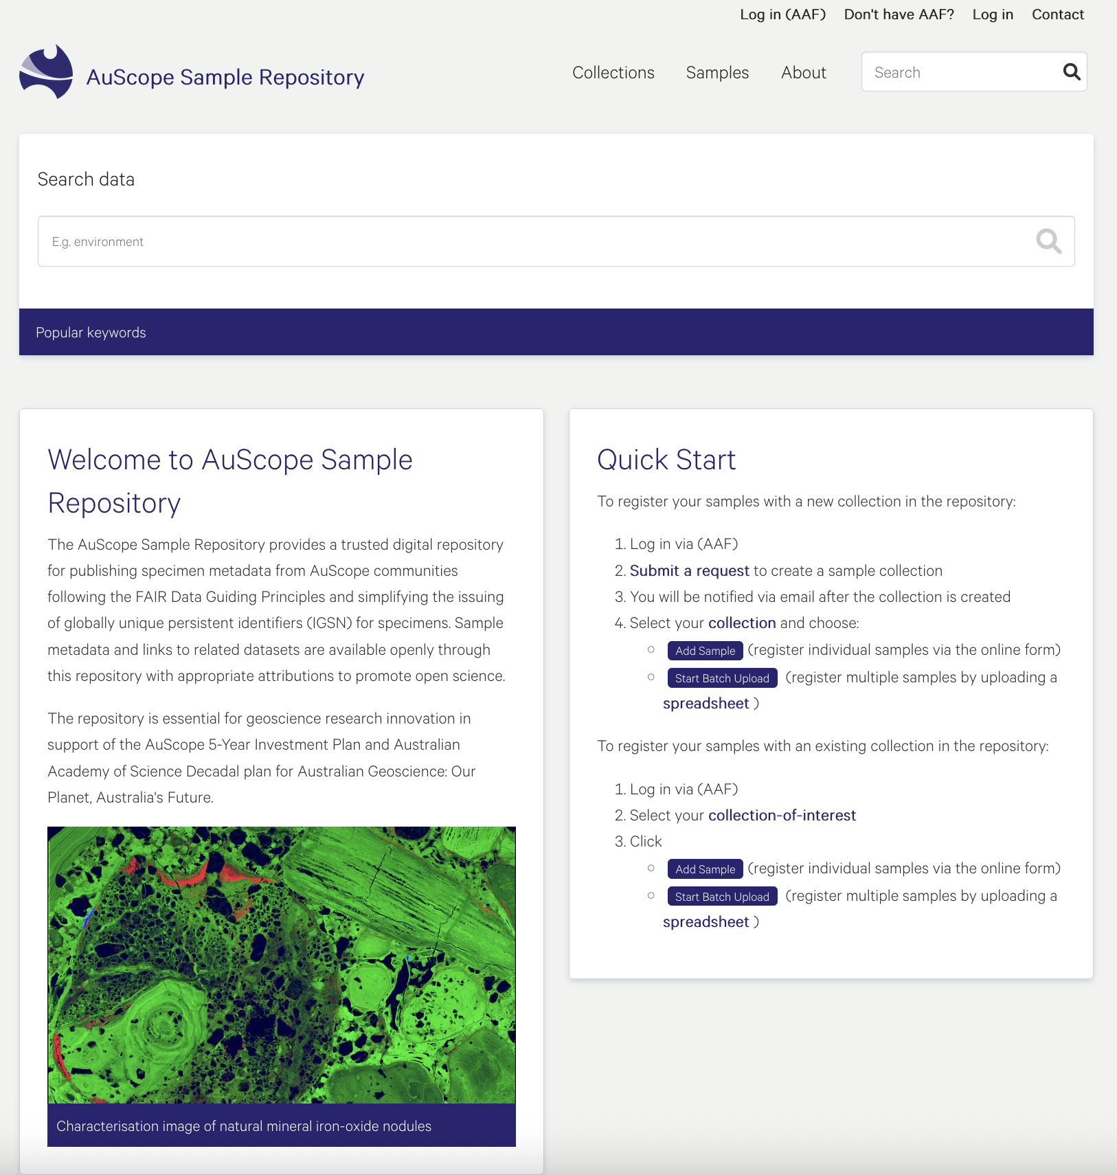
3. AuScope Sample Repository
Catalogue of geoscience samples and sample collections.
Recently launched to help geoscience communities discover geo-samples from different projects/initiatives in Australia.
https://sample.data.auscope.org.au/

Slide 20
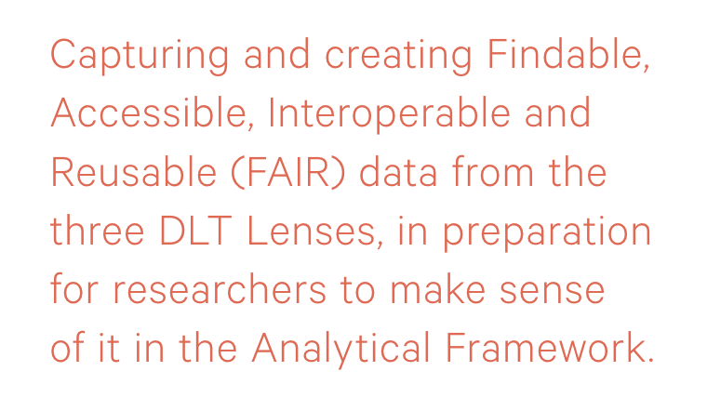
Conclusions
Digital assets (data and tools) are essential for addressing Australia’s national geoscience challenges.
AuScope builds capacity for predictive geoscience by providing open access to data, software, and analytics.
AuScope partners with global geoscience initiatives to support inclusive research through shared data, tools and expertise.
Source: AuScope 5-Year Investment Plan

Slide 21
Thank you
CSIRO Mineral Resources
Dr. Anusuriya Devaraju
anusuriya.Devaraju@csiro.au
https://people.csiro.au/d/a/anusuriya-devaraju

